Slide 1

http://xkcd.com/894/

Slide 2
Neural Networks
David Kauchak
CS30
Spring 2015

Slide 3

Machine Learning is…
Machine learning, a branch of artificial intelligence, concerns the construction and study of systems that can learn from data.

Slide 4
Machine Learning is…
Machine learning is programming computers to optimize a performance criterion using example data or past experience.
-- Ethem Alpaydin
The goal of machine learning is to develop methods that can automatically detect patterns in data, and then to use the uncovered patterns to predict future data or other outcomes of interest.
-- Kevin P. Murphy
The field of pattern recognition is concerned with the automatic discovery of regularities in data through the use of computer algorithms and with the use of these regularities to take actions.
-- Christopher M. Bishop

Slide 5

Machine Learning is…
Machine learning is about predicting the future based on the past.
-- Hal Daume III

Slide 6
Machine Learning is…
Machine learning is about predicting the future based on the past.
-- Hal Daume III
past
future
predict
learn
Training
Data
model/
predictor
Testing
Data
model/
predictor

Slide 7
Machine Learning, aka
data mining: machine learning applied to “databases”, i.e. collections of data
inference and/or estimation in statistics
pattern recognition in engineering
signal processing in electrical engineering
induction
optimization

Slide 8

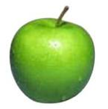


Data
examples
Data

Slide 9

Data
examples
Data

Slide 10

Data
examples
Data

Slide 11



Data
examples
Data

Slide 12
Supervised learning
examples
label
label₁
label₃
labeled examples
label₄
label₅
Supervised learning: given labeled examples

Slide 13
Supervised learning
label
label₁
model/
predictor
label₃
label₄
label₅
Supervised learning: given labeled examples

Slide 14

Supervised learning
model/
predictor
predicted label
Supervised learning: learn to predict new example

Slide 15
Supervised learning: classification
label
apple
Classification:
a finite set of labels
apple
banana
banana
Supervised learning: given labeled examples

Slide 16
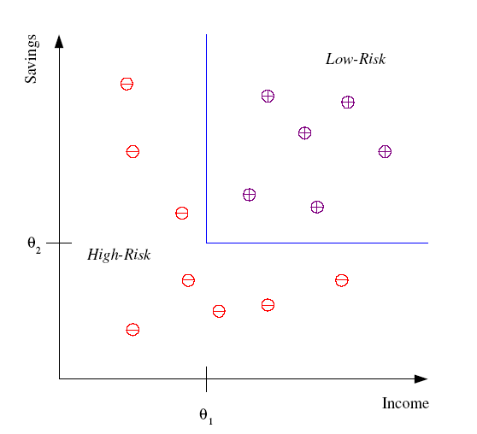
Classification Example
Differentiate between low-risk and high-risk customers from their income and savings

Slide 17
Classification Applications
Face recognition
Character recognition
Spam detection
Medical diagnosis: From symptoms to illnesses
Biometrics: Recognition/authentication using physical and/or behavioral characteristics: Face, iris, signature, etc
...

Slide 18
Supervised learning: regression
label
-4.5
Regression:
label is real-valued
10.1
3.2
4.3
Supervised learning: given labeled examples

Slide 19
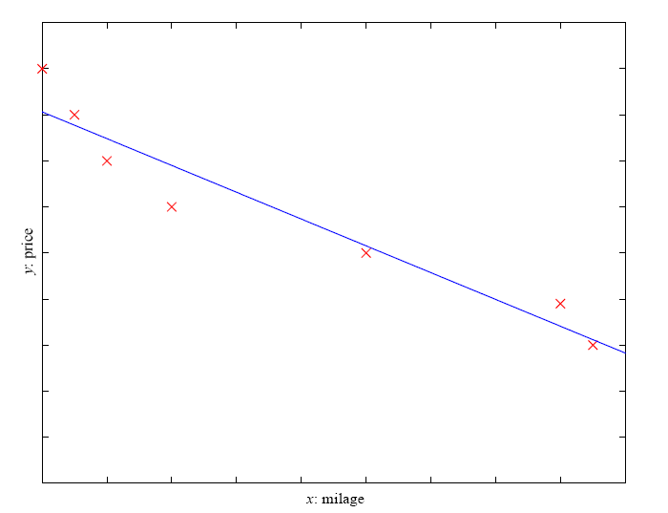
Regression Example
Price of a used car
x : car attributes
(e.g. mileage)
y : price
y = wx+w₀

Slide 20
Regression Applications
Economics/Finance: predict the value of a stock
Epidemiology
Car/plane navigation: angle of the steering wheel, acceleration, …
Temporal trends: weather over time
…

Slide 21
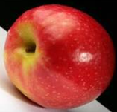
Unsupervised learning
Unsupervised learning: given data, i.e. examples, but no labels

Slide 22
Unsupervised learning applications
  learn clusters/groups without any label
customer segmentation (i.e. grouping)
image compression
bioinformatics: learn motifs
…

Slide 23
Reinforcement learning
left, right, straight, left, left, left, straight
GOOD
left, straight, straight, left, right, straight, straight
BAD
left, right, straight, left, left, left, straight
18.5
left, straight, straight, left, right, straight, straight
-3
Given a sequence of examples/states and a reward after completing that sequence, learn to predict the action to take in for an individual example/state

Slide 24
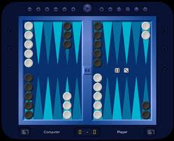
Reinforcement learning example
Backgammon
…
WIN!
…
LOSE!
Given sequences of moves and whether or not the player won at the end, learn to make good moves

Slide 25

Reinforcement learning example
http://www.youtube.com/watch?v=VCdxqn0fcnE

Slide 26
Other learning variations
What data is available:
    Supervised, unsupervised, reinforcement learning
    semi-supervised, active learning, …
How are we getting the data:
    online vs. offline learning
Type of model:
    generative vs. discriminative
    parametric vs. non-parametric

Slide 27
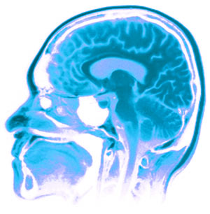
Neural Networks
Neural Networks try to mimic the structure and function of our nervous system
People like biologically motivated approaches

Slide 28
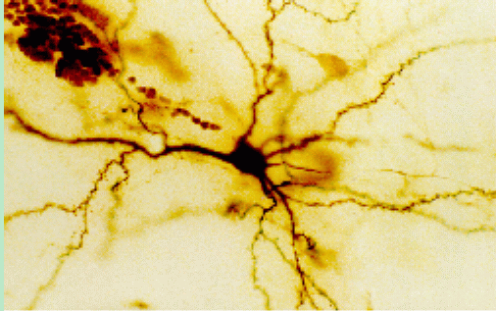
Our Nervous System
Neuron
What do you know?

Slide 29
Our nervous system: the computer science view
the human brain is a large collection of interconnected neurons
a NEURON is a brain cell
  collect, process, and disseminate electrical signals
  Neurons are connected via synapses
  They FIRE depending on the conditions of the neighboring neurons

Slide 30
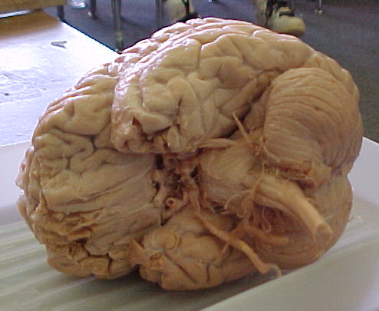
Our nervous system
The human brain
  contains ~10¹¹ (100 billion) neurons
  each neuron is connected to ~10⁴ (10,000) other neurons
  Neurons can fire as fast as 10⁻³ seconds
How does this compare to a computer?

Slide 31
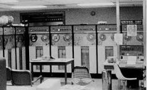
Man vs. Machine
10¹¹ neurons
10¹¹ neurons
10¹⁴ synapses
10⁻³ “cycle” time
10¹⁰ transistors
10¹¹ bits of ram/memory
10¹³ bits on disk
10⁻⁹ cycle time

Slide 32

Brains are still pretty fast
Who is this?

Slide 33
Brains are still pretty fast
If you were me, you’d be able to identify this person in 10⁻¹ (1/10) s!
Given a neuron firing time of 10⁻³ s, how many neurons in sequence could fire in this time?
  A few hundred
What are possible explanations?
  either neurons are performing some very complicated computations
  brain is taking advantage of the massive parallelization

Slide 34
Artificial Neural Networks
Node (Neuron)
Edge (synapses)
our approximation

Slide 35
Node A
Weight w
Node B
(neuron)
(neuron)
W is the strength of signal sent between A and B.
If A fires and w is positive, then A stimulates B.
If A fires and w is negative, then A inhibits B.

Slide 36
…
A given neuron has many, many connecting, input neurons
If a neuron is stimulated enough, then it also fires.
How much stimulation is required is determined by its threshold.

Slide 37
A Single Neuron/Perceptron
Input x₁
Each input contributes:
x_{i} * w_{i}
Weight w₁
Weight w₂
Input x₂
Output y
threshold function
Input x₃
Weight w₃
Weight w₄
Input x₄

Slide 38
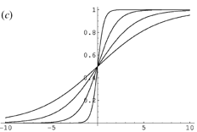
Possible threshold functions
hard threshold
Sigmoid

Slide 39
A Single Neuron/Perceptron
1
1
1
-1
?
0
1
Threshold of 1
0.5
1

Slide 40
A Single Neuron/Perceptron
1
1
1
-1
?
0
1
Threshold of 1
0.5
1
1*1 + 1*-1 + 0*1 + 1*0.5 = 0.5

Slide 41
A Single Neuron/Perceptron
1
1
1
-1
0
Weighted sum is 0.5, which is not larger than the threshold
0
1
Threshold of 1
0.5
1

Slide 42
A Single Neuron/Perceptron
1
1
0
-1
?
0
1
Threshold of 1
0.5
1
1*1 + 0*-1 + 0*1 + 1*0.5 = 1.5

Slide 43
A Single Neuron/Perceptron
1
1
0
-1
1
Weighted sum is 1.5, which is larger than the threshold
0
1
Threshold of 1
0.5
1

Slide 44
Neural network
inputs
Individual perceptrons/neurons
Notes:
- often we view a slice of them

Slide 45
Neural network
inputs
Notes:
- often we view a slice of them

Slide 46
Neural network
inputs
each perceptron computes and calculates an answer
Notes:
- often we view a slice of them

Slide 47
Neural network
inputs
those answers become inputs for the next level
Notes:
- often we view a slice of them

Slide 48
Neural network
inputs
finally get the answer after all levels compute
Notes:
- often we view a slice of them

Slide 49
Activation spread
http://www.youtube.com/watch?v=Yq7d4ROvZ6I

Slide 50
Neural networks
Different kinds/characteristics of networks
inputs
inputs
inputs
How are these different?

Slide 51
Neural networks
inputs
inputs
hidden units/layer
Feed forward networks

Slide 52
Neural networks
inputs
Recurrent network
Output is fed back to input
Can support memory!
How?

Slide 53
History of Neural Networks
McCulloch and Pitts (1943) – introduced model of artificial neurons and suggested they could learn
Hebb (1949) – Simple updating rule for learning
Rosenblatt (1962) - the perceptron model
Minsky and Papert (1969) – wrote Perceptrons
Bryson and Ho (1969, but largely ignored until 1980s--Rosenblatt) – invented back-propagation learning for multilayer networks

Slide 54
Perceptron
First wave in neural networks in the 1960’s
Single neuron
Trainable: its threshold and input weights can be modified
If the neuron doesn’t give the desired output, then it has made a mistake.
Input weights and threshold can be changed according to a learning algorithm

Slide 55
Examples - Logical operators
AND – if all inputs are 1, return 1, otherwise return 0
OR – if at least one input is 1, return 1, otherwise return 0
NOT – return the opposite of the input
XOR – if exactly one input is 1, then return 1, otherwise return 0

Slide 56
AND
x₁ | x₂ | x₁ and x₂
0 | 0 | 0
0 | 1 | 0
1 | 0 | 0
1 | 1 | 1
Notes:
We have the truth table for AND

Slide 57
AND
x₁ | x₂ | x₁ and x₂
0 | 0 | 0
0 | 1 | 0
1 | 0 | 0
1 | 1 | 1
Input x₁
W₁ = ?
T = ?
Output y
Input x₂
W₂ = ?
Notes:
And here we have the node for AND
Assume that all inputs are either 1 or 0, “on” or “off”
When they are activated, they become “on”
So what weights do we need to assign to these two links and what threshold do we need to put in this unit in order to represent an AND gate?

Slide 58
AND
x₁ | x₂ | x₁ and x₂
0 | 0 | 0
0 | 1 | 0
1 | 0 | 0
1 | 1 | 1
Input x₁
W₁ = 1
T = 2
Output y
Output is 1 only if
all inputs are 1
Input x₂
W₂ = 1
Inputs are either 0 or 1

Slide 59
AND
Input x₁
W₁ = ?
W₂ = ?
Input x₂
T = ?
Output y
Input x₃
W₃ = ?
W₄ = ?
Input x₄
Notes:
We can extend this to take more inputs
What are the new weights and thresholds?

Slide 60
AND
Input x₁
W₁ = 1
W₂ = 1
Input x₂
T = 4
Output y
Output is 1 only if
all inputs are 1
Input x₃
W₃ = 1
W₄ = 1
Input x₄
Inputs are either 0 or 1

Slide 61
OR
x₁ | x₂ | x₁ or x₂
0 | 0 | 0
0 | 1 | 1
1 | 0 | 1
1 | 1 | 1

Slide 62
OR
x₁ | x₂ | x₁ or x₂
0 | 0 | 0
0 | 1 | 1
1 | 0 | 1
1 | 1 | 1
Input x₁
W₁ = ?
T = ?
Output y
Input x₂
W₂ = ?
Notes:
What about for an OR gate?
What weights and thresholds would serve to create an OR gate?

Slide 63
OR
x₁ | x₂ | x₁ or x₂
0 | 0 | 0
0 | 1 | 1
1 | 0 | 1
1 | 1 | 1
Input x₁
W₁ = 1
T = 1
Output y
Output is 1 if at
least 1 input is 1
Input x₂
W₂ = 1
Inputs are either 0 or 1

Slide 64
OR
Input x₁
W₁ = ?
W₂ = ?
Input x₂
T = ?
Output y
Input x₃
W₃ = ?
W₄ = ?
Input x₄
Notes:
Similarly, we can expand it to take more inputs

Slide 65
OR
Input x₁
W₁ = 1
W₂ = 1
Input x₂
T = 1
Output y
Output is 1 if at
least 1 input is 1
Input x₃
W₃ = 1
W₄ = 1
Input x₄
Inputs are either 0 or 1

Slide 66
NOT
x₁ | not x₁
0 | 1
1 | 0

Slide 67
x₁ | not x₁
0 | 1
1 | 0
NOT
W₁ = ?
Input x₁
T = ?
Output y
Notes:
Now it gets a little bit trickier, what weight and threshold might work to create a NOT gate?

Slide 68
NOT
W₁ = -1
Input x₁
T = 0
Output y
Input is either 0 or 1
If input is 1, output is 0.
If input is 0, output is 1.

Slide 69
How about…
x₁ | x₂ | x₃ | x₁ and x₂
0 | 0 | 0 | 1
0 | 1 | 0 | 0
1 | 0 | 0 | 1
1 | 1 | 0 | 0
0 | 0 | 1 | 1
0 | 1 | 1 | 1
1 | 0 | 1 | 1
1 | 1 | 1 | 0
Input x₁
w₁ = ?
w₂ = ?
Input x₂
Output y
T = ?
Input x₃
w₃ = ?

Slide 70
Training neural networks
Learn individual node parameters (e.g. threshold)
Learn the individual weights between nodes

Slide 71
Positive or negative?
NEGATIVE

Slide 72
Positive or negative?
NEGATIVE

Slide 73
Positive or negative?
POSITIVE

Slide 74
Positive or negative?
NEGATIVE

Slide 75
Positive or negative?
POSITIVE

Slide 76
Positive or negative?
POSITIVE

Slide 77
Positive or negative?
NEGATIVE

Slide 78
Positive or negative?
POSITIVE

Slide 79
A method to the madness
blue = positive
yellow triangles = positive
all others negative
How did you figure this out (or some of it)?

Slide 80
Training neural networks
x₁ | x₂ | x₃ | x₁ and x₂
0 | 0 | 0 | 1
0 | 1 | 0 | 0
1 | 0 | 0 | 1
1 | 1 | 0 | 0
0 | 0 | 1 | 1
0 | 1 | 1 | 1
1 | 0 | 1 | 1
1 | 1 | 1 | 0
Input x₁
w₁ = ?
w₂ = ?
Input x₂
Output y
T = ?
Input x₃
w₃ = ?
start with some initial weights and thresholds
show examples repeatedly to NN
update weights/thresholds by comparing NN output to actual output

Slide 81
Perceptron learning algorithm
repeat until you get all examples right:
for each “training” example:
  calculate current prediction on example
  if wrong:
    update weights and threshold towards getting this example correct

Slide 82
Perceptron learning
Weighted sum is 0.5, which is not equal or larger than the threshold
1
1
predicted
1
-1
0
0
actual
1
Threshold of 1
1
0.5
1
What could we adjust to make it right?

Slide 83
Perceptron learning
1
1
predicted
1
-1
0
0
actual
1
Threshold of 1
1
0.5
1
This weight doesn’t matter, so don’t change

Slide 84
Perceptron learning
1
1
predicted
1
-1
0
0
actual
1
Threshold of 1
1
0.5
1
Could increase any of these weights

Slide 85
Perceptron learning
1
1
predicted
1
-1
0
0
actual
1
Threshold of 1
1
0.5
1
Could decrease the threshold

Slide 86
Perceptron learning
A few missing details, but not much more than this
Keeps adjusting weights as long as it makes mistakes
If the training data is linearly separable the perceptron learning algorithm is guaranteed to converge to the “correct” solution (where it gets all examples right)

Slide 87
Linearly Separable
x₁ | x₂ | x₁ and x₂
0 | 0 | 0
0 | 1 | 0
1 | 0 | 0
1 | 1 | 1
x₁ | x₂ | x₁ or x₂
0 | 0 | 0
0 | 1 | 1
1 | 0 | 1
1 | 1 | 1
x₁ | x₂ | x₁ xor x₂
0 | 0 | 0
0 | 1 | 1
1 | 0 | 1
1 | 1 | 0
A data set is linearly separable if you can separate one example type from the other
Which of these are linearly separable?

Slide 88
Which of these are linearly separable?
x₁ | x₂ | x₁ and x₂
0 | 0 | 0
0 | 1 | 0
1 | 0 | 0
1 | 1 | 1
x₁ | x₂ | x₁ or x₂
0 | 0 | 0
0 | 1 | 1
1 | 0 | 1
1 | 1 | 1
x₁ | x₂ | x₁ xor x₂
0 | 0 | 0
0 | 1 | 1
1 | 0 | 1
1 | 1 | 0
x₁
x₁
x₁
x₂
x₂
x₂

Slide 89
Perceptrons
1969 book by Marvin Minsky and Seymour Papert
The problem is that they can only work for classification problems that are linearly separable
Insufficiently expressive
“Important research problem” to investigate multilayer networks although they were pessimistic about their value

Slide 90
XOR
?
Input x₁
T = ?
?
?
Output = x₁ xor x₂
T = ?
?
?
Input x₂
T = ?
?
x₁ | x₂ | x₁ xor x₂
0 | 0 | 0
0 | 1 | 1
1 | 0 | 1
1 | 1 | 0

Slide 91
XOR
1
Input x₁
T = 1
1
-1
Output = x₁ xor x₂
T = 1
-1
1
Input x₂
T = 1
1
x₁ | x₂ | x₁ xor x₂
0 | 0 | 0
0 | 1 | 1
1 | 0 | 1
1 | 1 | 0
Notes:
-

