Slide 1
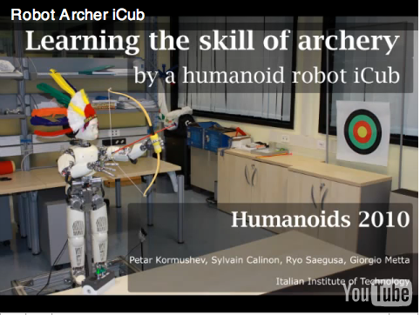
http://www.motherboard.tv/2010/9/26/this-robot-taught-itself-to-shoot-a-bow-and-arrow--2

Slide 2
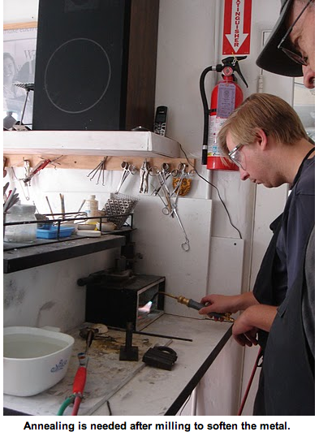

Slide 3
CS 311: Reasoning with Knowledge and Probability Theory (Review?)

Slide 4
Admin
Will have mancala tournament soon (probably Thursday)
  If you’re taking an extension, make sure to get it in by 1:30pm tomorrow
Schedule
  Assignment 3 (paper review) out soon, due next Tuesday, solo assignment
  Look at written problems 2 by Thursday
  Assignment 4 out next Tuesday
    Due before spring break
  First midterm (take-home) week before spring break

Slide 5
Human agents
How do humans represent knowledge?
  ontologies
  scripts
How do humans reason/make decisions?
  logic
  probability
  utility/cost-benefit
  two decision systems: intuition/reasoning
    http://www.princeton.edu/~kahneman/

Slide 6
An example
Answer the following as quickly as possible…

Slide 7
An example
A bat and a ball together cost $1.10. The bat costs a dollar more than the ball. How much does the ball cost?
Your first guess is often wrong…

Slide 8
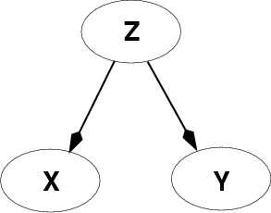
Policy design: what should an agent do?
Reasoning with knowledge
and uncertainty
Search
At the core of this class
will be several
techniques for Policy
design and implementation
Learning
Reasoning with
Utility

Slide 9
Knowledge-Based Agent
sensors
?
environment
agent
actuators
Knowledge
base

Slide 10
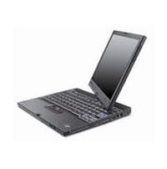
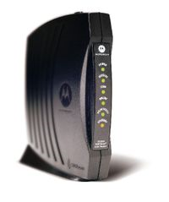
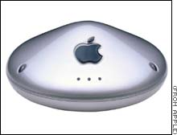
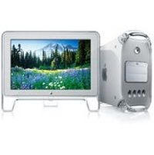
Example: Connecting to a home network
Consider an “agent” trying to connect its laptop to a wireless network

Slide 11
Example: Connecting to a home network
but it’s not working… what should the agent do?

Slide 12
Example: Connecting to a home network
but it’s not working… what should the agent do?
Knowledge Base (prior information):
Laptops can be flakey
Flakey computers need to have their network
connections reset frequently
Lights on the router should be flashing
Lights on the modem should be solid
If the lights on the modem or the router are off, unplugging
it and then reconnecting it often fixes the problem

Slide 13
Example: Connecting to a home network
Knowledge Base (prior information):
Laptops can be flakey
Flakey computers need to have their network
connections reset frequently
Lights on the router should be flashing
Lights on the modem should be solid
If the lights on the modem or the router are off, unplugging
it and then reconnecting it often fixes the problem
Resetting the computer's network connection did not help
The lights on the modem are off

Slide 14
How do we represent knowledge?
Procedurally (HOW):
  Write methods that encode how to handle specific situations in the world
    chooseMoveMancala()
    driveOnHighway()
Declaratively (WHAT):
  Specify facts about the world
    Two adjacent regions must have different colors
    If the lights on the modem are off, it is not sending a signal
  Key is then how do we reason about these facts

Slide 15
Logic for Knowledge Representation
Logic is a declarative language to:
Assert sentences representing facts that hold in a world W (these sentences are given the value true)
Deduce the true/false values to sentences representing other aspects of W

Slide 16
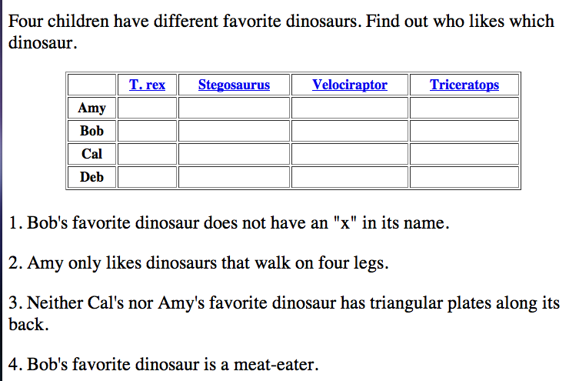
Propositional logic

Slide 17
Propositional logic
T.Rex has an x in it
Stegasaurus and Triceritops walk on 4 legs
T.Rex and Velociraptors eat meat
Bob likes Amy
…

Slide 18
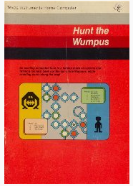
Hunt the Wumpus
Invented in the early 70s (i.e. the “good old days” of computer science)
  originally command-line (think black screen with greenish text)

Slide 19
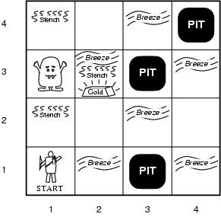
The Wumpus World (as defined by the book)
Performance measure
  gold +1000, death -1000 (falling into pit or eaten by wumpus)
  -1 per step, -10 for using the arrow
Environment
  4x4 grid of rooms
  Agent starts in [1,1] facing right
  gold/wumpus squares randomly
  chosen
  Any other room can have a pit
  (prob = 0.2)
Sensors: Stench, Breeze, Glitter,
Bump, Scream
Actuators: Left turn, Right turn,
Forward, Grab, Release, Shoot
Notes:
The wumpus world is introduced in chapter 7, so incase you want a little clarification, you should look there
-to talk about KBA’s, we’ll talk about the “wumpus world”
-has anyone heard about any wumpus games? Hunt the wumpus - 70s arcade game - early commandline computer game as well
-the game is based off of this environment that we’ll talk about - the wumpus env is an excellent testbed for intelligent agents
-wumpus world = a cave of rooms connected by passageways
-there is a wumpus lurking somewhere in the cave (a beast that eats anyone who enters its room)
-the wumpus can be shot by an agent, but the agent only has one arrow
-some rooms contain bottomless pits that will trap anyone who wanders into these rooms (except for a wumpus, which is too big to fall in)
-there is a possibility of finding a heap of gold
-this is a sample wumpus world
-we can describe this world in the following ways…
Squares with and adjacent to wumpus are smelly
Squares adjacent to pit are breezy
Glitter in the same square as the gold
Shooting kills wumpus if you are facing it
(arrow goes in a straight line and continues until it hits a wumpus or a wall)
Shooting uses up the only arrow
Grabbing picks up gold if in same square
Releasing drops the gold in same square
Walking into a wall makes the agent perceive a bump
When the wumpus is killed, it emits a scream that is heard throughout the cave
A Percept comes as a list of 5 symbols representing the 5 sensors - as on or off
[stench, breeze, none, none, none]
So the agent will be standing in a square, facing some direction and will get a certain set of percepts
The agent will be exploring this world
Choosing where to explore next based on its knowledge about the environment and percepts
And will add knowledge to its KB along the way as it explores

Slide 20
Wumpus world characterization
Fully Observable?
  No… until we explore, we don’t know things about the world
Deterministic
  Yes
Discrete
  Yes

Slide 21
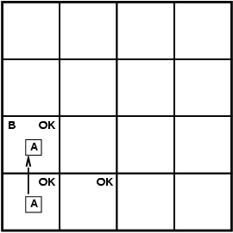
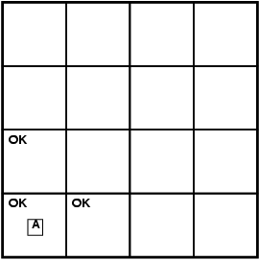
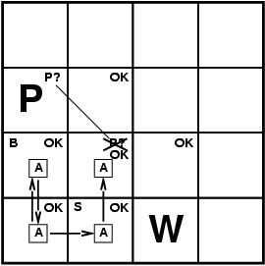
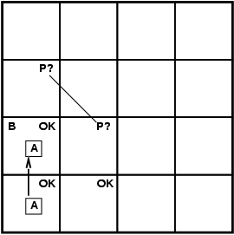
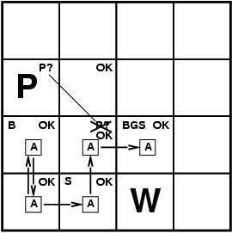
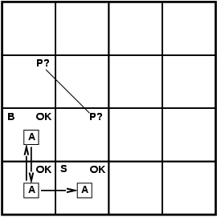
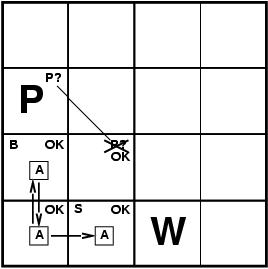

Exploring a wumpus world
A = Agent
B = Breeze
G = Glitter/Gold
OK = Safe Square
P = Pit
S = Stench
W = Wumpus
What do we know?
stench = none, breeze = none, glitter = none, bump = none, scream = none

Slide 22
Exploring a wumpus world
A = Agent
B = Breeze
G = Glitter/Gold
OK = Safe Square
P = Pit
S = Stench
W = Wumpus
What do we know?
stench = none, breeze, glitter = none, bump = none, scream = none

Slide 23
Exploring a wumpus world
A = Agent
B = Breeze
G = Glitter/Gold
OK = Safe Square
P = Pit
S = Stench
W = Wumpus
p?
B
p?
stench = none, breeze, glitter = none, bump = none, scream = none

Slide 24
Exploring a wumpus world
A = Agent
B = Breeze
G = Glitter/Gold
OK = Safe Square
P = Pit
S = Stench
W = Wumpus
p?
What do we know?
B
p?
stench, breeze = none, glitter = none, bump = none, scream = none

Slide 25
Exploring a wumpus world
A = Agent
B = Breeze
G = Glitter/Gold
OK = Safe Square
P = Pit
S = Stench
W = Wumpus
p?
B
p?
S
W?
stench, breeze = none, glitter = none, bump = none, scream = none

Slide 26
Exploring a wumpus world
A = Agent
B = Breeze
G = Glitter/Gold
OK = Safe Square
P = Pit
S = Stench
W = Wumpus
p?
What do we know?
B
ok
S
W?
stench = none, breeze = none, glitter = none, bump = none, scream = none

Slide 27
Exploring a wumpus world
A = Agent
B = Breeze
G = Glitter/Gold
OK = Safe Square
P = Pit
S = Stench
W = Wumpus
p?
ok
B
ok
ok
S
W?
stench = none, breeze = none, glitter = none, bump = none, scream = none

Slide 28
Exploring a wumpus world
A = Agent
B = Breeze
G = Glitter/Gold
OK = Safe Square
P = Pit
S = Stench
W = Wumpus
p?
ok
B
ok
ok
S
W?
stench, breeze, glitter, bump = none, scream = none

Slide 29
Wumpus with propositional logic
Using logic statements could determine all of the “safe” squares
A few problems?
  Sometimes, you have to guess (i.e. no safe squares)
  Sometimes the puzzle isn’t solvable (21% of the puzzles are not solvable at all)
  Wumpus may eat you ☺

Slide 30


Hunt the Wumpus
A modern version…
  http://www.dreamcodex.com/wumpus.php

Slide 31
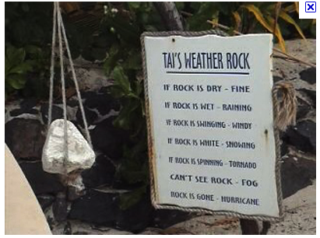
Weather rock

Slide 32
Weather rock
Is the weather always “fine” if the rock is dry?

Slide 33

Weather rock

Slide 34
Weather rock
Is the weather always “fine” if the rock is dry AND there isn’t an umbrella over it?

Slide 35

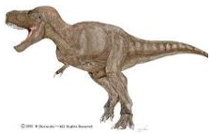
The real world…
Cannot always be explained by rules/facts
  The real world does not conform to logic
Sometimes rocks get wet for other reasons (e.g. dogs)
Sometimes tomatoes are green, bananas taste like apples and T.Rex’s are vegetarians

Slide 36
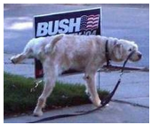
Probability theory
Probability theory enables us to make rational decisions
Allows us to account for uncertainty
  Sometimes rocks get wet for other reasons

Slide 37
Basic Probability Theory: terminology
An experiment has a set of potential outcomes, e.g., throw a die
The sample space of an experiment is the set of all possible outcomes, e.g., {1, 2, 3, 4, 5, 6}
An event is a subset of the sample space.
  {2}
  {3, 6}
  even = {2, 4, 6}
  odd = {1, 3, 5}
We will talk about the probability of events

Slide 38
Random variables
A random variable is a mapping of all possible outcomes of an experiment to an event
It represents all the possible values of something we want to measure in an experiment
For example, random variable, X, could be the number of heads for a coin
  note this is different than the sample space
space | HHH | HHT | HTH | HTT | THH | THT | TTH | TTT
X | 3 | 2 | 2 | 1 | 2 | 1 | 1 | 0

Slide 39
Random variables
We can then talk about the probability of the different values of a random variable
The definition of probabilities over all of the possible values of a random variable defines a probability distribution
space | HHH | HHT | HTH | HTT | THH | THT | TTH | TTT
X | 3 | 2 | 2 | 1 | 2 | 1 | 1 | 0
X | P(X)
3 | P(X=3) =
2 | P(X=2) =
1 | P(X=1) =
0 | P(X=0) =
?

Slide 40
Random variables
We can then talk about the probability of the different values of a random variable
The definition of probabilities over all of the possible values of a random variable defines a probability distribution
space | HHH | HHT | HTH | HTT | THH | THT | TTH | TTT
X | 3 | 2 | 2 | 1 | 2 | 1 | 1 | 0
X | P(X)
3 | P(X=3) = 1/8
2 | P(X=2) = 3/8
1 | P(X=1) = 3/8
0 | P(X=0) = 1/8

Slide 41
Probability distribution
To be explicit:
  A probability distribution assigns probability values to all possible values of a random variable
  These values must be >= 0 and <= 1
  These values must sum to 1 for all possible values of the random variable
Are these probability distributions?
X | P(X)
3 | P(X=3) = 1/2
2 | P(X=2) = 1/2
1 | P(X=1) = 1/2
0 | P(X=0) = 1/2
X | P(X)
3 | P(X=3) = -1
2 | P(X=2) = 2
1 | P(X=1) = 0
0 | P(X=0) = 0

Slide 42
Unconditional/prior probability
Simplest form of probability is
  P(X)
Prior probability: without any additional information, what is the probability
  What is the probability of a heads?
  What is the probability it will rain today?
  What is the probability a student will get an A in AI?
  What is the probability a person is male?
  …

Slide 43
Joint distributions
We can also talk about probability distributions over multiple variables, called a joint distribution
P(X,Y)
  probability of X and Y
  a distribution over the cross product of possible values
AIPass | P(AIPass)
true | 0.89
false | 0.13
AIPass AND EngPass | P(AIPass, EngPass)
true, true | .88
true, false | .01
false, true | .04
false, false | .07
EngPass | P(EngPass)
true | 0.92
false | 0.08

Slide 44
Joint distribution
Still a probability distribution
  all values between 0 and 1, inclusive
  all values sum to 1
All questions/probabilities of the two variables can be calculate from the joint distribution
  P(X), P(Y), …
AIPass AND EngPass | P(AIPass, EngPass)
true, true | .88
true, false | .01
false, true | .04
false, false | .07

Slide 45
Conditional probability
As we learn more information about the world, we can update our probability distribution
  Allows us to incorporate evidence
P(X|Y) models this (read “probability of X given Y”)
  What is the probability of a heads given that both sides of the coin are heads?
  What is the probability it will rain today given that it is cloudy?
  What is the probability a student will get an A in AI given that he/she does all of the written problems?
  What is the probability a person is male given that they are over 6 ft. tall?
Notice that the distribution is still over the values of X

Slide 46
Conditional probability
Given that Y=y has happened, what proportion of those events does X=x also happen
X=x
Y=y

Slide 47
Conditional probability
Given that Y=y has happened, what proportion of those events does X=x also happen
X=x
Y=y
AIPass AND EngPass | P(AIPass, EngPass)
true, true | .88
true, false | .01
false, true | .04
false, false | .07
What is:
p(AIPass=true | EngPass=false)?

Slide 48
Conditional probability
AIPass AND EngPass | P(AIPass, EngPass)
true, true | .88
true, false | .01
false, true | .04
false, false | .07
What is:
p(AIPass=true | EngPass=false)?
= 0.125
Notice this is different than p(AIPass=true) = 0.89

Slide 49
A note about notation
When talking about a particular assignment, you should technically write p(X=x), etc.
However, when it’s clear (like below), we’ll often shorten it
Also, we may also say P(X) to generically mean any particular value, i.e. P(X=x)
= 0.125

Slide 50

Another example
Start with the joint probability distribution:
P(toothache) = ?

Slide 51

Another example
Start with the joint probability distribution:
P(toothache) = 0.108 + 0.012 + 0.016 + 0.064 = 0.2
Notes:
So the probability of a toothache is the sum of all of these atomic events (we called them models in logic) in which toothache is true

Slide 52
Another example
Start with the joint probability distribution:
P(¬cavity | toothache) = ?

Slide 53

Another example
Start with the joint probability distribution:
P(¬cavity | toothache) = P(¬cavity, toothache)
P(toothache)
= 0.016+0.064
0.108 + 0.012 + 0.016 + 0.064
= 0.4

Slide 54
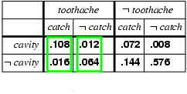
Normalization
Denominator can be viewed as a normalization constant α
P(CAVITY | toothache) = α P(CAVITY,toothache)
  = α [P(CAVITY,toothache,catch) + P(CAVITY,toothache,¬ catch)]
  = α [<0.108,0.016> + <0.012,0.064>]
  = α <0.12,0.08> = <0.6,0.4>
General idea: compute distribution on query variable by fixing evidence variables and summing over hidden/unknown variables
unnormalized p(cavity|toothache)
unnormalized p(¬cavity|toothache)
Notes:
On the last slide, we were computing the conditional probability that I don’t’ have a cavity, given that I have a toothache P(¬cavity | toothache)
If we try the inverse of that P(cavity|toothache), we end up dividing by the same denominator P(toothache)
P(cavity|toothache) = P(cavity n toothache) / P(toothache)
So, we can view the denominator as a normalization constant alpha for the distribution P(Cavity|toothache)
Notice that Cavity is capitalized here, that is because I’m talking about all possible values for the variable Cavity (true or false), whereas I’m saying that toothache is true
Using this constant, we can merge these two calculations into 1 (instead of calculating P(toothache) twice, or doing these extra steps), where the probabilities obviously still add up to 1
This gives us a shortcut here, we can calculate both the Probability of cavity and not cavity (given toothache) in one calculation
We have the set of probabilities for which toothache and catch are true and the set of values for which toothache and not catch are true
Doing vector addition here, we get <0.12, 0.08> which we then multiply by the constant alpha (which in this case was 1/P(toothache) = 1/0.2)
CALCULATE ALPHA - ADD TWO PROBS - DIVIDE EACH BY THIS SUM
We get the set of two probabilities which correspond to the probability of cavity and the probability of not cavity given toothache

Slide 55
Properties of probabilities
P(A or B) = ?

Slide 56
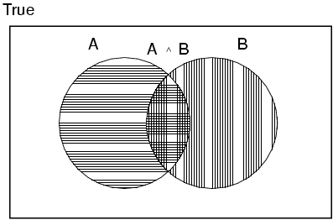
Properties of probabilities
P(A or B) = P(A) + P(B) - P(A,B)

Slide 57
Properties of probabilities
P(¬E) = 1– P(E)
If E1 and E2 are logically equivalent, then: P(E1)=P(E2).
  E1: Not all philosophers are more than six feet tall.
  E2: Some philosopher is not more that six feet tall.
    Then P(E1)=P(E2).
P(E1, E2) ≤ P(E1).

Slide 58
The Three-Card Problem
Three cards are in a hat. One is red on both sides (the red-red card). One is white on both sides (the white-white card). One is red on one side and white on the other (the red-white card). A single card is drawn randomly and tossed into the air.
  What is the probability that the red-red card was drawn?
  b. What is the probability that the drawn cards lands with a white side up?
  c. What is the probability that the red-red card was not drawn, assuming that the drawn card lands with the a red side up?

Slide 59
The Three-Card Problem
Three cards are in a hat. One is red on both sides (the red-red card). One is white on both sides (the white-white card). One is red on one side and white on the other (the red-white card). A single card is drawn randomly and tossed into the air.
  What is the probability that the red-red card was drawn? p(RR) = 1/3
  b. What is the probability that the drawn cards lands with a white side? p(W-up) = 1/2
  c. What is the probability that the red-red card was not drawn, assuming that the drawn card lands with the a red side up?
    p(not-RR|R-up)?
    Two approaches:
      3 ways that red can be up… of those, only 1 doesn’t involve RR = 1/3
      p(not-RR|R-up) = p(not-RR, R-up) / p(R-up) =
        1/6 / 1/2 = 1/3

Slide 60
Fair Bets
A bet is fair to an individual I if, according to the individual's probability assessment, the bet will break even in the long run.
Are the following best fair?:
  Bet (a): Win $4.20 if RR;
  lose $2.10 otherwise
  Bet (b): Win $2.00 if W-up;
  lose $2.00 otherwise
  Bet (c): Win $4.00 if R-up and not-RR;
  lose $4.00 if R-up and RR;
  neither win nor lose if not-R-up

Slide 61
Verification
there are six possible outcomes, all equally likely
  RR drawn, R-up (side 1)
  RR drawn, R-up (side 2)
  WR drawn, R-up
  WR drawn, W-up
  WW drawn, W-up (side 1)
  WW drawn, W-up (side 2)
 | 1 | 2 | 3 | 4 | 5 | 6
a. | $4.20 | $4.20 | -$2.10 | -$2.10 | -$2.10 | -$2.10
b. | -$2.00 | -$2.00 | -$2.00 | $2.00 | $2.00 | $2.00
c. | -$4.00 | -$4.00 | $4.00 | $0.00 | $0.00 | $0.00

Slide 62
Verification
 | 1 | 2 | 3 | 4 | 5 | 6
a. | $4.20 | $4.20 | -$2.10 | -$2.10 | -$2.10 | -$2.10
b. | -$2.00 | -$2.00 | -$2.00 | $2.00 | $2.00 | $2.00
c. | -$4.00 | -$4.00 | $4.00 | $0.00 | $0.00 | $0.00
expected values:

Slide 63
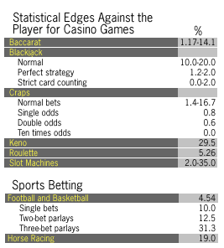
Why take a bad bet?
http://www.pbs.org/wgbh/pages/frontline/shows/gamble/odds/odds.html

Slide 64
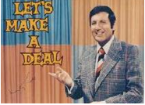

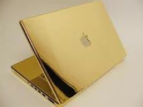
Monty Hall
3 doors
  behind two, something bad
  behind one, something good
You pick one door, but are not shown
the contents
Host opens one of the other two doors that has the bad thing behind it (he always opens one with the bad thing)
You can now switch your door to the other unopened. Should you?

Slide 65
Monty Hall
p(win) initially?
  3 doors, 1 with a winner, p(win) = 1/3
p(win | shown_other_door)?
  One reasoning:
    once you’re shown one door, there are just two remaining doors
    one of which has the winning prize
    1/2
This is not correct!

Slide 66
Be careful! – Player picks door 1
winning location
host opens
Door 2
1/2
Door 1
1/3
Door 3
1/2
Door 2
Door 3
In these two cases, switching will give you the correct answer. Key: host knows where it is.
1/3
1
Door 2
Door 3
1
1/3

Slide 67
Another view
1000 doors
  behind 999, something bad
  behind one, something good
You pick one door, but are not shown the contents
Host opens 998 of the other 999 doors that have the bad thing behind it (he always opens ones with the bad thing)
In essence, you’re picking between it being behind your one door or behind any one of the other doors (whether that be 2 or 999)
…

