Slide 1
Local Search
CS311
David Kauchak
Spring 2013
Some material borrowed from:
Sara Owsley Sood and others

Slide 2
Administrative
Assignment 2 due Tuesday before class
Written problems 2 posted
Class participation
http://www.youtube.com/watch?v=irHFVdphfZQ&list=UUCDOQrpqLqKVcTCKzqarxLg

Slide 3
N-Queens problem
How big is the search space?
Does the path matter?

Slide 4
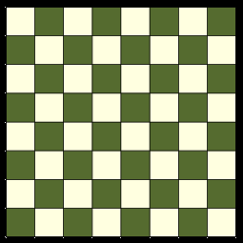

N-Queens problem
How big is the search space?
Does the path matter?

Slide 5
N-Queens problem
What is the depth?
  8
What is the branching factor?
  ≤ 8
How many nodes?
  8⁸ = 17 million nodes
Do we care about the path?
What do we really care about?
How big is the search space?
Does the path matter?

Slide 6
Local search
So far a systematic exploration:
  Explore full search space (possibly) using principled pruning (A*, . . . )
Best such algorithms (IDA*) can handle
  10¹⁰⁰ states ≈ 500 binary-valued variables (ballpark figures only!)
but. . . some real-world problem have 10,000 to 100,000 variables 10^{30,000} states
We need a completely different approach

Slide 7
Local search
Key difference: we don’t care about the path to the solution, only the solution itself!
Other similar problems?
  sudoku
  crossword puzzles
  VLSI design
  job scheduling
  Airline fleet scheduling
    http://www.innovativescheduling.com/company/Publications/Papers.aspx
  …

Slide 8
Alternate Approach
Start with a random configuration
repeat
  generate a set of “local” next states
  move to one of these next states
How is this different?

Slide 9
Local search
Start with a random configuration
repeat
  generate a set of “local” next states
  move to one of these next states
Requirements:
  ability to generate an initial, random guess
  generate the set of next states that are “local”
  criterion for evaluating what state to pick!

Slide 10
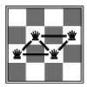
Example: 4 Queens
State:
  4 queens in 4 columns
Generating random state:
  any configuration
  any configuration without row conflicts?
Operations:
  move queen in column
Goal test:
  no attacks
Evaluation:
  h(state) = number of attacks

Slide 11
Local search
Start with a random configuration
repeat
  generate a set of “local” next states
  move to one of these next states
Starting state and next states are generally constrained/specified by the problem

Slide 12
Local search
Start with a random configuration
repeat
  generate a set of “local” next states
  move to one of these next states
How should we pick the next state to go to?

Slide 13
Greedy: Hill-climbing search
Start with a random configuration
repeat
  generate a set of “local” next states
  move to one of these next states
pick the best one according to our heuristic
again, unlike A* and others, we don’t care about the path

Slide 14
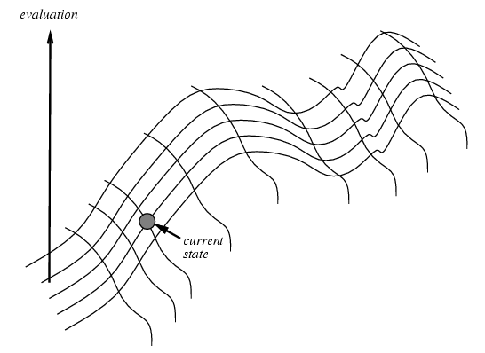
Hill-Climbing
def hillClimbing(problem):
""" This function takes a problem specification and returns
a solution state which it finds via hill climbing """
currentNode = makeNode(initialState(problem))
while True:
nextNode = getHighestSuccessor(currentNode,problem)
if value(nextNode) <= value(currentNode):
return currentNode
currentNode = nextNode

Slide 15

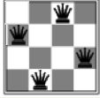
Example: n-queens
3 steps!

Slide 16
Graph coloring
What is the graph coloring problem?

Slide 17
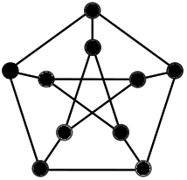
Graph coloring
Given a graph, label the nodes of the graph with n colors such that no two nodes connected by an edge have the same color
Is this a hard problem?
  NP-hard (NP-complete problem)
Applications
  scheduling
  sudoku

Slide 18
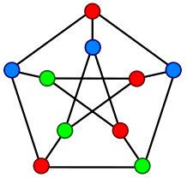
Graph coloring
Given a graph, label the nodes of the graph with n colors such that no two nodes connected by an edge have the same color
Is this a hard problem?
  NP-hard (NP-complete problem)
Applications
  scheduling
  sudoku

Slide 19
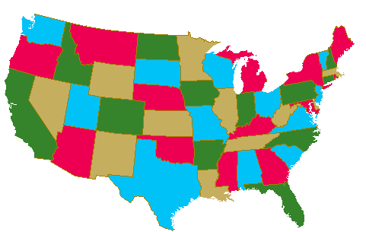
Local search: graph 3-coloring
Initial state?
Next states?
Heuristic/evaluation measure?

Slide 20
Example: Graph Coloring
Start with random coloring of nodes
Change color of one node to reduce # of conflicts
Repeat 2
Eval: number of “conflicts”, pairs adjacent nodes with the same color:
2

Slide 21
Example: Graph Coloring
Start with random coloring of nodes
Change color of one node to reduce # of conflicts
Repeat 2
Eval: number of “conflicts”, pairs adjacent nodes with the same color:
1

Slide 22
Example: Graph Coloring
Start with random coloring of nodes
Change color of one node to reduce # of conflicts
Repeat 2
Eval: number of “conflicts”, pairs adjacent nodes with the same color:

Slide 23
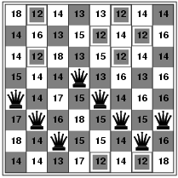
Hill-climbing Search: 8-queens problem
h = number of pairs of queens that are attacking each other, either directly or indirectly
h = 17 for the above state

Slide 24
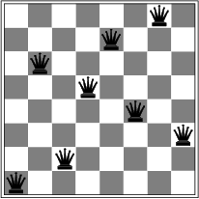
Hill-climbing search: 8-queens problem
86% of the time, this happens
After 5 moves, we’re here… now what?

Slide 25
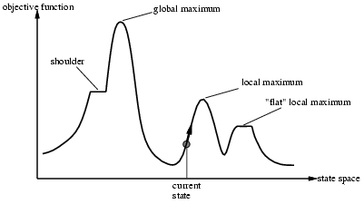
Problems with hill-climbing

Slide 26
Hill-climbing Performance
Complete?
Optimal?
Time Complexity
Space Complexity

Slide 27
Problems with hill-climbing
Ideas?

Slide 28
Idea 1: restart!
Random-restart hill climbing
  if we find a local minima/maxima start over again at a new random location
Pros:
Cons:

Slide 29
Idea 1: restart!
Random-restart hill climbing
  if we find a local minima/maxima start over again at a new random location
Pros:
  simple
  no memory increase
  for n-queens, usually a few restarts gets us there
    the 3 million queens problem can be solve in < 1 min!
Cons:
  if space has a lot of local minima, will have to restart a lot
  loses any information we learned in the first search
  sometimes we may not know we’re in a local minima/maxima

Slide 30
Idea 2: introduce randomness
def hillClimbing(problem):
""" This function takes a problem specification and returns
a solution state which it finds via hill climbing """
currentNode = makeNode(initialState(problem))
while True:
nextNode = getHighestSuccessor(currentNode,problem)
if value(nextNode) <= value(currentNode):
return currentNode
currentNode = nextNode
Rather than always selecting the best, pick a random move with some probability
sometimes pick best, sometimes random (epsilon greedy)
make better states more likely, worse states less likely
book just gives one… many ways of introducing randomness!

Slide 31
Idea 3: simulated annealing
What the does the term annealing mean?
“When I proposed to my wife I was annealing down on one knee”?

Slide 32
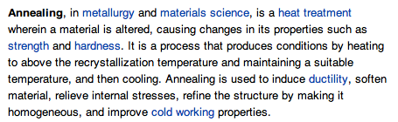
Idea 3: simulated annealing
What the does the term annealing mean?

Slide 33
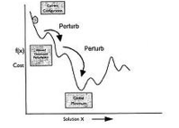
Simulated annealing
Early on, lots of randomness
  avoids getting stuck in local minima
  avoids getting lost on a plateau
As time progresses, allow less and less randomness
Specify a “cooling” schedule, which is how much randomness is included over time
randomness
time

Slide 34
Idea 4: why just 1 initial state?
Local beam search: keep track of k states
  Start with k randomly generated states
  At each iteration, all the successors of all k states are generated
  If any one is a goal state
    stop
  else
    select the k best successors from the complete list and repeat

Slide 35
Local beam search
Pros/cons?
  uses/utilized more memory
  over time, set of states can become very similar
How is this different than just randomly restarting k times?
What do you think regular beam search is?

Slide 36
An aside…
Traditional beam search
A number of variants:
  BFS except only keep the top k at each level
  best-first search (e.g. greedy search or A*) but only keep the top k in the priority queue
Complete?
Used in many domains
  e.g. machine translation
    http://www.isi.edu/licensed-sw/pharaoh/
    http://www.statmt.org/moses/

Slide 37
A few others local search variants
Stochastic beam search
  Instead of choosing k best from the pool, choose k semi-randomly
Taboo list: prevent returning quickly to same state
  keep a fixed length list (queue) of visited states
  add most recent and drop the oldest
  never visit a state that’s in the taboo list

Slide 38
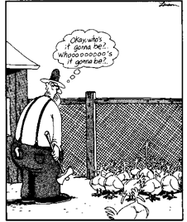
Idea 5: genetic algorithms
We have a pool of k states
Rather than pick from these, create new states by combining states
Maintain a “population” of states

Slide 39
Genetic Algorithms
A class of probabilistic optimization algorithms
  A genetic algorithm maintains a population of candidate solutions for the problem at hand, and makes it evolve by iteratively applying a set of stochastic operators
Inspired by the biological evolution process
Uses concepts of “Natural Selection” and “Genetic Inheritance” (Darwin 1859)
Originally developed by John Holland (1975)

Slide 40
The Algorithm
Randomly generate an initial population.
Repeat the following:
  Select parents and “reproduce” the next generation
  Randomly mutate some
  Evaluate the fitness of the new generation
  Discard old generation and keep some of the best from the new generation

Slide 41
Genetic Algorithm Operators
Mutation and Crossover
Parent 1
1 0 1 0 1 1 1
Parent 2
1 1 0 0 0 1 1
Child 1
1 0 1 0 0 1 1
Child 2
1 1 0 0 1 1 0
Mutation

Slide 42
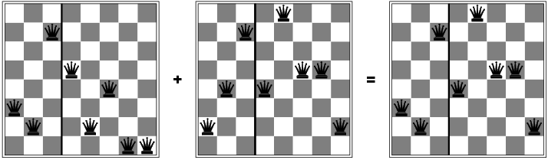
Genetic algorithms

Slide 43
Genetic algorithms

Slide 45
Local Search Summary
Surprisingly efficient search technique
Wide range of applications
Formal properties elusive
Intuitive explanation:
  Search spaces are too large for systematic search anyway. . .
Area will most likely continue to thrive

Slide 46
Local Search Example: SAT
Many real-world problems can be translated into propositional logic:
(A v B v C) ^ (¬B v C v D) ^ (A v ¬C v D)
. . . solved by finding truth assignment to variables (A, B, C, . . . ) that satisfies the formula
Applications
  planning and scheduling
  circuit diagnosis and synthesis
  deductive reasoning
  software testing
  . . .

Slide 47
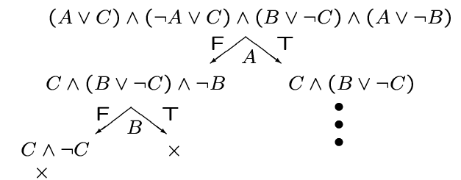
Satisfiability Testing
Best-known systematic method:
  Davis-Putnam Procedure (1960)
  Backtracking depth-first search (DFS) through space of truth assignments (with unit-propagation)

Slide 48
Greedy Local Search (Hill Climbing)

Slide 49
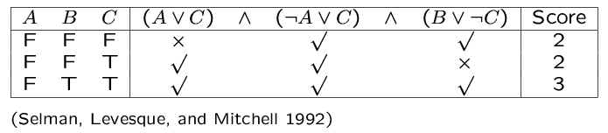
Greedy Local Search (Hill Climbing): GSAT
GSAT:
  1. Guess random truth assignment
  2. Flip value assigned to the variable that yields the greatest # of satisfied clauses. (Note: Flip even if no improvement)
  3. Repeat until all clauses satisfied, or have performed “enough” flips
  4. If no sat-assign found, repeat entire process, starting from a different initial random assignment.

Slide 50
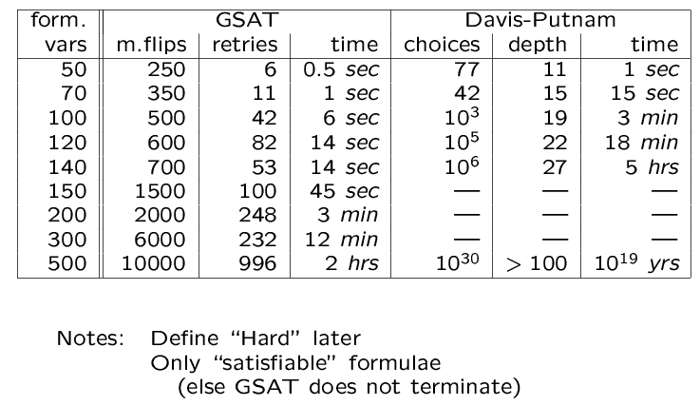
GSAT vs. DP on Hard Random Instances

Slide 51
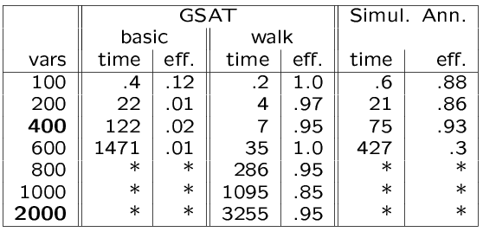
Experimental Results: Hard Random 3SAT
Effectiveness: prob. that random initial assignment leads to a solution.
Complete methods, such as DP, up to 400 variables
  Mixed Walk better than Simulated Annealing
  better than Basic GSAT
  better than Davis-Putnam

Slide 52
Local search for mancala?

Slide 53
Clustering
Group together similar items. Find clusters.

Slide 54
For example…

Slide 55
Hierarchical Clustering
Recursive partitioning/merging of a data set
1−clustering
5
2−clustering
1
3−clustering
4
2
4−clustering
3
5−clustering
1 2 3 4 5

Slide 56
Dendogram
  Represents all partitionings of the data
  We can get a K clustering by looking at the connected components at any given level
  Frequently binary dendograms, but n-ary dendograms are generally easy to obtain with minor changes to the algorithms

Slide 57
Hierarchical clustering as local search
State?
  a hierarchical clustering of the data
  basically, a tree over the data
  huge state space!
“adjacent states”?
  swap two sub-trees
  can also “graft” a sub-tree on somewhere else

Slide 58
Swap without temporal constraints, example 1
swap B and D
A B C D E
A D C B E
no change to the structure

Slide 59
Swap without temporal constraints, example 2
swap (D,E) and C
A B C D E
A B D E C
structure changed!

Slide 60
Hierarchical clustering as local search
state criterion?

Slide 61
Hierarchical clustering as local search
state criterion?
  how close together are the k-clusterings defined by the hierarchical clustering
weighted mean of k-clusterings
sum of squared distances from cluster centers

Slide 62
SS-Hierarchical vs. Ward’s
Yeast gene expression data set
 | SS-Hierarchical Greedy, Ward’s initialize | Ward’s
20 points | 21.59 8 iterations | 21.99
100 points | 411.83 233 iterations | 444.15
500 points | 5276.30 ? iterations | 5570.95

