Slide 1
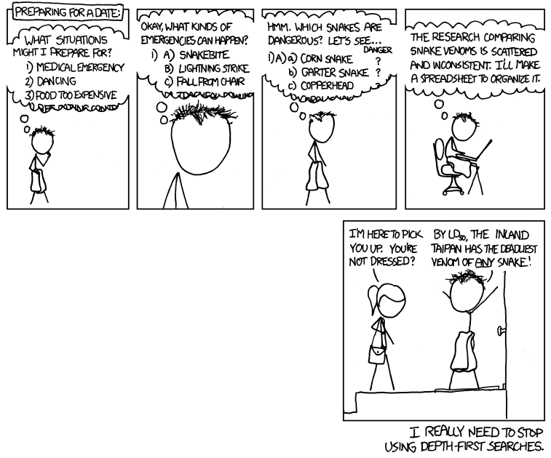
http://xkcd.com/761/

Slide 2
More Adversarial Search
CS311 David Kauchak
Spring 2013
Some material borrowed from :
Sara Owsley Sood and others

Slide 3
Admin
Written 2 posted today
Assignment 2
Last chance for a partner
How’s it going?
If working with a partner, should both be there when working on it!

Slide 4
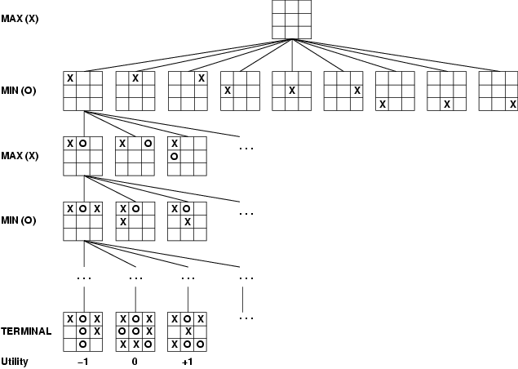
Last time
Game playing as search

Slide 5
Last time
Game playing as search
Assume the opponent will play optimally
MAX is trying to maximize utility
MIN is trying to minimize utility
MINIMAX algorithm backs-up the value from the leaves by alternatively minimizing and maximizing action options
plays “optimally”, that is can play no better than
Won’t work for deep trees or trees with large branching factors

Slide 6
Last time
Pruning alleviates this be excluding paths
Alpha-Beta pruning retains the optimality, by pruning paths that will never be chosen
alpha is the best choice down this path for MAX
beta is the best choice down this path for MIN

Slide 7
Pruning: do we have to traverse the whole tree?
MAX
A1
A2
A3
MIN
A11
A12
A13
A21
A22
A23
A31
A32
A33
4
12
7
10
3
16
2
4
1

Slide 8
Minimax example 2
MAX
A1
A2
A3
MIN
4
3?
2?
prune!
A11
A12
A13
A21
A22
A31
4
12
7
10
3
2

Slide 9
Baby NIM2: take 1, 2 or 3 sticks
6

Slide 10
alpha = best choice we’ve found so far for MAX
beta = best choice we’ve found so far for MIN
def maxValue(state, alpha, beta):
if state is terminal:
return utility(state)
else:
value = -∞
for all actions a in actions(state):
value = max(value, minValue(result(state,a), alpha, beta)
if value >= beta:
return value # prune!
alpha = max(alpha, value) # update alpha
return value
We’re making a decision for MAX.
When considering MIN’s choices, if we find a value that is greater than beta, stop, because MIN won’t make this choice
if we find a better path than alpha, update alpha

Slide 11
alpha = best choice we’ve found so far for MAX
beta = best choice we’ve found so far for MIN
def minValue(state, alpha, beta):
if state is terminal:
return utility(state)
else:
value = +∞
for all actions a in actions(state):
value = min(value, maxValue(result(state,a), alpha, beta)
if value <= alpha:
return value # prune!
beta = min(beta, value) # update alpha
return value
We’re making a decision for MIN.
When considering MAX’s choices, if we find a value that is less than alpha, stop, because MAX won’t make this choice
if we find a better path than beta for MIN, update beta

Slide 12
Effectiveness of alpha-beta pruning
As we gain more information about the state of things, we’re more likely to prune
What affects the performance of pruning?
key: which order we visit the states
can try and order them so as to improve pruning

Slide 13
Effectiveness of pruning
If perfect state ordering:
O(b^{m}) becomes O(b^{m/2})
We can solve a tree twice as deep!
Random order:
O(b^{m}) becomes O(b^{3m/4})
still pretty good
For chess using a basic ordering
Within a factor of 2 of O(b^{m/2})

Slide 14
Evaluation functions
O(b^{m/2}) is still exponential (and that’s assuming optimal pruning)
for chess, this gets us ~10-14 ply deep (a bit more with some more heuristics)
200 million moves per second (on a reasonable machine)
35⁵ = 50 million, or < 1 second
not enough to solve most games!
Ideas?
heuristic function – evaluate the desirability of the position
This is not a new idea:
Claude Shannon (think-- information theory, entropy), “Programming a Computer for Playing Chess” (1950)
http://vision.unipv.it/IA1/ProgrammingaComputerforPlayingChess.pdf
page 3
page 5

Slide 15
Cutoff search
How does an evaluation function help us?
search until some stopping criterion is met
return our heuristic evaluation of the state at that point
This serves as a proxy for the actual scoring function
When should we stop?
as deep as possible, for the time constraints
generally speaking, the further we are down the tree, the more accurate our evaluation function will be
based on a fixed depth
keep track of our depth during recursion
if we reach our depth limit, return EVAL(state)

Slide 16
Cutoff search
When should we stop?
fixed depth
based on time
start a timer and run IDS
when we run out of time, return the result from the last completed depth
quiescence search
search using one of the cutoffs above
but if we find ourselves in a volatile state (for example a state where a piece is about to be captured) keep searching!
attempts to avoid large swings in EVAL scores

Slide 17
Heuristic EVAL
What is the goal of EVAL, our state evaluation function?
estimate the expected utility of the game at a given state
What are some requirements?
must be efficient (we’re going to be asking this about a lot of states)
EVAL should play nice with terminal nodes
it should order terminal nodes in the same order at UTILITY
a win should be the most desirable thing
a loss should be the least desirable thing

Slide 18
Heuristic EVAL
What are some desirable properties?
value should be higher the closer we are to a win
and lower the closer we are to a lose
The quality of the evaluation function impacts the quality of the player
Remember last time (De Groot), we expert players were good at evaluating board states!
Simple Mancala Heuristic: Goodness of board = # stones in my Mancala minus the number of stones in my opponents.

Slide 19
Tic Tac Toe evaluation functions
O
X
X
O
Ideas?

Slide 20
Example Tic Tac Toe EVAL
Tic Tac Toe
Assume MAX is using “X”
EVAL(state) =
if state is win for MAX:
+ ∞
if state is win for MIN:
- ∞
else:
(number of rows, columns and diagonals available to MAX) - (number of rows, columns and diagonals available to MIN)
X
O
= 6 - 4 = 2
O
X
X
O
= 4 - 3 = 1

Slide 21
Chess evaluation functions
Ideas?

Slide 22
Chess EVAL
Assume each piece has the following values
pawn = 1;
knight = 3;
bishop = 3;
rook = 5;
queen = 9;
EVAL(state) =
sum of the value of white pieces –
sum of the value of black pieces
= 31 - 36 = -5

Slide 23
Chess EVAL
Assume each piece has the following values
pawn = 1;
knight = 3;
bishop = 3;
rook = 5;
queen = 9;
EVAL(state) =
sum of the value of white pieces –
sum of the value of black pieces
Any problems with this?

Slide 24
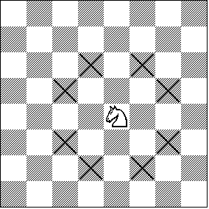
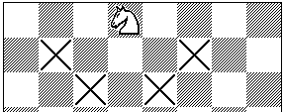
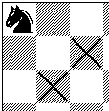
Chess EVAL
Ignores actual positions!
Actual heuristic functions are often a weighted combination of features

Slide 25
Chess EVAL
number of pawns
number of attacked knights
1 if king has knighted, 0 otherwise
A feature can be any numerical information about the board
as general as the number of pawns
to specific board configurations
Deep Blue: 8000 features!

Slide 26
Chess EVAL
number of pawns
number of attacked knights
1 if king has knighted, 0 otherwise
How can we determine the weights (especially if we have 8000 of them!)?

Slide 27
Chess EVAL
number of pawns
number of attacked knights
1 if king has knighted, 0 otherwise
Machine learning!
play/examine lots of games
adjust the weights so that the EVAL(s) correlates with the actual utility of the states

Slide 28
Horizon effect
Who’s ahead? What move should Black make?

Slide 29
Horizon effect
The White pawn is about to become a queen
A naïve EVAL function may not account for this behavior
We can delay this from happening for a long time by putting the king in check
If we do this long enough, it will go beyond our search cutoff and it will appear to be a better move than any move allowing the pawn to become a queen
But it’s only delaying the inevitable (the book also has another good example)

Slide 30
Other improvements
Computers have lots of memory these days
DFS (or IDS) is only using a linear amount of memory
How can we utilize this extra memory?
transposition table
history/end-game tables
“opening” moves
…

Slide 31
Transposition table
Similar to keeping track of the list of explored states
“transpositions” are differing move sequences that start and end in the same place
Keeps us from duplicating work
Can double the search depth in chess!

Slide 32
history/end-game tables
History
keep track of the quality of moves from previous games
use these instead of search
end-game tables
do a reverse search of certain game configurations, for example all board configurations with king, rook and king
tells you what to do in any configuration meeting this criterion
if you ever see one of these during search, you lookup exactly what to do

Slide 33
end-game tables
Devastatingly good
Allows much deeper branching
for example, if the end-game table encodes a 20-move finish and we can search up to 14
can search up to depth 34
Stiller (1996) explored all end-games with 5 pieces
one case check-mate required 262 moves!
Knoval (2006) explored all end-games with 6 pieces
one case check-mate required 517 moves!
Traditional rules of chess require a capture or pawn move within 50 or it’s a stalemate

Slide 34
Opening moves
At the very beginning, we’re the farthest possible from any goal state
People are good with opening moves
Tons of books, etc. on opening moves
Most chess programs use a database of opening moves rather than search

Slide 35
Chance/non-determinism in games
All the approaches we’ve looked at are only appropriate for deterministic games
Some games have a randomness component, often imparted either via dice or shuffling
Why consider games of chance?
because they’re there!
more realistic… life is not deterministic
more complicated, allowing us to further examine search techniques

Slide 36
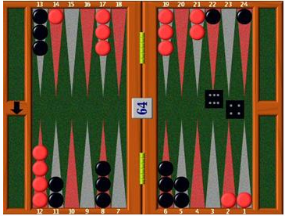
Backgammon
Basic idea: move your pieces around the board and then off
Amount you get to move is determined by a roll of two dice

Slide 37
Backgammon
If we know the dice rolls, then it’s straightforward to get the next states
For example, white rolls a 5 and a 6
Possible moves?
13 14 15 16 17 18
19 20 21 22 23 24
12 11 10 9 8 7
6 5 4 3 2 1

Slide 38
Backgammon
If we know the dice rolls, then it’s straightforward to get the next states
For example, white rolls a 5 and a 6
Possible moves (7-2,7-1), (17-12,17-11), …
13 14 15 16 17 18
19 20 21 22 23 24
12 11 10 9 8 7
6 5 4 3 2 1

Slide 39
Backgammon
13 14 15 16 17 18
19 20 21 22 23 24
Which is better:
(7-2,7-1) or (17-12,17-11)?
We’d like to search…
Ideas?
12 11 10 9 8 7
6 5 4 3 2 1

Slide 40
Searching with chance
We know there are 36 different dice rolls (21 unique)
Insert a “chance” layer in each ply with branching factor 21
What does this do to the branching factor?
drastically increases the branching factor (by a factor of 21!)

Slide 41
Searching with chance
Are all dice combinations equally likely?

Slide 42
Searching with chance
Associate a probability with each chance branch
each double ([1,1], [2,2], …) have probability 1/36
all others have probability 1/18
Generally the probabilities are easy to calculate

Slide 43
Searching with chance
Assume we can reach the bottom.
How can we calculate the value of a state?

Slide 44
Expected minimax value
Rather than the actual value calculate the expected value based on the probabilities
EXPECTI-MINIMAX-VALUE(n)=
UTILITY(n) If n is a terminal
max_{s ∈ successors(n)} MINIMAX-VALUE(s) If n is a max node
min_{s ∈ successors(n)} MINIMAX-VALUE(s) If n is a min node
∑_{s ∈ successors(n)} P(s) . EXPECTIMINIMAX(s) If n is a chance node
multiply the minimax value by the probability of going to that state

Slide 45
EXPECTEDMINIMAX example
MAX
CHANCE
.9
.1
.9
.1
MIN
values?
2
4
5
3
1
1
6
4

Slide 46
EXPECTEDMINIMAX example
MAX
CHANCE
values?
.9
.1
.9
.1
2
3
1
4
MIN
2
4
5
3
1
1
6
4

Slide 47
EXPECTEDMINIMAX example
MAX
value?
2.1
1.3
CHANCE
.9
.1
.9
.1
2
3
1
4
MIN
2
4
5
3
1
1
6
4

Slide 48
EXPECTEDMINIMAX example
MAX
2.1
2.1
1.3
CHANCE
.9
.1
.9
.1
2
3
1
4
MIN
2
4
5
3
1
1
6
4

Slide 49
Chance and evaluation functions
Left, A1 wins
Right A2 wins
Outcome of evaluation function may not change when values are scaled differently.
Behavior is preserved only by a positive linear transformation of EVAL.
Which move will be picked for these different MINIMAX trees?
Does this change any requirements on the evaluation function?

Slide 50
Chance and evaluation functions
Left, A1 wins
Right A2 wins
Outcome of evaluation function may not change when values are scaled differently.
Behavior is preserved only by a positive linear transformation of EVAL.
Even though we haven’t changed the ranking of the final states, we changed the outcome
Magnitude matters, not just ordering
Notes:
-the presence of chance nodes means that one has to be more careful about what the utility of terminal states (or evaluation of non-terminal states for that matter) means
-if we assign utility values of the terminal states [1,2,3,4] on left and [1,20,30,400] on right, the EXPECTIMINIMAX decision for MAX actually changes
In the one on the left,what will MAX choose to do?
EMV(Chance1) = .9*2 + .1*3 = 1.8 + .3 = 2.1
EMV(Chance2) = .9*1 + .1*4 = .9 + .4 = 1.3
MAX will choose A1 - left
In the one on the right, what will MAX choose to do?
EMV(Chance1) = .9*20 + .1*30 = 21
EMV(Chance2) = .9*1 + .1*400 = 40.9
MAX will choose A2 - right
The 10% chance of a hugely great outcome makes the node on the right seem much more desirable, when in practice, its not likely (10%) to happen
so, just changing the scale of the utility values, the program behaves totally differently
This is like the lottery, the more money it has in the jackpot, the more desirable it becomes, but you’re still equally if not more unlikely to win
MiniMax was O(b^m) because it was expanding the whole game tree
Expectiminimax’s game tree has expanded with the addition of chance nodes, so the number of nodes it looks at will be O(b^m*n^m) where n is the number of dice rolls
Alpha Beta was good before because it ignores future developments that just are not going to happen, given best (optimal) play by each player
In games with dice or coins, there are no “likely” sequences of moves, because for the moves to happen, the dice would first have to come out the right way to make them legal
Problem with games with dice, with uncertainty, is that the possibilities are multiplied enormously and forming detailed plans becomes pointless unless you can get the dice to completely cooperate
You can use AlphaBeta on games with dice (example in book - page 178), but the game tree is still huge - still more things to explore than without chance

Slide 51
Games with chance
Original branching factor b, chance factor n
What happens to our search run-time?
O((nb)^{m})
in essence, multiplies our branching factor by n
For this reason, many games with chance don’t use much search
backgammon frequently only looks ahead 3 ply
Instead, evaluation functions play a more important roll
TD-Gammon learned an evaluation function by playing itself over a million times!

Slide 52
Partially observable games
In many games we don’t have all the information about the world, for example?

Slide 53
Partially observable games
In many games we don’t have all the information about the world
battleship
bridge
poker
scrabble
Kriegspiel
pretty cool game
“hidden” chess
…
How can we deal with this?

Slide 54
Simple Kriegspeil
To start with:
I know where my pieces are
and I know exactly where the opponents pieces are

Slide 55
Simple Kriegspeil
As the game progresses, though
I know where my pieces are
but I no longer know where the opponents pieces are
?
?
?
?
?
?
?
?
?
?
?
?

Slide 56
Simple Kriegspeil
However, I can have some expectation/estimation of where the are
.75
.75
.75
.75
.25
.25
.25
.25
0
0
0
0
starts to look like a game of chance

Slide 57
Challenges with partially observable games?
state space can be huge!
our MINIMAX assumption is probably not true
reasons for the opponent to purposefully play suboptimally
may make moves just to explore
These are hard!
when humans play Kriegspeil, most of the checkmates are accidental ☺

Slide 58
Other things to watch out for…
What will minimax do here?
Is that OK?
What might you do instead?
Return probability distribution over possible values
Yet expensive calculation
Utility of node expansion
Only expand those nodes which lead to significanlty better moves
Both suggestions require meta-reasoning

Slide 59
State of the art
5.7 of the book gives a pretty good recap of popular games
Still lots of research going on!
AAAI has an annual poker competition
Lots of other tournaments going on for a variety of games
New games being invented/examined all the time
google “quantum chess”
University of Alberta has a big games group
http://webdocs.cs.ualberta.ca/~games/

