Slide 1
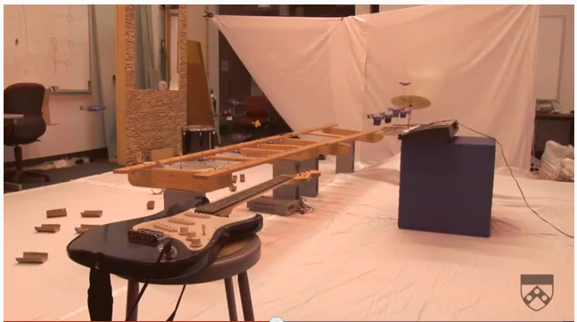
http://www.youtube.com/watch?v=LcPWEMwGJVQ

Slide 2
Adversarial Search
CS311
David Kauchak
Spring 2013
Some material borrowed from :
Sara Owsley Sood and others

Slide 3
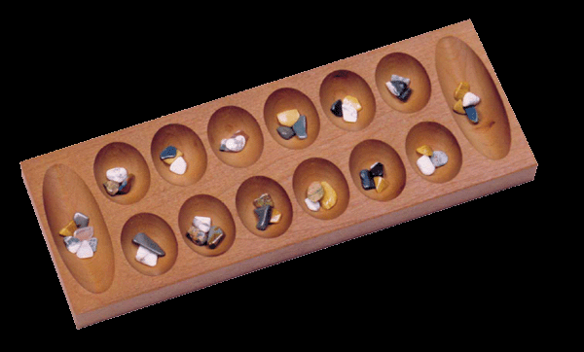
Admin
Reading/book?
Assignment 2
  On the web page
  3 parts
  Anyone looking for a partner?
  Get started!
Written assignments
  Make sure to look at them asap!
  Post next written assignment soon

Slide 4
A quick review of search
Rational thinking via search – determine a plan of actions by searching from starting state to goal state
Uninformed search vs. informed search
  what’s the difference?
  what are the techniques we’ve seen?
  pluses and minuses?
Heuristic design
  admissible?
  dominant?

Slide 5
Why should we study games?
Clear success criteria
Important historically for AI
Fun ☺
Good application of search
  hard problems (chess 35¹⁰⁰ nodes in search tree, 10⁴⁰ legal states)
Some real-world problems fit this model
  game theory (economics)
  multi-agent problems

Slide 6
Types of games
What are some of the games you’ve played?

Slide 7
Types of games: game properties
single-player vs. 2-player vs. multiplayer
Fully observable (perfect information) vs. partially observable
Discrete vs. continuous
real-time vs. turn-based
deterministic vs. non-deterministic (chance)

Slide 8

Strategic thinking = intelligence
?
For reasons previously stated, two-player games have been a focus of AI since its inception…
Begs the question: Is strategic thinking the same as intelligence?

Slide 9
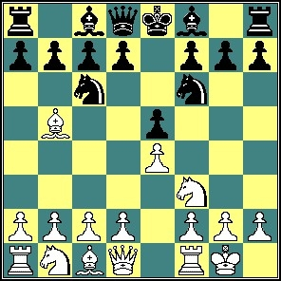
Strategic thinking = intelligence
?
Humans and computers have different relative strengths in these games:
humans
computers
good at evaluating the strength of a board for a player
good at looking ahead in the game to find winning combinations of moves

Slide 10
Strategic thinking = intelligence
?
How could you figure out how humans approach playing chess?
humans
good at evaluating the strength of a board for a player

Slide 11
How humans play games…
An experiment (by deGroot) was performed in which chess positions were shown to novice and expert players…
- experts could reconstruct these perfectly
- novice players did far worse…

Slide 12
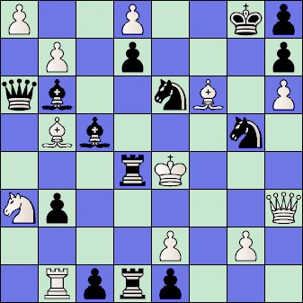
How humans play games…
An experiment (by deGroot) was performed in which chess positions were shown to novice and expert players…
- experts could reconstruct these perfectly
- novice players did far worse…
Random chess positions (not legal
ones) were then shown to the two
groups
- experts and novices did just as
badly at reconstructing them!

Slide 13
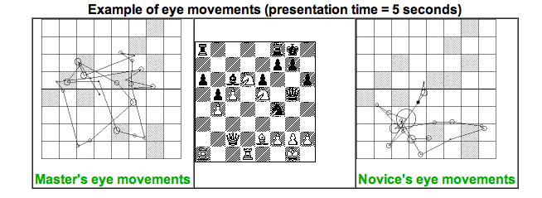
People are still working on this problem…
http://people.brunel.ac.uk/~hsstffg/frg-research/chess_expertise/

Slide 14
Tic Tac Toe as search
How can we pose this as a search problem?

Slide 15
Tic Tac Toe as search
X
X
…
X

Slide 16
Tic Tac Toe as search
X
X
O
X
O
X
…
O
…

Slide 17
Tic Tac Toe as search
Eventually, we’ll get to a leaf
X
X
O
O
X
O
X
X
O
X
O
O
X
X
O
…
O
X
O
X
O
X
X
O
X
X
O
+1
0
-1
The UTILITY of a state tells us how good the states are.

Slide 18
Defining the problem
INITIAL STATE – board position and the player whose turn it is
SUCCESSOR FUNCTION– returns a list of (move, next state) pairs
TERMINAL TEST – is game over? Are we in a terminal state?
UTILITY FUNCTION – (objective or payoff func) gives a numeric value for terminal states (ie – chess – win/lose/draw +1/-1/0, backgammon +192 to -192)

Slide 19
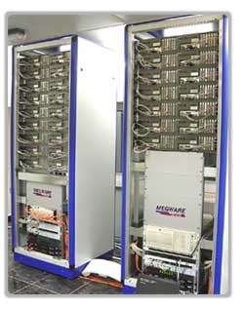
Games’ Branching Factors
On average, there are ~35 possible moves that a chess player can make from any board configuration…
0 Ply
1 Ply
18 Ply!!
2 Ply
Branching Factor Estimates
for different two-player games
Tic-tac-toe 4
Connect Four 7
Checkers 10
Othello 30
Chess 35
Go 300
Hydra at home in the United Arab Emirates…

Slide 20
Games’ Branching Factors
On average, there are ~35 possible moves that a chess player can make from any board configuration…
0 Ply
1 Ply
2 Ply
Branching Factor Estimates
for different two-player games
Tic-tac-toe 4
Connect Four 7
Checkers 10
Othello 30
Chess 35
Go 300
Boundaries for qualitatively different games…

Slide 21
Games’ Branching Factors
On average, there are ~35 possible moves that a chess player can make from any board configuration…
0 Ply
1 Ply
2 Ply
Branching Factor Estimates
for different two-player games
“solved” games
Tic-tac-toe 4
Connect Four 7
Checkers 10
Othello 30
Chess 35
Go 300
CHINOOK (2007)
computer-dominated
human-dominated

Slide 22
Games vs. search problems?
Opponent!
  unpredictable/uncertainty
  deal with opponent strategy
Time limitations
  must make a move in a reasonable amount of time
  can’t always look to the end
Path costs
  not about moves, but about UTILITY of the resulting state/winning

Slide 23
Back to Tic Tac TOe
X’s turn
x
x
…
x
O’s turn
…
X’s turn
…
…
…

Slide 24
I’m X, what will ‘O’ do?
X
X
O
O
X
O
X
O’s turn
X
X
O
X
X
O
O
X
O
O
X
O
X
O
X
O

Slide 25
Minimizing risk
The computer doesn’t know what move O (the opponent) will make
It can assume, though, that it will try and make the best move possible
Even if O actually makes a different move, we’re no worse off
X
X
O
O
X
O
X
X
X
O
X
X
O
O
X
O
O
X
O
X
O
X
O

Slide 26
Optimal Strategy
An Optimal Strategy is one that is at least as good as any other, no matter what the opponent does
  If there's a way to force the win, it will
  Will only lose if there's no other option

Slide 27
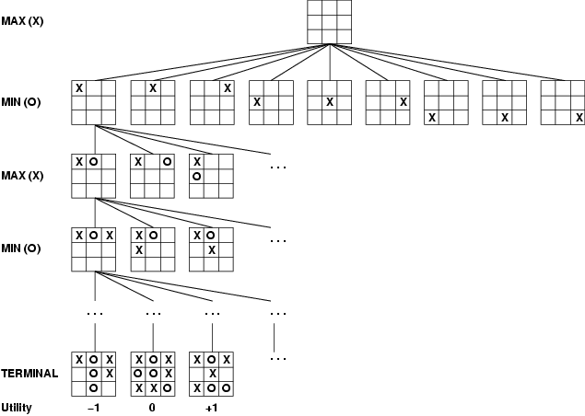
How can X play optimally?

Slide 28
How can X play optimally?
Start from the leaves and propagate the utility up:
  if X’s turn, pick the move that maximizes the utility
  if O’s turn, pick the move that minimizes the utility
Is this optimal?

Slide 29
Minimax Algorithm: An Optimal Strategy
minimax(state) =
- if state is a terminal state
Utility(state)
- if MAX’s turn
return the maximum of minimax(...)
on all successors of current state
- if MIN’s turn
return the minimum of minimax(…)
on all successors to current state
Uses recursion to compute the “value” of each state
Proceeds to the leaves, then the values are “backed up” through the tree as the recursion unwinds
What type of search is this?
What does this assume about how MIN will play? What if this isn’t true?
Note: We can't always search all the way down to the bottom of the tree…

Slide 30
def minimax(state):
for all actions a in actions(state):
return the a with the largest minValue(result(state,a))
def maxValue(state):
if state is terminal:
return utility(state)
else:
# return the a with the largest minValue(result(state,a))
value = -∞
for all actions a in actions(state):
value = max(value, minValue(result(state,a))
return value
ME: Assume the opponent will try and minimize value, maximize my move
def minValue(state):
if state is terminal:
return utility(state)
else:
# return the a with the smallest maxValue(result(state,a))
value = +∞
for all actions a in actions(state):
value = min(value, maxValue(result(state,a))
return value
OPPONENT:
Assume I will try and maximize my value, minimize his/her move

Slide 31
Baby Nim
MAX
MIN
Take 1 or 2 at each turn
Goal: take the last match
MAX
What move should I take?
MIN
MAX

Slide 32
Baby Nim
MAX
5
MAX
1
2
MIN
4
3
MIN
2
1
2
1
Take 1 or 2 at each turn
Goal: take the last match
MAX
3
2
2
1
MAX
MAX wins
1
2
1
2
1
2
1
MIN
MIN
2
1
1
W
1
W
W
W
= 1.0
1
2
1
1
1
MAX
1
W
W
W
W
W
= -1.0
MAX
1
MIN wins/
MAX loses
W

Slide 33
Baby Nim
MAX
5
MAX
1
2
MIN
4
3
MIN
2
1
2
1
Take 1 or 2 at each turn
Goal: take the last match
MAX
3
2
2
1
MAX
MAX wins
1
2
1
2
1
2
1
MIN
MIN
2
1
1
W
1
W
W
W
= 1.0
1.0
1.0
1.0
1
1
1
2
1
MAX
1
W
W
W
W
W
= -1.0
MAX
-1.0
-1.0
-1.0
-1.0
1
MIN wins/
MAX loses
W
1.0

Slide 34
Baby Nim
MAX
5
MAX
1
2
MIN
4
3
MIN
2
1
2
1
Take 1 or 2 at each turn
Goal: take the last match
MAX
3
2
2
1
MAX
MAX wins
1
2
1
2
1
2
1
MIN
MIN
2
1
1
W
1
W
W
W
= 1.0
1.0
1.0
1.0
1
1
1
2
1
MAX
1
W
W
W
W
W
= -1.0
MAX
1.0
-1.0
-1.0
-1.0
-1.0
1
MIN wins/
MAX loses
W
1.0

Slide 35
Baby Nim
MAX
5
MAX
1
2
MIN
4
3
MIN
2
1
2
1
Take 1 or 2 at each turn
Goal: take the last match
MAX
3
2
2
1
MAX
MAX wins
1
2
1
2
1
2
1
MIN
MIN
2
1
1
W
1
W
W
W
= 1.0
-1.0
1.0
1.0
1.0
1
1
1
2
1
MAX
1
W
W
W
W
W
= -1.0
MAX
1.0
-1.0
-1.0
-1.0
-1.0
1
MIN wins/
MAX loses
W
1.0

Slide 36
Baby Nim
MAX
5
MAX
1
2
MIN
4
3
MIN
2
1
2
1
Take 1 or 2 at each turn
Goal: take the last match
MAX
3
2
2
1
MAX
MAX wins
1
2
1
2
1
2
1
MIN
MIN
2
1
1
W
1
W
W
W
= 1.0
-1.0
-1.0
1.0
1.0
1.0
1
1
1
2
1
MAX
1
W
W
W
W
W
= -1.0
MAX
1.0
-1.0
-1.0
-1.0
-1.0
1
MIN wins/
MAX loses
W
1.0

Slide 37
Baby Nim
MAX
5
MAX
1
2
MIN
4
3
MIN
2
1
2
1
Take 1 or 2 at each turn
Goal: take the last match
MAX
3
2
2
1
MAX
-1.0
MAX wins
1
2
1
2
1
2
1
MIN
MIN
2
1
1
W
1
W
W
W
= 1.0
-1.0
-1.0
1.0
1.0
1.0
1
1
1
2
1
MAX
1
W
W
W
W
W
= -1.0
MAX
1.0
-1.0
-1.0
-1.0
-1.0
1
MIN wins/
MAX loses
W
1.0

Slide 38
Baby Nim
MAX
5
MAX
1
2
MIN
4
3
MIN
2
1
2
1
Take 1 or 2 at each turn
Goal: take the last match
MAX
3
2
2
1
MAX
-1.0
MAX wins
1
2
1
2
1
2
1
MIN
MIN
2
1
1
W
1
W
W
-1.0
-1.0
-1.0
1.0
1.0
W
= 1.0
1
1.0
2
1
1
1
MAX
1
W
W
W
W
W
= -1.0
MAX
1.0
-1.0
-1.0
-1.0
-1.0
1
MIN wins/
MAX loses
W
1.0

Slide 39
Baby Nim
MAX
5
MAX
1
2
MIN
4
3
MIN
2
1
2
1
Take 1 or 2 at each turn
Goal: take the last match
MAX
3
2
2
1
MAX
-1.0
1.0
MAX wins
1
2
1
2
1
2
1
MIN
MIN
2
1
1
W
1
W
W
-1.0
-1.0
-1.0
1.0
1.0
W
= 1.0
1
1.0
2
1
1
1
MAX
1
W
W
W
W
W
= -1.0
MAX
1.0
-1.0
-1.0
-1.0
-1.0
1
MIN wins/
MAX loses
W
1.0

Slide 40
Baby Nim
MAX
5
MAX
1
2
MIN
4
3
MIN
-1.0
2
1
2
1
Take 1 or 2 at each turn
Goal: take the last match
MAX
3
2
2
1
MAX
1.0
-1.0
MAX wins
1
2
1
2
1
2
1
MIN
MIN
2
1
1
W
1
W
W
-1.0
-1.0
-1.0
1.0
1.0
W
= 1.0
1
1.0
2
1
1
1
MAX
1
W
W
W
W
W
= -1.0
MAX
1.0
-1.0
-1.0
-1.0
-1.0
1
MIN wins/
MAX loses
W
1.0

Slide 41
Baby Nim
MAX
5
MAX
1
2
MIN
4
3
MIN
-1.0
2
1
2
1
Take 1 or 2 at each turn
Goal: take the last match
MAX
3
2
2
1
MAX
1.0
-1.0
MAX wins
1
2
1
2
1
2
1
MIN
MIN
2
1
1
W
1
W
W
-1.0
-1.0
-1.0
-1.0
1.0
1.0
W
= 1.0
1
1.0
2
1
1
1
MAX
1
W
W
W
W
W
= -1.0
MAX
1.0
-1.0
-1.0
-1.0
-1.0
1
MIN wins/
MAX loses
W
1.0

Slide 42
Baby Nim
MAX
5
MAX
1
2
MIN
4
3
MIN
-1.0
2
1
2
1
Take 1 or 2 at each turn
Goal: take the last match
MAX
3
2
2
1
MAX
1.0
1.0
-1.0
MAX wins
1
2
1
2
1
2
1
MIN
MIN
2
1
1
W
1
W
W
-1.0
-1.0
-1.0
-1.0
1.0
1.0
W
= 1.0
1
1.0
2
1
1
1
MAX
1
W
W
W
W
W
= -1.0
MAX
1.0
-1.0
-1.0
-1.0
-1.0
1
MIN wins/
MAX loses
W
1.0

Slide 43
Baby Nim
MAX
5
MAX
1
2
MIN
4
3
MIN
-1.0
2
1
2
1
Take 1 or 2 at each turn
Goal: take the last match
MAX
3
2
2
1
MAX
1.0
1.0
1.0
-1.0
MAX wins
1
2
1
2
1
2
1
MIN
MIN
2
1
1
W
1
W
W
-1.0
-1.0
-1.0
-1.0
1.0
1.0
W
= 1.0
1
1.0
2
1
1
1
MAX
1
W
W
W
W
W
= -1.0
MAX
1.0
-1.0
-1.0
-1.0
-1.0
1
MIN wins/
MAX loses
W
1.0

Slide 44
Baby Nim
could still win, but not optimal!!!
MAX
5
MAX
1
2
MIN
4
3
MIN
-1.0
2
1
1.0
2
1
Take 1 or 2 at each turn
Goal: take the last match
MAX
3
2
2
1
MAX
1.0
1.0
1.0
-1.0
MAX wins
1
2
1
2
1
2
1
MIN
MIN
2
1
1
W
1
W
W
-1.0
-1.0
-1.0
-1.0
1.0
1.0
W
= 1.0
1
1.0
2
1
1
1
MAX
1
W
W
W
W
W
= -1.0
MAX
1.0
-1.0
-1.0
-1.0
-1.0
1
MIN wins/
MAX loses
W
1.0

Slide 45
Minimax example 2
A1
A2
A3
A11
A12
A13
A21
A22
A23
A31
A32
A33
3
12
8
2
4
6
14
5
2
Which move should be made: A₁, A₂ or A₃?

Slide 46
Minimax example 2
MAX
A1
A2
A3
MIN
3
2
2
A11
A12
A13
A21
A22
A23
A31
A32
A33
3
12
8
2
4
6
2
5
14

Slide 47
Properties of minimax
Minimax is optimal!
Are we done?
  For chess, b ≈ 35, d ≈100 for reasonable games → exact solution completely infeasible
  Is minimax feasible for Mancala or Tic Tac Toe?
    Mancala: 6 possible moves. average depth of 40, so 6⁴⁰ which is on the edge
    Tic Tac Toe: branching factor of 4 (on average) and depth of 9… yes!
Ideas?
  pruning!
  improved state utility/evaluation functions
Yes (if tree is finite)
Yes (against an optimal opponent)
O(bm)
O(bm) (depth-first exploration)

Slide 48
Pruning: do we have to traverse the whole tree?
MAX
A1
A2
A3
MIN
A11
A12
A13
A21
A22
A23
A31
A32
A33
4
12
7
10
3
16
2
4
1

Slide 49
Pruning: do we have to traverse the whole tree?
MAX
A1
A2
A3
MIN
4
A11
A12
A13
A21
A22
A23
A31
A32
A33
4
12
7
10
3
16
2
4
1

Slide 50
Minimax example 2
MAX
A1
A2
A3
MIN
4
3?
?
A11
A12
A13
A21
A22
A23
A31
A32
A33
4
12
7
10
3
16
2
4
1

Slide 51
Minimax example 2
MAX
A1
A2
A3
MIN
4
3?
prune!
A11
A12
A13
A21
A22
A31
A32
A33
4
12
7
10
3
2
4
1
Any others if we continue?

Slide 52
Minimax example 2
MAX
A1
A2
A3
MIN
4
3?
2?
A11
A12
A13
A21
A22
A31
A32
A33
4
12
7
10
3
2
4
1

Slide 53
Minimax example 2
MAX
A1
A2
A3
MIN
4
3?
2?
prune!
A11
A12
A13
A21
A22
A31
4
12
7
10
3
2

Slide 54
Alpha-Beta pruning
An optimal pruning strategy
  only prunes paths that are suboptimal (i.e. wouldn’t be chosen by an optimal playing player)
  returns the same result as minimax, but faster
As we go, keep track of the best and worst along a path
  alpha = best choice we’ve found so far for MAX
  beta = best choice we’ve found so far for MIN

Slide 55
Alpha-Beta pruning
alpha = best choice we’ve found so far for MAX
Using alpha and beta to prune:
  We’re examining MIN’s options for a ply
  To do this, we’re examining all possible moves for MAX. If we find a value for one of MAX’s moves that is less than alpha, return. (MIN could do better down this path)
MIN
MAX
return if any < alpha

Slide 56
Alpha-Beta pruning
beta = best choice we’ve found so far for MIN
Using alpha and beta to prune:
  We’re examining MAX’s options for a ply
  To do this, we’re examining all possible moves for MIN. If we find a value for one of MIN’s possible moves that is greater than beta, return. (MIN won’t end up down here)
MAX
MIN
return if any > beta

Slide 57
Alpha-Beta pruning
Do DFS until we reach a leaf:
[-∞, +∞]
Range of possible values
[-∞, +∞]

Slide 58
Alpha-Beta pruning
alpha = best choice we’ve found so far for MAX
beta = best choice we’ve found so far for MIN
[-∞, +∞]
Range of possible values
What do we know?
[-∞, +∞]
3

Slide 59
Alpha-Beta pruning
alpha = best choice we’ve found so far for MAX
beta = best choice we’ve found so far for MIN
[-∞, +∞]
Range of possible values
What do we know?
[-∞, +∞]
3

Slide 60
Alpha-Beta pruning
alpha = best choice we’ve found so far for MAX
beta = best choice we’ve found so far for MIN
[-∞, +∞]
Range of possible values
[-∞, 3]
≤ 3
3

Slide 61
Alpha-Beta pruning
alpha = best choice we’ve found so far for MAX
beta = best choice we’ve found so far for MIN
[-∞, +∞]
Range of possible values
What do we know?
[-∞, 3]
≤ 3
3
12

Slide 62
Alpha-Beta pruning
alpha = best choice we’ve found so far for MAX
beta = best choice we’ve found so far for MIN
[-∞, +∞]
Range of possible values
[-∞, 3]
≤ 3
3
12

Slide 63
Alpha-Beta pruning
alpha = best choice we’ve found so far for MAX
beta = best choice we’ve found so far for MIN
[-∞, +∞]
Range of possible values
What do we know?
[-∞, 3]
≤ 3
3
12
8

Slide 64
Alpha-Beta pruning
alpha = best choice we’ve found so far for MAX
beta = best choice we’ve found so far for MIN
[3, +∞]
Range of possible values
[3, 3]
3
3
12
8

Slide 65
Alpha-Beta pruning
alpha = best choice we’ve found so far for MAX
beta = best choice we’ve found so far for MIN
[3, +∞]
Range of possible values
What do we know?
[3, 3]
3
[-∞, +∞]
3
12
8
2

Slide 66
Alpha-Beta pruning
alpha = best choice we’ve found so far for MAX
beta = best choice we’ve found so far for MIN
[3, +∞]
Range of possible values
[3, 3]
3
[-∞, 2]
≤ 2
Prune!
3
12
8
2
X
X

Slide 67
Alpha-Beta pruning
alpha = best choice we’ve found so far for MAX
beta = best choice we’ve found so far for MIN
[3,+∞]
Range of possible values
What do we know?
[3, 3]
3
[-∞, 2]
≤ 2
[-∞, +∞]
3
12
8
2
X
X
14

Slide 68
Alpha-Beta pruning
alpha = best choice we’ve found so far for MAX
beta = best choice we’ve found so far for MIN
[3, 14]
≥ 3
Range of possible values
[3, 3]
3
[-∞, 2]
≤ 2
[-∞, 14]
≤ 14
3
12
8
2
X
X
14

Slide 69
Alpha-Beta pruning
alpha = best choice we’ve found so far for MAX
beta = best choice we’ve found so far for MIN
[3, 14]
≥ 3
What do we know?
Range of possible values
[3, 3]
3
[-∞, 2]
≤ 2
[-∞, 14]
≤ 14
3
12
8
2
X
X
14
5

Slide 70
Alpha-Beta pruning
alpha = best choice we’ve found so far for MAX
beta = best choice we’ve found so far for MIN
[3, 5]
≥ 3
Range of possible values
[3, 3]
3
[-∞, 2]
≤ 2
[-∞, 5]
≤ 5
3
12
8
2
X
X
14
5

Slide 71
Alpha-Beta pruning
alpha = best choice we’ve found so far for MAX
beta = best choice we’ve found so far for MIN
[3, 14]
≥ 3
What do we know?
Range of possible values
[3, 3]
3
[-∞, 2]
≤ 2
[-∞, 5]
≤ 5
3
12
8
2
X
X
14
5
2

Slide 72
Alpha-Beta pruning
alpha = best choice we’ve found so far for MAX
beta = best choice we’ve found so far for MIN
[3, 3]
3
Range of possible values
[3, 3]
3
[-∞, 2]
≤ 2
[2, 2]
2
3
12
8
2
X
X
14
5
2

Slide 73
alpha = best choice we’ve found so far for MAX
beta = best choice we’ve found so far for MIN
def maxValue(state, alpha, beta):
if state is terminal:
return utility(state)
else:
value = -∞
for all actions a in actions(state):
value = max(value, minValue(result(state,a), alpha, beta)
if value >= beta:
return value # prune!
alpha = max(alpha, value) # update alpha
return value
We’re making a decision for MAX.
When considering MIN’s choices, if we find a value that is greater than beta, stop, because MIN won’t make this choice
if we find a better path than alpha, update alpha

Slide 74
alpha = best choice we’ve found so far for MAX
beta = best choice we’ve found so far for MIN
def minValue(state, alpha, beta):
if state is terminal:
return utility(state)
else:
value = +∞
for all actions a in actions(state):
value = min(value, maxValue(result(state,a), alpha, beta)
if value <= alpha:
return value # prune!
beta = min(beta, value) # update alpha
return value
We’re making a decision for MIN.
When considering MAX’s choices, if we find a value that is less than alpha, stop, because MAX won’t make this choice
if we find a better path than beta for MIN, update beta

Slide 75
Baby NIM2: take 1, 2 or 3 sticks
6

Slide 76
Effectiveness of pruning
Notice that as we gain more information about the state of things, we’re more likely to prune
What affects the performance of pruning?
  key: which order we visit the states
  can try and order them so as to improve pruning

Slide 77
Effectiveness of pruning
If perfect state ordering:
  O(b^{m}) becomes O(b^{m/2})
  We can solve a tree twice as deep!
Random order:
  O(b^{m}) becomes O(b^{3m/4})
  still pretty good
For chess using a basic ordering
  Within a factor of 2 of O(b^{m/2})

