Slide 1
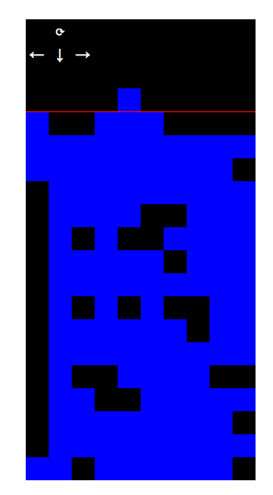
http://qntm.org/files/hatetris/hatetris.html

Slide 2
Computer Vision
CS311, Spring 2013
David Kauchak
some slides modified from slides obtained from Zach Dodds

Slide 3
Admin
Exam #2 available
  Take by Sunday at 11:59pm
No office hours on Friday
Status reports
  Keep working on the project ☺
  Status report 2 due Monday

Slide 4
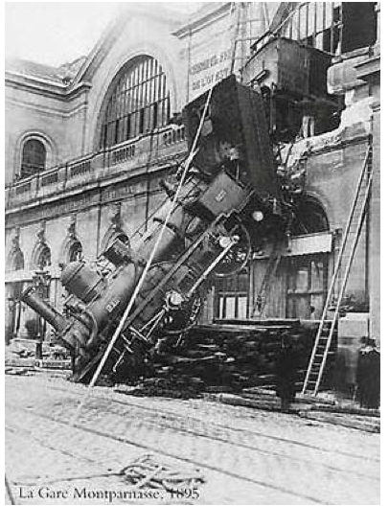
Every picture tells a story…
What is going on in this picture?
How did you figure it out?

Slide 5
Computer Vision
What is computer vision?

Slide 6
Computer Vision
the goal of computer vision is to write computer programs that can interpret images (and videos)
What are some of the challenges?
Applications?

Slide 7
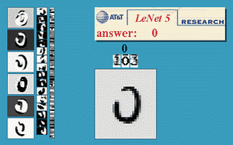
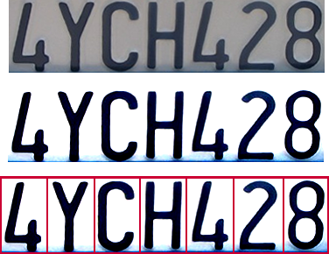

Optical character recognition
deskew
binarize
Long-term work on digits, AT&T labs
segment
recognize
License plate readers
and ways to get around them!
Notes:
motion blur (high-speed cameras)
reflective sprays, etc.

Slide 8
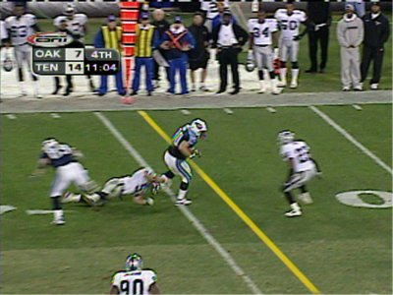
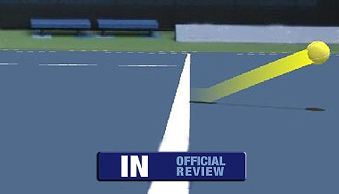
Sports
HawkEye: Federer vs. Nadal
[machines vs. humans]
“The balls moving so fast these days that sometimes its impossible for anyone to see, even a trained official.
- James Blake
Sportvision
What are some of the problems that these two systems need to handle?
Notes:
and tennis - others cricket and snooker

Slide 9
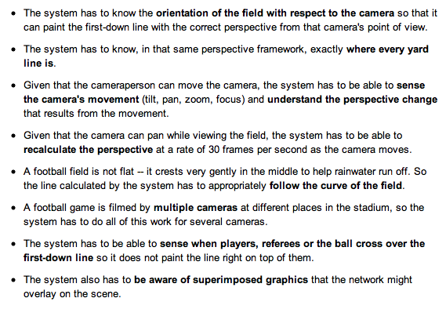
high-resolution encoders on the cameras
detailed field model ~ crest!
color palettes: in and out
Sportvision
slight delay in the network feed
Notes:
and tennis - others

Slide 10
Challenges
high-resolution encoders on the cameras
orientation of the field with respect to camera
handle camera movement
  recalculate perspective
where the yard lines are
multiple cameras
don’t paint over players refs!
other superimposed graphics
detailed field model
color palettes: in and out
Sportvision
slight delay in the network feed
Notes:
and tennis - others

Slide 11
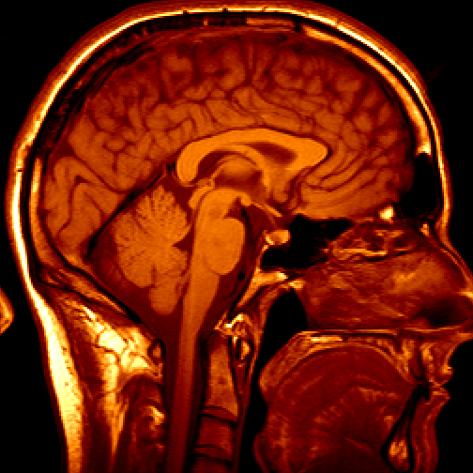
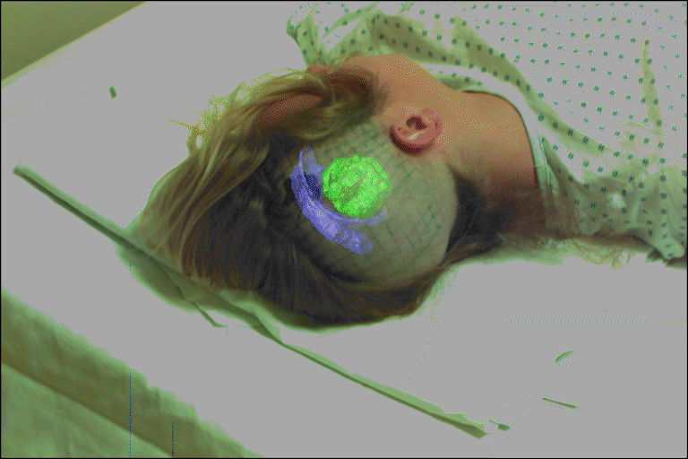
Medical imaging
Image guided surgery: Eric Grimson @ MIT
3D imaging: MRI, CT

Slide 12
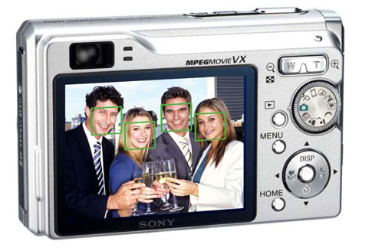
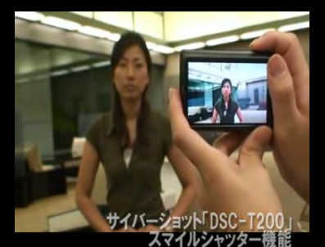
Face detection
Recognition is more difficult…
but products are pushing that way!
http://www.youtube.com/watch?v=N1WC_00L0b0
on many cameras…
Notes:
Why would this be useful? Main reason is focus. Also enables “smart” cropping.

Slide 13
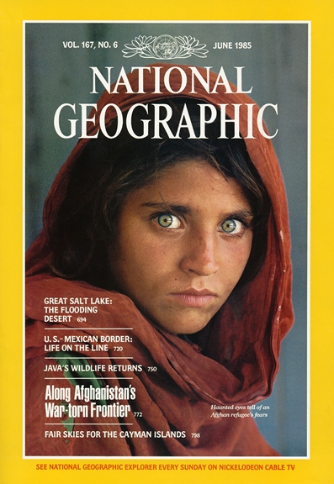
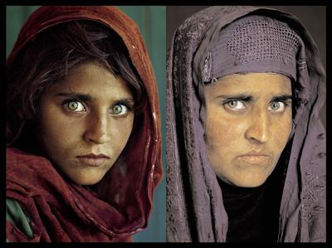
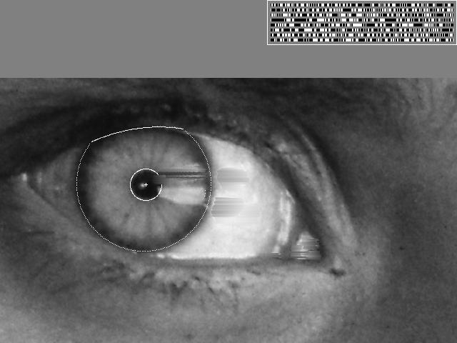
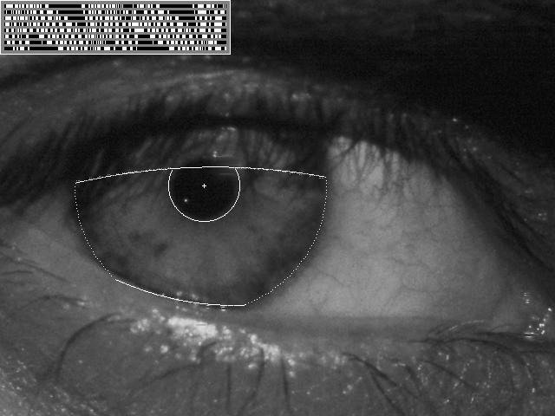
Face Recognition
Notes:
really face-part recognition!

Slide 14
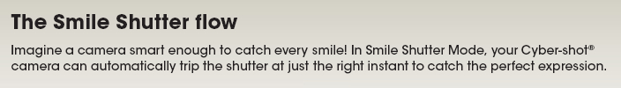
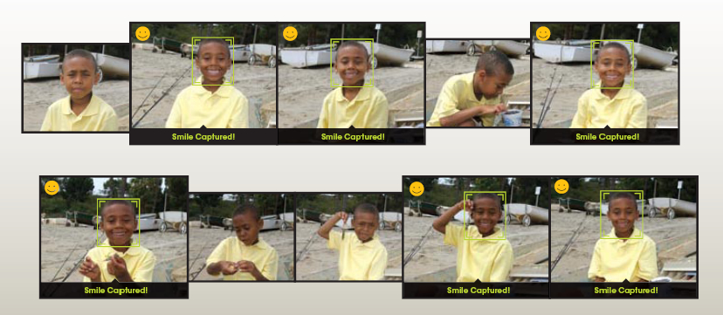
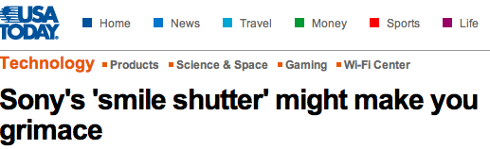
Smile detection?

Slide 15
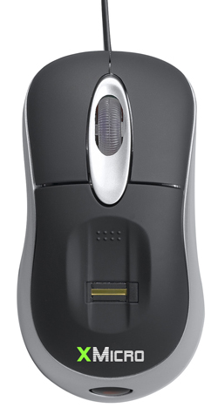
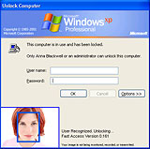
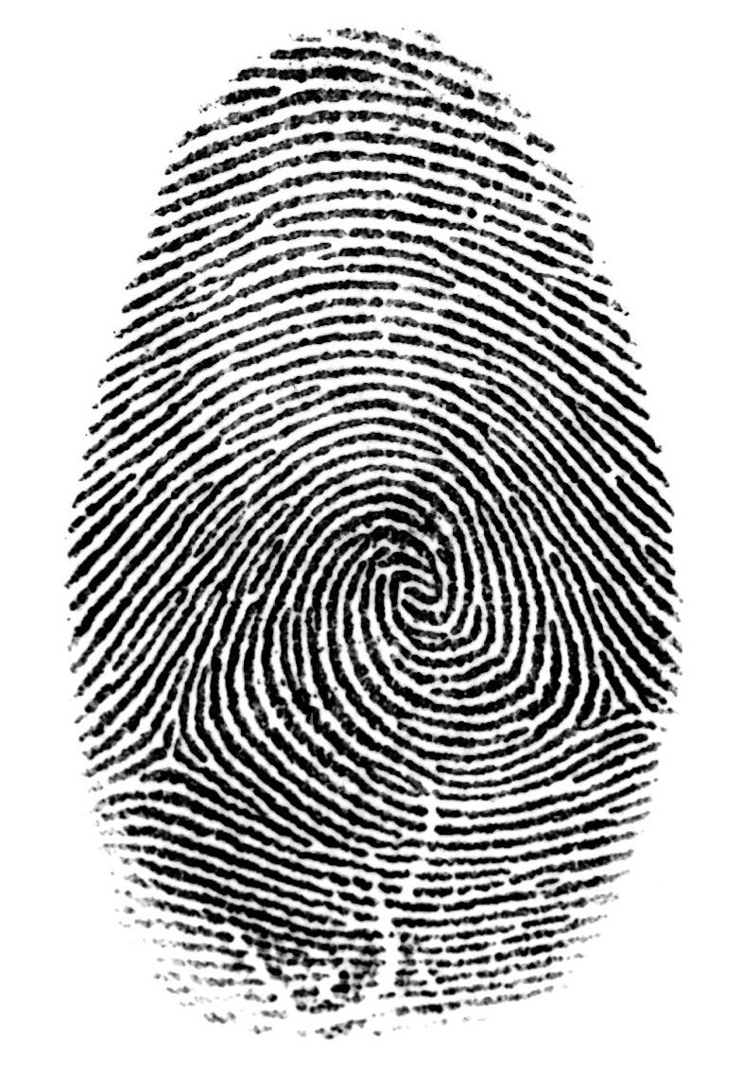

Security
Face recognition systems now beginning to appear more widely
www.sensiblevision.com
Fingerprint scanners can be vision-based devices
key drawbacks?!
Notes:
biometrics

Slide 16
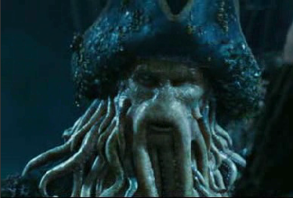
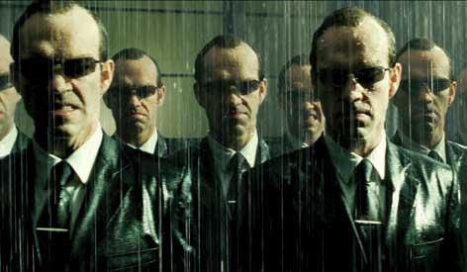
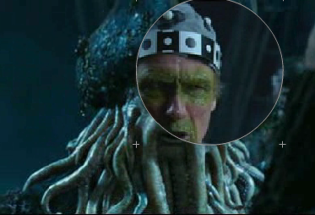
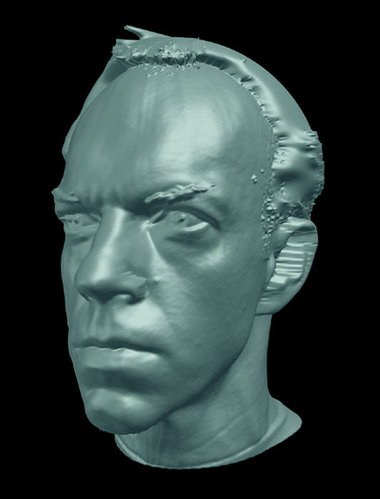
Entertainment
Shape capture
ESC Entertainment, XYZRGB, NRC
Motion capture
http://www.ilm.com/theshow/
Notes:
http://www.ilm.com/theshow/

Slide 17
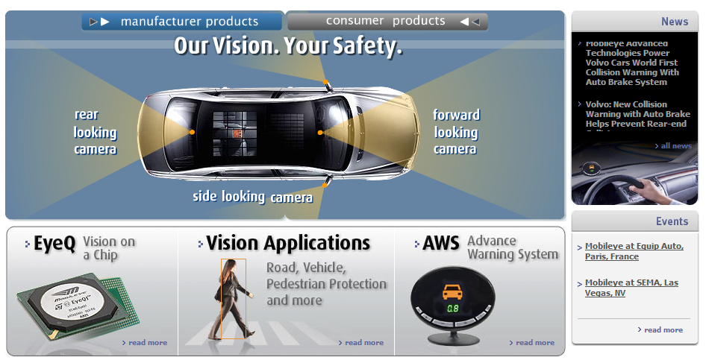
Safety
MobilEye vision systems currently in high-end BMW, GM, Volvo model: ~70% of car manufacturers use cameras for safety
courtesy of Amnon Shashua
Notes:
find mobileye.wmv

Slide 18
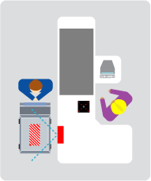
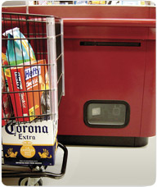
LaneHawk
simpler recognition: products passing by…
“A smart camera is flush-mounted in the checkout lane, continuously watching for items. When an item is detected and recognized, the cashier verifies the quantity of items that were found under the basket, and continues to close the transaction. The item can remain under the basket, and with LaneHawk,you are assured to get paid for it… “ ~ Evolution Robotics, Pasadena.

Slide 19
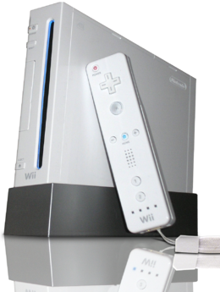
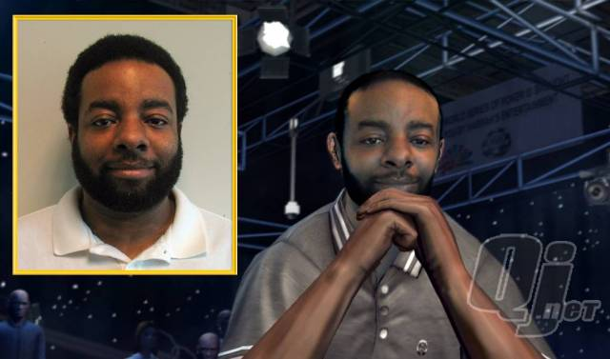
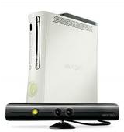
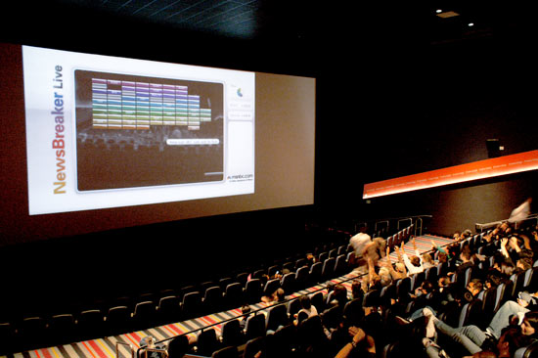
Games and vision-based interaction
Digimask: put your face on a 3D avatar.
Wiimotes: infrared images
Camera tracking for crowd interactions…
XBOX 360 Kinect
Notes:
http://news.cnet.com/Game-turns-moviegoers-into-human-joysticks/2100-1026_3-6184662.html
http://www.monzy.org/audience/

Slide 20
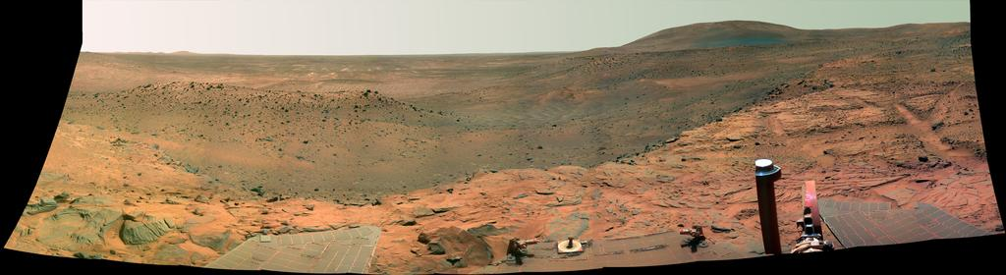
Exploration in hostile environments (OK, robots!)
NASA's MER "Spirit" captured this westward view from atop
a low plateau where Spirit spent the closing months of 2007.
Vision systems (JPL) used for several tasks
  Panorama stitching
  3D terrain modeling
  Obstacle detection, position tracking
  slip detection on uncertain terrain
Larry Mathies, CMU

Slide 21

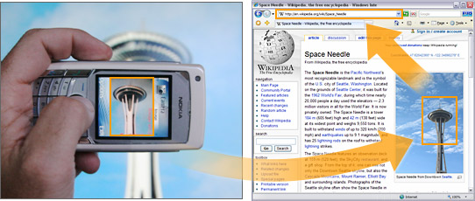
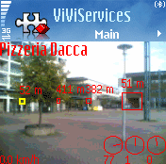
Object recognition with mobile phones
Microsoft research
"Hyperlinking Reality via Phones"
also: Point & Find, Nokia
Notes:
http://www.technologyreview.com/Biztech/17807/?a=f

Slide 22
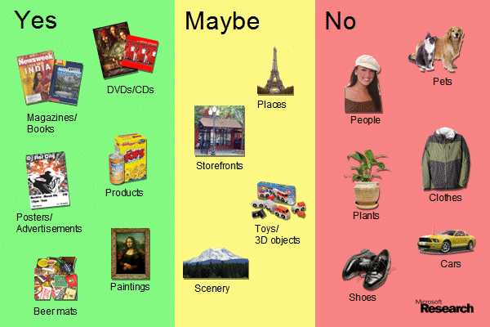
Object recognition with mobile phones
Microsoft research
pretty much sums up the state-of-the art!
Notes:
http://www.technologyreview.com/Biztech/17807/?a=f

Slide 23

How is an image represented?

Slide 24
How is an image represented?
images are made up of pixels
for a color image, each pixel corresponds to an RGB value (i.e. three numbers)

Slide 25
Image file formats
BitMaP
JPEG
TIFF
Gif
Png
…

Slide 26
Bitmap
R, G, B

Slide 27
JPEG Compression Process

Slide 28
JPEG Compression Process

Slide 29
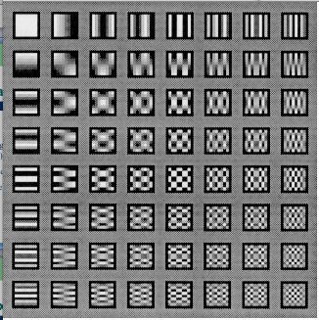
JPEG Compression Process

Slide 30
JPEG Compression Process
Quantizer: Weights the various spectral coefficients according to their importance, with respect to the human visual system.

Slide 31
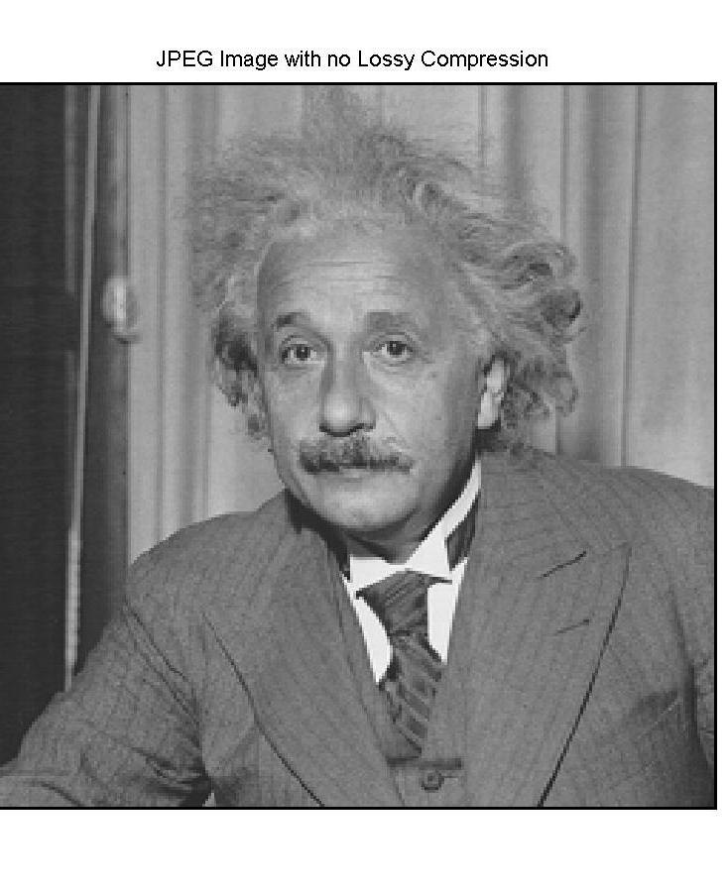
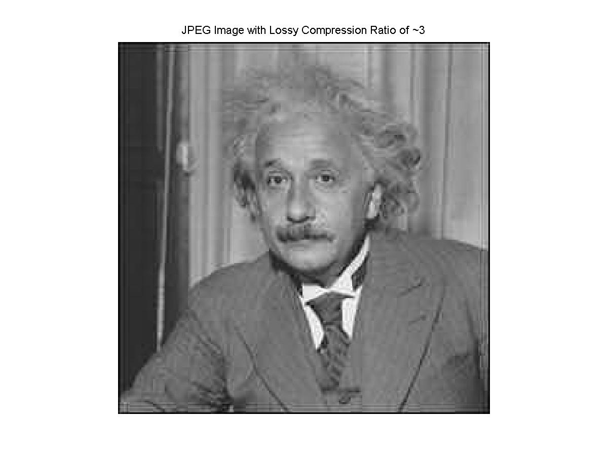
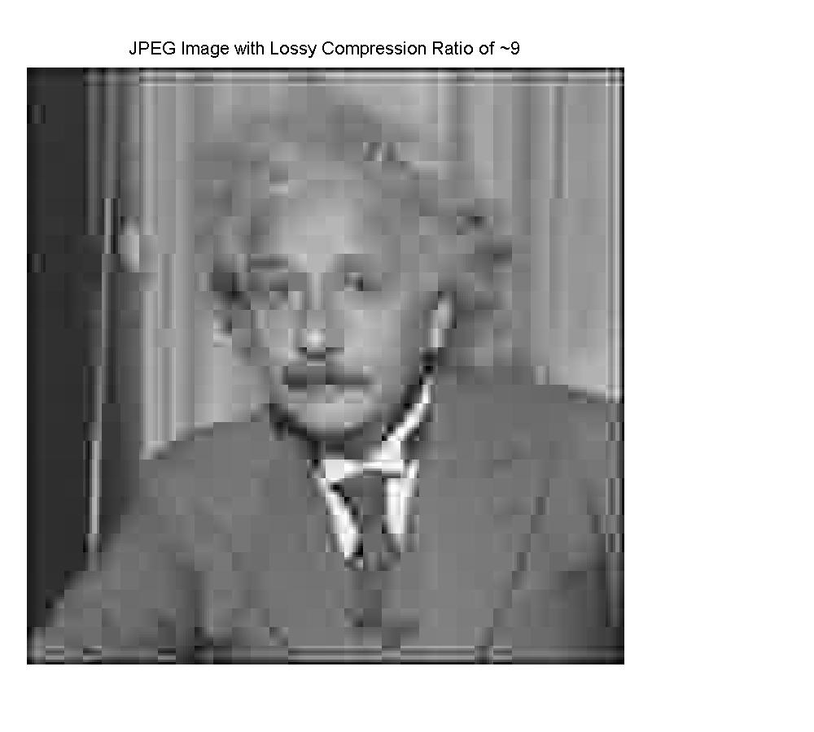
JPEG Compression

Slide 32
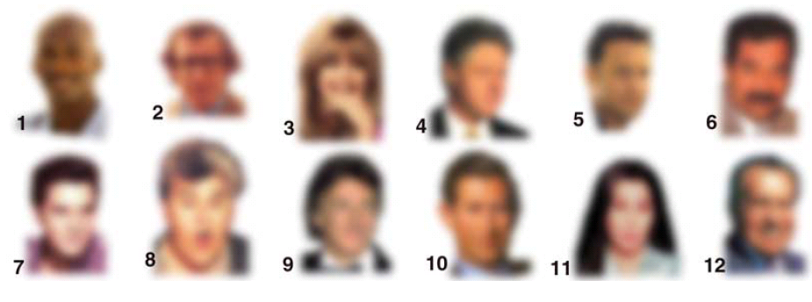
Object Recognition
What are these?

Slide 33
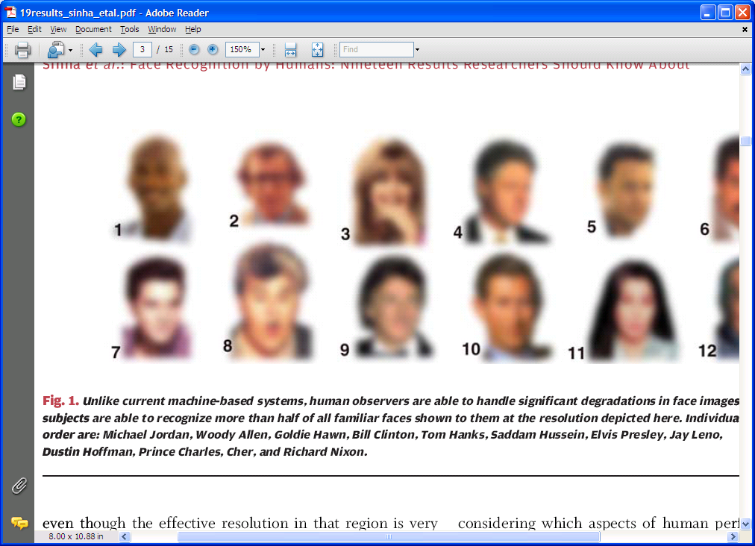
Object Recognition
Do you recognize these people?

Slide 34
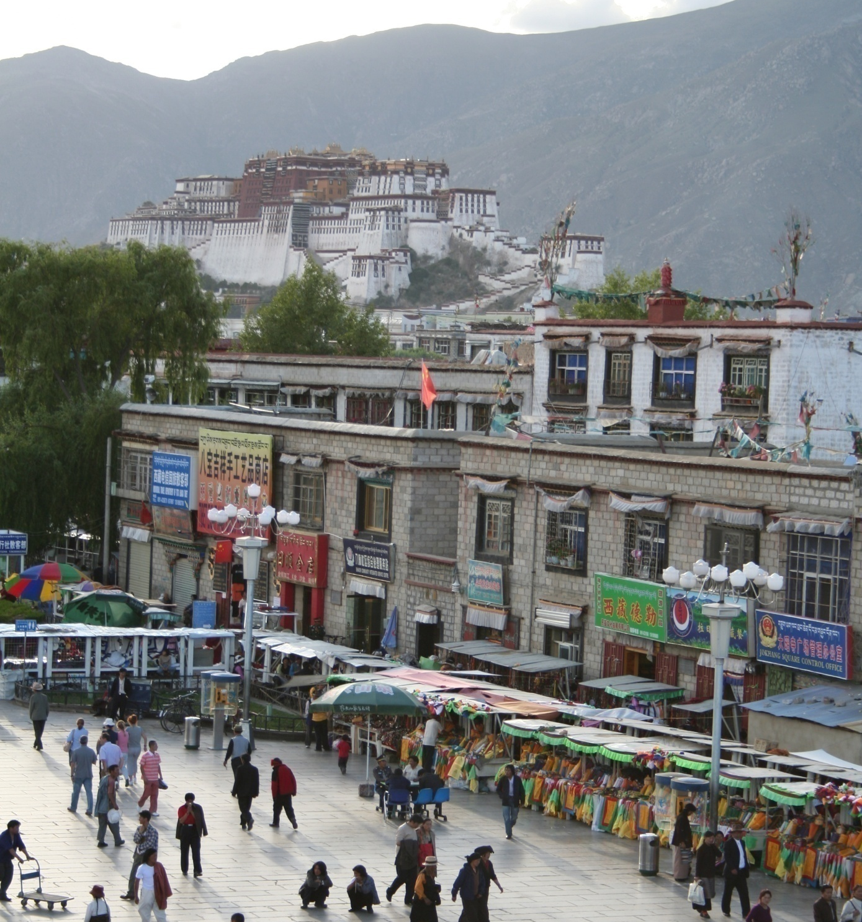
Different kinds of object recognition?

Slide 35
Identification: is that Potala Palace?

Slide 36
Detection: are there people (or faces)?

Slide 37
Object and scene categorization
mountain
tree
building
banner
street lamp
vendor
people

Slide 38
Verification: is that a lamp?

Slide 39
Recognition Question(s)
Identification: Where is this particular object?
Detection: Locate all instances of a given class
Content-based image retrieval: Find something similar
Categorization: What kind of object(s) is(are) present?
Verification: Is this what I think it is?
How might you arrange these, in order of difficulty?
[Csurka et al. 2006]:

Slide 40
Recognition Questions
More accessible
Verification: Is this what I think it is?
Identification: Where is this particular object?
Content-based image retrieval: Find something similar
Detection: Locate all instances of a given class
Categorization: What kind of object(s) is(are) present?
More challenging
Certainly arguable !

Slide 41
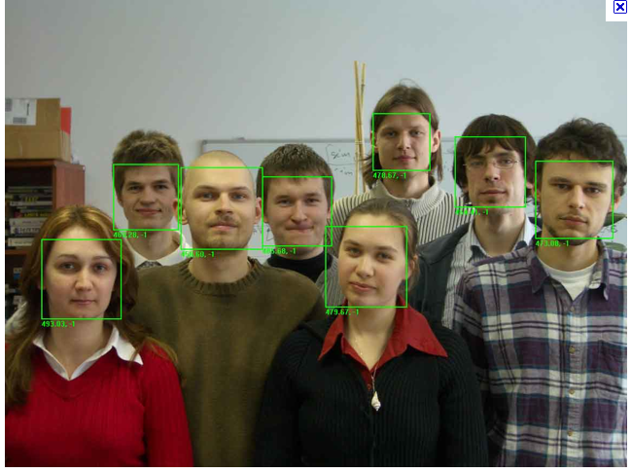
Today: face recognition

Slide 42
Face recognition?
Verification: Is this what I think it is?
Identification: Where is this particular object?
Content-based image retrieval: Find something similar
Detection: Locate all instances of a given class
Categorization: What kind of object(s) is(are) present?

Slide 43
Face recognition?
Verification: Is this what I think it is?
Identification: Where is this particular object?
Content-based image retrieval: Find something similar
Detection: Locate all instances of a given class
Categorization: What kind of object(s) is(are) present?

Slide 44
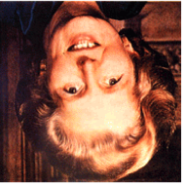
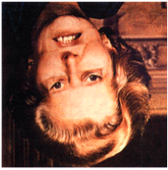
Eigenfaces: how do people do it?
The “Margaret Thatcher Illusion”, by Peter Thompson
Eigenfaces for recognition
Matthew Turk and Alex Pentland
J. Cognitive Neuroscience, 1991

Slide 45
Eigenfaces: how do people do it?
The “Margaret Thatcher Illusion”, by Peter Thompson
Eigenfaces for recognition
Matthew Turk and Alex Pentland
J. Cognitive Neuroscience, 1991

Slide 46
Image features
We’d like to represent an image as a vector of features
  good for machine learning techniques
  distance/similarity measures
  etc.
What are possible features?

Slide 47
Color
How can we represent color?
Which is more similar?

Slide 48
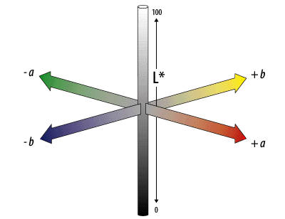
L*a*b*
L*a*b* was designed to be uniform in that perceptual “closeness” corresponds to Euclidean distance in the space.
L – lightness (white to black)
a – red-greeness
b – yellowness-blueness
Notes:
Nice features: easy to adjust contrast

Slide 49
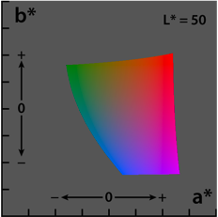
L*a*b*
Is color useful for face detection/verification?

Slide 50

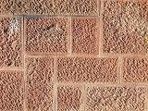

Texture
How is texture different than color?

Slide 51
Texture
Texture is not pointwise like color
Texture involves a local neighborhood
How can we capture texture?

Slide 52


Local “response” to feature functions
A “feature” is a particular low-resolution image (intensities)
“convolution”
  matrix dot product
  image portions with similar intensities will have high values
Lots of possible features!

Slide 53



Example: Gabor Filters
Gabor filters are Gaussians modulated by sinusoids
They can be tuned in both the scale (size) and the orientation
Scale: 3 at 72°
Scale: 4 at 108°
Scale: 5 at 144°

Slide 54
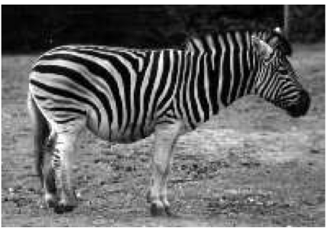
Gabor filters
What would the response look like to a vertical filter?

Slide 55

Gabor filters

Slide 56


Eigenfaces
Given a face, we can then calculate it’s response to a number of theses filters generating a feature vector
First-thoughts for detection?
First-thoughts for identification?
~10,000 dimensional space

Slide 57
Eigenfaces
non-faces in purple
Idea: faces have distinctive appearance
faces in orange
There is some intra-class variation
But nowhere near the inter-class variation with “everything else”

Slide 58


Only a few dimensions needed
x-y projection
x-z projection
but which ones?

Slide 59

Only a few dimensions needed
x-y projection
x-z projection
this is a promising view!

Slide 60

Learning a projection
We saw data projection when we were looking at machine learning techniques… where?
How did we figure our the projection for clustering?

Slide 61
Dimensionality reduction
How can we find the data’s natural coordinate system?

Slide 62

Principal component analysis
Suppose each data point is N-dimensional
  What directions maximize variance?
  Solution: the eigenvectors of the variance matrix A
    eigenvector with largest eigenvalue captures the most variation among training vectors x
    eigenvector with smallest eigenvalue has least variation
  We can use only the top few eigenvectors
    corresponds to choosing a “linear subspace”
      represent points on a line, plane, or “hyper-plane”
    these eigenvectors are known as the principal components

Slide 63

Eigenfaces: pictures!
Does this look like anyone you know?

Slide 64
Eigenfaces: pictures!
What do each of these mean?
Eigenfaces (plus the average face)

Slide 65






Projecting onto low-d eigenspace
The eigenfaces v₁, ..., v_{K} span the space of faces
  A face is converted to eigenface coordinates by

Slide 66


Eigenfaces: pictures!
Progressive reconstructions…
Eigenfaces (without the average face)

Slide 67


How many dimensions?
eigenvalues
The hope…
i =
K
NM
How many eigenfaces to use?
Look at the decay of the eigenvalues
  the eigenvalue tells you the amount of variance “in the direction” of that eigenface
  ignore eigenfaces with low variance

Slide 68

How many dimensions?
In practice
Total variance captured vs. number of eigenfaces used
  K = 10 captures about 36% of the variance
  K = 25 captures about 56%

Slide 69

Eigenfaces: recognition (id)
32 test cases
Novel image on left; best-matching image on right

Slide 70


Eigenfaces: recognition (id)
Different lighting conditions
Different facial expressions
On which set do you think eigenfaces will perform better?

Slide 71
Eigenfaces: recognition (id)
Different lighting conditions
Different facial expressions
9/16 for lighting changes … 23/26 for expression changes

Slide 72

Eigenfaces: detection
How can we do this using eigenfaces?

Slide 73

Eigenfaces: detection
Difficult to avoid false positives…
Top 4

Slide 74

Eigenfaces: detection
Difficult to avoid false positives…
Top 3

Slide 75

Eigenfaces: detection
Top few

Slide 76

Receiver-operating curve
shows true positive vs. false positive rate

Slide 77

What’s wrong with detection?
each top image, projected onto eigenspace
How do we improve this?

Slide 78
What’s wrong with detection?
each top image, projected onto eigenspace
Reasonable once we have an image of a face (recognition)
Not so good at finding faces (detection)

Slide 79

What parts are important?
what’s missing?
who are these two people?

Slide 80
What parts are important?
eyes vs. eyebrows
who are these two people?

Slide 81
What parts parts are important?
Nixon
Winona Ryder
who are these two people?

Slide 82
Robust real-time face detection
Paul A. Viola and Michael J. Jones
Intl. J. Computer Vision. 57(2), 137–154, 2004
Learn which “parts” are most important…

Slide 83


Image features
“Rectangle/box filters”
  Similar to Haar wavelets
Differences between
sums of pixels in
adjacent rectangles
Simple thresholding
face ~ simple parts
24x24
gray regions are subtracted (after summing)
white regions are added (after summing)
each box filter is present or absent

Slide 84

Huge library of filters

Slide 85
Constructing the classifier
For each round of boosting: (AdaBoost)
Evaluate each rectangle filter on each example
Sort examples by filter values
Select best threshold for each filter (min error)
  Use sorting to quickly scan for optimal threshold
Select best filter/threshold combination
Reweight examples
  (There are many tricks to make this more efficient.)

Slide 86
Characteristics of algorithm
Feature set (…is huge about 16M features)
Efficient feature selection using AdaBoost
New image representation
Cascaded Classifier combining simple weak classifiers for rapid detection
Fastest known face detector for gray scale images

Slide 87

Viola and Jones: Results

Slide 88

First two filters
First classifier:
  2 features
  100% detection
  40% false detection
The whole cascade:
  38 stages
  6000 features in total
  On dataset with 507 faces and 75 millions sub-windows, faces are detected using 10 feature evaluations on average.
  On average, 10 feature evals/sub-window

Slide 89

Robustness…
Receiver – operating curve for best 200 features
shows true positive vs. false positive rate

Slide 90
Summary (Viola-Jones)
Fastest known face detector for gray images
Three contributions with broad applicability:
  Cascaded classifier yields rapid classification
  AdaBoost as an extremely efficient feature selector
  Rectangle Features + Integral Image can be used for rapid image analysis
But, there are better ones out there…

Slide 91




Other algorithms are available…
Viola &
Jones
Schneiderman
Kanade

Slide 92

Happy face!

