Slide 1
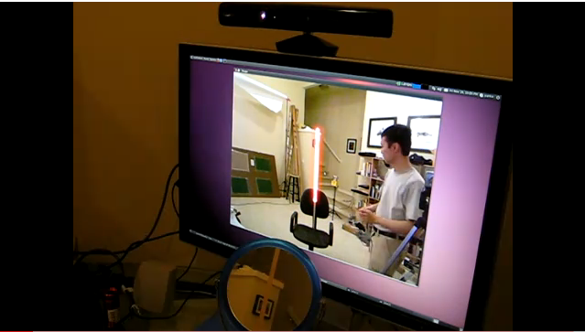
http://www.youtube.com/watch?v=3EeJCln5KYg

Slide 2
Robotics
CS311, Spring 2013
David Kauchak
Some material adapted from slides from Zach Dodds

Slide 3
Admin
Assignment 5 graded
Exam #2 available later today
To be done by Sunday at midnight

Slide 4
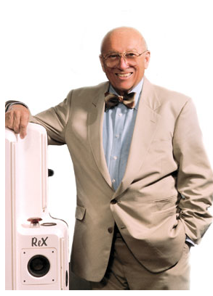
What is a robot?
"I can't define a robot, but I know one when I see one.”
--Joseph Engelberger (1966)
Justice Potter Stewart wrote in Jacobellis v. Ohio (1964), "I can't define pornography, but I know it when I see it."
Notes:
Joseph Engelberger has been called the father of robotics. The American engineer and entrepreneur helped create the first industrial robot. In 1966, he appeared on The Tonight Show with Johnny Carson along with a robot that served a beer, sunk a putt and led the band. Asked to define a robot, he once said, "I can't define a robot, but I know one when I see one."

Slide 5
Robot Defined
Word robot was coined by a Czech novelist Karel Capek in a 1920 play titled Rossum’s Universal Robots (RUR)
Robota in Czech is a word for worker or servant
Karel Capek
Definition of robot:
Any machine made by one our members: Robot Institute of America ☺
A robot is a reprogrammable, multifunctional manipulator designed to move material, parts, tools or specialized devices through variable programmed motions for the performance of a variety of tasks: Robot Institute of America, 1979

Slide 6
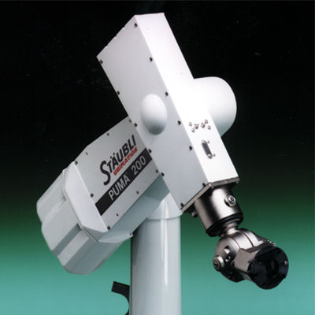
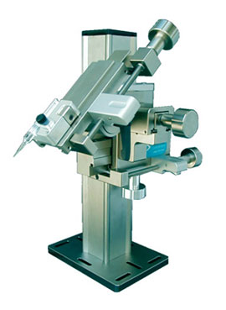
What is a Robot
Manipulator

Slide 7
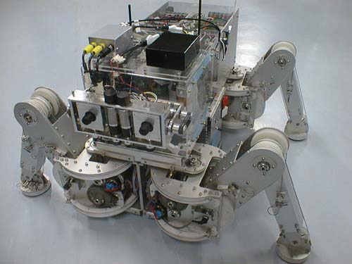
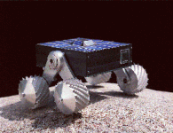
What is a Robot
Legged Robot
Wheeled Robot

Slide 8
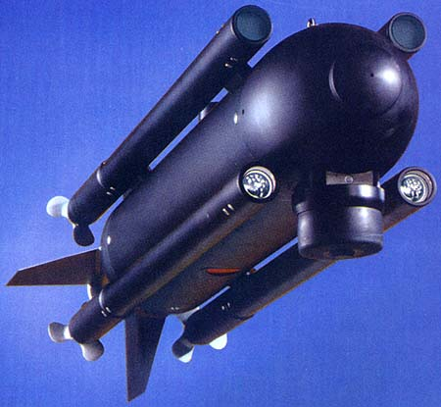
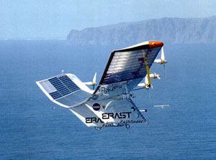
What is a Robot
Autonomous Underwater Vehicle
Unmanned Aerial Vehicle

Slide 9
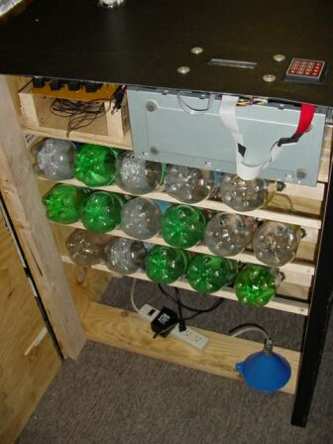
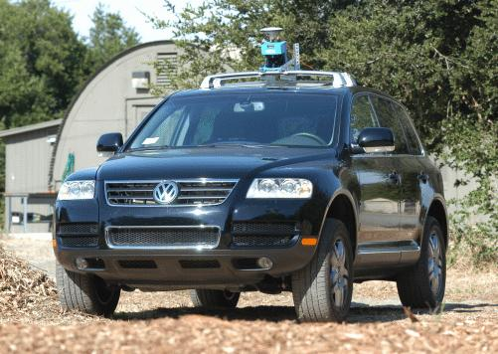
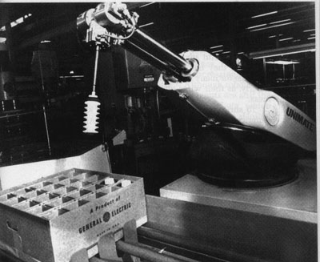
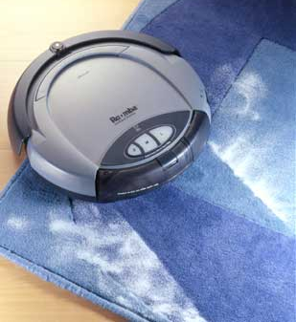
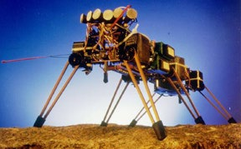
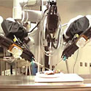
World Modeling
Capability (0-10)
Robot Plot
more
Sims (5)
Stanley/Boss (9)
Shakey (3)
MERs (8)
Stanford Cart (3)
Bar Monkey (9)
less
da Vinci (2)
Unimate (4)
Roomba (7)
Genghis (3)
human-controlled
Autonomy
independent

Slide 10
Robot timeline?
...
1921
1950
2020
2150
2421

Slide 11
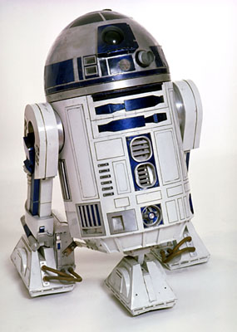
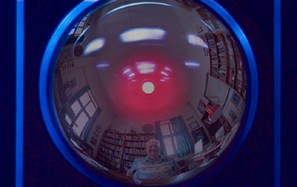
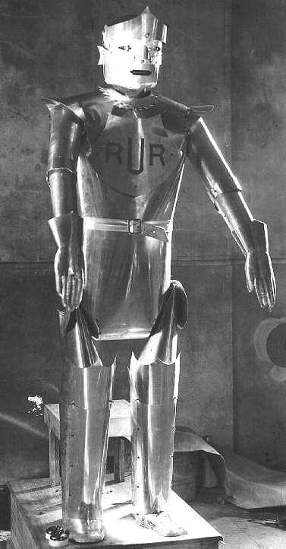
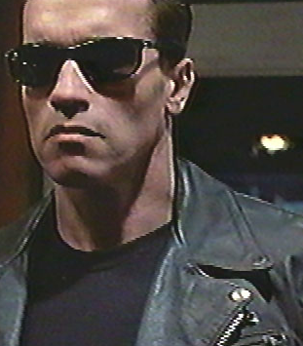
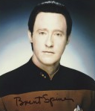
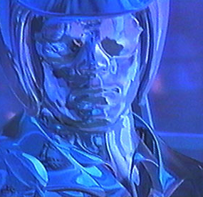
Fictional Robot timeline
Put these robots in chronological order?
...
1921
2020
2150
2421
Notes:
protectors and terminators
as well as _ex_terminators…

Slide 12
Fictional robot timeline
Karl Capek
Rossum’s Universal Robots
I, Robot
Asimov
...
1921
1950
2020
2150
2421
Notes:
exterminate all humans sound <- mac iTunes
robots: need to be freed from their work! RUR

Slide 13
Real robot timeline
...
1951
1968
1976
1985

Slide 14
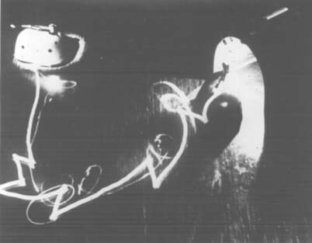
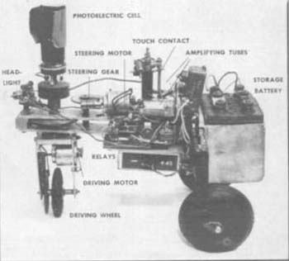
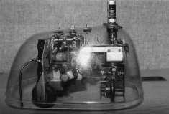
Real robot timeline
Tortoise “Elsie”
by Neurophysiologist Grey Walter
...
1951
http://www.frc.ri.cmu.edu/~hpm/talks/revo.slides/1950.html

Slide 15
Shakey
Nils Nilsson @ Stanford Research Inst.
first “general-purpose” mobile platform
Living Room (L)
Kitchen (K)
sp
sh
tv
rem
Bedroom (B)
...
...
1968

Slide 16
Robotics's Shakey start
START
Go(from,to)
Preconditions: At(sh,from)
Postconditions: At(sh,to)
Push(obj,fr,to)
Preconditions: At(sh,fr) ∧ At(obj,fr)
Postconditions: At(sh,to) ∧ At(obj,to)
ACTIONS
At(sh,L) ∧ At(sp,K) ∧ At(rem,B) ∧ At(tv,L)
Go(L,B)
Push(tv,L,B)
Go(L,K)
Push(tv,L,K)
At(sh,K) ∧ At(sp,K) ∧ At(rem,B) ∧ At(tv,K)
At(sh,L) ∧ At(sp,L) ∧ At(rem,L) ∧ At(tv,L)
GOAL
Notes:
STRIPS planning
explicit representation of high-level environmental states…
-- low-level engineering of actuation and control had to be improved
- -algorithms for reasoning about the robot's environment had to be improved
VIDEO!

Slide 17
Shakey in video
http://www.youtube.com/watch?v=qXdn6ynwpiI

Slide 18
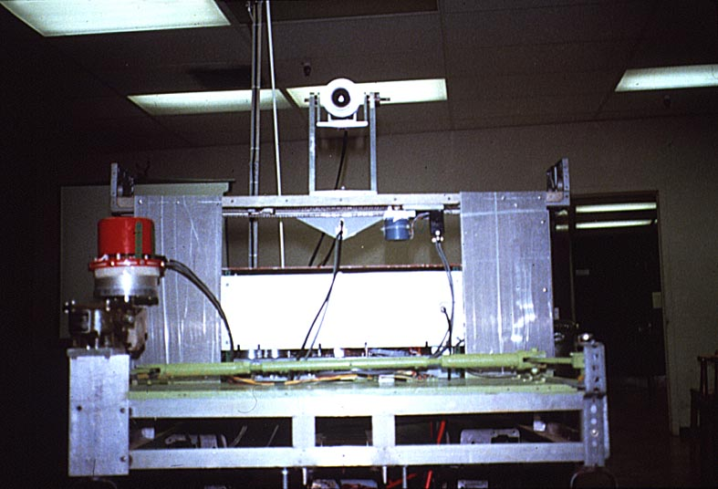
Stanford Cart: SPA
Hans Moravec @ SAIL
“functional” task decomposition
SENSING
ACTING
perception
Planning
task execution
world modeling
motor control
“horizontal” subtasks
...
...
1976
Notes:
The field moved slowly, mostly because computation moved slowly!

Slide 19
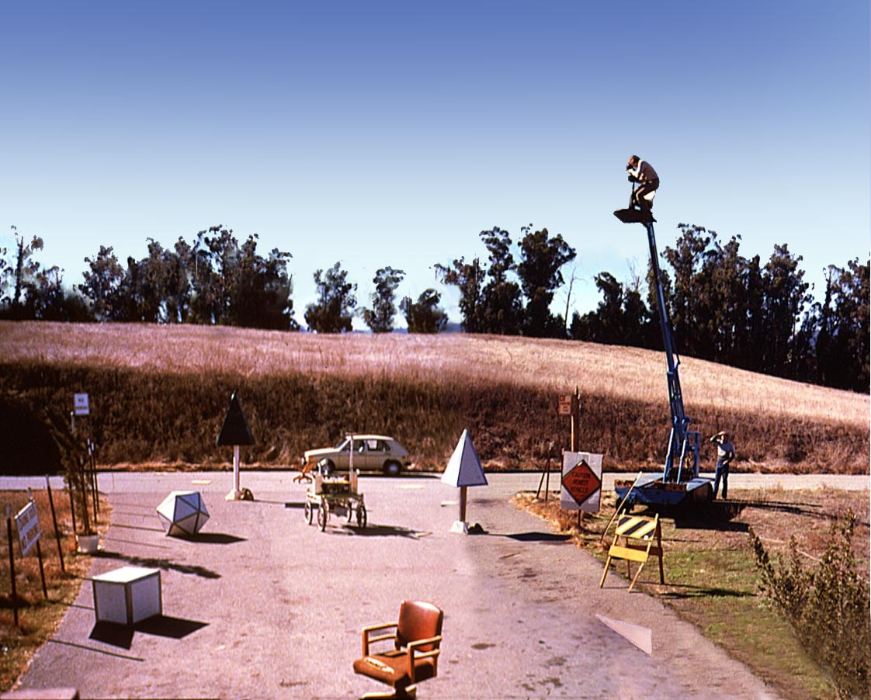
Cartland (outdoors)

Slide 20
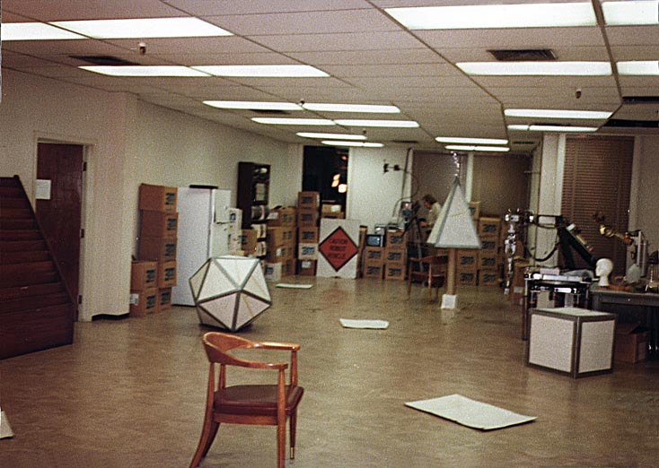
Cartland (indoors)

Slide 21
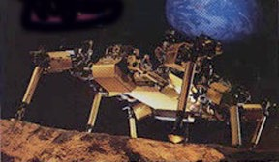
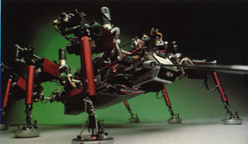
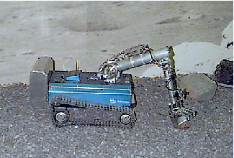
“Robot Insects”
Rodney Brooks @ MIT
planning and reasoning
“behavioral” task decomposition
identify objects
“vertical” subtasks
SENSING
build maps
ACTING
explore
wander
avoid objects
...
...
1985
Notes:
picture of Rodney Brooks – his paper!!

Slide 22
Robotics
What are the challenges?
How do these relate to AI?

Slide 23
AI
Search
planning
Game playing
CSPs
Bayesian
HMMs
Machine learning
neural nets
Knowledge representation
Natural Language processing
Computer vision

Slide 24
Autonomy/behavior
how much of the world do we need to represent internally ?
how should we internalize the world ?
what outputs can we effect ?
what inputs do we have ?
what algorithms connect the two ?
how do we use this “internal world” effectively ?
Robot Architecture

Slide 25
Robot Architecture
how much / how do we represent the world internally ?
As much as possible!
sense
plan
act
SPA paradigm
Not at all
Reactive paradigm
Task-specific
Behavior-based architecture
As much as possible.
Hybrid approaches
history…
Notes:
historically, this has come full circle!

Slide 26
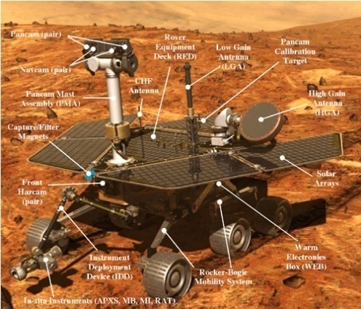
Sense - Plan - Act
Shakey
SENSING
planning
ACTING
world modeling
task execution
perception
motor control
sense
plan
act
...
...
Stanford Cart
MERs
1968
1976
… - 2009
Notes:
Shakey video

Slide 27
Mars Exploration Rovers
Sense – Plan – Act "deliberative" architecture
Mars Science Lab
2011 - lasers, lifebio, and maybe nuclear-powered
Notes:
Video!

Slide 28
Robot Architecture
how much / how do we represent the world internally ?
As much as possible!
sense
plan
act
SPA paradigm
Not at all
sense
act
Reactive paradigm
stimulus - response
Task-specific
Behavior-based architecture
As much as possible.
Hybrid approaches

Slide 29
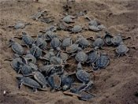
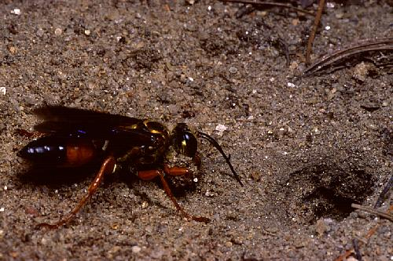
Biological Inspiration
Ethology: describing animal behavior
Getting to the ocean?
Digger wasps’ nest-building sequence
AI reasoning systems abstract too much away: frame problem
“The world is its own best model”
sense
act
Decision-making is based only on current sensor inputs.
Notes:
Some Sphex wasps drop a paralyzed insect near the opening of the nest. Before taking provisions into the nest, the Sphex first inspects the nest, leaving the prey outside. During the inspection, an experimenter can move the prey a few inches away from the opening. When the Sphex emerges from the nest ready to drag in the prey, it finds the prey missing. The Sphex quickly locates the moved prey, but now its behavioral "program" has been reset. After dragging the prey back to the opening of the nest, once again the Sphex is compelled to inspect the nest, so the prey is again dropped and left outside during another stereotypical inspection of the nest. This iteration can be repeated again and again, with the Sphex never seeming to notice what is going on, never able to escape from its programmed sequence of behaviors.

Slide 30
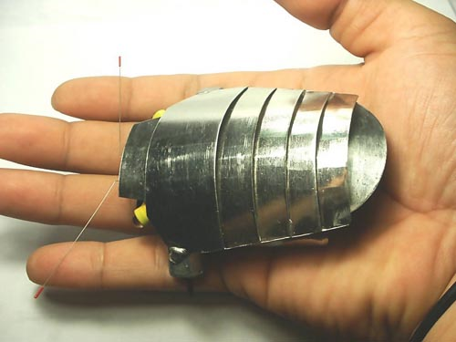
Analog reactive robots
“Tortoise”
Gray Walter
Valentino Braitenberg
Mark Tilden
“BEAM”
commercial products…
“light-headed” behavior
http://people.cs.uchicago.edu/~wiseman/vehicles/
http://haroldsbeambugs.solarbotics.net/mercury.htm
robot made from Playstation pieces…!
...
1951
1984
1989-
stateless...
Notes:
BEAM == Biology, Electronics, Aesthetics, and Mechanics
http://people.cs.uchicago.edu/~wiseman/vehicles/

Slide 31
Robot Architecture
how much / how do we represent the world internally ?
As much as possible!
sense
plan
act
SPA paradigm
Not at all
sense
act
Reactive paradigm
stimulus – response == "behavior"
Task-specific
Behavior-based architecture
Subsumption paradigm
different ways of composing behaviors
Potential Fields
As much as possible.
Hybrid approaches

Slide 32
Behavior-based control
Behavior
a direct mapping of sensory inputs to a pattern of task-specific motor actions
sense
act
extinguish
approach
wander
“Vertical” task decomposition
little explicit deliberation except through system state
planning and reasoning
identify objects
SENSING
build maps
ACTING
explore
wander
...
avoid objects
Genghis
...
1985

Slide 33
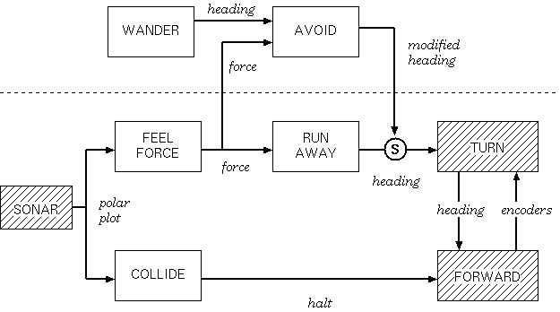
Subsumption
Subsumption builds intelligence incrementally in layers
wander behavior
runaway behavior

Slide 34
Subsumption
Where would a light-seeking behavior/layer connect?
wander behavior
runaway behavior

Slide 35
Subsumption
Where would a light-seeking behavior/layer connect?
LIGHT
Closest Light
phototaxis
S
SONAR
wander behavior
runaway behavior

Slide 36
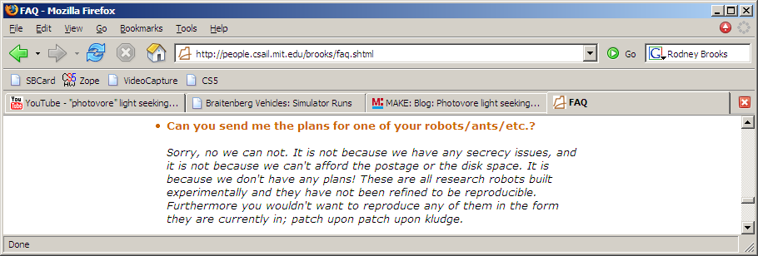
Subsumption - Limits
Reaching the end of the subsumption architecture and purely reactive approaches.
Herbert, a soda-can-collecting robot
http://www.youtube.com/watch?v=YtNKuwiVYm0
Success of behavior-based systems depends on how well-tuned they are to their environment. This is a huge strength, but it's also a weakness …

Slide 37
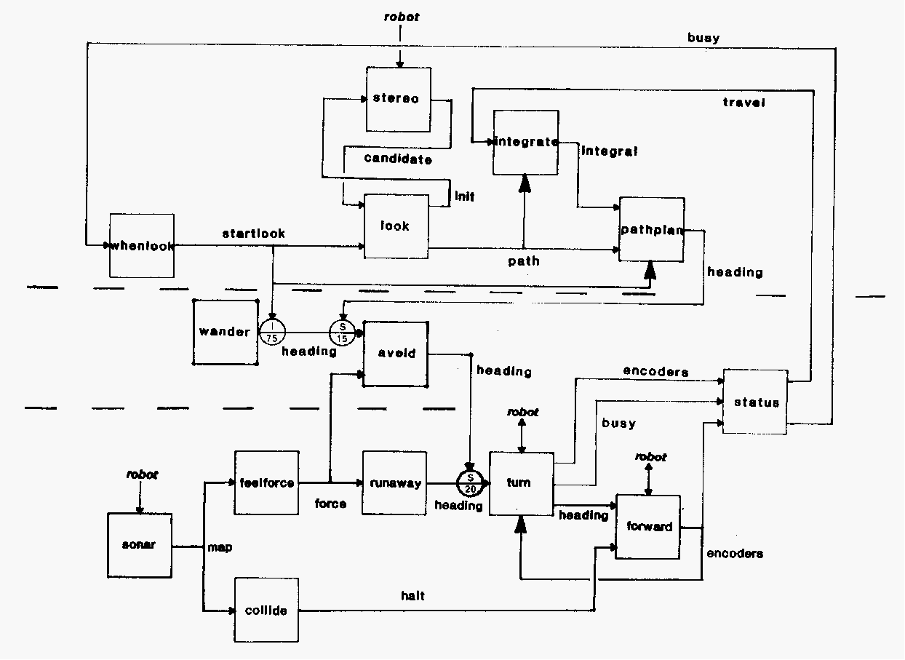
Subsumption limits: Genghis
navigate behavior
wander behavior
runaway behavior
FSM / DFA

Slide 38
Unwieldy!
Larger example -- Genghis
1) Standing by tuning the parameters of two behaviors: the leg “swing” and the leg “lift”
2) Simple walking: one leg at a time
3) Force Balancing: via incorporated force sensors on the legs
4) Obstacle traversal: the legs should lift much higher if need be
5) Anticipation: uses touch sensors (whiskers) to detect obstacles
6) Pitch stabilization: uses an inclinometer to stabilize fore/aft pitch
7) Prowling: uses infrared sensors to start walking when a human approaches
8) Steering: uses the difference in two IR/range sensors to follow
57 modules wired together !

Slide 39
Robot Architecture
how much / how do we represent the world internally ?
As much as possible!
sense
plan
act
SPA paradigm
Not at all
sense
act
Reactive paradigm
Task-specific
Subsumption paradigm
different ways of composing behaviors
Behavior-based architecture
Potential Fields
As much as possible.
Hybrid approaches

Slide 40
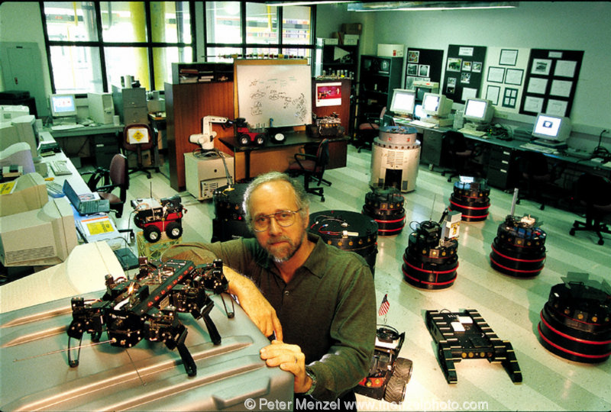
Potential Fields
Potential fields compose simple behaviors by adding the outputs that each sensor/input sends the robot
Individual potential fields (motor schemas) contain state
A sequencing process (FSM/DFA) updates the potential fields and/or decides which ones to run next…
Ron Arkin @ Georgia Tech

Slide 41
Motor Schemas / Potential Fields
Direct mapping from the environment to a control signal
obstacle-avoiding schema
goal-seeking schema
note that the complete environmental vector fields are only for visualization!
combine?

Slide 42
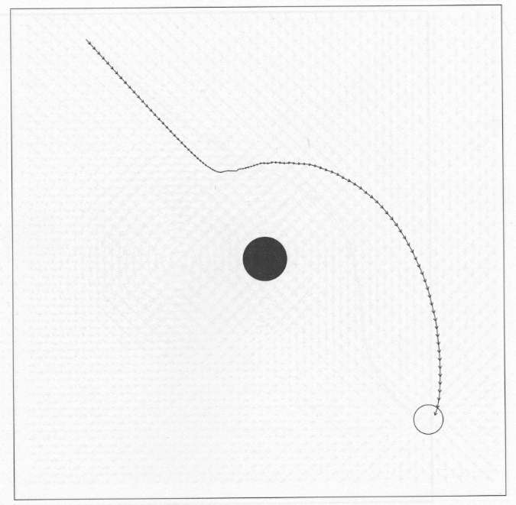
Behavior Summer
path taken by a robot controlled by the resulting field
vector sum of the avoid and goal motor schemas

Slide 43
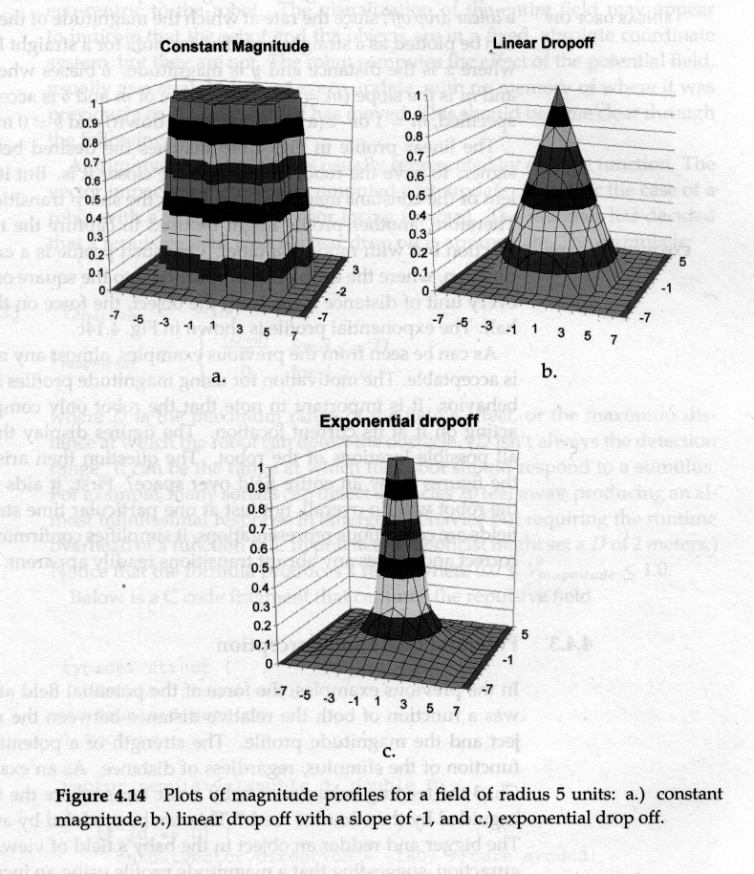
Implementation details
the extent to which potential field force drops off with distance…
what crucial assumption is being made here?
corridor-following schema(s)?
Notes:
Crucial assumption: that the robot KNOWS the potential field
sensor networks or significant sensing challenge!

Slide 44
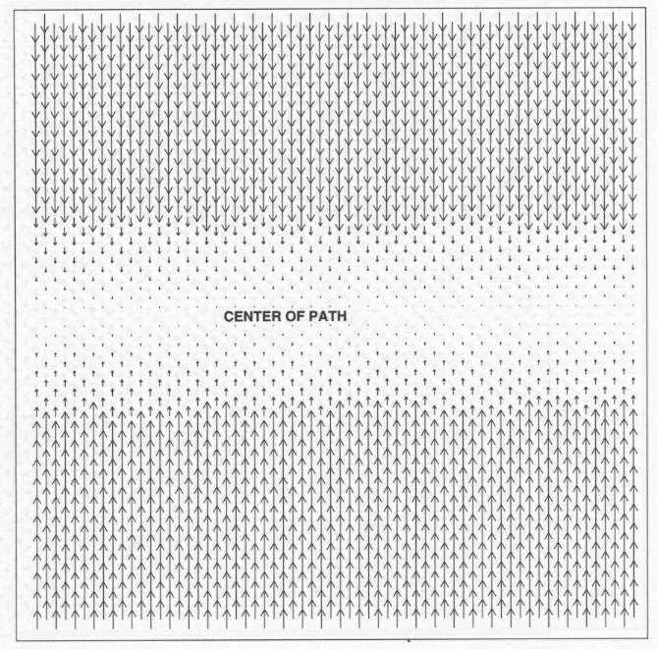
Additional behavior primitives
corridor-centering schema
go! schema

Slide 45
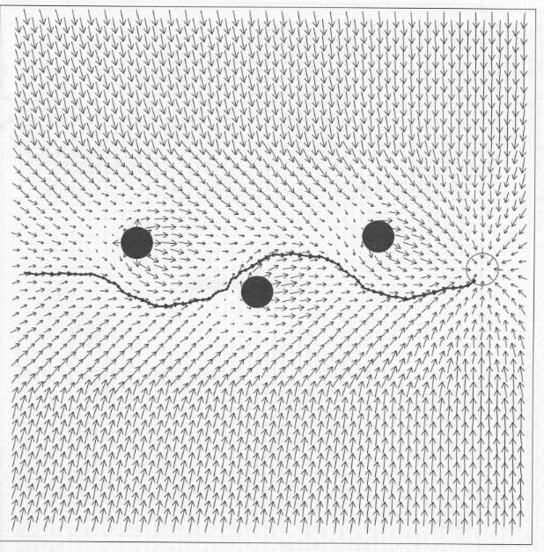
A more complex task
Direct mapping from the environment to a control signal
How many individual fields are summed in this task?
Not necessarily all at one time!
larger composite task
Notes:
5 or 6 vector fields here

Slide 46
Local minima
A potential-field-based system can get stuck!
What would happen if a robot came in in the middle on the left?
a solution?
the problem

Slide 47
Local minima
A potential-field-based system can get stuck!
Why is the “local minimum” problem, as illustrated to the left, not likely to actually cause a robot to get stuck in practice?
robots controlled by summing goal/obstacle potential fields can get stuck in practice -- draw an example of an environment with both obstacle(s) and goals(s) in which getting stuck might actually occur.
Suggest how a robot might overcome the problem of getting stuck in such cases…
the problem

Slide 48
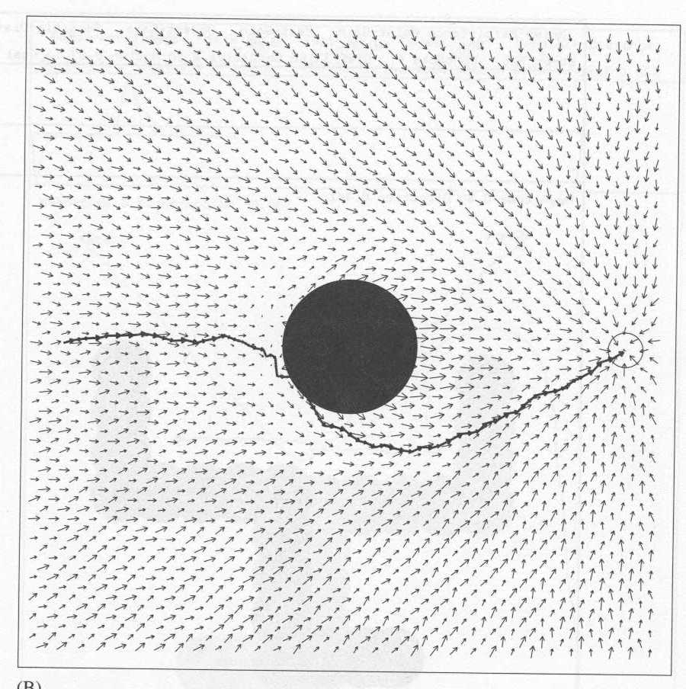
Local minima
A potential-field-based system can get stuck!
the problem
a solution

Slide 49
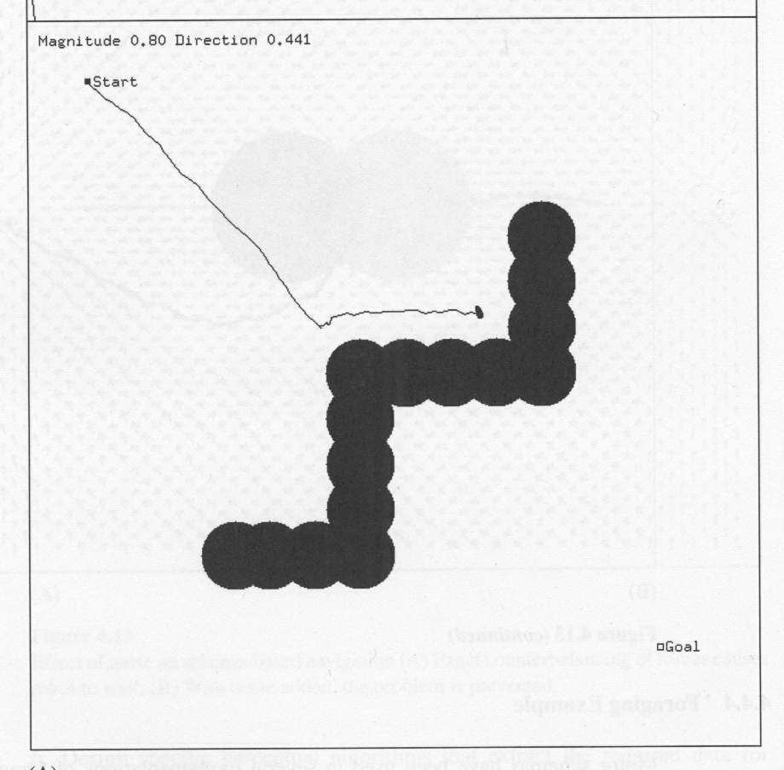
Bigger deadends...
How to get out of larger wells ?

Slide 50
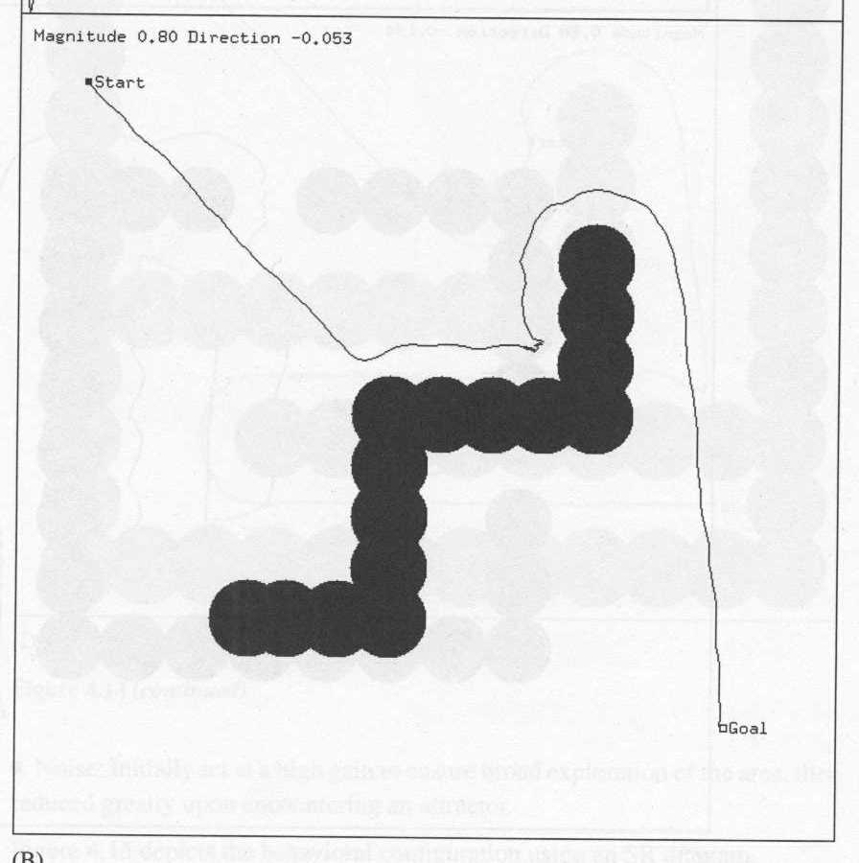
Bigger deadends...
uses memory of where the robot has been
past-avoiding motor schema

Slide 51
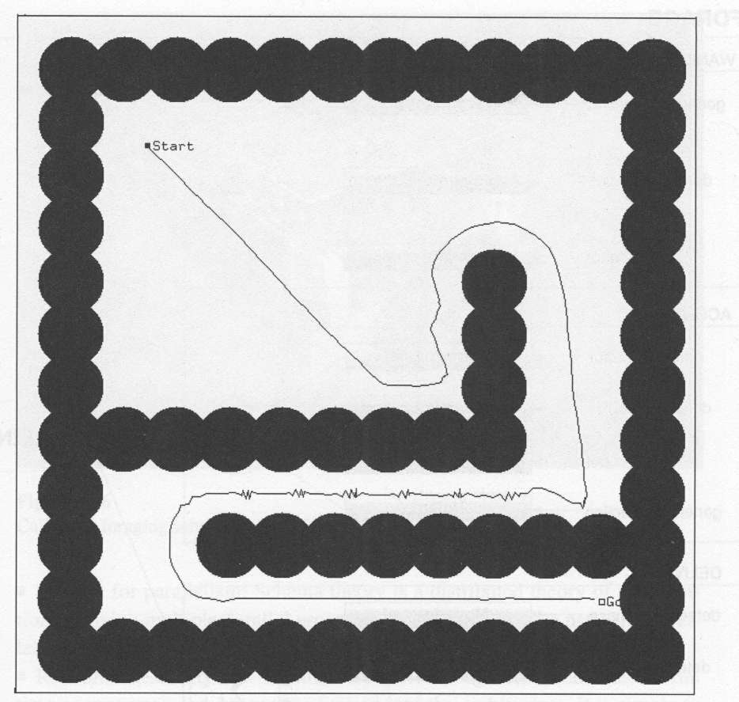
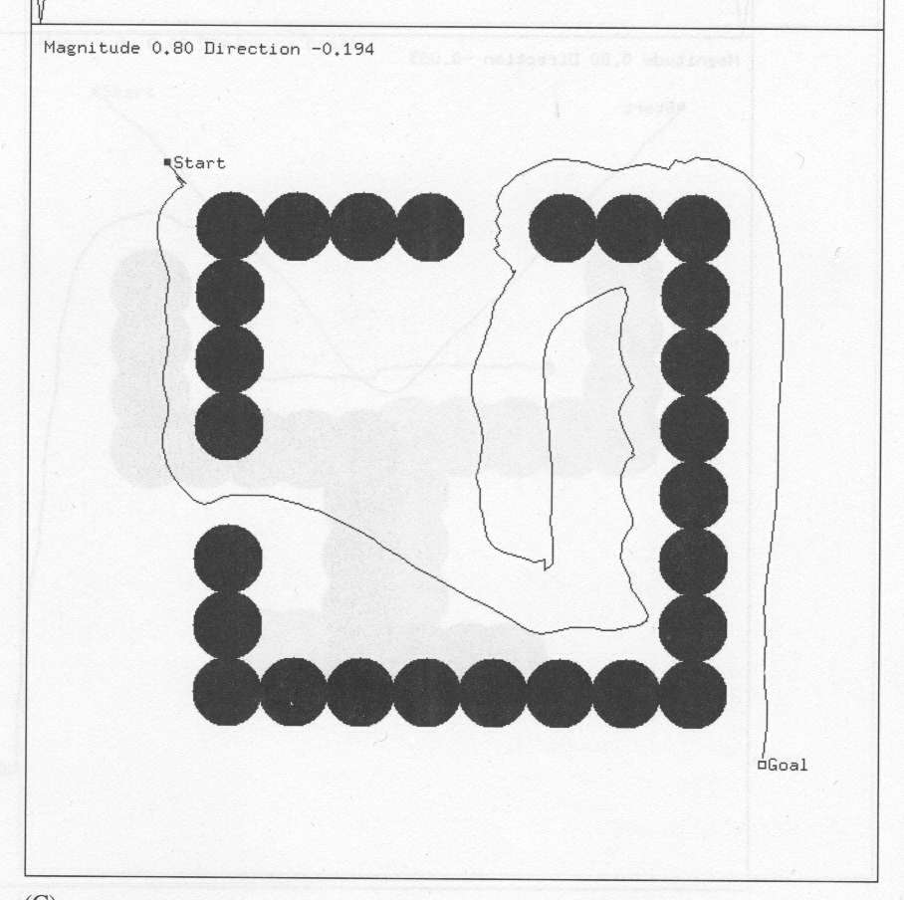
Another example
Keeping away from past locations...

Slide 52
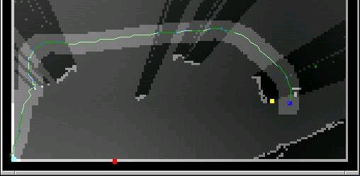
Pfields in Practice
Steathy navigation @ USC (Ashley Tews, Gaurav S. Sukhatme, and Maja J. Mataric)
http://robotics.usc.edu/interaction/?l=Research:Projects:stealth:index#experiments
part of the potential field… What's going on here?
Notes:
red == observer we want to avoid
yellow == goal
blue == robot
obstacles cast "unobservable shadows"
show Lec2/usc_pfields_exp1_r1.mov

Slide 53
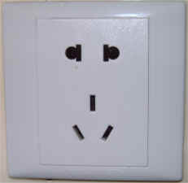
Docking with potential fields
Why might a simple attractive force not be sufficient for docking (plugging-in, etc.)?
example goals
How does the idea of docking, e.g., with an electrical outlet change the requirements for a potential field?

Slide 54
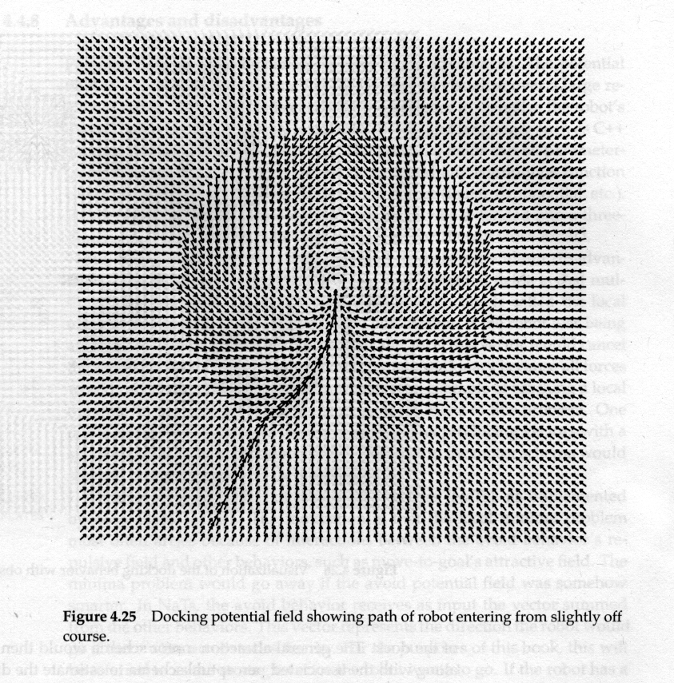
Docking with potential fields
The key insight is the need to establish an approach direction
example goals

Slide 55
Docking with potential fields
The key insight is the need to establish an approach direction

Slide 56
Review
Machine learning
general learning concepts
supervised vs. unsupervised
features/feature-based problems/feature space
bias/variance
overfitting
hyperplanes/linear seperability
Supervised learning
applications
approaches
k-NN
decision trees
NB
SVM (large margin classifiers)
Ensemble approaches (boosting)

Slide 57
Review
Machine learning (continued)
unsupervised learning
application
issues
number of clusters
flat vs. hierarchical
soft vs. hard clustering
approaches
k-means
EM
word alignment
clustering (mixture of gaussians)
spectral clustering (min-cut)

Slide 58
Review
Neural networks (Machine learning?)
perceptrons/neurons
activation functions (threshold vs. sigmoid)
perceptron learning
multi-layer networks
Knowledge representation
basic logic
ontology
NELL

Slide 59
Review
CSPs
problem formulation
variables
domain
constraints
why CSPs? applications?
constraint graph
CSP as search
backtracking algorithm
forward checking
arc consistency
heuristics
most constrained variable
least constrained value
...

Slide 60
Review
Natural language processing
Applications
Problem areas
Why it’s hard?
Machine translation setup

Slide 61
Guest speaker
Rodney Brooks
Professor at MIT (was previous director of CSAIL)
Founder of iRobot
http://www.youtube.com/watch?v=B79D9nW2AFA

