Slide 1
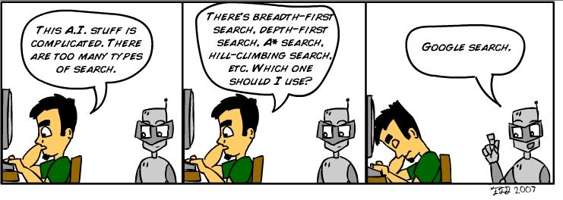
http://blog.lib.umn.edu/torre107/si/pics/superficialintelligence2.jpg

Slide 2
Uninformed Search
CS311
David Kauchak
Spring 2013
Adapted from notes from:
Sara Owsley Sood, Eric Eaton

Slide 3
Administrative
Send me videos!
Written problems will be posted today
Programming assignment 1 due before class on Tue.
  Anyone started?
My office hours posted:
  Mon/Wed 1-2:30pm
  Fri 11am-12
  and by appointment

Slide 4
Python
Whether importing or running, python executes code from the top down
  Be careful about calling functions before they’re defined
Comments and docstrings
Don’t mix tabs and spaces! (setup your text editor to only use spaces)

Slide 5
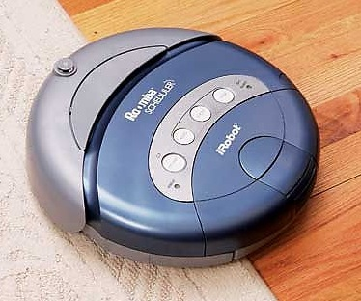
How do we make a computer "smart?"
Computer,
clean the house!
Um… OK…??
This one's got no chance…
Notes:
Assume that we want this vacuum to clean this house
To us - if someone told us to use a vacuum to clean a house, the sequence of events that should follow are pretty clear
We’d walk into the house, figure out what rooms needed to be vacuumed and start vacuuming
We’d methodically go through the room, not vacuuming over places we’ve already been, until we cover the whole room, then move to the next room

Slide 6
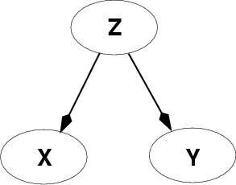
Fundamental problem of AI
Reasoning with knowledge
and uncertainty
Search
Many different ways of making an agent intelligent
Learning
Reasoning with
Utility

Slide 7
Today: search
Brute force approach
Very unlikely how humans do it
Enumerate out possibilities in a reasonable order
Think like a human Cognitive Modeling | Think rationally Logic-based Systems
Act like a human Turing Test | Act rationally Rational Agents

Slide 8

What is an “agent”?
“anything that can be viewed as perceiving its environment through sensors and acting upon that environment through actuators”
Human agent
  sensors = eyes, ears, etc
  actuators = hands, legs, mouth, etc
Software agent
  sensors = any input devices - keyboard gives it keystrokes, commands over the network, files give it text or data
  actuators = any output devices - using the screen to display things, pass things over the network, write things to files, etc

Slide 9
search agents
Search agent is an agent that approaches problem solving via search
To accomplish a task:
  Formulate problem and goal
  Search for a sequence of actions that will lead to the goal (the policy)
  Execute the actions one at a time
done offline!

Slide 10
Formulating the problem:
What information does a search agent need to know to plan out a solution?

Slide 11
Formulating the problem:
Initial state: where are we starting from
  what are the states?
Actions: what are the possible actions
Transition model: aka state-space, mapping from action x state to state
Goal/goal test: what is the end result we’re trying to achieve?
Cost: what are the costs of the different actions

Slide 12
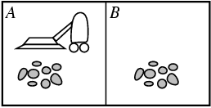
Let’s start with our vacuum cleaner example
State space
  Just two possible spaces in the house (though this generalizes easily to more)
  each space can either be dirty or clean
  vaccum is in one space at a time

Slide 13
Let’s start with our vacuum cleaner example
State space
  Just two possible spaces in the house (though this generalizes easily to more)
  each space can either be dirty or clean
  vaccum is in one space at a time
How many states?

Slide 14
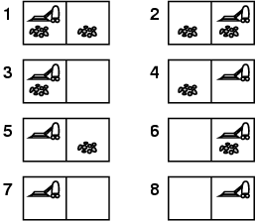
Vacuum world
Only 8 states

Slide 15
Vacuum world
goal state(s)?

Slide 16
Vacuum world

Slide 17
Vacuum world
Actions?
  move left
  move right
  suck
  no-op

Slide 18
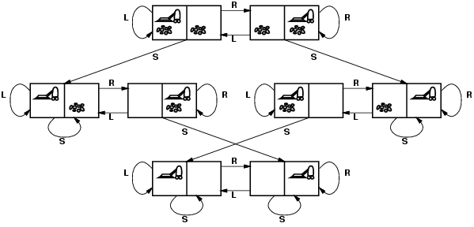
Vacuum world: state space/transition model

Slide 19
Problem characteristics
Fully observable vs. partially observable
  do we have access to all of the relevant information
  noisy information, inaccurate sensors, missing information
Deterministic vs. non-deterministic (stochastic)
  outcome of an action are not always certain
  probabilistic sometimes
Known/unknown environment
  Do we know a priori what the problem space is like (e.g. do we have a map)

Slide 20
Search problem types
Deterministic, fully observable
  Agent knows exactly which state it will be in
  solution is a sequence of actions
Non-observable → sensorless problem
  Agent may have no idea where it is
  solution is still a sequence
Non-deterministic and/or partially observable
→ contingency problem
  percepts provide new information about current state
  often interleave search, execution
Unknown state space → exploration problem
  this is how roomba works

Slide 21
Example: vacuum world
Deterministic, fully observable
start in #5. Solution?
[Right, Suck]

Slide 22
Example: vacuum world
Sensorless
start in {1,2,3,4,5,6,7,8}
Solution?
[Right,Suck,Left,Suck]

Slide 23
Example: Vacuum world
Non-deterministic and/or partially observable
  Nondeterministic: Suck may
  dirty a clean carpet
  Partially observable: location,
  dirt at current location.
  Percept: [L, Clean],
  i.e., start in #5 or #7
  Solution?
  [Right, if dirt then Suck]

Slide 24
Vacuum world
Cost?

Slide 25
Some example problems
Toy problems and micro-worlds
  8-Puzzle
  Missionaries and Cannibals
  Cryptarithmetic
  Remove 5 Sticks
  Water Jug Problem
Real-world problems

Slide 26
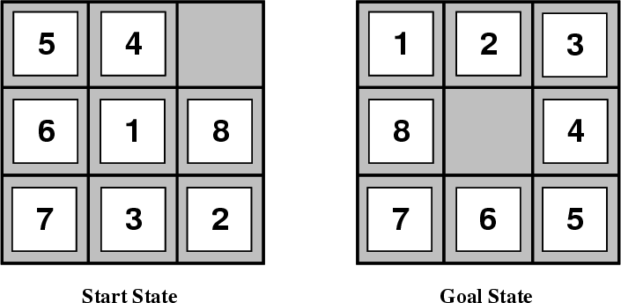
Another problem: 8-Puzzle

Slide 27
8-puzzle
goal
states?
actions?
path cost?

Slide 28
8-Puzzle
state:
  all 3 x 3 configurations of the tiles on the board
actions:
  Move Blank Square Left, Right, Up or Down.
  This is a more efficient encoding than moving each of the 8 distinct tiles
path cost:
  +1 for each action

Slide 29
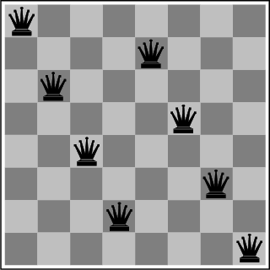
The 8-Queens Problem
State transition:?
Initial State?
Actions?
Goal: Place eight queens on a chessboard such that no queen attacks any other!

Slide 30
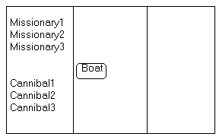
Missionaries and Cannibals
Three missionaries and three cannibals wish to cross the river. They have a small boat that will carry up to two people. Everyone can navigate the boat. If at any time the Cannibals outnumber the Missionaries on either bank of the river, they will eat the Missionaries. Find the smallest number of crossings that will allow everyone to cross the river safely.

Slide 31
Cryptarithmetic
Find an assignment of digits (0, ..., 9) to letters so that a given arithmetic expression is true. examples:
SEND + MORE = MONEY
    FORTY Solution: 29786
    + TEN 850
    + TEN 850
    ----- -----
    SIXTY 31486
    F=2, O=9, R=7, etc.

Slide 32
Remove 5 Sticks
Given the following configuration of sticks, remove exactly 5 sticks in such a way that the remaining configuration forms exactly 3 squares.

Slide 33
Water Jug Problem
Given a full 5-gallon jug and a full 2-gallon jug, fill the 2-gallon jug with exactly one gallon of water.
5
2

Slide 34
Water Jug Problem
State = (x,y), where x is the number of gallons of water in the 5-gallon jug and y is # of gallons in the 2-gallon jug
Initial State = (5,2)
Goal State = (*,1), where * means any amount
Operator table
5
Name | Cond. | Transition | Effect
Empty5 | – | (x,y)→(0,y) | Empty 5-gal. jug
Empty2 | – | (x,y)→(x,0) | Empty 2-gal. jug
2to5 | x ≤ 3 | (x,2)→(x+2,0) | Pour 2-gal. into 5-gal.
5to2 | x ≥ 2 | (x,0)→(x-2,2) | Pour 5-gal. into 2-gal.
5to2part | y < 2 | (1,y)→(0,y+1) | Pour partial 5-gal. into 2-gal.
2

Slide 35
Some real-world problems
Route finding
  directions, maps
  computer networks
  airline travel
VLSI layout
Touring (traveling salesman)
Agent planning

Slide 36
Search algorithms
We’ve defined the problem
Now we want to find the solution!
Use search techniques
  offline, simulated exploration of state space by generating successors of already-explored states (a.k.a. expanding states)
  Start at the initial state and search for a goal state
What are candidate search techniques?
  BFS
  DFS
  Uniform-cost search
  Depth limited DFS
  Depth-first iterative deepening

Slide 37
Finding the path: Tree search algorithms
Basic idea:
  keep a set of nodes to visit next (frontier)
  pick a node from this set
  check if it’s the goal state
  if not, expand out adjacent nodes and repeat
def treeSearch(start):
add start to the frontier
while frontier isn’t empty:
get the next node from the frontier
if node contains goal state:
return solution
else:
expand node and add resulting nodes to frontier

Slide 38
BFS and DFS
How do we get BFS and DFS from this?
def treeSearch(start):
add start to the frontier
while frontier isn’t empty:
get the next node from the frontier
if node contains goal state:
return solution
else:
expand node and add resulting nodes to frontier

Slide 39
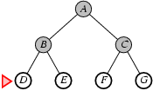
Breadth-first search
Expand shallowest unexpanded node
Nodes are expanded a level at a time (i.e. all nodes at a given depth)
Implementation:
  frontier is a FIFO queue, i.e., new successors go at end
frontier
Notes:
Curr = D Fringe = [E, F, G]
And so on and so forth until we either reach a goal state or have no more leaf nodes to expand (fringe is empty)

Slide 40
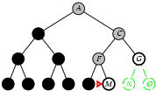
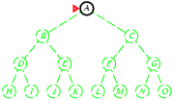
Depth-first search
Expand deepest unexpanded node
Implementation:
  frontier = LIFO queue, i.e., put successors at front
frontier

Slide 41
Search algorithm properties
Time (using Big-O)
Space (using Big-O)
Complete
  If a solution exists, will we find it?
Optimal
  If we return a solution, will it be the best/optimal solution
A divergence from algorithms/data structures
  we generally won’t use V and E to define time and space. Why?
    Often V and E are infinite!
    Instead, we often use the branching factor (b) and depth (d)

Slide 42
Activity
Analyze DFS and BFS according to the criteria time, space, completeness and optimality
  (for time and space, analyze in terms of b, d, and m (max depth); for complete and optimal - simply YES or NO)
  Which strategy would you use and why?
Brainstorm improvements to DFS and BFS

Slide 43
BFS
Time:
Space:
Complete:
Optimal:
O(b^{d})
b = branching factor
d = depth
m = max depth of tree
O(b^{d})
YES
YES if action costs are fixed, NO otherwise

Slide 44
Time and Memory requirements for BFS
Depth | Nodes | Time | Memory
2 | 1100 | .11 sec | 1 MB
4 | 111,100 | 11 sec | 106 MB
6 | 10⁷ | 19 min | 10 GB
8 | 10⁹ | 31 hours | 1 terabyte
10 | 10¹¹ | 129 days | 101 terabytes
12 | 10¹³ | 35 years | 10 petabytes
14 | 10¹⁵ | 3,523 years | 1 exabyte
DFS requires only
118KB, 10 billion times less space
10^15, 2^50
1 billion gigabytes
10^18, 2^60
BFS with b=10, 10,000 nodes/sec; 10 bytes/node

Slide 45
DFS
Time:
Space:
Complete:
Optimal:
O(b^{m})
b = branching factor
d = depth
m = max depth of tree
O(bm)
YES, if space is finite (and no circular paths), NO otherwise
NO

Slide 46
Problems with BFS and DFS
BFS
  doesn’t take into account costs
  memory! ☹
DFS
  doesn’t take into account costs
  not optimal
  can’t handle infinite spaces
  loops

Slide 47
Uniform-cost search
Expand unexpanded node with the smallest path cost, g(x)
Implementation?

Slide 48
Uniform-cost search
Expand unexpanded node with the smallest path cost, g(x)
Implementation:
  frontier = priority queue ordered by path cost
  similar to Dijkstra’s algorithm
How does it relate to bfs?
equivalent if costs are fixed

Slide 49
Uniform-cost search
Time? and Space?
  dependent on the costs and optimal path cost, so cannot be represented in terms of b and d
  Space will still be expensive (e.g. take uniform costs)
Complete?
  YES, assuming costs > 0
Optimal?
  Yes, assuming costs > 0
This helped us tackle the issue of costs, but still going to be expensive from a memory standpoint!

Slide 50

Ideas?
Can we combined the optimality and completeness of BFS with the memory of DFS?
+
=

Slide 51
Depth limited DFS
DFS, but with a depth limit L specified
  nodes at depth L are treated as if they have no successors
  we only search down to depth L
Time?
  O(b^{L})
Space?
  O(bL)
Complete?
  NO, if solution is longer than L
Optimal
  NO, for same reasons DFS isn’t

Slide 52

Ideas?

Slide 53
Iterative deepening search
For depth 0, 1, …., ∞
  run depth limited DFS
  if solution found, return result
Blends the benefits of BFS and DFS
  searches in a similar order to BFS
  but has the memory requirements of DFS
Will find the solution when L is the depth of the shallowest goal

Slide 54
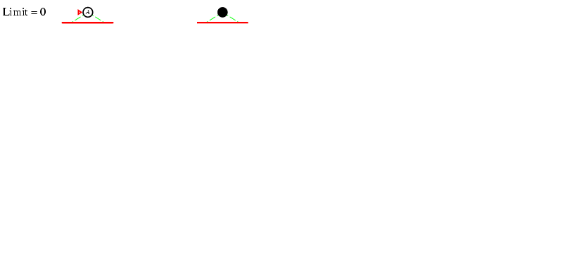
Iterative deepening search L =0

Slide 55
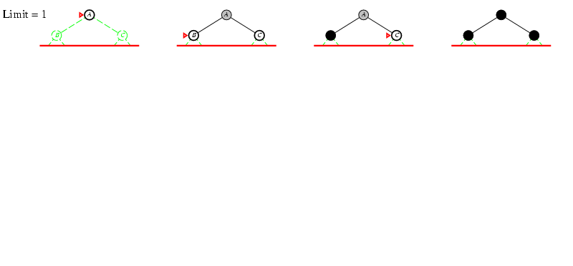
Iterative deepening search L =1

Slide 56
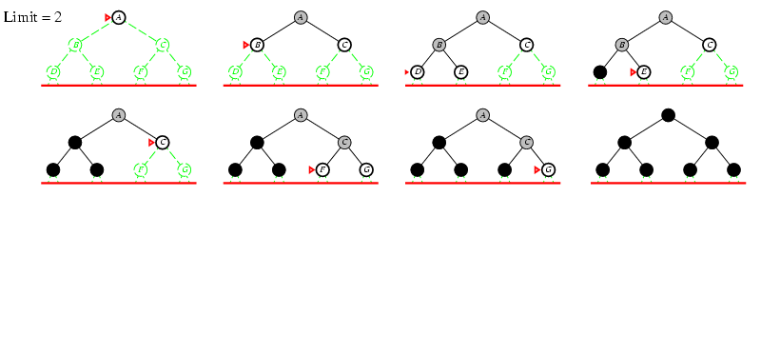
Iterative deepening search L =2

Slide 57
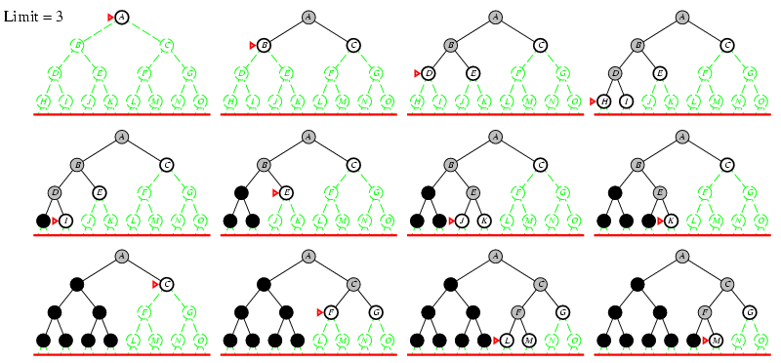
Iterative deepening search L =3

Slide 58
Time?
L = 0: 1
L = 1: 1 + b
L = 2: 1 + b + b²
L = 3: 1 + b + b² + b³
…
L = d: 1 + b + b² + b³ + … + b^{d}
Overall:
  d(1) + (d-1)b + (d-2)b² + (d-3)b³ + … + b^{d}
  O(b^{d})
  the cost of the repeat of the lower levels is subsumed by the cost at the highest level

Slide 59
Properties of iterative deepening search
Space?
  O(bd)
Complete?
  YES
Optimal?
  YES, if step size = 1

Slide 60
Missionaries and Cannibals Solution
Near side Far side
0 Initial setup: MMMCCC B -
1 Two cannibals cross over: MMMC B CC
2 One comes back: MMMCC B C
3 Two cannibals go over again: MMM B CCC
4 One comes back: MMMC B CC
5 Two missionaries cross: MC B MMCC
6 A missionary & cannibal return: MMCC B MC
7 Two missionaries cross again: CC B MMMC
8 A cannibal returns: CCC B MMM
9 Two cannibals cross: C B MMMCC
10 One returns: CC B MMMC
11 And brings over the third: - B MMMCCC

