Slide 1
Constraint Satisfaction Problems (CSPs)
CS311
David Kauchak
Spring 2013
Some material borrowed from:
Sara Owsley Sood and others

Slide 2
Admin
Final project comments:
  Use pre-existing code
  Get your data now!
    Use pre-existing data sets
  Finding good references
    Google scholar (http://scholar.google.com/)
    Other papers
Final project proposals due tomorrow at 6pm
Some written problems will be posted tomorrow

Slide 3
Quick search recap
Search
  uninformed
    BFS, DFS, IDS
  informed
    A*, IDA*, greedy-search
Adversarial search
  assume player makes the optimal move
  minimax and alpha-beta pruning
Local search (aka state space search)
  start random, make small changes
  dealing with local minima, plateaus, etc.
    random restart, randomization in the approach, simulated annealing, beam search, genetic algorithms

Slide 4
Intro Example: 8-Queens
Where should I put the queens in columns 3 and 4?
Notes:
Using local search, we would generate a random configuration of queens on the board
Check if it is the goal state
If not, make some alteration and try again
Is there anything bad about this?
Its easy to generate and alter, but might have to do that many times
There are various ways to do this smarter, with genetic algorithms, etc, but this state space is still huge
How would you go about figuring out where to put another queen on this board in column 3?
What are the positions that you would try?
TRY THIS ON YOUR PAPER - BE CONSCIOUS OF YOUR METHOD - TRY COL 3, then COL 4, …

Slide 5
Intro Example: 8-Queens
The decisions you make constrain the possible set of next states

Slide 6
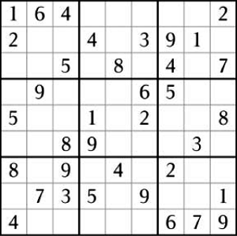
Sudoku
What value?

Slide 7
Sudoku
1
2
3
4
5
6
7
8
9

Slide 8
Sudoku
1
2
3
4
5
6
7
8
9

Slide 9
Sudoku
We could try and solve this by searching, but the problem constraints may direct us better allowing for a much faster solution finding.

Slide 10
Constraint satisfaction problem
Another form of search (more or less)!
- Set of variables: x₁, x₂, …, x_{n}
Domain for each variable indicating possible values: D_{x1}, D_{x2}, …, D_{xn}
Set of constraints: C₁, C₂, …, C_{m}
  Each constraint limits the values the variables can take
    x₁ ≠ x₂
    x₁ < x₂
    x₁ + x₂ = x₃
    x₄ < x₅²
Goal: an assignment of values to the variables that satisfies all of the contraints

Slide 11
Applications?

Slide 12
Applications
Scheduling:
I'd like to try and meet this week, just to touch base and see how everything is going. I'm free:
Anytime Tue., Wednesday after 4pm, Thursday 1-4pm
Me
S1
I can do Tuesday 11-2:30, 4+, Wednesday 5-6, Thursday 11-2:30
I can do anytime Tuesday (just before or after lunch is best), not Wednesday, or Thursday afternoon.
P2
S2
I'm free Tuesday and Thursday from 2:45-4 or so, and also Wednesday any time after 3.
S3
I can meet from 4-5 on Tuesday or Wednesday after 5.

Slide 13
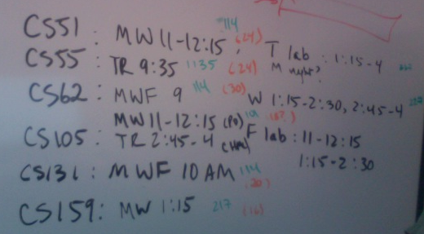
Applications
Scheduling

Slide 14
Applications
Scheduling
  manufacturing
  Hubble telescope time usage
  Airlines
  Cryptography
  computer vision (image interpretation)
  …

Slide 15
Why CSPs?
“Constraint programming represents one of the closest approaches computer science has yet made to the Holy Grail of programming: the user states the problem, the computer solves it.”
Eugene C. Freuder, Constraints, April 1997

Slide 16
Why CSPs?
If you can represent it in this standard way (set of variables with a domain of values and constraints), the successor function and goal test can be written in a generic way that applies to all CSPs
We can develop effective generic heuristics that require no domain specific expertise
The structure of the constraints can be used to simplify the solution process

Slide 17
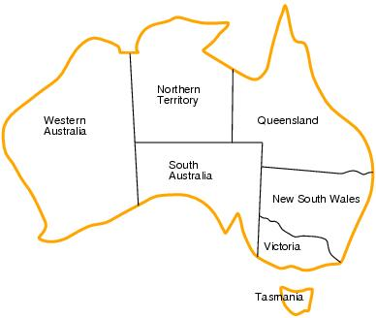
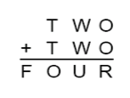
Defining CSP problems
Graph coloring
Sudoku
Cryptarithmatic
variables
domains of the variables
constraints
8-queens

Slide 18
Example: 8-Queens Problem
8 variables x₁, x₂, …, x₈
Domain for each variable: {1,2,…,8}
Constraints are of the forms:
  row constraints: x_{i} ≠ x_{j} for all i, j where j≠i
  diagonal constraints: |i-j| ≠ |x_{i} – x_{j}|, for all i, j where j≠i
Notes:
DRAW on BOARD
Xi represents the row in which you’ll place the queen in col i
K is row num
-no worries about col conflicts because we are assigning 1 queen in each column
Constraint 1
Row number k can’t appear twice (would imply that we have a row conflict)
Constraint 2
Diagonal conflict

Slide 19
Example: Map Coloring
7 variables {WA,NT,SA,Q,NSW,V,T}
Each variable has the same domain {red, green, blue}
No two adjacent variables have the same value:
WA≠NT, WA≠SA, NT≠SA, NT≠Q, SA≠Q, SA≠NSW, SA≠V,Q≠NSW, NSW≠V

Slide 20
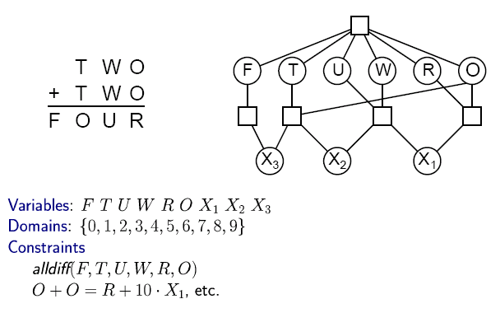

CSP Example: Cryptharithmetic puzzle

Slide 21
Example: Task Scheduling
T1
T2
T4
T3
T1 must be done during T3
T2 must be achieved before T1 starts
T2 must overlap with T3
T4 must start after T1 is complete
Notes:
This is much like the scheduling example that we saw in looking at AISPACE.org last week

Slide 22
Many different constraint types
Unary constraints: involve only a single variable (x₁ != green)
Binary constraints: involve two variables
Higher order constraints: involve 3 or more variables (e.g. all-diff(a,b,c,d,e))
  all higher order constraints can be rewritten as binary constraints by introducing additional variables!
Preference constraints - no absolute - they indicate which solutions are preferred
  I can meet between 3-4, but I’d prefer to meet between 2-3
  Electricity is cheaper at night
  Workers prefer to work in the daytime

Slide 23
Constraint Graph
Binary constraints
NT
Q
WA
SA
NSW
V
T
Two variables are adjacent or neighbors if they
are connected by an edge or an arc

Slide 24
CSP as a Search Problem
Initial state:
  {} no assignments
Successor function:
  any assignment to an unassigned variable that does not conflict
Goal test:
  all variables assigned to?
Max search depth?
  number of variables
empty assignment
Assign unassigned var v, value val s.t. no constraints are violated
assignment is complete
N/A
Notes:
It might be good to use search just so we don’t repeat extra work here - systematically work through the problem as opposed to wandering
TRY THIS ON YOUR PAPER - generically
incremental formulation of the search problem
initial state = {} no assignments
successor function = value can be assigned to any unassigned variable, provided that it does not conflict with any previously assigned variables
goal test = the current assignment is complete
path cost = constant cost (1) for each step
*if we were to represent this as a search tree, and our successor function allowed us to make one assignment to a variable at each step, at what depth would the solution be in a tree?
any solution could only appear at depth n (where n is the number of variables)
*What is the max depth of any tree?
Tree can’t be deeper than n because that’s how many variables we have
Just like with our local search problems, the path by which a solution is reach is irrelevant (by path I mean the order at which values are assigned to the variables, the order in which the queens are placed on the board)

Slide 25
CSP as search

Slide 26
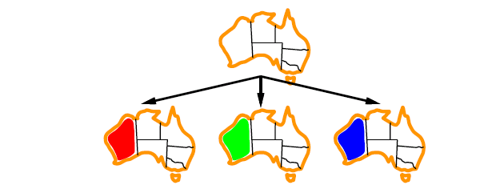
CSP as search

Slide 27
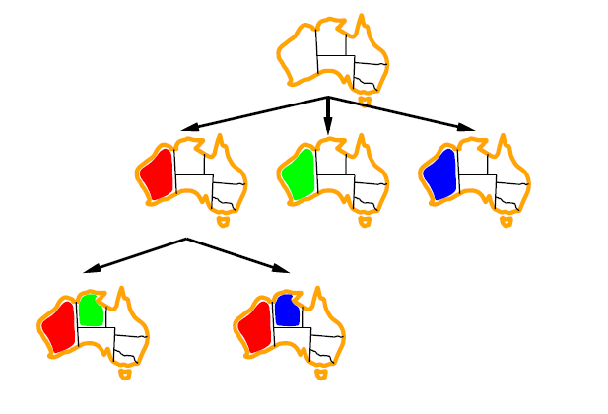
CSP as search

Slide 28
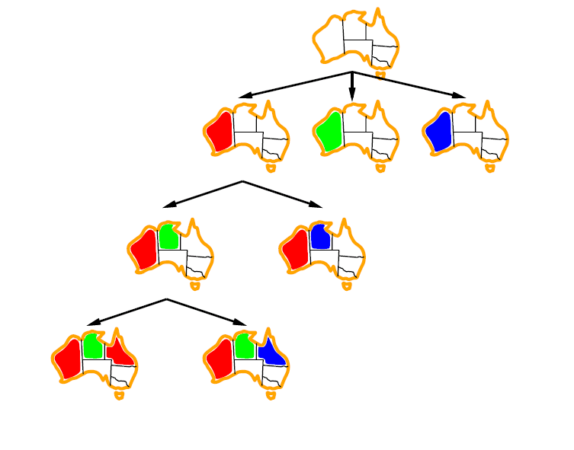
CSP as search

Slide 29
CSP as search
{}
WA=red
WA=green
WA=blue
WA=red
NT=green
WA=red
NT=blue
NT
Q
WA=red
NT=green
Q=red
WA=red
NT=green
Q=blue
WA
SA
NSW
V
T

Slide 30
Backtracking Algorithm
CSP-BACKTRACKING(PartialAssignment a)
  If a is complete
    return a
  x ← select an unassigned variable
  D ← select an ordering for the domain of x
  For each value v in D do
    If v is consistent with a then
      Add (x = v) to a
      result ← CSP-BACKTRACKING(a)
      If result ≠ failure then return result
  Return failure
CSP-BACKTRACKING({})
Notes:
Remember ‘consistent’ means ‘legal’

Slide 31
Questions
CSP-BACKTRACKING(PartialAssignment a)
  If a is complete
    return a
  x ← select an unassigned variable
  D ← select an ordering for the domain of x
  For each value v in D do
    If v is consistent with a then
      Add (x = v) to a
      result ← CSP-BACKTRACKING(a)
      If result ≠ failure then return result
  Return failure
Which variable x should be assigned a value next?
In which order should its domain D be sorted?
How do choices made affect assignments for unassigned variables?
Notes:
We haven’t specified these things yet

Slide 32
Choice of Variable
  x ← select an unassigned variable
Which variable should we pick?
The most constrained variable, i.e. the one
with the fewest remaining values – column 3
Notes:
What about now?
The most constrained column - 3

Slide 33
Choice of Variable
NT
Q
WA
SA
NSW
V
T
NT
WA
SA
  x ← select an unassigned variable
Which variable should we start with?
The variable involved with the most
constraints - SA

Slide 34
Choice of Variable
NT
NT
Q
WA
WA
SA
NSW
V
{}
T
  D ← select an ordering for the domain of x
Which value should we pick for Q?
Least constraining value - RED

Slide 35
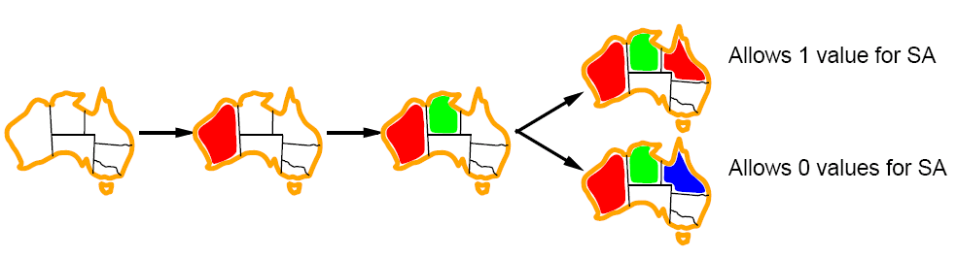
Least constraining value
Prefer the value that leaves the largest subset of legal values for other unassigned variables

Slide 36
Why CSPs?
Notice that our heuristics work for any CSP problem formulation
  unlike our previous search problems!
  does not require any domain knowledge
    mancala heuristics
    straight-line distance

Slide 37
Eliminating wasted search
One of the other important characteristics of CSPs is that we can prune the domain values without actually searching (searching implies guessing)
Our goal is to avoid searching branches that will ultimately dead-end
How can we use the information available at early on to help with this process?

Slide 38
Constraint Propagation …
… is the process of determining how the possible values of one variable affect the possible values (domains) of other variables

Slide 39
Forward Checking
After a variable X is assigned a value v, look at each unassigned variable Y that is connected to X by a constraint and delete from Y’s domain any value that is inconsistent with v

Slide 40
Forward checking
NT
Q
WA
NSW
T
SA
V
WA | NT | Q | NSW | V | SA | T
RGB | RGB | RGB | RGB | RGB | RGB | RGB
Can we detect inevitable failure early?
  And avoid it later?
Forward checking idea: keep track of remaining legal values for unassigned variables.
Terminate search when any variable has no legal values.

Slide 41
Map Coloring
NT
Q
WA
NSW
T
SA
V
WA | NT | Q | NSW | V | SA | T
RGB | RGB | RGB | RGB | RGB | RGB | RGB
Pick red for WA… how does it change the domains?

Slide 42
Map Coloring
NT
Q
WA
NSW
T
SA
V
WA | NT | Q | NSW | V | SA | T
RGB | RGB | RGB | RGB | RGB | RGB | RGB
R | GB | RGB | RGB | RGB | GB | RGB
Notes:
If we assign WA to be red
That eliminates red from the possibilities for NT and SA

Slide 43
Map Coloring
NT
Q
WA
NSW
T
SA
V
WA | NT | Q | NSW | V | SA | T
RGB | RGB | RGB | RGB | RGB | RGB | RGB
R | GB | RGB | RGB | RGB | GB | RGB
Pick green for Q… how does it change the domains?
Notes:
If we assign WA to be red
That eliminates red from the possibilities for NT and SA

Slide 44
Map Coloring
NT
Q
WA
NSW
T
SA
V
WA | NT | Q | NSW | V | SA | T
RGB | RGB | RGB | RGB | RGB | RGB | RGB
R | GB | RGB | RGB | RGB | GB | RGB
R | B | G | RB | RGB | B | RGB
Notes:
Now after we assign Q to be Green
That removes some other possibilities

Slide 45
Map Coloring
NT
Q
WA
NSW
T
SA
V
WA | NT | Q | NSW | V | SA | T
RGB | RGB | RGB | RGB | RGB | RGB | RGB
R | GB | RGB | RGB | RGB | GB | RGB
R | B | G | RB | RGB | B | RGB
Pick blue for V… how does it change the domains?
Notes:
Now after we assign Q to be Green
That removes some other possibilities

Slide 46
Map Coloring
NT
Q
WA
NSW
T
SA
V
Impossible assignments that forward
checking do not detect
WA | NT | Q | NSW | V | SA | T
RGB | RGB | RGB | RGB | RGB | RGB | RGB
R | GB | RGB | RGB | RGB | GB | RGB
R | B | G | RB | RGB | B | RGB
R | B | G | R | B |  | RGB
Only picked 3 colors, but already know we’re at a dead end!

Slide 47
Map Coloring
NT
Q
WA
NSW
T
SA
V
WA | NT | Q | NSW | V | SA | T
RGB | RGB | RGB | RGB | RGB | RGB | RGB
R | GB | RGB | RGB | RGB | GB | RGB
R | B | G | RB | RGB | B | RGB
After just selecting 2… anything wrong with this?
Notes:
Now after we assign Q to be Green
That removes some other possibilities

Slide 48
Map Coloring
NT
Q
WA
NSW
T
SA
V
WA | NT | Q | NSW | V | SA | T
RGB | RGB | RGB | RGB | RGB | RGB | RGB
R | GB | RGB | RGB | RGB | GB | RGB
R | B | G | RB | RGB | B | RGB
After just selecting 2… anything wrong with this?
Notes:
Now after we assign Q to be Green
That removes some other possibilities

Slide 49
Removal of Arc Inconsistencies
Given two variables x_{j} and x_{k} that are connected by some constraint
We have the current remaining domains D_{xj} and D_{xk}
For every possible label in D_{xj}
  if using that label leaves no possible labels in D_{xk}
  Then get rid of that possible label
See full pseudocode in the book
Notes:
Forward checking was one way of avoiding getting too far down DEADEND branches, REMOVING ARC INCONSISTENCIES is another
Given two variables j and k that are connected by some constraint
We have a set of possible remaining values X and Y
For every possible label in Y, if using that label y for K leaves no possible labels in X for J
Then get rid of that possible label y

Slide 50
Arc consistency: AC-3 algorithm
What happens if we remove a possible value during an arc consistency check?
  may cause other domains to change!
When do we stop?
  keep running repeatedly until no inconsistencies remain
  can get very complicated to keep track of which to check

Slide 51
Arc consistency: AC-3 algorithm
  systematic way to keep track of which arcs still need to be checked
  AC-3
  keep track of the set of possible constraints/arcs that may need to be checked
  grab one from this set
  if we make changes to variable’s domain, add all of it’s constraints into the set
  keep doing this until no constraints exist

Slide 52
Solving a CSP
Search:
  can find good solutions, but must examine non-solutions along the way
Constraint Propagation:
  can rule out non-solutions, but this is not the same as finding solutions
Interweave constraint propagation and search
  Perform constraint propagation at each search step.

Slide 53
4-Queens Problem
X1
{1,2,3,4}
X2
{1,2,3,4}
1
2
3
4
1
2
3
4
X3
{1,2,3,4}
X4
{1,2,3,4}
What can we remove with forward checking?
Notes:
Given this assignment of 1 to X1, we can remove a lot of values from the list of possibilities for the other variables

Slide 54
4-Queens Problem
X1
{1,2,3,4}
X2
{1,2,3,4}
1
2
3
4
1
2
3
4
X3
{1,2,3,4}
X4
{1,2,3,4}
Anything else with arc consistency?
forward propagation
Can’t have X2 = 3!
Notes:
Removing arc inconsistencies, do you see any others we can remove?
Consider the varaibles in pairs (x1, x2), (x1, x3),….
hint: (x2, x3)
What if you consider X2 and X3
What if we assigned 3 to X2?
Then there would be no possibilities for X3 bc of diagonal conflict
So we can also eliminate 3 from X2

Slide 55
4-Queens Problem
X1
{1,2,3,4}
X2
{1,2,3,4}
1
2
3
4
1
2
3
4
X3
{1,2,3,4}
X4
{1,2,3,4}
Anything else?
Can’t have X3 = 4!
Notes:
Any other arc inconsistencies? Hint: try (x3,x2)
If we consider X3 and X2 again
If we assigned 4 to X3, then that would eliminate the possibilities for X2, so get rid of 4 for X3
Lets consider X3 and X4
If we assigned 2 to X3, that would eliminate all possibilities from X4, so we should get rid of 2 from X3

Slide 56
4-Queens Problem
X1
{1,2,3,4}
X2
{1,2,3,4}
1
2
3
4
1
2
3
4
X3
{1,2,3, }
X4
{1,2,3,4}
Anything else?
Can’t have X3 = 2!
Notes:
Any other arc inconsistencies? Hint: try (x3,x2)
If we consider X3 and X2 again
If we assigned 4 to X3, then that would eliminate the possibilities for X2, so get rid of 4 for X3
Lets consider X3 and X4
If we assigned 2 to X3, that would eliminate all possibilities from X4, so we should get rid of 2 from X3

Slide 57
4-Queens Problem
X1
{1,2,3,4}
X2
{1,2,3,4}
1
2
3
4
1
2
3
4
X3
{1,2,3,4}
X4
{1,2,3,4}
Technically no search over values was involved. Only looked at constraints.
Notes:
Now since X3 has no more possibilities, we need to back track and change our last assignment

Slide 58
4-Queens Problem
X1
{1,2,3,4}
X2
{1,2,3,4}
1
2
3
4
1
2
3
4
X3
{1,2,3,4}
X4
{1,2,3,4}
Notes:
So we try the second branch in the tree - we know that x1 can’t be 1 now

Slide 59
4-Queens Problem
X1
{1,2,3,4}
X2
{1,2,3,4}
1
2
3
4
1
2
3
4
X3
{1,2,3,4}
X4
{1,2,3,4}
?
Can’t have X3 = 3
Notes:
Again, remove arc inconsistencies
Arc (X3, X2)
If we assign X3=3
That removes all possibilities for X2, so get rid of X3=3

Slide 60
4-Queens Problem
X1
{1,2,3,4}
X2
{1,2,3,4}
1
2
3
4
1
2
3
4
X3
{1,2,3,4}
X4
{1,2,3,4}
?
Can’t have X4 = 1 or X4 = 4
Notes:
Arc (X4, X3)
X4 = 1 - remove
X4 = 3 - fine
Arc(X4, X2)
X4 = 4 - remove

Slide 61
4-Queens Problem
X1
{1,2,3,4}
X2
{1,2,3,4}
1
2
3
4
1
2
3
4
X3
{1,2,3,4}
X4
{1,2,3,4}
Notes:
Now we have one value for each variable remaining

Slide 62
4-Queens Problem
X1
{1,2,3,4}
X2
{1,2,3,4}
1
2
3
4
1
2
3
4
X3
{1,2,3,4}
X4
{1,2,3,4}
Only searched 2 nodes!

Slide 63
CSP Summary
Key: allow us to use heuristics that are problem independent
CSP as a search problem
  Backtracking algorithm
  General heuristics
Forward checking
Constraint propagation
Interweaving CP and backtracking

Slide 64

Edge Labeling in Computer Vision
How do you know what the 3-D shape looks like?
Notes:
When we look at a line drawing like this one, we get a vivid perception of 3D shape and layout
HOW?
We even get a perception of surface slant and tilt
How do we do this? - AI - study people first, then build a system
When thinking about how a machine could do this, we’ll consider the qualitative knowledge available from a line drawing
Lines can have multiple significance
The task of LINE LABELING (task of evaluating the actual significance of each line) was one of the first tasks in computer vision
Specifically, we’ll talk about EDGES between SURFACES in an image
If a program were able to automatically label these EDGES in some way, the program would know more about the image
Assume that the computer can see the lines and their intersections in some way, but doesn’t know how to interpret them

Slide 65
Edge Labeling
In or out?

Slide 66
Edge Labeling
In or out?

Slide 67
Edge Labeling
In or out?

Slide 68
Edge Labeling
Information about the other edges constrains the possibilities

Slide 69
Labels of Edges
Convex edge:
  two surfaces intersecting at an angle greater than 180°
  often, “sticking out”, “towards us”
Concave edge
  two surfaces intersecting at an angle less than 180°
  often, “folded in”, “away from us”
+ convex edge, both surfaces visible
− concave edge, both surfaces visible
← convex edge, only one surface is visible and it is on the right side of ←
Notes:
And the types of edges that we’re talking about are CONVEX, CONCAVE
If there is an arrow on an edge, it is an “occluding convex edge”
There are two surfaces, one completely occluding the other from our perspective
So we label the edge with an arrow
If you follow the arrow, the occluding surface will be on the right

Slide 70
Edge Labeling

Slide 71
Edge Labeling
+
+
+
+
+
-
-
+
+
+
+
+

Slide 72
Junction Label Sets
+
+
-
-
+
+
-
-
-
+
+
-
-
-
-
+
+
+
+
-
(Waltz, 1975; Mackworth, 1977)
Notes:
An exhaustive listing of the different ways each vertex can be viewed
We get 3 different junction types, L, Y arrow, and T Junctions
L junctions come from 2 visible edges
Y arrow junctions come from 3 edges, none of which have an angle > 180
T junctions are associated with occlusion

Slide 73
Edge Labeling
CSP?

Slide 74
Edge Labeling as a CSP
A variable is associated with each junction
The domain of a variable is the label set of the corresponding junction
Each constraint imposes that the values given to two adjacent junctions give the same label to the joining edge
Notes:
The variables are the junctions
The values are labelings for the junctions
And the constraints are that each line has a single label
CSP performs well in this task

Slide 75
Edge Labeling
+
-

Slide 76
Edge Labeling
+
+
-
-
-
+
+
+
-
Notes:
We have two sets of values for these two different edges
Say we try the bottom value in the top corner
What does that make the other value have to be?
Doesn’t constrain anything yet, let’s keep looking

Slide 77
Edge Labeling
+
+
-
-
-
-
+
+
-
-
+
Notes:
Since a + is coming in here, we only have one option

Slide 78
Edge Labeling
+
+
+
+
+
+
+
+
+
-
+
+
-
-
+
+
Notes:
Now that this has been assigned, we have two possible values for the next one

Slide 79
Edge Labeling
+
+
+
+
+
+
+
+
+
+
+
-
-
Notes:
Now that this has been assigned, we have two possible values for the next one

Slide 80
Edge Labeling
+
+
-
-
+
+
+
+
+
-
-
Notes:
What about arc inconsistencies?
If we labeled the left with #1, what could the right be?
#3
If we labeled the left with #2, what could the right be?
nothing! ARC INCONSISTENCY - remove #2 from left
If we labeled the left with #3, what could the right be?
nothing! ARC INCONSISTENCY - remove #3 from left
If we labeled the left with #4, what could the right be?
#2
If we labeled the left with #5, what could the right be?
#1
If we labeled the left with #6, what could the right be?
#1

