Slide 1
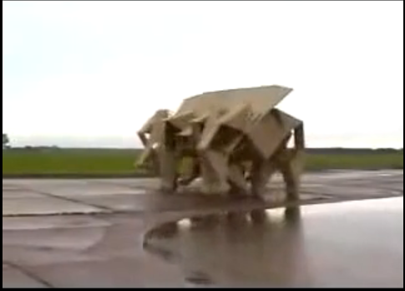
http://www.youtube.com/watch?v=OR_-Y-eIlQo

Slide 2
Machine learning:
Unsupervised learning
David Kauchak
cs311
Spring 2013
adapted from:
http://www.stanford.edu/class/cs276/handouts/lecture17-clustering.ppt

Slide 3
Administrative
Assignment 5 out
  due next Friday… get started now!
  implement k-means
  experiment with variants
    good chance to practice experimentation/analysis

Slide 4
k-means demo

Slide 5
Clustering evaluation
Use data with known classes
  For example, document classification data
data
Label
Ideally produce clusters
that mimic labels

Slide 6
Common approach: use labeled data
Purity, the proportion of the dominant class in the cluster
• •
• •
• •
• •
• •
• •
• •
•
Cluster I
Cluster II
Cluster III
Cluster I: Purity = 1/4 (max(3, 1, 0)) = 3/4
Cluster II: Purity = 1/6 (max(1, 4, 1)) = 4/6
Overall purity?
Cluster III: Purity = 1/5 (max(2, 0, 3)) = 3/5

Slide 7
Overall purity
Cluster I: Purity = 1/4 (max(3, 1, 0)) = 3/4
Cluster II: Purity = 1/6 (max(1, 4, 1)) = 4/6
Cluster III: Purity = 1/5 (max(2, 0, 3)) = 3/5
Cluster average:
Weighted average:

Slide 8
Purity issues…
Purity, the proportion of the dominant class in the cluster
Good for comparing two algorithms, but not understanding how well a single algorithm is doing, why?
  Increasing the number of clusters increases purity

Slide 9
Purity isn’t perfect
Which is better based on purity?
Which do you think is better?
Ideas?

Slide 10
Common approach: use labeled data
Average entropy of classes in clusters
where p(class_{i}) is proportion of class i in cluster

Slide 11
Common approach: use labeled data
Average entropy of classes in clusters
entropy?

Slide 12
Common approach: use labeled data
Average entropy of classes in clusters

Slide 13
Problems with K-means
Determining K is challenging
Spherical assumption about the data (distance to cluster center)
Hard clustering isn’t always right
Greedy approach

Slide 14
Problems with K-means
What would K-means give us here?

Slide 15
Assumes spherical clusters
k-means assumes spherical clusters!

Slide 16
EM clustering: mixtures of Gaussians
Assume data came from a mixture of Gaussians (elliptical data), assign data to cluster with a certain probability
k-means
EM

Slide 17
Bayesian Classification
We represent a data item based on the features:
Classifying
Given an new example, the Bayesian model gives us the probability of the model belonging to that class

Slide 18
Unsupervised
We represent a data item based on the features:
How likely is a point to be long to a cluster…

Slide 19
Training a Bayesian Classifier
features
Label
f₁, f₂, f₃, …, f_{n}
0
f₁, f₂, f₃, …, f_{n}
0
f₁, f₂, f₃, …, f_{n}
1
classifier
f₁, f₂, f₃, …, f_{n}
1
train a
predictive
model
f₁, f₂, f₃, …, f_{n}
0

Slide 20
Training
use Bayes rule and learn
p(feature|Label)
not as clear here…

Slide 21
EM is a general framework
Create an initial model, θ’
  Arbitrarily, randomly, or with a small set of training examples
Use the model θ’ to obtain another model θ such that
  Σ_{i} log P_{θ}(data_{i}) > Σ_{i} log P_{θ’}(data_{i})
Let θ’ = θ and repeat the above step until reaching a local maximum
  Guaranteed to find a better model after each iteration
i.e. better models data
(increased log likelihood)
Where else have you seen EM?

Slide 22
EM shows up all over the place
Training HMMs (Baum-Welch algorithm)
Learning probabilities for Bayesian networks
EM-clustering
Learning word alignments for language translation
Learning Twitter friend network
Genetics
Finance
Anytime you have a model and unlabeled data!

Slide 23
E and M steps: creating a better model
Expectation: Given the current model, figure out the expected probabilities of the data points to each cluster
p(x|θ_{c})
What is the probability of each point belonging to each cluster?
Maximization: Given the probabilistic assignment of all the points, estimate a new model, θ_{c}
Just like NB maximum likelihood estimation, except we use fractional counts instead of whole counts

Slide 24
Similar to k-means
Iterate:
  Assign/cluster each point to closest center
  Recalculate centers as the mean of the points in a cluster
Expectation: Given the current model, figure out the expected probabilities of the points to each cluster
p(x|θ_{c})
Maximization: Given the probabilistic assignment of all the points, estimate a new model, θ_{c}

Slide 25
E and M steps
Expectation: Given the current model, figure out the expected probabilities of the data points to each cluster
Maximization: Given the probabilistic assignment of all the points, estimate a new model, θ_{c}
Iterate:
each iterations increases the likelihood of the data and guaranteed to converge (though to a local optimum)!

Slide 26
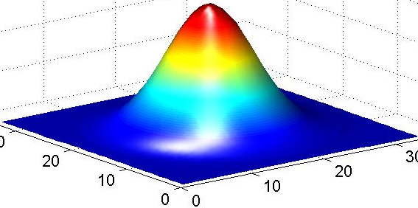
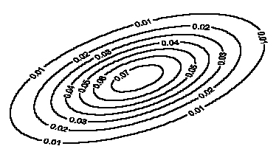
Model: mixture of Gaussians
Covariance determines
the shape of these contours
Fit these Gaussian densities to the data, one per cluster

Slide 27
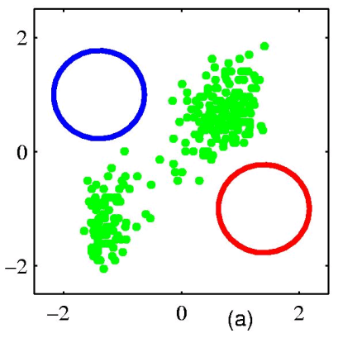
EM example
Figure from Chris Bishop

Slide 28
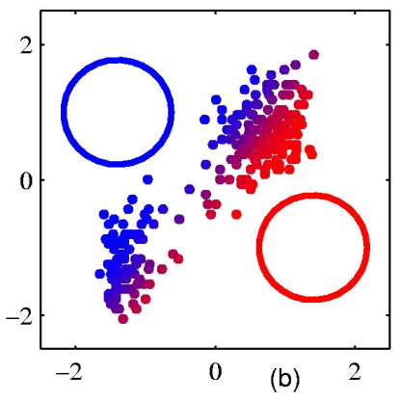
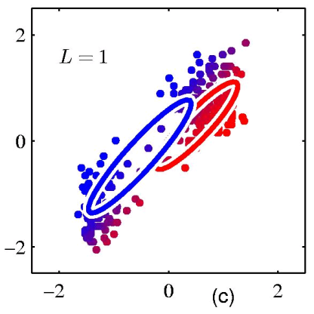
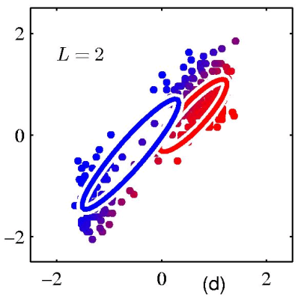
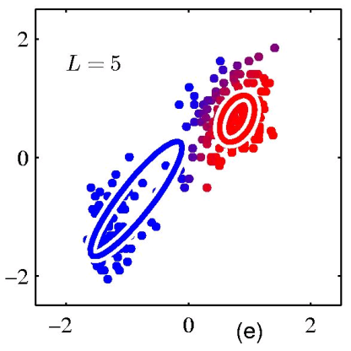
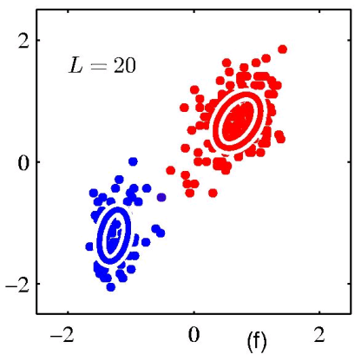
EM example
Figure from Chris Bishop

Slide 29
EM
EM is a general purpose approach for training a model when you don’t have labels
Not just for clustering!
  K-means is just for clustering
One of the most general purpose unsupervised approaches
  can be hard to get right!

Slide 30
Finding Word Alignments
… la maison … la maison bleue … la fleur …
… the house … the blue house … the flower …
In machine translation, we train from pairs of translated sentences
Often useful to know how the words align in the sentences
Use EM!
  learn a model of P(french-word | english-word)

Slide 31
Finding Word Alignments
… la maison … la maison bleue … la fleur …
… the house … the blue house … the flower …
All word alignments are equally likely
All P(french-word | english-word) equally likely

Slide 32
Finding Word Alignments
… la maison … la maison bleue … la fleur …
… the house … the blue house … the flower …
“la” and “the” observed to co-occur frequently,
so P(la | the) is increased.

Slide 33
Finding Word Alignments
… la maison … la maison bleue … la fleur …
… the house … the blue house … the flower …
“house” co-occurs with both “la” and “maison”, but
P(maison | house) can be raised without limit, to 1.0,
while P(la | house) is limited because of “the”
(pigeonhole principle)

Slide 34
Finding Word Alignments
… la maison … la maison bleue … la fleur …
… the house … the blue house … the flower …
settling down after another iteration

Slide 35
Finding Word Alignments
… la maison … la maison bleue … la fleur …
… the house … the blue house … the flower …
Inherent hidden structure revealed by EM training!
For details, see
- “A Statistical MT Tutorial Workbook” (Knight, 1999).
- 37 easy sections, final section promises a free beer.
- “The Mathematics of Statistical Machine Translation”
(Brown et al, 1993)
- Software: GIZA++

Slide 36
Statistical Machine Translation
… la maison … la maison bleue … la fleur …
… the house … the blue house … the flower …
P(maison | house ) = 0.411
P(maison | building) = 0.027
P(maison | manson) = 0.020
…
Estimating the model from training data

Slide 37
Other clustering algorithms
K-means and EM-clustering are by far the most popular for clustering
However, they can’t handle all clustering tasks
What types of clustering problems can’t they handle?

Slide 38
Non-gaussian data
What is the problem?
Similar to classification:
global decision vs. local decision
Spectral clustering

Slide 39
Similarity Graph
Represent dataset as a weighted graph G(V,E)
Data points:
V={x_{i}} Set of n vertices representing points
E={w_{ij}} Set of weighted edges indicating pair-wise similarity between points
0.1
0.8
1
5
0.8
0.8
0.6
6
2
4
0.7
0.8
0.2
3
What does clustering represent?

Slide 40
Graph Partitioning
Clustering can be viewed as partitioning a similarity graph
Bi-partitioning task:
  Divide vertices into two disjoint groups (A,B)
A
B
1
5
2
4
6
3
What would define a good partition?

Slide 41
Clustering Objectives
Traditional definition of a “good” clustering:
  within cluster should be highly similar.
  between different clusters should be highly dissimilar.
Apply these objectives to our graph representation
0.1
0.8
1
5
0.8
0.8
0.6
6
2
4
0.7
0.8
0.2
3
1. Maximise weight of within-group connections
2. Minimise weight of between-group connections

Slide 42
Graph Cuts
Express partitioning objectives as a function of the “edge cut” of the partition.
Cut: Set of edges with only one vertex in a group.
A
B
0.1
0.8
1
0.8
5
0.8
cut(A,B) = 0.3
0.6
6
2
4
0.8
0.2
0.7
3
Can we use the minimum cut?

Slide 43
Graph Cut Criteria
Optimal cut
Minimum cut
Problem:
  Only considers external cluster connections
  Does not consider internal cluster density

Slide 44
Graph Cut Criteria
Criterion: Normalised-cut (Shi & Malik,’97)
  Consider the connectivity between groups relative to the density of each group:
  Normalize the association between groups by volume
    Vol(A): The total weight of the edges within group A
A
B
0.1
0.8
1
0.8
5
0.8
0.6
6
2
4
0.8
0.2
0.7
3

Slide 45
Normalized cut
A
B
0.1
0.8
1
0.8
5
0.8
0.6
6
2
4
0.8
0.2
0.7
3
    Vol(A): The total weight of the edges originating from group A
minimize between group connections
maximize within group connections

Slide 46
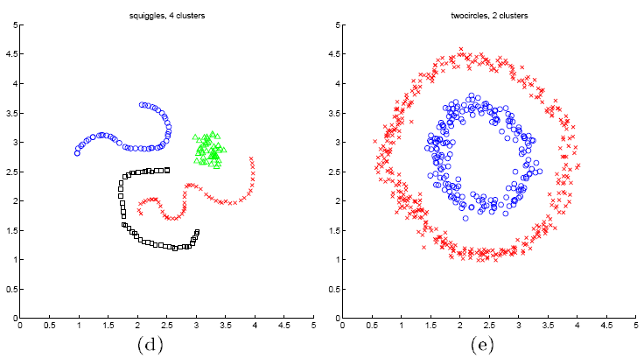
Spectral clustering examples
Ng et al On Spectral clustering: analysis and algorithm

Slide 47
Spectral clustering examples
Ng et al On Spectral clustering: analysis and algorithm

Slide 48
Spectral clustering examples
Ng et al On Spectral clustering: analysis and algorithm

Slide 49
Hierarchical Clustering
Recursive partitioning/merging of a data set
1−clustering
5
2−clustering
1
3−clustering
4
2
4−clustering
3
5−clustering
1 2 3 4 5

Slide 50
Dendogram
  Represents all partitionings of the data
  Frequently binary dendograms, but n-ary dendograms are generally easy to obtain with minor changes to the algorithms

Slide 51
Dendogram
Can obtain any k-clustering
from the dendogram
Where is the 4-clustering?

Slide 52
Advantages of hierarchical clustering
Don’t need to specify the number of clusters
Good for data visualization
  See how the data points interact at many levels
  Can view the data at multiple levels of granularity
  Understand how all points interact
Specifies all of the K clusterings/partitions

Slide 53
Hierarchical clustering
Ideas? How are we going to do this?

Slide 54
Hierarchical Clustering
Common in many domains
  Biologists and social scientists
  Gene expression data
  Document/web page organization
    DMOZ
    Yahoo directories
Two main approaches…
animal
vertebrate
invertebrate
fish reptile amphib. mammal worm insect crustacean

Slide 55
Divisive hierarchical clustering
Finding the best partitioning of the data is generally exponential in time
Common approach:
  Let C be a set of clusters
  Initialize C to be the one-clustering of the data
  While there exists a cluster c in C
    remove c from C
    partition c into 2 clusters using a flat clustering algorithm, c₁ and c₂
    Add to c₁ and c₂ C
Bisecting k-means

Slide 56
Divisive clustering

Slide 57
Divisive clustering
start with one cluster

Slide 58
Divisive clustering
split using flat clustering

Slide 59
Divisive clustering

Slide 60
Divisive clustering
split using flat clustering

Slide 61
Divisive clustering
split using flat clustering

Slide 62
Divisive clustering
Note, there is a “temporal” component not seen here

Slide 63
Hierarchical Agglomerative Clustering (HAC)
Let C be a set of clusters
Initialize C to be all points/docs as separate clusters
While C contains more than one cluster
  find c₁ and c₂ in C that are closest together
  remove c₁ and c₂ from C
  merge c₁ and c₂ and add resulting cluster to C
The history of merging forms a binary tree or hierarchy
How do we measure the distance between clusters?

Slide 64
Distance between clusters
Single-link
  Similarity of the most similar (single-link)

Slide 65
Distance between clusters
Complete-link
  Similarity of the “furthest” points, the least similar
Why are these “local” methods used?
efficiency

Slide 66
Distance between clusters
Centroid
  Clusters whose centroids (centers of gravity) are the most similar

Slide 67
Distance between clusters
Centroid
  Clusters whose centroids (centers of gravity) are the most similar
Ward’s method
What does this do?

Slide 68
Distance between clusters
Centroid
  Clusters whose centroids (centers of gravity) are the most similar
Ward’s method
Encourages similar sized clusters

Slide 69
Distance between clusters
Average-link
  Average similarity between all pairs of elements

Slide 70
Single Link Example

Slide 71
Complete Link Example

Slide 72
Computational Complexity
For
  m dimensions
  n documents/points
How many iterations?
  n-1 iterations
First iteration
  Need to compute similarity of all pairs of n points/documents: O(n²m)
Remaining n−2 iterations
  compute the distance between the most recently created cluster and all other existing clusters: O(nm)
  Does depend on the cluster similarity approach
Overall run-time: O(n²m) – generally slower than flat clustering!

Slide 73
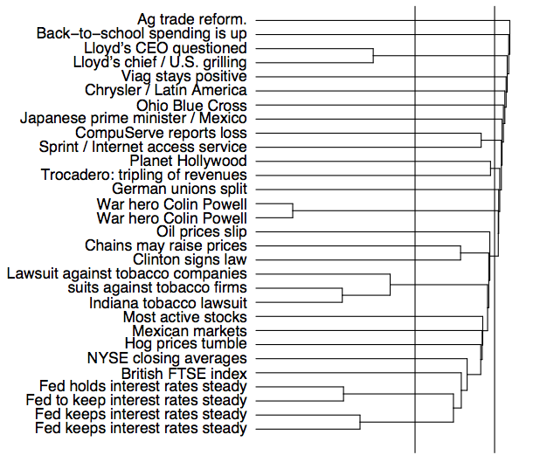
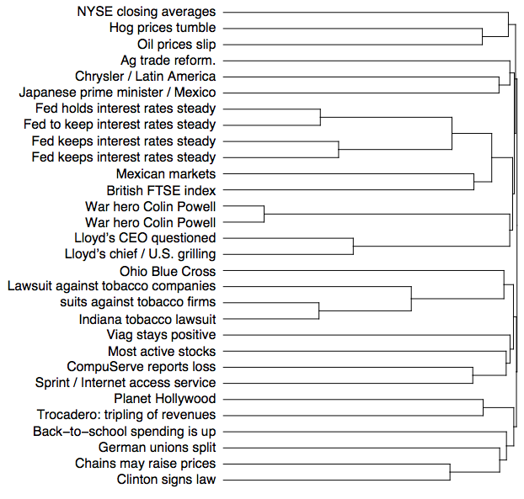
complete linkage
single linkage

Slide 74
Problems with hierarchical clustering

