Slide 1
Machine learning: Unsupervised learning
David Kauchak
cs311
Spring 2013
adapted from: http://www.stanford.edu/class/cs276/handouts/lecture17-clustering.ppt

Slide 2
Administrative
Assignment 5 out soon

Slide 3
Machine learning code
Weka
Java based
Tons of approaches
Good for playing with different approaches, but faster/better of individual approaches can be found
http://www.cs.waikato.ac.nz/ml/weka/
SVMs
SVMLight (C-based… fast)
http://www.cs.cornell.edu/People/tj/svm_light/
LIBSVM (Java)
http://www.csie.ntu.edu.tw/~cjlin/libsvm/
Others
many others out there… search for them
e.g. PyML (in Python, but I’ve never used it)

Slide 4
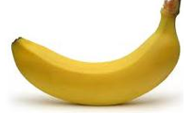
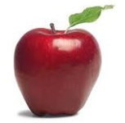
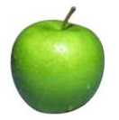
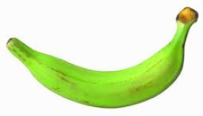
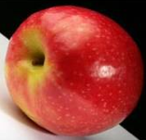
Supervised learning (e.g. classification)
APPLES
BANANAS
Supervised learning: given labeled data

Slide 5
Supervised learning
Training or learning phase
Label
Raw data
Label
features
f₁, f₂, f₃, …, f_{n}
f₁, f₂, f₃, …, f_{n}
f₁, f₂, f₃, …, f_{n}
classifier
f₁, f₂, f₃, …, f_{n}
train a
predictive
model
extract
features
f₁, f₂, f₃, …, f_{n}
User “supervision”, we’re given the labels (classes)

Slide 6
Unsupervised learning
Unsupervised learning: put these into groups

Slide 7
Unsupervised learning
Given some example without labels, do something!

Slide 8
Unsupervised learning: clustering
Raw data
features
f₁, f₂, f₃, …, f_{n}
f₁, f₂, f₃, …, f_{n}
Clusters
f₁, f₂, f₃, …, f_{n}
f₁, f₂, f₃, …, f_{n}
group into classes/clusters
extract
features
f₁, f₂, f₃, …, f_{n}
No “supervision”, we’re only given data and want to find natural groupings

Slide 9
Unsupervised learning: modeling
Most frequently, when people think of unsupervised learning they think clustering
Another category: learning probabilities/parameters for models without supervision
Learn a translation dictionary
Learn a grammar for a language
Learn the social graph

Slide 10
Clustering
Clustering: the process of grouping a set of objects into classes of similar objects
Applications?

Slide 11
Gene expression data
Data from Garber et al.
PNAS (98), 2001.

Slide 12
Face Clustering
Face Clustering

Slide 13
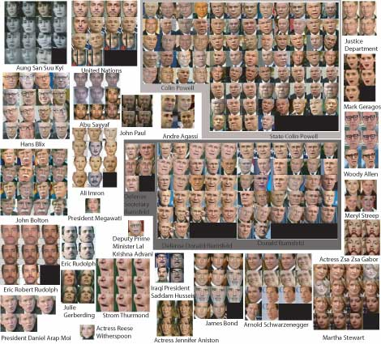
Face clustering

Slide 14
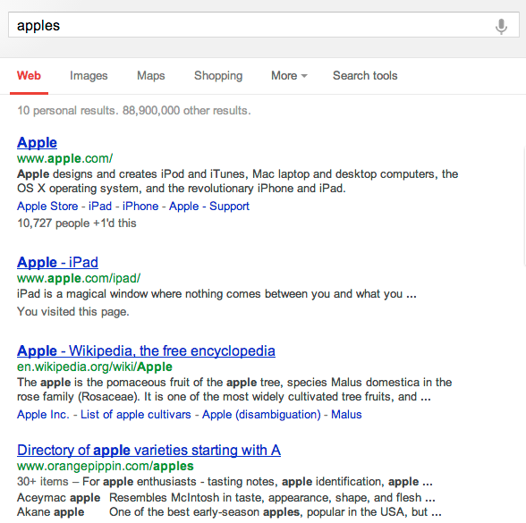
Search result clustering

Slide 15
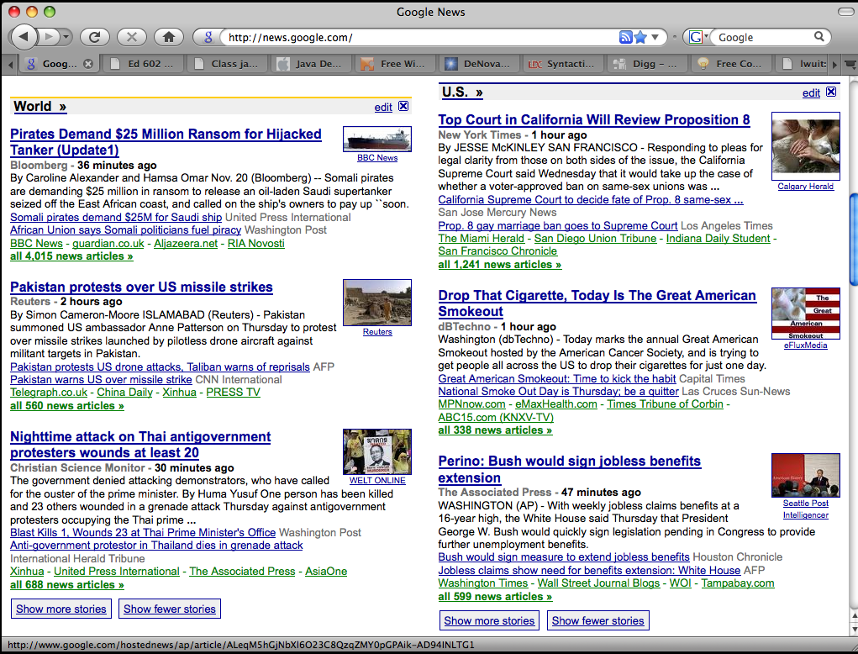
Google News

Slide 16
Clustering in search advertising
Find clusters of advertisers and keywords
Keyword suggestion
Performance estimation
bids
Advertiser
Bidded Keyword
~10M nodes

Slide 17
Clustering applications
Find clusters of users
Targeted advertising
Exploratory analysis
Clusters of the Web Graph
Distributed pagerank computation
Who-messages-who IM/text/twitter graph
~100M nodes

Slide 18
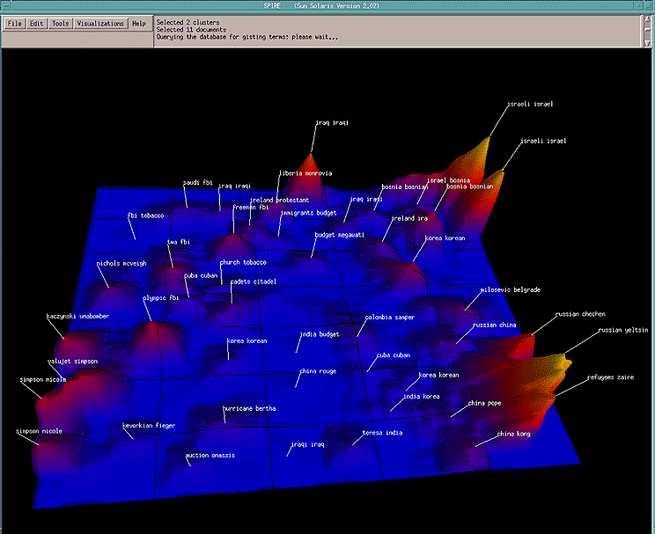
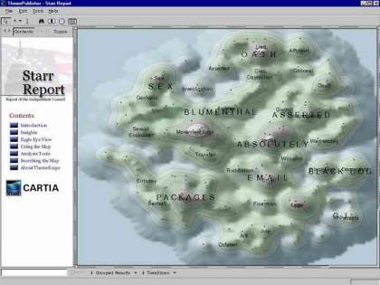
Data visualization
Wise et al, “Visualizing the non-visual” PNNL
ThemeScapes, Cartia
[Mountain height = cluster size]

Slide 19
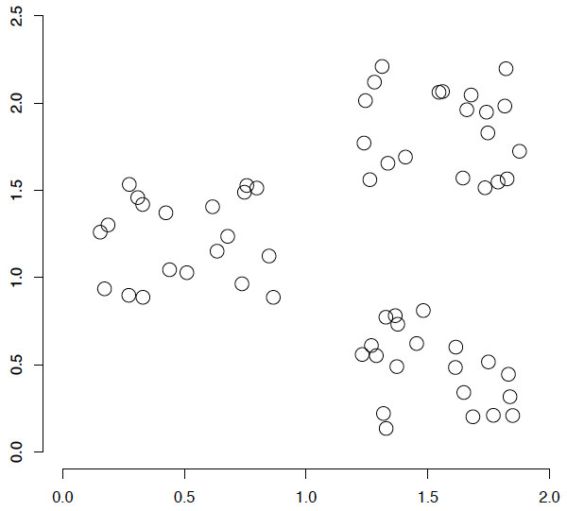
A data set with clear cluster structure
What are some of the issues for clustering?
What clustering algorithms have you seen/used?

Slide 20
Issues for clustering
Representation for clustering
How do we represent an example
features, etc.
Similarity/distance between examples
Flat clustering or hierarchical
Number of clusters
Fixed a priori
Data driven?

Slide 21
Clustering Algorithms
Flat algorithms
Usually start with a random (partial) partitioning
Refine it iteratively
K means clustering
Model based clustering
Spectral clustering
Hierarchical algorithms
Bottom-up, agglomerative
Top-down, divisive

Slide 22
Hard vs. soft clustering
Hard clustering: Each example belongs to exactly one cluster
Soft clustering: An example can belong to more than one cluster (probabilistic)
Makes more sense for applications like creating browsable hierarchies
You may want to put a pair of sneakers in two clusters: (i) sports apparel and (ii) shoes

Slide 23
K-means
Most well-known and popular clustering algorithm:
Start with some initial cluster centers
Iterate:
Assign/cluster each example to closest center
Recalculate centers as the mean of the points in a cluster

Slide 24
K-means: an example

Slide 25
K-means: Initialize centers randomly

Slide 26
K-means: assign points to nearest center

Slide 27
K-means: readjust centers

Slide 28
K-means: assign points to nearest center

Slide 29
K-means: readjust centers

Slide 30
K-means: assign points to nearest center

Slide 31
K-means: readjust centers

Slide 32
K-means: assign points to nearest center
No changes: Done

Slide 33
K-means
Iterate:
Assign/cluster each example to closest center
Recalculate centers as the mean of the points in a cluster
How do we do this?

Slide 34
K-means
Iterate:
Assign/cluster each example to closest center
Recalculate centers as the mean of the points in a cluster
iterate over each point:
- get distance to each cluster center
- assign to closest center (hard cluster)

Slide 35
K-means
Iterate:
Assign/cluster each example to closest center
Recalculate centers as the mean of the points in a cluster
iterate over each point:
- get distance to each cluster center
- assign to closest center (hard cluster)
what distance measure should we use?

Slide 36
Distance measures
Euclidean:
good for spatial data

Slide 37
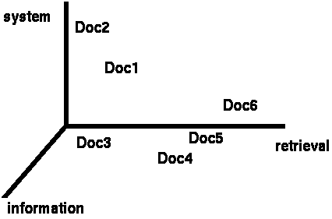
Clustering documents
One feature for each word. Value is the number of times that word occurs.
Documents are points or vectors in this space

Slide 38
When Euclidean distance doesn’t work
Which document is closest to q using Euclidian distance?
Which do you think should be closer?

Slide 39
Issues with Euclidian distance
the Euclidean distance between q and d₂ is large
but, the distribution of terms in the query q and the distribution of terms in the document d₂ are very similar
This is not what we want!

Slide 40
Cosine similarity
correlated with the angle between two vectors

Slide 41
cosine distance
cosine similarity is a similarity between 0 and 1, with things that are similar 1 and not 0
We want a distance measure, cosine distance:
good for text data and many other “real world” data sets

Slide 42
K-means
Iterate:
Assign/cluster each example to closest center
Recalculate centers as the mean of the points in a cluster
where are the cluster centers?

Slide 43
K-means
Iterate:
Assign/cluster each example to closest center
Recalculate centers as the mean of the points in a cluster
how do we calculate these?

Slide 44
K-means
Iterate:
Assign/cluster each example to closest center
Recalculate centers as the mean of the points in a cluster
Mean of the points in the cluster:
where:

Slide 45
K-means variations/parameters
Start with some initial cluster centers
Iterate:
Assign/cluster each example to closest center
Recalculate centers as the mean of the points in a cluster
What are some other variations/parameters we haven’t specified?

Slide 46
K-means variations/parameters
Initial (seed) cluster centers
Convergence
A fixed number of iterations
partitions unchanged
Cluster centers don’t change
K!

Slide 47
K-means: Initialize centers randomly
What would happen here?
Seed selection ideas?

Slide 48
Seed Choice
Results can vary drastically based on random seed selection
Some seeds can result in poor convergence rate, or convergence to sub-optimal clusterings
Common heuristics
Random centers in the space
Randomly pick examples
Points least similar to any existing center
Try out multiple starting points
Initialize with the results of another clustering method

Slide 49
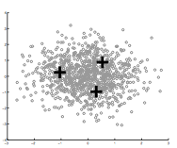
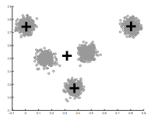
How Many Clusters?
Number of clusters K must be provided
Somewhat application dependent
How should we determine the number of clusters?
too many
too few

Slide 50
One approach
Assume data is Gaussian (i.e. spherical)
Test for this
Testing in high dimensions doesn’t work well
Testing in lower dimensions does work well
ideas?

Slide 51
Project to one dimension and check
For each cluster, project down to one dimension
Use a statistical test to see if the data is Gaussian

Slide 52
Project to one dimension and check
For each cluster, project down to one dimension
Use a statistical test to see if the data is Gaussian
What will this look like projected to 1-D?

Slide 53
Project to one dimension and check
For each cluster, project down to one dimension
Use a statistical test to see if the data is Gaussian

Slide 54
Project to one dimension and check
For each cluster, project down to one dimension
Use a statistical test to see if the data is Gaussian
What will this look like projected to 1-D?

Slide 55
Project to one dimension and check
For each cluster, project down to one dimension
Use a statistical test to see if the data is Gaussian

Slide 56
Project to one dimension and check
For each cluster, project down to one dimension
Use a statistical test to see if the data is Gaussian
The dimension of the projection is based on the data

Slide 57
On synthetic data
Split too far

Slide 58
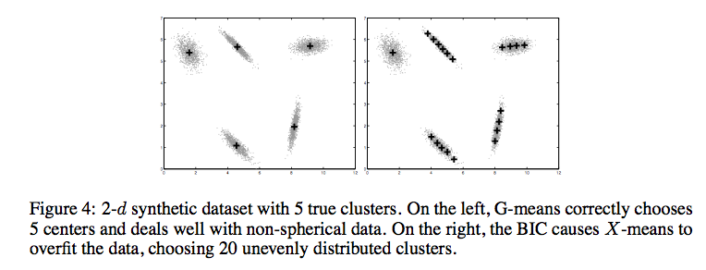
Compared to other approaches
http://cs.baylor.edu/~hamerly/papers/nips_03.pdf

Slide 59
K-Means time complexity
Variables: K clusters, n data points, m features/dimensions, I iterations
What is the runtime complexity?
Computing distance between two points
Reassigning clusters
Computing new centers
Iterate…

Slide 60
K-Means time complexity
Variables: K clusters, n data points, m features/dimensions, I iterations
What is the runtime complexity?
Computing distance between two points is O(m) where m is the dimensionality of the vectors.
Reassigning clusters: O(Kn) distance computations, or O(Knm)
Computing centroids: Each points gets added once to some centroid: O(nm)
Assume these two steps are each done once for I iterations: O(Iknm)
In practice, K-means converges quickly and is fairly fast

Slide 61
What Is A Good Clustering?
Internal criterion: A good clustering will produce high quality clusters in which:
the intra-class (that is, intra-cluster) similarity is high
the inter-class similarity is low
How would you evaluate clustering?

Slide 62
Common approach: use labeled data
Use data with known classes
For example, document classification data
data
Label
If we clustered this data (ignoring labels) what would we like to see?
Reproduces class partitions
How can we quantify this?

Slide 63
Common approach: use labeled data
Purity, the proportion of the dominant class in the cluster
• •
• •
• •
• •
• •
• •
• •
• •
•
Cluster I
Cluster II
Cluster III
Cluster I: Purity = 1/6 (max(5, 1, 0)) = 5/6
Cluster II: Purity = 1/6 (max(1, 4, 1)) = 4/6
Cluster III: Purity = 1/5 (max(2, 0, 3)) = 3/5

Slide 64
Other purity issues…
Purity, the proportion of the dominant class in the cluster
Good for comparing two algorithms, but not understanding how well a single algorithm is doing, why?
Increasing the number of clusters increases purity

Slide 65
Purity isn’t perfect
Which is better based on purity?
Which do you think is better?
Ideas?

Slide 66
Common approach: use labeled data
Average entropy of classes in clusters
where p(class_{i}) is proportion of class i in cluster

Slide 67
Common approach: use labeled data
Average entropy of classes in clusters
entropy?

Slide 68
Common approach: use labeled data
Average entropy of classes in clusters

