Slide 1
Linear Classifiers/SVMs
David Kauchak, CS311, Spring 2013

Slide 2
Admin
Midterm exam posted
Assignment 4 due Friday by 6pm
No office hours tomorrow

Slide 3
Math
Machine learning often involves a lot of math
  some aspects of AI also involve some familiarity
Don’t let this be daunting
  Many of you have taken more math than me
  Gets better over time
  Often, just have to not be intimidated

Slide 4
Learning
sensors
?
environment
agent
actuators
As an agent interacts with the world, it should learn about it’s environment

Slide 5
Quick review
Three classifiers
  Naïve Bayes
  k-nearest neighbor
  decision tree
  good and bad?
Bias vs. variance
  a measure of the model
  where do NB, k-nn and decision trees fit on the bias/variance spectrum?

Slide 6
Separation by Hyperplanes
A strong high-bias assumption is linear separability:
  in 2 dimensions, can separate classes by a line
  in higher dimensions, need hyperplanes

Slide 7
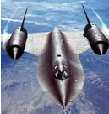
Hyperplanes
A hyperplane is line/plane in a high dimensional space
What defines a hyperplane? What defines a line?

Slide 8
Hyperplanes
A hyperplane in an n-dimensional space is defined by n+1 values
e.g. a line
f(x) = ax+b
or a plane
f(x,y) = ax+by + c

Slide 9
NB as a linear classifier
To classify:
Another way to view this (for 2 classes):
Given d how would we classify?

Slide 10
NB as a linear classifier
To classify:
We can take the log:

Slide 11
NB as a linear classifier

Slide 12
NB as a linear classifier
binary
features
weight for that dimension
w_{n+1}

Slide 13
Lots of linear classifiers
Many common text classifiers are linear classifiers
  Naïve Bayes
  Perceptron
  Rocchio
  Logistic regression
  Support vector machines (with linear kernel)
  Linear regression
Despite this similarity, noticeable performance difference
How might algorithms differ?

Slide 14
Which Hyperplane?
lots of possible solutions

Slide 15
Which Hyperplane?
lots of possible solutions

Slide 16
Which examples are important?

Slide 17
Which examples are important?

Slide 18
Which examples are important?

Slide 19
Dealing with noise
linearly separable?

Slide 20
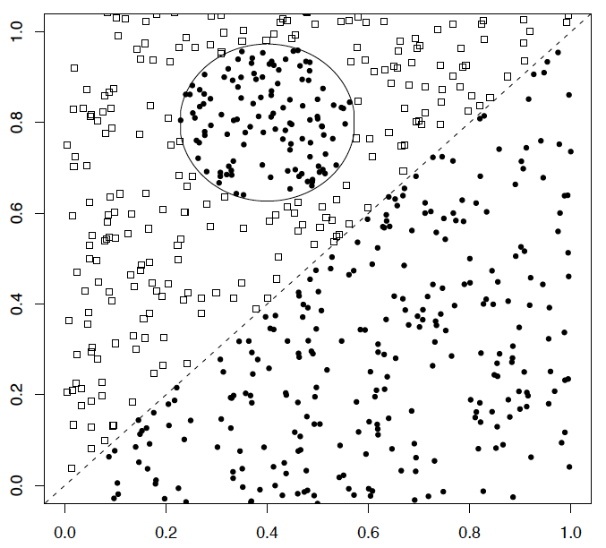
A nonlinear problem
A linear classifier like Naïve Bayes does badly on this task
k-NN will do very well (assuming enough training data)

Slide 21
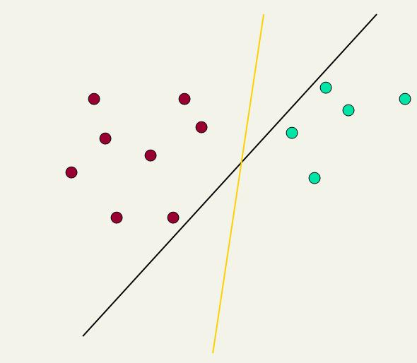
Linear classifiers: Which Hyperplane?
Lots of possible solutions for a,b,c
Support Vector Machine (SVM) finds an optimal solution
  Maximizes the distance between the hyperplane and the “difficult points” close to decision boundary
This line represents the decision boundary:
ax + by - c = 0

Slide 22
Another intuition
Think of it as trying to place a wide separator between the points.
Will constrain the possible options

Slide 23
Support Vector Machine (SVM)
SVMs maximize the margin around the separating hyperplane
    aka large margin classifiers
specified by a subset of training samples, the support vectors
Posed as a quadratic programming problem
Seen by many as the most successful current text classification method*
Support vectors
Maximize
margin
*but other discriminative methods often perform very similarly

Slide 24
Margin maximization

Slide 25
Margin maximization

Slide 26
Measuring the margin
The support vectors define the hyperplane
and the margin

Slide 27
Measuring the margin
How do we classify points given the hyperplane?

Slide 28
Measuring the margin
f(x_{i}) = sign(w^{T}x_{i} + b)
w^{T}
b

Slide 29
Measuring the margin
How can we calculate margin?
ρ
w^{T}
b

Slide 30
Measuring the margin
Minimum of the distance from the hyperplane
to any point(s) (specifically the support vectors)
ρ
w^{T}
b

Slide 31
Basic SVM setp
Find the largest margin hyperplane where:
all the positive examples are on one side
all the negative examples are on the other side
ρ
w^{T}
b

Slide 32
Measuring the margin
x’ – x is perpendicular to hyperplane
Want to calculate r
w/|w| is the unit vector in direction of w
x
ρ
x’ = x – rw/|w|
x’ satisfies w^{T}x’+b = 0 because it’s on w^{T}
r
x′
So w^{T}(x –rw/|w|) + b = 0
w^{T}x –w^{T}rw/|w| + b = 0
|w| = sqrt(w^{T}w)
w^{T}x –w^{T}rw|w|/|w||w| + b = 0
w^{T}x –w^{T}rw|w|/w^{T}w + b = 0
w^{T}x –r|w| + b = 0
w^{T}
b

Slide 33
Linear SVM Mathematically
The linearly separable case
Assume that all data is at least distance 1 from the hyperplane, then the following two constraints follow for a training set {(x_{i} ,y_{i})}
positive examples on one side
w^{T}x_{i} + b ≥ 1 if y_{i} = 1
w^{T}x_{i} + b ≤ -1 if y_{i} = -1
negative examples on the other side

Slide 34
Measuring the margin
w^{T}x_{i} + b ≥ 1 if y_{i} = 1
w^{T}x_{i} + b ≤ -1 if y_{i} = -1
The support vectors are those that define the hyperplane. They’re the “boderline” cases where this weight is exactly 1.
Then, since each example’s distance from the hyperplane is
The margin is:
x
ρ
r
x′
w^{T}
b

Slide 35
Linear SVMs Mathematically (cont.)
Then we can formulate the quadratic optimization problem:
Find w and b such that
is maximized;
for all {(x_{i} , y_{i})}
w^{T}x_{i} + b ≥ 1 if y_{i}=1; w^{T}x_{i} + b ≤ -1 if y_{i} = -1
maximize margin
make sure points are on correct size
Notes:
norm(w) involves a square root, which is hard do deal with when optimizing. wTw is the square of the vector and removes this square root

Slide 36
Linear SVMs Mathematically (cont.)
A better formulation (min ||w|| = max 1/ ||w|| ):
Find w and b such that
Φ(w) = w^{T}w is minimized;
and for all {(x_{i} ,y_{i})}: y_{i} (w^{T}x_{i} + b) ≥ 1
Notes:
norm(w) involves a square root, which is hard do deal with when optimizing. wTw is the square of the vector and removes this square root

Slide 37
Solving the Optimization Problem
This is a quadratic function subject to linear constraints
Quadratic optimization problems are well-known
Many ways exist for solving these
Find w and b such that
Φ(w) = w^{T}w is minimized;
and for all {(x_{i} ,y_{i})}: y_{i} (w^{T}x_{i} + b) ≥ 1

Slide 38
An LP example
400
300
200
100
100
200
300
400

Slide 39
An LP example
400
300
200
100
100
200
300
400
Where is the feasibility region?

Slide 40
An LP example
400
300
200
100
100
200
300
400

Slide 41
An LP example
400
300
c = 2100
200
c = 1800
c = 1500
100
c = 1200
c = 900
c = 600
100
200
300
400

Slide 42
An LP example
400
300
c = 2100
200
c = 1800
c = 1500
100
c = 1200
c = 900
c = 600
100
200
300
400
to maximize, move as far in this direction as the constraints allow

Slide 43
Soft Margin Classification
What about this problem?

Slide 44
Soft Margin Classification
Like to learn something like this, but our constraints won’t allow it ☹

Slide 45
Soft Margin Classification
Slack variables: allow it to make some mistakes, but penalize it

Slide 46
Soft Margin Classification Mathematically
Old:
Find w and b such that
Φ(w) =½ w^{T}w is minimized and for all {(x_{i} ,y_{i})}
y_{i} (w^{T}x_{i} + b) ≥ 1
With slack variables:
Find w and b such that
Φ(w) =½ w^{T}w + CΣξ_{i} is minimized and for all {(x_{i} ,y_{i})}
y_{i} (w^{T}x_{i} + b) ≥ 1- ξ_{i} and ξ_{i} ≥ 0 for all i
- allows us to make a mistake, but penalizes it
- C trades off noisiness vs. error

Slide 47
Linear SVMs: Summary
Classifier is a separating hyperplane
  large margin classifier: learn a hyperplane that maximally separates the examples
Most “important” training points are support vectors; they define the hyperplane
Quadratic optimization algorithm

Slide 48
Non-linear SVMs
Datasets that are linearly separable (with some noise) work out great:
But what are we going to do if the dataset is just too hard?
0
x
0
x

Slide 49
Non-linear SVMs
How about … mapping data to a higher-dimensional space:
0
x
x²
0
x

Slide 50
Non-linear SVMs
How about … mapping data to a higher-dimensional space:
0
x
x²
0
x

Slide 51
Non-linear SVMs: Feature spaces
General idea: map original feature space to higher-dimensional feature space where the training set is separable:
Φ: x → φ(x)

Slide 52
The “Kernel Trick”
The linear classifier relies on an inner product between vectors K(x_{i},x_{j})=x_{i}^{T}x_{j}
If every datapoint is mapped into high-dimensional space via some transformation Φ: x → φ(x), the inner product becomes:
K(x_{i},x_{j})= φ(x_{i}) ^{T}φ(x_{j})
A kernel function is some function that corresponds to an inner product in some expanded feature space.

Slide 53

Kernels
Why use kernels?
  Make non-separable problem separable.
  Map data into better representational space
Common kernels
  Linear
  Polynomial K(x,z) = (1+x^{T}z)^{d}
    Gives feature conjunctions
  Radial basis function (infinite dimensional space)

Slide 54
Demo
http://svm.dcs.rhbnc.ac.uk/pagesnew/GPat.shtml

Slide 55
SVM implementations
SVMLight (C)
SVMLib (Java)

Slide 56
Switching gears: weighted examples
Are all examples equally important?

Slide 57

Weak classifiers
Sometimes, it can be intractable (or very
expensive) to train a full classifier
However, we can get some information using simple classifiers
A weak classifier is any classifier that gets more than half of the examples right
  not that hard to do
  a weak classifier does better than random
Ideas?

Slide 58

Decision stumps
A decision stump is a common weak classifier
Decision stump: 1 level decision tree:
feature_{i}
class 1
class 2

Slide 59
Ensemble methods
If one classifier is good, why not 10 classifiers, or 100?
Ensemble methods combine different classifiers in a reasonable way to get at a better solution
  similar to how we combined heuristic functions
Boosting is one approach that combines multiple weak classifiers

Slide 60
Boosting
Start with equal weighted examples
Learn a weak classifier
Weights:
Examples:
E1
E2
E3
E4
E5

Slide 61
Boosting
Weak₁
It will do well on some of our training examples and not so well on others
Weights:
Examples:
E1
E2
E3
E4
E5

Slide 62
Boosting
Weak₁
We’d like to reweight the examples and learn another weak classifier. Ideas?
Weights:
Examples:
E1
E2
E3
E4
E5

Slide 63
Boosting
Weak₁
Downweight ones that we’re doing well, and upweight those that we’re having problems with
Weights:
Examples:
E1
E2
E3
E4
E5

Slide 64
Boosting
Weak₁
Learn a new classifier based on the new set of weighted examples
Weights:
Examples:
E1
E2
E3
E4
E5

Slide 65
Boosting
Weak₁
Weak₂
Learn a new classifier based on the new set of weighted examples
Weights:
Examples:
E1
E2
E3
E4
E5

Slide 66
Boosting
Weak₁
Weak₂
Reweight again:
Weights:
Examples:
E1
E2
E3
E4
E5

Slide 67
Boosting
Continue this for some number of “rounds”
  at each round we learn a new weak classifier
  and then reweight the examples again
Our final classifier is a weighted combination of these weak classifiers
Adaboost is one common version of boosting
  specifies how to reweight and how to combine learned classifiers
  nice theoretical guarantees
  tends not to have problems with overfitting
http://cseweb.ucsd.edu/classes/fa01/cse291/AdaBoost.pdf

Slide 68
Classification: concluding thoughts
Lots of classifiers out there
  SVMs work very well on broad range of settings
Many challenges still:
  coming up with good features
  preprocessing
  picking the right kernel
  learning hyper parameters (e.g. C for SVMs)
Still a ways from computers “learning” in the traditional sense

