Slide 1
Machine Learning: Classification
CS311
David Kauchak
Spring 2013
Some material borrowed from:
Sara Owsley Sood and others

Slide 2
Admin
Assignment 4
  Start working on part 2 now!
  I’ll post solutions to part 1 soon
    Compare with what you submitted and make sure you understand your mistakes (if any)
    Use part 1 to test your code!
Review on Tuesday
  E-mail me any topics you want me to revisit

Slide 3
Bayesian Classification
We represent a data item based on the features:
Training
a:
b:
For each label/class, learn a probability distribution based on the features

Slide 4
Bayesian Classification
We represent a data item based on the features:
Classifying
Given an new example, classify it as the label with the largest conditional probability

Slide 5
Bayes rule for classification
conditional
(posterior)
probability
prior
probability

Slide 6
The Naive Bayes Classifier
Flu
x₁
x₂
x₃
x₄
x₅
runnynose
sinus
cough
fever
muscle-ache
Conditional Independence Assumption: features are independent of eachother given the class:

Slide 7
Naïve Bayes classifier

Slide 8
Bayesian Classification
Classifying
Given an new example, classify it as the label with the largest conditional probability
Two Classes
Compare and pick the largest!

Slide 9
Bayesian Classification
Classifying
Given an new example, classify it as the label with the largest conditional probability
Two Classes
What is P(F)? Does it matter for classification?

Slide 10
Bayesian Classification
Classifying
Given an new example, classify it as the label with the largest conditional probability
Two Classes
Compare these two and see which is larger

Slide 11
Estimating parameters
How do we estimate these?

Slide 12
Maximum likelihood estimates
number of items with label
total number of items
number of items with the label with feature
number of items with label
Any problems with this approach?
Hint: What was the p(I thought I hated it but loved it)?

Slide 13
Maximum likelihood estimates
number of items with the label with feature
number of items with label
What if we have seen no training cases where patient had no flu and muscle aches? Or no positive documents with the word “thought”?

Slide 14
Maximum likelihood estimates
number of items with the label with feature
number of items with label
What are the implications of this?

Slide 15
Problem with Max Likelihood
Zero probabilities cannot be conditioned away, no matter the other evidence!
If ANY p(f | l) = 0, then the whole probability is 0
Ideas?

Slide 16
Smoothing to Avoid Overfitting
Make every event a little probable…
# of features
Many ways to smooth….

Slide 17
Unseen features
Note that this is different from coming in with a feature we’ve never seen before (in any of the classes)
  For example, “bloating”
Flu
x₁
x₂
x₃
x₄
x₅
runnynose
sinus
cough
fever
muscle-ache
How?

Slide 18
Classification evaluation
Labeled data
Data
Label
0
0
How can we see how well we’re doing?
1
1
0
1
0

Slide 19
Classification evaluation
Labeled data
Data
Label
Training data
0
0
classifier
1
train a
predictive
model
1
0
1
Testing data
0

Slide 20
Classification evaluation
Data
Label
1
0
Pretend like we don’t know the labels

Slide 21
Classification evaluation
Data
Label
1
1
classifier
1
0
Pretend like we don’t know the labels
Classify

Slide 22
Classification evaluation
Data
Label
1
1
classifier
1
0
Pretend like we don’t know the labels
Classify
Compare predicted labels to actual labels

Slide 23
Classification evaluation measures?

Slide 24
Classification evaluation measures?
Accuracy
  num correct / total
Class specific measures
  Precision
    num correct with class A / num predicted class A
  Recall
    num correct with class A / num with class A
  F1-measure
    2 * (precision * recall) / (precision + recall)
Why have these class specific measures?

Slide 25
NB: The good and the bad
Good
  Easy to understand
  Fast to train
  Reasonable performance
Bad
  We can do better
  Independence assumptions are rarely true
  Smoothing is challenging
  Feature selection is usually required

Slide 26
The mind-reading game
How good are you at guessing random numbers?
Repeat 100 times:
Computer guesses whether you’ll type 0/1
You type 0 or 1
http://seed.ucsd.edu/~mindreader/
[written by Y. Freund and R. Schapire]

Slide 27
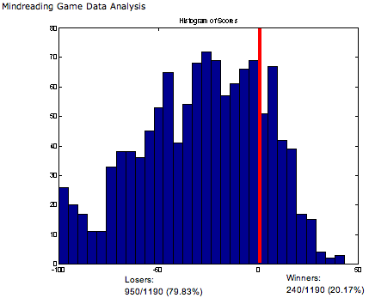
The mind-reading game
The computer is right much more than half the time…

Slide 28
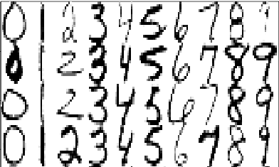
Another example
Database of 20,000 images of handwritten digits, each labeled by a human
[28 x 28 greyscale; pixel values 0-255; labels 0-9]
Use these to learn a classifier which will label digit-images automatically…
Notes:
This is perhaps the most well-studied data set in ML… handwritten digits, part of zipcodes scanned off envelopes by the post office.

Slide 29
Another example
Database of 20,000 images of handwritten digits, each labeled by a human
[28 x 28 greyscale; pixel values 0-255; labels 0-9]
Features?
Notes:
This is perhaps the most well-studied data set in ML… handwritten digits, part of zipcodes scanned off envelopes by the post office.

Slide 30



The learning problem
features = {0,1,…,255}⁷⁸⁴
labels = {0,1,…,9}
28x28 features,
values ranging from 0 to 255
predicts
0
1
2
3
4
5
6
7
8
9
5
classifier
0
train a
predictive
model
9
…

Slide 31
Points in a feature space
One way to view the data
f₂
Class 1
Class 2
Class 3
f₁

Slide 32
Test example: what class?
f₂
Class 1
Class 2
Class 3
f₁

Slide 33
Test example = Class 1
Class 1
Class 2
closest to a red
Class 3

Slide 34





Nearest neighbor
Image to label
Nearest neighbor
Overall:
error rate = 6
(on test set)
What is the error rate for random guessing?

Slide 35
What does it get wrong?
Who knows… but here’s a hypothesis:
Each digit corresponds to some connected region of R⁷⁸⁴. Some of the regions come close to each other; problems occur at these boundaries.
R₁
R₂

Slide 36
What does it get wrong?
Any ideas for improving this?
R₁
R₂

Slide 37
What does it get wrong?
a random point in this ball has only a 70% chance of being in R₂
How can we approximate this?
R₁
R₂

Slide 38
k-Nearest Neighbor (k-NN)
To classify an example d:
  Find k nearest neighbors of d
  Choose as the class the majority class within the k nearest neightbors
Can get rough approximations of probability of belonging to a class as fraction of k

Slide 39
k-Nearest Neighbor (k-NN)
To classify an example d:
  Find k nearest neighbors of d
  Choose as the class the majority class within the k nearest neightbors
Does not explicitly compute boundary or model
Also called:
  Case-based learning
  Memory-based learning
  Lazy learning

Slide 40
Example: k=6 (6-NN)
Which class?
Class 1
Class 2
Class 3

Slide 41
k Nearest Neighbor
What value of k should we use?
  Using only the closest example (1NN) to determine the class is subject to errors due to:
    A single atypical example
    Noise
  Pick k too large and you end up with looking at neighbors that are not that close
  Value of k is typically odd to avoid ties; 3 and 5 are most common.

Slide 42
k-NN decision boundaries
The decision boundaries are places in the features space where the classification of a point changes
Class 1
Class 2
Class 3
Where are the decision boundaries for k-NN?

Slide 43
k-NN decision boundaries
Class 1
Class 2
Class 3
k-NN gives locally defined decision boundaries between classes

Slide 44
k-NN: The good and the bad
Good
  No training is necessary
  No feature selection necessary
  Scales well with large number of classes
    Don’t need to train n classifiers for n classes
Bad
  Classes can influence each other
    Small changes to one class can have ripple effect
  Scores can be hard to convert to probabilities
  Can be more expensive at test time
  “Model” is all of your training examples which can be large

Slide 45
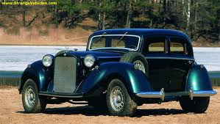
Feature space
f₁, f₂, f₃, …, f_{m}
m-dimensional space
How big will m be for us?

Slide 46
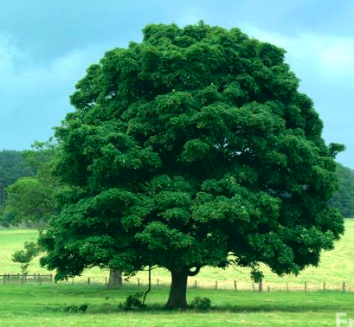
Bias/variance trade-off
Is this a tree?

Slide 47

Bias/variance trade-off
Is this a tree?

Slide 48
Bias/variance trade-off
Is this a tree?

Slide 49
Bias/variance trade-off
Is this a tree?

Slide 50
Bias/Variance
Bias: How well does the model predict the training data?
  high bias – the model doesn’t do a good job of predicting the training data (high training set error)
  The model predictions are biased by the model
Variance: How sensitive to the training data is the learned model?
  high variance – changing the training data can drastically change the learned model

Slide 51
Bias/Variance
Another way to think about it is model complexity
Simple models
  may not model data well
  high bias
Complicated models
  may overfit to the training data
  high variance
Why do we care about bias/variance?

Slide 52
Bias/variance trade-off
We want to fit a polynomial to this, which one should we use?

Slide 53
Bias/variance trade-off
Bias: How well does the model predict the training data?
  high bias – the model doesn’t do a good job of predicting the training data (high training set error)
  The model predictions are biased by the model
Variance: How sensitive to the training data is the learned model?
  high variance – changing the training data can drastically change the learned model
High variance OR high bias?

Slide 54
Bias/variance trade-off
Bias: How well does the model predict the training data?
  high bias – the model doesn’t do a good job of predicting the training data (high training set error)
  The model predictions are biased by the model
Variance: How sensitive to the training data is the learned model?
  high variance – changing the training data can drastically change the learned model
High bias

Slide 55
Bias/variance trade-off
Bias: How well does the model predict the training data?
  high bias – the model doesn’t do a good job of predicting the training data (high training set error)
  The model predictions are biased by the model
Variance: How sensitive to the training data is the learned model?
  high variance – changing the training data can drastically change the learned model
High variance OR high bias?

Slide 56
Bias/variance trade-off
Bias: How well does the model predict the training data?
  high bias – the model doesn’t do a good job of predicting the training data (high training set error)
  The model predictions are biased by the model
Variance: How sensitive to the training data is the learned model?
  high variance – changing the training data can drastically change the learned model
High variance

Slide 57
Bias/variance trade-off
Bias: How well does the model predict the training data?
  high bias – the model doesn’t do a good job of predicting the training data (high training set error)
  The model predictions are biased by the model
Variance: How sensitive to the training data is the learned model?
  high variance – changing the training data can drastically change the learned model
What do we want?

Slide 58
Bias/variance trade-off
Bias: How well does the model predict the training data?
  high bias – the model doesn’t do a good job of predicting the training data (high training set error)
  The model predictions are biased by the model
Variance: How sensitive to the training data is the learned model?
  high variance – changing the training data can drastically change the learned model
Compromise between bias and variance

