Slide 1
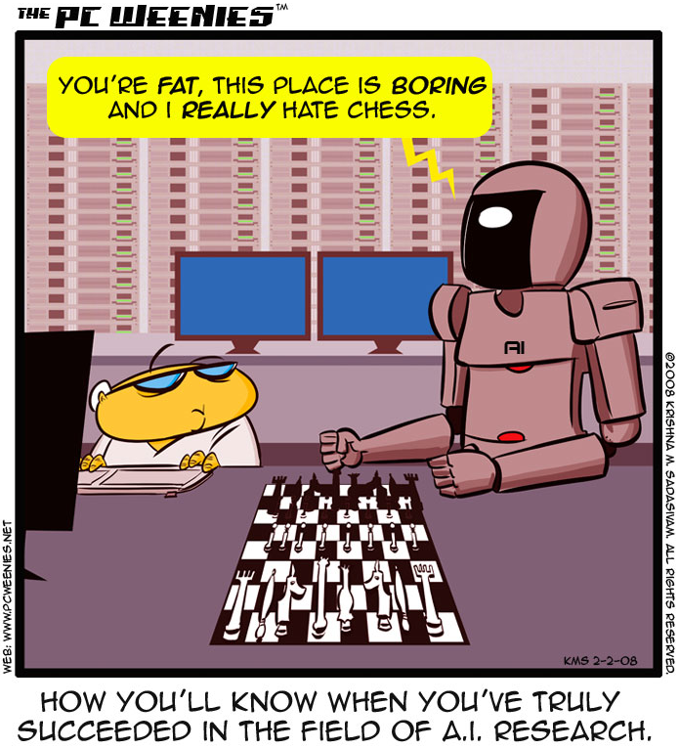
http://www.bbspot.com/comics/PC-Weenies/2008/02/3248.php

Slide 2
Intro to AI &
Intro to Python
CS311: Introduction to Artificial Intelligence
CS311
David Kauchak
Spring 2013
Adapted from notes from:
Sara Owsley Sood

Slide 3
Who are you and why are you here?
Name/nickname
Major and year
What is AI? (or what do you think AI is? ☺)
Why are you taking this course?
What topics would you like to see covered?

Slide 4
Course goals
Be able to answer the question “What is AI”?
Learn and apply basic AI techniques…
…to solve real-world (current) problems, and in the process…
…appreciate how HARD AI really is (and why)

Slide 5
AI is a huge field
So, what is AI…
One definition:
“Building programs that enable computers to do what humans can do.”
For example:
read, walk around, drive, play games, solve problems, learn, have conversations…

Slide 6
How do we measure success?
“Building programs that enable computers to do what humans can do.”
there are many interpretations of this goal…
human vs. rational
Think like a human Cognitive Modeling | Think rationally Logic-based Systems
Act like a human Turing Test | Act rationally Rational Agents
thinking
vs.
acting

Slide 7
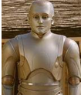


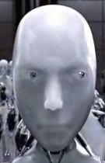

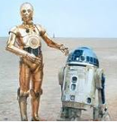

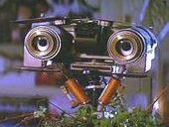


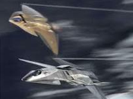
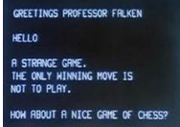
How is AI viewed in popular media?

Slide 8

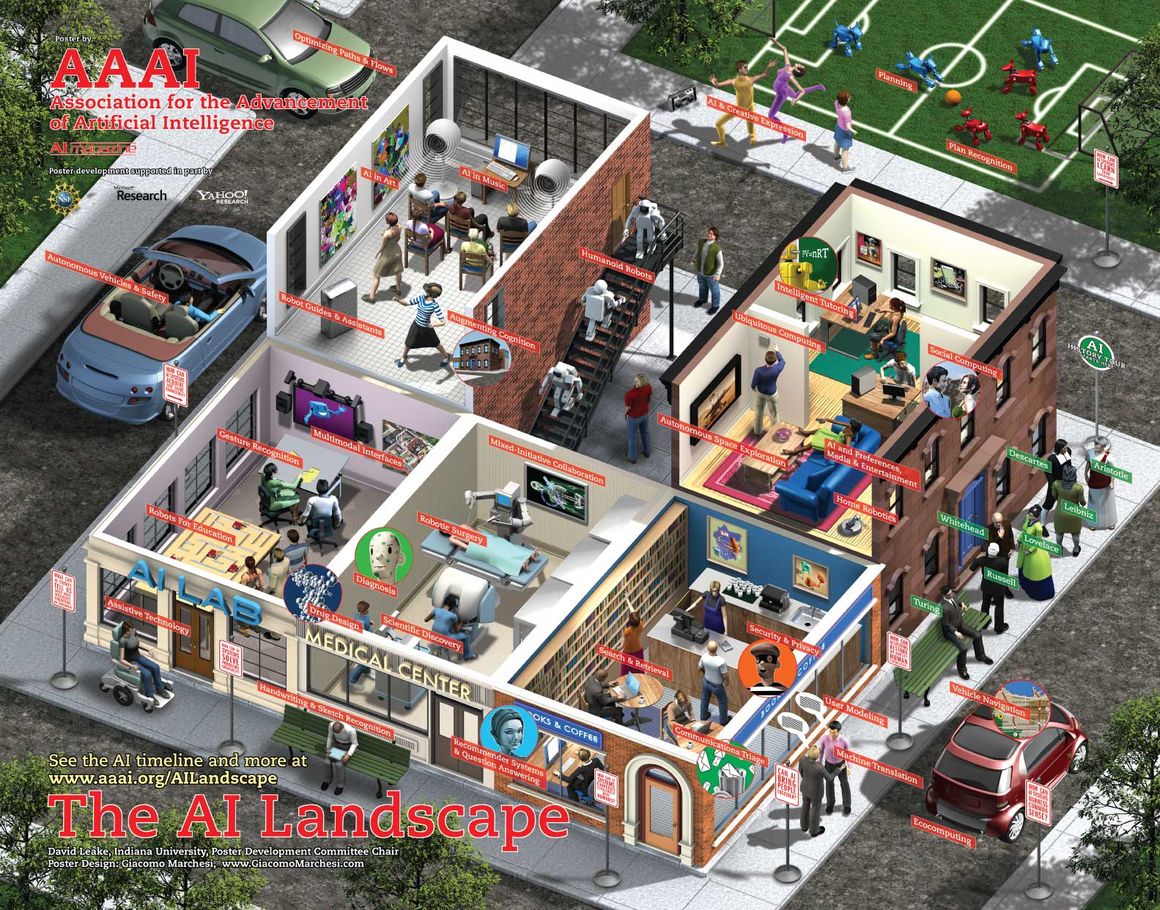
What challenges are there?

Slide 9
What challenges are there?
Perception
  perceive the environment via sensors
Computer vision (perception via images/video)
  process visual information
  object identification, face recognition, motion tracking
Natural language processing and generation
  speech recognition, language understanding
  language translation, speech generation, summarization

Slide 10
What challenges are there?
Knowledge representation
  encode known information
  water is wet, the sun is hot, Dave is a person, …
Learning
  learn from environment
  What type of feedback? (supervised vs. unsupervised vs. reinforcement vs …)
Reasoning/problem solving
  achieve goals, solve problems
  planning
  How do you make an omelet? I’m carrying an umbrella and it’s raining… will I get wet?
Robotics
  How can computers interact with the physical world?

Slide 11
What can we currently do?
Understand spoken language?
  speech recognition is really good, if:
    restricted vocabulary
    specific speaker with training
  Gotten quite good in the last few years and shows up in lots of places:
    Mac has built-in dictation software
    Siri is pretty good (though there’s more than speech recognition going on there)
    Google allows you to search via voice command
  What does the spoken language actually mean (language understanding)?
    much harder problem!
    many advances in NLP in small things, but still far away from a general solution

Slide 12


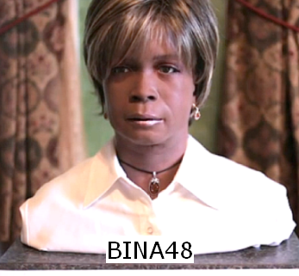
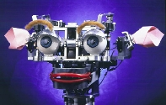
What can we currently do?
Speak?
  Understandable, but you wouldn’t confuse it for a person
  Can do accents, intonations, etc.
  Better with restricted vocabulary
  Loquendo
    http://tts.loquendo.com/ttsdemo/default.asp
  Dealing with facial expression is challenging
Kismet (MIT)

Slide 13
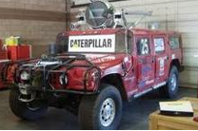
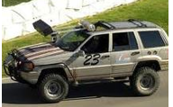
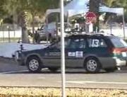
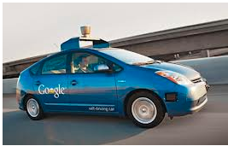
What can we currently do?
Drive a car?
  Freeway driving is relatively straightforward
  Off-road a bit harder
    see DARPA grand challenges (2004, 2005)
  And urban driving is even trickier
    See DARPA urban challenge (2007)
    Google’s autonomous vehicle
Hint: there’s a connection here

Slide 14

What can we currently do?
Identify emotion?
  This is hard!
  Some success in text
    movie reviews
    blogs
    twitter
    dealing with sarcasm is hard
  Some success with faces
    strongly biased by training data
    works best when exaggerated

Slide 15
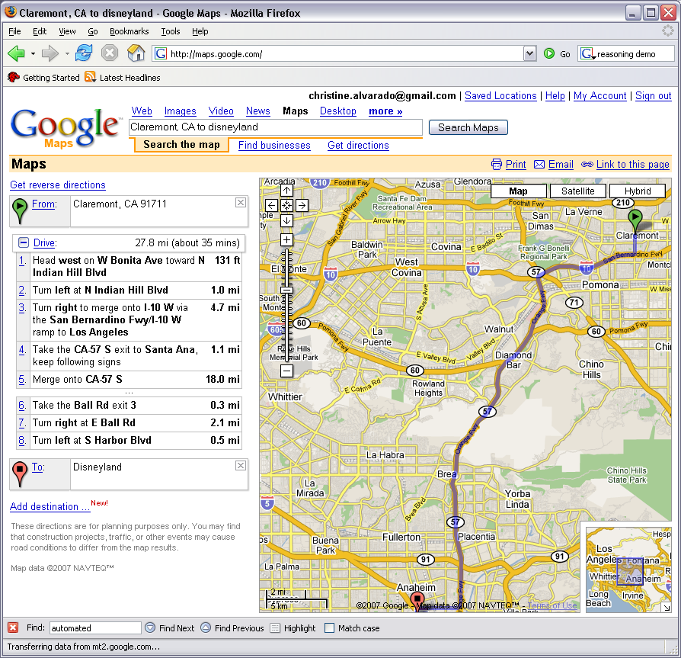
What can we currently do?
Reasoning?
  Success on small sub-problems
  General purpose reasoning is harder
    Wolfram Alpha
    OpenCyc

Slide 16
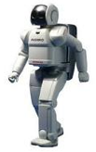
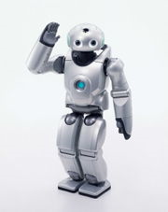
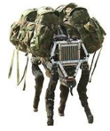
What can we currently do?
Walk?
  Robots have had a variety of locomotion methods
  Walking with legs, is challenging
    Differing terrains, stairs, running, ramps, etc.
    Recently, a number of successes
      Honda’s Asimo
        http://www.youtube.com/watch?v=W1czBcnX1Ww
      Sony QRIO
        http://www.youtube.com/watch?v=9vwZ5FQEUFg
      Boston Dynamic’s Big Dog
        http://www.youtube.com/watch?v=W1czBcnX1Ww

Slide 17
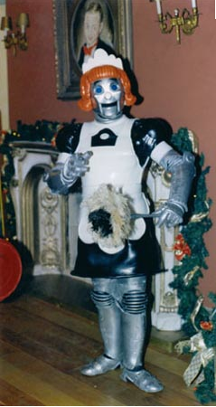
When will I have my robot helper?

Slide 18
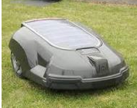
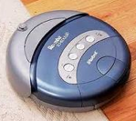
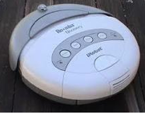
What can we currently do?
Vacuum? Clean the floor? Mow the lawn?

Slide 19
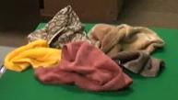
What can we currently do?
Fold a pile of towels?
UC Berkeley towel folding robot:
http://www.youtube.com/watch?v=gy5g33S0Gzo

Slide 20
Administrivia
go/cs311
  Office hours, schedule, assigned readings, problem sets
  Everything will be posted here
Read the “administrivia” page!
  ~4 programming assignments (in Python)
  ungraded written assignments
  quizzes
  2 exams (dates are tentative)
  final project for the last month
    teams of 2-3 people
    research-like with write-up and presentation
  class participation
  readings
Academic honesty and collaboration

Slide 21
Python basics
>>> x = 5 #no variable types or declarations
>>> y = 10.0 #python has implicit typing
>>> type(y) # gets the type of an expression
<type 'float'>
>>> type(x)
<type 'int'>
>>> x + y #meaning that the type is implied by whatever
#you do to the variable
15.0
>>> type(x + y)
<type 'float’>
>>> x = 'hi there'
>>> x + y
Traceback (most recent call last):
File "<stdin>", line 1, in <module>
TypeError: cannot concatenate 'str' and 'int' objects
>>> x + str(y)
'hi there10'

Slide 22
More python fun
>>> x[0] ##treat a string as a list
'h'
>>> x[0:4] ##substring of a string is a sublist - slices
'hi t’
>>> x[-1]
‘e’
>>> x[-3:]
‘ere’
>>> myL = [2]*5 ##can do powerful things
>>> myL ##what do you think this will do?
[2, 2, 2, 2, 2]
>>> myL[2] = 0
>>> x = 1
>>> y = ‘hello’
>>> x, y = y, x
>>> x
‘hello’
>>> y
1

Slide 23
Defining functions
look at functions.py
  def defines a new function
  : indicates the beginning of a new block of text
    no curly braces (for better or worse)
    a block is indicated by it’s indentation
    DON’T MIX SPACES AND TABS
      Whatever editor you use look up how to “Auto-expand” tabs into spaces!
  == for equality
  True and False

Slide 24
External files
  You can edit in your favorite text editor (for example Aquamacs or TextWrangler).
  You could also use an IDE like IDLE or WingIDE if you’d like.
  When you’re ready, you can import the commands in the file using import
>>> import functions # don’t include the .py
>>> L = [1,2,3,4]
>>> functions.listSearch(L, 5)
False
>>> functions.listSearch(L, 1)
True

Slide 25
External files
  You can edit in your favorite text editor (for example Aquamacs or TextWrangler).
  You could also use an IDE like IDLE or WingIDE if you’d like.
  If you don’t want to have to type <module>. before the commands:
>>> from functions import * # don’t include the .py
>>> L = [1,2,3,4]
>>> listSearch(L, 5)
False
>>> listSearch(L, 1)
True

Slide 26
STDOUT and STDIN
look at IO.py
  print prints to the console (you can use it in functional form with () or without)
  help(raw_input)
    takes an optional prompt which is printed to the user
    returns a string
    we typecast it to an int using int()
      can get a typecast error if user doesn’t enter an int
  notice that this is a script!
    Python executes from the top of the file to the bottom
    Functions must be declared before calling
    The last line is the method call to the function

Slide 27
Defining classes
look at polygon class in classes.py
  class <classname>: again, denotes a new block of code
  self should be the first argument to any class method
    It allows you to use the ‘.’ notation for calling methods
    It gives you a handle to the data associated with the current object
    When you call the method, you don’t actually specify it
  __init__ is similar to a constructor
    p = polygon(…)
  __str__ is similar to toString in Java and is called whenever an object is printed
  we can define optional parameters using ‘=‘ in the parameter list
    must be the last parameters in the list
    if not specified, they get the default value
    can specify using the name if desired

Slide 28
Defining classes
look at box class in classes.py
  can define multiple classes in a file (and filename doesn’t matter, remember these are just scripts. You could type these into the interpreter if you’d like)
  isinstance function is similar to instanceof in Java

Slide 29
dir and help !
provide all of the methods and data members available to an object
help(listSearch)
dir(“foo”)
help(“foo”.split)
dir(str)
help(str.split)
dir(42)
dir([])
No memorizing! Just use dir & help…
(and online documentation ☺)
Notes:
q to get out of help screen

Slide 30
Comments and docstrings
# denotes a comment (use them!)
""" denotes a multi-line string. When put at the top of a file or as the first line in a function definition these provide documentation via help (use them!)
help(classes)

