Slide 1
Improving QA Accuracy by Question Inversion
John Prager, Pablo Duboue, Jennifer Chu-Carroll
Presentation by Sam Cunningham and Martin Wintz

Slide 2
Goal
Re-rank answers based on additional “inverted questions” in order to improve accuracy.
Also: Identify pressing issues related to question answering (QA)

Slide 3
QA basic framework
Question
Query
Docs
query processing
Information retrieval
Answer processing
Answer
Corpus

Slide 4
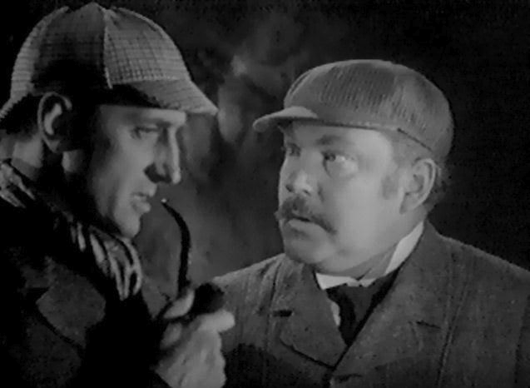
“Inverted Questions”
“What is the capital of France?”
Becomes: “Of what country is Paris the capital?”

Slide 5
Related Work
The LCC system (Moldovan & Rus, 2001)
“Logic Prover”
Clarke et al., 2001; Prager et al. 2004b
Assign confidence boost based on redundancy of answer

Slide 6
System Overview

Slide 7
Inverting the question
Identify term with known type (the pivot term)
For example in: “What was the capital of Germany in 1985” Germany is identified as a (COUNTRY).
Then given a candidate answer <CandAns> formulate the inverted question as:
“Of what (COUNTRY) was <CandAns> the capital in 1985”

Slide 8
Difficulties
Estimated 79% of question in TREC can be inverted meaningfully and those questions are hard to identify.
Need to have a comprehensive and accurate notion of types
Some inverted questions have so many answers they’re not useful

Slide 9
Inversion Algorithm
Not actually formulating inversions in natural language.
Qframe
Keywords
Answertype
Relationships

Slide 11
Using the inversion
If the answer to an inverted question (validating answer) matches the original question, that question is validated
Use this notion of validation, along with the scores of the validating answers, to re-rank candidate answers

Slide 12
Using the inversion
Only concerned with re-ranking top two results
Learn a decision tree to decide whether to re-rank second result as first one

Slide 13
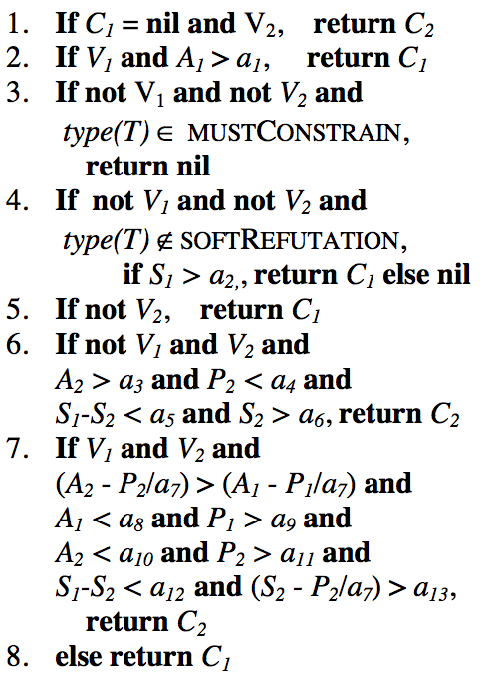
Decision tree algorithm
VARIABLES

Slide 14
Decision tree algorithm
Don’t be scared by the variables!
a_{k}: Learned parameters
C_{i}: top two candidate answers
S_{i}: Scores of candidate answers
V_{i}: whether C_{i} is validated
P_{i}: rank of validating answer
A_{i}: Score of validating answer

Slide 15
Decision tree algorithm
If there is no first answer and the second answer has been validated return the second answer.

Slide 16
Decision tree algorithm
If the first answer is validated with a score above a given threshold return the first answer.

Slide 17
Decision tree algorithm
If neither answers have been validated, either reject both answers or possibly return the first one depending on the type of the pivot term.

Slide 18
Decision tree algorithm
If only the second answer is validated then compare the score of both the answer and the validating answer.

Slide 19
Decision tree algorithm
If both answers are validated compare the scores of both the candidate answers and the validating answers

Slide 20
Decision tree algorithm
Train on TREC11corpus of question-answer sets to learn threshold values (a_{k})

Slide 21
Evaluation
50 hand-crafted questions of the form “What is the capital of X?”
AQUAINT corpus
~1 million news-wire documents.
CNS corpus
37,000 documents from the Center for Nonproliferation Studies.

Slide 22
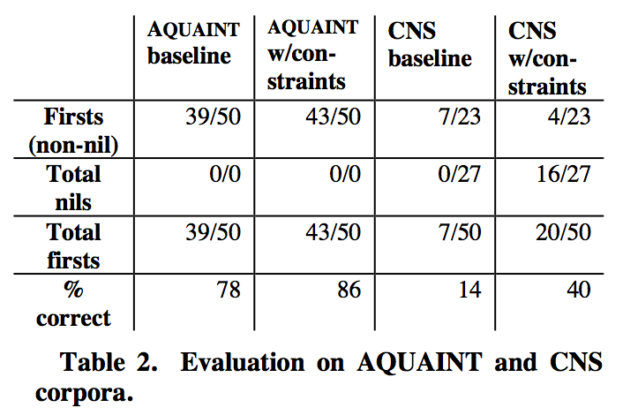

Slide 23
Evaluation II
Processed 414 factoid questions from TREC12

Slide 24
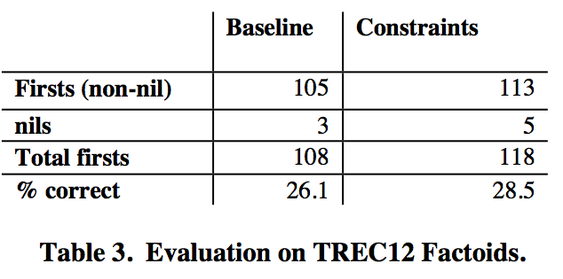

Slide 25
Conclusion
Slight improvement
Computationally expensive
Lacks robust notion of term equivalence

Slide 26
Discussion
Probability-based scores
Better confidences
Better NER
Establishing term equivalence

