Slide 1


Slide 2
Language modeling:
Smoothing
David Kauchak
CS159 – Spring 2011
some slides adapted from Jason Eisner

Slide 3
Admin
Assignment 2 out
  bigram language modeling
  Java
  Can work with partners
    Anyone looking for a partner?
  Due Wednesday 2/16 (but start working on it now!)
  HashMap

Slide 4
Admin
Our first quiz next Monday (2/14)
  In-class (~30 min.)
  Topics
    corpus analysis
    regular expressions
    probability
    language modeling
  Open book
    we’ll try it out for this one
    better to assume closed book (30 minutes goes by fast!)
  5% of your grade

Slide 5
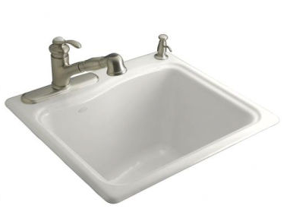
Today
smoothing techniques

Slide 6
Today
Take home ideas:
  Key idea of smoothing is to redistribute the probability to handle less see (or never seen) events
    Still must always maintain a true probability distribution
  Lots of ways of smoothing data
  Should take into account features in your data!
  For n-grams, backoff models and, in particular, Kneser-Ney smoothing work well

Slide 7
Smoothing
What if our test set contains the following sentence, but one of the trigrams never occurred in our training data?
P(I think today is a good day to be me) =
P(I | <start> <start>) x
P(think | <start> I) x
P(today| I think) x
If any of these has never been seen before, prob = 0!
P(is| think today) x
P(a| today is) x
P(good| is a) x
…

Slide 8
Smoothing
P(I think today is a good day to be me) =
P(I | <start> <start>) x
P(think | <start> I) x
P(today| I think) x
These probability estimates may be inaccurate. Smoothing can help reduce some of the noise.
P(is| think today) x
P(a| today is) x
P(good| is a) x
…

Slide 9
Add-lambda smoothing
A large dictionary makes novel events too probable.
add λ = 0.01 to all counts
see the abacus | 1 | 1/3 | 1.01 | 1.01/203
see the abbot | 0 | 0/3 | 0.01 | 0.01/203
see the abduct | 0 | 0/3 | 0.01 | 0.01/203
see the above | 2 | 2/3 | 2.01 | 2.01/203
see the Abram | 0 | 0/3 | 0.01 | 0.01/203
… |  |  | 0.01 | 0.01/203
see the zygote | 0 | 0/3 | 0.01 | 0.01/203
Total | 3 | 3/3 | 203

Slide 10
Vocabulary
n-gram language modeling assumes we have a fixed vocabulary
  why?
Whether implicit or explicit, an n-gram language model is defined over a finite, fixed vocabulary
What happens when we encounter a word not in our vocabulary (Out Of Vocabulary)?
  If we don’t do anything, prob = 0
  Smoothing doesn’t really help us with this!

Slide 11
Vocabulary
To make this explicit, smoothing helps us with…
all entries in our vocabulary
see the abacus | 1 | 1.01
see the abbot | 0 | 0.01
see the abduct | 0 | 0.01
see the above | 2 | 2.01
see the Abram | 0 | 0.01
… |  | 0.01
see the zygote | 0 | 0.01

Slide 12
Vocabulary
and…
Vocabulary
Counts
Smoothed counts
a
able
about
account
acid
across
…
young
zebra
10
1
2
0
0
3
…
1
0
10.01
1.01
2.01
0.01
0.01
3.01
…
1.01
0.01
How can we have words in our vocabulary we’ve never seen before?
Notes:
some people find this a bit weird, how could we have

Slide 13
Vocabulary
Choosing a vocabulary: ideas?
  Grab a list of English words from somewhere
  Use all of the words in your training data
  Use some of the words in your training data
    for example, all those the occur more than k times
Benefits/drawbacks?
  Ideally your vocabulary should represents words your likely to see
  Too many words, end up washing out your probability estimates (and getting poor estimates)
  Too few, lots of out of vocabulary

Slide 14
Vocabulary
No matter your chosen vocabulary, you’re still going to have out of vocabulary (OOV)
How can we deal with this?
  Ignore words we’ve never seen before
    Somewhat unsatisfying, though can work depending on the application
    Probability is then dependent on how many in vocabulary words are seen in a sentence/text
  Use a special symbol for OOV words and estimate the probability of out of vocabulary

Slide 15
Out of vocabulary
Add an extra word in your vocabulary to denote OOV (<OOV>, <UNK>)
Replace all words in your training corpus not in the vocabulary with <UNK>
  You’ll get bigrams, trigrams, etc with <UNK>
    p(<UNK> | “I am”)
    p(fast | “I <UNK>”)
During testing, similarly replace all OOV with <UNK>

Slide 16
Choosing a vocabulary
A common approach (and the one we’ll use for the assignment):
  Replace the first occurrence of each word by <UNK> in a data set
  Estimate probabilities normally
Vocabulary then is all words that occurred two or more times
This also discounts all word counts by 1 and gives that probability mass to <UNK>

Slide 17
Storing the table
How are we storing this table?
Should we store all entries?
see the abacus | 1 | 1/3 | 1.01 | 1.01/203
see the abbot | 0 | 0/3 | 0.01 | 0.01/203
see the abduct | 0 | 0/3 | 0.01 | 0.01/203
see the above | 2 | 2/3 | 2.01 | 2.01/203
see the Abram | 0 | 0/3 | 0.01 | 0.01/203
… |  |  | 0.01 | 0.01/203
see the zygote | 0 | 0/3 | 0.01 | 0.01/203
Total | 3 | 3/3 | 203

Slide 18
Storing the table
Hashtable
  fast retrieval
  fairly good memory usage
Only store those entries of things we’ve seen
  for example, we don’t store V³ trigrams
For trigrams we can:
  Store one hashtable with bigrams as keys
  Store a hashtable of hashtables (I’m recommending this)

Slide 19
Storing the table: add-lambda smoothing
For those we’ve seen before:
Unseen n-grams: p(z|ab) = ?
Store the lower order counts (or probabilities)

Slide 20
How common are novel events?
number of words occurring X times in the corpus
How likely are novel/unseen events?
Notes:
- similar to Zipf’s law

Slide 21
How common are novel events?
number of words occurring X times in the corpus
If we follow the pattern, something like this…
Notes:
- similar to Zipf’s law

Slide 22
Good-Turing estimation
9876543210

Slide 23
Good-Turing estimation
N_{c} = number of words/bigrams occurring c times
Replace MLE counts for things with count c:
Estimate the probability of novel events as:
scale down the next frequency up

Slide 24
Good-Turing (classic example)
Imagine you are fishing
  8 species: carp, perch, whitefish, trout, salmon, eel, catfish, bass
You have caught
  10 carp, 3 perch, 2 whitefish, 1 trout, 1 salmon, 1 eel = 18 fish
How likely is it that the next fish caught is from a new species (one not seen in our previous catch)?

Slide 25
Good-Turing (classic example)
Imagine you are fishing
  8 species: carp, perch, whitefish, trout, salmon, eel, catfish, bass
You have caught
  10 carp, 3 perch, 2 whitefish, 1 trout, 1 salmon, 1 eel = 18 fish
How likely is it that next species is trout?

Slide 26
Good-Turing (classic example)
Imagine you are fishing
  8 species: carp, perch, whitefish, trout, salmon, eel, catfish, bass
You have caught
  10 carp, 3 perch, 2 whitefish, 1 trout, 1 salmon, 1 eel = 18 fish
How likely is it that next species is perch?
N₄ is 0!
Nice idea, but kind of a pain to implement in practice

Slide 27
Problems with frequency based smoothing
The following bigrams have never been seen:
p( X | San )
p( X| ate)
Which would add-lambda pick as most likely?
Which would you pick?
Notes:
ignores a lot of information!

Slide 28
Witten-Bell Discounting
Some words are more likely to be followed by new words
food
apples
bananas
hamburgers
a lot
for two
grapes
…
Diego
Francisco
Luis
Jose
Marcos
San
ate

Slide 29
Witten-Bell Discounting
Probability mass is shifted around, depending on the context of words
If P(w_{i} | w_{i-1},…,w_{i-m}) = 0, then the smoothed probability P_{WB}(w_{i} | w_{i-1},…,w_{i-m}) is higher if the sequence w_{i-1},…,w_{i-m} occurs with many different words w_{i}

Slide 30
Witten-Bell Smoothing
For bigrams
  T(w_{i-1}) is the number of different words (types) that occur to the right of w_{i-1}
  N(w_{i-1}) is the number of times w_{i-1} occurred
  Z(w_{i-1}) is the number of bigrams in the current data set starting with w_{i-1} that do not occur in the training data

Slide 31
Witten-Bell Smoothing
if c(w_{i-1},w_{i}) > 0
# times we saw the bigram
# times w_{i-1} occurred + # of types to the right of w_{i-1}

Slide 32
Witten-Bell Smoothing
If c(w_{i-1},w_{i}) = 0

Slide 33
Problems with frequency based smoothing
The following trigrams have never been seen:
p( car | see the )
p( zygote | see the )
p( cumquat | see the )
Which would add-lambda pick as most likely? Good-Turing? Witten-Bell?
Which would you pick?
Notes:
ignores a lot of information!

Slide 34
Better smoothing approaches
Utilize information in lower-order models
Interpolation
  p*(z| x,y) = λp(z | x, y) + μp(z | y) + (1-λ-μ)p(z)
  Combine the probabilities in some linear combination
Backoff
  Often k = 0 (or 1)
  Combine the probabilities by “backing off” to lower models only when we don’t have enough information

Slide 35
Smoothing: Simple Interpolation
Trigram is very context specific, very noisy
Unigram is context-independent, smooth
Interpolate Trigram, Bigram, Unigram for best combination
How should we determine λ andμ?

Slide 36
Smoothing: Finding parameter values
Just like we talked about before, split training data into training and development
  can use cross-validation, leave-one-out, etc.
Try lots of different values for λ, μ on heldout data, pick best
Two approaches for finding these efficiently
  EM (expectation maximization)
  “Powell search” – see Numerical Recipes in C

Slide 37


Smoothing: Jelinek-Mercer
Simple interpolation:
Should all bigrams be smoothed equally? Which of these is it more likely to start an unseen trigram?
Notes:
we have something like:
“the dow <word>”
or
“Adobe acquired <word>”

Slide 38
Smoothing: Jelinek-Mercer
Simple interpolation:
Multiple parameters: smooth a little after “The Dow”, more after “Adobe acquired”

Slide 39
Smoothing: Jelinek-Mercer continued
Bin counts by frequency and assign λs for each bin
Find λs by cross-validation on held-out data

Slide 40
Backoff models: absolute discounting
Subtract some absolute number from each of the counts (e.g. 0.75)
  will have a large effect on low counts
  will have a small effect on large counts

Slide 41
Backoff models: absolute discounting
What is α(xy)?

Slide 42
Backoff models: absolute discounting
see the dog 1
see the cat 2
see the banana 4
see the man 1
see the woman 1
see the car 1
the Dow Jones 10
the Dow rose 5
the Dow fell 5
p( rose | the Dow ) = ?
p( cat | see the ) = ?
p( jumped | the Dow ) = ?
p( puppy | see the ) = ?

Slide 43
Backoff models: absolute discounting
see the dog 1
see the cat 2
see the banana 4
see the man 1
see the woman 1
see the car 1
p( cat | see the ) = ?

Slide 44
Backoff models: absolute discounting
see the dog 1
see the cat 2
see the banana 4
see the man 1
see the woman 1
see the car 1
p( puppy | see the ) = ?
α(see the) = ?
How much probability mass did we reserve/discount for the bigram model?

Slide 45
Backoff models: absolute discounting
see the dog 1
see the cat 2
see the banana 4
see the man 1
see the woman 1
see the car 1
p( puppy | see the ) = ?
α(see the) = ?
# of types starting with “see the” * D
count(“see the”)
For each of the unique trigrams, we subtracted D/count(“see the”) from the probability distribution
Notes:
for each of the types,

Slide 46
Backoff models: absolute discounting
see the dog 1
see the cat 2
see the banana 4
see the man 1
see the woman 1
see the car 1
p( puppy | see the ) = ?
α(see the) = ?
# of types starting with “see the” * D
count(“see the”)
distribute this probability mass to all bigrams that we backed off to
Notes:
for each of the types,

Slide 47
Calculating α
We have some number of bigrams we’re going to backoff to, i.e. those X where C(see the X) = 0, that is unseen trigrams starting with “see the”
When we backoff, for each of these, we’ll be including their probability in the model: P(X | the)
αis the normalizing constant so that the sum of these probabilities equals the reserved probability mass

Slide 48
Calculating α
We can calculate α two ways
  Based on those we haven’t seen:
  Or, more often, based on those we do see:

Slide 49
Calculating α in general: trigrams
Calculate the reserved mass
Calculate the sum of the backed off probability. For bigram “A B”:
Calculate α
# of types starting with bigram * D
reserved_mass(bigram) =
count(bigram)
either is fine in practice, the left is easier
1 – the sum of the bigram probabilities of those trigrams that we saw starting with bigram A B

Slide 50
Calculating α in general: bigrams
Calculate the reserved mass
Calculate the sum of the backed off probability. For bigram “A B”:
Calculate α
# of types starting with unigram * D
reserved_mass(unigram) =
count(unigram)
either is fine in practice, the left is easier
1 – the sum of the unigram probabilities of those bigrams that we saw starting with word A

Slide 51
Calculating backoff models in practice
Store the αs in another table
  If it’s a trigram backed off to a bigram, it’s a table keyed by the bigrams
  If it’s a bigram backed off to a unigram, it’s a table keyed by the unigrams
Compute the αs during training
  After calculating all of the probabilities of seen unigrams/bigrams/trigrams
  Go back through and calculate the αs (you should have all of the information you need)
During testing, it should then be easy to apply the backoff model with the αs pre-calculated

Slide 52
Backoff models: absolute discounting
the Dow Jones 10
the Dow rose 5
the Dow fell 5
p( jumped | the Dow ) = ?
α(the Dow) = ?
# of types starting with “see the” * D
count(“see the”)

Slide 53
Backoff models: absolute discounting
# of types starting with bigram * D
reserved_mass =
count(bigram)
Two nice attributes:
  decreases if we’ve seen more bigrams
    should be more confident that the unseen trigram is no good
  increases if the bigram tends to be followed by lots of other words
    will be more likely to see an unseen trigram

Slide 54
Kneser-Ney
Idea: not all counts should be discounted with the same value
common
P(Francisco | eggplant) vs
P(stew | eggplant)
rarer
If we’ve never seen either, which should be more likely? why?
What would an normal discounted backoff model say?
What is the problem?

Slide 55
Kneser-Ney
Idea: not all counts should be discounted with the same value
P(Francisco | eggplant) vs
P(stew | eggplant)
Problem:
Both of these would have the same backoff parameter since they’re both conditioning on eggplant
We then would end up picking based on which was most frequent
However, even though Francisco tends to only be preceded by a small number of words

Slide 56
Kneser-Ney
Idea: not all counts should be discounted with the same value
“Francisco” is common, so backoff/interpolated methods say it is likely
  But it only occurs in context of “San”
“Stew” is common in many contexts
Weight backoff by number of contexts word occurs in
P(Francisco | eggplant) low
P(stew | eggplant) higher

Slide 57
Kneser-Ney
instead of the probability of the word/bigram occurring, use the probability of the

Slide 58
P_{CONTINUATION}
Relative to other words, how likely is this word to continue (i.e. follow) many other words

Slide 59
Other language model ideas?
Skipping models: rather than just the previous 2 words, condition on the previous word and the 3rd word back, etc.
Caching models: phrases seen are more likely to be seen again (helps deal with new domains)
Clustering:
  some words fall into categories (e.g. Monday, Tuesday, Wednesday…)
  smooth probabilities with category probabilities
Domain adaptation:
  interpolate between a general model and a domain specific model

Slide 60
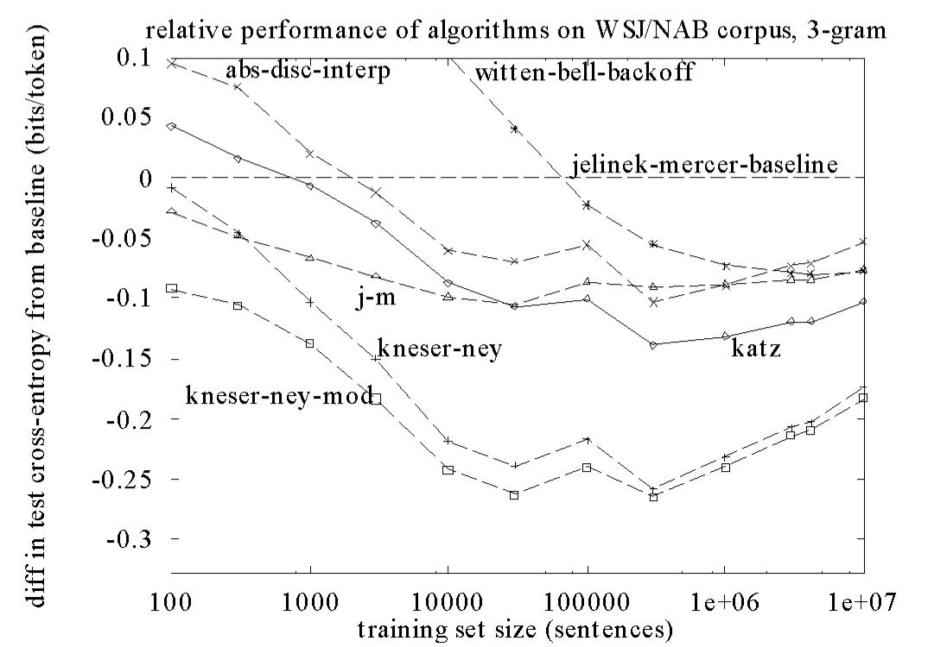
Smoothing results

Slide 61
Language Modeling Toolkits
SRI
  http://www-speech.sri.com/projects/srilm/
CMU
  http://www.speech.cs.cmu.edu/SLM_info.html

