Slide 1
CORpus analysis
David Kauchak
CS159 – Spring 2011

Slide 2
Administrivia
Assignment 0 due today
article discussion
Assignment 1 out soon
due Wednesday, 2/2 in class
no code submitted, but will require coding
Send me an e-mail if you’d like me to e-mail announcements to another account besides your school account
Send videos…

Slide 3
NLP models
How do people learn/acquire language?

Slide 4
NLP models
A lot of debate about how human’s learn language
Rationalist (e.g. Chomsky)
Empiricist
From my perspective (and many people who study NLP)…
I don’t care :)
Strong AI vs. weak AI: don’t need to accomplish the task the same way people do, just the same task
Machine learning
Statistical NLP

Slide 5
Vocabulary
Word
a unit of language that native speakers can identify
words are the blocks from which sentences are made
Sentence
a string of words satisfying the grammatical rules of a language
Document
A collection of sentences
Corpus
A collection of related texts

Slide 6
Corpora characteristics
monolingual vs. parallel
language
annotated (e.g. parts of speech, classifications, etc.)
source (where it came from)
size

Slide 7
Corpora examples
Linguistic Data Consortium
http://www.ldc.upenn.edu/Catalog/byType.jsp
Dictionaries
WordNet – 206K English words
CELEX2 – 365K German words
Monolingual text
Gigaword corpus
4M documents (mostly news articles)
1.7 trillion words
11GB of data (4GB compressed)

Slide 8
Corpora examples
Monolingual text continued
Enron e-mails
517K e-mails
Twitter
Chatroom
Many non-English resources
Parallel data
~10M sentences of Chinese-English and Arabic-English
Europarl
~1.5M sentences English with 10 different languages

Slide 9
Corpora examples
Annotated
Brown Corpus
1M words with part of speech tag
Penn Treebank
1M words with full parse trees annotated
Other treebanks
Treebank refers to a corpus annotated with trees (usually syntactic)
Chinese: 51K sentences
Arabic: 145K words
many other languages…
BLIPP: 300M words (automatically annotated)
Notes:
Many other data

Slide 10
Corpora examples
Many others…
Spam and other text classification
Google n-grams
2006 (24GB compressed!)
13M unigrams
300M bigrams
~1B 3,4 and 5-grams
Speech
Video (with transcripts)

Slide 11
Corpus analysis
Corpora are important resources
Often give examples of an NLP task we’d like to accomplish
Much of NLP is data-driven!
A common and important first step to tackling many problems is analyzing the data you’ll be processing

Slide 12
Corpus analysis
What types of questions might we want to ask?
How many…
documents, sentences, words
On average, how long are the:
documents, sentences, words
What are the most frequent words? pairs of words?
How many different words are used?
Data set specifics, e.g. proportion of different classes?
…

Slide 13
Corpora issues
Somebody gives you a file and says there’s text in it
Issues with obtaining the text?
text encoding
language recognition
formatting (e.g. web, xml, …)
misc. information to be removed
header information
tables, figures
footnotes

Slide 14
A rose by any other name…
Word
a unit of language that native speakers can identify
words are the blocks from which sentences are made
Concretely:
We have a stream of characters
We need to break into words
What is a word?
Issues/problem cases?
Word segmentation/tokenization?

Slide 15
Tokenization issues: ‘
Finland’s capital…
?

Slide 16
Tokenization issues: ‘
Finland’s capital…
Finland
Finland ‘ s
Finland ‘s
Finlands
Finland s
Finland’s
What are the benefits/drawbacks?

Slide 17
Tokenization issues: ‘
Aren’t we …
?

Slide 18
Tokenization issues: ‘
Aren’t we …
Aren’t
Arent
Are n’t
Aren t
Are not

Slide 19
Tokenization issues: hyphens
Hewlett-Packard
state-of-the-art
co-education
lower-case
take-it-or-leave-it
26-year-old
?

Slide 20
Tokenization issues: hyphens
Hewlett-Packard
state-of-the-art
co-education
lower-case
Keep as is
merge together
HewlettPackard
stateoftheart
Split on hyphen
lower case
co education
What are the benefits/drawbacks?

Slide 21
More tokenization issues
Compound nouns: San Francisco, Los Angelos, …
One token or two?
Numbers
Examples
Dates: 3/12/91
Model numbers: B-52
Domain specific numbers: PGP key - 324a3df234cb23e
Phone numbers: (800) 234-2333
Scientific notation: 1.456 e-10

Slide 22
Tokenization: language issues
Lebensversicherungsgesellschaftsangestellter
‘life insurance company employee’
Opposite problem we saw with English (San Francisco)
German compound nouns are not segmented
German retrieval systems frequently use a compound splitter module

Slide 23
Tokenization: language issues
莎拉波娃现在居住在美国东南部的佛罗里达。
Where are the words?
thisissue
Many character based languages (e.g. Chinese) have no spaces between words
A word can be made up of one or more characters
There is ambiguity about the tokenization, i.e. more than one way to break the characters into words
Word segmentation problem
can also come up in speech recognition

Slide 24
Word counts
Tom Sawyer
How many words?
71,370 total
8,018 unique
Is this a lot or a little? How might we find this out?
Random sample of news articles: 11K unique words
What does this say about Tom Sawyer?
Simpler vocabulary (colloquial, audience target, etc.)

Slide 25
Word counts
Word | Frequency
the and a to of was it in that he I his you Tom with | 3332 2972 1775 1725 1440 1161 1027 906 877 877 783 772 686 679 642
What are the most frequent words?
What types of words are most frequent?

Slide 26
Word counts
Word Frequency | Frequency of frequency
1 2 3 4 5 6 7 8 9 10 11-50 51-100 > 100 | 3993 1292 664 410 243 199 172 131 82 91 540 99 102
8K words in vocab
71K total occurrences
how many occur once? twice?

Slide 27
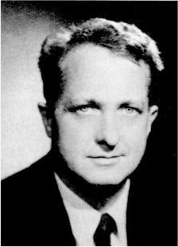
Zipf’s “Law”
･ Frequency of occurrence of words is inversely proportional to the rank in this frequency of occurrence
･ When both are plotted on a log scale, the graph is a straight line
George Kingsley Zipf
1902-1950

Slide 28
Zipf’s law
At a high level:
a few words occur very frequently
a medium number of elements have medium frequency
many elements occur very infrequently

Slide 29
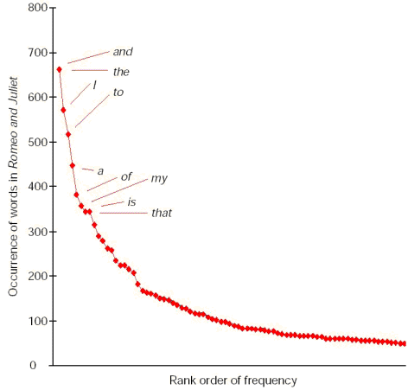
Zipf’s law
The product of the frequency of words (f) and their rank (r) is approximately constant

Slide 30
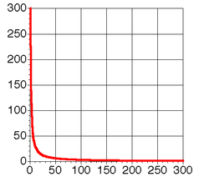
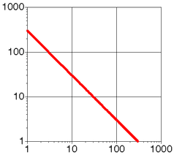
Zipf Distribution

Slide 31
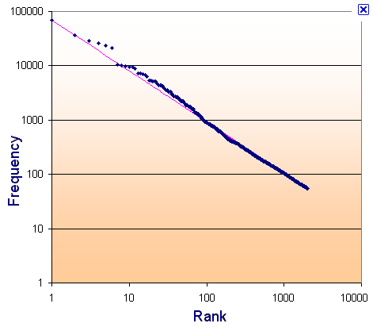
Zipf’s law: Brown corpus
log
log

Slide 32
Zipf’s law: Tom Sawyer
Word | Frequency | Rank | f * r
the and a he but be Oh two name group friends family sins Applausive | 332 2972 1775 877 410 294 116 104 21 13 10 8 2 1 | 1 2 3 10 20 30 90 100 400 600 800 1000 3000 8000 | 3332 5944 5235 8770 8400 8820 10440 10400 8400 7800 8000 8000 6000 8000

Slide 33
Sentences
Sentence
a string of words satisfying the grammatical rules of a language
Sentence segmentation
How do we identify a sentence?
Issues/problem cases?
Approach?

Slide 34
Sentence segmentation: issues
A first answer:
something ending in a: . ? !
gets 90% accuracy
Dr. Kauchak gives us just the right amount of homework.
Abbreviations can cause problems

Slide 35
Sentence segmentation: issues
A first answer:
something ending in a: . ? !
gets 90% accuracy
The scene is written with a combination of unbridled passion and sure-handed control: In the exchanges of the three characters and the rise and fall of emotions, Mr. Weller has captured the heartbreaking inexorability of separation.
sometimes: : ; and – might also denote a sentence split

Slide 36
Sentence segmentation: issues
A first answer:
something ending in a: . ? !
gets 90% accuracy
“You remind me,” she remarked, “of your mother.”
Quotes often appear outside the ending marks

Slide 37
Sentence segmentation
Place initial boundaries after: . ? !
Move the boundaries after the quotation marks, if they follow a break
Remove a boundary following a period if:
it is a known abbreviation that doesn’t tend to occur at the end of a sentence (Prof., vs.)
it is preceded by a known abbreviation and not followed by an uppercase word

Slide 38
Sentence length
What is the average sentence length, say for news text?
23
Length | percent | cumul. percent
1-5 6-10 11-15 16-20 21-25 26-30 31-35 36-40 41-45 46-50 51-100 101+ | 3 8 14 17 17 15 11 7 4 2 1 0.01 | 3 11 25 42 59 74 86 92 96 98 99.99 100

Slide 39
Regular expressions
Regular expressions are a very powerful tool to do string matching and processing
Allows you to do things like:
Tell me if a string starts with a lowercase letter, then is followed by 2 numbers and ends with “ing” or “ion”
Replace all occurrences of one or more spaces with a single space
Split up a string based on whitespace or periods or commas or …
Give me all parts of the string where a digit is proceeded by a letter and then the ‘#’ sign

Slide 40
Regular expressions: literals
We can put any string in a regular expression
/test/
matches any string that has “test” in it
/this class/
matches any string that has “this class” in it
/Test/
case sensitive: matches any string that has “Test” in it

Slide 41
Regular expressions: character classes
A set of characters to match:
put in brackets: []
[abc] matches a single character a or b or c
For example:
/[Tt]est/
matches any string with “Test” or “test” in it
Can use – to represent ranges
[a-z] is equivalent to [abcdefghijklmnopqrstuvwxyz]
[A-D] is equivalent to [ABCD]
[0-9] is equivalent to [0123456789]

Slide 42
Regular expressions: character classes
For example:
/[0-9][0-9][0-9][0-9]/
matches any four digits, e.g. a year
Can also specify a set NOT to match
^ means all character EXCEPT those specified
[^a] all characters except ‘a’
[^0-9] all characters except numbers
[^A-Z] not an upper case letter

Slide 43
Regular expressions: character classes
Meta-characters (not always available)
\w - word character (a-zA-Z_0-9)
\W - non word-character (i.e. everything else)
\d - digit (0-9)
\s - whitespace character (space, tab, endline, …)
\S - non-whitespace
\b matches a word boundary (whitespace, beginning or end of line)
. - matches any character

Slide 44
For example
/19\d\d/
would match a year starting with 19
/\s/
matches anything with a space
/\S/ or /[^\s]/
matches anything with at least on non-space character

Slide 45
Regular expressions: repetition
* matches zero or more of the preceding
/ba*d/
matches any string with:
bd
bad
baad
baaad
/A.*A/
matches any string that has two or more As in it
+ matches one or more of the preceding
/ba+d/
matches any string with
bad
baad
baaad
baaaad

Slide 46
Regular expressions: repetition
? zero or 1 occurrence of the preceding
/fights?/
matches any string with “fight” or “fights” in it
{n,m} matches n to m inclusive
/ba{3,4}d/
matches any string with
baaad
baaaad

Slide 47
Regular expressions: beginning and end
^ marks the beginning of the line
$ marks the end of the line
/test/
test can occur anywhere
/^test/
must start with test
/test$/
must end with test
/^test$/
must be exactly test

Slide 48
Regular expressions: repetition revisited
What if we wanted to match:
This is very interesting
This is very very interesting
This is very very very interesting
Would /This is very+ interesting/ work?
No… + only corresponds to the ‘y’
/This is (very )+interesting/

Slide 49
Regular expressions: discjunction
| has the lowest precedence and can be used
/cats|dogs/
matches:
cats
dogs
does NOT match:
catsogs
/^I like (cats|dogs)$/
matches:
I like cats
I like dogs

Slide 50
Some examples
All strings that start with a capital letter
IP addresses
255.255.122.122
Matching a decimal number
All strings that end in ing
All strings that end in ing or ed
All strings that begin and end with the same character

Slide 51
Some examples
All strings that start with a capital letter
/^[A-Z]/
IP addresses
/\b\d{1,3}\.\d{1,3}\.\d{1,3}\.\d{1,3}\b/
Matching a decimal number
/[-+]?[0-9]*\.?[0-9]+/
All strings that end in ing
/ing$/
All strings that end in ing or ed
/ing|ed$

Slide 52
Regular expressions: memory
All strings that begin and end with the same character
Requires us to know what we matched already
()
used for precedence
also records a matched grouping, which can be referenced later
/(.).*\1/
all strings that begin and end with the same character

Slide 53
Regular expression: memory
/She likes (\w+) and he likes \1/
We can use multiple matches
/She likes (\w+) and (\w+) and he also likes \1 and \2/

Slide 54
Regular expressions: substitution
Most languages also allow for substitution
s/banana/apple/
substitute first occurrence banana for apple
s/banana/apple/g
substitute all occurrences (globally)
s/^(.*)$/\1 \1/
s/\s+/ /g

Slide 55
Regular expressions by language
Java:
String s = “this is a test”
s.matches(“test”)
s.matches(“.*test.*”)
s.matches(“this\\sis .* test”)
s.split(“\\s+”)
s.replaceAll(“\\s+”, “ “);

Slide 56
Regular expressions by language
perl:
s = “this is a test”
s =~ /test/
s =~ /^test$/
s =~ /this\sis .* test/
split /\s+/, s
s =~ s/\s+/ /g

Slide 57
Regular expressions by language
Python:
import re
s = “this is a test”
p = re.compile(“test”)
p.match(s)
p = re.compile(“.*test.*”)
re.split(‘\s+’, s)
re.sub(‘\s+’, ‘ ‘, s)

Slide 58
Regular expression by language
grep
command-line tool for regular expressions (general regular expression print/parser)
returns all lines that match a regular expression
grep “@” twitter.posts
grep “http:” twiter.posts
can’t used metacharacters (\d, \w), use [] instead

Slide 59
Regular expression by language
sed
another command-line tool using that regexs to print and manipulate strings
very powerful, though we’ll just play with it
Most common is substitution:
sed “s/ is a / is not a/” twitter.posts
sed “s/ +/ /” twitter.posts
Can also do things like delete all that match, etc.

Slide 60
Regular expression resources
General regular expressions:
Ch 2.1 of the book
http://www.regular-expressions.info/
good general tutorials
many language specific examples as well
Java
http://download.oracle.com/javase/tutorial/essential/regex/
See also the documentation for java.util.regex
Python
http://docs.python.org/howto/regex.html
http://docs.python.org/library/re.html

Slide 61
Regular expression resources
Perl
http://perldoc.perl.org/perlretut.html
http://perldoc.perl.org/perlre.html
grep
See the write-up at the end of Assignment 1
http://www.panix.com/~elflord/unix/grep.html
sed
See the write-up at the end of Assignment 1
http://www.grymoire.com/Unix/Sed.html
http://www.panix.com/~elflord/unix/sed.html

