Slide 1
Introduction to
Statistical Machine Translation
David Kauchak
CS159 – Spring 2011
Some slides adapted from
Philipp Koehn Kevin Knight
CSAIL
Massachusetts Institute of Technology
USC/Information Sciences Institute
USC/Computer Science Department

Slide 2
Admin
How did assignment 5 go?
Project proposals?
  I will give you feedback soon
Start working on the projects!
Quiz on Wednesday

Slide 3
Quiz #3
text similarity
  set overlap methods
  vector-based methods
    different distance metrics
    weighting schemes: IDF and PMI
word similarity
  character-based
  semantic web-based
  dictionary-based
  distributional/similarity-based
misc topics:
  stoplist
  WordNet
  edit distance
information retrieval
  general problems, evaluation, etc.
  papers/student presentations

Slide 4





Language translation
Yo quiero Taco Bell

Slide 5
MT Systems
Where have you seen machine translation systems?

Slide 6
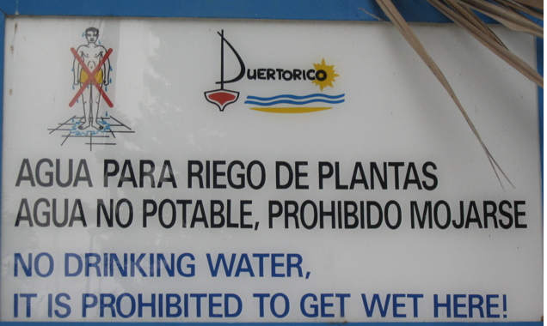

Slide 7
Machine Translation
美国关岛国际机场及其办公室均接获一名自称沙地阿拉伯富商拉登等发出的电子邮件，威胁将会向机场等公众地方发动生化袭击後，关岛经保持高度戒备。
The U.S. island of Guam is maintaining a high state of alert after the Guam airport and its offices both received an e-mail from someone calling himself the Saudi Arabian Osama bin Laden and threatening a biological/chemical attack against public places such as the airport .
The classic acid test for natural language processing.
Requires capabilities in both interpretation and generation.
People around the world stubbornly refuse to write
everything in English.

Slide 8
Machine Translation
美国关岛国际机场及其办公室均接获一名自称沙地阿拉伯富商拉登等发出的电子邮件，威胁将会向机场等公众地方发动生化袭击後，关岛经保持高度戒备。
Machine translation is becoming very prevalent
Even PowerPoint has translation built into it!
The U.S. island of Guam is maintaining a high state of alert after the Guam airport and its offices both received an e-mail from someone calling himself the Saudi Arabian Osama bin Laden and threatening a biological/chemical attack against public places such as the airport .
The American Guam international airport and the office will receive one to call self Saudi Arabian rich merchant Radden and so on the email which will send out, the threat can after public place launch biochemistry attacks and so on the airport, Guam after maintenance high alert.

Slide 9
2004: Which is the human?
Beijing Youth Daily said that under the Ministry of Agriculture, the beef will be destroyed after tests.
The Beijing Youth Daily pointed out that the seized beef would be disposed of after being examined according to advice from the Ministry of Agriculture.
?

Slide 10
2004: Which is the human?
Pakistan President Pervez Musharraf Wins Senate Confidence Vote
Pakistani President Musharraf Won the Trust Vote in Senate and Lower House
?

Slide 11
2004: Which is the human?
There was not a single vote against him."
No members vote against him. "
?

Slide 12
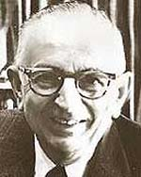
Warren Weaver (1947)
ingcmpnqsnwf cv fpn owoktvcv
hu ihgzsnwfv rqcffnw cw owgcnwf
kowazoanv ...

Slide 13
Warren Weaver (1947)
e e e e
ingcmpnqsnwf cv fpn owoktvcv
e e e
hu ihgzsnwfv rqcffnw cw owgcnwf
e
kowazoanv ...

Slide 14
Warren Weaver (1947)
e e e the
ingcmpnqsnwf cv fpn owoktvcv
e e e
hu ihgzsnwfv rqcffnw cw owgcnwf
e
kowazoanv ...

Slide 15
Warren Weaver (1947)
e he e the
ingcmpnqsnwf cv fpn owoktvcv
e e e t
hu ihgzsnwfv rqcffnw cw owgcnwf
e
kowazoanv ...

Slide 16
Warren Weaver (1947)
e he e of the
ingcmpnqsnwf cv fpn owoktvcv
e e e t
hu ihgzsnwfv rqcffnw cw owgcnwf
e
kowazoanv ...

Slide 17
Warren Weaver (1947)
e he e of the fof
ingcmpnqsnwf cv fpn owoktvcv
e f o e o oe t
hu ihgzsnwfv rqcffnw cw owgcnwf
ef
kowazoanv ...

Slide 18
Warren Weaver (1947)
e he e of the
ingcmpnqsnwf cv fpn owoktvcv
e e e t
hu ihgzsnwfv rqcffnw cw owgcnwf
e
kowazoanv ...

Slide 19
Warren Weaver (1947)
e he e is the sis
ingcmpnqsnwf cv fpn owoktvcv
e s i e i ie t
hu ihgzsnwfv rqcffnw cw owgcnwf
es
kowazoanv ...

Slide 20
Warren Weaver (1947)
decipherment is the analysis
ingcmpnqsnwf cv fpn owoktvcv
of documents written in ancient
hu ihgzsnwfv rqcffnw cw owgcnwf
languages ...
kowazoanv ...

Slide 21
Warren Weaver (1947)
The non-Turkish guy next to me is even deciphering Turkish! All he needs is a statistical table of letter-pair frequencies in Turkish …
Can this be
computerized?
Collected mechanically from a
Turkish body of text, or corpus

Slide 22
“When I look at an article in Russian, I say: this is really written in English, but it has been coded in some strange symbols. I will now proceed to decode.”
- Warren Weaver, March 1947

Slide 23
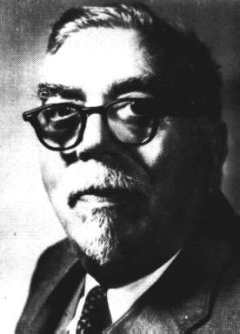
“When I look at an article in Russian, I say: this is really written in English, but it has been coded in some strange symbols. I will now proceed to decode.”
- Warren Weaver, March 1947
“... as to the problem of mechanical translation, I frankly am afraid that the [semantic] boundaries of words in different languages are too vague ... to make any quasi-mechanical translation scheme very hopeful.”
- Norbert Wiener, April 1947

Slide 24
MT Pyramid
interlingua
semantics
semantics
syntax
syntax
phrases
phrases
words
words
SOURCE
TARGET

Slide 25

Data-Driven Machine Translation
Hmm, every time he sees
“banco”, he either types
“bank” or “bench” … but if
he sees “banco de…”,
he always types “bank”,
never “bench”…
Man, this is so boring.
Translated documents

Slide 26

Welcome to the Chinese Room
Chinese texts with
English translations
New
Chinese
Document
English
Translation
You can teach yourself to translate Chinese
using only bilingual data (without grammar books,
dictionaries, any people to answer your questions…)

Slide 27
Centauri/Arcturan [Knight, 1997]
Your assignment, translate this to Arcturan: farok crrrok hihok yorok clok kantok ok-yurp
1a. ok-voon ororok sprok .
1b. at-voon bichat dat .
7a. lalok farok ororok lalok sprok izok enemok .
7b. wat jjat bichat wat dat vat eneat .
2a. ok-drubel ok-voon anok plok sprok .
2b. at-drubel at-voon pippat rrat dat .
8a. lalok brok anok plok nok .
8b. iat lat pippat rrat nnat .
3a. erok sprok izok hihok ghirok .
3b. totat dat arrat vat hilat .
9a. wiwok nok izok kantok ok-yurp .
9b. totat nnat quat oloat at-yurp .
4a. ok-voon anok drok brok jok .
4b. at-voon krat pippat sat lat .
10a. lalok mok nok yorok ghirok clok .
10b. wat nnat gat mat bat hilat .
5a. wiwok farok izok stok .
5b. totat jjat quat cat .
11a. lalok nok crrrok hihok yorok zanzanok .
11b. wat nnat arrat mat zanzanat .
6a. lalok sprok izok jok stok .
6b. wat dat krat quat cat .
12a. lalok rarok nok izok hihok mok .
12b. wat nnat forat arrat vat gat .

Slide 28
Centauri/Arcturan [Knight, 1997]
Your assignment, translate this to Arcturan: farok crrrok hihok yorok clok kantok ok-yurp
1a. ok-voon ororok sprok .
1b. at-voon bichat dat .
7a. lalok farok ororok lalok sprok izok enemok .
7b. wat jjat bichat wat dat vat eneat .
2a. ok-drubel ok-voon anok plok sprok .
2b. at-drubel at-voon pippat rrat dat .
8a. lalok brok anok plok nok .
8b. iat lat pippat rrat nnat .
3a. erok sprok izok hihok ghirok .
3b. totat dat arrat vat hilat .
9a. wiwok nok izok kantok ok-yurp .
9b. totat nnat quat oloat at-yurp .
4a. ok-voon anok drok brok jok .
4b. at-voon krat pippat sat lat .
10a. lalok mok nok yorok ghirok clok .
10b. wat nnat gat mat bat hilat .
5a. wiwok farok izok stok .
5b. totat jjat quat cat .
11a. lalok nok crrrok hihok yorok zanzanok .
11b. wat nnat arrat mat zanzanat .
6a. lalok sprok izok jok stok .
6b. wat dat krat quat cat .
12a. lalok rarok nok izok hihok mok .
12b. wat nnat forat arrat vat gat .

Slide 29
Centauri/Arcturan [Knight, 1997]
Your assignment, translate this to Arcturan: farok crrrok hihok yorok clok kantok ok-yurp
1a. ok-voon ororok sprok .
1b. at-voon bichat dat .
7a. lalok farok ororok lalok sprok izok enemok .
7b. wat jjat bichat wat dat vat eneat .
2a. ok-drubel ok-voon anok plok sprok .
2b. at-drubel at-voon pippat rrat dat .
8a. lalok brok anok plok nok .
8b. iat lat pippat rrat nnat .
3a. erok sprok izok hihok ghirok .
3b. totat dat arrat vat hilat .
9a. wiwok nok izok kantok ok-yurp .
9b. totat nnat quat oloat at-yurp .
4a. ok-voon anok drok brok jok .
4b. at-voon krat pippat sat lat .
10a. lalok mok nok yorok ghirok clok .
10b. wat nnat gat mat bat hilat .
5a. wiwok farok izok stok .
5b. totat jjat quat cat .
11a. lalok nok crrrok hihok yorok zanzanok .
11b. wat nnat arrat mat zanzanat .
6a. lalok sprok izok jok stok .
6b. wat dat krat quat cat .
12a. lalok rarok nok izok hihok mok .
12b. wat nnat forat arrat vat gat .

Slide 30
Centauri/Arcturan [Knight, 1997]
Your assignment, translate this to Arcturan: farok crrrok hihok yorok clok kantok ok-yurp
1a. ok-voon ororok sprok .
1b. at-voon bichat dat .
7a. lalok farok ororok lalok sprok izok enemok .
7b. wat jjat bichat wat dat vat eneat .
2a. ok-drubel ok-voon anok plok sprok .
2b. at-drubel at-voon pippat rrat dat .
8a. lalok brok anok plok nok .
8b. iat lat pippat rrat nnat .
3a. erok sprok izok hihok ghirok .
3b. totat dat arrat vat hilat .
9a. wiwok nok izok kantok ok-yurp .
9b. totat nnat quat oloat at-yurp .
4a. ok-voon anok drok brok jok .
4b. at-voon krat pippat sat lat .
10a. lalok mok nok yorok ghirok clok .
10b. wat nnat gat mat bat hilat .
5a. wiwok farok izok stok .
5b. totat jjat quat cat .
11a. lalok nok crrrok hihok yorok zanzanok .
11b. wat nnat arrat mat zanzanat .
???
6a. lalok sprok izok jok stok .
6b. wat dat krat quat cat .
12a. lalok rarok nok izok hihok mok .
12b. wat nnat forat arrat vat gat .

Slide 31
Centauri/Arcturan [Knight, 1997]
Your assignment, translate this to Arcturan: farok crrrok hihok yorok clok kantok ok-yurp
1a. ok-voon ororok sprok .
1b. at-voon bichat dat .
7a. lalok farok ororok lalok sprok izok enemok .
7b. wat jjat bichat wat dat vat eneat .
2a. ok-drubel ok-voon anok plok sprok .
2b. at-drubel at-voon pippat rrat dat .
8a. lalok brok anok plok nok .
8b. iat lat pippat rrat nnat .
3a. erok sprok izok hihok ghirok .
3b. totat dat arrat vat hilat .
9a. wiwok nok izok kantok ok-yurp .
9b. totat nnat quat oloat at-yurp .
4a. ok-voon anok drok brok jok .
4b. at-voon krat pippat sat lat .
10a. lalok mok nok yorok ghirok clok .
10b. wat nnat gat mat bat hilat .
5a. wiwok farok izok stok .
5b. totat jjat quat cat .
11a. lalok nok crrrok hihok yorok zanzanok .
11b. wat nnat arrat mat zanzanat .
6a. lalok sprok izok jok stok .
6b. wat dat krat quat cat .
12a. lalok rarok nok izok hihok mok .
12b. wat nnat forat arrat vat gat .

Slide 32
Centauri/Arcturan [Knight, 1997]
Your assignment, translate this to Arcturan: farok crrrok hihok yorok clok kantok ok-yurp
1a. ok-voon ororok sprok .
1b. at-voon bichat dat .
7a. lalok farok ororok lalok sprok izok enemok .
7b. wat jjat bichat wat dat vat eneat .
2a. ok-drubel ok-voon anok plok sprok .
2b. at-drubel at-voon pippat rrat dat .
8a. lalok brok anok plok nok .
8b. iat lat pippat rrat nnat .
3a. erok sprok izok hihok ghirok .
3b. totat dat arrat vat hilat .
9a. wiwok nok izok kantok ok-yurp .
9b. totat nnat quat oloat at-yurp .
4a. ok-voon anok drok brok jok .
4b. at-voon krat pippat sat lat .
10a. lalok mok nok yorok ghirok clok .
10b. wat nnat gat mat bat hilat .
5a. wiwok farok izok stok .
5b. totat jjat quat cat .
11a. lalok nok crrrok hihok yorok zanzanok .
11b. wat nnat arrat mat zanzanat .
6a. lalok sprok izok jok stok .
6b. wat dat krat quat cat .
12a. lalok rarok nok izok hihok mok .
12b. wat nnat forat arrat vat gat .

Slide 33
Centauri/Arcturan [Knight, 1997]
Your assignment, translate this to Arcturan: farok crrrok hihok yorok clok kantok ok-yurp
1a. ok-voon ororok sprok .
1b. at-voon bichat dat .
7a. lalok farok ororok lalok sprok izok enemok .
7b. wat jjat bichat wat dat vat eneat .
2a. ok-drubel ok-voon anok plok sprok .
2b. at-drubel at-voon pippat rrat dat .
8a. lalok brok anok plok nok .
8b. iat lat pippat rrat nnat .
3a. erok sprok izok hihok ghirok .
3b. totat dat arrat vat hilat .
9a. wiwok nok izok kantok ok-yurp .
9b. totat nnat quat oloat at-yurp .
4a. ok-voon anok drok brok jok .
4b. at-voon krat pippat sat lat .
10a. lalok mok nok yorok ghirok clok .
10b. wat nnat gat mat bat hilat .
5a. wiwok farok izok stok .
5b. totat jjat quat cat .
11a. lalok nok crrrok hihok yorok zanzanok .
11b. wat nnat arrat mat zanzanat .
6a. lalok sprok izok jok stok .
6b. wat dat krat quat cat .
12a. lalok rarok nok izok hihok mok .
12b. wat nnat forat arrat vat gat .

Slide 34
Centauri/Arcturan [Knight, 1997]
Your assignment, translate this to Arcturan: farok crrrok hihok yorok clok kantok ok-yurp
1a. ok-voon ororok sprok .
1b. at-voon bichat dat .
7a. lalok farok ororok lalok sprok izok enemok .
7b. wat jjat bichat wat dat vat eneat .
2a. ok-drubel ok-voon anok plok sprok .
2b. at-drubel at-voon pippat rrat dat .
8a. lalok brok anok plok nok .
8b. iat lat pippat rrat nnat .
3a. erok sprok izok hihok ghirok .
3b. totat dat arrat vat hilat .
9a. wiwok nok izok kantok ok-yurp .
9b. totat nnat quat oloat at-yurp .
4a. ok-voon anok drok brok jok .
4b. at-voon krat pippat sat lat .
10a. lalok mok nok yorok ghirok clok .
10b. wat nnat gat mat bat hilat .
???
5a. wiwok farok izok stok .
5b. totat jjat quat cat .
11a. lalok nok crrrok hihok yorok zanzanok .
11b. wat nnat arrat mat zanzanat .
6a. lalok sprok izok jok stok .
6b. wat dat krat quat cat .
12a. lalok rarok nok izok hihok mok .
12b. wat nnat forat arrat vat gat .

Slide 35
Centauri/Arcturan [Knight, 1997]
Your assignment, translate this to Arcturan: farok crrrok hihok yorok clok kantok ok-yurp
1a. ok-voon ororok sprok .
1b. at-voon bichat dat .
7a. lalok farok ororok lalok sprok izok enemok .
7b. wat jjat bichat wat dat vat eneat .
2a. ok-drubel ok-voon anok plok sprok .
2b. at-drubel at-voon pippat rrat dat .
8a. lalok brok anok plok nok .
8b. iat lat pippat rrat nnat .
3a. erok sprok izok hihok ghirok .
3b. totat dat arrat vat hilat .
9a. wiwok nok izok kantok ok-yurp .
9b. totat nnat quat oloat at-yurp .
4a. ok-voon anok drok brok jok .
4b. at-voon krat pippat sat lat .
10a. lalok mok nok yorok ghirok clok .
10b. wat nnat gat mat bat hilat .
5a. wiwok farok izok stok .
5b. totat jjat quat cat .
11a. lalok nok crrrok hihok yorok zanzanok .
11b. wat nnat arrat mat zanzanat .
6a. lalok sprok izok jok stok .
6b. wat dat krat quat cat .
12a. lalok rarok nok izok hihok mok .
12b. wat nnat forat arrat vat gat .

Slide 36
Centauri/Arcturan [Knight, 1997]
Your assignment, translate this to Arcturan: farok crrrok hihok yorok clok kantok ok-yurp
1a. ok-voon ororok sprok .
1b. at-voon bichat dat .
7a. lalok farok ororok lalok sprok izok enemok .
7b. wat jjat bichat wat dat vat eneat .
2a. ok-drubel ok-voon anok plok sprok .
2b. at-drubel at-voon pippat rrat dat .
8a. lalok brok anok plok nok .
8b. iat lat pippat rrat nnat .
3a. erok sprok izok hihok ghirok .
3b. totat dat arrat vat hilat .
9a. wiwok nok izok kantok ok-yurp .
9b. totat nnat quat oloat at-yurp .
4a. ok-voon anok drok brok jok .
4b. at-voon krat pippat sat lat .
10a. lalok mok nok yorok ghirok clok .
10b. wat nnat gat mat bat hilat .
process of
elimination
5a. wiwok farok izok stok .
5b. totat jjat quat cat .
11a. lalok nok crrrok hihok yorok zanzanok .
11b. wat nnat arrat mat zanzanat .
6a. lalok sprok izok jok stok .
6b. wat dat krat quat cat .
12a. lalok rarok nok izok hihok mok .
12b. wat nnat forat arrat vat gat .

Slide 37
Centauri/Arcturan [Knight, 1997]
Your assignment, translate this to Arcturan: farok crrrok hihok yorok clok kantok ok-yurp
1a. ok-voon ororok sprok .
1b. at-voon bichat dat .
7a. lalok farok ororok lalok sprok izok enemok .
7b. wat jjat bichat wat dat vat eneat .
2a. ok-drubel ok-voon anok plok sprok .
2b. at-drubel at-voon pippat rrat dat .
8a. lalok brok anok plok nok .
8b. iat lat pippat rrat nnat .
3a. erok sprok izok hihok ghirok .
3b. totat dat arrat vat hilat .
9a. wiwok nok izok kantok ok-yurp .
9b. totat nnat quat oloat at-yurp .
4a. ok-voon anok drok brok jok .
4b. at-voon krat pippat sat lat .
10a. lalok mok nok yorok ghirok clok .
10b. wat nnat gat mat bat hilat .
5a. wiwok farok izok stok .
5b. totat jjat quat cat .
11a. lalok nok crrrok hihok yorok zanzanok .
11b. wat nnat arrat mat zanzanat .
cognate?
6a. lalok sprok izok jok stok .
6b. wat dat krat quat cat .
12a. lalok rarok nok izok hihok mok .
12b. wat nnat forat arrat vat gat .

Slide 38
Centauri/Arcturan [Knight, 1997]
Your assignment, put these words in order: { jjat, arrat, mat, bat, oloat, at-yurp }
1a. ok-voon ororok sprok .
1b. at-voon bichat dat .
7a. lalok farok ororok lalok sprok izok enemok .
7b. wat jjat bichat wat dat vat eneat .
2a. ok-drubel ok-voon anok plok sprok .
2b. at-drubel at-voon pippat rrat dat .
8a. lalok brok anok plok nok .
8b. iat lat pippat rrat nnat .
3a. erok sprok izok hihok ghirok .
3b. totat dat arrat vat hilat .
9a. wiwok nok izok kantok ok-yurp .
9b. totat nnat quat oloat at-yurp .
4a. ok-voon anok drok brok jok .
4b. at-voon krat pippat sat lat .
10a. lalok mok nok yorok ghirok clok .
10b. wat nnat gat mat bat hilat .
5a. wiwok farok izok stok .
5b. totat jjat quat cat .
11a. lalok nok crrrok hihok yorok zanzanok .
11b. wat nnat arrat mat zanzanat .
zero
fertility
6a. lalok sprok izok jok stok .
6b. wat dat krat quat cat .
12a. lalok rarok nok izok hihok mok .
12b. wat nnat forat arrat vat gat .

Slide 39
It’s Really Spanish/English
Clients do not sell pharmaceuticals in Europe => Clientes no venden medicinas en Europa
1a. Garcia and associates .
1b. Garcia y asociados .
7a. the clients and the associates are enemies .
7b. los clients y los asociados son enemigos .
2a. Carlos Garcia has three associates .
2b. Carlos Garcia tiene tres asociados .
8a. the company has three groups .
8b. la empresa tiene tres grupos .
3a. his associates are not strong .
3b. sus asociados no son fuertes .
9a. its groups are in Europe .
9b. sus grupos estan en Europa .
4a. Garcia has a company also .
4b. Garcia tambien tiene una empresa .
10a. the modern groups sell strong pharmaceuticals .
10b. los grupos modernos venden medicinas fuertes .
5a. its clients are angry .
5b. sus clientes estan enfadados .
11a. the groups do not sell zenzanine .
11b. los grupos no venden zanzanina .
6a. the associates are also angry .
6b. los asociados tambien estan enfadados .
12a. the small groups are not modern .
12b. los grupos pequenos no son modernos .

Slide 40
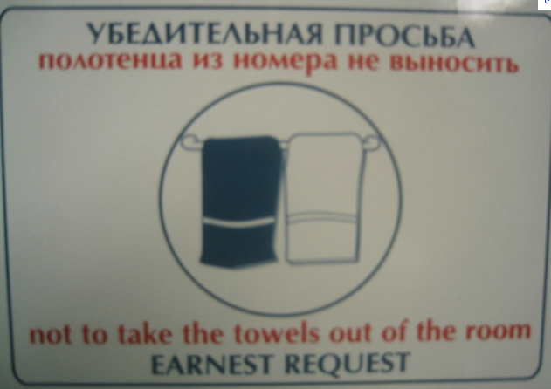

Slide 41
Data available
Many languages
  Europarl corpus has all European languages
    http://www.statmt.org/europarl/
    From a few hundred thousand sentences to a few million
  French/English from French parliamentary proceedings
  Lots of Chinese/English and Arabic/English from government projects/interests
    Chinese-English: 440 million words (15-20 million sentence pairs)
    Arabic-English: 790 million words (30-40 million sentence pairs)
  Smaller corpora in many, many other languages
Lots of monolingual data available in many languages
Even less data with multiple translations available
Available in limited domains
  most data is either news or government proceedings
  some other domains recently, like blogs

Slide 42
Statistical MT Overview
training
learned parameters
Bilingual data
model
monolingual data
Find the best
translation given the foreign sentence and the model
Translation
Foreign sentence
English
sentence

Slide 43
Statistical MT
We will model the translation process probabilistically
Given a foreign sentence to translate, for any possible English sentence, we want to know what the probability that sentence is a translation of the foreign sentence
If we can find the most probable English sentence, we’re done
p(english sentence | foreign sentence)

Slide 44
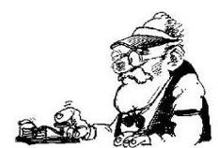

Noisy channel model
some message
is sent
along the way the message gets messed up
What was originally sent?
We have the mutated message, but would like to recover the original
Notes:
- think about the message passing game…

Slide 45
Noisy channel model
sent
received
model: p(sent | received)

Slide 46
Noisy channel model
Probabilistic model:
p(English| Foreign)
Given sentence pairs, gives us the probability
p(compressed| uncompressed)
p(simplified| unsimplified)
Notes:
general idea started with information theory and Shannon in the 40s
used in the early 90s by IBM team for machine translation
- started to become a prevalent model for text-to-text approaches in the late 1990s

Slide 47
Noisy channel model
Bayes’ rule
probability of the foreign sentence
language model: what are likely English word sequences?
translation model: how does the translation process happen? probability of the translated English sentence given the foreign sentence

Slide 48
Noisy channel model
Bayes’ rule
probability of the foreign sentence
language model: what are likely English word sequences?
translation model: how does the translation process happen? probability of the translated English sentence given the foreign sentence

Slide 49
Noisy channel model
model
translation model
language model
how do foreign sentences get translated to English sentences?
what do English sentences look like?

Slide 50
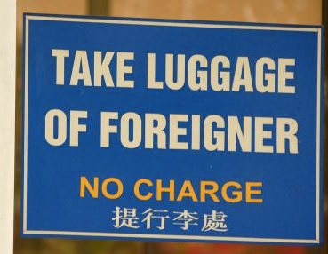

Slide 51
Translation model
The models define probabilities over inputs
Morgen fliege ich nach Kanada zur Konferenz
Tomorrow I will fly to the conference in Canada
What is the probability that the English sentence is a translation of the foreign sentence?

Slide 52
Translation model
The models define probabilities over inputs
Morgen
fliege
ich
nach Kanada
zur Konferenz
Tomorrow
I
will fly
to the conference
In Canada
What is the probability of a foreign word being translated as a particular English word?
What is the probability of a foreign foreign phrase being translated as a particular English phrase?
What is the probability of a word/phrase changing ordering?
What is the probability of a foreign word/phrase disappearing?
What is the probability of a English word/phrase appearing?

Slide 53
Translation model
The models define probabilities over inputs
p( Morgen fliege ich nach Kanada zur Konferenz |
Tomorrow I will fly to the conference in Canada )
= 0.1
p( Morgen fliege ich nach Kanada zur Konferenz |
I like peanut butter and jelly )
= 0.0001

Slide 54
Language model
The models define probabilities over inputs
Tomorrow I will fly to the conference in Canada

Slide 55
What is a probability distribution?
A probability distribution defines the probability over a space of possible inputs
For the language model, what is the space of possible inputs?
  A language model describes the probability over ALL possible combinations of English words
For the translation model, what is the space of possible inputs?
  ALL possible combinations of foreign words with ALL possible combinations of English words

Slide 56
One way to think about it…
Translation
model
Broken
English
language
model
Spanish
(foreign)
English
What hunger have I,
Hungry I am so,
I am so hungry,
Have I that hunger …
Que hambre tengo yo
I am so hungry

Slide 57
Translation
Let’s assume we have a translation model and a language model
Given a foreign sentence, what question do we want to ask to translate that sentence into English?

Slide 58
Statistical MT Overview
training
learned parameters
“nice” fragment aligned data
Bilingual data
Translation model
preprocessing
monolingual data
Language model
Decoder
(what English sentence is most probable given foreign sentence with learned models)
Translation
Foreign sentence

Slide 59
Basic Model, Revisited
argmax P(e | f) =
e
argmax P(e) x P(f | e) / P(f) =
e
argmax P(e) x P(f | e)
e

Slide 60
Basic Model, Revisited
argmax P(e | f) =
e
argmax P(e) x P(f | e) / P(f) =
e
argmax P(e)^{2.4} x P(f | e) … works better!
e

Slide 61
Basic Model, Revisited
argmax P(e | f) =
e
argmax P(e) x P(f | e) / P(f)
e
argmax P(e)^{2.4} x P(f | e) x length(e)^{1.1}
e
Rewards longer hypotheses, since
these are unfairly punished by P(e)

Slide 62
Basic Model, Revisited
argmax P(e)^{2.4} x P(f | e) x length(e)^{1.1} x KS ^{3.7} …
e
Lots of knowledge sources vote on any given hypothesis.
“Knowledge source” = “feature function” = “score component”.
A feature function simply scores a hypothesis with a real value.
(May be binary, as in “e has a verb”).

Slide 63
Problems for Statistical MT
Preprocessing
  How do we get aligned bilingual text?
  Tokenization
  Segmentation (document, sentence, word)
Language modeling
  Given an English string e, assigns P(e) by formula
Translation modeling
  Given a pair of strings <f,e>, assigns P(f | e) by formula
Decoding
  Given a language model, a translation model, and a new sentence f … find translation e maximizing P(e) * P(f | e)
Parameter optimization
  Given a model with multiple feature functions, how are they related? What are the optimal paraeters?
Evaluation
  How well is a system doing? How can we compare two systems?

Slide 64
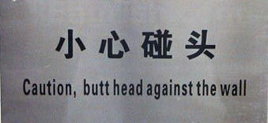

Slide 65
Problems for Statistical MT
Preprocessing
Language modeling
Translation modeling
Decoding
Parameter optimization
Evaluation

Slide 66
From No Data to Sentence Pairs
Easy way: Linguistic Data Consortium (LDC)
Really hard way: pay $$$
  Suppose one billion words of parallel data were sufficient
  At 20 cents/word, that’s $200 million
Pretty hard way: Find it, and then earn it!
  De-formatting
  Remove strange characters
  Character code conversion
  Document alignment
  Sentence alignment
  Tokenization (also called Segmentation)

Slide 67
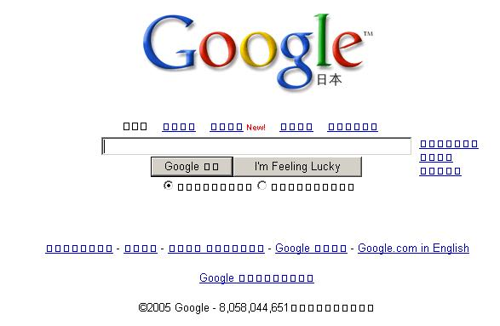
If you don’t get the characters right…

Slide 68
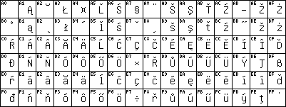
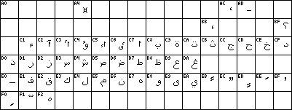
ISO-8859-2 (Latin2)
ISO-8859-6 (Arabic)

Slide 69
Chinese?
GB Code
GBK Code
Big 5 Code
CNS-11643-1992
…

Slide 70
Document Alignment
Input:
  Big bag of files obtained from somewhere, believed to contain pairs of files that are translations of each other.
Output:
  List of pairs of files that are actually translations.
E
C
E
C
C
C
E
E
C
E
E
C
C
E
E
E
C
C
C
C
E
E
C
E
E
C
C
C
E
E

Slide 71
Document Alignment
Input:
  Big bag of files obtained from somewhere, believed to contain pairs of files that are translations of each other.
Output:
  List of pairs of files that are actually translations.
E
C
E
C
C
C
E
E
C
E
E
C
C
E
E
E
C
C
C
C
E
E
C
E
E
C
C
C
E
E

Slide 72
Sentence Alignment
The old man is happy. He has fished many times. His wife talks to him. The fish are jumping. The sharks await.
El viejo está feliz porque ha pescado muchos veces. Su mujer habla con él. Los tiburones esperan.

Slide 73
Sentence Alignment
The old man is happy.
He has fished many times.
His wife talks to him.
The fish are jumping.
The sharks await.
El viejo está feliz porque ha pescado muchos veces.
Su mujer habla con él.
Los tiburones esperan.

Slide 74
Sentence Alignment
The old man is happy.
He has fished many times.
His wife talks to him.
The fish are jumping.
The sharks await.
El viejo está feliz porque ha pescado muchos veces.
Su mujer habla con él.
Los tiburones esperan.

Slide 75
Sentence Alignment
The old man is happy. He has fished many times.
His wife talks to him.
The sharks await.
El viejo está feliz porque ha pescado muchos veces.
Su mujer habla con él.
Los tiburones esperan.
Note that unaligned sentences are thrown out, and
sentences are merged in n-to-m alignments (n, m > 0).

Slide 76
Tokenization (or Segmentation)
English
  Input (some byte stream):
    "There," said Bob.
  Output (7 “tokens” or “words”):
  " There , " said Bob .
Chinese
  Input (byte stream):
  Output:
美国关岛国际机场及其办公室均接获一名自称沙地阿拉伯富商拉登等发出的电子邮件。
美国 关岛国 际机 场 及其 办公 室均接获 一名 自称 沙地 阿拉 伯富 商拉登 等发 出 的 电子邮件。

Slide 77
Problems for Statistical MT
Preprocessing
Language modeling
Translation modeling
Decoding
Parameter optimization
Evaluation

Slide 78
Language Modeling
Most common: n-gram language models
More data the better (Google n-grams)
Domain is important

Slide 79
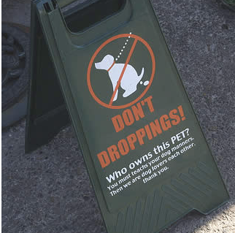

Slide 80
Problems for Statistical MT
Preprocessing
Language modeling
Translation modeling
Decoding
Parameter optimization
Evaluation

Slide 81
Translation Model
Learn How to Translate from Data
Direct Estimation:
Mary did not slap the green witch
not enough data for this
(most input sentences unseen)
Maria no dió una botefada a la bruja verde

Slide 82
Generative Model
Break up process into smaller steps:
Mary did not slap the green witch
sufficient statistics for smaller steps
Maria no dió una botefada a la bruja verde

Slide 83
What kind of Translation Model?
May use syntactic and semantic representations:
Mary did not slap the green witch
Word-level models
Phrasal models
Syntactic models
Semantic models
Maria no dió una botefada a la bruja verde

Slide 84
The Classic Translation Model
Word Substitution/Permutation [IBM Model 3, Brown et al., 1993]
Generative story:
Mary did not slap the green witch
n(3|slap)
Mary not slap slap slap the green witch
P-Null
Mary not slap slap slap NULL the green witch
t(la|the)
Maria no dió una botefada a la verde bruja
d(j|i)
Maria no dió una botefada a la bruja verde
Probabilities can be learned from raw bilingual text.

Slide 85
Phrase-Based Statistical MT
Morgen
fliege
ich
nach Kanada
zur Konferenz
Tomorrow
I
will fly
to the conference
In Canada
Foreign input segmented in to phrases
  “phrase” is any sequence of words
Each phrase is probabilistically translated into English
  P(to the conference | zur Konferenz)
  P(into the meeting | zur Konferenz)
Phrases are probabilistically re-ordered
See [Koehn et al, 2003] for an intro.

Slide 86
Advantages of Phrase-Based
Many-to-many mappings can handle non-compositional phrases
Easy to understand
Local context is very useful for disambiguating
  “Interest rate” → …
  “Interest in” → …
The more data, the longer the learned phrases
  Sometimes whole sentences

Slide 87
Syntax
S
VP
NP
VP
PP
NP
NP
NP
NP
NP
DT
CD
NNS
VBP
NNS
VBG
IN
NNP
CC
NNP
PUNC
These
7
people
include
astronauts
coming
from
France
and
Russia
.

Slide 88
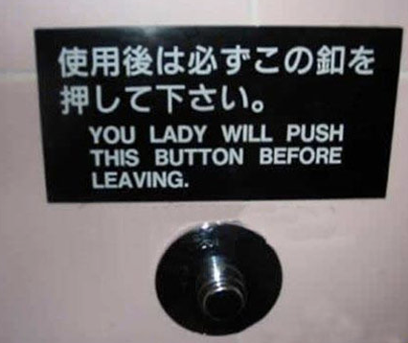

Slide 89
Problems for Statistical MT
Preprocessing
Language modeling
Translation modeling
Decoding
Parameter optimization
Evaluation

Slide 90
Decoding
Of all conceivable English word strings, find the one maximizing P(e) x P(f | e)
Decoding is an NP-complete problem (for many translation models
  (Knight, 1999)
Several decoding strategies are often available

Slide 91
Search
f₁ f₂ f₃ f₄ f₅ f₆

Slide 92
Search
partial trans.
f₁ f₂ f₃ f₄ f₅ f₆
f₁ f₂ f₃ f₄ f₅ f₆
partial trans.
f₁ f₂ f₃ f₄ f₅ f₆
…
partial trans.
f₁ f₂ f₃ f₄ f₅ f₆

Slide 93
Search
partial trans.
f₁ f₂ f₃ f₄ f₅ f₆
partial trans.
f₁ f₂ f₃ f₄ f₅ f₆
partial trans.
f₁ f₂ f₃ f₄ f₅ f₆
partial trans.
f₁ f₂ f₃ f₄ f₅ f₆
f₁ f₂ f₃ f₄ f₅ f₆
partial trans.
f₁ f₂ f₃ f₄ f₅ f₆
…
…
partial trans.
f₁ f₂ f₃ f₄ f₅ f₆

Slide 94
Search
partial trans.
f₁ f₂ f₃ f₄ f₅ f₆
partial trans.
f₁ f₂ f₃ f₄ f₅ f₆
partial trans.
f₁ f₂ f₃ f₄ f₅ f₆
partial trans.
f₁ f₂ f₃ f₄ f₅ f₆
f₁ f₂ f₃ f₄ f₅ f₆
partial trans.
f₁ f₂ f₃ f₄ f₅ f₆
…
…
partial trans.
f₁ f₂ f₃ f₄ f₅ f₆
State space search problem
Huge space
Evaluate intermediate hypotheses using model and prune partial hypotheses

Slide 95
Problems for Statistical MT
Preprocessing
Language modeling
Translation modeling
Decoding
Parameter optimization
Evaluation

Slide 96
The Problem: Learn Lambdas
Given a data set with foreign/English sentences, find the λ’s that:
maximize the likelihood of the data
maximize an evaluation criterion

Slide 97
Problems for Statistical MT
Preprocessing
Language modeling
Translation modeling
Decoding
Parameter optimization
Evaluation

Slide 98

MT Evaluation
Source only
Manual:
  SSER (subjective sentence error rate)
  Correct/Incorrect
  Error categorization
Objective usage testing
Automatic:
  WER (word error rate)
  BLEU (Bilingual Evaluation Understudy)
  NIST
  Named-Entity

Slide 99
Reference Evaluation
Reference (human) translation:
The U.S. island of Guam is maintaining a high state of alert after the Guam airport and its offices both received an e-mail from someone calling himself the Saudi Arabian Osama bin Laden and threatening a biological/chemical attack against public places such as the airport .
Machine translation:
The American [?] international airport and its the office all receives one calls self the sand Arab rich business [?] and so on electronic mail , which sends out ; The threat will be able after public place and so on the airport to start the biochemistry attack , [?] highly alerts after the maintenance.

Slide 100
BLEU Evaluation Metric
(Papineni et al, ACL-2002)
Reference (human) translation:
The U.S. island of Guam is maintaining a high state of alert after the Guam airport and its offices both received an e-mail from someone calling himself the Saudi Arabian Osama bin Laden and threatening a biological/chemical attack against public places such as the airport .
N-gram precision (score is between 0 & 1)
  What percentage of machine n-grams can be found in the reference translation?
    An n-gram is an sequence of n words
  Not allowed to use same portion of reference translation twice (can’t cheat by typing out “the the the the the”)
Brevity penalty
  Can’t just type out single word “the” (precision 1.0!)
*** Amazingly hard to “game” the system (i.e., find a way to change machine output so that BLEU goes up, but quality doesn’t)
Machine translation:
The American [?] international airport and its the office all receives one calls self the sand Arab rich business [?] and so on electronic mail , which sends out ; The threat will be able after public place and so on the airport to start the biochemistry attack , [?] highly alerts after the maintenance.

Slide 101
BLEU Evaluation Metric
(Papineni et al, ACL-2002)
Reference (human) translation:
The U.S. island of Guam is maintaining a high state of alert after the Guam airport and its offices both received an e-mail from someone calling himself the Saudi Arabian Osama bin Laden and threatening a biological/chemical attack against public places such as the airport .
BLEU formula
  Generally N=4
  w_{i}=1/N (uniform weights)
  BP=brevity penalty
  p_{i}=i-gram precision
Machine translation:
The American [?] international airport and its the office all receives one calls self the sand Arab rich business [?] and so on electronic mail , which sends out ; The threat will be able after public place and so on the airport to start the biochemistry attack , [?] highly alerts after the maintenance.

Slide 102
Multiple Reference Translations
Reference translation 1:
The U.S. island of Guam is maintaining a high state of alert after the Guam airport and its offices both received an e-mail from someone calling himself the Saudi Arabian Osama bin Laden and threatening a biological/chemical attack against public places such as the airport .
Reference translation 1:
The U.S. island of Guam is maintaining a high state of alert after the Guam airport and its offices both received an e-mail from someone calling himself the Saudi Arabian Osama bin Laden and threatening a biological/chemical attack against public places such as the airport .
Reference translation 2:
Guam International Airport and its offices are maintaining a high state of alert after receiving an e-mail that was from a person claiming to be the wealthy Saudi Arabian businessman Bin Laden and that threatened to launch a biological and chemical attack on the airport and other public places .
Reference translation 2:
Guam International Airport and its offices are maintaining a high state of alert after receiving an e-mail that was from a person claiming to be the wealthy Saudi Arabian businessman Bin Laden and that threatened to launch a biological and chemical attack on the airport and other public places .
Machine translation:
The American [?] international airport and its the office all receives one calls self the sand Arab rich business [?] and so on electronic mail , which sends out ; The threat will be able after public place and so on the airport to start the biochemistry attack , [?] highly alerts after the maintenance.
Machine translation:
The American [?] international airport and its the office all receives one calls self the sand Arab rich business [?] and so on electronic mail , which sends out ; The threat will be able after public place and so on the airport to start the biochemistry attack , [?] highly alerts after the maintenance.
Reference translation 3:
The US International Airport of Guam and its office has received an email from a self-claimed Arabian millionaire named Laden , which threatens to launch a biochemical attack on such public places as airport . Guam authority has been on alert .
Reference translation 3:
The US International Airport of Guam and its office has received an email from a self-claimed Arabian millionaire named Laden , which threatens to launch a biochemical attack on such public places as airport . Guam authority has been on alert .
Reference translation 4:
US Guam International Airport and its office received an email from Mr. Bin Laden and other rich businessman from Saudi Arabia . They said there would be biochemistry air raid to Guam Airport and other public places . Guam needs to be in high precaution about this matter .
Reference translation 4:
US Guam International Airport and its office received an email from Mr. Bin Laden and other rich businessman from Saudi Arabia . They said there would be biochemistry air raid to Guam Airport and other public places . Guam needs to be in high precaution about this matter .

Slide 103
Available Resources
Bilingual corpora
  100m+ words of Chinese/English and Arabic/English, LDC (www.ldc.upenn.edu)
  Lots of French/English, Spanish/French/English, LDC
  European Parliament (sentence-aligned), 11 languages, Philipp Koehn, ISI
    (www.isi.edu/~koehn/publications/europarl)
  20m words (sentence-aligned) of English/French, Ulrich Germann, ISI
    (www.isi.edu/natural-language/download/hansard/)
Sentence alignment
  Dan Melamed, NYU (www.cs.nyu.edu/~melamed/GMA/docs/README.htm)
  Xiaoyi Ma, LDC (Champollion)
Word alignment
  GIZA, JHU Workshop ’99 (www.clsp.jhu.edu/ws99/projects/mt/)
  GIZA++, RWTH Aachen (www-i6.Informatik.RWTH-Aachen.de/web/Software/GIZA++.html)
  Manually word-aligned test corpus (500 French/English sentence pairs), RWTH Aachen
  Shared task, NAACL-HLT’03 workshop
Decoding
  ISI ReWrite Model 4 decoder (www.isi.edu/licensed-sw/rewrite-decoder/)
  ISI Pharaoh phrase-based decoder
Statistical MT Tutorial Workbook, ISI (www.isi.edu/~knight/)
Annual common-data evaluation, NIST (www.nist.gov/speech/tests/mt/index.htm)

Slide 104
Some Papers Referenced on Slides
ACL
  [Och, Tillmann, & Ney, 1999]
  [Och & Ney, 2000]
  [Germann et al, 2001]
  [Yamada & Knight, 2001, 2002]
  [Papineni et al, 2002]
  [Alshawi et al, 1998]
  [Collins, 1997]
  [Koehn & Knight, 2003]
  [Al-Onaizan & Knight, 2002]
  [Och & Ney, 2002]
  [Och, 2003]
  [Koehn et al, 2003]
EMNLP
  [Marcu & Wong, 2002]
  [Fox, 2002]
  [Munteanu & Marcu, 2002]
AI Magazine
  [Knight, 1997]
www.isi.edu/~knight
  [MT Tutorial Workbook]
AMTA
  [Soricut et al, 2002]
  [Al-Onaizan & Knight, 1998]
EACL
  [Cmejrek et al, 2003]
Computational Linguistics
  [Brown et al, 1993]
  [Knight, 1999]
  [Wu, 1997]
AAAI
  [Koehn & Knight, 2000]
IWNLG
  [Habash, 2002]
MT Summit
  [Charniak, Knight, Yamada, 2003]
NAACL
  [Koehn, Marcu, Och, 2003]
  [Germann, 2003]
  [Graehl & Knight, 2004]
  [Galley, Hopkins, Knight, Marcu, 2004]

