Slide 1
PI
http://www.youtube.com/watch?v=jG7vhMMXagQ

Slide 2
Word Similarity
David Kauchak CS159 Spring 2011

Slide 3
Class presentations
IR (3/30)
Article 1: Scott and Maksym
Article 2: Devin and Dandre
MT (4/11)
Article 1: Jonny, Chysanthia and Daniel M.
Article 2: Eric and Benson
IE (4/18)
Article 1: Kathryn and Audrey
Article 2: Josh and Michael
QA (4/25)
Article 1: Dustin and Brennen
Article 2: Sam and Martin
Summ (4/27???)
Article 1: Andres and Camille
Article 2: Jeremy and Dan F.

Slide 4
Admin
Assignment 5 posted, due next Friday (4/1) at 6pm
can turn in by Sunday at 6pm
Class schedule

Slide 5
Final project
Read the entire handout
Groups of 2-3 people
e-mail me asap if you’re looking for a group
research-oriented project
must involve some evaluation!
must be related to NLP
Schedule
Monday, 4/4 project proposal
4/15 status report 1
4/27 status report 2
5/2, 5/4 presentations
5/4 writeup
There are lots of resources out there that you can leverage

Slide 6
Final project ideas
pick a text classification task
evaluate different machine learning methods
implement a machine learning method
analyze different feature categories
n-gram language modeling
implement and compare other smoothing techniques
implement alternative models
parsing
PCFG-based language modeling
lexicalized PCFG (with smoothing)
true n-best list generation
parse output reranking
implement another parsing approach and compare
parsing non-traditional domains (e.g. twitter)
EM
word-alignment for text-to-text translation
grammar induction

Slide 7
Final project ideas
spelling correction
part of speech tagger
text chunker
dialogue generation
pronoun resolution
compare word similarity measures (more than the ones we’re looking at for assign. 5)
word sense disambiguation
machine translation
compare sentence alignment techniques
information retrieval
information extraction
question answering
summarization
speech recognition

Slide 8
Text Similarity
A common question in NLP is how similar are texts
sim(
,
) = ?
score:
rank:
?

Slide 9
Text similarity recapped
Set based – easy and efficient to calculate
word overlap
Jaccard
Dice
Vector based
create a feature vector based on word occurrences (or other features)
Can use any distance measure
L1 (Manhattan)
L2 (Euclidean)
Cosine
Normalize the length
Feature/dimension weighting
inverse document frequency (IDF)

Slide 10
Stoplists: extreme weighting
Some words like ‘a’ and ‘the’ will occur in almost every document
IDF will be 0 for any word that occurs in all document
For words that occur in almost all of the documents, they will be nearly 0
A stoplist is a list of words that should not be considered (in this case, similarity calculations)
Sometimes this is the n most frequent words
Often, it’s a list of a few hundred words manually created

Slide 11
Stoplist
I
a
aboard
about
above
across
after
afterwards
against
agin
ago
agreed-upon
ah
alas
albeit
all
all-over
almost
along
alongside
altho
although
amid
amidst
among
amongst
an
and
another
any
anyone
anything
around
as
aside
astride
at
atop
avec
away
back
be
because
before
beforehand
behind
behynde
below
beneath
beside
besides
between
bewteen
beyond
bi
both
but
by
ca.
de
des
despite
do
down
due
durin
during
each
eh
either
en
every
ever
everyone
everything
except
far
fer
for
from
go
goddamn
goody
gosh
half
have
he
hell
her
herself
hey
him
himself
his
ho
how
If most of these end up with low weights anyway, why use a stoplist?

Slide 12
Stoplists
Two main benefits
More fine grained control: some words may not be frequent, but may not have any content value (alas, teh, gosh)
Often does contain many frequent words, which can drastically reduce our storage and computation
Any downsides to using a stoplist?
For some applications, some stop words may be important

Slide 13
Our problems
Which of these have we addressed?
word order
length
synonym
spelling mistakes
word importance
word frequency
A model of word similarity!

Slide 14
Word overlap problems
A: When the defendant and his lawyer walked into the court, some of the victim supporters turned their backs to him.
B: When the defendant walked into the courthouse with his attorney, the crowd truned their backs on him.

Slide 15
Word similarity
How similar are two words?
w₁
w₂
w₃
w
?
sim(w₁, w₂) = ?
score:
rank:
list: w₁ and w₂ are synonyms
applications?

Slide 16
Word similarity applications
General text similarity
Thesaurus generation
Automatic evaluation
Text-to-text
paraphrasing
summarization
machine translation
information retrieval (search)

Slide 17
Word similarity
How similar are two words?
w₁
w₂
w₃
w
?
sim(w₁, w₂) = ?
score:
rank:
list: w₁ and w₂ are synonyms
ideas? useful resources?

Slide 18
Word similarity
Four categories of approaches (maybe more)
Character-based
turned vs. truned
cognates (night, nacht, nicht, natt, nat, noc, noch)
Semantic web-based (e.g. WordNet)
Dictionary-based
Distributional similarity-based
similar words occur in similar contexts

Slide 19
WordNet
Lexical database for English
155,287 words
206,941 word senses
117,659 synsets (synonym sets)
~400K relations between senses
Parts of speech: nouns, verbs, adjectives, adverbs
Word graph, with word senses as nodes and edges as relationships
Psycholinguistics
WN attempts to model human lexical memory
Design based on psychological testing
Created by researchers at Princeton
http://wordnet.princeton.edu/
Lots of programmatic interfaces

Slide 20
WordNet relations
synonym
antonym
hypernyms
hyponyms
holonym
meronym
troponym
entailment
(and a few others)

Slide 21
WordNet relations
synonym – X and Y have similar meaning
antonym – X and Y have opposite meanings
hypernyms – subclass
beagle is a hypernym of dog
hyponyms – superclass
dog is a hyponym of beagle
holonym – contains part
car is a holonym of wheel
meronym – part of
wheel is a meronym of car
troponym – for verbs, a more specific way of doing an action
run is a troponym of move
dice is a troponym of cut
entailment – for verbs, one activity leads to the next
(and a few others)

Slide 22
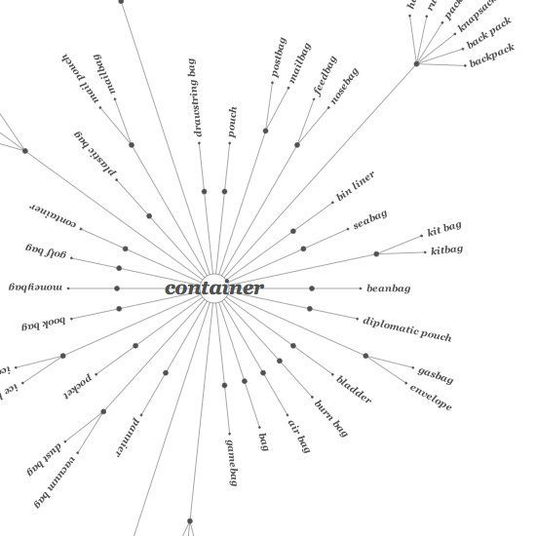
WordNet
Graph, where nodes are words and edges are relationships
There is some hierarchical information, for example with
hyp-er/o-nomy

Slide 23
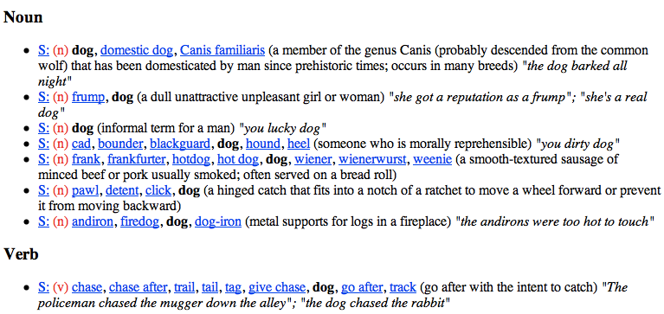
WordNet: dog

Slide 24
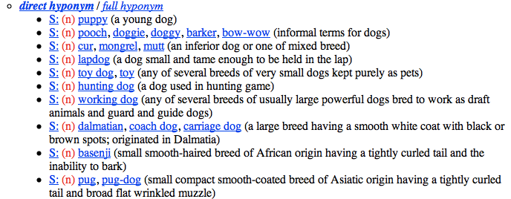
WordNet: dog

Slide 25
Word similarity: Exercise
How could you calculate word similarity if your only resource was:
the words themselves
WordNet
a dictionary
a corpus

Slide 26
Word similarity
Four general categories
Character-based
turned vs. truned
cognates (night, nacht, nicht, natt, nat, noc, noch)
Semantic web-based (e.g. WordNet)
Dictionary-based
Distributional similarity-based
similar words occur in similar contexts

Slide 27
Character-based similarity
sim(turned, truned) = ?
How might we do this using only the words (i.e. no outside resources?

Slide 28
Edit distance (Levenshtein distance)
The edit distance between w₁ and w₂ is the minimum number of operations to transform w₁ into w₂
Operations:
insertion
deletion
substitution
EDIT(turned, truned) = ?
EDIT(computer, commuter) = ?
EDIT(banana, apple) = ?
EDIT(wombat, worcester) = ?

Slide 29
Edit distance
EDIT(turned, truned) = 2
delete u
insert u
EDIT(computer, commuter) = 1
replace p with m
EDIT(banana, apple) = 5
delete b
replace n with p
replace a with p
replace n with l
replace a with e
EDIT(wombat, worcester) = 6

Slide 30
Better edit distance
Are all operations equally likely?
No
Improvement, give different weights to different operations
replacing a for e is more likely than z for y
Ideas for weightings?
Learn from actual data (known typos, known similar words)
Intuitions: phonetics
Intuitions: keyboard configuration

Slide 31
Vector character-based word similarity
sim(turned, truned) = ?
Any way to leverage our vector-based similarity approaches from last time?

Slide 32
Vector character-based word similarity
sim(turned, truned) = ?
Generate a feature vector based on the characters
(or could also use the set based measures at the character level)
a: 0
b: 0
c: 0
d: 1
e: 1
f: 0
g: 0
…
a: 0
b: 0
c: 0
d: 1
e: 1
f: 0
g: 0
…
problems?

Slide 33
Vector character-based word similarity
sim(restful, fluster) = ?
Character level loses a lot of information
a: 0
b: 0
c: 0
d: 1
e: 1
f: 0
g: 0
…
a: 0
b: 0
c: 0
d: 1
e: 1
f: 0
g: 0
…
ideas?

Slide 34
Vector character-based word similarity
sim(restful, fluster) = ?
Use character bigrams or even trigrams
aa: 0
ab: 0
ac: 0
…
es: 1
…
fu: 1
…
re: 1
…
aa: 0
ab: 0
ac: 0
…
er: 1
…
fl: 1
…
lu: 1
…

Slide 35
Word similarity
Four general categories
Character-based
turned vs. truned
cognates (night, nacht, nicht, natt, nat, noc, noch)
Semantic web-based (e.g. WordNet)
Dictionary-based
Distributional similarity-based
similar words occur in similar contexts

Slide 36
WordNet-like Hierarchy
animal
fish
mammal
reptile
amphibian
wolf
horse
dog
cat
mare
stallion
hunting dog
dachshund
terrier
To utilize WordNet, we often want to think about some graph-based measure.

Slide 37
WordNet-like Hierarchy
animal
fish
mammal
reptile
amphibian
wolf
horse
dog
cat
mare
stallion
hunting dog
dachshund
terrier
Rank the following based on similarity:
SIM(wolf, dog)
SIM(wolf, amphibian)
SIM(terrier, wolf)
SIM(dachshund, terrier)

Slide 38
WordNet-like Hierarchy
animal
fish
mammal
reptile
amphibian
wolf
horse
dog
cat
SIM(dachshund, terrier)
SIM(wolf, dog)
SIM(terrier, wolf)
SIM(wolf, amphibian)
mare
stallion
hunting dog
dachshund
terrier
What information/heuristics did you use to rank these?

Slide 39
WordNet-like Hierarchy
animal
fish
mammal
reptile
amphibian
wolf
horse
dog
cat
SIM(dachshund, terrier)
SIM(wolf, dog)
SIM(terrier, wolf)
SIM(wolf, amphibian)
mare
stallion
hunting dog
dachshund
terrier
path length is important (but not the only thing)
words that share the same ancestor are related
words lower down in the hierarchy are finer grained and therefore closer

Slide 40
WordNet similarity measures
path length doesn’t work very well
Some ideas:
path length scaled by the depth (Leacock and Chodorow, 1998)
With a little cheating:
utilize the probability of a word based on the corpus frequency counts of the word and all children of that word (-log of this is the information content)
words higher up tend to have less information content
more frequent words (and ancestors of more frequent words) tend to have less information content

Slide 41
WordNet similarity measures
Utilizing information content:
information content of the lowest common parent (Resnik, 1995)
information content of the words minus information content of the lowest common parent (Jiang and Conrath, 1997)
information content of the lowest common parent divided by the information content of the words (Lin, 1998)

Slide 42
Word similarity
Four general categories
Character-based
turned vs. truned
cognates (night, nacht, nicht, natt, nat, noc, noch)
Semantic web-based (e.g. WordNet)
Dictionary-based
Distributional similarity-based
similar words occur in similar contexts

Slide 43
Dictionary-based similarity
Word
Dictionary blurb
a large, nocturnal, burrowing mammal, Orycteropus afer, ofcentral and southern Africa, feeding on ants and termites andhaving a long, extensile tongue, strong claws, and long ears.
aardvark
One of a breed of small hounds having long ears, short legs, and a usually black, tan, and white coat.
beagle
Any carnivore of the family Canidae, having prominent canine teeth and, in the wild state, a long and slender muzzle, a deep-chested muscular body, a bushy tail, and large, erect ears. Compare canid.
dog

Slide 44
Dictionary-based similarity
Utilize our text similarity measures
sim(dog, beagle) =
sim( ,
One of a breed of small hounds having long ears, short legs, and a usually black, tan, and white coat.
Any carnivore of the family Canidae, having prominent canine teeth and, in the wild state, a long and slender muzzle, a deep-chested muscular body, a bushy tail, and large, erect ears. Compare canid.
)

Slide 45
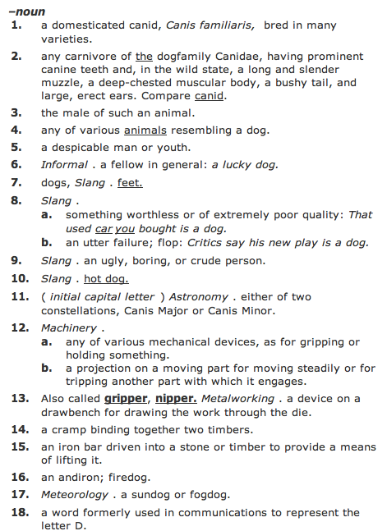
Dictionary-based similarity
What about words that have multiple senses/parts of speech?

Slide 46
Dictionary-based similarity
part of speech tagging
word sense disambiguation
most frequent sense
average similarity between all senses
max similarity between all senses
sum of similarity between all senses

Slide 47
Dictionary + WordNet
WordNet also includes a “gloss” similar to a dictionary definition
Other variants include the overlap of the word senses as well as those word senses that are related (e.g. hypernym, hyponym, etc.)
incorporates some of the path information as well
Banerjee and Pedersen, 2003

Slide 48
Word similarity
Four general categories
Character-based
turned vs. truned
cognates (night, nacht, nicht, natt, nat, noc, noch)
Semantic web-based (e.g. WordNet)
Dictionary-based
Distributional similarity-based
similar words occur in similar contexts

Slide 49
Corpus-based approaches
Word
ANY blurb
aardvark
Ideas?
beagle
dog

Slide 50
Corpus-based
The Beagle is a breed of small to medium-sized dog. A member of the Hound Group, it is similar in appearance to the Foxhound but smaller, with shorter leg
Beagles are intelligent, and are popular as pets because of their size, even temper, and lack of inherited health problems.
Dogs of similar size and purpose to the modern Beagle can be traced in Ancient Greece[2] back to around the 5th century BC.
From medieval times, beagle was used as a generic description for the smaller hounds, though these dogs differed considerably from the modern breed.
In the 1840s, a standard Beagle type was beginning to develop: the distinction between the North Country Beagle and Southern

Slide 51
Corpus-based: feature extraction
The Beagle is a breed of small to medium-sized dog. A member of the Hound Group, it is similar in appearance to the Foxhound but smaller, with shorter leg
We’d like to utilize or vector-based approach
How could we we create a vector from these occurrences?
collect word counts from all documents with the word in it
collect word counts from all sentences with the word in it
collect all word counts from all words within X words of the word
collect all words counts from words in specific relationship: subject-object, etc.

Slide 52
Word-context co-occurrence vectors
The Beagle is a breed of small to medium-sized dog. A member of the Hound Group, it is similar in appearance to the Foxhound but smaller, with shorter leg
Beagles are intelligent, and are popular as pets because of their size, even temper, and lack of inherited health problems.
Dogs of similar size and purpose to the modern Beagle can be traced in Ancient Greece[2] back to around the 5th century BC.
From medieval times, beagle was used as a generic description for the smaller hounds, though these dogs differed considerably from the modern breed.
In the 1840s, a standard Beagle type was beginning to develop: the distinction between the North Country Beagle and Southern

Slide 53
Word-context co-occurrence vectors
The Beagle is a breed
Beagles are intelligent, and
to the modern Beagle can be traced
From medieval times, beagle was used as
1840s, a standard Beagle type was beginning
the: 2
is: 1
a: 2
breed: 1
are: 1
intelligent: 1
and: 1
to: 1
modern: 1
…
Often do some preprocessing like lowercasing and removing stop words

Slide 54
Corpus-based similarity
sim(dog, beagle) =
sim(context_vector(dog), context_vector(beagle))
the: 5
is: 1
a: 4
breeds: 2
are: 1
intelligent: 5
…
the: 2
is: 1
a: 2
breed: 1
are: 1
intelligent: 1
and: 1
to: 1
modern: 1
…

Slide 55
Another feature weighting
TFIDF weighting tanks into account the general importance of a feature
For distributional similarity, we have the feature (f_{i}), but we also have the word itself (w) that we can use for information
This is different from traditional text similarity where we only have f_{i}
Another feature weighting idea
don’t use raw co-occurrence
count how likely feature f_{i} and word w are to occur together
incorporates co-occurrence
but also incorporates how often w and f_{i} occur in other instances

Slide 56
Mutual information
A bit more probability ☺
When will this be high and when will this be low?

Slide 57
Mutual information
A bit more probability ☺
if x and y are independent (i.e. one occurring doesn’t impact the other occurring) p(x,y) = p(x)p(y) and the sum is 0
if they’re dependent then p(x,y) = p(x)p(y|x) = p(y)p(x|y) then we get p(y|x)/p(y) (i.e. how much more likely are we to see y given x has a particular value) or vice versa p(x|y)/p(x)

Slide 58
Pointwise mutual information
Mutual information
How related are two variables (i.e. over all possible values/events)
Pointwise mutual information
How related are two events/values

Slide 59
PMI weighting
Mutual information is often used for features selection in many problem areas
PMI weighting weights co-occurrences based on their correlation (i.e. high PMI)
context_vector(beagle)
this would likely be lower
the: 2
is: 1
a: 2
breed: 1
are: 1
intelligent: 1
and: 1
to: 1
modern: 1
…
this would likely be higher

Slide 60
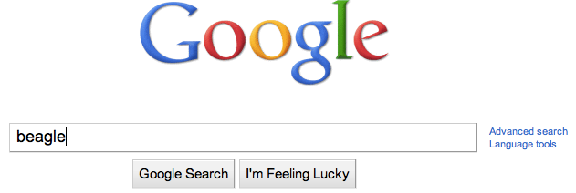
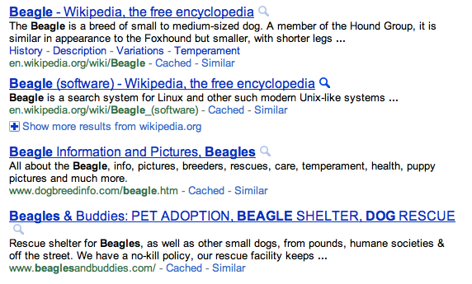
Web-based similarity
beagle
How can we make a document/blurb from this?
Notes:
yahoo and some others allow you API access to their search engine

Slide 61
Web-based similarity
Concatenate the snippets for the top N results
Concatenate the web page text for the top N results

