Slide 1
Text Similarity
David Kauchak CS159 Spring 2011

Slide 2
Quiz #2
Out of 30 points
High: 28.75
Ave: 23
Will drop lowest quiz
I do not grade based on absolutes

Slide 3
Class feedback
Thanks!
Specific comments:
“Less/no Java :)”
http://www.langpop.com/
http://www.devtopics.com/most-popular-programming-languages/
“tell us to get up more often and stretch and high-five”
“Drop lowest quiz grade”
“more labs”

Slide 4
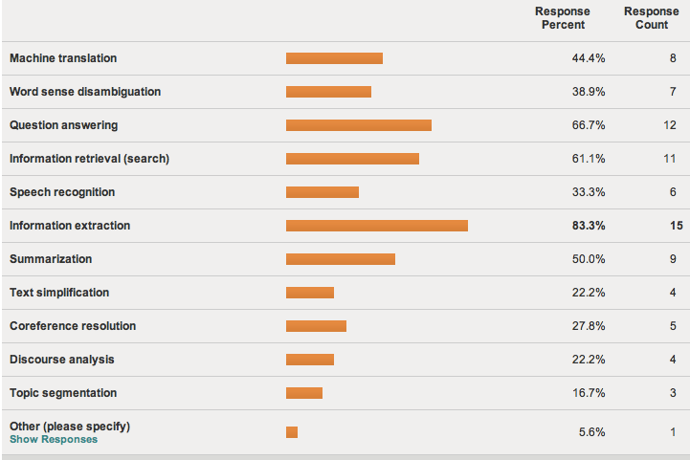
Class presentations

Slide 5
Class presentations
Presentations done in pairs (and one triplet)
25 minutes for presentation 10 min. for Q+A
In the week following your presentation, come by and see me for 5-10 min. for feedback
5% of your grade is based on your presentation
I will also be looking for improvement from this presentation to your final project presentation
If you are not presenting, you should spend at least 30 min. on each paper reading it before class

Slide 6
Class presentations
7 of you still haven’t e-mailed me preferences!
If you e-mail me by 5pm today, I’ll take those into account
I will post the assignments later today
I’ll try and give everyone their first choice

Slide 7
Other Admin
Assignment 5 (last assignment!) will be posted soon and due next Friday (4/1)
I will post final project deadlines, specifications, etc. soon
Groups 2-3 (possibly 4)
~4 weeks of actual coding/writing
Start thinking about final projects
Project proposals will be due ~ April 4
How many of you are seniors?
I will have to shift some things in the schedule since you’re grades are due early ☺

Slide 8
Text Similarity
A common question in NLP is how similar are texts
sim(
,
) = ?
score:
?
How could these be useful? Applications?
rank:

Slide 9
Text similarity: applications
Information retrieval (search)
Data set (e.g. web)
query

Slide 10
Text similarity: applications
Text classification
sports
These “documents” could be actual documents, for example using k-means or pseudo-documents, like a class centroid/average
politics
business

Slide 11
Text similarity: applications
Text clustering
Notes:
need some notion of the distance between text documents if we’re going to cluster them

Slide 12
Text similarity: application
Automatic evaluation
human answer
sim
text to text
output
(machine translation,
summarization,
simplification)

Slide 13
Text similarity: applications
Word similarity
Word-sense disambiguation
sim( banana, apple ) = ?
I went to the bank to get some money.
financial bank
river bank

Slide 14
Text similarity: application
Automatic grader
Question: what is a variable? Answer: a location in memory that can store a value
How good are:
a variable is a location in memory where a value can be stored
a named object that can hold a numerical or letter value
it is a location in the computer 's memory where it can be stored for use by a program
a variable is the memory address for a specific type of stored data or from a mathematical perspective a symbol representing a fixed definition with changing values
a location in memory where data can be stored and retrieved

Slide 15
Text similarity
There are many different notions of similarity depending on the domain and the application
Today, we’ll look at some different tools
There is no one single tool that works in all domains

Slide 16
Text similarity approaches
sim(
,
) = ?
A: When the defendant and his lawyer walked into the court, some of the victim supporters turned their backs to him.
B: When the defendant walked into the courthouse with his attorney, the crowd truned their backs on him.
How can we do this?

Slide 17
The basics: text overlap
Texts that have overlapping words are more similar
A: When the defendant and his lawyer walked into the court, some of the victim supporters turned their backs to him.
B: When the defendant walked into the courthouse with his attorney, the crowd truned their backs on him.

Slide 18
Word overlap: a numerical score
Idea 1: number of overlapping words
A: When the defendant and his lawyer walked into the court, some of the victim supporters turned their backs to him.
B: When the defendant walked into the courthouse with his attorney, the crowd truned their backs on him.
sim( T1, T2 ) = 11
problems?

Slide 19
Word overlap problems
Doesn’t take into word order
Related: doesn’t reward longer overlapping sequences
A: defendant his the When lawyer into walked backs him the court, of supporters and some the victim turned their backs him to.
B: When the defendant walked into the courthouse with his attorney, the crowd truned their backs on him.
sim( T1, T2 ) = 11

Slide 20
Word overlap problems
Doesn’t take into account length
A: When the defendant and his lawyer walked into the court, some of the victim supporters turned their backs to him.
B: When the defendant walked into the courthouse with his attorney, the crowd truned their backs on him. I ate a large banana at work today and thought it was great!
sim( T1, T2 ) = 11

Slide 21
Word overlap problems
Doesn’t take into account synonyms
A: When the defendant and his lawyer walked into the court, some of the victim supporters turned their backs to him.
B: When the defendant walked into the courthouse with his attorney, the crowd truned their backs on him.
sim( T1, T2 ) = 11

Slide 22
Word overlap problems
Doesn’t take into account spelling mistakes
A: When the defendant and his lawyer walked into the court, some of the victim supporters turned their backs to him.
B: When the defendant walked into the courthouse with his attorney, the crowd truned their backs on him. I ate a large banana at work today and thought it was great!
sim( T1, T2 ) = 11

Slide 23
Word overlap problems
Treats all words the same
A: When the defendant and his lawyer walked into the court, some of the victim supporters turned their backs to him.
B: When the defendant walked into the courthouse with his attorney, the crowd truned their backs on him.

Slide 24
Word overlap problems
May not handle frequency properly
A: When the defendant and his lawyer walked into the court, some of the victim supporters turned their backs to him. I ate a banana and then another banana and it was good!
B: When the defendant walked into the courthouse with his attorney, the crowd truned their backs on him. I ate a large banana at work today and thought it was great!

Slide 25
Word overlap: sets
and
backs
court
defendant
him
…
A: When the defendant and his lawyer walked into the court, some of the victim supporters turned their backs to him.
B: When the defendant walked into the courthouse with his attorney, the crowd truned their backs on him.
and
backs
courthouse
defendant
him
…

Slide 26
Word overlap: sets
What is the overlap, using sets?
|A∧B| the size of the intersection
How can we incorporate length/size into this measure?

Slide 27
Word overlap: sets
What is the overlap, using sets?
|A∧B| the size of the intersection
How can we incorporate length/size into this measure?
Jaccard index (Jaccard similarity coefficient)
Dice’s coefficient

Slide 28
Word overlap: sets
How are these related?
Hint: break them down in terms of
words in A but not B
words in B but not A
words in both A and B

Slide 29
Word overlap: sets
in A but not B
in B but not A
Dice’s coefficient gives twice the weight to overlapping words

Slide 30
Set overlap
Our problems:
word order
length
synonym
spelling mistakes
word importance
word frequency
Set overlap measures can be good in some situations, but often we need more general tools

Slide 31
Bag of words representation
For now, let’s ignore word order:
Clinton said banana repeatedly last week on tv, “banana, banana, banana”
(4, 1, 1, 0, 0, 1, 0, 0, …)
clinton
said
california
across
tv
wrong
banana
capital
Frequency of word occurrence

Slide 32
Vector based word
A
a₁: When 1
a₂: the 2
a₃: defendant 1
a₄: and 1
a₅: courthouse 0
…
Think of these as feature vectors
B
b₁: When 1
b₂: the 2
b₃: defendant 1
b₄: and 0
b₅: courthouse 1
…
How do we calculate the similarity based on these feature vectors?

Slide 33
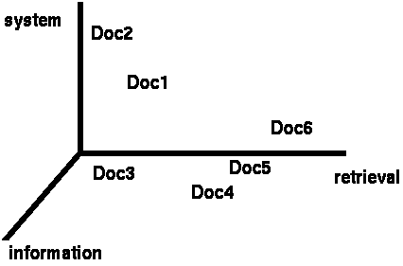
Vector based similarity
We have a |V|-dimensional vector space
Terms are axes of the space
Documents are points or vectors in this space
Very high-dimensional
This is a very sparse vector - most entries are zero
What question are we asking in this space for similarity?

Slide 34
Vector based similarity
Similarity relates to distance
We’d like to measure the similarity of documents in the |V| dimensional space
What are some distance measures?

Slide 35
Distance measures
Euclidean (L2)
Manhattan (L1)

Slide 36
Distance can be problematic
Which d is closest to q using one of the previous distance measures?
Which do you think should be closer?

Slide 37
Distance can be problematic
The Euclidean (or L1) distance between q and d₂ is large even though the distribution of words is similar

Slide 38
Use angle instead of distance
Thought experiment:
take a document d
make a new document d’ by concatenating two copies of d
“Semantically” d and d’ have the same content
What is the Euclidean distance between d and d’? What is the angle between them?
The Euclidean distance can be large
The angle between the two documents is 0

Slide 39
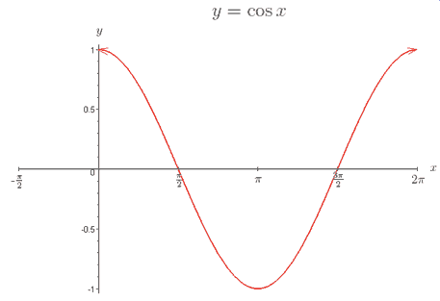
From angles to cosines
Cosine is a monotonically decreasing function for the interval [0º, 180º]
decreasing angle is equivalent to increasing cosine

Slide 40
cosine
How do we calculate the cosine between two vectors?

Slide 41
cosine
Dot product
Just another distance measure, like the others:

Slide 42
Dealing with length
Thought experiment, revisited:
take a document d
make a new document d’ by concatenating two copies of d
How does sim_{cos}(d,d) relate to sim_{cos}(d, d’)?
Does this make sense?

Slide 43
Cosine of two vectors

Slide 44
Length normalization
A vector can be length-normalized by dividing each of its components by its length
Often, we’ll use L₂ norm (could also normalize by other norms):
Dividing a vector by its L₂ norm makes it a unit (length) vector

Slide 45
Unit length vectors
1
1
1
1
In many situations, normalization improves similarity, but not in all situations

Slide 46
Normalized distance measures
Cosine
L2
L1
a’ and b’ are length normalized versions of the vectors

Slide 47
Cosine similarity with 3 documents
How similar are the novels:
SaS: Sense and Sensibility
PaP: Pride and Prejudice, and
WH: Wuthering Heights?
term | SaS | PaP | WH
affection | 115 | 58 | 20
jealous | 10 | 7 | 11
gossip | 2 | 0 | 6
Term frequencies (counts)
Notes:
plot out vectors on the board

Slide 48
Length normalized
term | SaS | PaP | WH
affection | 115 | 58 | 20
jealous | 10 | 7 | 11
gossip | 2 | 0 | 6
Often becomes much clearer after length normalization
term | SaS | PaP | WH
affection | 0.99 | 0.99 | 0.84
jealous | 0.08 | 0.1 | 0.46
gossip | 0.02 | 0 | 0.25

Slide 49
Our problems
Which of these have we addressed?
word order
length
synonym
spelling mistakes
word importance
word frequency

Slide 50
Our problems
Which of these have we addressed?
word order
length
synonym
spelling mistakes
word importance
word frequency

Slide 51
Word overlap problems
Treats all words the same
A: When the defendant and his lawyer walked into the court, some of the victim supporters turned their backs to him.
B: When the defendant walked into the courthouse with his attorney, the crowd truned their backs on him.

Slide 52
Word importance
Include a weight for each word/feature
A
a₁: When 1
a₂: the 2
a₃: defendant 1
a₄: and 1
a₅: courthouse 0
…
w₁
w₂
w₃
w₄
w₅
…
B
b₁: When 1
b₂: the 2
b₃: defendant 1
b₄: and 0
b₅: courthouse 1
…
w₁
w₂
w₃
w₄
w₅
…

Slide 53
Distance + weights
We can incorporate the weights into the distances
Think of it as either (both work out the same):
preprocessing the vectors by multiplying each dimension by the weight
incorporating it directly into the similarity measure

Slide 54
Idea: use corpus statistics
the
defendant
What would be a quantitative measure of word importance?

Slide 55
Document frequency
document frequency (df) is one measure of word importance
Terms that occur in many documents are weighted less, since overlapping with these terms is very likely
In the extreme case, take a word like the that occurs in EVERY document
Terms that occur in only a few documents are weighted more

Slide 56
Document vs. overall frequency
The overall frequency of a word is the number of occurrences in a dataset, counting multiple occurrences
Example:
Which word is a better search term (and should get a higher weight)?
Word | Overall frequency | Document frequency
insurance | 10440 | 3997
try | 10422 | 8760

Slide 57
Document frequency
Word | Collection frequency | Document frequency
insurance | 10440 | 3997
try | 10422 | 8760
Document frequency is often related to word importance, but we want an actual weight. Problems?

Slide 58
From document frequency to weight
Word | Collection frequency | Document frequency
insurance | 10440 | 3997
try | 10422 | 8760
weight and document frequency are inversely related
higher document frequency should have lower weight and vice versa
document frequency is unbounded
document frequency will change depending on the size of the data set (i.e. the number of documents)

Slide 59
Inverse document frequency
# of documents in dataset
document frequency of w
idf is inversely correlated with df
higher df results in lower idf
N incorporates a dataset dependent normalizer
log dampens the overall weight

Slide 60
idf example, suppose N= 1 million
term | df_{t} | idf_{t}
calpurnia | 1
animal | 100
sunday | 1,000
fly | 10,000
under | 100,000
the | 1,000,000
What are the idfs assuming log base 10?

Slide 61
idf example, suppose N= 1 million
term | df_{t} | idf_{t}
calpurnia | 1 | 6
animal | 100 | 4
sunday | 1,000 | 3
fly | 10,000 | 2
under | 100,000 | 1
the | 1,000,000 | 0
There is one idf value/weight for each word

Slide 62
idf example, suppose N= 1 million
term | df_{t} | idf_{t}
calpurnia | 1
animal | 100
sunday | 1,000
fly | 10,000
under | 100,000
the | 1,000,000
What if we didn’t use the log to dampen the weighting?

Slide 63
idf example, suppose N= 1 million
term | df_{t} | idf_{t}
calpurnia | 1 | 1,000,000
animal | 100 | 10,000
sunday | 1,000 | 1,000
fly | 10,000 | 100
under | 100,000 | 10
the | 1,000,000 | 1
What if we didn’t use the log to dampen the weighting?

Slide 64
TF-IDF
One of the most common weighting schemes
TF = term frequency
IDF = inverse document frequency
word importance weight
We can then use this with any of our similarity measures!

