Slide 1
Natural Language Learning: Linear models
David Kauchak
CS159, Spring 2011

Slide 2
Admin
Assignment 2
Perplexity
What was the best training set size?
In general, come talk to me if you’re having problems
Real world: debugging is hard!
Java skills
Assignment 3
Assignment 4, out today

Slide 3
The mind-reading game
How good are you at guessing random numbers?
Repeat 100 times:
Computer guesses whether you’ll type 0/1
You type 0 or 1
http://seed.ucsd.edu/~mindreader/
[written by Y. Freund and R. Schapire]

Slide 4
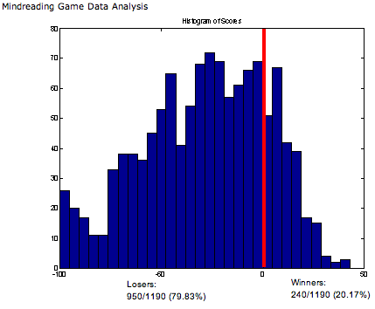
The mind-reading game
The computer is right much more than half the time…

Slide 5
The mind-reading game
The computer is right much more than half the time…
Strategy: computer predicts next keystroke based on the last few (maintains weights on different patterns)
There are patterns everywhere… even in “randomness”!

Slide 6
Why machine learning?
Lot’s of data
Hand-written rules just don’t do it
Performance is much better than what people can do
Why not just study machine learning?
Domain knowledge/expertise is still very important
What types of features to use
What models are important

Slide 7
Machine learning problems
Lots of different types of problems
What data is available:
Supervised, unsupervised, semi-supervised, reinforcement learning
How are we getting the data:
online vs. offline learning
Type of model:
generative vs. disciminative
parametric vs. non-parametric
SVM, NB, decision tree, k-means
What are we trying to predict:
classification vs. regression

Slide 8
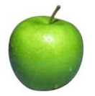
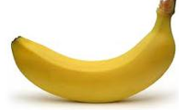
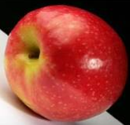
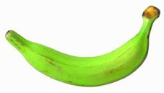
Unsupervised learning
Unupervised learning: given data, but no labels

Slide 9
Unsupervised learning
Much easier to get our hands on unlabeled data
EM was an unsupervised approach
learned clusters/groups without any label
learned grammar probabilities without trees
learned HMM probabilities without labels
Because there is no label, often can get odd results
grammar learned by inside-outside often has little relation to linguistically motivated grammar
may cluster bananas/apples or green/red/yellow

Slide 10
Supervised learning
APPLES
BANANAS
Supervised learning: given labeled data

Slide 11
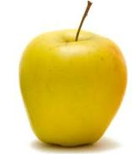
Supervised learning
Given labeled examples, learn to label unlabeled examples
APPLE or BANANA?
Supervised learning: learn to classify unlabeled

Slide 12
Supervised learning: training
Labeled data
Data
Label
0
0
model
1
train a
predictive
model
1
0

Slide 13
Supervised learning: testing/classifying
Unlabeled data
labels
1
0
model
0
1
predict
the label
0

Slide 14
Feature based learning
Training or learning phase
Raw data
Label
features
Label
f₁, f₂, f₃, …, f_{m}
0
0
f₁, f₂, f₃, …, f_{m}
0
0
f₁, f₂, f₃, …, f_{m}
1
classifier
1
f₁, f₂, f₃, …, f_{m}
1
train a
predictive
model
extract
features
1
f₁, f₂, f₃, …, f_{m}
0
0

Slide 15
Feature based learning
Testing or classification phase
Raw data
labels
features
f₁, f₂, f₃, …, f_{m}
1
f₁, f₂, f₃, …, f_{m}
0
f₁, f₂, f₃, …, f_{m}
classifier
0
extract
features
f₁, f₂, f₃, …, f_{m}
1
predict
the label
f₁, f₂, f₃, …, f_{m}
0

Slide 16
Feature examples
Raw data
Features?

Slide 17
Feature examples
Raw data
Features
Clinton said banana repeatedly last week on tv, “banana, banana, banana”
(1, 1, 1, 0, 0, 1, 0, 0, …)
clinton
said
california
across
tv
wrong
banana
capital
Occurrence of words

Slide 18
Feature examples
Raw data
Features
Clinton said banana repeatedly last week on tv, “banana, banana, banana”
(4, 1, 1, 0, 0, 1, 0, 0, …)
clinton
said
california
across
tv
wrong
banana
capital
Frequency of word occurrence

Slide 19
Feature examples
Raw data
Features
Clinton said banana repeatedly last week on tv, “banana, banana, banana”
(1, 1, 1, 0, 0, 1, 0, 0, …)
clinton said
said banana
california schools
across the
tv banana
wrong way
capital city
banana repeatedly
Occurrence of bigrams

Slide 20
Lots of other features
POS: occurrence, counts, sequence
Constituents
Whether ‘V1agra’ occurred 15 times
Whether ‘banana’ occurred more times than ‘apple’
If the document has a number in it
…
Features are very important, but we’re going to focus on the models today

Slide 21
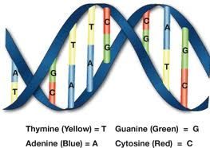
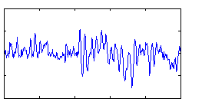
Power of feature-base methods
General purpose: any domain where we can represent a data point as a set of features, we can use the method

Slide 22
The feature space
f₂
Government
Science
Arts
f₁
Notes:
- once we have the features, often nice to think about these as just data points in some m-dimensional space

Slide 23
The feature space
Spam
f₂
not-Spam
f₃
f₁

Slide 24
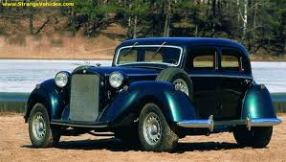
Feature space
f₁, f₂, f₃, …, f_{m}
m-dimensional space
How big will m be for us?

Slide 25
Bayesian Classification
We represent a data item based on the features:
Training
a:
b:
For each label/class, learn a probability distribution based on the features

Slide 26
Bayesian Classification
We represent a data item based on the features:
Classifying
Given an new example, classify it as the label with the largest conditional probability

Slide 27
Bayes rule for classification
conditional (posterior) probability
prior probability
Why not model P(Label|Data) directly?

Slide 28
Bayesian classifiers
different distributions for different labels
Bayes rule
two models to learn for each label/class

Slide 29
The Naive Bayes Classifier
spam
buy
enlargement
assume binary features for now
viagra
now
the
Conditional Independence Assumption: features are independent of each other given the class:

Slide 30
Estimating parameters
p(‘v1agra’ | spam)
p(‘the’ | spam)
p(‘enlargement’ | not-spam)
…
For us:

Slide 31
Maximum likelihood estimates
number of items with label
total number of items
number of items with the label with feature
number of items with label

Slide 32
Naïve Bayes Text Classification
Features: word occurring in a document (though others could be used…)
Does the Naïve Bayes assumption hold?
Are word occurrences independent given the label?
Lot’s of text classification problems
sentiment analysis: positive vs. negative reviews
category classification
spam

Slide 33
Naive Bayes on spam email
http://www.cnbc.cmu.edu/~jp/research/email.paper.pdf
Notes:
This graph is from
http://www.cs.utexas.edu/users/jp/research/email.paper.pdf
Naive-Bayes vs. Rule-Learning in Classification of Email
Jefferson Provost, UT Austin

Slide 34
Linear models
A linear model predicts the label based on a weighted, linear combination of the features
For two classes, a linear model can be viewed as a plane (hyperplane) in the feature space
f₂
f₃
f₁

Slide 35
Linear models
Is naïve bayes a linear model?
f₂
f₃
f₁

Slide 36
Linear models: NB
f₁w₁
f₂w₂
w₀

Slide 37
Regression vs. classification
Raw data
Label
features
Label
f₁, f₂, f₃, …, f_{n}
0
classification: discrete (some finite set of labels)
regression: real value
f₁, f₂, f₃, …, f_{n}
0
f₁, f₂, f₃, …, f_{n}
1
extract
features
f₁, f₂, f₃, …, f_{n}
1
f₁, f₂, f₃, …, f_{n}
0

Slide 38
Regression vs. classification
Examples
features
response
predict a readability score between 0-100 for a document
predict the number of votes/reposts
predict cost to insure
predict income
predict life longevity
…
f₁, f₂, f₃, …, f_{n}
1.0
f₁, f₂, f₃, …, f_{n}
2.3
f₁, f₂, f₃, …, f_{n}
.3
f₁, f₂, f₃, …, f_{n}
100.4
f₁, f₂, f₃, …, f_{n}
123

Slide 39
Model-based regression
Just like unsupervised approaches, may supervised approaches start with some model and try and “fit it” to the data
Regression models
linear
logistic
polynomial
…

Slide 40
Linear regression
Given some points, find the line that best fits/explains the data
Our model is a line, i.e. we’re assuming a linear relationship between the feature and the label value
response (y)
f₁
How can we find this line?

Slide 41
Linear regression
Learn a line h that minimizes some error function:
Sum of the individual errors:
response
(y)
for that example, what was the difference between actual and predicted
feature (x)
Notes:
- squared error is optimal if we assume that the data was actually generated from a line with gaussian data

Slide 42
Error minimization
How do we find the minimum of an equation (think back to calculus…)?
Take the derivative, set to 0 and solve (going to be a min or a max)
Any problems here?
Ideas?

Slide 43
Linear regression
response
what’s the difference?
feature
Notes:
- squared error is optimal if we assume that the data was actually generated from a line with gaussian data

Slide 44
Linear regression
Learn a line h that minimizes an error function:
response
in the case of a 2d line:
function for a line
feature
Notes:
- squared error is optimal if we assume that the data was actually generated from a line with gaussian data

Slide 45
Linear regression
We’d like to minimize the error
Find w₁ and w₀ such that the error is minimized
We can solve this in closed form

Slide 46
Multiple linear regression
Often, we don’t just have one feature, but have many features, say m
Now we have a line in m dimensions
Still just a line
weights
A linear model is additive. The weight of the feature dimension specifies importance/direction

Slide 47
Multiple linear regression
We can still calculate the squared error like before
Still can solve this exactly!

Slide 48
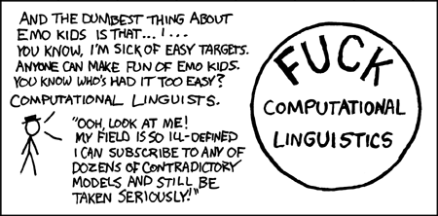
Probabilistic classification
We’re NLP people
We like probabilities!
http://xkcd.com/114/
We’d like to do something like regression, but that gives us a probability
Notes:
we could just train a model with our labels between 0 and 1

Slide 49
Classification
- Nothing constrains it to be a probability
- Could still have combination of features and weight that exceeds 1 or is below 0

Slide 50
The challenge
Linear regression
probability
+∞
1
Find some equation based on the probability that ranges from -∞ to +∞
-∞
0

Slide 51
Odds ratio
Rather than predict the probability, we can predict the ratio of 1/0 (true/false)
Predict the odds that it is 1 (true): How much more likely is 1 than 0.
Does this help us?

Slide 52
Odds ratio
Linear regression
odds ratio
+∞
+∞
Where is the dividing line between class 1 and class 0 being selected?
-∞
0

Slide 53
Odds ratio
We’re trying to find some transformation that transforms the odds ratio to a number that is -∞ to +∞
Does this suggest another transformation?
odds ratio
0 1 2 3 4 5 6 7 8 9 ….

Slide 54
Log odds (logit function)
Linear regression
odds ratio
+∞
+∞
How do we get the probability of an example?
-∞
-∞

Slide 55
Log odds (logit function)
…
anyone recognize this?

Slide 56
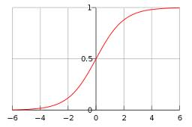
Logistic function

Slide 57
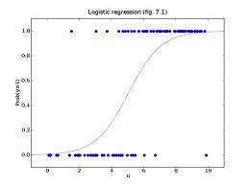
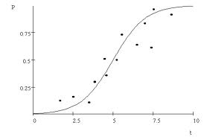
Logistic regression
Find the best fit of the data based on a logistic

Slide 58
Logistic regression
How would we classify examples once we had a trained model?
If the sum > 0 then p(1)/p(0) > 1, so positive
if the sum < 0 then p(1)/p(0) < 1, so negative
Still a linear classifier (decision boundary is a line)

