Slide 1
Hand video
http://www.youtube.com/watch?v=-KxjVlaLBmk

Slide 2
Parsing 3
David Kauchak
CS159 – Spring 2011
some slides adapted from Dan Klein

Slide 3
Admin
Assignment 3 out
  Due Friday at 6pm
How are things going?
Where we’ve been
Where we’re going

Slide 4
Parsing evaluation
You’ve constructed a parser
You want to know how good it is
Ideas?

Slide 5
Parsing evaluation
Treebank
Train
Dev
Test
Learn a model using the training set
Parse the test set without looking at the “correct” trees
Compare our generated parse tree to the “correct” tree

Slide 6
Comparing trees
Computed Tree P
Correct Tree T
S
S
S
VP
VP
NP
NP
NP
PP
NP
PP
PRP
V
PRP
V
N
IN
N
N
IN
N
I eat sushi with tuna
I eat sushi with tuna
Ideas?

Slide 7
Comparing trees
Idea 1: see if the trees match exactly
  Problems?
    Will have a low number of matches (people often disagree)
    Doesn’t take into account getting it almost right
Idea 2: compare the constituents

Slide 8
Comparing trees
Computed Tree P
Correct Tree T
S
S
S
VP
VP
NP
NP
NP
PP
NP
PP
PRP
V
PRP
V
N
IN
N
N
IN
N
I eat sushi with tuna
I eat sushi with tuna
How many constituents match?
How can we turn this into a score?

Slide 9
Evaluation measures
Precision
Recall
F1
# of correct constituents
# of constituents in the computed tree
# of correct constituents
# of constituents in the correct tree
2 * Precision * Recall
Precision + Recall

Slide 10
Comparing trees
Computed Tree P
Correct Tree T
S
S
S
VP
VP
NP
NP
NP
PP
NP
PP
PRP
V
PRP
V
N
IN
N
N
IN
N
I eat sushi with tuna
I eat sushi with tuna
# Constituents: 11
# Correct Constituents: 9
# Constituents: 10
Precision:
9/11
Recall:
9/10
F1:
0.857

Slide 11
Parsing evaluation
Corpus: Penn Treebank, WSJ
Parsing has been fairly standardized to allow for easy comparison between systems
Training: | sections | 02-21
Development: | section | 22 (here, first 20 files)
Test: | section | 23

Slide 12
Treebank PCFGs
Use PCFGs for broad coverage parsing
Can take a grammar right off the trees (doesn’t work well):
ROOT → S
S → NP VP .
NP → PRP
VP → VBD ADJP
…..
Model | F1
Baseline | 72.0

Slide 13
Generic PCFG Limitations
PCFGs do not use any information about where the current constituent is in the tree
PCFGs do not rely on specific words or concepts, only general structural disambiguation is possible (e.g. prefer to attach PPs to Nominals)
MLE estimates are not always the best

Slide 14
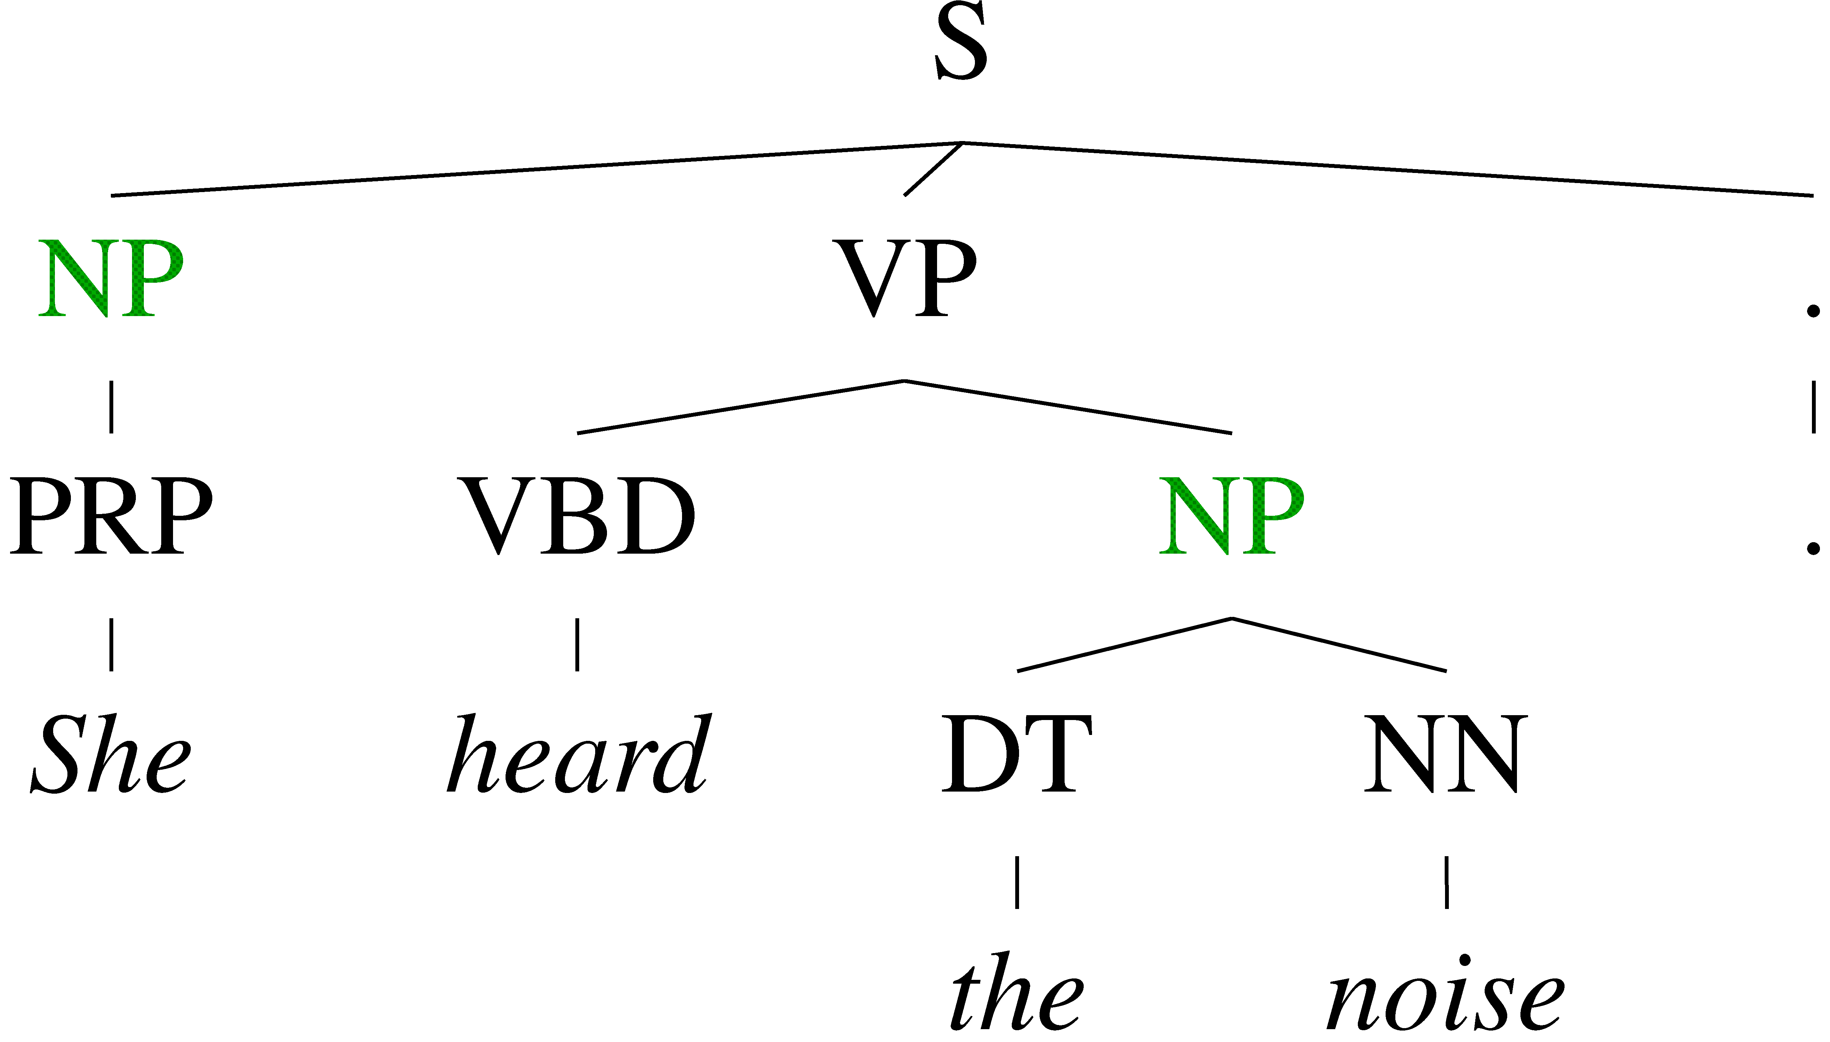
Conditional Independence?
Not every NP expansion can fill every NP slot
  A grammar with symbols like “NP” won’t be context-free
  Statistically, conditional independence too strong

Slide 15
Non-Independence
Independence assumptions are often too strong.
Example: the expansion of an NP is highly dependent on the parent of the NP (i.e., subjects vs. objects).
Also: the subject and object expansions are correlated
All NPs
NPs under S
NPs under VP

Slide 16
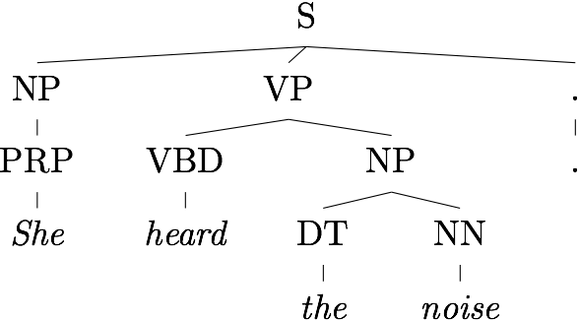
Grammar Refinement
PCFG would treat these two NPs the same… but they’re not!
We can’t exchange them: “the noise heard she”
Idea: expand/refine our grammar
Challenges:
  Must refine in ways that facilitate disambiguation
  Too much refinement -> sparsity problems
  To little -> can’t discriminate (PCFG)

Slide 17
Grammar Refinement
Ideas?

Slide 18
Grammar Refinement
Structure Annotation [Johnson ’98, Klein&Manning ’03]
  Differentiate constituents based on their local context
Lexicalization [Collins ’99, Charniak ’00]
  Differentiate constituents based on the spanned words
Constituent splitting [Matsuzaki et al. 05, Petrov et al. ’06]
  Cluster/group words into sub-constituents

Slide 19
Less independence
S
S -> NP VP
NP -> PRP
PRP -> I
VP -> V NP
V -> eat
NP -> N PP
N -> sushi
PP -> IN N
IN -> with
N -> tuna
VP
NP
NP
PP
PRP
V
N
IN
N
I eat sushi with tuna
We’re making a strong independence assumption here!

Slide 20
Markovization
Except for the root node, every node in a parse tree has:
  A vertical history/context
  A horizontal history/context
S
NP
VP
VBD
NP
NP
Traditional PCFGs use the full horizontal context and a vertical context of 1

Slide 21
Vertical Markovization
Vertical Markov order: rewrites depend on past k ancestor nodes.
Order 1 is most common: aka parent annotation
Order 1
Order 2

Slide 22
Allows us to make finer grained distinctions
^S
^VP

Slide 23
Vertical Markovization
F1 performance
# of non-terminals
Notes:
we increase the size of the grammar, allowing us to better discriminate

Slide 24
Horizontal Markovization
Horizontal Markov order: rewrites depend on past k ancestor nodes
Order 1 is most common: condition on a single sibling
Order 1
Order ∞

Slide 25
Horizontal Markovization
F1 performance
# of non-terminals

Slide 26
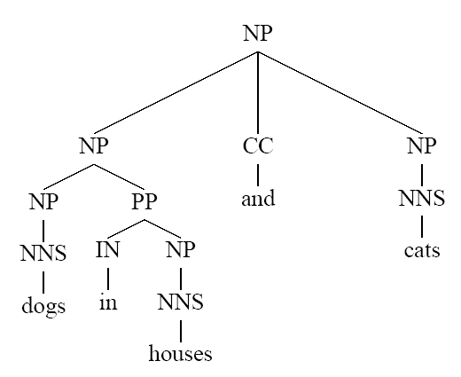
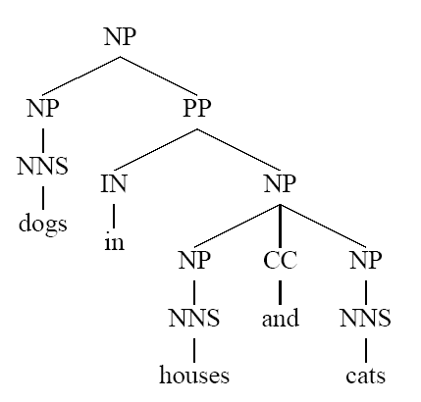
Problems with PCFGs
What’s different between basic PCFG scores here?

Slide 27
Example of Importance of Lexicalization
A general preference for attaching PPs to NPs rather than VPs can be learned by a vanilla PCFG.
But the desired preference can depend on specific words.
John put the dog in the pen.
S → NP VP
S → VP
NP → Det A N
NP → NP PP
NP → PropN
A → ε
A → Adj A
PP → Prep NP
VP → V NP
VP → VP PP
0.9
0.1
0.5
0.3
0.2
0.6
0.4
1.0
0.7
0.3
S
NP VP
PCFG
Parser
John V NP PP
put the dog in the pen
English
27

Slide 28
Example of Importance of Lexicalization
A general preference for attaching PPs to NPs rather than VPs can be learned by a vanilla PCFG.
But the desired preference can depend on specific words.
John put the dog in the pen.
S → NP VP
S → VP
NP → Det A N
NP → NP PP
NP → PropN
A → ε
A → Adj A
PP → Prep NP
VP → V NP
VP → VP PP
0.9
0.1
0.5
0.3
0.2
0.6
0.4
1.0
0.7
0.3
S
X
NP VP
PCFG
Parser
John V NP
put the dog in the pen
English
28
Notes:
28

Slide 29
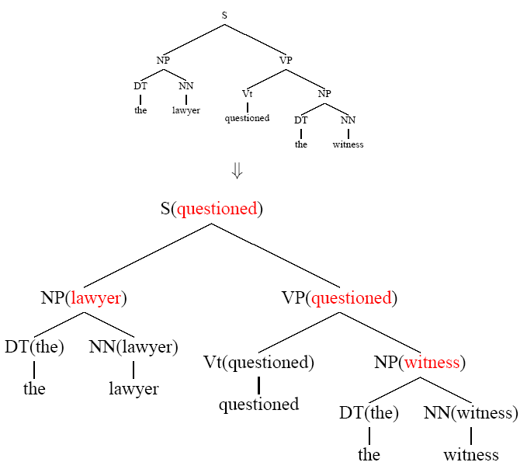
Lexicalized Trees
How could we lexicalize the grammar/tree?

Slide 30
Lexicalized Trees
Add “headwords” to each phrasal node
  Syntactic vs. semantic heads
  Headship not in (most) treebanks
  Usually use head rules, e.g.:
    NP:
      Take leftmost NP
      Take rightmost N*
      Take rightmost JJ
      Take right child
    VP:
      Take leftmost VB*
      Take leftmost VP
      Take left child

Slide 31
Lexicalized PCFGs?
Problem: we now have to estimate probabilities like
How would we estimate the probability of this rule?
Never going to get these automically off of a treebank
Ideas?
VP(put) → VBD(put) NP(dog) PP(in)
Count(VP(put) -> VBD(put) NP(dog) PP(in))
Count(VP (put))

Slide 32
One approach
Combine this with some of the markovization techniques we saw
Collins’ (1999) parser
  Models productions based on context to the left and the right of the head daughter.
    LHS → L_{n}L_{n−1}…L₁H R₁…R_{m−1}R_{m}
  First generate the head (H) and then repeatedly generate left (L_{i}) and right (R_{i}) context symbols until the symbol STOP is generated.

Slide 33
Sample Production Generation
Note: Penn treebank tends to
have fairly flat parse trees that
produce long productions.
VPput → VBDput NPdog PPin
VPput →
STOP
VBDput
NPdog
PPin
STOP
L₁
H
R₁
R₂
R₃
P_{L}(STOP | VPput) * P_{H}(VBD | Vpput)*
P_{R}(NPdog | VPput)*
P_{R}(PPin | VPput) * P_{R}(STOP | PPin)

Slide 34
Estimating Production Generation Parameters
Estimate P_{H}, P_{L}, and P_{R} parameters from treebank data.
Count(PPin right of head in a VPput production)
P_{R}(PPin | VPput) =
Count(symbol right of head in a VPput-VBD)
Count(NPdog right of head in a VPput production)
P_{R}(NPdog | VPput) =
Count(symbol right of head in a VPput)
Smooth estimates by combining with simpler models conditioned on just POS tag or no lexical info
smP_{R}(PPin | VPput-) = λ₁ P_{R}(PPin | VPput)
+ (1− λ₁) (λ₂ P_{R}(PPin | VPVBD) +
(1− λ₂) P_{R}(PPin | VP))

Slide 35
Problems with lexicalization
We’ve solved the estimation problem
There’s also the issue of performance
Lexicalization causes the size of the number of grammar rules to explode!
Our parsing algorithms take too long too finish
Ideas?

Slide 36
Pruning during search
We can no longer keep all possible parses around
We can no longer guarantee that we actually return the most likely parse
Beam search [Collins 99]
  In each cell only keep the K most likely hypothesis
  Disregard constituents over certain spans (e.g. punctuation)
  F1 of 88.6!

Slide 37
Pruning with a PCFG
The Charniak parser prunes using a two-pass approach [Charniak 97+]
  First, parse with the base grammar
  For each X:[i,j] calculate P(X|i,j,s)
    This isn’t trivial, and there are clever speed ups
  Second, do the full O(n⁵) CKY
    Skip any X :[i,j] which had low (say, < 0.0001) posterior
  Avoids almost all work in the second phase!
F1 of 89.7!

Slide 38
Tag splitting
Lexicalization is an extreme case of splitting the tags to allow for better discrimination
Idea: what if rather than doing it for all words, we just split some of the tags

Slide 39
Tag Splits
Problem: Treebank tags are too coarse
Example: Sentential, PP, and other prepositions are all marked IN
Partial Solution:
  Subdivide the IN tag
Annotation | F1 | Size
Previous | 78.3 | 8.0K
SPLIT-IN | 80.3 | 8.1K

Slide 40
Other Tag Splits
F1 | Size
80.4 | 8.1K
80.5 | 8.1K
81.2 | 8.5K
81.6 | 9.0K
81.7 | 9.1K
81.8 | 9.3K
UNARY-DT: mark demonstratives as DT^U (“the X” vs. “those”)
UNARY-RB: mark phrasal adverbs as RB^U (“quickly” vs. “very”)
TAG-PA: mark tags with non-canonical parents (“not” is an RB^VP)
SPLIT-AUX: mark auxiliary verbs with –AUX [cf. Charniak 97]
SPLIT-CC: separate “but” and “&” from other conjunctions
SPLIT-%: “%” gets its own tag.

Slide 41
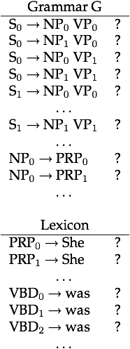
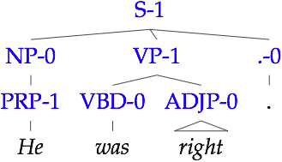
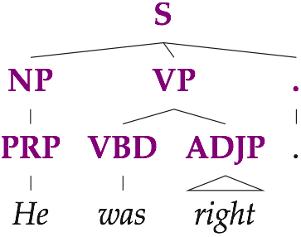
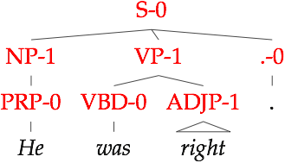

Learning good splits:
Latent Variable Grammars
...
Parse Tree
Sentence
Derivations
Parameters
Notes:
So, what are latent variable grammars? The idea is that we take our observed parse trees and augment them with latent variables at each node. Each observed category, like NP, is thereby split into a set of subcategories NP-0 through NP-k. This also creates a set of exponentially many derivations. We then learn distributions over the new subcategories and these derivations. The resulting grammars look like this, where we have now many rules for each of the original rules that we started with. For example ...
The learning process determines the exact set of rules, as well as the parameter values.

