Slide 1
Clustering Beyond
K-means
David Kauchak
CS 158 – Fall 2019

Slide 2
Administrative
Assignment 8 back
Final project
  Status reports due tomorrow (can use late days)
  Presentations on Tuesday
    4 minute max
    2-3 slides. E-mail me by noon on Tuesday
    What problem you tackled and results
  Paper and final code submitted on Wednesday
Next class: skim the papers

Slide 3
K-means
Start with some initial cluster centers
Iterate:
  Assign/cluster each example to closest center
  Recalculate centers as the mean of the points in a cluster

Slide 4
Problems with K-means
Determining K is challenging
Hard clustering isn’t always right
Assumes clusters are spherical
Greedy approach

Slide 5
Problems with K-means
What would K-means give us here?

Slide 6
Assumes spherical clusters
k-means assumes spherical clusters!

Slide 7
K-means: another view

Slide 8
K-means: another view

Slide 9
K-means: assign points to nearest center

Slide 10
K-means: readjust centers
Iteratively learning a collection of spherical clusters

Slide 11
EM clustering: mixtures of Gaussians
Assume data came from a mixture of Gaussians (elliptical data), assign data to cluster with a certain probability (soft clustering)
k-means
EM

Slide 12
EM clustering
Very similar at a high-level to K-means
Iterate between assigning points and recalculating cluster centers
Two main differences between K-means and EM clustering:
We assume elliptical clusters (instead of spherical)
It is a “soft” clustering algorithm

Slide 13
Soft clustering
p(red) = 0.8
p(blue) = 0.2
p(red) = 0.9
p(blue) = 0.1

Slide 14
EM clustering
Start with some initial cluster centers
Iterate:
soft assign points to each cluster
recalculate the cluster centers
Calculate: p(θ_{c}| x)
the probability of each point belonging to each cluster
Calculate new cluster parameters, θ_{c}
maximum likelihood cluster centers given the current soft clustering

Slide 15
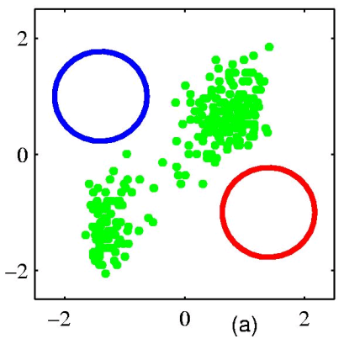
EM example
Start with some initial cluster centers
Figure from Chris Bishop

Slide 16
Step 1: soft cluster points
Which points belong to which clusters (soft)?
Figure from Chris Bishop

Slide 17
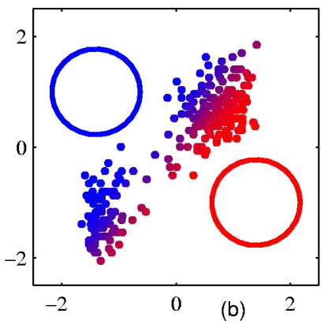
Step 1: soft cluster points
Notice it’s a soft (probabilistic) assignment
Figure from Chris Bishop

Slide 18
Step 2: recalculate centers
What do the new centers look like?
Figure from Chris Bishop

Slide 19
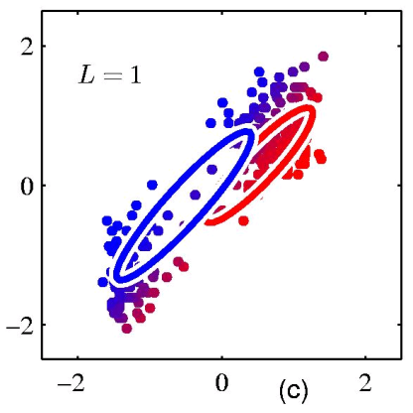
Step 2: recalculate centers
Cluster centers get a weighted contribution from points
Figure from Chris Bishop

Slide 20
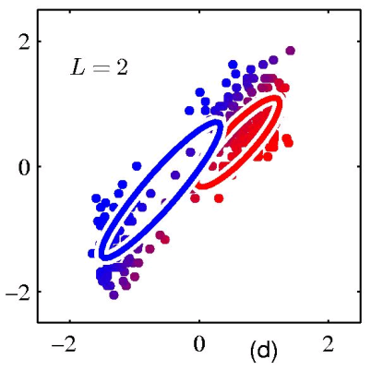
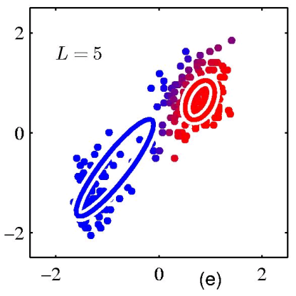
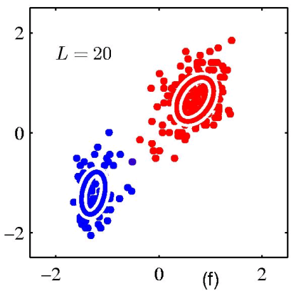
keep iterating…
Figure from Chris Bishop

Slide 21
Model: mixture of Gaussians
How do you define a Gaussian (i.e. ellipse)?
In 1-D?
In m-D?

Slide 22
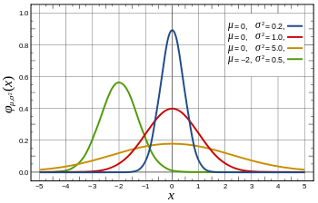
Gaussian in 1D
parameterized by the mean and the standard deviation/variance

Slide 23
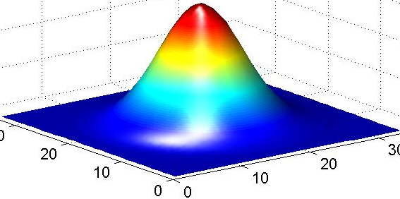
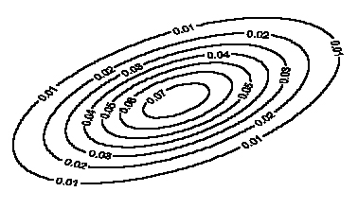
Gaussian in multiple dimensions
Covariance determines
the shape of these contours
We learn the means of each cluster (i.e. the center) and the covariance matrix (i.e. how spread out it is in any given direction)

Slide 24
Step 1: soft cluster points
soft assign points to each cluster
  Calculate: p(θ_{c}|x)
  the probability of each point belonging to each cluster
How do we calculate these probabilities?

Slide 25
Step 1: soft cluster points
soft assign points to each cluster
  Calculate: p(θ_{c}|x)
  the probability of each point belonging to each cluster
Just plug into the Gaussian equation for each cluster!
(and normalize to make a probability)

Slide 26
Step 2: recalculate centers
Recalculate centers:
  calculate new cluster parameters, θ_{c}
  maximum likelihood cluster centers given the current soft clustering
How do calculate the cluster centers?

Slide 27
Fitting a Gaussian
What is the “best”-fit Gaussian for this data?
10, 10, 10, 9, 9, 8, 11, 7, 6, …
Recall this is the 1-D Gaussian equation:

Slide 28
Fitting a Gaussian
What is the “best”-fit Gaussian for this data?
10, 10, 10, 9, 9, 8, 11, 7, 6, …
The MLE is just the mean and variance of the data!
Recall this is the 1-D Gaussian equation:

Slide 29
Step 2: recalculate centers
Recalculate centers:
  Calculate θ_{c}
  maximum likelihood cluster centers given the current soft clustering
How do we deal with “soft” data points?

Slide 30
Step 2: recalculate centers
Recalculate centers:
  Calculate θ_{c}
  maximum likelihood cluster centers given the current soft clustering
Use fractional counts!

Slide 31
E and M steps: creating a better model
EM stands for Expectation Maximization
Expectation: Given the current model, figure out the expected probabilities of the data points to each cluster
p(θ_{c}|x)
What is the probability of each point belonging to each cluster?
Maximization: Given the probabilistic assignment of all the points, estimate a new model, θ_{c}
Just like NB maximum likelihood estimation, except we use fractional counts instead of whole counts

Slide 32
Similar to k-means
Iterate:
  Assign/cluster each point to closest center
  Recalculate centers as the mean of the points in a cluster
Expectation: Given the current model, figure out the expected probabilities of the points to each cluster
p(θ_{c}|x)
Maximization: Given the probabilistic assignment of all the points, estimate a new model, θ_{c}

Slide 33
E and M steps
Expectation: Given the current model, figure out the expected probabilities of the data points to each cluster
Maximization: Given the probabilistic assignment of all the points, estimate a new model, θ_{c}
Iterate:
each iterations increases the likelihood of the data and is guaranteed to converge (though to a local optimum)!

Slide 34
EM
EM is a general purpose approach for training a model when you don’t have labels
Not just for clustering!
  K-means is just for clustering
One of the most general purpose unsupervised approaches
  can be hard to get right!

Slide 35
EM is a general framework
Create an initial model, θ’
  Arbitrarily, randomly, or with a small set of training examples
Use the model θ’ to obtain another model θ such that
  Σ_{i} log P_{θ}(data_{i}) > Σ_{i} log P_{θ’}(data_{i})
Let θ’ = θ and repeat the above step until reaching a local maximum
  Guaranteed to find a better model after each iteration
i.e. better models data
(increased log likelihood)
Where else have you seen EM?

Slide 36
EM shows up all over the place
Training HMMs (Baum-Welch algorithm)
Learning probabilities for Bayesian networks
EM-clustering
Learning word alignments for language translation
Learning Twitter friend network
Genetics
Finance
Anytime you have a model and unlabeled data!

Slide 37
Finding Word Alignments
… la maison … la maison bleue … la fleur …
… the house … the blue house … the flower …
In machine translation, we train from pairs of translated sentences
Often useful to know how the words align in the sentences
Use EM!
  learn a model of P(french-word | english-word)

Slide 38
Finding Word Alignments
… la maison … la maison bleue … la fleur …
… the house … the blue house … the flower …
All word alignments are equally likely
All P(french-word | english-word) equally likely

Slide 39
Finding Word Alignments
… la maison … la maison bleue … la fleur …
… the house … the blue house … the flower …
“la” and “the” observed to co-occur frequently,
so P(la | the) is increased.

Slide 40
Finding Word Alignments
… la maison … la maison bleue … la fleur …
… the house … the blue house … the flower …
“house” co-occurs with both “la” and “maison”, but
P(maison | house) can be raised without limit, to 1.0,
while P(la | house) is limited because of “the”
(pigeonhole principle)

Slide 41
Finding Word Alignments
… la maison … la maison bleue … la fleur …
… the house … the blue house … the flower …
settling down after another iteration

Slide 42
Finding Word Alignments
… la maison … la maison bleue … la fleur …
… the house … the blue house … the flower …
Inherent hidden structure revealed by EM training!
For details, see
- “A Statistical MT Tutorial Workbook” (Knight, 1999).
- 37 easy sections, final section promises a free beer.
- “The Mathematics of Statistical Machine Translation”
(Brown et al, 1993)
- Software: GIZA++

Slide 43
Statistical Machine Translation
… la maison … la maison bleue … la fleur …
… the house … the blue house … the flower …
P(maison | house ) = 0.411
P(maison | building) = 0.027
P(maison | manson) = 0.020
…
Estimating the model from training data

Slide 44
Other clustering algorithms
K-means and EM-clustering are by far the most popular for clustering
However, they can’t handle all clustering tasks
What types of clustering problems can’t they handle?

Slide 45
Non-Gaussian data
What is the problem?
Similar to classification:
global decision (linear model) vs. local decision (K-NN)
Spectral clustering

Slide 46
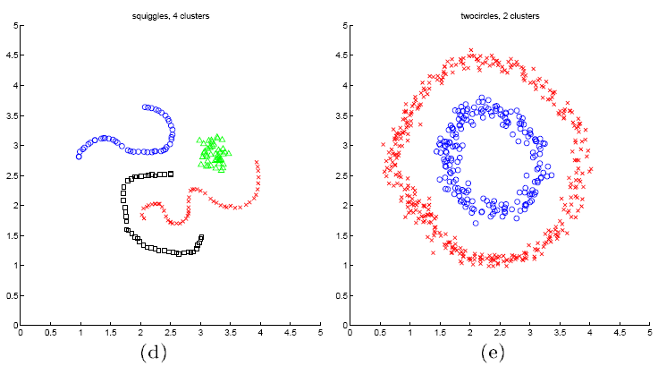
Spectral clustering examples
Ng et al On Spectral clustering: analysis and algorithm

Slide 47
Spectral clustering examples
Ng et al On Spectral clustering: analysis and algorithm

Slide 48
Spectral clustering examples
Ng et al On Spectral clustering: analysis and algorithm

Slide 49
What Is A Good Clustering?
Internal criterion: A good clustering will produce high quality clusters in which:
  the intra-class (that is, intra-cluster) similarity is high
  the inter-class similarity is low
How would you evaluate clustering?

Slide 50
Common approach: use labeled data
Use data with known classes
  For example, document classification data
data
label
If we clustered this data (ignoring labels) what would we like to see?
Reproduces class partitions
How can we quantify this?

Slide 51
Common approach: use labeled data
Purity, the proportion of the dominant class in the cluster
• •
• •
• •
• •
• •
• •
• •
•
Cluster I
Cluster II
Cluster III
Cluster I: Purity = (max(3, 1, 0)) / 4 = 3/4
Cluster II: Purity = (max(1, 4, 1)) / 6 = 4/6
Overall purity?
Cluster III: Purity = (max(2, 0, 3)) / 5 = 3/5

Slide 52
Overall purity
Cluster I: Purity = (max(3, 1, 0)) / 4 = 3/4
Cluster II: Purity = (max(1, 4, 1)) / 6 = 4/6
Cluster III: Purity = (max(2, 0, 3)) / 5 = 3/5
Cluster average:
Weighted average:
Notes:
Similar to macroaveraging vs. microaveraging for multiclass classification

Slide 53
Purity issues…
Purity, the proportion of the dominant class in the cluster
Good for comparing two algorithms, but not understanding how well a single algorithm is doing, why?
  Increasing the number of clusters increases purity

Slide 54
Purity isn’t perfect
Which is better based on purity?
Which do you think is better?
Ideas?

Slide 55
Common approach: use labeled data
Average entropy of classes in clusters
where p(class_{i}) is proportion of class i in cluster

Slide 56
Common approach: use labeled data
Average entropy of classes in clusters
entropy?

Slide 57
Common approach: use labeled data
Average entropy of classes in clusters

Slide 58
Where we’ve been!
How many slides?
1,385 slides

Slide 59
Where we’ve been!
Our ML suite:
How many classes?
How many lines of code?

Slide 60
Where we’ve been!
Our ML suite:
29 classes
2951 lines of code

Slide 61
Where we’ve been!
Our ML suite:
Supports 7 classifiers
  Decision Tree
  Perceptron
  Average Perceptron
  Gradient descent
    2 loss functions
    2 regularization methods
  K-NN
  Naïve Bayes
  2 layer neural network
Supports two types of data normalization
  feature normalization
  example normalization
Supports two types of meta-classifiers
  OVA
  AVA

Slide 62
Where we’ve been!
Hadoop!
- 532 lines of hadoop code in demos

Slide 63
Where we’ve been!
Geometric view of data
Model analysis and interpretation (linear, etc.)
Evaluation and experimentation
Probability basics
Regularization (and priors)
Deep learning
Ensemble methods
Unsupervised learning (clustering)

