Slide 1
Large Margin classifiers
David Kauchak
CS 158 – Fall 2019

Slide 2
Admin
Assignment 5
  Experiments
Assignment 6
Next class: Meet in Edmunds 105
Midterm
Course feedback
  Thanks!
  We’ll go over it at the beginning of next class

Slide 3
Which hyperplane?
Two main variations in linear classifiers:
which hyperplane they choose when the data is linearly separable
how they handle data that is not linearly separable

Slide 4
Linear approaches so far
Perceptron:
  separable:
  non-separable:
Gradient descent:
  separable:
  non-separable:

Slide 5
Linear approaches so far
Perceptron:
  separable:
    finds some hyperplane that separates the data
  non-separable:
    will continue to adjust as it iterates through the examples
    final hyperplane will depend on which examples it saw recently
Gradient descent:
  separable and non-separable
    finds the hyperplane that minimizes the objective function (loss + regularization)
  Which hyperplane is this?

Slide 6
Which hyperplane would you choose?

Slide 7
Large margin classifiers
margin
margin
Choose the line where the distance to the nearest point(s) is as large as possible

Slide 8
Large margin classifiers
margin
margin
The margin of a classifier is the distance to the closest points of either class
Large margin classifiers attempt to maximize this

Slide 9
Support vectors
For any separating hyperplane, there exist some set of “closest points”
These are called the support vectors
For n dimensions, there will be at least n+1 support vectors
Notes:
- they are vectors (i.e. points) and they support/define the line

Slide 10
Measuring the margin
The margin is the distance to the support vectors, i.e. the “closest points”, on either side of the hyperplane

Slide 11
Measuring the margin
negative examples
positive examples

Slide 12
Measuring the margin
What are the equations for the margin lines?
negative examples
positive examples

Slide 13
Measuring the margin
We know they’re the same distance apart (otherwise, they wouldn’t be support vectors!)
What is c?

Slide 14
Measuring the margin
Depends! If we scale w, we vary the constant without changing the separating hyperplane

Slide 15
Measuring the margin
Depends! If we scale w, we vary the constant without changing the separating hyperplane
Larger w result in larger constants

Slide 16
Measuring the margin
Depends! If we scale w, we vary the constant without changing the separating hyperplane
Smaller w result in smaller constants

Slide 17
Measuring the margin
For now, let’s assume c = 1.
What is this distance?

Slide 18
Distance from the hyperplane
How far away is this point from the hyperplane?
f₂
w=(1,2)
f₁
(-1,-2)

Slide 19

Distance from the hyperplane
How far away is this point from the hyperplane?
f₂
w=(1,2)
$$d= \sqrt{\left(−1\right)2+(−2)2}=\sqrt{5}$$
f₁
(-1,-2)

Slide 20
Distance from the hyperplane
How far away is this point from the hyperplane?
f₂
w=(1,2)
(1,1)
f₁

Slide 21
Distance from the hyperplane
How far away is this point from the hyperplane?
f₂
w=(1,2)
Is it?
(1,1)
f₁

Slide 22
Distance from the hyperplane
Does that seem right? What’s the problem?
f₂
w=(1,2)
(1,1)
f₁

Slide 23
Distance from the hyperplane
How far away is the point from the hyperplane?
f₂
w=(2,4)
(1,1)
f₁

Slide 24
Distance from the hyperplane
How far away is the point from the hyperplane?
f₂
w=(2,4)
(1,1)
f₁

Slide 25
Distance from the hyperplane
How far away is this point from the hyperplane?
f₂
w=(1,2)
(1,1)
f₁
length normalized weight vectors

Slide 26
Distance from the hyperplane
How far away is this point from the hyperplane?
f₂
w=(1,2)
(1,1)
f₁

Slide 27
Distance from the hyperplane
The magnitude of the weight vector doesn’t matter
f₂
w=(2,4)
(1,1)
f₁
length normalized weight vectors

Slide 28
Distance from the hyperplane
The magnitude of the weight vector doesn’t matter
f₂
w=(0.5,1)
(1,1)
f₁
length normalized weight vectors

Slide 29
Measuring the margin
For now, let’s just assume c = 1.
What is this distance?

Slide 30
Measuring the margin
For now, let’s just assume c = 1.
?

Slide 31
Measuring the margin
For now, let’s just assume c = 1.

Slide 32
Large margin classifier setup
Select the hyperplane with the largest margin where the points are classified correctly and outside the margin!
Setup as a constrained optimization problem:
subject to:
what does this say?
Notes:
All points are classified correctly AND they have a prediction >= 1.

Slide 33
Large margin classifier setup
Select the hyperplane with the largest margin where the points are classified correctly and outside the margin!
Setup as a constrained optimization problem:
subject to:
Notes:
All points are classified correctly AND they have a prediction >= 1.

Slide 34
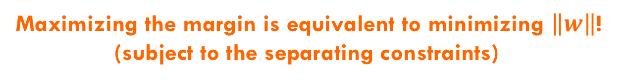
Maximizing the margin
subject to:
Maximizing the margin is equivalent to minimizing $\left\|w\right\|$!
(subject to the separating constraints)

Slide 35
Maximizing the margin
The minimization criterion wants w to be as small as possible
subject to:
The constraints:
make sure the data is separable
encourages w to be larger (once the data is separable)

Slide 36
Measuring the margin
For now, let’s just assume c = 1.
Claim: it does not matter what c we choose for the SVM problem. Why?

Slide 37
Measuring the margin
What is this distance?

Slide 38
Measuring the margin

Slide 39
Maximizing the margin
subject to:
vs.
What’s the difference?
subject to:

Slide 40
Maximizing the margin
subject to:
Learn the exact same hyperplane just scaled by a constant amount
Because of this, often see it with c = 1
vs.
subject to:

Slide 41
For those that are curious…
scaled version of w

Slide 42
Maximizing the margin: the real problem
subject to:
Why the squared?

Slide 43
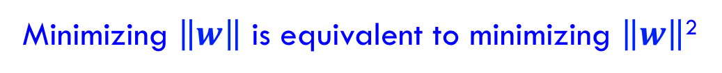
Maximizing the margin: the real problem
subject to:
subject to:
Minimizing $\left\|w\right\|$ is equivalent to minimizing $\left\|w\right\|$²
The sum of the squared weights is a convex function!

Slide 44
Support vector machine problem
subject to:
This is a version of a quadratic optimization problem
Maximize/minimize a quadratic function
Subject to a set of linear constraints
Many, many variants of solving this problem (we’ll see one in a bit)

Slide 45
Soft Margin Classification
subject to:
What about this problem?

Slide 46
Soft Margin Classification
subject to:
We’d like to learn something like this, but our constraints won’t allow it ☹

Slide 47
Slack variables
subject to:
slack variables
(one for each example)
subject to:
What effect does this have?

Slide 48
Slack variables
subject to:
slack penalties

Slide 49
Slack variables
trade-off between margin maximization and penalization
margin
penalized by how far from “correct”
subject to:
allowed to make a mistake

Slide 50
Soft margin SVM
subject to:
Still a quadratic optimization problem!

Slide 51
Demo
http://cs.stanford.edu/people/karpathy/svmjs/demo/

Slide 52
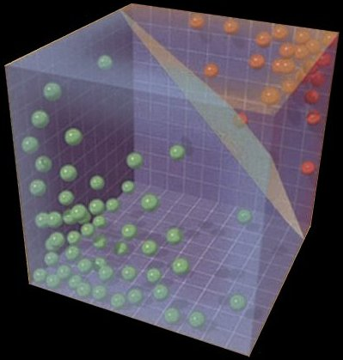
Solving the SVM problem

Slide 53
Understanding the Soft Margin SVM
subject to:
Given the optimal solution, w, b:
Can we figure out what the slack penalties are for each point?

Slide 54
Understanding the Soft Margin SVM
What do the margin lines
represent wrt w,b?
subject to:

Slide 55
Understanding the Soft Margin SVM
subject to:
Or:

Slide 56
Understanding the Soft Margin SVM
subject to:
What are the slack values for points outside (or on) the margin AND correctly classified?

Slide 57
Understanding the Soft Margin SVM
subject to:
0! The slack variables have to be greater than or equal to zero and if they’re on or beyond the margin then y_{i}(wx_{i}+b) ≥ 1 already

Slide 58
Understanding the Soft Margin SVM
subject to:
What are the slack values for points inside the margin AND classified correctly?

Slide 59
Understanding the Soft Margin SVM
subject to:
Difference from the point to the margin. Which is?

Slide 60
Understanding the Soft Margin SVM
subject to:
What are the slack values for points that are incorrectly classified?

Slide 61
Understanding the Soft Margin SVM
subject to:
Which is?

Slide 62
Understanding the Soft Margin SVM
subject to:
“distance” to the hyperplane plus the “distance” to the margin
?
Notes:
“distance” is the unnormalized projection, not to be confused with the true distance which would be with respect to w/||w||

Slide 63
Understanding the Soft Margin SVM
subject to:
“distance” to the hyperplane plus the “distance” to the margin
Why -?
Notes:
the points are incorrectly classified so the prediction (wx+b) times the label (yi) will have different signs

Slide 64
Understanding the Soft Margin SVM
subject to:
“distance” to the hyperplane plus the “distance” to the margin
?

Slide 65
Understanding the Soft Margin SVM
subject to:
“distance” to the hyperplane plus the “distance” to the margin
1

Slide 66
Understanding the Soft Margin SVM
subject to:
“distance” to the hyperplane plus the “distance” to the margin

Slide 67
Understanding the Soft Margin SVM
subject to:

Slide 68
Understanding the Soft Margin SVM
Does this look familiar?

Slide 69
Hinge loss!
0/1 loss:
Hinge:
Exponential:
Squared loss:

Slide 70
Understanding the Soft Margin SVM
subject to:
Do we need the constraints still?

Slide 71
Understanding the Soft Margin SVM
subject to:
Unconstrained problem!

Slide 72
Understanding the Soft Margin SVM
Does this look like something we’ve seen before?
Gradient descent problem!

Slide 73
Soft margin SVM as gradient descent
multiply through by 1/C
and rearrange
let λ=1/C
What type of gradient descent problem?

Slide 74
Soft margin SVM as gradient descent
One way to solve the soft margin SVM problem is using gradient descent
hinge loss
L2 regularization

Slide 75
Gradient descent SVM solver
  pick a starting point (w)
  repeat until loss doesn’t decrease in all dimensions:
    pick a dimension
    move a small amount in that dimension towards decreasing loss (using the derivative)
hinge loss
L2 regularization
Finds the largest margin hyperplane while allowing for a soft margin

Slide 76





Support vector machines: 2013
One of the most successful (if not the most successful) classification approach:
2013
2016
2019
decision tree
Support vector machine
k nearest neighbor
perceptron algorithm

Slide 77
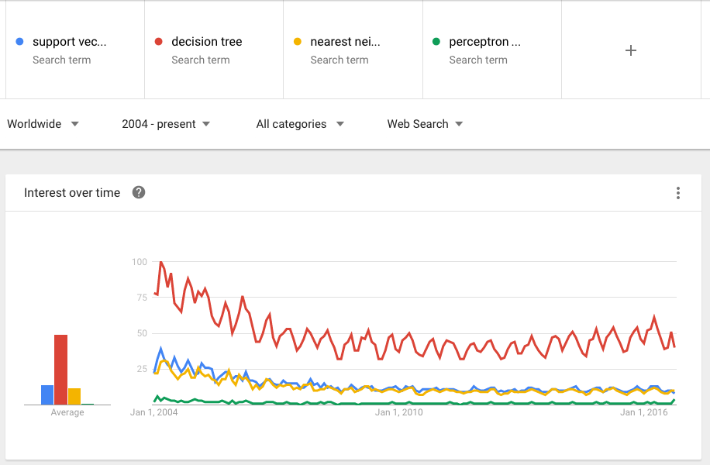
Trends over time

