Slide 1
deep learning
David Kauchak
CS158 – Fall 2016

Slide 2
Admin
Assignment 7
Assignment 8
No office hours Thursday
Wednesday office hours extended 2-5pm

Slide 3

Deep learning
Deep learning is a branch of machine learning based on a set of algorithms that attempt to model high level abstractions in data by using a deep graph with multiple processing layers, composed of multiple linear and non-linear transformations.
Deep learning is part of a broader family of machine learning methods based on learning representations of data.

Slide 4
Deep learning
Key: learning better features that abstract from the “raw” data
Using learned feature representations based on large amounts of data, generally unsupervised
Using classifiers with multiple layers of learning

Slide 5
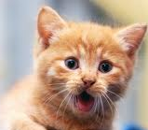
Deep learning
More abstract representation
    Train multiple layers of features/abstractions from data.
    Try to discover representation that makes decisions easy.
Low-level
Features
Mid-level
Features
High-level
Features
Classifier
“Cat”?
Deep Learning: train layers of features so that classifier works well.
Slide adapted from: Adam Coates

Slide 6
Deep learning for neural networks
Traditional NN models: 1-2 hidden layers
Deep learning NN models: 3+ hidden layers
…

Slide 7

Geoffrey Hinton
I now work part-time for Google as an Engineering Fellow and part-time for the University of Toronto as an Emeritus Distinguished Professor. For much of the year, I work at the University in the morning and at the Google Toronto office at 111 Richmond Street from 2.00pm to 6.00pm. I also spend several months per year working full-time for Google in Mountain View, California.
http://www.cs.toronto.edu/~hinton/

Slide 8
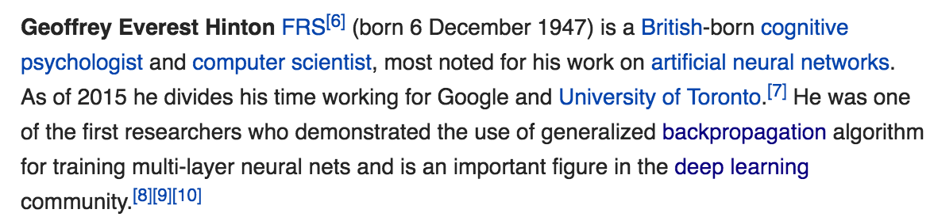
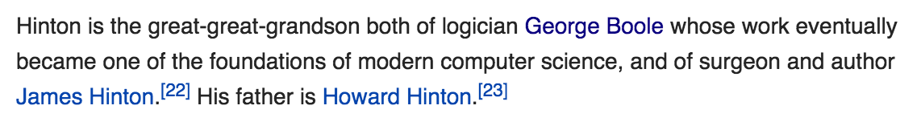
Geoffrey Hinton
https://en.wikipedia.org/wiki/Geoffrey_Hinton

Slide 9
Importance of features: Hinton
  Once you have the right features, the algorithm you pick is relatively unimportant
  Normal process = hand-crafted features
  Deep learning: find algorithms to automatically discover features from the data

Slide 10
Challenges
What makes “deep learning” hard for NNs?
…

Slide 11
Challenges
What makes “deep learning” hard for NNs?
…
…
What will happened to the modified errors further up?

Slide 12
Challenges
What makes “deep learning” hard for NNs?
…
…
Modified errors tend to get diluted as they get combined with many layers of weight corrections

Slide 13
Deep learning
Growing field
Driven by:
  Increase in data availability
  Increase in computational power
  Parallelizability of many of the algorithms
Involves more than just neural networks (though, they’re a very popular model)

Slide 14
word2vec
How many people have heard of it?
What is it?

Slide 15
Word representations
Wine data uses word occurrences as a feature
What does this miss?

Slide 16
Word representations
Wine data uses word occurrences as a feature
What does this miss?
“The wine had a dark red color” Zinfandel
“The wine was a deep crimson color” label?
“The wine was a deep yellow color” label?
Would like to recognize that words have similar meaning even though they aren’t lexically the same

Slide 17
Word representations
Key idea: project words into a multi-dimensional “meaning” space
word
[x₁, x₂, …, x_{d}]

Slide 18
Word representations
Key idea: project words into a multi-dimensional “meaning” space
word
[x₁, x₂, …, x_{d}]
red
[r₁, r₂, …, r_{d}]
[y₁, y₂, …, y_{d}]
crimson
[c₁, c₂, …, c_{d}]
[r₁, r₂, …, r_{d}]
[c₁, c₂, …, c_{d}]
yellow
[y₁, y₂, …, y_{d}]

Slide 19
Word representations
Key idea: project words into a multi-dimensional “meaning” space
word
[x₁, x₂, …, x_{d}]
The idea of word representations is not new:
Co-occurrence matrices
Latent Semantic Analysis (LSA)
New idea: learn word representation using a task-driven approach

Slide 20
A prediction problem
I like to eat bananas with cream cheese
Given a context of words
Predict what words are likely to occur in that context

Slide 21
A prediction problem
Given text, can generate lots of positive examples:
I like to eat bananas with cream cheese
input
prediction
___ like to eat
I ___ to eat bananas
I like ___ eat bananas with
I like to ___ bananas with cream
…
I
like
to
eat
…

Slide 22
A prediction problem
Use data like this to learn a distribution:
words before
words after

Slide 23
A prediction problem
Any problems with using only positive examples?
input
prediction
___ like to eat
I ___ to eat bananas
I like ___ eat bananas with
I like to ___ bananas with cream
…
I
like
to
eat
…

Slide 24
A prediction problem
Want to learn a distribution over all words
input
prediction
___ like to eat
I ___ to eat bananas
I like ___ eat bananas with
I like to ___ bananas with cream
…
I
like
to
eat
…

Slide 25
A prediction problem
Negative examples?
I like to eat bananas with cream cheese
input
prediction
___ like to eat
I ___ to eat bananas
I like ___ eat bananas with
I like to ___ bananas with cream
…
I
like
to
eat
…

Slide 26
A prediction problem
Use random words to generate negative examples
I like to eat bananas with cream cheese
input
prediction (negative)
___ like to eat
I ___ to eat bananas
I like ___ eat bananas with
I like to ___ bananas with cream
…
car
snoopy
run
sloth
…

Slide 27
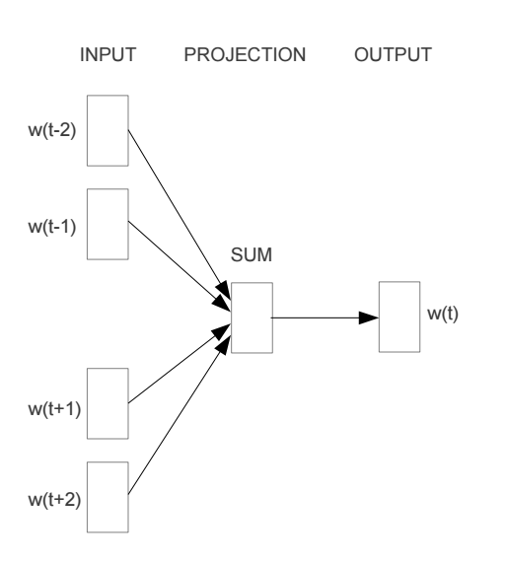
Train a neural network on this problem
https://arxiv.org/pdf/1301.3781v3.pdf

Slide 28
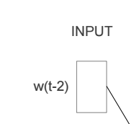
Encoding words
How can we input a “word” into a network?

Slide 29
“One-hot” encoding
For a vocabulary of V words, have V input nodes
All inputs are 0 except the for the one corresponding to the word
a
apple
…
V nodes
banana
…
zebra

Slide 30
“One-hot” encoding
For a vocabulary of V words, have V input nodes
All inputs are 0 except the for the one corresponding to the word
0
a
0
apple
banana
…
1
banana
…
0
zebra

Slide 31
“One-hot” encoding
For a vocabulary of V words, have V input nodes
All inputs are 0 except the for the one corresponding to the word
0
a
1
apple
apple
…
0
banana
…
0
zebra

Slide 32
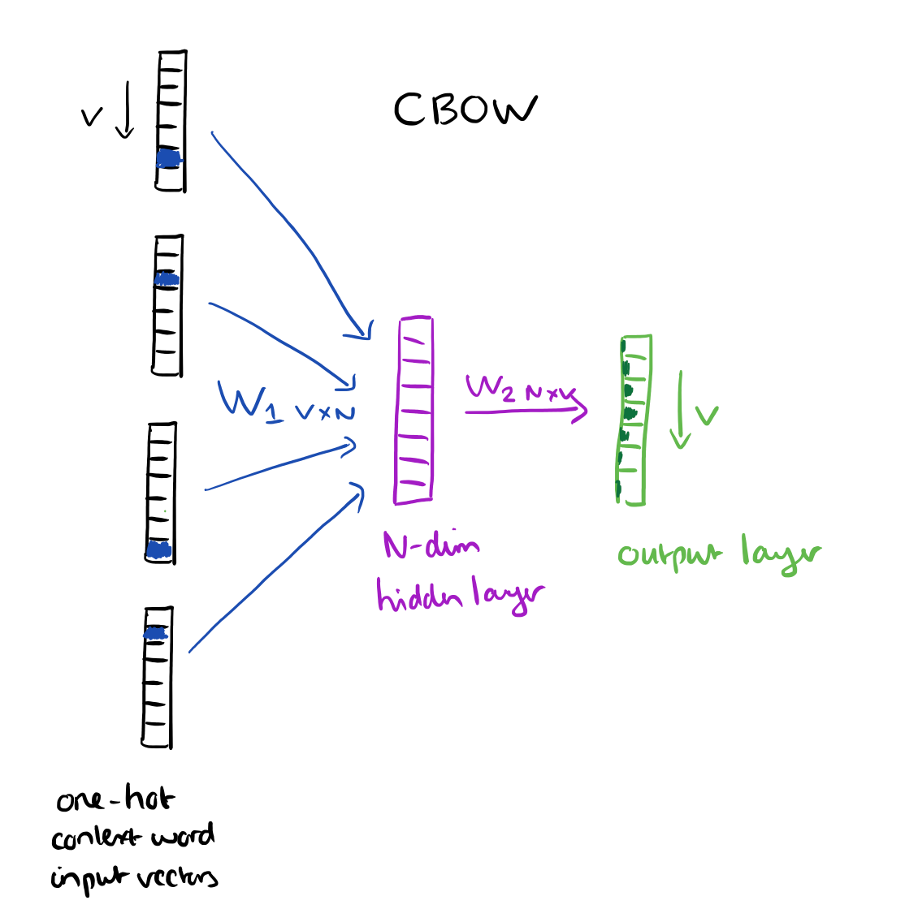
N = 100 to 1000
https://blog.acolyer.org/2016/04/21/the-amazing-power-of-word-vectors/

Slide 33
Another view
…
…
…
N hidden nodes
V input nodes
V output nodes

Slide 34
Training: backpropagation
___ like to eat
I ___ to eat bananas
I like ___ eat bananas with
I like to ___ bananas with cream
…
I
like
to
eat
…
…
…
…
N hidden nodes
V input nodes
V output nodes

Slide 35
Training: backpropagation
eat
I like to ___ bananas with cream
0
0
…
1
0
…
1
0
…
1
0
…
0
0
…
1
0
…
eat
I
…
like
…
…
to
N hidden nodes
V input nodes
V output nodes

Slide 36
Training: backpropagation
___ like to eat
I ___ to eat bananas
I like ___ eat bananas with
I like to ___ bananas with cream
…
I
like
to
eat
…

Slide 37
Word representation
VxN weights
The weights for each word provide an N dimensional mapping of the word
Words that predict similarly should have similar weights
…
…
…
N hidden nodes
V input nodes
V output nodes

Slide 38
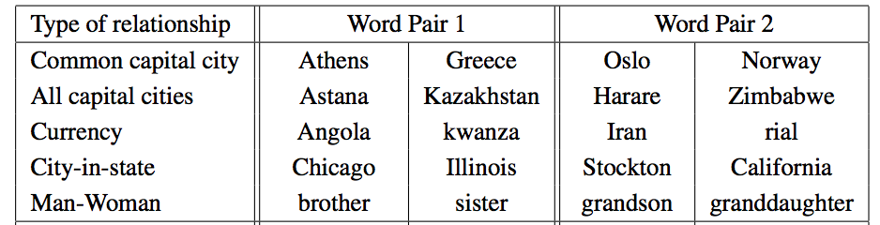
Results
vector(word1) – vector(word2) = vector(word3) - X
word1 is to word2 as word3 is to X

Slide 39
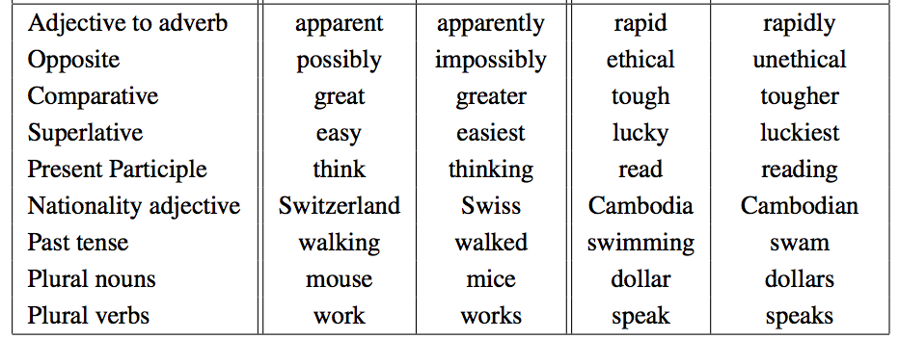
Results
vector(word1) – vector(word2) = vector(word3) - X
word1 is to word2 as word3 is to X

Slide 40
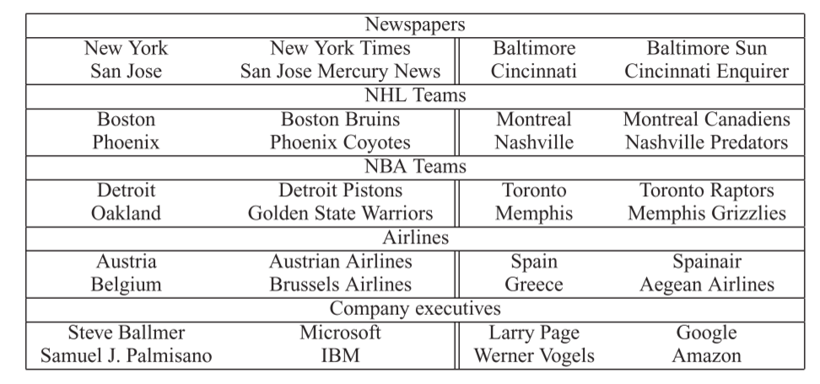
Results
vector(word1) – vector(word2) = vector(word3) - X
word1 is to word2 as word3 is to X

Slide 41
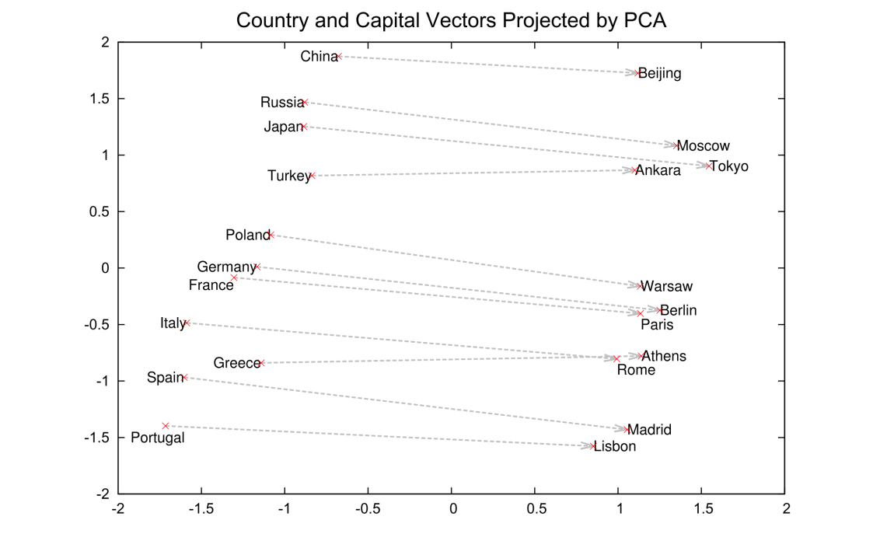
Results
2-Dimensional projection of the N-dimensional space

Slide 42
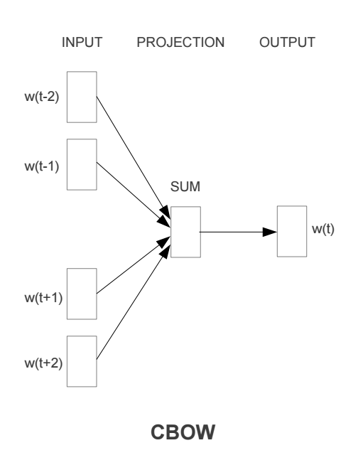
Continuous Bag Of Words

Slide 43
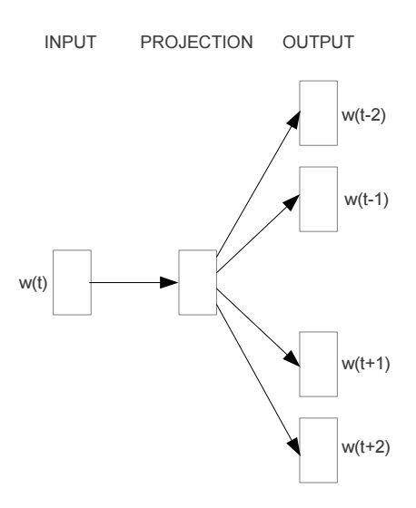
Other models: skip-gram

Slide 44
word2vec
A model for learning word representations from large amounts of data
Has become a popular pre-processing step for learning a more robust feature representation
Models like word2vec have also been incorporated into other learning approaches (e.g. translation tasks)

Slide 45
word2vec resources
https://blog.acolyer.org/2016/04/21/the-amazing-power-of-word-vectors/
https://code.google.com/archive/p/word2vec/
https://deeplearning4j.org/word2vec
https://arxiv.org/pdf/1301.3781v3.pdf

Slide 47
Big Data
What is “big data”?
What are some sources of big data?
What are the challenges of dealing with big data?
What are some of the tools you’ve heard of?

Slide 48
Big data and ML
Why talk about it in a course like this?

Slide 49
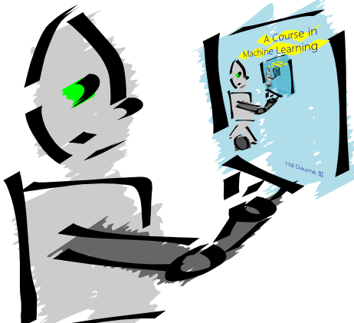
Machine Learning is…
Machine learning is about predicting the future based on the past.
-- Hal Daume III

Slide 50
Machine Learning is…
Machine learning is about predicting the future based on the past.
-- Hal Daume III
If the “past” has lots of data, then we need tools to process it!

Slide 51
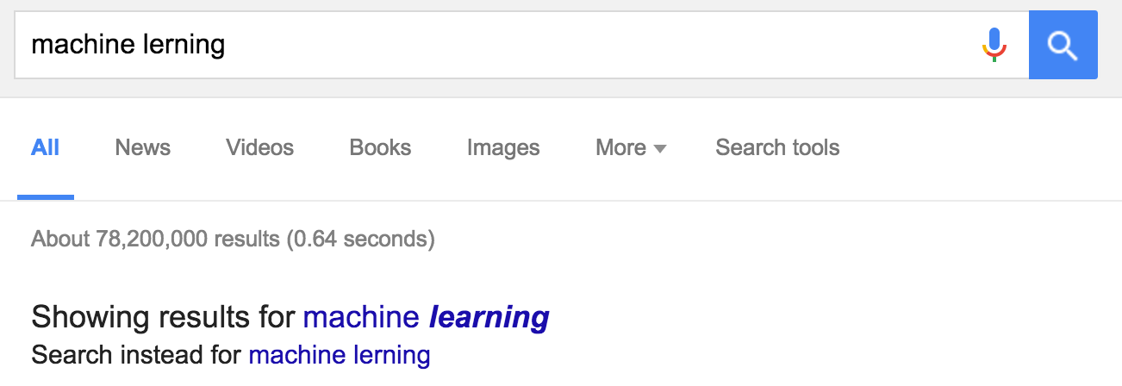
Big data and ML
Why talk about it in a course like this?
Many “machine learning” problems become much easier when you have lots of data

Slide 52

Big data and ML
How would you do it?

Slide 53
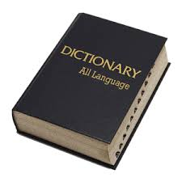
Big data and ML
How would you do it?
edit distance

Slide 54
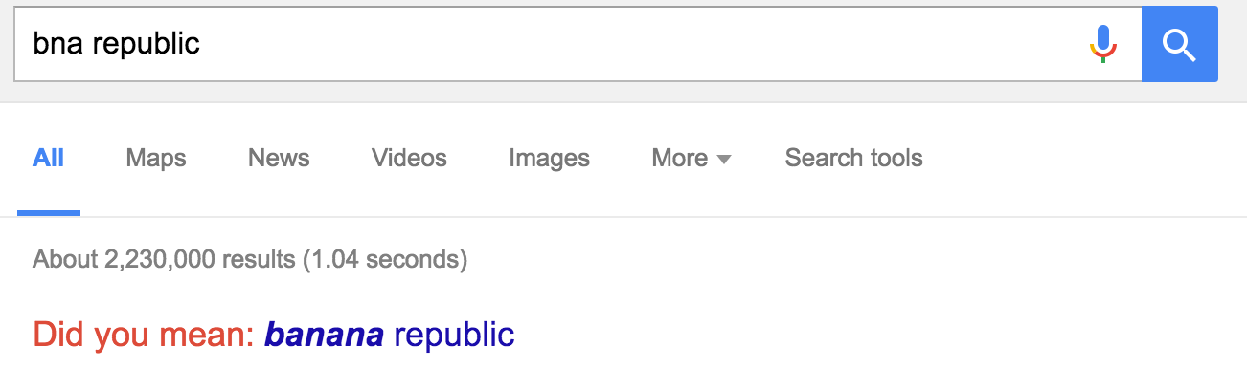
Big data and ML
How would you do it?
May not get example like this!

Slide 55
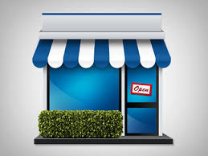
Big data and ML
How would they do it?
(small company)
May not get example like this correct!

Slide 56

Big data and ML
How would they do it?
(small company)
machine learning
model/
predictor
text corpus

Slide 57

Big data and ML
How does Google do it?
May not get example like this!

Slide 58
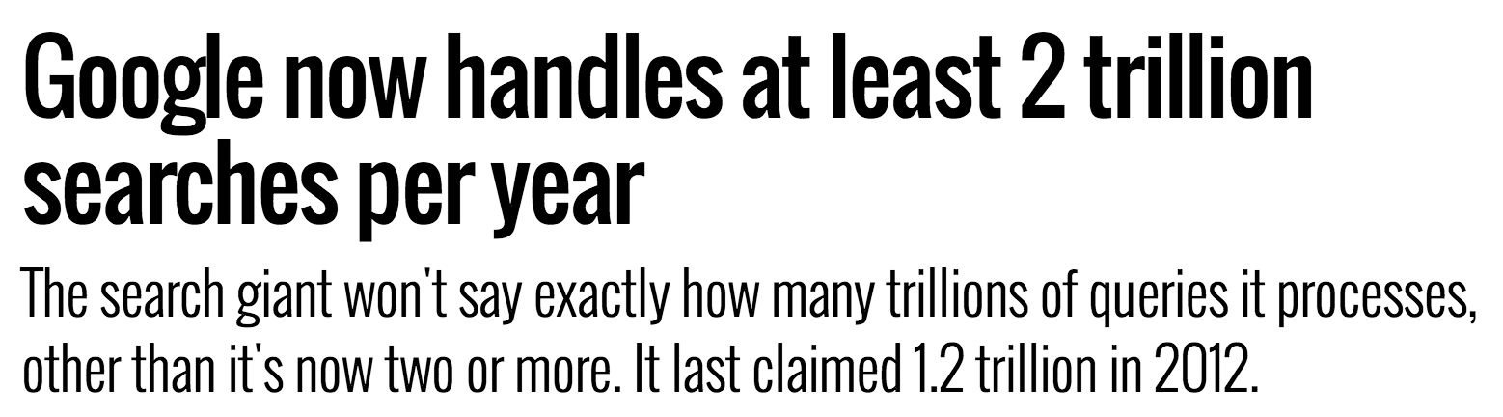
Big data and ML
http://searchengineland.com/google-now-handles-2-999-trillion-searches-per-year-250247

Slide 59
Big data and ML
Search logs
user_id time query
…
131524 t bn republic
…
131524 t+5s banana republic
…
Many problems get easy when you have lots of data!

Slide 60
Big data and ML
Many problems get easy when you have lots of data!
Challenge: processing all this data in an efficient way

Slide 61
Hadoop
https://www.youtube.com/watch?v=irK7xHUmkUA&index=20&list=PLAwxTw4SYaPkXJ6LAV96gH8yxIfGaN3H-
Videos 20, 24-35 (15 min)

