Slide 1
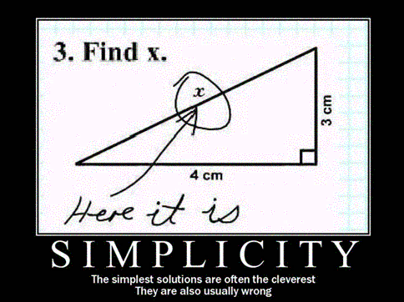
Text Simplification
David Kauchak
CS159 – Fall 2014
Collaborators: Will Coster, Dan Feblowitz and Gondy Leroy

Slide 2
Admin
Paper draft due 5pm Wednesday
  Must be done with all of your experiments
  “Results” section is required
1 hr quiz on Tuesday

Slide 3
Review
Corpus analysis
Basic probability
Language modeling
  n-gram language models
  different smoothing techniques
Parsing
  CFG, PCFGs
  CKY algorithm
  improved models
Text and word similarity

Slide 4
Review
Machine translation
  MT basics
  translation models
  word alignment
Machine learning
  ML basics
  NB (multinomial and Bernouli)
  smoothing
  other models (k-NN, SVM)
NLP research topics
  text modeling
  text simplification
High-level themes
  Probabilistic modeling and data-driven modeling
  Evaluation

Slide 5
Course summary
Number of assignments:
Number of labs:
Pages read:
Number of lines of code:
Number of slides:
8 (4 “A” assignments)
4
218
3,776
1,251

Slide 7
Text simplification
Any intelligent fool can make things bigger, more complex, and more violent. It takes a touch of genius and a lot of courage to move in the opposite direction.
E. F. Schumacher
Goal:
Reduce the reading complexity of a sentence by incorporating more accessible vocabulary and sentence structure while maintaining the content.

Slide 8
Text simplification
Any intelligent fool can make things bigger, more complex, and more violent. It takes a touch of genius and a lot of courage to move in the opposite direction.
E. F. Schumacher
Simpler is better.

Slide 9
Text simplification: real examples
Alfonso Perez Munoz, usually referred to as Alfonso, is a former Spanish footballer, in the striker position.
Alfonso Perez is a former Spanish football player.
What types of transformations are happening?

Slide 10
Text simplification: real examples
Alfonso Perez Munoz, usually referred to as Alfonso, is a former Spanish footballer, in the striker position.
Alfonso Perez is a former Spanish football player.
Deletion

Slide 11
Text simplification: real examples
Alfonso Perez Munoz, usually referred to as Alfonso, is a former Spanish footballer, in the striker position.
Alfonso Perez is a former Spanish football player.
Rewording

Slide 12
Text simplification: real examples
Endemic types or species are especially likely to develop on islands because of their geographical isolation.
Endemic types are most likely to develop on islands because they are isolated.
What types of transformations are happening?

Slide 13
Text simplification: real examples
Endemic types or species are especially likely to develop on islands because of their geographical isolation.
Endemic types are most likely to develop on islands because they are isolated.
Deletion

Slide 14
Text simplification: real examples
Endemic types or species are especially likely to develop on islands because of their geographical isolation.
Endemic types are most likely to develop on islands because they are isolated.
Rewording

Slide 15
Text simplification: real examples
The reverse process, producing electrical energy from mechanical energy, is accomplished by a generator or dynamo.
A dynamo or an electric generator does the reverse: it changes mechanical movement into electric energy.
What types of transformations are happening?

Slide 16
Text simplification: real examples
The reverse process, producing electrical energy from mechanical energy, is accomplished by a generator or
dynamo.
A dynamo or an electric generator does the reverse: it changes mechanical movement into electric energy.

Slide 17
Text simplification: real examples
The reverse process, producing electrical energy from mechanical energy, is accomplished by a generator or
dynamo.
A dynamo or an electric generator does the reverse: it changes mechanical movement into electric energy.
Deletion and rewording
Insertion and reordering
Notes:
Text simplification can be challenging
-- text to text application
-- full range of text manipulation operations
-- a range of

Slide 18

Goals today
Introduce the text simplification problem
Understand why it’s important
Examine what makes text difficult/simple
Overview of approaches to text simplification

Slide 19
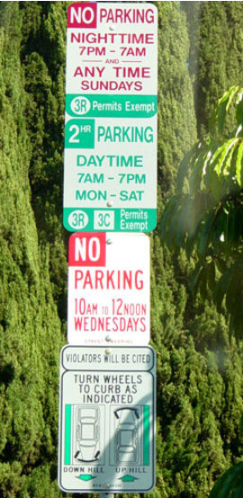
Why text simplification?
DO NOT PARK HERE
Notes:
- life is complicated

Slide 20





Why text simplification?
A lot of text data is available
Problem: much of this content is written above many people’s reading level
Notes:
on average, half of the people read at a below average reading level ☺
numbers:
tens of billions of web pages
English Wikipedia has ~4.5 million articles
half a billion tweets/day
billions of e-mails/day

Slide 21
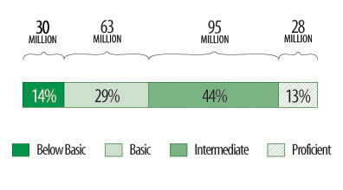
Adult literacy
Below Basic: no more than the most simple and concrete literacy skills
Basic: can perform simple and everyday literacy activities
Intermediate: can perform moderately challenging literacy activities
Proficient: can perform complex and challenging literacy activities
http://nces.ed.gov/naal/kf_demographics.asp
Notes:
National Center for Education Statistics: National Assessment of Adult Literacy

Slide 22
Why text simplification?
Broader availability of standard text resources
  language learners
  people with aphasia or other cognitive disabilities
  children
Broader availability of domain-specific text resources
  health and medical documents
    90M Americans (at least a third!) do not have sufficient health literacy to understand currently provided materials
    Cost of low health literacy is estimated to be hundreds of billions
  academic papers
  legal documents
Notes:
~14% of Americans speak a language besides English as their native language (http://nces.ed.gov/pubs93/93275.pdf)

Slide 23

Why text simplification?
Make life easier for computers!
I find forest colored chicken ovum and smoked pork thigh to be dietarily disturbing.
I do not like green eggs and ham.
Notes:
what doesn’t the person like?

Slide 24
What makes text difficult/simple?
?

Slide 25
What makes text difficult/simple?
Lots of previous research going back decades!
Some ideas:
vocabulary
sentence structure/grammatical components
  passive vs. active tense
  use of relative clauses
  compound nouns
  nominalization (turning verbs into nouns)
  …
organization/flow
Notes:
Nominalization example:
I will investigate how nominalization affects text difficulty.
I will do an investigation of how nominalization affects text difficulty.

Slide 26
Quantifying text difficulty
vocabulary
sentence structure/grammatical components
  passive vs. active tense
  use of relative clauses
  compound nouns
  nominalization (turning verbs into nouns)
  …
organization/flow
How do we measure/quantify these things, particularly with minimal human intervention?
Notes:
- if we want to look at semi-automated or automated approaches we need to be able to automatically (or semi-automatically) detect and correct these things

Slide 27



Quantifying word difficulty
Hypothesis:
The more often a person sees a word, the more familiar they are with it, and therefore the simpler it is
Proxy for “how often you see a word”:
Frequency on the web!

Slide 28
Validating frequency hypothesis
Google unigrams: ~13M
randomly pick 25 words from each bin
sort based on frequency
275 words
Does the frequency of these words relate to people’s knowledge/familiarity with these words?
11 bins based on frequency:
1%, 10%, 20%, …, 100%

Slide 29

Validating frequency hypothesis
Google unigrams: ~13M
Annotate with definition
randomly pick 25 words from each bin
275 words
11 bins based on frequency:
1%, 10%, 20%, …, 100%

Slide 30
Validating frequency hypothesis
marmorean:
crimson-and-grey songbird that inhabits town walls and mountain cliffs of southern Eurasia and northern Africa
of or relating to or characteristic of marble
the most common protein in muscle
a woman policeman

Slide 31
Validating frequency hypothesis
marmorean:
crimson-and-grey songbird that inhabits town walls and mountain cliffs of southern Eurasia and northern Africa
of or relating to or characteristic of marble
the most common protein in muscle
a woman policeman
random definitions from other words in data set

Slide 32

Study participants
50 participants per word =
1,250 annotations/frequency bin
13,750 total annotations!

Slide 33
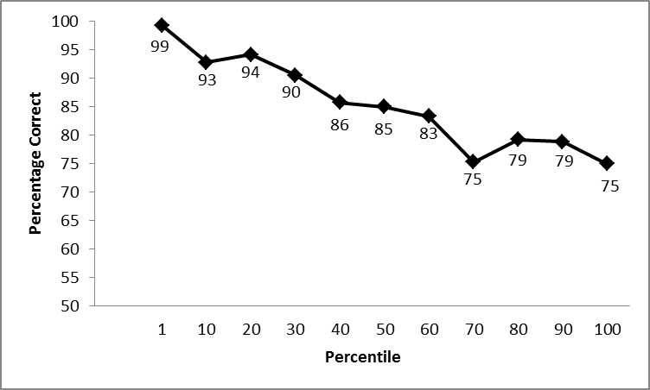
Frequency correlates with understanding!
more frequent
Frequency percentile
What does this tell us about simplifying text?
Notes:
mechanical turk
50 users per word, averaged per bin (50 users * 25 words = 1250 per bin and 13,750 annotations!!!)

Slide 34
Frequency correlates with understanding!
more frequent
Frequency percentile
Avoid less frequent words. Use more frequent words.
Notes:
mechanical turk
50 users per word, averaged per bin

Slide 35
Quantifying text difficulty
vocabulary
sentence structure/grammatical components
  passive vs. active tense
  use of relative clauses
  compound nouns
  nominalization (turning verbs into nouns)
  …
organization/flow
Still many, many aspects of language to explore…
Notes:
- if we want to look at semi-automated or automated approaches we need to be able to automatically (or semi-automatically) detect and correct these things

Slide 36
Goals today
Introduce the text simplification problem
Understand why it’s important
Examine what makes text difficult/simple
Overview of approaches to text simplification

Slide 37

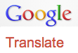

Spectrum of solutions
Focus on these types of approaches today
writer assist tools/resources
readability formulas
simple word lists
flag difficult text sections
simplification thesauruses
rule-based with human verification
…
Simplify
manual
semi-automated
fully automated

Slide 38
A semi-automated approach
I disdain green chicken ovum and ham.
identify difficult words
I disdain green chicken ovum and ham.
How can we do this?

Slide 39
A semi-automated approach
I disdain green chicken ovum and ham.
identify difficult words
I disdain green chicken ovum and ham.
Based on word frequency!
(low-frequency words)

Slide 40

A semi-automated approach
I disdain green chicken ovum and ham.
dislike
hate
scorn
…
egg cell
seed
egg
…
generate candidate word simplifications from text resources (e.g. thesauruses, dictionaries, etc.)
Human annotator
Notes:
This is still a huge savings over a fully manual approach:
only have to focus on the words/phrases that are flagged
given hints of possible words, ideally ranked by likelihood of replacement
Why we call it a “semi-automated” approach

Slide 41
A semi-automated approach
I disdain green chicken ovum and ham.
dislike
hate
scorn
…
egg cell
seed
egg
…
I do not like green eggs and ham.

Slide 42

Evaluation/experimentation
I disdain green chicken ovum and ham.
I do not like green eggs and hame
How do we tell if our system is useful?

Slide 43
An experiment
original document
simplified document
Examine if people’s learning and understanding improve with the simplified article

Slide 44
An experiment
Page 1:
Page 2:
Page 3:
original
simple
Q1
Q2
Q3
…
Q1
Q2
Q3
…
or
Q4, Q5, Q6, …
answer some questions related to the article topic
read one version of the article and answer some different questions with the text
answer the same questions again!
Notes:
pre/post questions check to see how much the user learned
questions with text check to see how well user understands text

Slide 45
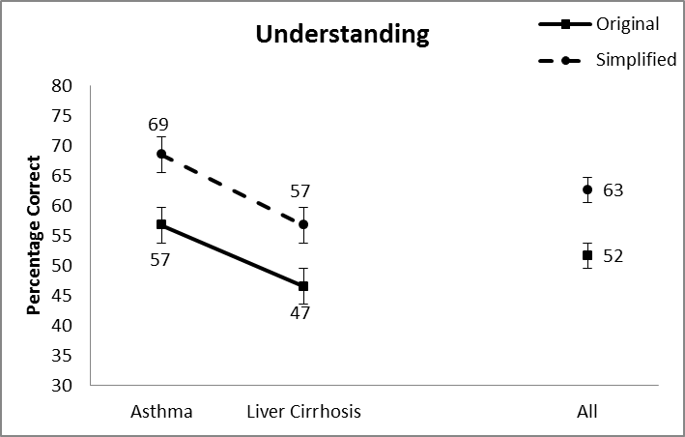
Results with the text: understanding
(questions Q3, Q4, Q5, …)
Notes:
mechanical turk
100 random participants
two articles

Slide 46
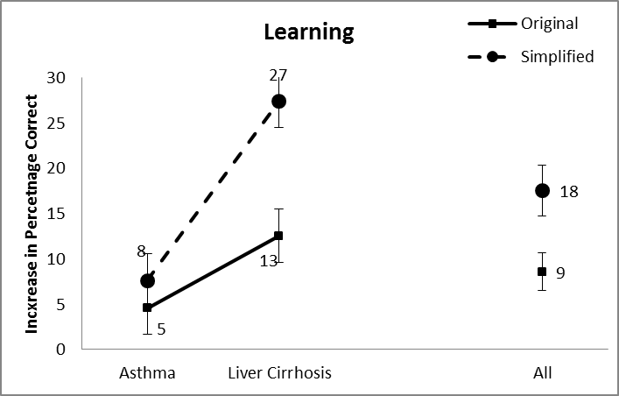
Results without the text: learning
(questions Q1, Q2, Q3,…)

Slide 47
Spectrum of solutions
readability formulas
simple word lists
flag difficult text sections
simplification thesauruses
rule-based with human check
…
Simplify
manual
semi-automated
fully automated

Slide 48
Data-driven approach
unsimplified
simplified
Alfonso Perez Munoz, usually referred to as Alfonso, is a former Spanish footballer, in the striker position.
Alfonso Perez is a former Spanish football player.
learning
The reverse process, producing electrical energy from mechanical, energy, is accomplished by a generator or dynamo.
A dynamo or an electric generator does the reverse: it changes mechanical movement into electric energy.
I find forest colored chicken ovum and pork rump to be dietarily disturbing.
I do not like green eggs and ham.
…
Given training data
(paired sentences)
learn a simplification model
Notes:
not the only way to pose the problem
-- could not require any data (for example, based on hand-written rules)
-- could also utilize monolingual text

Slide 49
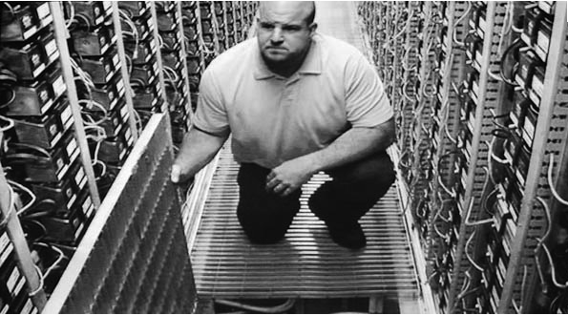

Collecting simplification data
    I took a speed reading course and read War and Peace in twenty minutes. It involves Russia. – Woody Allen

Slide 50

Wikipedia for text simplification
“We use Simple English words and grammar here. The Simple English Wikipedia is for everyone! That includes children and adults who are learning English.”
Notes:
- 67K articles

Slide 51
Wikipedia for text simplification
“Simple does not mean little. Writing in Simple English means that simple words are used. It does not mean readers want simple information. Articles do not have to be short to be simple; expand articles, include a lot of information, but use basic vocabulary.”
Notes:
- 67K articles

Slide 52
Wikipedia for text simplification
4.4M articles
97K articles
unsimplified
simplified
Alfonso Perez Munoz, usually referred to as Alfonso, is a former Spanish footballer, in the striker position.
Alfonso Perez is a former Spanish football player.
The reverse process, producing electrical energy from mechanical, energy, is accomplished by a generator or dynamo.
A dynamo or an electric generator does the reverse: it changes mechanical movement into electric energy.
I find forest colored chicken ovum and pork rump to be dietarily disturbing.
I do not like green eggs and ham.

Slide 53
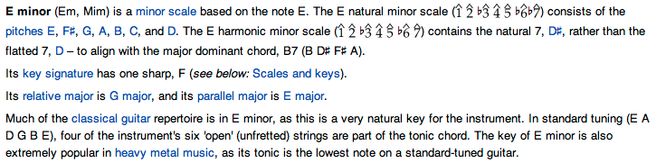
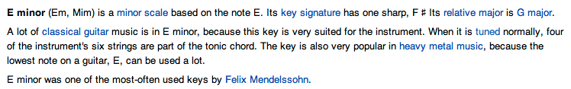
From aligned documents to aligned sentences

Slide 54
From aligned documents to aligned sentences

Slide 55
Wikipedia for text simplification
4.4M articles
97K articles
unsimplified
simplified
167K aligned sentence pairs
Alfonso Perez Munoz, usually referred to as Alfonso, is a former Spanish footballer, in the striker position.
Alfonso Perez is a former Spanish football player.
The reverse process, producing electrical energy from mechanical, energy, is accomplished by a generator or dynamo.
A dynamo or an electric generator does the reverse: it changes mechanical movement into electric energy.
I find forest colored chicken ovum and pork rump to be dietarily disturbing.
I do not like green eggs and ham.

Slide 56
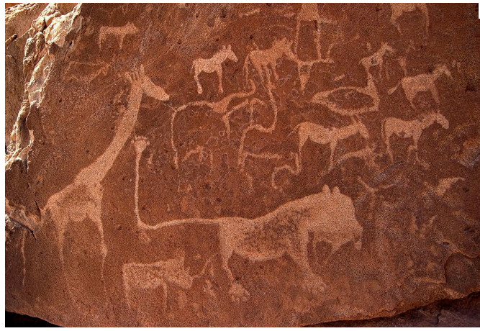
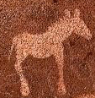
Simplification approaches

Slide 57
Phrase-based sentence simplification
I disdain green ham with green eggs
Notes:
this is the approach for phrase-based machine translation
the actual approach is a bit more involved, but this is the high-level idea
phrase-based approaches are roughly state of the art. Used by google’s translation approach.

Slide 58
Phrase-based sentence simplification
I disdain
green ham
with
green eggs
Unsimplified sentence is probabilistically broken into phrases
  “phrase” is a sequence of words
Notes:
this is the approach for phrase-based machine translation
the actual approach is a bit more involved, but this is the high-level idea
phrase-based approaches are roughly state of the art. Used by google’s translation approach.

Slide 59
Phrase-based sentence simplification
I disdain
green ham
with
green eggs
I do not like
ham
and
green eggs
Each phrase is probabilistically simplified (translation model)
Notes:
this is the approach for phrase-based machine translation
the actual approach is a bit more involved, but this is the high-level idea
phrase-based approaches are roughly state of the art. Used by google’s translation approach.

Slide 60
Phrase-based sentence simplification
I disdain
green ham
with
green eggs
I do not like
green eggs
and
ham
Phrases are probabilistically reordered (language model)
Notes:
this is the approach for phrase-based machine translation
the actual approach is a bit more involved, but this is the high-level idea
phrase-based approaches are roughly state of the art. Used by google’s translation approach.

Slide 61
Phrase-based sentence simplification
I disdain the food
green ham
with
green eggs
I do not like
green eggs
and
ham
Why is that a problem here?
Notes:
reasons are mostly historical
-- this doesn’t happen much in language translation
-- makes the model more complicated
-- and can make translation more complicated

Slide 62
Phrase-based sentence simplification
Problem: does not allow for phrasal deletion
I disdain the food
green ham
with
green eggs
I do not like
green eggs
and
ham
Notes:
reasons are mostly historical
-- this doesn’t happen much in language translation
-- makes the model more complicated
-- and can make translation more complicated

Slide 63
Phrase-based sentence simplification
Problem: does not allow for phrasal deletion
I disdain
the food green ham
with
green eggs
I do not like
green eggs
and
ham
Notes:
reasons are mostly historical
-- this doesn’t happen much in language translation
-- makes the model more complicated
-- and can make translation more complicated

Slide 64
Phrase-based sentence simplification
We add phrasal deletion
I disdain
the food
green ham
with
green eggs
I do not like
green eggs
and
ham
Each phrase is probabilistically simplified (translation model)
  p(NULL | the food)

Slide 65
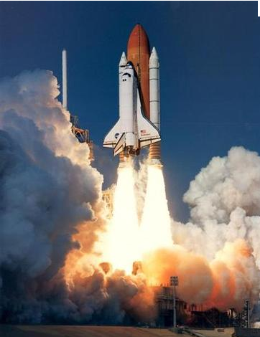
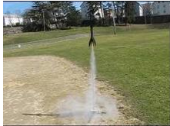
Phrase-based performance

Slide 66
Experiments
5 approaches
  none – output the unsimplified sentence
  K&M – noisy channel sentence compression with PCFGs
    Only allows for deletion
    Uses syntactic information
  T3 – Cohn and Lapata (2009)
    All transformation operations
    Uses syntactic information
    Only been previously employed for sentence compression
  Moses – noisy channel, phrase-based without deletion
  Moses+Del – with delection

Slide 67
Evaluation
3 measures
  BLEU (0-1.0)
    weighted mean of n-gram precisions
    brevity penalty to avoid overly short results
  word-F1 (0-1.0)
    F1 measure of system word occurrences
    F1 combines precision and recall into one measure
  Simple String Accuracy - SSA (0-1.0)
    length normalized edit distance
machine translation
sentence compression
Notes:
bleu
- for each n-gram in the system simplification see if it occurs in the human simplification
- calculate the precision over the different n-gram levels

Slide 68
Results
System | BLEU | word-F1 | SSA
none | 0.5937 | 0.5967 | 0.6179
K&M T3* | 0.4352 0.2437 | 0.4352 0.2190 | 0.4871 0.3651
Moses Moses+Del | 0.5987 0.6046 | 0.6076 0.6149 | 0.6224 0.6259
All results are significantly different at the p=0.01 level
* T3 was only trained on 30K sentence pairs
Notes:
all of the metrics rank the systems in the same order
one of the challenges with this domain is that doing nothing, does surprisingly well
only Moses and Moses+Del do better than not doing anything at all and are massive improvements over the previous approaches
to put these results in perspective, in machine translation, humans can notice a difference in BLEU of .01 and an improvement of .01 will get you published :)

Slide 69
Results: phrasal systems
If we remove those sentence pairs from the test set that are identical:
System | BLEU
none Moses Moses+Del | 0.4560 0.4723 0.4752

Slide 70
Moses+Del results
In 8.5% of the test sentences deletion was used
 |  | BLEU
 | Case | none | output
Moses+DEL | correct change incorrect change | 0.4087 1.0 | 0.4788 0.8706
Results separated by sentence pairs that were different (“correct change”) and those that were the same and did not require any simplification (“incorrect change”)
Notes:
we see that when a simplification is required, we get large improvements
if we could filter these out early, would result in large improvements

Slide 71
Qualitatively: Phrase-based
Critical reception for The Wild has been negative.
Reviews for The Wild has been negative.
rewording

Slide 72
Qualitatively: Phrase-based
Bauska is a town in Bauska county, in the Zemgale region of southern Latvia.
Bauska is a town in Bauska county, in the region of Zemgale.
rewording/reordering, deletion

Slide 73
Qualitatively: Phrase-based
Nicolas Anelka is a French footballer who currently plays as a striker for Chelsea in the English premier league.
Nicolas Anelka is a French football player. He plays for Chelsea.
rewording, deletion, sentence splitting

Slide 74
Qualitatively: Phrase-based
Each edge of a tesseract is of the same length.
Same edge of the same length.

Slide 75
Qualitatively: Previous approach
He often recuperated at Menton, near Nice, France, where he eventually died on 1892 January 31.
He died.
Notes:
T3 in general tended to be overly aggressive with deletion
averaged 13 words per sentence, as compared to 21 words for the human simplifications

Slide 76
Phrase-based limitations
Phrasal reordering is only motivated by the resulting words, not the input sentence
  tends not to reorder much
In general, tends not to change much when simplifying
System | length ratio | % unmodified
Moses+Del (phrase-based) | 0.9907 | 56.9%
In-corpus average | 0.85 | 26.7%

Slide 77
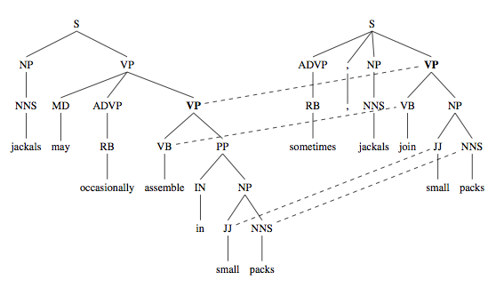
Syntax-based approach
Rather than operating on phrases, operate on grammar trees

Slide 78
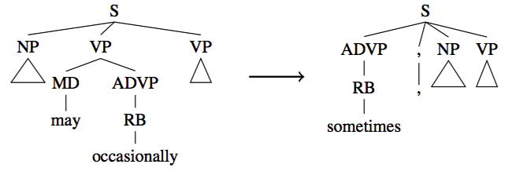
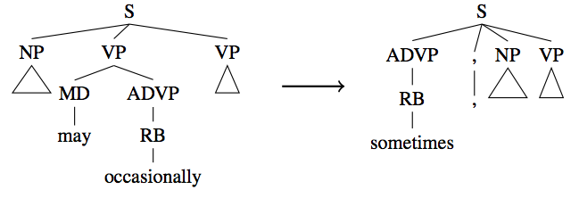
Learn probabilistic, syntax-based rules
They may occasionally eat
sometimes, they eat

Slide 79
Learn probabilistic, syntax-based rules
The scary cats from the park may occasionally walk around on two legs
sometimes, the scary cats from the park walk around on two legs

Slide 80

An aside
sometimes, the scary cats from the park walk around on two legs

Slide 81
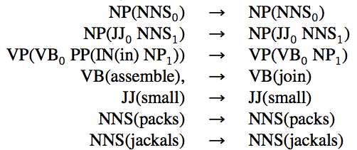
The hard part
…

Slide 82
Results
System | BLEU | oracle | length ratio | % unmodified
Syntax | 0.5640 | 0.6627 | 0.8487 | 57.5%
Moses+Del | 0.6046 | 0.6421 | 0.9907 | 56.9%
Baseline (no change) | 0.5937 | -* | 1.0 | 100%
In-corpus average | - | - | 0.85 | 26.7%

Slide 83
Human Evaluation
Human annotators were asked to rate outputs from simplify, Moses+Del, and the gold standard for grammaticality, meaning preservation, and overall simplification quality
 | Grammar | Meaning | Simplicity
Syntax | 4.7 | 4.1 | 2.9
Moses+Del | 4.5 | 4.2 | 2.0
Gold standard | 4.5 | 3.7 | 2.7

Slide 84
Our life is frittered away by detail.
Simplify, simplify.
- H.D. Thoreau
Our life is frittered away.
- Lab Machine 227-31

Slide 85
Qualitatively: syntax-based
After Anton Szandor Lavey's death, his position as head of the church of satan passed on to Blanche Barton.
Syntax:
After Anton Szandor Lavey's death, his position passed on to Blanche Barton.
Phrase-based:
(same as input)

Slide 86
Qualitatively: syntax-based
Overall Bamberga is the tenth brightest main belt asteroid after, in order, Vesta, Pallas, Ceres, Iris, Hebe, Juno, Melpomene, Eunomia and Flora.
Syntax:
Overall Bamberga is the tenth brightest main belt asteroid.
Phrase-based: (same as input)

Slide 87
Future thoughts/challenges
How do people do it?
What is simple?
  different domains may have different notion
How do domain constraints affect approaches
  medical and legal
    deletion is frowned upon
    insertions are much more common (e.g. definitions)
  can our algorithms vary the simplicity?

Slide 88
Future work
More/better data
Word-level changes seem to be very effective. Can we automate the semi-automated approaches?
  - some work here already with Katie Manduca and Colby Horn!
Incorporate more syntactic information
Discourse modeling (between sentence)

Slide 89
Questions?
References
Word difficulty analysis:
Gondy Leroy and David Kauchak (2013). The Effect of Word Familiarity on Actual and Perceived Text Difficulty. In JAMIA.
Semi-supervised approach:
Gondy Leroy, James Endicott, David Kauchak, Obay Mouradi and Melissa Just (2013). User Evaluation of the Effects of a Text Simplification Algorithm Using Term Familiarity on Perception, Understanding, Learning and Information Retention. In JMIR.
Data generation:
Will Coster and David Kauchak (2011). Simple English Wikipedia: A New Simplification Task. In Proceedings of ACL.
Phrase-based approach:
Will Coster and David Kauchak (2011). Learning to Simplify Sentences Using Wikipedia. In ACL Workshop.
Syntax-based approach:
Dan Feblowitz and David Kauchak (2013), Sentence Simplification as Tree Transduction. In Proceedings of PITR.

