Slide 1
priors
David Kauchak CS159 Fall 2014

Slide 2
Admin
Assignment 7 due Friday at 5pm
Project proposals due Thursday at 11:59pm
Grading update

Slide 3
Maximum likelihood estimation
Intuitive
Sets the probabilities so as to maximize the probability of the training data
Problems?
Overfitting!
Amount of data
particularly problematic for rare events
Is our training data representative

Slide 4
Basic steps for probabilistic modeling
Probabilistic models
Step 1: pick a model
Step 2: figure out how to estimate the probabilities for the model
Step 3 (optional): deal with overfitting
Which model do we use, i.e. how do we calculate p(feature, label)?
How do train the model, i.e. how to we we estimate the probabilities for the model?
How do we deal with overfitting?

Slide 5
Priors
Coin1 data: 3 Heads and 1 Tail
Coin2 data: 30 Heads and 10 tails
Coin3 data: 2 Tails
Coin4 data: 497 Heads and 503 tails
If someone asked you what the probability of heads was for each of these coins, what would you say?

Slide 6
Training revisited
From a probability standpoint, MLE training is selecting the Θ that maximizes:
i.e.
We pick the most likely model parameters given the data

Slide 7
Estimating revisited
We can incorporate a prior belief in what the probabilities might be!
To do this, we need to break down our probability
(Hint: Bayes rule)

Slide 8
Estimating revisited
What are each of these probabilities?

Slide 9
Priors
likelihood of the data under the model
probability of different parameters,
call the prior
probability of seeing the data (regardless of model)

Slide 10
Priors
Does p(data) matter for the argmax?
Notes:
no, it doesn’t very as theta changes. It’s a constant

Slide 11
Priors
likelihood of the data under the model
probability of different parameters,
call the prior
What does MLE assume for a prior on the model parameters?

Slide 12
Priors
likelihood of the data under the model
probability of different parameters,
call the prior
Assumes a uniform prior, i.e. all Θ are equally likely!
Relies solely on the likelihood

Slide 13
A better approach
We can use any distribution we’d like
This allows us to impart addition bias into the model

Slide 14
Another view on the prior
Remember, the max is the same if we take the log:
We can use any distribution we’d like
This allows us to impart addition bias into the model

Slide 15
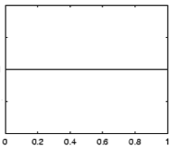
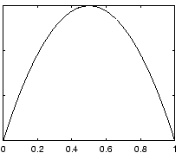
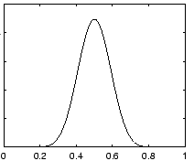
Prior for NB
Uniform prior
Dirichlet prior
λ= 0
increasing
Notes:
- as lambda gets larger we bias more and more towards

Slide 16
Prior: another view
MLE:
What happens to our likelihood if, for one of the labels, we never saw a particular feature?
Goes to 0!
Notes:
- Goes to 0!

Slide 17
Prior: another view
Adding a prior avoids this!

Slide 18
Smoothing
training data
for each label, pretend like we’ve seen each feature/word occur inλadditional examples
Sometimes this is also called smoothing because it is seen as smoothing or interpolating between the MLE and some other distribution

