Slide 1
Naïve bayes
David Kauchak
CS159 Fall 2014

Slide 2
Admin
Assignment 7 out soon (due next Friday at 5pm)
Quiz #3 next Tuesday
- Text similarity -> this week (though, light on ML)
Project proposal presentations Tuesday

Slide 3
Probabilistic Modeling
Model the data with a probabilistic model
specifically, learn p(features, label)
p(features, label) tells us how likely these features and this example are
train
probabilistic model
training data

Slide 4
Basic steps for probabilistic modeling
Probabilistic models
Step 1: pick a model
Step 2: figure out how to estimate the probabilities for the model
Step 3 (optional): deal with overfitting
Which model do we use, i.e. how do we calculate p(feature, label)?
How do train the model, i.e. how to we we estimate the probabilities for the model?
How do we deal with overfitting?

Slide 5
Naïve Bayes assumption
What does this assume?

Slide 6
Naïve Bayes assumption
Assumes feature i is independent of the the other features given the label

Slide 7
Naïve Bayes model
naïve Bayes assumption
p(x_{i}|y) is the probability of a particular feature value given the label
How do we model this?
for binary features (e.g., “banana” occurs in the text)
for discrete features (e.g., “banana” occurs x_{i} times)
for real valued features (e.g, the text contains x_{i} proportion of verbs)

Slide 8
p(x|y)
Binary features (aka, Bernoulli Naïve Bayes) :
biased coin toss!
Other features types:
Could use a lookup table for each value, but doesn’t generalize well
Better, model as a distribution:
gaussian (i.e. normal) distribution
poisson distribution
multinomial distribution (more on this later)
…
Notes:
- for discrete, we could simply do a much larger table, but often that doesn’t capture everything we want

Slide 9
Basic steps for probabilistic modeling
Probabilistic models
Step 1: pick a model
Step 2: figure out how to estimate the probabilities for the model
Step 3 (optional): deal with overfitting
Which model do we use, i.e. how do we calculate p(feature, label)?
How do train the model, i.e. how to we we estimate the probabilities for the model?
How do we deal with overfitting?

Slide 10
Obtaining probabilities
train
probabilistic model
training data
…
(m = number of features)

Slide 11
MLE estimation for NB
train
probabilistic model
training data
What are the MLE estimates for these?

Slide 12
Maximum likelihood estimates
number of examples with label
total number of examples
number of examples with the label with feature
number of examples with label
What does training a NB model then involve?
How difficult is this to calculate?
Notes:
just involves iterating over the data and aggregating these counts!

Slide 13
Text classification
Unigram features:
w_{j}, whether or not word w_{j} occurs
in the text
What are these counts for text classification with unigram features?
Notes:
just involves iterating over the data and aggregating these counts!

Slide 14
text classification
number of texts with label
total number of texts
number of texts with the label with word w_{j}
number of texts with label
Notes:
just involves iterating over the data and aggregating these counts!

Slide 15
Naïve Bayes classification
NB Model
p(features, label)
yellow, curved, no leaf, 6oz, banana
0.004
Given an unlabeled example:
yellow, curved, no leaf, 6oz
predict the label
How do we use a probabilistic model for classification/prediction?

Slide 16
NB classification
probabilistic model:
p(features, label1)
yellow, curved, no leaf, 6oz, banana
pick largest
yellow, curved, no leaf, 6oz, apple
label =

Slide 17
NB classification
probabilistic model:
p(features, label1)
yellow, curved, no leaf, 6oz, banana
pick largest
yellow, curved, no leaf, 6oz, apple
Notice that each label has it’s own separate set of parameters, i.e. p(x_{j}|y)

Slide 18
Bernoulli NB for text classification
probabilistic model:
p(features, label1)
(1, 1, 1, 0, 0, 1, 0, 0, …)
pick largest
w₁
w₂
w₄
w₈
w₇
w₆
w₃
w₅
How good is this model for text classification?

Slide 19
Bernoulli NB for text classification
(1, 1, 1, 0, 0, 1, 0, 0, …)
w₁
w₂
w₄
w₆
w₇
w₈
w₃
w₅
pick largest
For text classification, what is this computation? Does it make sense?
Notes:
- Concern:

Slide 20
Bernoulli NB for text classification
(1, 1, 1, 0, 0, 1, 0, 0, …)
w₁
w₂
w₄
w₆
w₇
w₈
w₃
w₅
pick largest
Each word that occurs, contributes p(w_{j}|y)
Each word that does NOT occur, contributes 1-p(w_{j}|y)
Notes:
- Concern:

Slide 21

Generative Story
To classify with a model, we’re given an example and we obtain the probability
We can also ask how a given model would generate an example
This is the “generative story” for a model
Looking at the generative story can help understand the model
We also can use generative stories to help develop a model
Notes:
- although we don’t generally “generate” a document from a model, it’s often useful to look at the generative story of a model (i.e. how the model says a document was generate) to help us understand why the model assigns certain probabilities

Slide 22
Bernoulli NB generative story
What is the generative story for the NB model?

Slide 23
Bernoulli NB generative story
Pick a label according to p(y)
  roll a biased, num_labels-sided die
For each feature:
  Flip a biased coin:
    if heads, include the feature
    if tails, don’t include the feature
What does this mean for text classification, assuming unigram features?

Slide 24
Bernoulli NB generative story
Pick a label according to p(y)
  roll a biased, num_labels-sided die
For each word in your vocabulary:
  Flip a biased coin:
    if heads, include the word in the text
    if tails, don’t include the word

Slide 25
Bernoulli NB
Pros/cons?

Slide 26
Bernoulli NB
Pros
  Easy to implement
  Fast!
  Can be done on large data sets
Cons
  Naïve Bayes assumption is generally not true
  Performance isn’t as good as more complicated models
  For text classification (and other sparse feature domains) the p(x_{i}=0|y) can be problematice

Slide 27
Another generative story
Randomly draw words from a “bag of words” until document length is reached
w₁
w₃
w₂
w₁
w₁
w₁
w₃

Slide 28
Draw words from a fixed distribution
Selected:
w₁
w₃
w₂
w₁
w₁
w₁
w₃

Slide 29
Draw words from a fixed distribution
Selected:
w₁
Put a copy of w₁ back
w₁
w₃
sampling with replacement
w₂
w₁
w₁
w₁
w₃

Slide 30
Draw words from a fixed distribution
Selected:
w₁
w₁
w₁
w₃
w₂
w₁
w₁
w₃

Slide 31
Draw words from a fixed distribution
Selected:
w₁
w₁
Put a copy of w₁ back
w₁
w₃
sampling with replacement
w₂
w₁
w₁
w₁
w₃

Slide 32
Draw words from a fixed distribution
Selected:
w₁
w₁
w₂
w₁
w₃
w₁
w₁
w₁
w₃

Slide 33
Draw words from a fixed distribution
Selected:
w₁
w₁
w₂
Put a copy of w₂ back
w₁
w₃
sampling with replacement
w₂
w₁
w₁
w₁
w₃

Slide 34
Draw words from a fixed distribution
Selected:
w₁
w₁
w₂
…
w₁
w₃
w₂
w₁
w₁
w₁
w₃

Slide 35
Draw words from a fixed distribution
Is this a NB model, i.e. does it assume each individual word occurrence is independent?
w₁
w₃
w₂
w₁
w₁
w₁
w₃

Slide 36
Draw words from a fixed distribution
Yes! Doesn’t matter what words were drawn previously, still the same probability of getting any particular word
w₁
w₃
w₂
w₁
w₁
w₁
w₃

Slide 37
Draw words from a fixed distribution
Does this model handle multiple word occurrences?
w₁
w₃
w₂
w₁
w₁
w₁
w₃

Slide 38
Draw words from a fixed distribution
Selected:
w₁
w₁
w₂
…
w₁
w₃
w₂
w₁
w₁
w₁
w₃

Slide 39
NB generative story
Bernoulli NB
Multinomial NB
Pick a label according to p(y)
  roll a biased, num_labels-sided die
For each word in your vocabulary:
  Flip a biased coin:
    if heads, include the word in the text
    if tails, don’t include the word
Pick a label according to p(y)
  roll a biased, num_labels-sided die
Keep drawing words from p(words|y) until text length has been reached.

Slide 40
Probabilities
Bernoulli NB
Multinomial NB
Pick a label according to p(y)
  roll a biased, num_labels-sided die
For each word in your vocabulary:
  Flip a biased coin:
    if heads, include the word in the text
    if tails, don’t include the word
Pick a label according to p(y)
  roll a biased, num_labels-sided die
Keep drawing words from p(words|y) until document length has been reached
?
(1, 1, 1, 0, 0, 1, 0, 0, …)
(4, 1, 2, 0, 0, 7, 0, 0, …)
w₁
w₂
w₄
w₈
w₇
w₆
w₁
w₂
w₄
w₈
w₃
w₅
w₇
w₆
w₃
w₅

Slide 41

A digression: rolling dice
What’s the probability of getting a 3 for a single roll of this dice?
1/6

Slide 42
A digression: rolling dice
What is the probability distribution over possible single rolls?
1/6
1/6
1/6
1/6
1/6
1/6
1
2
3
4
5
6

Slide 43
A digression: rolling dice
What if I told you 1 was twice as likely as the others?
2/7
1/7
1/7
1/7
1/7
1/7
1
2
3
4
5
6

Slide 44
A digression: rolling dice
What if I rolled 400 times and got the following number?
1: 100
2: 50
3: 50
4: 100
5: 50
6: 50
1/4
1/8
1/8
1/4
1/8
1/8
1
2
3
4
5
6

Slide 45
A digression: rolling dice
What it the probability of rolling a 1 and a 5 (in any order)?
Two 1s and a 5 (in any order)?
Five 1s and two 5s (in any order)?
1/4
1/8
1/8
1/4
1/8
1/8
1
2
3
4
5
6

Slide 46
A digression: rolling dice
What it the probability of rolling a 1 and a 5 (in any order)?
Two 1s and a 5 (in any order)?
Five 1s and two 5s (in any order)?
(1/4 * 1/8) * 2 = 1/16
number of ways that can happen
(1,5 and 5,1)
prob. of those two rolls
((1/4)² * 1/8) * 3 = 3/128
((1/4)⁵ * (1/8)³) * 21 = 21/524,288 = 0.00004
General formula?
1/4
1/8
1/8
1/4
1/8
1/8
1
2
3
4
5
6

Slide 47
Multinomial distribution
Multinomial distribution: independent draws over m possible categories
If we have frequency counts x1, x2, …, xm over each of the categories, the probability is:
number of different ways to get those counts
probability of particular counts
θ₁
θ₂
θ₃
θ₄
θ₅
θ₆
…
1
2
3
4
5
6

Slide 48
Multinomial distribution
What are θ_{j}?
Are there any constraints on the values that they can take?
θ₁
θ₂
θ₃
θ₄
θ₅
θ₆
…
1
2
3
4
5
6

Slide 49
Multinomial distribution
θ_{j}: probability of rolling “j”
θ₁
θ₂
θ₃
θ₄
θ₅
θ₆
…
1
2
3
4
5
6

Slide 50
Back to words…
Why the digression?
Drawing words from a bag is the same as rolling a die!
number of sides = number of words in the vocabulary

Slide 51
Back to words…
Why the digression?
θ_{j} for class y

Slide 52
Basic steps for probabilistic modeling
Model each class as a multinomial:
Step 2: figure out how to estimate the probabilities for the model
How do we train the model, i.e. estimate θ_{j} for each class?

Slide 53
A digression: rolling dice
What if I rolled 400 times and got the following number?
1: 100
2: 50
3: 50
4: 100
5: 50
6: 50
1/4
1/8
1/8
1/4
1/8
1/8
1
2
3
4
5
6

Slide 54
Training a multinomial
label₁
label₂
1/4
1/8
1/8
1/4
1/8
1/8
1
2
3
4
5
6

Slide 55
Training a multinomial
label₁
For each label, y:
w1: 100 times
w2: 50 times
w3: 10 times
w4: …
number of times word w_{j} occurs in label y docs
total number of words in label y docs
1/4
1/8
1/8
1/4
1/8
1/8
1
2
3
4
5
6

Slide 56
Classifying with a multinomial
(10, 2, 6, 0, 0, 1, 0, 0, …)
w₁
w₂
w₄
w₆
w₇
w₈
w₃
w₅
Any way I can make this simpler?
pick largest

Slide 57
Classifying with a multinomial
(10, 2, 6, 0, 0, 1, 0, 0, …)
w₁
w₂
w₄
w₆
w₇
w₈
w₃
w₅
Is a constant!
pick largest

Slide 58
Multinomial finalized
Training:
  Calculate p(label)
  For each label, calculate θs
Classification:
  Get word counts
  For each label you had in training, calculate:
  and pick the largest

Slide 59
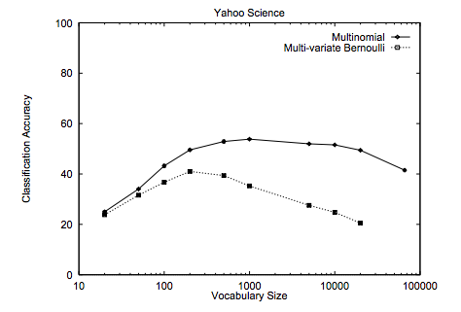
Multinomial vs. Bernoulli?
Handles word frequency
Given enough data, tends to performs better
http://www.cs.cmu.edu/~knigam/papers/multinomial-aaaiws98.pdf

Slide 60
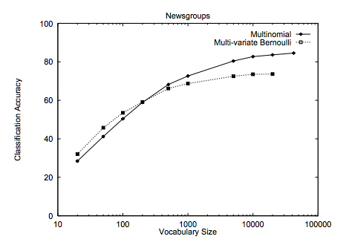
Multinomial vs. Bernoulli?
Handles word frequency
Given enough data, tends to performs better
http://www.cs.cmu.edu/~knigam/papers/multinomial-aaaiws98.pdf

Slide 61
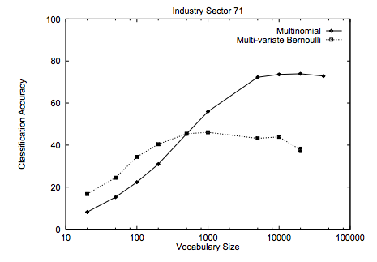
Multinomial vs. Bernoulli?
Handles word frequency
Given enough data, tends to performs better
http://www.cs.cmu.edu/~knigam/papers/multinomial-aaaiws98.pdf

