Slide 1
SMT – Final thoughts
David Kauchak
CS159 – Fall 2014
Some slides adapted from
Philipp Koehn
Kevin Knight
Dan Klein
School of Informatics
University of Edinburgh
USC/Information Sciences Institute
USC/Computer Science Department
Computer Science Department
UC Berkeley

Slide 2
Admin
Assignment 4b graded (except for 2 of them)
Assignment 6
MT lab on Thursday in Edmunds 105

Slide 3





Language translation
Yo quiero Taco Bell

Slide 4
If we had the alignments
If we estimate this from a corpus, what does this represent?
Probability that f is aligned to e in the corpus.

Slide 5
If we had the alignments
?
If we have the alignments, how do we estimate this?

Slide 6
If we had the alignments
Number of times f is aligned to e in the corpus

Slide 7
If we had the alignments

Slide 8
If we had the alignments…
Input: corpus of English/Foreign sentence pairs along with alignment
for (E, F) in corpus:
for e in E:
for f in F:
if f aligned-to e:
count(e,f) += 1
count(e) += 1
for all (e,f) in count:
p(f|e) = count(e,f) / count(e)

Slide 9
Without the alignments
With alignments:
Without
alignments:
Instead of actual counts, use “expected counts”

Slide 10
Without the alignments
With alignments:
Without
alignments:

Slide 11
Probability of alignment
e1 e2 e3
What is p(f₂->e₂)?
Is it p(f₂|e₂)?
f1 f2 f3

Slide 12
Probability of alignment
e1 e2 e3
No. p(f₂|e₂) is over the whole corpus!
f1 f2 f3

Slide 13
Probability of alignment
In this example, there are three options.
p(f₂->e₂): Over all options, how likely does the model think it is to align f₂ to e₂.
e1 e2 e3
f1 f2 f3
How do we calculate this value?

Slide 14
Probability of alignment
In this example, there are three options.
p(f₂->e₂): Over all options, how likely does the model think it is to align f₂ to e₂.
e1 e2 e3
f1 f2 f3

Slide 15
Without the alignments
Input: corpus of English/Foreign sentence pairs along with alignment
for (E, F) in corpus:
for e in E:
for f in F:
count(e,f) += p( f -> e)
count(e) += p(f -> e)
for all (e,f) in count:
p(f|e) = count(e,f) / count(e)

Slide 16
Benefits of word-level model
Rarely used in practice for modern MT system
Mary did not slap the green witch
Maria no dió una botefada a la bruja verde
Two key side effects of training a word-level model:
  Word-level alignment
  p(f | e): translation dictionary
How do I get this?

Slide 17
Word alignment
100 iterations
green house
p( casa | green) | 0.005
p( verde | green) | 0.995
p( la | green ) | 0
casa verde
How should these be aligned?
p( casa | house) | ~1.0
p( verde | house) | ~0.0
p( la | house ) | ~0.0
the house
la casa
p( casa | the) | 0.005
p( verde | the) | 0
p( la | the ) | 0.995

Slide 18
Word alignment
100 iterations
green house
p( casa | green) | 0.005
p( verde | green) | 0.995
p( la | green ) | 0
casa verde
Why?
p( casa | house) | ~1.0
p( verde | house) | ~0.0
p( la | house ) | ~0.0
the house
la casa
p( casa | the) | 0.005
p( verde | the) | 0
p( la | the ) | 0.995

Slide 19
Word-level alignment
Which for IBM model 1 is:
Given a trained model (i.e. p(f|e) values), how do we find this?
Align each foreign word (f in F) to the English word (e in E) with highest p(f|e)

Slide 20
Word-alignment Evaluation
The old man is happy. He has fished many times.
El viejo está feliz porque ha pescado muchos veces.
How good of an alignment is this?
How can we quantify this?

Slide 21
Word-alignment Evaluation
System:
The old man is happy. He has fished many times.
El viejo está feliz porque ha pescado muchos veces.
Human
The old man is happy. He has fished many times.
El viejo está feliz porque ha pescado muchos veces.
How can we quantify this?

Slide 22
Word-alignment Evaluation
System:
The old man is happy. He has fished many times.
El viejo está feliz porque ha pescado muchos veces.
Human
The old man is happy. He has fished many times.
El viejo está feliz porque ha pescado muchos veces.
Precision and recall!

Slide 23
Word-alignment Evaluation
System:
The old man is happy. He has fished many times.
El viejo está feliz porque ha pescado muchos veces.
Human
The old man is happy. He has fished many times.
El viejo está feliz porque ha pescado muchos veces.
6
6
Precision:
Recall:
7
10

Slide 24
Problems for Statistical MT
Preprocessing
Language modeling
Translation modeling
Decoding
Parameter optimization
Evaluation

Slide 25
What kind of Translation Model?
Mary did not slap the green witch
Word-level models
Phrasal models
Syntactic models
Semantic models
Maria no dió una botefada a la bruja verde

Slide 26
Phrase-Based Statistical MT
Morgen
fliege
ich
nach Kanada
zur Konferenz
Tomorrow
I
will fly
to the conference
In Canada
Generative story has three steps:
Foreign input segmented in to phrases
  “phrase” is any sequence of words
Each phrase is probabilistically translated into English
  P(to the conference | zur Konferenz)
  P(into the meeting | zur Konferenz)
Phrases are probabilistically re-ordered

Slide 27
Phrase-Based Statistical MT
Morgen
fliege
ich
nach Kanada
zur Konferenz
Tomorrow
I
will fly
to the conference
In Canada
Advantages?

Slide 28
Advantages of Phrase-Based
Many-to-many mappings can handle non-compositional phrases
Easy to understand
Local context is very useful for disambiguating
  “Interest rate” → …
  “Interest in” → …
The more data, the longer the learned phrases
  Sometimes whole sentences!

Slide 29
Syntax-based models
S
Benefits?
VP
NP
VP
PP
NP
NP
NP
NP
NP
DT
CD
NNS
VBP
NNS
VBG
IN
NNP
CC
NNP
PUNC
These
7
people
include
astronauts
coming
from
France
and
Russia
.

Slide 30
Syntax-based models
Benefits
  Can use syntax to motivate word/phrase movement
  Could ensure grammaticality
Two main types:
p(foreign string | English parse tree)
p(foreign parse tree | English parse tree)

Slide 31
Tree to string rule
S
ADVP
,
x0:NP
x1:VP
->
x0:NP “*” x1:VP
RB
“,”
“therefore”

Slide 32
Tree to string rules examples
DT(these) → 这
VBP(include) → 中包括
VBP(includes) → 中包括
NNP(France) → 法国
CC(and) → 和
NNP(Russia) → 俄罗斯
IN(of) → 的
NP(NNS(astronauts)) → 宇航 , 员
PUNC(.) → .
NP(x0:DT, CD(7), NNS(people) → x0 , 7人
VP(VBG(coming), PP(IN(from), x0:NP)) → 来自 ,x0
IN(from) → 来自
NP(x0:NNP, x1:CC, x2:NNP) → x0 , x1 , x2
VP(x0:VBP, x1:NP) → x0 , x1
S(x0:NP, x1:VP, x2:PUNC) → x0 , x1, x2
NP(x0:NP, x1:VP) → x1 , 的 , x0
NP(DT(“the”), x0:JJ, x1:NN) → x0 , x1
Contiguous phrase pair
substitution rules
(alignment templates)
Higher-level rules

Slide 33
Tree to string rules examples
DT(these) → 这
VBP(include) → 中包括
VBP(includes) → 中包括
NNP(France) → 法国
CC(and) → 和
NNP(Russia) → 俄罗斯
IN(of) → 的
NP(NNS(astronauts)) → 宇航 , 员
PUNC(.) → .
NP(x0:DT, CD(7), NNS(people) → x0 , 7人
VP(VBG(coming), PP(IN(from), x0:NP)) → 来自 ,x0
IN(from) → 来自
NP(x0:NNP, x1:CC, x2:NNP) → x0 , x1 , x2
VP(x0:VBP, x1:NP) → x0 , x1
S(x0:NP, x1:VP, x2:PUNC) → x0 , x1, x2
NP(x0:NP, x1:VP) → x1 , 的 , x0
NP(DT(“the”), x0:JJ, x1:NN) → x0 , x1
Both VBP(“include”) and
VBP(“includes”) will translate
to “中包括” in Chinese.
Contiguous phrase pair
substitution rules
(alignment templates)
Higher-level rules

Slide 34
Tree Transformations
DT(these) → 这
VBP(include) → 中包括
VBP(includes) → 中包括
NNP(France) → 法国
CC(and) → 和
NNP(Russia) → 俄罗斯
IN(of) → 的
NP(NNS(astronauts)) → 宇航 , 员
PUNC(.) → .
NP(x0:DT, CD(7), NNS(people) → x0 , 7人
VP(VBG(coming), PP(IN(from), x0:NP)) → 来自 ,x0
IN(from) → 来自
NP(x0:NNP, x1:CC, x2:NNP) → x0 , x1 , x2
VP(x0:VBP, x1:NP) → x0 , x1
S(x0:NP, x1:VP, x2:PUNC) → x0 , x1, x2
NP(x0:NP, x1:VP) → x1 , 的 , x0
NP(DT(“the”), x0:JJ, x1:NN) → x0 , x1
The phrase “coming from”
translates to “来自” only if
followed by an NP (whose
translation is then placed to
the right of “来自”).
Contiguous phrase pair
Substitution rules
(alignment templates)
Higher-level rules

Slide 35
Tree Transformations
Translate an English NP (“astronauts”)
modified by a gerund VP (“coming
from France and Russia”) as follows:
(1) translate the gerund VP,
(2) type the Chinese word “的”,
(3) translate the NP.
DT(these) → 这
VBP(include) → 中包括
VBP(includes) → 中包括
NNP(France) → 法国
CC(and) → 和
NNP(Russia) → 俄罗斯
IN(of) → 的
NP(NNS(astronauts)) → 宇航 , 员
PUNC(.) → .
NP(x0:DT, CD(7), NNS(people) → x0 , 7人
VP(VBG(coming), PP(IN(from), x0:NP)) → 来自 ,x0
IN(from) → 来自
NP(x0:NNP, x1:CC, x2:NNP) → x0 , x1 , x2
VP(x0:VBP, x1:NP) → x0 , x1
S(x0:NP, x1:VP, x2:PUNC) → x0 , x1, x2
NP(x0:NP, x1:VP) → x1 , 的 , x0
NP(DT(“the”), x0:JJ, x1:NN) → x0 , x1
Contiguous phrase pair
Substitution rules
(alignment templates)
Higher-level rules

Slide 36
Tree Transformations
DT(these) → 这
VBP(include) → 中包括
VBP(includes) → 中包括
NNP(France) → 法国
CC(and) → 和
NNP(Russia) → 俄罗斯
IN(of) → 的
NP(NNS(astronauts)) → 宇航 , 员
PUNC(.) → .
NP(x0:DT, CD(7), NNS(people) → x0 , 7人
VP(VBG(coming), PP(IN(from), x0:NP)) → 来自 ,x0
IN(from) → 来自
NP(x0:NNP, x1:CC, x2:NNP) → x0 , x1 , x2
VP(x0:VBP, x1:NP) → x0 , x1
S(x0:NP, x1:VP, x2:PUNC) → x0 , x1, x2
NP(x0:NP, x1:VP) → x1 , 的 , x0
NP(DT(“the”), x0:JJ, x1:NN) → x0 , x1
Contiguous phrase pair
Substitution rules
(alignment templates)
To translate “the JJ NN”,
just translate the JJ and then
translate the NN (drop “the”).
Higher-level rules

Slide 37
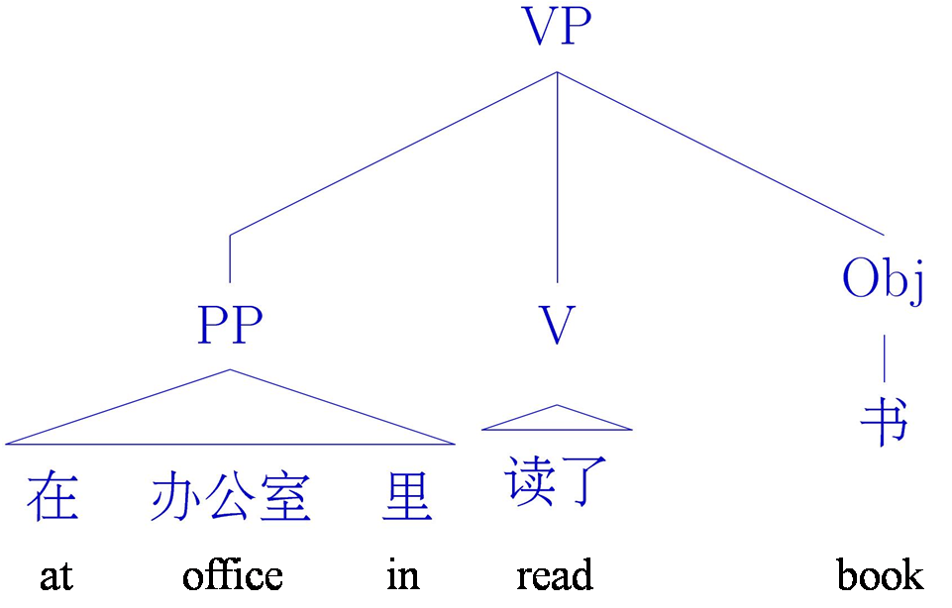
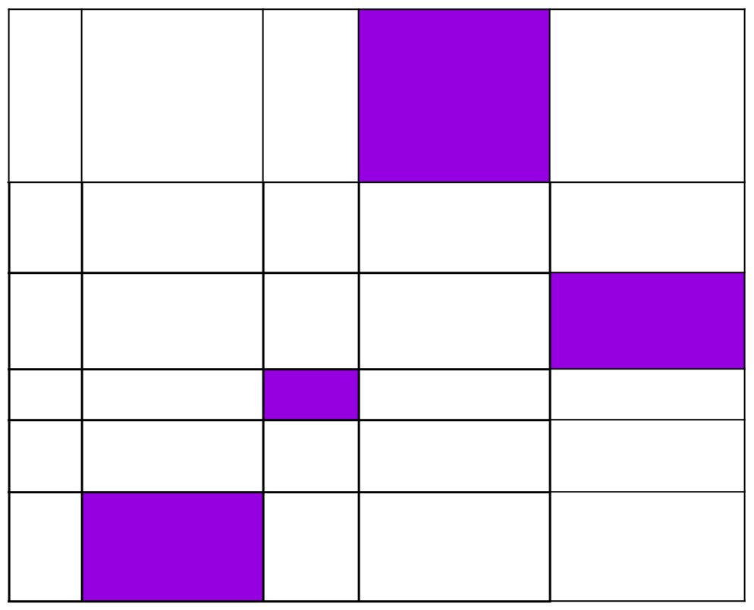
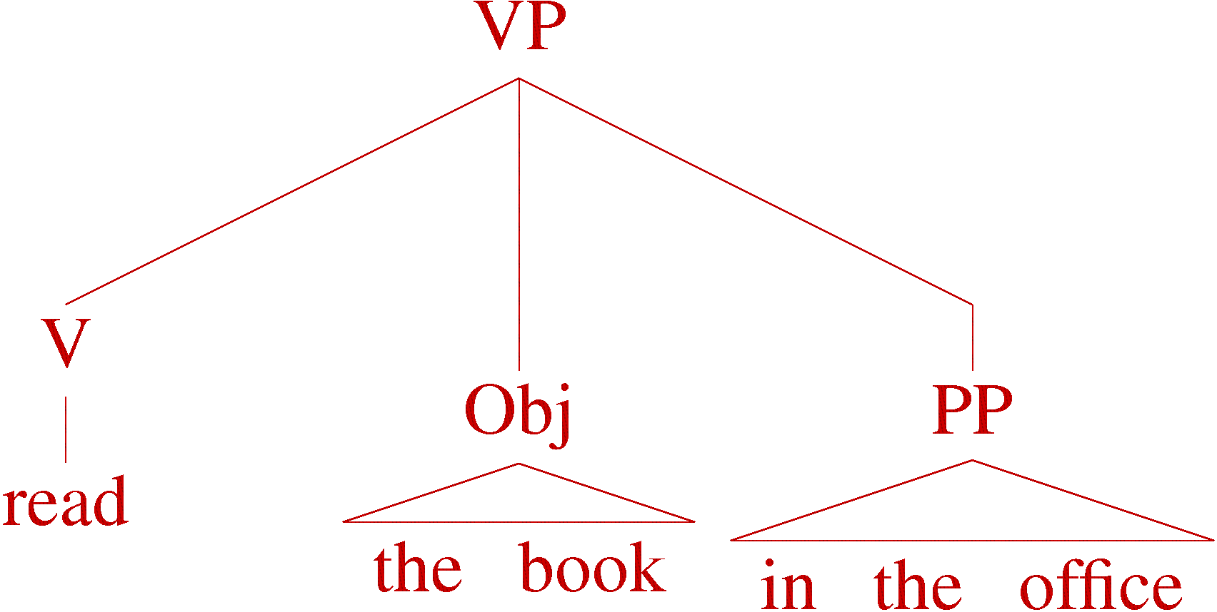


Tree to tree example
Build a model
中文
EN

Slide 38
Problems for Statistical MT
Preprocessing
Language modeling
Translation modeling
Decoding
Parameter optimization
Evaluation

Slide 39
Decoding
Of all conceivable English word strings, find the one maximizing P(e) x P(f | e)
Decoding is an NP-complete problem! (for many translation models)
Several decoding strategies are often available
Notes:
What does being NP-complete imply?

Slide 40
Decoding
Of all conceivable English word strings, find the one maximizing P(e) x P(f | e)
Decoding is an NP-complete problem! (for many translation models)
Several decoding strategies are often available
Notes:
What does being NP-complete imply?

Slide 41
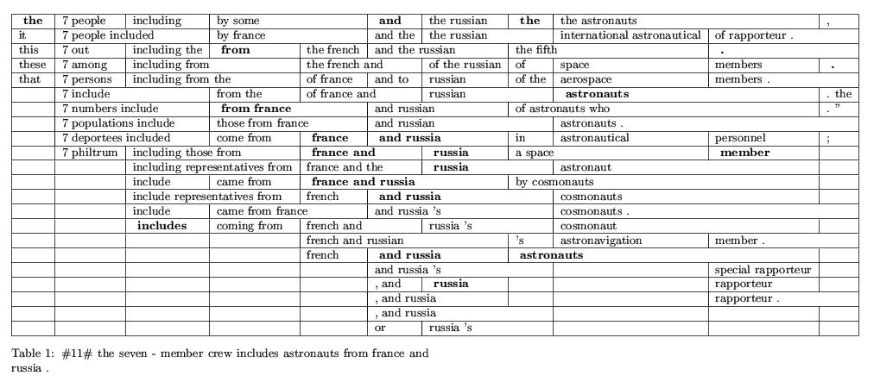
Phrase-Based Decoding
这 7人 中包括 来自 法国 和 俄罗斯 的 宇航 员 .
What is the best translation?

Slide 42
Phrase-Based Decoding
这 7人 中包括 来自 法国 和 俄罗斯 的 宇航 员 .
These 7 people include astronauts coming from France and Russia.

Slide 43
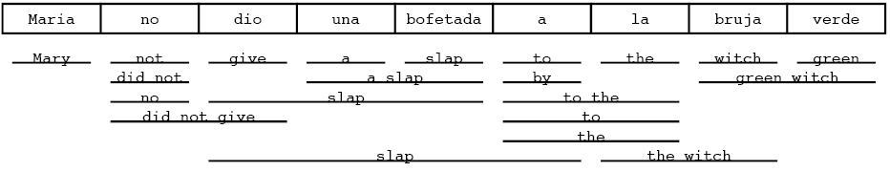
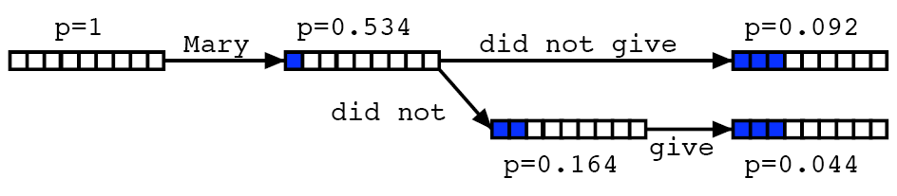
Hypotheis Lattices

Slide 44
Problems for Statistical MT
Preprocessing
Language modeling
Translation modeling
Decoding
Parameter optimization
Evaluation

Slide 45
The Problem: Learn Lambdas
How should we optimize these?

Slide 46
The Problem: Learn Lambdas
Given a data set with foreign/English sentences, find the λ’s that:
maximize the likelihood of the data
maximize an evaluation criterion

Slide 47
Problems for Statistical MT
Preprocessing
Language modeling
Translation modeling
Decoding
Parameter optimization
Evaluation

Slide 48
MT Evaluation
How do we do it?
What data might be useful?

Slide 49

MT Evaluation
Source only
Manual:
  SSER (subjective sentence error rate)
  Correct/Incorrect
  Error categorization
Extrinsic:
Objective usage testing
Automatic:
  WER (word error rate)
  BLEU (Bilingual Evaluation Understudy)
  NIST

Slide 50
Automatic Evaluation
Common NLP/machine learning/AI approach
Training sentence pairs
All sentence pairs
Testing sentence pairs
Notes:
“train” a model on the training sentences (that is learn the probabilities)
then evaluate on the test sentences (which the model has never seen before)

Slide 51
Automatic Evaluation
Reference (human) translation:
The U.S. island of Guam is maintaining a high state of alert after the Guam airport and its offices both received an e-mail from someone calling himself the Saudi Arabian Osama bin Laden and threatening a biological/chemical attack against public places such as the airport .
Machine translation:
The American [?] international airport and its the office all receives one calls self the sand Arab rich business [?] and so on electronic mail , which sends out ; The threat will be able after public place and so on the airport to start the biochemistry attack , [?] highly alerts after the maintenance.
Machine translation 2:
United States Office of the Guam International Airport and were received by a man claiming to be Saudi Arabian businessman Osama bin Laden, sent emails, threats to airports and other public places will launch a biological or chemical attack, remain on high alert in Guam.
Ideas?

Slide 52
BLEU Evaluation Metric
(Papineni et al, ACL-2002)
Reference (human) translation:
The U.S. island of Guam is maintaining a high state of alert after the Guam airport and its offices both received an e-mail from someone calling himself the Saudi Arabian Osama bin Laden and threatening a biological/chemical attack against public places such as the airport .
Basic idea:
Combination of n-gram precisions of varying size
What percentage of machine n-grams can be found in the reference translation?
Machine translation:
The American [?] international airport and its the office all receives one calls self the sand Arab rich business [?] and so on electronic mail , which sends out ; The threat will be able after public place and so on the airport to start the biochemistry attack , [?] highly alerts after the maintenance.

Slide 53
Multiple Reference Translations
Reference translation 1:
The U.S. island of Guam is maintaining a high state of alert after the Guam airport and its offices both received an e-mail from someone calling himself the Saudi Arabian Osama bin Laden and threatening a biological/chemical attack against public places such as the airport .
Reference translation 1:
The U.S. island of Guam is maintaining a high state of alert after the Guam airport and its offices both received an e-mail from someone calling himself the Saudi Arabian Osama bin Laden and threatening a biological/chemical attack against public places such as the airport .
Reference translation 2:
Guam International Airport and its offices are maintaining a high state of alert after receiving an e-mail that was from a person claiming to be the wealthy Saudi Arabian businessman Bin Laden and that threatened to launch a biological and chemical attack on the airport and other public places .
Reference translation 2:
Guam International Airport and its offices are maintaining a high state of alert after receiving an e-mail that was from a person claiming to be the wealthy Saudi Arabian businessman Bin Laden and that threatened to launch a biological and chemical attack on the airport and other public places .
Machine translation:
The American [?] international airport and its the office all receives one calls self the sand Arab rich business [?] and so on electronic mail , which sends out ; The threat will be able after public place and so on the airport to start the biochemistry attack , [?] highly alerts after the maintenance.
Machine translation:
The American [?] international airport and its the office all receives one calls self the sand Arab rich business [?] and so on electronic mail , which sends out ; The threat will be able after public place and so on the airport to start the biochemistry attack , [?] highly alerts after the maintenance.
Reference translation 3:
The US International Airport of Guam and its office has received an email from a self-claimed Arabian millionaire named Laden , which threatens to launch a biochemical attack on such public places as airport . Guam authority has been on alert .
Reference translation 3:
The US International Airport of Guam and its office has received an email from a self-claimed Arabian millionaire named Laden , which threatens to launch a biochemical attack on such public places as airport . Guam authority has been on alert .
Reference translation 4:
US Guam International Airport and its office received an email from Mr. Bin Laden and other rich businessman from Saudi Arabia . They said there would be biochemistry air raid to Guam Airport and other public places . Guam needs to be in high precaution about this matter .
Reference translation 4:
US Guam International Airport and its office received an email from Mr. Bin Laden and other rich businessman from Saudi Arabia . They said there would be biochemistry air raid to Guam Airport and other public places . Guam needs to be in high precaution about this matter .

Slide 54
N-gram precision example
Candidate 1: It is a guide to action which ensures that the military always obey the commands of the party.
Reference 1: It is a guide to action that ensures that the military will forever heed Party commands.
Reference 2: It is the guiding principle which guarantees the military forces always being under the command of the Party.
Reference 3: It is the practical guide for the army always to heed directions of the party.
What percentage of machine n-grams can be found in the reference translations? Do unigrams, bigrams and trigrams.

Slide 55
N-gram precision example
Candidate 1: It is a guide to action which ensures that the military
always obey the commands of the party.
Reference 1: It is a guide to action that ensures that the military will forever heed Party commands.
Reference 2: It is the guiding principle which guarantees the military forces always being under the command of the Party.
Reference 3: It is the practical guide for the army always to heed directions of the party.
Unigrams: 17/18

Slide 56
N-gram precision example
Candidate 1: It is a guide to action which ensures that the military
always obey the commands of the party.
Reference 1: It is a guide to action that ensures that the military will forever heed Party commands.
Reference 2: It is the guiding principle which guarantees the military forces always being under the command of the Party.
Reference 3: It is the practical guide for the army always to heed directions of the party.
Unigrams: 17/18
Bigrams: 10/17

Slide 57
N-gram precision example
Candidate 1: It is a guide to action which ensures that the military
always obey the commands of the party.
Reference 1: It is a guide to action that ensures that the military will forever heed Party commands.
Reference 2: It is the guiding principle which guarantees the military forces always being under the command of the Party.
Reference 3: It is the practical guide for the army always to heed directions of the party.
Unigrams: 17/18
Bigrams: 10/17
Trigrams: 7/16

Slide 58
N-gram precision example 2
Candidate 2: It is to ensure the army forever hearing the directions guide that party commands.
Reference 1: It is a guide to action that ensures that the military will forever heed Party commands.
Reference 2: It is the guiding principle which guarantees the military forces always being under the command of the Party.
Reference 3: It is the practical guide for the army always to heed directions of the party.

Slide 59
N-gram precision example 2
Candidate 2: It is to ensure the army forever hearing the directions guide that party commands.
Reference 1: It is a guide to action that ensures that the military will forever heed Party commands.
Reference 2: It is the guiding principle which guarantees the military forces always being under the command of the Party.
Reference 3: It is the practical guide for the army always to heed directions of the party.
Unigrams: 12/14

Slide 60
N-gram precision example 2
Candidate 2: It is to ensure the army forever hearing the directions
guide that party commands.
Reference 1: It is a guide to action that ensures that the military will forever heed Party commands.
Reference 2: It is the guiding principle which guarantees the military forces always being under the command of the Party.
Reference 3: It is the practical guide for the army always to heed directions of the party.
Unigrams: 12/14
Bigrams: 4/13

Slide 61
N-gram precision example 2
Candidate 2: It is to ensure the army forever hearing the directions
guide that party commands.
Reference 1: It is a guide to action that ensures that the military will forever heed Party commands.
Reference 2: It is the guiding principle which guarantees the military forces always being under the command of the Party.
Reference 3: It is the practical guide for the army always to heed directions of the party.
Unigrams: 12/14
Bigrams: 4/13
Trigrams: 1/12

Slide 62
N-gram precision
Candidate 1: It is a guide to action which ensures that the military always obey the commands of the party.
Unigrams: 17/18
Bigrams: 10/17
Trigrams: 7/16
Candidate 2: It is to ensure the army forever hearing the directions guide that party commands.
Unigrams: 12/14
Bigrams: 4/13
Trigrams: 1/12
Any problems/concerns?

Slide 63
N-gram precision example
Candidate 3: the
Candidate 4: It is a
Reference 1: It is a guide to action that ensures that the military will forever heed Party commands.
Reference 2: It is the guiding principle which guarantees the military forces always being under the command of the Party.
Reference 3: It is the practical guide for the army always to heed directions of the party.
What percentage of machine n-grams can be found in the reference translations? Do unigrams, bigrams and trigrams.

Slide 64
BLEU Evaluation Metric
(Papineni et al, ACL-2002)
Reference (human) translation:
The U.S. island of Guam is maintaining a high state of alert after the Guam airport and its offices both received an e-mail from someone calling himself the Saudi Arabian Osama bin Laden and threatening a biological/chemical attack against public places such as the airport .
N-gram precision (score is between 0 & 1)
  What percentage of machine n-grams can be found in the reference translation?
  Not allowed to use same portion of reference translation twice (can’t cheat by typing out “the the the the the”)
Brevity penalty
  Can’t just type out single word “the” (precision 1.0!)
*** Amazingly hard to “game” the system (i.e., find a way to change machine output so that BLEU goes up, but quality doesn’t)
Machine translation:
The American [?] international airport and its the office all receives one calls self the sand Arab rich business [?] and so on electronic mail , which sends out ; The threat will be able after public place and so on the airport to start the biochemistry attack , [?] highly alerts after the maintenance.

Slide 65
BLEU Tends to Predict Human Judgments
(variant of BLEU)
slide from G. Doddington (NIST)

Slide 66
BLEU in Action
枪手被警方击毙。 (Foreign Original)
the gunman was shot to death by the police . (Reference Translation)
the gunman was police kill . #1
wounded police jaya of #2
the gunman was shot dead by the police . #3
the gunman arrested by police kill . #4
the gunmen were killed . #5
the gunman was shot to death by the police . #6
gunmen were killed by police ?SUB>0 ?SUB>0 #7
al by the police . #8
the ringer is killed by the police . #9
police killed the gunman . #10

Slide 67
BLEU in Action
枪手被警方击毙。 (Foreign Original)
the gunman was shot to death by the police . (Reference Translation)
the gunman was police kill . #1
wounded police jaya of #2
the gunman was shot dead by the police . #3
the gunman arrested by police kill . #4
the gunmen were killed . #5
the gunman was shot to death by the police . #6
gunmen were killed by police ?SUB>0 ?SUB>0 #7
al by the police . #8
the ringer is killed by the police . #9
police killed the gunman . #10
green = 4-gram match (good!)
red = word not matched (bad!)

Slide 68
BLEU in Action
枪手被警方击毙。 (Foreign Original)
the gunman was shot to death by the police . (Reference Translation)
the gunman was police kill . #1 Machine
wounded police jaya of #2 Machine
the gunman was shot dead by the police . #3 Human
the gunman arrested by police kill . #4 Machine
the gunmen were killed . #5 Machine
the gunman was shot to death by the police . #6 Human
gunmen were killed by police ?SUB>0 ?SUB>0 #7 Machine
al by the police . #8 Machine
the ringer is killed by the police . #9 Machine
police killed the gunman . #10 Human
green = 4-gram match (good!)
red = word not matched (bad!)

Slide 69
BLEU: Problems?
Doesn’t care if an incorrectly translated word is a name or a preposition
  gave it to Albright (reference)
  gave it at Albright (translation #1)
  gave it to altar (translation #2)
What happens when a program reaches human level performance in BLEU but the translations are still bad?
  maybe sooner than you think …

Slide 70
11 Human Translation Agencies Employed to Translate 100 Chinese News Articles
  上个星期的战斗至少夺取12个人的生命。
  At least 12 people were killed in the battle last week.
    Last week 's fight took at least 12 lives.
    The fighting last week killed at least 12.
    The battle of last week killed at least 12 persons.
    At least 12 people lost their lives in last week 's fighting.
    At least 12 persons died in the fighting last week.
    At least 12 died in the battle last week.
    At least 12 people were killed in the fighting last week.
    During last week 's fighting , at least 12 people died.
    Last week at least twelve people died in the fighting.
    Last week 's fighting took the lives of twelve people.

Slide 71
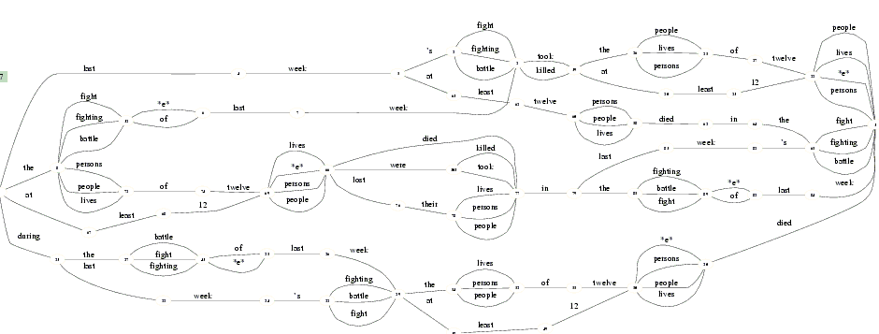
Merging Translations
(Pang, Knight, and Marcu, NAACL-HLT 2003)
  Create word graphs by merging paraphrases
  => from 10 sentences to over a thousand
  11th human translation is often found in the graph!

