Slide 1
Introduction to
Statistical Machine Translation
David Kauchak
CS159 – Fall 2014
Some slides adapted from
Philipp Koehn
Kevin Knight
Dan Klein
School of Informatics
University of Edinburgh
USC/Information Sciences Institute
USC/Computer Science Department
Computer Science Department
UC Berkeley

Slide 2
Admin
Assignment 5
Quiz #2
  Mean 26.5 (88%)
  Median 26.5

Slide 3





Language translation
Yo quiero Taco Bell

Slide 4
MT Systems
Where have you seen machine translation systems?

Slide 5
Machine Translation
美国关岛国际机场及其办公室均接获一名自称沙地阿拉伯富商拉登等发出的电子邮件，威胁将会向机场等公众地方发动生化袭击後，关岛经保持高度戒备。
The U.S. island of Guam is maintaining a high state of alert after the Guam airport and its offices both received an e-mail from someone calling himself the Saudi Arabian Osama bin Laden and threatening a biological/chemical attack against public places such as the airport .
The classic acid test for natural language processing.
Requires capabilities in both interpretation and generation.
“People around the world stubbornly refuse to write
everything in English.” ☺

Slide 6
Machine Translation
美国关岛国际机场及其办公室均接获一名自称沙地阿拉伯富商拉登等发出的电子邮件，威胁将会向机场等公众地方发动生化袭击後，关岛经保持高度戒备。
Machine translation is becoming very prevalent
Even PowerPoint has translation built into it!
The U.S. island of Guam is maintaining a high state of alert after the Guam airport and its offices both received an e-mail from someone calling himself the Saudi Arabian Osama bin Laden and threatening a biological/chemical attack against public places such as the airport .
United States Office of the Guam International Airport and were received by a man claiming to be Saudi Arabian businessman Osama bin Laden, sent emails, threats to airports and other public places will launch a biological or chemical attack, remain on high alert in Guam.

Slide 7
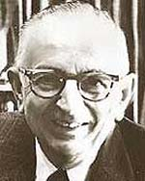
Warren Weaver (1947)
ingcmpnqsnwf cv fpn owoktvcv
hu ihgzsnwfv rqcffnw cw owgcnwf
kowazoanv ...

Slide 8
Warren Weaver (1947)
e e e e
ingcmpnqsnwf cv fpn owoktvcv
e e e
hu ihgzsnwfv rqcffnw cw owgcnwf
e
kowazoanv ...

Slide 9
Warren Weaver (1947)
e e e the
ingcmpnqsnwf cv fpn owoktvcv
e e e
hu ihgzsnwfv rqcffnw cw owgcnwf
e
kowazoanv ...

Slide 10
Warren Weaver (1947)
e he e the
ingcmpnqsnwf cv fpn owoktvcv
e e e t
hu ihgzsnwfv rqcffnw cw owgcnwf
e
kowazoanv ...

Slide 11
Warren Weaver (1947)
e he e of the
ingcmpnqsnwf cv fpn owoktvcv
e e e t
hu ihgzsnwfv rqcffnw cw owgcnwf
e
kowazoanv ...

Slide 12
Warren Weaver (1947)
e he e of the fof
ingcmpnqsnwf cv fpn owoktvcv
e f o e o oe t
hu ihgzsnwfv rqcffnw cw owgcnwf
ef
kowazoanv ...

Slide 13
Warren Weaver (1947)
e he e of the
ingcmpnqsnwf cv fpn owoktvcv
e e e t
hu ihgzsnwfv rqcffnw cw owgcnwf
e
kowazoanv ...

Slide 14
Warren Weaver (1947)
e he e is the sis
ingcmpnqsnwf cv fpn owoktvcv
e s i e i ie t
hu ihgzsnwfv rqcffnw cw owgcnwf
es
kowazoanv ...

Slide 15
Warren Weaver (1947)
decipherment is the analysis
ingcmpnqsnwf cv fpn owoktvcv
of documents written in ancient
hu ihgzsnwfv rqcffnw cw owgcnwf
languages ...
kowazoanv ...

Slide 16
Warren Weaver (1947)
The non-Turkish guy next to me is even deciphering Turkish! All he needs is a statistical table of letter-pair frequencies in Turkish …
Can this be
computerized?
Collected mechanically from a
Turkish body of text, or corpus

Slide 17
“When I look at an article in Russian, I say: this is really written in English, but it has been coded in some strange symbols. I will now proceed to decode.”
- Warren Weaver, March 1947

Slide 18
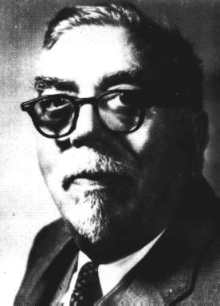
“When I look at an article in Russian, I say: this is really written in English, but it has been coded in some strange symbols. I will now proceed to decode.”
- Warren Weaver, March 1947
“... as to the problem of mechanical translation, I frankly am afraid that the [semantic] boundaries of words in different languages are too vague ... to make any quasi-mechanical translation scheme very hopeful.”
- Norbert Wiener, April 1947

Slide 19
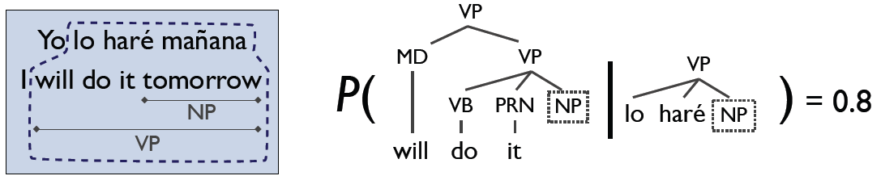
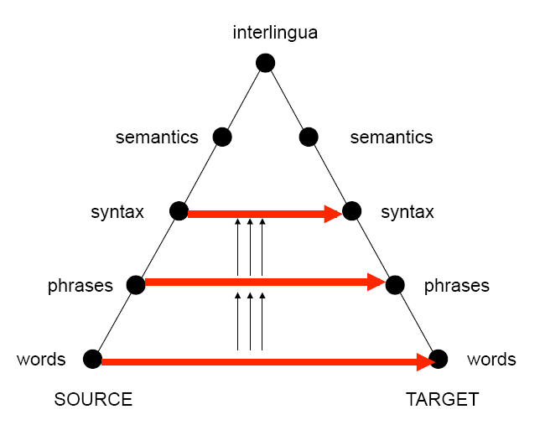
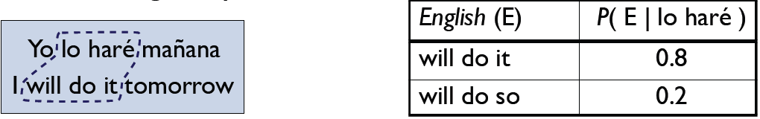
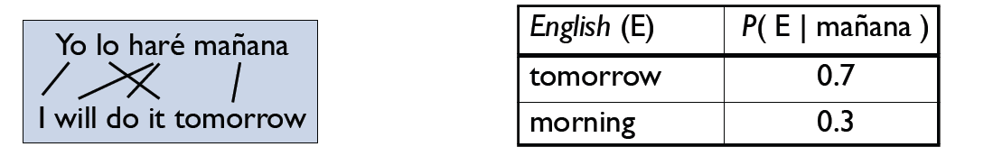
Levels of Transfer

Slide 20
World-Level MT: Examples
la politique de la haine . (Foreign Original)
politics of hate . (Reference Translation)
the policy of the hatred . (IBM4+N-grams+Stack)
nous avons signé le protocole . (Foreign Original)
we did sign the memorandum of agreement . (Reference Translation)
we have signed the protocol . (IBM4+N-grams+Stack)
où était le plan solide ? (Foreign Original)
but where was the solid plan ? (Reference Translation)
where was the economic base ? (IBM4+N-grams+Stack)

Slide 21
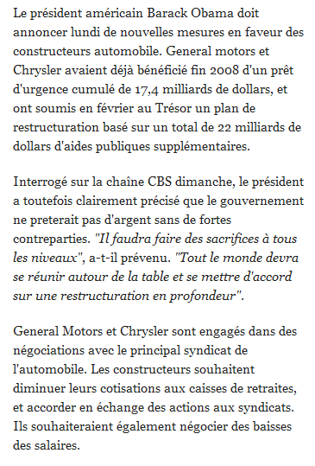
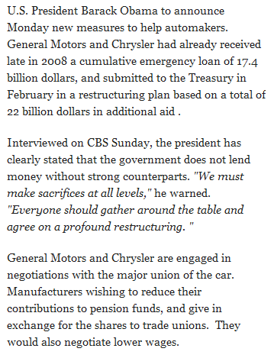
Phrasal / Syntactic MT: Examples

Slide 22

Data-Driven Machine Translation
Hmm, every time he sees
“banco”, he either types
“bank” or “bench” … but if
he sees “banco de…”,
he always types “bank”,
never “bench”…
Man, this is so boring.
Translated documents

Slide 23
Welcome to the Chinese Room
Chinese texts with
English translations
New
Chinese
Document
English
Translation
You can teach yourself to translate Chinese
using only bilingual data (without grammar books,
dictionaries, any people to answer your questions…)

Slide 24
Centauri/Arcturan [Knight, 1997]
Your assignment, translate this to Arcturan: farok crrrok hihok yorok clok kantok ok-yurp
1a. ok-voon ororok sprok .
1b. at-voon bichat dat .
7a. lalok farok ororok lalok sprok izok enemok .
7b. wat jjat bichat wat dat vat eneat .
2a. ok-drubel ok-voon anok plok sprok .
2b. at-drubel at-voon pippat rrat dat .
8a. lalok brok anok plok nok .
8b. iat lat pippat rrat nnat .
3a. erok sprok izok hihok ghirok .
3b. totat dat arrat vat hilat .
9a. wiwok nok izok kantok ok-yurp .
9b. totat nnat quat oloat at-yurp .
4a. ok-voon anok drok brok jok .
4b. at-voon krat pippat sat lat .
10a. lalok mok nok yorok ghirok clok .
10b. wat nnat gat mat bat hilat .
5a. wiwok farok izok stok .
5b. totat jjat quat cat .
11a. lalok nok crrrok hihok yorok zanzanok .
11b. wat nnat arrat mat zanzanat .
6a. lalok sprok izok jok stok .
6b. wat dat krat quat cat .
12a. lalok rarok nok izok hihok mok .
12b. wat nnat forat arrat vat gat .

Slide 25
Centauri/Arcturan [Knight, 1997]
Your assignment, translate this to Arcturan: farok crrrok hihok yorok clok kantok ok-yurp
1a. ok-voon ororok sprok .
1b. at-voon bichat dat .
7a. lalok farok ororok lalok sprok izok enemok .
7b. wat jjat bichat wat dat vat eneat .
2a. ok-drubel ok-voon anok plok sprok .
2b. at-drubel at-voon pippat rrat dat .
8a. lalok brok anok plok nok .
8b. iat lat pippat rrat nnat .
3a. erok sprok izok hihok ghirok .
3b. totat dat arrat vat hilat .
9a. wiwok nok izok kantok ok-yurp .
9b. totat nnat quat oloat at-yurp .
4a. ok-voon anok drok brok jok .
4b. at-voon krat pippat sat lat .
10a. lalok mok nok yorok ghirok clok .
10b. wat nnat gat mat bat hilat .
5a. wiwok farok izok stok .
5b. totat jjat quat cat .
11a. lalok nok crrrok hihok yorok zanzanok .
11b. wat nnat arrat mat zanzanat .
6a. lalok sprok izok jok stok .
6b. wat dat krat quat cat .
12a. lalok rarok nok izok hihok mok .
12b. wat nnat forat arrat vat gat .

Slide 26
Centauri/Arcturan [Knight, 1997]
Your assignment, translate this to Arcturan: farok crrrok hihok yorok clok kantok ok-yurp
1a. ok-voon ororok sprok .
1b. at-voon bichat dat .
7a. lalok farok ororok lalok sprok izok enemok .
7b. wat jjat bichat wat dat vat eneat .
2a. ok-drubel ok-voon anok plok sprok .
2b. at-drubel at-voon pippat rrat dat .
8a. lalok brok anok plok nok .
8b. iat lat pippat rrat nnat .
3a. erok sprok izok hihok ghirok .
3b. totat dat arrat vat hilat .
9a. wiwok nok izok kantok ok-yurp .
9b. totat nnat quat oloat at-yurp .
4a. ok-voon anok drok brok jok .
4b. at-voon krat pippat sat lat .
10a. lalok mok nok yorok ghirok clok .
10b. wat nnat gat mat bat hilat .
5a. wiwok farok izok stok .
5b. totat jjat quat cat .
11a. lalok nok crrrok hihok yorok zanzanok .
11b. wat nnat arrat mat zanzanat .
6a. lalok sprok izok jok stok .
6b. wat dat krat quat cat .
12a. lalok rarok nok izok hihok mok .
12b. wat nnat forat arrat vat gat .

Slide 27
Centauri/Arcturan [Knight, 1997]
Your assignment, translate this to Arcturan: farok crrrok hihok yorok clok kantok ok-yurp
1a. ok-voon ororok sprok .
1b. at-voon bichat dat .
7a. lalok farok ororok lalok sprok izok enemok .
7b. wat jjat bichat wat dat vat eneat .
2a. ok-drubel ok-voon anok plok sprok .
2b. at-drubel at-voon pippat rrat dat .
8a. lalok brok anok plok nok .
8b. iat lat pippat rrat nnat .
3a. erok sprok izok hihok ghirok .
3b. totat dat arrat vat hilat .
9a. wiwok nok izok kantok ok-yurp .
9b. totat nnat quat oloat at-yurp .
4a. ok-voon anok drok brok jok .
4b. at-voon krat pippat sat lat .
10a. lalok mok nok yorok ghirok clok .
10b. wat nnat gat mat bat hilat .
5a. wiwok farok izok stok .
5b. totat jjat quat cat .
11a. lalok nok crrrok hihok yorok zanzanok .
11b. wat nnat arrat mat zanzanat .
???
6a. lalok sprok izok jok stok .
6b. wat dat krat quat cat .
12a. lalok rarok nok izok hihok mok .
12b. wat nnat forat arrat vat gat .

Slide 28
Centauri/Arcturan [Knight, 1997]
Your assignment, translate this to Arcturan: farok crrrok hihok yorok clok kantok ok-yurp
1a. ok-voon ororok sprok .
1b. at-voon bichat dat .
7a. lalok farok ororok lalok sprok izok enemok .
7b. wat jjat bichat wat dat vat eneat .
2a. ok-drubel ok-voon anok plok sprok .
2b. at-drubel at-voon pippat rrat dat .
8a. lalok brok anok plok nok .
8b. iat lat pippat rrat nnat .
3a. erok sprok izok hihok ghirok .
3b. totat dat arrat vat hilat .
9a. wiwok nok izok kantok ok-yurp .
9b. totat nnat quat oloat at-yurp .
4a. ok-voon anok drok brok jok .
4b. at-voon krat pippat sat lat .
10a. lalok mok nok yorok ghirok clok .
10b. wat nnat gat mat bat hilat .
5a. wiwok farok izok stok .
5b. totat jjat quat cat .
11a. lalok nok crrrok hihok yorok zanzanok .
11b. wat nnat arrat mat zanzanat .
6a. lalok sprok izok jok stok .
6b. wat dat krat quat cat .
12a. lalok rarok nok izok hihok mok .
12b. wat nnat forat arrat vat gat .

Slide 29
Centauri/Arcturan [Knight, 1997]
Your assignment, translate this to Arcturan: farok crrrok hihok yorok clok kantok ok-yurp
1a. ok-voon ororok sprok .
1b. at-voon bichat dat .
7a. lalok farok ororok lalok sprok izok enemok .
7b. wat jjat bichat wat dat vat eneat .
2a. ok-drubel ok-voon anok plok sprok .
2b. at-drubel at-voon pippat rrat dat .
8a. lalok brok anok plok nok .
8b. iat lat pippat rrat nnat .
3a. erok sprok izok hihok ghirok .
3b. totat dat arrat vat hilat .
9a. wiwok nok izok kantok ok-yurp .
9b. totat nnat quat oloat at-yurp .
4a. ok-voon anok drok brok jok .
4b. at-voon krat pippat sat lat .
10a. lalok mok nok yorok ghirok clok .
10b. wat nnat gat mat bat hilat .
5a. wiwok farok izok stok .
5b. totat jjat quat cat .
11a. lalok nok crrrok hihok yorok zanzanok .
11b. wat nnat arrat mat zanzanat .
6a. lalok sprok izok jok stok .
6b. wat dat krat quat cat .
12a. lalok rarok nok izok hihok mok .
12b. wat nnat forat arrat vat gat .

Slide 30
Centauri/Arcturan [Knight, 1997]
Your assignment, translate this to Arcturan: farok crrrok hihok yorok clok kantok ok-yurp
1a. ok-voon ororok sprok .
1b. at-voon bichat dat .
7a. lalok farok ororok lalok sprok izok enemok .
7b. wat jjat bichat wat dat vat eneat .
2a. ok-drubel ok-voon anok plok sprok .
2b. at-drubel at-voon pippat rrat dat .
8a. lalok brok anok plok nok .
8b. iat lat pippat rrat nnat .
3a. erok sprok izok hihok ghirok .
3b. totat dat arrat vat hilat .
9a. wiwok nok izok kantok ok-yurp .
9b. totat nnat quat oloat at-yurp .
4a. ok-voon anok drok brok jok .
4b. at-voon krat pippat sat lat .
10a. lalok mok nok yorok ghirok clok .
10b. wat nnat gat mat bat hilat .
5a. wiwok farok izok stok .
5b. totat jjat quat cat .
11a. lalok nok crrrok hihok yorok zanzanok .
11b. wat nnat arrat mat zanzanat .
6a. lalok sprok izok jok stok .
6b. wat dat krat quat cat .
12a. lalok rarok nok izok hihok mok .
12b. wat nnat forat arrat vat gat .

Slide 31
Centauri/Arcturan [Knight, 1997]
Your assignment, translate this to Arcturan: farok crrrok hihok yorok clok kantok ok-yurp
1a. ok-voon ororok sprok .
1b. at-voon bichat dat .
7a. lalok farok ororok lalok sprok izok enemok .
7b. wat jjat bichat wat dat vat eneat .
2a. ok-drubel ok-voon anok plok sprok .
2b. at-drubel at-voon pippat rrat dat .
8a. lalok brok anok plok nok .
8b. iat lat pippat rrat nnat .
3a. erok sprok izok hihok ghirok .
3b. totat dat arrat vat hilat .
9a. wiwok nok izok kantok ok-yurp .
9b. totat nnat quat oloat at-yurp .
4a. ok-voon anok drok brok jok .
4b. at-voon krat pippat sat lat .
10a. lalok mok nok yorok ghirok clok .
10b. wat nnat gat mat bat hilat .
???
5a. wiwok farok izok stok .
5b. totat jjat quat cat .
11a. lalok nok crrrok hihok yorok zanzanok .
11b. wat nnat arrat mat zanzanat .
6a. lalok sprok izok jok stok .
6b. wat dat krat quat cat .
12a. lalok rarok nok izok hihok mok .
12b. wat nnat forat arrat vat gat .

Slide 32
Centauri/Arcturan [Knight, 1997]
Your assignment, translate this to Arcturan: farok crrrok hihok yorok clok kantok ok-yurp
1a. ok-voon ororok sprok .
1b. at-voon bichat dat .
7a. lalok farok ororok lalok sprok izok enemok .
7b. wat jjat bichat wat dat vat eneat .
2a. ok-drubel ok-voon anok plok sprok .
2b. at-drubel at-voon pippat rrat dat .
8a. lalok brok anok plok nok .
8b. iat lat pippat rrat nnat .
3a. erok sprok izok hihok ghirok .
3b. totat dat arrat vat hilat .
9a. wiwok nok izok kantok ok-yurp .
9b. totat nnat quat oloat at-yurp .
4a. ok-voon anok drok brok jok .
4b. at-voon krat pippat sat lat .
10a. lalok mok nok yorok ghirok clok .
10b. wat nnat gat mat bat hilat .
5a. wiwok farok izok stok .
5b. totat jjat quat cat .
11a. lalok nok crrrok hihok yorok zanzanok .
11b. wat nnat arrat mat zanzanat .
6a. lalok sprok izok jok stok .
6b. wat dat krat quat cat .
12a. lalok rarok nok izok hihok mok .
12b. wat nnat forat arrat vat gat .

Slide 33
Centauri/Arcturan [Knight, 1997]
Your assignment, translate this to Arcturan: farok crrrok hihok yorok clok kantok ok-yurp
1a. ok-voon ororok sprok .
1b. at-voon bichat dat .
7a. lalok farok ororok lalok sprok izok enemok .
7b. wat jjat bichat wat dat vat eneat .
2a. ok-drubel ok-voon anok plok sprok .
2b. at-drubel at-voon pippat rrat dat .
8a. lalok brok anok plok nok .
8b. iat lat pippat rrat nnat .
3a. erok sprok izok hihok ghirok .
3b. totat dat arrat vat hilat .
9a. wiwok nok izok kantok ok-yurp .
9b. totat nnat quat oloat at-yurp .
4a. ok-voon anok drok brok jok .
4b. at-voon krat pippat sat lat .
10a. lalok mok nok yorok ghirok clok .
10b. wat nnat gat mat bat hilat .
process of
elimination
5a. wiwok farok izok stok .
5b. totat jjat quat cat .
11a. lalok nok crrrok hihok yorok zanzanok .
11b. wat nnat arrat mat zanzanat .
6a. lalok sprok izok jok stok .
6b. wat dat krat quat cat .
12a. lalok rarok nok izok hihok mok .
12b. wat nnat forat arrat vat gat .

Slide 34
Centauri/Arcturan [Knight, 1997]
Your assignment, translate this to Arcturan: farok crrrok hihok yorok clok kantok ok-yurp
1a. ok-voon ororok sprok .
1b. at-voon bichat dat .
7a. lalok farok ororok lalok sprok izok enemok .
7b. wat jjat bichat wat dat vat eneat .
2a. ok-drubel ok-voon anok plok sprok .
2b. at-drubel at-voon pippat rrat dat .
8a. lalok brok anok plok nok .
8b. iat lat pippat rrat nnat .
3a. erok sprok izok hihok ghirok .
3b. totat dat arrat vat hilat .
9a. wiwok nok izok kantok ok-yurp .
9b. totat nnat quat oloat at-yurp .
4a. ok-voon anok drok brok jok .
4b. at-voon krat pippat sat lat .
10a. lalok mok nok yorok ghirok clok .
10b. wat nnat gat mat bat hilat .
5a. wiwok farok izok stok .
5b. totat jjat quat cat .
11a. lalok nok crrrok hihok yorok zanzanok .
11b. wat nnat arrat mat zanzanat .
cognate?
6a. lalok sprok izok jok stok .
6b. wat dat krat quat cat .
12a. lalok rarok nok izok hihok mok .
12b. wat nnat forat arrat vat gat .

Slide 35
Centauri/Arcturan [Knight, 1997]
Your assignment, put these words in order: { jjat, arrat, mat, bat, oloat, at-yurp }
1a. ok-voon ororok sprok .
1b. at-voon bichat dat .
7a. lalok farok ororok lalok sprok izok enemok .
7b. wat jjat bichat wat dat vat eneat .
2a. ok-drubel ok-voon anok plok sprok .
2b. at-drubel at-voon pippat rrat dat .
8a. lalok brok anok plok nok .
8b. iat lat pippat rrat nnat .
3a. erok sprok izok hihok ghirok .
3b. totat dat arrat vat hilat .
9a. wiwok nok izok kantok ok-yurp .
9b. totat nnat quat oloat at-yurp .
4a. ok-voon anok drok brok jok .
4b. at-voon krat pippat sat lat .
10a. lalok mok nok yorok ghirok clok .
10b. wat nnat gat mat bat hilat .
5a. wiwok farok izok stok .
5b. totat jjat quat cat .
11a. lalok nok crrrok hihok yorok zanzanok .
11b. wat nnat arrat mat zanzanat .
zero
fertility
6a. lalok sprok izok jok stok .
6b. wat dat krat quat cat .
12a. lalok rarok nok izok hihok mok .
12b. wat nnat forat arrat vat gat .

Slide 36
It’s Really Spanish/English
Clients do not sell pharmaceuticals in Europe => Clientes no venden medicinas en Europa
1a. Garcia and associates .
1b. Garcia y asociados .
7a. the clients and the associates are enemies .
7b. los clients y los asociados son enemigos .
2a. Carlos Garcia has three associates .
2b. Carlos Garcia tiene tres asociados .
8a. the company has three groups .
8b. la empresa tiene tres grupos .
3a. his associates are not strong .
3b. sus asociados no son fuertes .
9a. its groups are in Europe .
9b. sus grupos estan en Europa .
4a. Garcia has a company also .
4b. Garcia tambien tiene una empresa .
10a. the modern groups sell strong pharmaceuticals .
10b. los grupos modernos venden medicinas fuertes .
5a. its clients are angry .
5b. sus clientes estan enfadados .
11a. the groups do not sell zenzanine .
11b. los grupos no venden zanzanina .
6a. the associates are also angry .
6b. los asociados tambien estan enfadados .
12a. the small groups are not modern .
12b. los grupos pequenos no son modernos .

Slide 37
Data available
Many languages
  Europarl corpus has all European languages
    http://www.statmt.org/europarl/
    From a few hundred thousand sentences to a few million
  French/English from French parliamentary proceedings
  Lots of Chinese/English and Arabic/English from government projects/interests
    Chinese-English: 440 million words (15-20 million sentence pairs)
    Arabic-English: 790 million words (30-40 million sentence pairs)
  Smaller corpora in many, many other languages
Lots of monolingual data available in many languages
Even less data with multiple translations available
Available in limited domains
  most data is either news or government proceedings
  some other domains recently, like blogs

Slide 38
Statistical MT Overview
training
learn parameters
Bilingual data
model
monolingual data
Find the best
translation given the foreign sentence and the model (aka “decoding”)
Translation
Foreign sentence
English
sentence

Slide 39
Statistical MT
We will model the translation process probabilistically
Given a foreign sentence to translate, for any possible English sentence, we want to know the probability that the sentence is a translation of the foreign sentence
If we can find the most probable English sentence, we’re done
p(english sentence | foreign sentence)

Slide 40
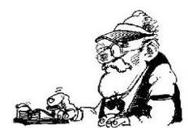

Noisy channel model
some message
is sent
along the way the message gets messed up
What was originally sent?
We have the mutated message, but would like to recover the original
Notes:
- think about the message passing game…

Slide 41
Noisy channel model
sent
received
model: p(sent | received)

Slide 42
Noisy channel model
Probabilistic model:
p(English | Foreign)
Given sentence pairs, gives us the probability
p(text | audio)
p(simplified | unsimplified)
p(compressed | uncompressed)
Notes:
general idea started with information theory and Shannon in the 40s
used in the early 90s by IBM team for machine translation
- started to become a prevalent model for text-to-text approaches in the late 1990s

Slide 43
Translation
Probabilistic model:
p(English | Foreign)
What is the translation problem then?
Notes:
general idea started with information theory and Shannon in the 40s
used in the early 90s by IBM team for machine translation
- started to become a prevalent model for text-to-text approaches in the late 1990s

Slide 44
Noisy channel model
Bayes’ rule
probability of the foreign sentence
language model: what are likely English word sequences?
translation model: how does the translation process happen? probability of the translated English sentence given the foreign sentence

Slide 45
Noisy channel model
Bayes’ rule
probability of the foreign sentence
why?
language model: what are likely English word sequences?
translation model: how does the translation process happen? probability of the translated English sentence given the foreign sentence

Slide 46
Noisy channel model
Bayes’ rule
probability of the foreign sentence
why?
this is a constant for any given f

Slide 47
Noisy channel model
model
translation model
language model
how do English sentences get translated to foreign?
what do English sentences look like?

Slide 48
Translation model
The models define probabilities over inputs
Morgen fliege ich nach Kanada zur Konferenz
Tomorrow I will fly to the conference in Canada
What is the probability that the English sentence is a translation of the foreign sentence?

Slide 49
Translation model
The models define probabilities over inputs
Morgen
fliege
ich
nach Kanada
zur Konferenz
Tomorrow
I
will fly
to the conference
In Canada
What is the probability of a foreign word being translated as a particular English word?
What is the probability of a foreign foreign phrase being translated as a particular English phrase?
What is the probability of a word/phrase changing ordering?
What is the probability of a foreign word/phrase disappearing?
What is the probability of a English word/phrase appearing?

Slide 50
Translation model
The models define probabilities over inputs
p( Morgen fliege ich nach Kanada zur Konferenz |
Tomorrow I will fly to the conference in Canada )
= 0.1
p( Morgen fliege ich nach Kanada zur Konferenz |
I like peanut butter and jelly )
= 0.0001

Slide 51
Language model
The models define probabilities over inputs
Tomorrow I will fly to the conference in Canada

Slide 52
What is a probability distribution?
A probability distribution defines the probability over a space of possible inputs
For the language model, what is the space of possible inputs?
  A language model describes the probability over ALL possible combinations of English words
For the translation model, what is the space of possible inputs?
  ALL possible combinations of foreign words with ALL possible combinations of English words

Slide 53
One way to think about it…
Translation
model
Broken
English
language
model
Spanish
(foreign)
English
What hunger have I,
Hungry I am so,
I am so hungry,
Have I that hunger …
Que hambre tengo yo
I am so hungry

Slide 54
Statistical MT Overview
training
learned parameters
“nice” fragment aligned data
Bilingual data
Translation model
preprocessing
monolingual data
Language model
Decoder
(what English sentence is most probable given foreign sentence with learned models)
Translation
Foreign sentence

Slide 55
Basic Model, Revisited
argmax P(e | f) =
e
argmax P(e) x P(f | e) / P(f) =
e
argmax P(e) x P(f | e)
e

Slide 56
Basic Model, Revisited
argmax P(e | f) =
e
argmax P(e) x P(f | e) / P(f) =
e
argmax P(e)^{2.4} x P(f | e) … works better!
e

Slide 57
Basic Model, Revisited
argmax P(e | f) =
e
argmax P(e) x P(f | e) / P(f)
e
argmax P(e)^{2.4} x P(f | e) x length(e)^{1.1}
e
Rewards longer hypotheses, since
these are unfairly punished by P(e)

Slide 58
Basic Model, Revisited
argmax P(e)^{2.4} x P(f | e) x length(e)^{1.1} x KS ^{3.7} …
e
Lots of knowledge sources vote on any given hypothesis.
“Knowledge source” = “feature function” = “score component”.
A feature function simply scores a hypothesis with a real value.
(May be binary, as in “e has a verb”).

Slide 59
Problems for Statistical MT
Preprocessing
  How do we get aligned bilingual text?
  Tokenization
  Segmentation (document, sentence, word)
Language modeling
  Given an English string e, assigns P(e) by formula
Translation modeling
  Given a pair of strings <f,e>, assigns P(f | e) by formula
Decoding
  Given a language model, a translation model, and a new sentence f … find translation e maximizing P(e) * P(f | e)
Parameter optimization
  Given a model with multiple feature functions, how are they related? What are the optimal parameters?
Evaluation
  How well is a system doing? How can we compare two systems?

