Slide 1
Distributional word Similarity
David Kauchak CS159 Fall 2014

Slide 2
Admin
Assignment 5 out

Slide 3
Word similarity
How similar are two words?
w₁
w₂
w₃
w
?
sim(w₁, w₂) = ?
score:
rank:
list: w₁ and w₂ are synonyms

Slide 4
Word similarity
Four categories of approaches (maybe more)
Character-based
turned vs. truned
cognates (night, nacht, nicht, natt, nat, noc, noch)
Semantic web-based (e.g. WordNet)
Dictionary-based
Distributional similarity-based
similar words occur in similar contexts

Slide 5
Word similarity
Four general categories
Character-based
turned vs. truned
cognates (night, nacht, nicht, natt, nat, noc, noch)
Semantic web-based (e.g. WordNet)
Dictionary-based
Distributional similarity-based
similar words occur in similar contexts

Slide 6
Dictionary-based similarity
Word
Dictionary blurb
a large, nocturnal, burrowing mammal, Orycteropus afer, ofcentral and southern Africa, feeding on ants and termites andhaving a long, extensile tongue, strong claws, and long ears.
aardvark
One of a breed of small hounds having long ears, short legs, and a usually black, tan, and white coat.
beagle
Any carnivore of the family Canidae, having prominent canine teeth and, in the wild state, a long and slender muzzle, a deep-chested muscular body, a bushy tail, and large, erect ears. Compare canid.
dog

Slide 7
Dictionary-based similarity
Utilize our text similarity measures
sim(dog, beagle) =
sim( ,
One of a breed of small hounds having long ears, short legs, and a usually black, tan, and white coat.
Any carnivore of the family Canidae, having prominent canine teeth and, in the wild state, a long and slender muzzle, a deep-chested muscular body, a bushy tail, and large, erect ears. Compare canid.
)

Slide 8
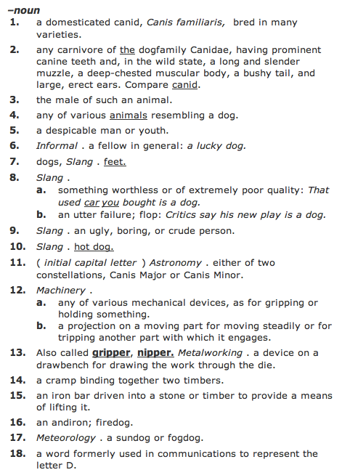
Dictionary-based similarity
What about words that have multiple senses/parts of speech?

Slide 9
Dictionary-based similarity
part of speech tagging
word sense disambiguation
most frequent sense
average similarity between all senses
max similarity between all senses
sum of similarity between all senses

Slide 10
Dictionary + WordNet
WordNet also includes a “gloss” similar to a dictionary definition
Other variants include the overlap of the word senses as well as those word senses that are related (e.g. hypernym, hyponym, etc.)
incorporates some of the path information as well
Banerjee and Pedersen, 2003

Slide 11
Word similarity
Four general categories
Character-based
turned vs. truned
cognates (night, nacht, nicht, natt, nat, noc, noch)
Semantic web-based (e.g. WordNet)
Dictionary-based
Distributional similarity-based
similar words occur in similar contexts

Slide 12
Corpus-based approaches
Word
ANY blurb with the word
aardvark
Ideas?
beagle
dog

Slide 13
Corpus-based
The Beagle is a breed of small to medium-sized dog. A member of the Hound Group, it is similar in appearance to the Foxhound but smaller, with shorter leg
Beagles are intelligent, and are popular as pets because of their size, even temper, and lack of inherited health problems.
Dogs of similar size and purpose to the modern Beagle can be traced in Ancient Greece[2] back to around the 5th century BC.
From medieval times, beagle was used as a generic description for the smaller hounds, though these dogs differed considerably from the modern breed.
In the 1840s, a standard Beagle type was beginning to develop: the distinction between the North Country Beagle and Southern

Slide 14
Corpus-based: feature extraction
The Beagle is a breed of small to medium-sized dog. A member of the Hound Group, it is similar in appearance to the Foxhound but smaller, with shorter leg
We’d like to utilize or vector-based approach
How could we we create a vector from these occurrences?
collect word counts from all documents with the word in it
collect word counts from all sentences with the word in it
collect all word counts from all words within X words of the word
collect all words counts from words in specific relationship: subject-object, etc.

Slide 15
Word-context co-occurrence vectors
The Beagle is a breed of small to medium-sized dog. A member of the Hound Group, it is similar in appearance to the Foxhound but smaller, with shorter leg
Beagles are intelligent, and are popular as pets because of their size, even temper, and lack of inherited health problems.
Dogs of similar size and purpose to the modern Beagle can be traced in Ancient Greece[2] back to around the 5th century BC.
From medieval times, beagle was used as a generic description for the smaller hounds, though these dogs differed considerably from the modern breed.
In the 1840s, a standard Beagle type was beginning to develop: the distinction between the North Country Beagle and Southern

Slide 16
Word-context co-occurrence vectors
The Beagle is a breed
Beagles are intelligent, and
to the modern Beagle can be traced
From medieval times, beagle was used as
1840s, a standard Beagle type was beginning
the: 2
is: 1
a: 2
breed: 1
are: 1
intelligent: 1
and: 1
to: 1
modern: 1
…
Often do some preprocessing like lowercasing and removing stop words

Slide 17
Corpus-based similarity
sim(dog, beagle) =
sim(context_vector(dog), context_vector(beagle))
the: 5
is: 1
a: 4
breeds: 2
are: 1
intelligent: 5
…
the: 2
is: 1
a: 2
breed: 1
are: 1
intelligent: 1
and: 1
to: 1
modern: 1
…

Slide 18
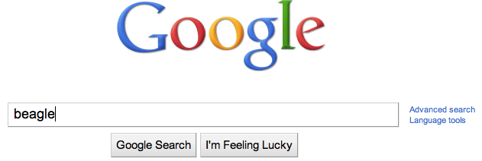
Web-based similarity
Ideas?
Notes:
yahoo and some others allow you API access to their search engine

Slide 19
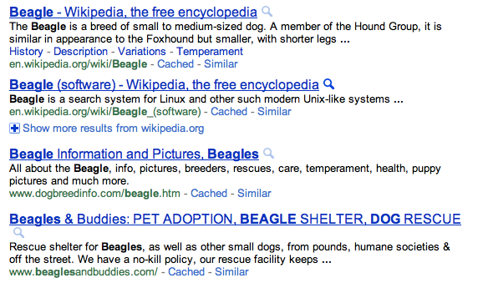
Web-based similarity
beagle
Notes:
yahoo and some others allow you API access to their search engine

Slide 20
Web-based similarity
Concatenate the snippets for the top N results
Concatenate the web page text for the top N results

Slide 21
Another feature weighting
TF- IDF weighting takes into account the general importance of a feature
For distributional similarity, we have the feature (f_{i}), but we also have the word itself (w) that we can use for information
sim(context_vector(dog), context_vector(beagle))
the: 5
is: 1
a: 4
breeds: 2
are: 1
intelligent: 5
…
the: 2
is: 1
a: 2
breed: 1
are: 1
intelligent: 1
and: 1
to: 1
modern: 1
…

Slide 22
Another feature weighting
Feature weighting ideas given this additional information?
sim(context_vector(dog), context_vector(beagle))
the: 5
is: 1
a: 4
breeds: 2
are: 1
intelligent: 5
…
the: 2
is: 1
a: 2
breed: 1
are: 1
intelligent: 1
and: 1
to: 1
modern: 1
…

Slide 23
Another feature weighting
count how likely feature f_{i} and word w are to occur together
incorporates co-occurrence
but also incorporates how often w and f_{i} occur in other instances
sim(context_vector(dog), context_vector(beagle))
Does IDF capture this?
Not really. IDF only accounts for f_{i} regardless of w

Slide 24
Mutual information
A bit more probability ☺
When will this be high and when will this be low?

Slide 25
Mutual information
A bit more probability ☺
if x and y are independent (i.e. one occurring doesn’t impact the other occurring) then:

Slide 26
Mutual information
A bit more probability ☺
if x and y are independent (i.e. one occurring doesn’t impact the other occurring) then:
What does this do to the sum?

Slide 27
Mutual information
A bit more probability ☺
if they are dependent then:

Slide 28
Mutual information
What is this asking?
When is this high?
How much more likely are we to see y given x has a particular value!

Slide 29
Point-wise mutual information
Mutual information
How related are two variables (i.e. over all possible values/events)
Point-wise mutual information
How related are two particular events/values

Slide 30
PMI weighting
Mutual information is often used for feature selection in many problem areas
PMI weighting weights co-occurrences based on their correlation (i.e. high PMI)
context_vector(beagle)
the: 2
is: 1
a: 2
breed: 1
are: 1
intelligent: 1
and: 1
to: 1
modern: 1
…
How do we calculate these?

