Slide 1
Clustering Beyond
K-means
David Kauchak
CS 451 – Fall 2013

Slide 2
Administrative
Final project
  Presentations on Friday
    3 minute max
    1-2 PowerPoint slides. E-mail me by 9am on Friday
    What problem you tackled and results
  Paper and final code submitted on Sunday
Final exam next week

Slide 3
K-means
Start with some initial cluster centers
Iterate:
  Assign/cluster each example to closest center
  Recalculate centers as the mean of the points in a cluster

Slide 4
Problems with K-means
Determining K is challenging
Spherical assumption about the data (distance to cluster center)
Hard clustering isn’t always right
Greedy approach

Slide 5
Problems with K-means
What would K-means give us here?

Slide 6
Assumes spherical clusters
k-means assumes spherical clusters!

Slide 7
K-means: another view

Slide 8
K-means: another view

Slide 9
K-means: assign points to nearest center

Slide 10
K-means: readjust centers
Iteratively learning a collection of spherical clusters

Slide 11
EM clustering: mixtures of Gaussians
Assume data came from a mixture of Gaussians (elliptical data), assign data to cluster with a certain probability
k-means
EM

Slide 12
EM clustering
Very similar at a high-level to K-means
Iterate between assigning points and recalculating cluster centers
Two main differences between K-means and EM clustering:
We assume elliptical clusters (instead of spherical)
It is a “soft” clustering algorithm

Slide 13
Soft clustering
p(red) = 0.8
p(blue) = 0.2
p(red) = 0.9
p(blue) = 0.1

Slide 14
EM clustering
Start with some initial cluster centers
Iterate:
soft assigned points to each cluster
recalculate the cluster centers
Calculate: p(θ_{c}| x)
the probability of each point belonging to each cluster
Calculate new cluster parameters, θ_{c}
maximum likelihood cluster centers given the current soft clustering

Slide 15
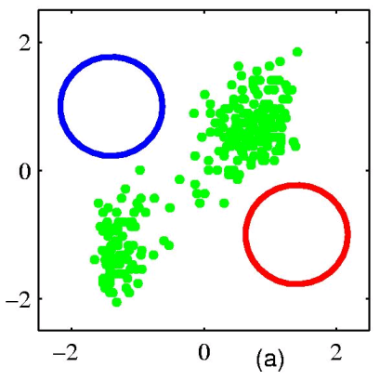
EM example
Start with some initial cluster centers
Figure from Chris Bishop

Slide 16
Step 1: soft cluster points
Which points belong to which clusters (soft)?
Figure from Chris Bishop

Slide 17
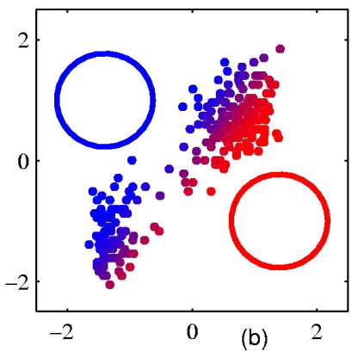
Step 1: soft cluster points
Notice it’s a soft (probabilistic) assignment
Figure from Chris Bishop

Slide 18
Step 2: recalculate centers
What do the new centers look like?
Figure from Chris Bishop

Slide 19
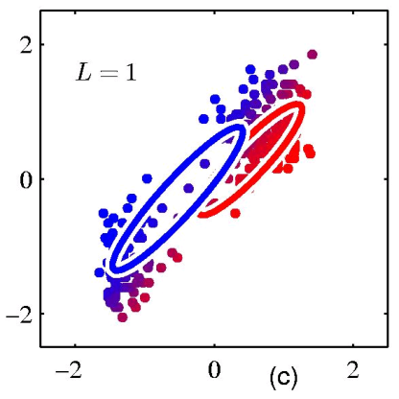
Step 2: recalculate centers
Cluster centers get a weighted contribution from points
Figure from Chris Bishop

Slide 20
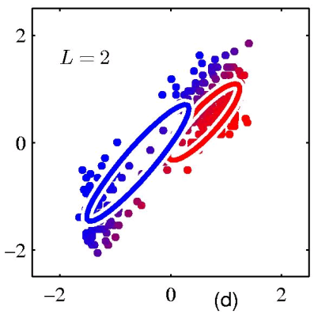
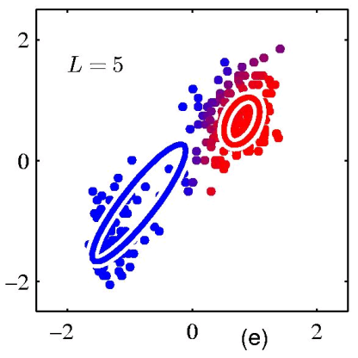
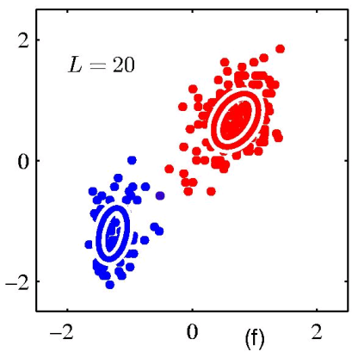
keep iterating…
Figure from Chris Bishop

Slide 21
Model: mixture of Gaussians
How do you define a Gaussian (i.e. ellipse)?
In 1-D?
In M-D?

Slide 22
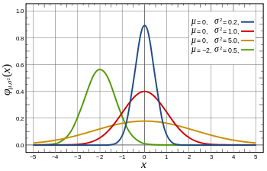
Gaussian in 1D
parameterized by the mean and the standard deviation/variance

Slide 23
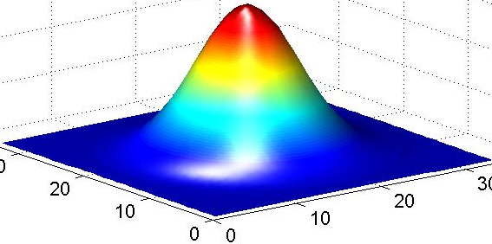
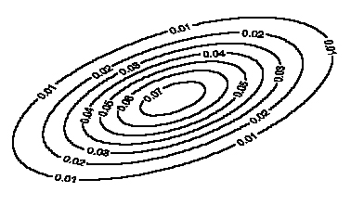
Gaussian in multiple dimensions
Covariance determines
the shape of these contours
We learn the means of each cluster (i.e. the center) and the covariance matrix (i.e. how spread out it is in any given direction)

Slide 24
Step 1: soft cluster points
soft assigned points to each cluster
  Calculate: p(θ_{c}|x)
  the probability of each point belonging to each cluster
How do we calculate these probabilities?

Slide 25
Step 1: soft cluster points
soft assigned points to each cluster
  Calculate: p(θ_{c}|x)
  the probability of each point belonging to each cluster
Just plug into the Gaussian equation for each cluster!
(and normalize to make a probability)

Slide 26
Step 2: recalculate centers
Recalculate centers:
  calculate new cluster parameters, θ_{c}
  maximum likelihood cluster centers given the current soft clustering
How do calculate the cluster centers?

Slide 27
Fitting a Gaussian
What is the “best”-fit Gaussian for this data?
10, 10, 10, 9, 9, 8, 11, 7, 6, …
Recall this is the 1-D Gaussian equation:

Slide 28
Fitting a Gaussian
What is the “best”-fit Gaussian for this data?
10, 10, 10, 9, 9, 8, 11, 7, 6, …
The MLE is just the mean and variance of the data!
Recall this is the 1-D Gaussian equation:

Slide 29
Step 2: recalculate centers
Recalculate centers:
  Calculate θ_{c}
  maximum likelihood cluster centers given the current soft clustering
How do we deal with “soft” data points?

Slide 30
Step 2: recalculate centers
Recalculate centers:
  Calculate θ_{c}
  maximum likelihood cluster centers given the current soft clustering
Use fractional counts!

Slide 31
E and M steps: creating a better model
EM stands for Expectation Maximization
Expectation: Given the current model, figure out the expected probabilities of the data points to each cluster
p(θ_{c}|x)
What is the probability of each point belonging to each cluster?
Maximization: Given the probabilistic assignment of all the points, estimate a new model, θ_{c}
Just like NB maximum likelihood estimation, except we use fractional counts instead of whole counts

Slide 32
Similar to k-means
Iterate:
  Assign/cluster each point to closest center
  Recalculate centers as the mean of the points in a cluster
Expectation: Given the current model, figure out the expected probabilities of the points to each cluster
p(θ_{c}|x)
Maximization: Given the probabilistic assignment of all the points, estimate a new model, θ_{c}

Slide 33
E and M steps
Expectation: Given the current model, figure out the expected probabilities of the data points to each cluster
Maximization: Given the probabilistic assignment of all the points, estimate a new model, θ_{c}
Iterate:
each iterations increases the likelihood of the data and guaranteed to converge (though to a local optimum)!

Slide 34
EM
EM is a general purpose approach for training a model when you don’t have labels
Not just for clustering!
  K-means is just for clustering
One of the most general purpose unsupervised approaches
  can be hard to get right!

Slide 35
EM is a general framework
Create an initial model, θ’
  Arbitrarily, randomly, or with a small set of training examples
Use the model θ’ to obtain another model θ such that
  Σ_{i} log P_{θ}(data_{i}) > Σ_{i} log P_{θ’}(data_{i})
Let θ’ = θ and repeat the above step until reaching a local maximum
  Guaranteed to find a better model after each iteration
i.e. better models data
(increased log likelihood)
Where else have you seen EM?

Slide 36
EM shows up all over the place
Training HMMs (Baum-Welch algorithm)
Learning probabilities for Bayesian networks
EM-clustering
Learning word alignments for language translation
Learning Twitter friend network
Genetics
Finance
Anytime you have a model and unlabeled data!

Slide 37
Other clustering algorithms
K-means and EM-clustering are by far the most popular for clustering
However, they can’t handle all clustering tasks
What types of clustering problems can’t they handle?

Slide 38
Non-gaussian data
What is the problem?
Similar to classification:
global decision (linear model) vs. local decision (K-NN)
Spectral clustering

Slide 39
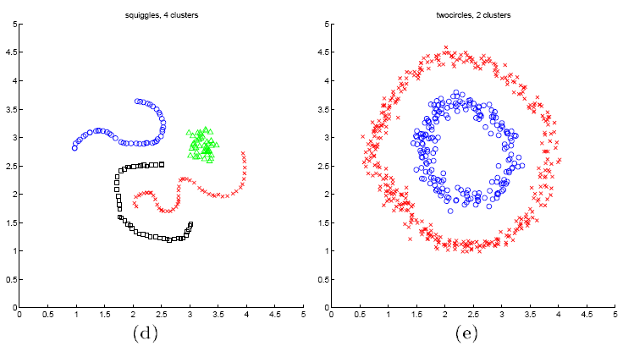
Spectral clustering examples
Ng et al On Spectral clustering: analysis and algorithm

Slide 40
Spectral clustering examples
Ng et al On Spectral clustering: analysis and algorithm

Slide 41
Spectral clustering examples
Ng et al On Spectral clustering: analysis and algorithm

