Slide 1
Unsupervised learning
David Kauchak CS 451 – Fall 2013

Slide 2
Administrative
Final project
Schedule for the rest of the semester

Slide 3
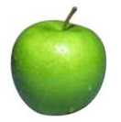
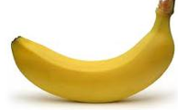
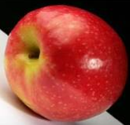
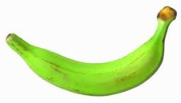
Unsupervised learning
Unsupervised learning: given data, i.e. examples, but no labels

Slide 4
K-means
Start with some initial cluster centers
Iterate:
Assign/cluster each example to closest center
Recalculate centers as the mean of the points in a cluster

Slide 5
K-means: an example

Slide 6
K-means: Initialize centers randomly

Slide 7
K-means: assign points to nearest center

Slide 8
K-means: readjust centers

Slide 9
K-means: assign points to nearest center

Slide 10
K-means: readjust centers

Slide 11
K-means: assign points to nearest center

Slide 12
K-means: readjust centers

Slide 13
K-means: assign points to nearest center
No changes: Done

Slide 14
K-means variations/parameters
Initial (seed) cluster centers
Convergence
A fixed number of iterations
partitions unchanged
Cluster centers don’t change
K!

Slide 15
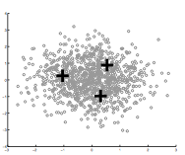
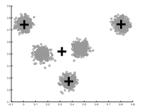
How Many Clusters?
Number of clusters K must be provided
How should we determine the number of clusters?
How did we deal with models becoming too complicated previously?
too many
too few

Slide 16
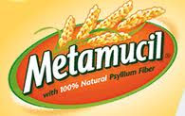
Many approaches
Regularization!!!
Statistical test

Slide 17
k-means loss revisited
K-means is trying to minimize:
What happens when k increases?

Slide 18
k-means loss revisited
K-means is trying to minimize:
Loss goes down!
Making the model more complicated allows us more flexibility, but can “overfit” to the data

Slide 19
k-means loss revisited
K-means is trying to minimize:
(where N = number of points)
2 regularization options
What effect will this have? Which will tend to produce smaller k?

Slide 20
k-means loss revisited
(where N = number of points)
2 regularization options
AIC penalizes increases in K more harshly
Both require a change to the K-means algorithm
Tend to work reasonably well in practice if you don’t know K

Slide 21
Statistical approach
Assume data is Gaussian (i.e. spherical)
Test for this
Testing in high dimensions doesn’t work well
Testing in lower dimensions does work well
ideas?

Slide 22
Project to one dimension and check
For each cluster, project down to one dimension
Use a statistical test to see if the data is Gaussian

Slide 23
Project to one dimension and check
For each cluster, project down to one dimension
Use a statistical test to see if the data is Gaussian
What will this look like projected to 1-D?

Slide 24
Project to one dimension and check
For each cluster, project down to one dimension
Use a statistical test to see if the data is Gaussian

Slide 25
Project to one dimension and check
For each cluster, project down to one dimension
Use a statistical test to see if the data is Gaussian
What will this look like projected to 1-D?

Slide 26
Project to one dimension and check
For each cluster, project down to one dimension
Use a statistical test to see if the data is Gaussian

Slide 27
Project to one dimension and check
For each cluster, project down to one dimension
Use a statistical test to see if the data is Gaussian
What will this look like projected to 1-D?

Slide 28
Project to one dimension and check
For each cluster, project down to one dimension
Use a statistical test to see if the data is Gaussian
Solution?

Slide 29
Project to one dimension and check
For each cluster, project down to one dimension
Use a statistical test to see if the data is Gaussian
Chose the dimension of the projection as the dimension with highest variance

Slide 30
On synthetic data
Split too far

Slide 31
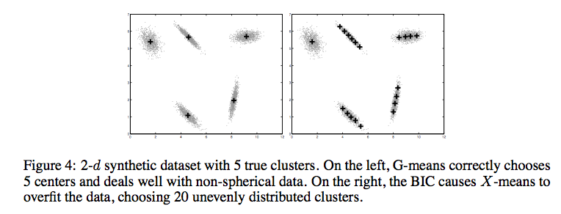
Compared to other approaches
http://cs.baylor.edu/~hamerly/papers/nips_03.pdf

Slide 32
K-Means time complexity
Variables: K clusters, n data points, m features/dimensions, I iterations
What is the runtime complexity?
Computing distance between two points (e.g. euclidean)
Reassigning clusters
Computing new centers
Iterate…

Slide 33
K-Means time complexity
Variables: K clusters, n data points, m features/dimensions, I iterations
What is the runtime complexity?
Computing distance between two points is O(m) where m is the dimensionality of the vectors/number of features.
Reassigning clusters: O(Kn) distance computations, or O(Knm)
Computing centroids: Each points gets added once to some centroid: O(nm)
Assume these two steps are each done once for I iterations: O(Iknm)
In practice, K-means converges quickly and is fairly fast

Slide 34
What Is A Good Clustering?
Internal criterion: A good clustering will produce high quality clusters in which:
the intra-class (that is, intra-cluster) similarity is high
the inter-class similarity is low
How would you evaluate clustering?

Slide 35
Common approach: use labeled data
Use data with known classes
For example, document classification data
data
label
If we clustered this data (ignoring labels) what would we like to see?
Reproduces class partitions
How can we quantify this?

Slide 36
Common approach: use labeled data
Purity, the proportion of the dominant class in the cluster
• •
• •
• •
• •
• •
• •
• •
•
Cluster I
Cluster II
Cluster III
Cluster I: Purity = 1/4 (max(3, 1, 0)) = 3/4
Cluster II: Purity = 1/6 (max(1, 4, 1)) = 4/6
Overall purity?
Cluster III: Purity = 1/5 (max(2, 0, 3)) = 3/5

Slide 37
Overall purity
Cluster I: Purity = 1/4 (max(3, 1, 0)) = 3/4
Cluster II: Purity = 1/6 (max(1, 4, 1)) = 4/6
Cluster III: Purity = 1/5 (max(2, 0, 3)) = 3/5
Cluster average:
Weighted average:

Slide 38
Purity issues…
Purity, the proportion of the dominant class in the cluster
Good for comparing two algorithms, but not understanding how well a single algorithm is doing, why?
Increasing the number of clusters increases purity

Slide 39
Purity isn’t perfect
Which is better based on purity?
Which do you think is better?
Ideas?

Slide 40
Common approach: use labeled data
Average entropy of classes in clusters
where p(class_{i}) is proportion of class i in cluster

Slide 41
Common approach: use labeled data
Average entropy of classes in clusters
entropy?

Slide 42
Common approach: use labeled data
Average entropy of classes in clusters

