Slide 1
Hadoop
David Kauchak
CS451 – Fall 2013

Slide 2
Admin
Assignment 7

Slide 3
logistic regression: three views
linear classifier
conditional model
logistic
linear model minimizing logistic loss

Slide 4
Logistic regression
Why is it called logistic regression?

Slide 5
A digression: regression vs. classification
Raw data
Label
features
Label
f₁, f₂, f₃, …, f_{n}
0
classification: discrete (some finite set of labels)
regression: real value
f₁, f₂, f₃, …, f_{n}
0
f₁, f₂, f₃, …, f_{n}
1
extract
features
f₁, f₂, f₃, …, f_{n}
1
f₁, f₂, f₃, …, f_{n}
0

Slide 6
linear regression
Given some points, find the line that best fits/explains the data
Our model is a line, i.e. we’re assuming a linear relationship between the feature and the label value
response
(y)
f₁
How can we find this line?

Slide 7
Linear regression
Learn a line h that minimizes some loss/error function:
Sum of the individual errors:
response
(y)
0/1 loss!
feature (x)
Notes:
- squared error is optimal if we assume that the data was actually generated from a line with gaussian data

Slide 8
Error minimization
How do we find the minimum of an equation?
Take the derivative, set to 0 and solve (going to be a min or a max)
Any problems here?
Ideas?

Slide 9
Linear regression
response
squared error is convex!
feature
Notes:
- squared error is optimal if we assume that the data was actually generated from a line with gaussian data

Slide 10
Linear regression
Learn a line h that minimizes an error function:
response
in the case of a 2d line:
function for a line
feature
Notes:
- squared error is optimal if we assume that the data was actually generated from a line with gaussian data

Slide 11
Linear regression
We’d like to minimize the error
  Find w₁ and w₀ such that the error is minimized
We can solve this in closed form

Slide 12
Multiple linear regression
If we have m features, then we have a line in m dimensions
weights

Slide 13
Multiple linear regression
We can still calculate the squared error like before
Still can solve this exactly!

Slide 14
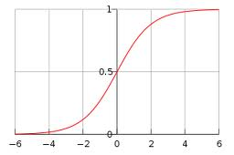
Logistic function

Slide 15
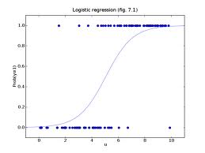
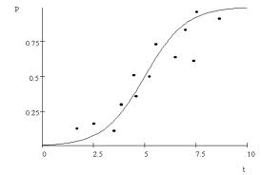
Logistic regression
Find the best fit of the data based on a logistic

Slide 16
Big Data
What is “big data”?
What are some sources of big data?
What are the challenges of dealing with big data?
What are some of the tools you’ve heard of?
For more info:
http://www.youtube.com/watch?v=eEpxN0htRKI

Slide 17

Hadoop: guest speaker
Patricia Florissi
CTO of EMC
PhD from Columbia University
http://www.mobileworldmag.com/emc-leads-it-transformation-at-the-emc-forum/

Slide 18
Hadoop
http://www.youtube.com/watch?v=XtLXPLb6EXs

