Slide 1
Logistic regression
David Kauchak
CS451 – Fall 2013

Slide 2
Admin
Assignment 7
CS Lunch on Thursday

Slide 3
Priors
Coin1 data: 3 Heads and 1 Tail
Coin2 data: 30 Heads and 10 tails
Coin3 data: 2 Tails
Coin4 data: 497 Heads and 503 tails
If someone asked you what the probability of heads was for each of these coins, what would you say?

Slide 4
Training revisited
From a probability standpoint, what we’re really doing when we’re training the model is selecting the Θ that maximizes:
i.e.
That we pick the most likely model parameters given the data

Slide 5
Estimating revisited
We can incorporate a prior belief in what the probabilities might be
To do this, we need to break down our probability
(Hint: Bayes rule)

Slide 6
Estimating revisited
What are each of these probabilities?

Slide 7
Priors
likelihood of the data under the model
probability of different parameters,
call the prior
probability of seeing the data (regardless of model)

Slide 8
Priors
Does p(data) matter for the argmax?
Notes:
no, it doesn’t very as theta changes. It’s a constant

Slide 9
Priors
likelihood of the data under the model
probability of different parameters,
call the prior
What does MLE assume for a prior on the model parameters?

Slide 10
Priors
likelihood of the data under the model
probability of different parameters,
call the prior
Assumes a uniform prior, i.e. all Θ are equally likely!
Relies solely on the likelihood

Slide 11
A better approach
We can use any distribution we’d like
This allows us to impart addition bias into the model

Slide 12
Another view on the prior
Remember, the max is the same if we take the log:
We can use any distribution we’d like
This allows us to impart addition bias into the model
Does this look like something we’ve seen before?

Slide 13
Regularization vs prior
likelihood based on the data
prior
fit
model bias
loss function based on the data
regularizer

Slide 14
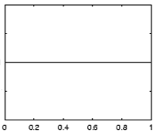
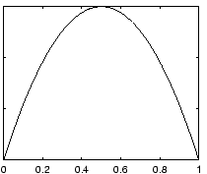
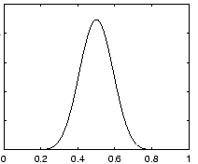
Prior for NB
Uniform prior
Dirichlet prior
λ= 0
increasing
Notes:
- as lambda gets larger we bias more and more towards

Slide 15
Prior: another view
MLE:
What happens to our likelihood if, for one of the labels, we never saw a particular feature?
Goes to 0!
Notes:
- Goes to 0!

Slide 16
Prior: another view
Adding a prior avoids this!

Slide 17
Smoothing
training data
for each label, pretend like we’ve seen each feature value occur inλadditional examples
Sometimes this is also called smoothing because it is seen as smoothing or interpolating between the MLE and some other distribution

Slide 18
Basic steps for probabilistic modeling
Probabilistic models
Step 1: pick a model
Step 2: figure out how to estimate the probabilities for the model
Step 3 (optional): deal with overfitting
Which model do we use, i.e. how do we calculate p(feature, label)?
How do train the model, i.e. how to we we estimate the probabilities for the model?
How do we deal with overfitting?

Slide 19
Joint models vs conditional models
We’ve been trying to model the joint distribution (i.e. the data generating distribution):
However, if all we’re interested in is classification, why not directly model the conditional distribution:

Slide 20
A first try: linear
Any problems with this?
- Nothing constrains it to be a probability
- Could still have combination of features and weight that exceeds 1 or is below 0
Notes:
let’s try a different route this time
rather than deriving a model (the book does it that way)
let’s start with a type of model and see if we can work our way towards a working model

Slide 21
The challenge
Linear model
probability
+∞
1
We like linear models, can we transform the probability into a function that ranges over all values?
-∞
0

Slide 22
Odds ratio
Rather than predict the probability, we can predict the ratio of 1/0 (positive/negative)
Predict the odds that it is 1 (true): How much more likely is 1 than 0.
Does this help us?

Slide 23
Odds ratio
Linear model
odds ratio
+∞
+∞
Where is the dividing line between class 1 and class 0 being selected?
-∞
0

Slide 24
Odds ratio
We’re trying to find some transformation that transforms the odds ratio to a number that is -∞ to +∞
Does this suggest another transformation?
odds ratio
0 1 2 3 4 5 6 7 8 9 ….

Slide 25
Log odds (logit function)
Linear regression
odds ratio
+∞
+∞
How do we get the probability of an example?
-∞
-∞

Slide 26
Log odds (logit function)
…
anyone recognize this?

Slide 27
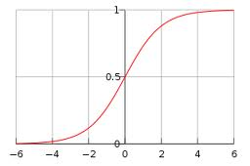
Logistic function

Slide 28
Logistic regression
How would we classify examples once we had a trained model?
If the sum > 0 then p(1)/p(0) > 1, so positive
if the sum < 0 then p(1)/p(0) < 1, so negative
Still a linear classifier (decision boundary is a line)

Slide 29
Training logistic regression models
How should we learn the parameters for logistic regression (i.e. the w’s)?
parameters

Slide 30
MLE logistic regression
Find the parameters that maximize the likelihood (or log-likelihood) of the data:
assume labels 1, -1

Slide 31
MLE logistic regression
We want to maximize, i.e.
Look familiar? Hint: anybody read the book?

Slide 32
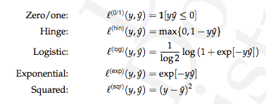
MLE logistic regression
Surrogate loss functions:

Slide 33
logistic regression: three views
linear classifier
conditional model
logistic
linear model minimizing logistic loss

Slide 34
Overfitting
If we minimize this loss function, in practice, the results aren’t great and we tend to overfit
Solution?

Slide 35
Regularization/prior
or
What are some of the regularizers we know?

Slide 36
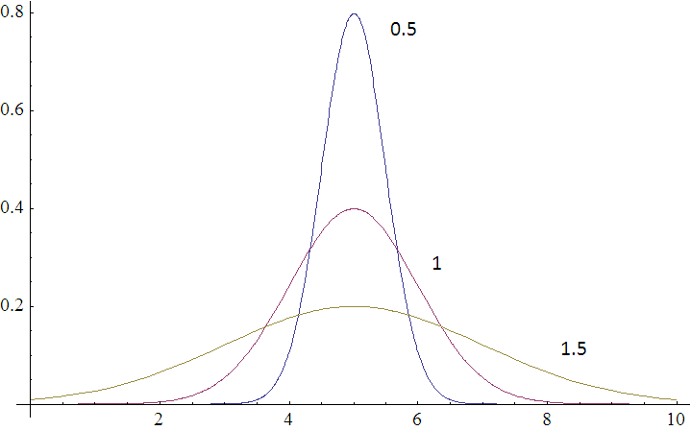
Regularization/prior
L2 regularization:
Gaussian prior:
p(w,b) ~

Slide 37
Regularization/prior
L2 regularization:
Gaussian prior:
Does theλmake sense?

Slide 38
Regularization/prior
L2 regularization:
Gaussian prior:
Notes:
Yes!
As the variance gets higher, the prior is weaker (more distributed probabilities). Higher variance = lower lambda.
As the variance gets lower, the prior is stronger (more peaked distribution). Lower variance = higher lambda.

Slide 39
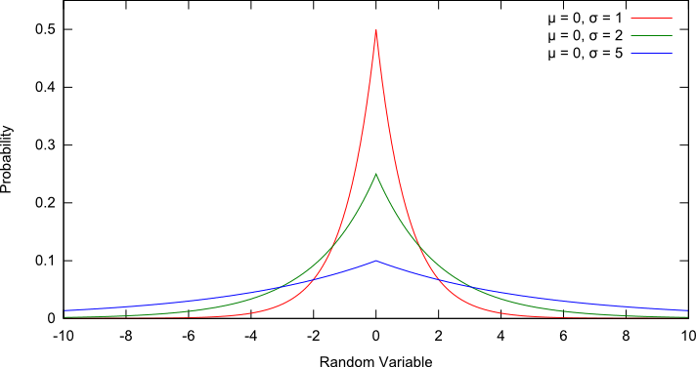
Regularization/prior
L1 regularization:
Laplacian prior:
p(w,b) ~

Slide 40
Regularization/prior
L1 regularization:
Laplacian prior:

Slide 41
L1 vs. L2
L1 = Laplacian prior
L2 = Gaussian prior

Slide 42
Logistic regression
Why is it called logistic regression?

Slide 43
A digression: regression vs. classification
Raw data
Label
features
Label
f₁, f₂, f₃, …, f_{n}
0
classification: discrete (some finite set of labels)
regression: real value
f₁, f₂, f₃, …, f_{n}
0
f₁, f₂, f₃, …, f_{n}
1
extract
features
f₁, f₂, f₃, …, f_{n}
1
f₁, f₂, f₃, …, f_{n}
0

Slide 44
linear regression
Given some points, find the line that best fits/explains the data
Our model is a line, i.e. we’re assuming a linear relationship between the feature and the label value
response
(y)
f₁
How can we find this line?

Slide 45
Linear regression
Learn a line h that minimizes some loss/error function:
Sum of the individual errors:
response
(y)
0/1 loss!
feature (x)
Notes:
- squared error is optimal if we assume that the data was actually generated from a line with gaussian data

Slide 46
Error minimization
How do we find the minimum of an equation?
Take the derivative, set to 0 and solve (going to be a min or a max)
Any problems here?
Ideas?

Slide 47
Linear regression
response
squared error is convex!
feature
Notes:
- squared error is optimal if we assume that the data was actually generated from a line with gaussian data

Slide 48
Linear regression
Learn a line h that minimizes an error function:
response
in the case of a 2d line:
function for a line
feature
Notes:
- squared error is optimal if we assume that the data was actually generated from a line with gaussian data

Slide 49
Linear regression
We’d like to minimize the error
  Find w₁ and w₀ such that the error is minimized
We can solve this in closed form

Slide 50
Multiple linear regression
If we have m features, then we have a line in m dimensions
weights

Slide 51
Multiple linear regression
We can still calculate the squared error like before
Still can solve this exactly!

Slide 52
Logistic function

Slide 53
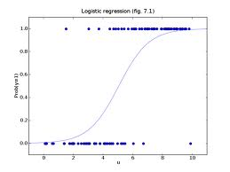
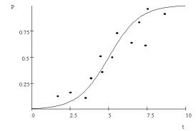
Logistic regression
Find the best fit of the data based on a logistic

