Slide 1
Soft Large Margin classifiers
David Kauchak CS 451 – Fall 2013

Slide 2
Admin
Assignment 5
Midterm
Friday’s class will be in MBH 632
CS lunch talk Thursday

Slide 3
Java tips for the data
-Xmx
-Xmx2g
http://www.youtube.com/watch?v=u0VoFU82GSw

Slide 4
Large margin classifiers
margin
margin
The margin of a classifier is the distance to the closest points of either class
Large margin classifiers attempt to maximize this

Slide 5
Support vector machine problem
subject to:
This is a a quadratic optimization problem
Maximize/minimize a quadratic function
Subject to a set of linear constraints
Many, many variants of solving this problem (we’ll see one in a bit)

Slide 6
Soft Margin Classification
subject to:
What about this problem?

Slide 7
Soft Margin Classification
subject to:
We’d like to learn something like this, but our constraints won’t allow it ☹

Slide 8
Slack variables
subject to:
slack variables (one for each example)
subject to:
What effect does this have?

Slide 9
Slack variables
subject to:
slack penalties

Slide 10
Slack variables
trade-off between margin maximization and penalization
margin
penalized by how far from “correct”
subject to:
allowed to make a mistake

Slide 11
Soft margin SVM
subject to:
Still a quadratic optimization problem!

Slide 12
Demo
http://cs.stanford.edu/people/karpathy/svmjs/demo/

Slide 13
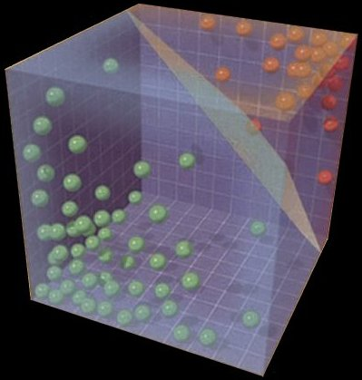
Solving the SVM problem

Slide 14
Understanding the Soft Margin SVM
subject to:
Given the optimal solution, w, b:
Can we figure out what the slack penalties are for each point?

Slide 15
Understanding the Soft Margin SVM
What do the margin lines
represent wrt w,b?
subject to:

Slide 16
Understanding the Soft Margin SVM
subject to:
Or:

Slide 17
Understanding the Soft Margin SVM
subject to:
What are the slack values for points outside (or on) the margin AND correctly classified?

Slide 18
Understanding the Soft Margin SVM
subject to:
0! The slack variables have to be greater than or equal to zero and if they’re on or beyond the margin then y_{i}(wx_{i}+b) ≥ 1 already

Slide 19
Understanding the Soft Margin SVM
subject to:
What are the slack values for points inside the margin AND classified correctly?

Slide 20
Understanding the Soft Margin SVM
subject to:
Difference from point to the margin. Which is?

Slide 21
Understanding the Soft Margin SVM
subject to:
What are the slack values for points that are incorrectly classified?

Slide 22
Understanding the Soft Margin SVM
subject to:
Which is?

Slide 23
Understanding the Soft Margin SVM
subject to:
“distance” to the hyperplane plus the “distance” to the margin
?
Notes:
“distance” is the unnormalized projection, not to be confused with the true distance which would be with respect to w/||w||

Slide 24
Understanding the Soft Margin SVM
subject to:
“distance” to the hyperplane plus the “distance” to the margin
Why -?
Notes:
the points are incorrectly classified so the prediction (wx+b) times the label (yi) will have different signs

Slide 25
Understanding the Soft Margin SVM
subject to:
“distance” to the hyperplane plus the “distance” to the margin
?

Slide 26
Understanding the Soft Margin SVM
subject to:
“distance” to the hyperplane plus the “distance” to the margin
1

Slide 27
Understanding the Soft Margin SVM
subject to:
“distance” to the hyperplane plus the “distance” to the margin

Slide 28
Understanding the Soft Margin SVM
subject to:

Slide 29
Understanding the Soft Margin SVM
Does this look familiar?

Slide 30
Hinge loss!
0/1 loss:
Hinge:
Exponential:
Squared loss:

Slide 31
Understanding the Soft Margin SVM
subject to:
Do we need the constraints still?

Slide 32
Understanding the Soft Margin SVM
subject to:
Unconstrained problem!

Slide 33
Understanding the Soft Margin SVM
Does this look like something we’ve seen before?
Gradient descent problem!

Slide 34
Soft margin SVM as gradient descent
multiply through by 1/C
and rearrange
let λ=1/C
What type of gradient descent problem?

Slide 35
Soft margin SVM as gradient descent
One way to solve the soft margin SVM problem is using gradient descent
hinge loss
L2 regularization

Slide 36
Gradient descent SVM solver
pick a starting point (w)
repeat until loss doesn’t decrease in all dimensions:
pick a dimension
move a small amount in that dimension towards decreasing loss (using the derivative)
hinge loss
L2 regularization
Finds the largest margin hyperplane while allowing for a soft margin

Slide 37
Support vector machines
One of the most successful (if not the most successful) classification approach:
decision tree
Support vector machine
k nearest neighbor
perceptron algorithm

Slide 38
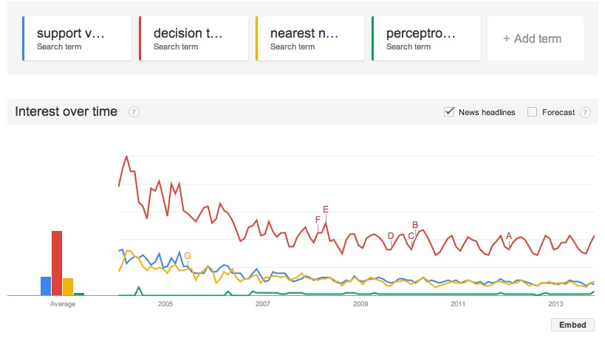
Trends over time

