Slide 1
multiclass continued and ranking
David Kauchak
CS 451 – Fall 2013

Slide 2
Admin
Assignment 4
Course feedback
Midterm

Slide 3
Java tip for the day
private vs. public vs. protected

Slide 4
Debugging tips

Slide 5
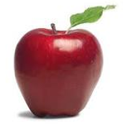

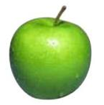
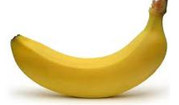
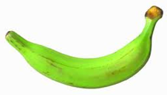

Multiclass classification
examples
label
Same setup where we have a set of features for each example
Rather than just two labels, now have 3 or more
apple
orange
apple
banana
banana
pineapple

Slide 6
Black box approach to multiclass
Abstraction: we have a generic binary classifier, how can we use it to solve our new problem
+1
binary classifier
optionally: also output a confidence/score
-1
Can we solve our multiclass problem with this?

Slide 7
Approach 1: One vs. all (OVA)
Training: for each label L, pose as a binary problem
  all examples with label L are positive
  all other examples are negative
apple vs. not
orange vs. not
banana vs. not
apple
+1
-1
-1
orange
-1
+1
-1
apple
+1
-1
-1
banana
-1
-1
+1
banana
-1
-1
+1

Slide 8
OVA: linear classifiers (e.g. perceptron)
banana vs. not
pineapple vs. not
apple vs. not

Slide 9
OVA: linear classifiers (e.g. perceptron)
banana vs. not
pineapple vs. not
apple vs. not
How do we classify?

Slide 10
OVA: linear classifiers (e.g. perceptron)
banana vs. not
pineapple vs. not
apple vs. not
How do we classify?

Slide 11
OVA: linear classifiers (e.g. perceptron)
banana vs. not
pineapple vs. not
apple vs. not
How do we classify?

Slide 12
OVA: linear classifiers (e.g. perceptron)
banana vs. not
pineapple vs. not
apple vs. not
How do we classify?

Slide 13
OVA: linear classifiers (e.g. perceptron)
none?
banana OR pineapple
banana vs. not
pineapple vs. not
apple vs. not
How do we classify?

Slide 14
OVA: linear classifiers (e.g. perceptron)
banana vs. not
pineapple vs. not
apple vs. not
How do we classify?

Slide 15
OVA: classify
Classify:
  If classifier doesn’t provide confidence (this is rare) and there is ambiguity, pick one of the ones in conflict
  Otherwise:
    pick the most confident positive
    if none vote positive, pick least confident negative

Slide 16
OVA: linear classifiers (e.g. perceptron)
banana vs. not
pineapple vs. not
What does the decision boundary look like?
apple vs. not

Slide 17
OVA: linear classifiers (e.g. perceptron)
PINEAPPLE
APPLE
BANANA

Slide 18
OVA: classify, perceptron
Classify:
  If classifier doesn’t provide confidence (this is rare) and there is ambiguity, pick majority in conflict
  Otherwise:
    pick the most confident positive
    if none vote positive, pick least confident negative
How do we calculate this for the perceptron?

Slide 19
OVA: classify, perceptron
Classify:
  If classifier doesn’t provide confidence (this is rare) and there is ambiguity, pick majority in conflict
  Otherwise:
    pick the most confident positive
    if none vote positive, pick least confident negative
Distance from the hyperplane

Slide 20
Approach 2: All vs. all (AVA)
Training:
For each pair of labels, train a classifier to distinguish between them
for i = 1 to number of labels:
  for k = i+1 to number of labels:
  train a classifier to distinguish between label_{j} and label_{k}:
  - create a dataset with all examples with label_{j} labeled positive and all examples with label_{k} labeled negative
  - train classifier on this subset of the data

Slide 21
AVA training visualized
apple vs orange
orange vs banana
+1
apple
+1
-1
orange
+1
-1
-1
apple
apple vs banana
banana
+1
banana
+1
-1
-1

Slide 22
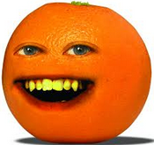
AVA classify
apple vs orange
+1
+1
orange vs banana
-1
+1
apple vs banana
-1
What class?
+1
-1
+1
-1
-1

Slide 23
AVA classify
apple vs orange
+1
orange
+1
orange vs banana
-1
+1
apple vs banana
orange
orange
-1
+1
-1
+1
apple
In general?
-1
-1

Slide 24
AVA classify
To classify example e, classify with each classifier f_{jk}
We have a few options to choose the final class:
Take a majority vote
Take a weighted vote based on confidence
  y = f_{jk}(e)
  score_{j} += y
  score_{k} -= y
How does this work?
Here we’re assuming that y encompasses both the prediction (+1,-1) and the confidence, i.e. y = prediction * confidence.

Slide 25
AVA classify
Take a weighted vote based on confidence
  y = f_{jk}(e)
  score_{j} += y
  score_{k} -= y
If y is positive, classifier thought it was of type j:
- raise the score for j
- lower the score for k
if y is negative, classifier thought it was of type k:
- lower the score for j
- raise the score for k

Slide 26
OVA vs. AVA
Train/classify runtime?
Error? Assume each binary classifier makes an error with probability ε

Slide 27
OVA vs. AVA
Train time:
AVA learns more classifiers, however, they’re trained on much smaller data this tends to make it faster if the labels are equally balanced
Test time:
AVA has more classifiers
Error (see the book for more justification):
AVA trains on more balanced data sets
AVA tests with more classifiers and therefore has more chances for errors
- Theoretically:
-- OVA: ε (number of labels -1)
-- AVA: 2 ε (number of labels -1)

Slide 28
Approach 3: Divide and conquer
vs
vs
vs
Pros/cons vs. AVA?
Notes:
less classifiers during training
less classifiers to make a mistake during testing
have to choose with examples to group together (and this can impact performance)

Slide 29
Multiclass summary
If using a binary classifier, the most common thing to do is OVA
Otherwise, use a classifier that allows for multiple labels:
  DT and k-NN work reasonably well
  We’ll see a few more in the coming weeks that will often work better

Slide 30
Multiclass evaluation
label
prediction
apple
orange
orange
orange
How should we evaluate?
apple
apple
banana
pineapple
banana
banana
pineapple
pineapple

Slide 31
Multiclass evaluation
label
prediction
apple
orange
orange
orange
Accuracy: 4/6
apple
apple
banana
pineapple
banana
banana
pineapple
pineapple

Slide 32
Multiclass evaluation imbalanced data
label
prediction
apple
orange
…
Any problems?
apple
apple
banana
pineapple
Data imbalance!
banana
banana
pineapple
pineapple
Notes:
- could try and do precision/recall for each class, but there can be lots of classes

Slide 33
Macroaveraging vs. microaveraging
microaveraging: average over examples (this is the “normal” way of calculating)
macroaveraging: calculate evaluation score (e.g. accuracy) for each label, then average over labels
What effect does this have?
Why include it?

Slide 34
Macroaveraging vs. microaveraging
microaveraging: average over examples (this is the “normal” way of calculating)
macroaveraging: calculate evaluation score (e.g. accuracy) for each label, then average over labels
Puts more weight/emphasis on rarer labels
Allows another dimension of analysis

Slide 35
Macroaveraging vs. microaveraging
label
prediction
microaveraging: average over examples
macroaveraging: calculate evaluation score (e.g. accuracy) for each label, then average over labels
apple
orange
orange
orange
apple
apple
banana
pineapple
banana
banana
pineapple
pineapple

Slide 36
Macroaveraging vs. microaveraging
label
prediction
microaveraging: 4/6
macroaveraging:
apple = 1/2
orange = 1/1
banana = 1/2
pineapple = 1/1
total = (1/2 + 1 + 1/2 + 1)/4
= 3/4
apple
orange
orange
orange
apple
apple
banana
pineapple
banana
banana
pineapple
pineapple

Slide 37
Confusion matrix
entry (i, j) represents the number of examples with label i that were predicted to have label j
another way to understand both the data and the classifier
 | Classic | Country | Disco | Hiphop | Jazz | Rock
Classic | 86 | 2 | 0 | 4 | 18 | 1
Country | 1 | 57 | 5 | 1 | 12 | 13
Disco | 0 | 6 | 55 | 4 | 0 | 5
Hiphop | 0 | 15 | 28 | 90 | 4 | 18
Jazz | 7 | 1 | 0 | 0 | 37 | 12
Rock | 6 | 19 | 11 | 0 | 27 | 48
Notes:
what do the entries along the diagonal represent?

Slide 38
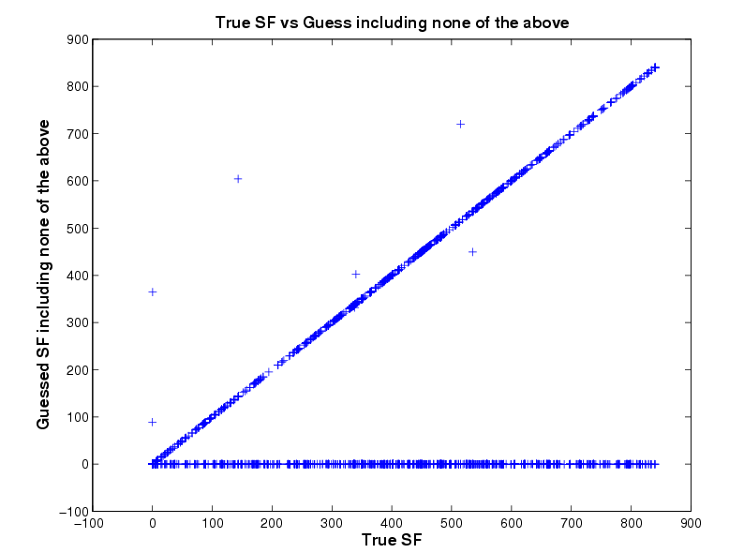
Confusion matrix
BLAST classification of proteins in 850 superfamilies

Slide 39
Multilabel vs. multiclass classification
  Is it edible?
  Is it sweet?
  Is it a fruit?
  Is it a banana?
Is it a banana?
Is it an apple?
Is it an orange?
Is it a pineapple?
Is it a banana?
Is it yellow?
Is it sweet?
Is it round?
Any difference in these labels/categories?

Slide 40
Multilabel vs. multiclass classification
  Is it edible?
  Is it sweet?
  Is it a fruit?
  Is it a banana?
Is it a banana?
Is it an apple?
Is it an orange?
Is it a pineapple?
Is it a banana?
Is it yellow?
Is it sweet?
Is it round?
Different structures
Nested/ Hierarchical
Exclusive/ Multiclass
General/Structured

Slide 41
Multiclass vs. multilabel
Multiclass: each example has one label and exactly one label
Multilabel: each example has zero or more labels. Also called annotation
Multilabel applications?

Slide 42
Multilabel
Image annotation
Document topics
Labeling people in a picture
Medical diagnosis

Slide 43
Multiclass vs. multilabel
Multiclass: each example has one label and exactly one label
Multilabel: each example has zero or more labels. Also called annotation
Which of our approaches work for multilabel?

