Slide 1
multiclass
David Kauchak
CS 451 – Fall 2013

Slide 2
Admin
Assignment 4
Assignment 2 back soon
If you need assignment feedback…
CS Lunch tomorrow (Thursday): 12:20pm in Ross
Student CS talks

Slide 3
Eclipse/IDEs
generate class files with package structure, etc.
auto-generate method stubs (auto generate getters/setters)
check syntax on the fly
auto-complete as you type
automatically add imports
automatically add try/catch blocks
debugging
variable, method, parameter, renaming
Javadoc

Slide 4
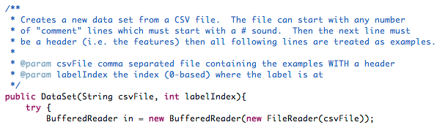
Javadoc
human readable
easily generated in most IDEs
can use tools to automatically generate documentation
http://www.cs.middlebury.edu/~dkauchak/classes/cs451/assignments/assign4/doc/

Slide 5


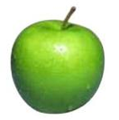



Multiclass classification
examples
label
Same setup where we have a set of features for each example
Rather than just two labels, now have 3 or more
apple
orange
apple
banana
real-world examples?
banana
pineapple

Slide 6
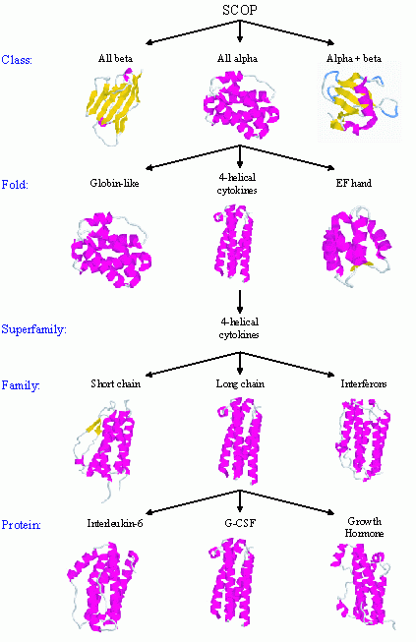
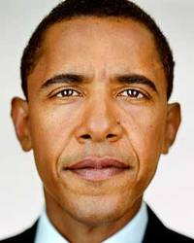



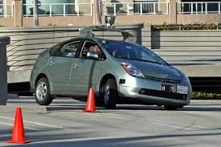
Real world multiclass classification
handwriting recognition
protein classification
face recognition
document classification
most real-world applications tend to be multiclass
emotion recognition
sentiment analysis
autonomous vehicles

Slide 7
Multiclass: current classifiers
Any of these work out of the box?
With small modifications?

Slide 8

k-Nearest Neighbor (k-NN)
To classify an example d:
  Find k nearest neighbors of d
  Choose as the label the majority label within the k nearest neighbors
No algorithmic changes!

Slide 9
Decision Tree learning
Base cases:
If all data belong to the same class, pick that label
If all the data have the same feature values, pick majority label
If we’re out of features to examine, pick majority label
If the we don’t have any data left, pick majority label of parent
If some other stopping criteria exists to avoid overfitting, pick majority label
Otherwise:
calculate the “score” for each feature if we used it to split the data
pick the feature with the highest score, partition the data based on that data value and call recursively
No algorithmic changes!

Slide 10
Perceptron learning
Hard to separate three classes with just one line ☹

Slide 11
Black box approach to multiclass
Abstraction: we have a generic binary classifier, how can we use it to solve our new problem
+1
binary classifier
optionally: also output a confidence/score
-1
Can we solve our multiclass problem with this?

