Slide 1
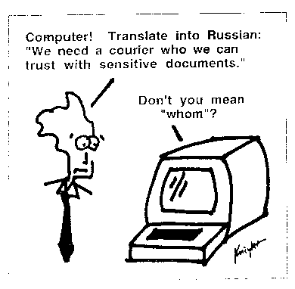
Kevin Knight, http://www.isi.edu/natural-language/people/pictures/ieee-expert-1.gif

Slide 2
Relevance Feedback
Query Expansion
David Kauchak
cs458
Fall 2012
adapted from:
http://www.stanford.edu/class/cs276/handouts/lecture9-queryexpansion.ppt

Slide 3
Administrative
computer use in class ☺
hw3 out
assignment 3 out later today
  due date?

Slide 4
Anomalous State of Knowledge
Basic paradox:
Information needs arise because the user doesn’t know something
Search systems are designed to satisfy these needs, but the user needs to know what he is looking for
However, if the user knows what he’s looking for, there may not be a need to search in the first place

Slide 5

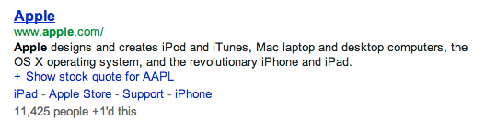
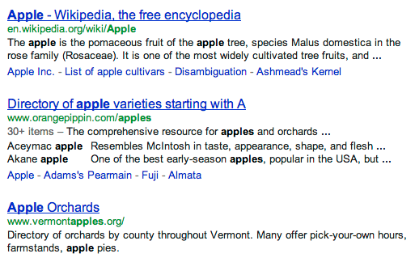

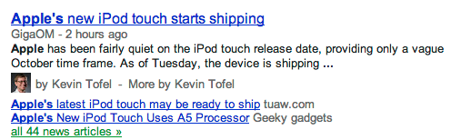
What should be returned?

Slide 6
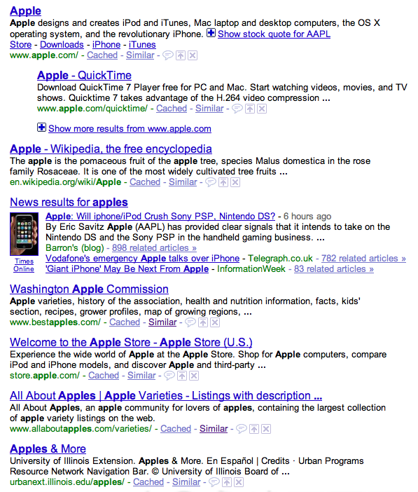
What is actually returned…

Slide 7

Similar pages
What did “similar pages” do?
Does this solve our problem?

Slide 8
Relevance feedback
User provides feedback on relevance of documents in the initial set of results:
User issues a query
The user marks some results as relevant or non-relevant
The system computes a better results based on the feedback
May iterate

Slide 9
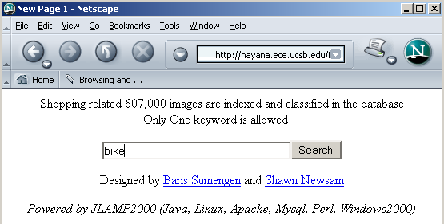
An example
Image search engine:
http://vision.ece.ucsb.edu/multimedia/

Slide 10
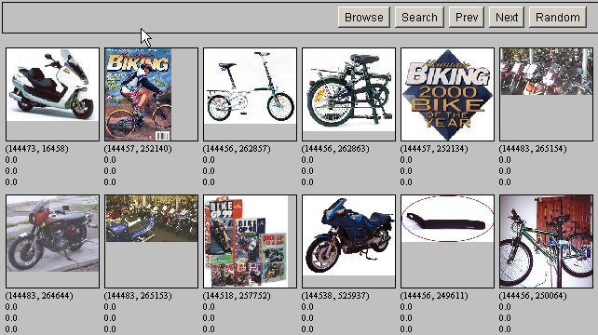
Results for initial query

Slide 11
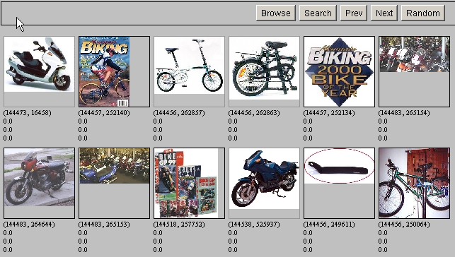
Relevance Feedback

Slide 12
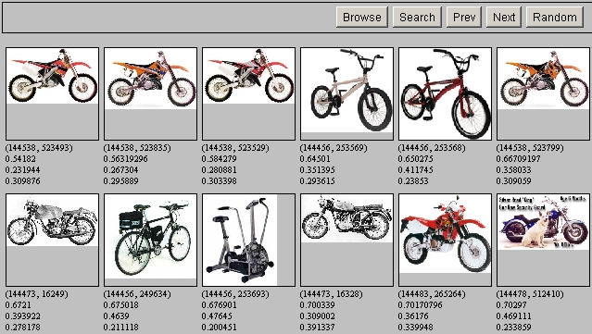
Results after Relevance Feedback

Slide 13
Ideas?
For ranked models we represent our query as a vector of weights, which we view as a point in a high dimensional space
We want to bias the query towards documents that the user selected (the “relevant documents”)
We want to bias the query away from documents that the user did not select (the “non-relevant documents”)
0
4
0
8
0
0

Slide 14
Relevance feedback
Initial query
x
x
x
o
x
x
x
x
Δ
x
x
x
o
x
x
o
x
o
x
o
o
x
x
x
x
x known non-relevant documents
o known relevant documents

Slide 15
Relevance feedback
Initial query
x
x
x
o
x
x
x
x
Δ
x
x
x
o
x
x
o
x
o
x
o
o
x
x
x
x
x known non-relevant documents
o known relevant documents

Slide 16
Relevance feedback on initial query
Initial query
x
x
x
o
x
x
x
x
Δ
x
x
x
o
x
o
x
Δ
x
o
x
o
o
x
x
x
x
Revised query
x known non-relevant documents
o known relevant documents
How can we “move” the query?

Slide 17
Rocchio Algorithm
The Rocchio algorithm uses the vector space model to pick a better query
Rocchio seeks the query q_{opt} that maximizes the difference between the query similarity with the relevant set of documents (C_{r}) vs. the non-relevant set of documents (C_{nr})

Slide 18
Centroid
The centroid is the center of mass of a set of points
x
x
x
x
x
x
x
x
x
x
x
x
x
x
x
x
x
x
x
x
Where is the centroid?

Slide 19
Rocchio Algorithm
Find the new query by moving it towards the centroid of the relevant queries and away from the centroid of the non-relevant queries

Slide 20
Rocchio in action
Original query
0
4
0
8
0
0
Relevant centroid
1
2
4
0
0
1
(+)
Non-relevant centroid
2
0
1
1
0
4
(-)
?
New query
-1
6
3
7
0
-3
Notes:
16

Slide 21
Rocchio in action
Original query
0
4
0
8
0
0
Relevant centroid
1
2
4
0
0
1
(+)
Non-relevant centroid
2
0
1
1
0
4
(-)
New query
0
6
3
7
0
0
Notes:
16

Slide 22
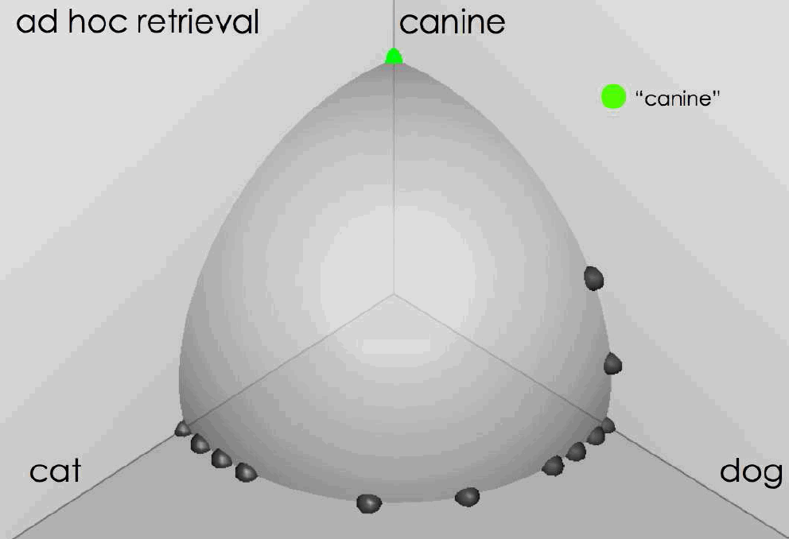
Rocchio in action
source: Fernando Diaz

Slide 23
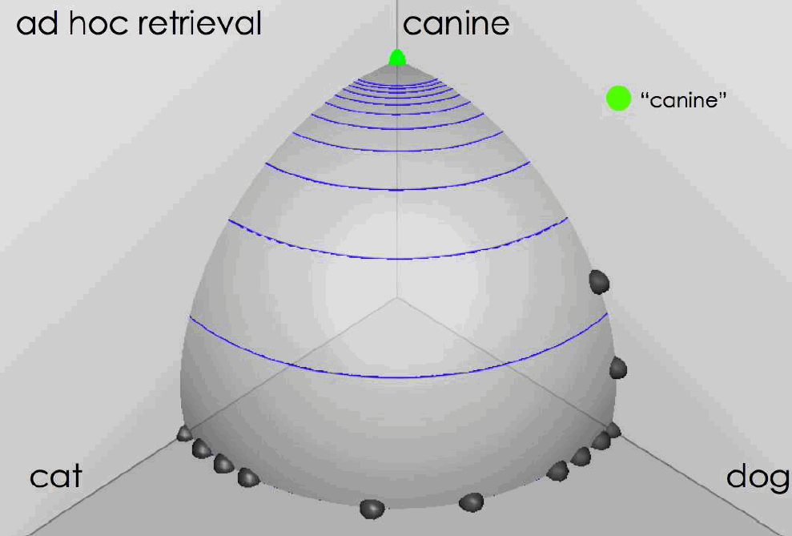
Rocchio in action
source: Fernando Diaz

Slide 24
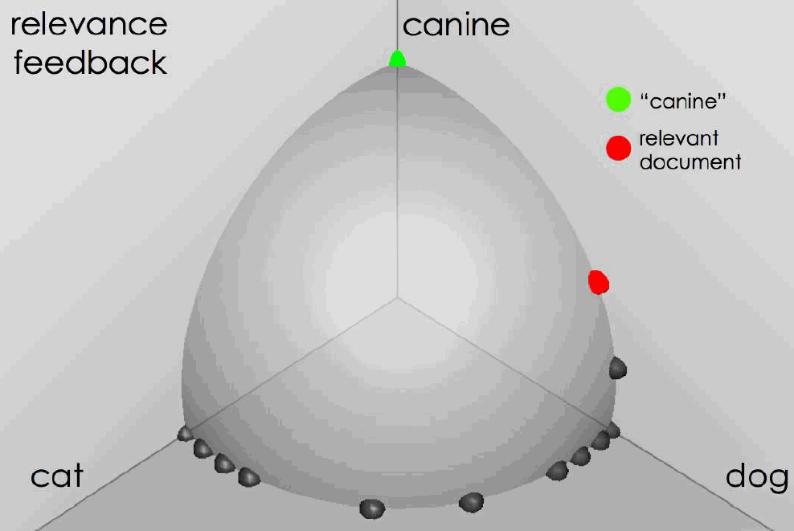
User feedback: Select what is relevant source: Fernando Diaz

Slide 25
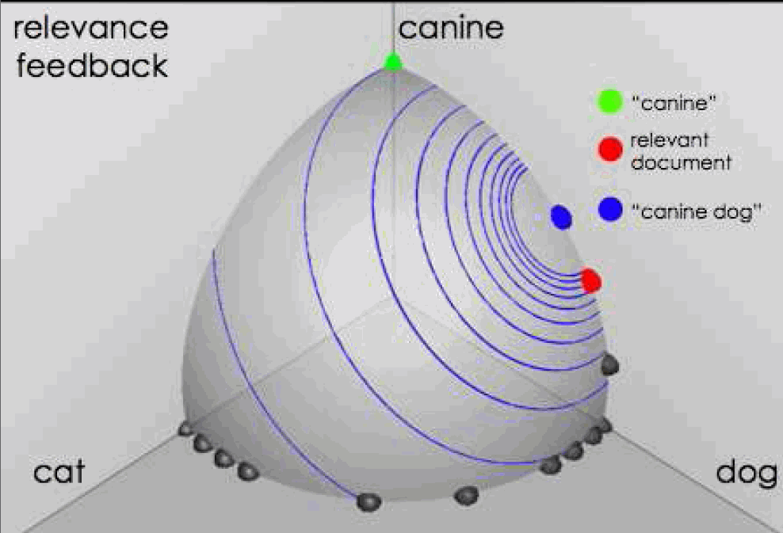
Results after relevance feedback source: Fernando Diaz

Slide 26
Any problems with this?
C_{r} and C_{nr} are all the relevant and non-relevant documents
We get a biased sample!

Slide 27
Rocchio 1971 Algorithm (SMART)
Used in practice:
D_{r} = set of known relevant doc vectors
D_{nr} = set of known irrelevant doc vectors
  Different from C_{r} and C_{nr}
q_{m} = modified query vector
q₀ = original query vector
α,β,γ: weights (hand-chosen or set empirically)
New query moves toward relevant documents and away from irrelevant documents
Notes:
SMART: Cornell (Salton) IR system of 1970s to 1990s.

Slide 28
Relevance Feedback in vector spaces
Relevance feedback can improve recall and precision
How might it improve each of these?
Which do you think it’s more likely to improve?
Notes:
Just as we modified the query in the vector space model, we can also modify it here. I’m not aware of work that uses language model based Ir this way.

Slide 29
Relevance Feedback in vector spaces
Relevance feedback can improve recall and precision
Relevance feedback is most useful for increasing recall in situations where recall is important
  Users can be expected to review results and to take time to iterate
Positive feedback is more valuable than negative feedback (so, set γ < β; e.g. γ = 0.25, β = 0.75).
Many systems only allow positive feedback (γ=0)
Notes:
Just as we modified the query in the vector space model, we can also modify it here. I’m not aware of work that uses language model based Ir this way.

Slide 30
Another example
Initial query: New space satellite applications
  1. 0.539, 08/13/91, NASA Hasn’t Scrapped Imaging Spectrometer
  2. 0.533, 07/09/91, NASA Scratches Environment Gear From Satellite Plan
  3. 0.528, 04/04/90, Science Panel Backs NASA Satellite Plan, But Urges Launches of Smaller Probes
  4. 0.526, 09/09/91, A NASA Satellite Project Accomplishes Incredible Feat: Staying Within Budget
  5. 0.525, 07/24/90, Scientist Who Exposed Global Warming Proposes Satellites for Climate Research
  6. 0.524, 08/22/90, Report Provides Support for the Critics Of Using Big Satellites to Study Climate
  7. 0.516, 04/13/87, Arianespace Receives Satellite Launch Pact From Telesat Canada
  8. 0.509, 12/02/87, Telecommunications Tale of Two Companies
User then marks relevant documents with “+”.
+
+
+

Slide 31
Expanded query after relevance feedback
2.074 new 15.106 space
30.816 satellite 5.660 application
5.991 nasa 5.196 eos
4.196 launch 3.972 aster
3.516 instrument 3.446 arianespace
3.004 bundespost 2.806 ss
2.790 rocket 2.053 scientist
2.003 broadcast 1.172 earth
0.836 oil 0.646 measure

Slide 32
Results for expanded query
1. 0.513, 07/09/91, NASA Scratches Environment Gear From Satellite Plan
2. 0.500, 08/13/91, NASA Hasn’t Scrapped Imaging Spectrometer
3. 0.493, 08/07/89, When the Pentagon Launches a Secret Satellite, Space Sleuths Do Some Spy Work of Their Own
4. 0.493, 07/31/89, NASA Uses ‘Warm’ Superconductors For Fast Circuit
5. 0.492, 12/02/87, Telecommunications Tale of Two Companies
6. 0.491, 07/09/91, Soviets May Adapt Parts of SS-20 Missile For Commercial Use
7. 0.490, 07/12/88, Gaping Gap: Pentagon Lags in Race To Match the Soviets In Rocket Launchers
8. 0.490, 06/14/90, Rescue of Satellite By Space Agency To Cost $90 Million

Slide 33
Expanded query after relevance feedback
2.074 new 15.106 space
30.816 satellite 5.660 application
5.991 nasa 5.196 eos
4.196 launch 3.972 aster
3.516 instrument 3.446 arianespace
3.004 bundespost 2.806 ss
2.790 rocket 2.053 scientist
2.003 broadcast 1.172 earth
0.836 oil 0.646 measure
Any problem with this?

Slide 34
Relevance Feedback: Problems
Long queries are inefficient for typical IR engine
  Long response times for user
  High cost for retrieval system
  Partial solution:
    Only reweight certain prominent terms
      Perhaps top 20 by term frequency
Users are often reluctant to provide explicit feedback
It’s often harder to understand why a particular document was retrieved after applying relevance feedback
Notes:
A long vector space query is like a disjunction: you have to consider documents with any of the words, and sum partial cosine similarities over the various terms.

Slide 35
Will relevance feedback work?
Brittany Speers
hígado
Cosmonaut

Slide 36
RF assumes the user has sufficient knowledge for initial query
Misspellings - Brittany Speers
Cross-language information retrieval – hígado
Mismatch of searcher’s vocabulary vs. collection vocabulary: cosmonaut/astronaut

Slide 37
Relevance Feedback on the Web
Some search engines offer a similar/related pages feature (this is a trivial form of relevance feedback)
  Google (used to…)
  Altavista
  Stanford WebBase
But some don’t because it’s hard to explain to average user:
  Google
  Alltheweb
  msn
  Yahoo
  Excite initially had true relevance feedback, but abandoned it due to lack of use

Slide 38
Excite Relevance Feedback
Spink et al. 2000
Only about 4% of query sessions from a user used relevance feedback option
  Expressed as “More like this” link next to each result
But about 70% of users only looked at the first page of results and didn’t pursue things further
  So 4% is about 1/8 of people extending search
Relevance feedback improved results about 2/3rds of the time

Slide 39
Pseudo relevance feedback
Pseudo-relevance algorithm:
  Retrieve a ranked list of hits for the user’s query
  Assume that the top k documents are relevant.
  Do relevance feedback (e.g., Rocchio)
How well do you think it works?
Any concerns?

Slide 40
Pseudo relevance feedback
Pseudo-relevance algorithm:
  Retrieve a ranked list of hits for the user’s query
  Assume that the top k documents are relevant.
  Do relevance feedback (e.g., Rocchio)
Works very well on average
But can go horribly wrong for some queries
Several iterations can cause query drift
What is query drift?
  http://www.youtube.com/watch?v=i1AwFY6MuwE

Slide 41
Expanding the query
We would like to suggest alternative query formulations to the user with the goal of:
  increasing precision
  increasing recall
What are methods we might try to accomplish this?

Slide 42

Increasing precision
Query assist:
  Generally done by query log mining
  Recommend frequent recent queries that contain partial string typed by user

Slide 43

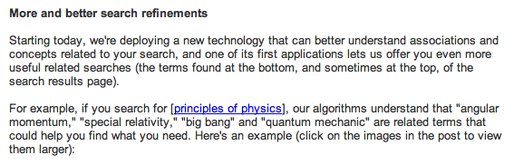
Increasing precision
http://googleblog.blogspot.com/2009/03/two-new-improvements-to-google-results.html

Slide 44
Increasing recall: query expansion
Automatically expand the query with related terms and run through index
Spelling correction can be thought of a special case of this
cosmonaut
cosmonaut astronaut space pilot
How might we come up with these expansions?

Slide 45
How do we augment the user query?
Manual thesaurus
  E.g. MedLine: physician, syn: doc, doctor, MD, medico
  Wordnet
Global Analysis: (static; of all documents in collection)
  Automatically derived thesaurus
    (co-occurrence statistics)
  Refinements based on query log mining
    Common on the web
Local Analysis: (dynamic)
  Analysis of documents in result set

Slide 46
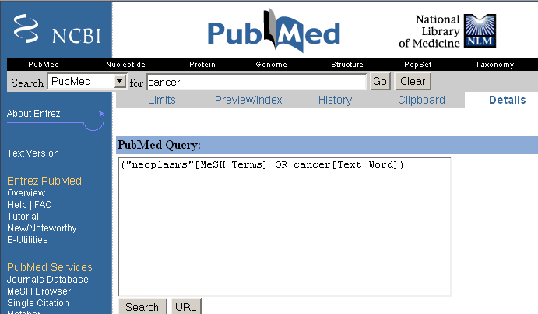
Example of manual thesaurus

Slide 47
Thesaurus-based query expansion
For each term, t, in a query, expand the query with synonyms and related words of t from the thesaurus
  feline → feline cat
May weight added terms less than original query terms.
May significantly decrease precision, particularly with ambiguous terms
  “interest rate” → “interest rate fascinate evaluate”
There is a high cost of manually producing a thesaurus
  And for updating it for scientific changes

Slide 48
Automatic thesaurus generation
Given a large collection of documents, how might we determine if two words are synonyms?
Two words are synonyms if they co-occur with similar words
I drive a car
I drive an automobile
I bought new tires for my car
I bought new tires
for my automobile
can I hitch a ride with
you in your car
can I hitch a ride with
you in your automobile

Slide 49
Automatic thesaurus generation
Given a large collection of documents, how might we determine if two words are synonyms?
Two words are synonyms if they co-occur with similar words
I drive a car
I drive an automobile
I bought new tires for my car
I bought new tires
for my automobile
can I hitch a ride with
you in your car
can I hitch a ride with
you in your automobile

Slide 50
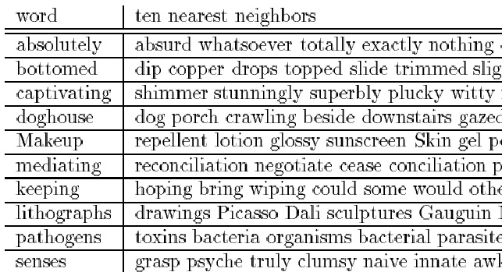
Automatic Thesaurus Generation
Example

Slide 51
Automatic Thesaurus Generation Discussion
Quality of associations is usually a problem
Term ambiguity may introduce irrelevant statistically correlated terms
  “Apple computer” → “Apple red fruit computer”
Since terms are highly correlated anyway, expansion may not retrieve many additional documents

Slide 52
Discussion
Certain query expansion techniques have thrived and many have disappeared (particularly for web search). Why? Which ones have survived?

Slide 53
IR: touching base

