Slide 1
Faster TF-IDF
David Kauchak
cs458
Fall 2012
adapted from: http://www.stanford.edu/class/cs276/handouts/lecture6-tfidf.ppt

Slide 2
Administrative
Videos
Homework 2
Assignment 2
CS lunch tomorrow

Slide 3
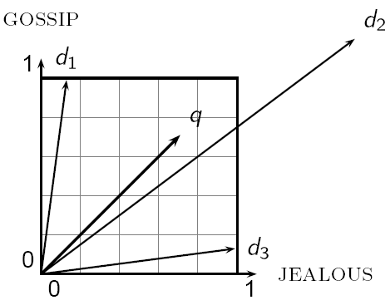
TF-IDF recap
Represent the queries as vectors
Represent the documents as vectors
proximity = similarity of vectors
What do the entries in the vector represent in the tf-idf scheme?

Slide 4
TF-IDF recap: document vectors
A document is represented by a vector of weights for each word

Slide 5
TF-IDF recap: document vectors
One option for this weighting is TF-IDF:

Slide 6
TF-IDF recap: similarity
Given weight vectors, how do we determine similarity (i.e. ranking)?

Slide 7
TF-IDF recap: similarity
Dot product
Unit vectors
cos(q,d) is the cosine similarity of q and d … or,
equivalently, the cosine of the angle between q and d.

Slide 8
Outline
Calculating tf-idf score
Faster ranking
Static quality scores
Impact ordering
Cluster pruning

Slide 9
The basic idea
Index-time:
calculate weight (e.g. TF-IDF) vectors for all documents
Query time:
calculate weight vector for query
calculate similarity (e.g. cosine) between query and all documents
sort by similarity and return top K

Slide 10
Calculating cosine similarity
weights
doc
How do we do this?
query

Slide 11
Calculating cosine similarity
weights
Traverse entries calculating the product
Accumulate the vector lengths and divide at the end
How can we do it faster if we have a sparse representation?
doc
query

Slide 12
Calculating cosine tf-idf from index
index
What should we store in the index?
How do we construct the index?
How do we calculate the document ranking?
w₁
w₂
w₃
…

Slide 13
Index construction: collect docIDs
Doc 1
I did enact Julius
Caesar I was killed
i' the Capitol;
Brutus killed me.
Doc 2
So let it be with
Caesar. The noble
Brutus hath told you
Caesar was ambitious

Slide 14
Index construction: sort dictionary
sort based on terms

Slide 15
Index construction: create postings list
word 1
word 2
create postings lists from identical entries
…
word n
Do we have all the information we need?

Slide 16
Obtaining tf-idf weights
Store the tf initially in the index
In addition, store the number of documents the term occurs in in the index (length of the postings list)
How do we get the idfs?
We can either compute these on the fly using the number of documents in each term
We can make another pass through the index and update the weights for each entry
Pros and cons of each approach?
Notes:
Computing on the fly
could save memory (store integer rather than real number)
could use different weighting schemes with the index
Store in index
more efficient

Slide 17
An aside: speed matters!
Urs Holzle, Google’s chief engineer:
When Google search queries slow down a mere 400 milliseconds, traffic drops 0.44%.
80% of people will click away from an Internet video if it stalls loading.
When car comparison pricing site Edmunds.com reduced loading time from 9 to 1.4 seconds, pageviews per session went up 17% and ad revenue went up 3%.
When Shopzilla dropped load times from 7 seconds to 2 seconds, pageviews went up 25% and revenue increased between 7% and 12%.
http://articles.businessinsider.com/2012-01-09/tech/30607322_1_super-fast-fiber-optic-network-google-services-loading

Slide 18
Do we have everything we need?
Still need the document lengths
Store these in a separate data structure
Make another pass through the data and update the weights
Benefits/drawbacks?
Notes:
separate
flexibility to use different weighting schemes
one less pass during indexing
store in structure
efficient
simpler

Slide 19
Computing cosine scores
Similar to the merge operation
Accumulate scores for each document
float scores[N] = 0
for each query term t
calculate w_{t,q}
for each entry in t’s postings list: docID, w_{t,d}
scores[docID] += w_{t,q} * w_{t,d}
return top k components of scores

Slide 20
Computing cosine scores
What are the inefficiencies here?
Only want the scores for the top k but are calculating all the scores
Sort to obtain top k?
float scores[N] = 0
for each query term t
calculate w_{t,q}
for each entry in t’s postings list: docID, w_{t,d}
scores[docID] += w_{t,q} * w_{t,d}
return top k components of scores

Slide 21
Outline
Calculating tf-idf score
Faster ranking
Static quality scores
Impact ordering
Cluster pruning

Slide 22
Key challenges for speedup
Ranked search is more computationally expensive
float scores[N] = 0
for each query term t
calculate w_{t,q}
for each entry in t’s postings list: docID, w_{t,d}
scores[docID] += w_{t,q} * w_{t,d}
return top k components of scores
Why is this more expensive than boolean?

Slide 23
Key challenges for speedup
Ranked search is more computationally expensive
float scores[N] = 0
for each query term t
calculate w_{t,q}
for each entry in t’s postings list: docID, w_{t,d}
scores[docID] += w_{t,q} * w_{t,d}
return top k components of scores
more expensive
sort?

Slide 24
Key challenges for speedup
query
query
document
document
boolean
ranked
Intersection
strictly intersection?

Slide 25
Key challenges for speedup
query
query
document
document
boolean
ranked
soft-intersection: only requires one or more words to overlap
Many, many more documents!
Intersection

Slide 26
Speeding up the “merge”
float scores[N] = 0
for each query term t
calculate w_{t,q}
for each entry in t’s postings list: docID, w_{t,d}
scores[docID] += w_{t,q} * w_{t,d}
return top k components of scores
Any simplifying assumptions to make this faster?
Queries are short!
Assume query terms only occur once
Assume no weighting on query terms

Slide 27
Speeding up the “merge”
float scores[N] = 0
for each query term t
calculate w_{t,q}
for each entry in t’s postings list: docID, w_{t,d}
scores[docID] += w_{t,q} * w_{t,d}
return top k components of scores
Assume query terms only occur once
Assume no weighting on query terms
float scores[N] = 0
for each query term t
for each entry in t’s postings list: docID, w_{t,d}
scores[docID] += w_{t,d}
return top k components of scores

Slide 28
Selecting top K
We could sort the scores and then pick the top K
What is the runtime of this approach?
O(N log N)
Can we do better?
Use a heap (i.e. priority queue)
Build a heap out of the scores
Get the top K scores from the heap
Running time?
O(N + K log N)
For N=1M, K=100, this is about 10% of the cost of sorting
1
.9
.3
.3
.8
.1
.1

Slide 29
Inexact top K
What if we don’t return exactly the top K, but almost the top K (i.e. a mostly similar set)?
User has a task and a query formulation
Cosine is a proxy for matching this task/query
If we get a list of K docs “close” to the top K by cosine measure, should still be ok

Slide 30
Current approach
Documents
Score documents
Pick top K

Slide 31
Approximate approach
Documents
Select A candidates K < A << N
Score documents in A
Pick top K in A

Slide 32
Exact vs. approximate
Depending on how A is selected and how large A is, can get different results
Can think of it as pruning the initial set of docs
How might we pick A?
Exact
Approximate

Slide 33
Exact vs. approximate
How might we pick A (subset of all documents) so as to get as close as possible to the original ranking?
Documents with more than one query term
Terms with high IDF (prune postings lists to consider)
Documents with the highest weights

Slide 34
Docs must contain multiple query terms
Right now, we consider any document with at least one query term in it
For multi-term queries, only compute scores for docs containing several of the query terms
Say, at least 3 out of 4 or 2 or more
Imposes a “soft conjunction” on queries seen on web search engines (early Google)
Implementation?
Just a slight modification of “merge” procedure

Slide 35
Multiple query terms
If we required all but 1 term be there, which docs would we keep?
Antony
3
4
8
16
32
64
128
Brutus
2
4
8
16
32
64
128
Caesar
1
2
3
5
8
13
21
34
Calpurnia
13
16
32
Scores only computed for 8, 16 and 32.

Slide 36
Multiple query terms
How many documents have we “pruned” or ignored?
Antony
3
4
8
16
32
64
128
Brutus
2
4
8
16
32
64
128
Caesar
1
2
3
5
8
13
21
34
Calpurnia
13
16
32
All the others! (1, 2, 3, 4, 5, 13, 21, 34, 64, 128)

Slide 37
High-idf query terms only
For a query such as catcher in the rye
Only accumulate scores from catcher and rye
Intuition: in and the contribute little to the scores and don’t alter rank-ordering much
Benefit:
Postings of low-idf terms have many docs → these (many) docs get eliminated from A
Can we calculate this efficiently from the index?

Slide 38
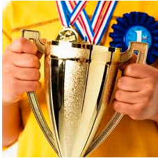
High scoring docs: champion lists
Precompute for each dictionary term the r docs of highest weight in the term’s postings
Call this the champion list for a term
(aka fancy list or top docs for a term)
Can we do this at query time?
Antony
3
4
8
16
32
64
128
Brutus
2
4
8
16
32
64
128
Caesar
1
2
3
5
8
13
21
34

Slide 39
Implementation details…
How can Champion Lists be implemented in an inverted index? How do we modify the data structure?
Antony
3
4
8
16
32
64
128
Brutus
2
4
8
16
32
64
128
Caesar
1
2
3
5
8
13
21
34

Slide 40
Champion lists
At query time, only compute scores for docs in the champion list of some query term
Pick the K top-scoring docs from amongst these
Are we guaranteed to always get K documents?
Antony
8
16
128
Brutus
8
32
128
Caesar
1
16
128

Slide 41
High and low lists
For each term, we maintain two postings lists called high and low
Think of high as the champion list
When traversing postings on a query, only traverse high lists first
If we get more than K docs, select the top K and stop
Else proceed to get docs from the low lists
A way to segment the index into two tiers

Slide 42
Tiered indexes
Break postings up into a hierarchy of lists
Most important
…
Least important
Inverted index thus broken up into tiers of decreasing importance
At query time use top tier unless it fails to yield K docs
If so drop to lower tiers

Slide 43
Example tiered index

Slide 44
Quick review
Rather than selecting the best K scores from all N documents
Initially filter the documents to a smaller set
Select the K best scores from this smaller set
Methods for selecting this smaller set
Documents with more than one query term
Terms with high IDF
Documents with the highest weights

Slide 45
Outline
Calculating tf-idf score
Faster ranking
Static quality scores
Impact ordering
Cluster pruning

Slide 46
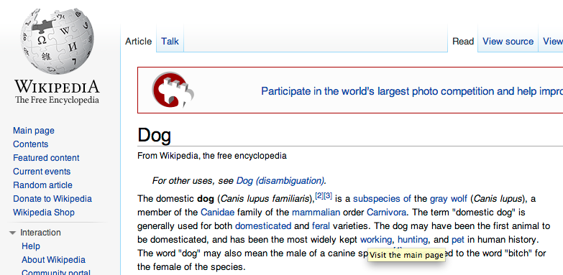
Static quality scores
We want top-ranking documents to be both relevant and authoritative
query: dog
Which will our current approach prefer?
my dog

Slide 47
Static quality scores
We want top-ranking documents to be both relevant and authoritative
Cosine score models relevance but not authority
Authority is typically a query-independent property of a document
What are some examples of authority signals?
Wikipedia among websites
Articles in certain newspapers
A paper with many citations
Many diggs, Y!buzzes or del.icio.us marks
Lots of inlinks
Pagerank

Slide 48
Modeling authority
Assign to each document a query-independent quality score in [0,1] denoted g(d)
A quantity like the number of citations is scaled into [0,1]
Google PageRank

Slide 49
Net score
We want a total score that combines cosine relevance and authority
How can we do this?
addition: net-score(q,d) = g(d) + cosine(q,d)
can use some other linear combination than an equal weighting
Any function of the two “signals” of user happiness

Slide 50
Net score
Now we want the top K docs by net score
What does this change in our indexing and query algorithms?
Easy to implement:
similar to incorporating document length normalization

Slide 51
Top K by net score – fast methods
Order all postings by g(d)… does it change our merge/traversal algorithms?
Key: this is still a common ordering for all postings
Antony
1
2
Brutus
3
1
2
Caesar
3
2
g(1) = 0.5, g(2) = .25, g(3) = 1

Slide 52
Why order postings by g(d)?
Under g(d)-ordering, top-scoring docs likely to appear early in postings traversal
In time-bound applications (say, we have to return whatever search results we can in 50 ms), this allows us to stop postings traversal
Antony
1
2
Brutus
3
1
2
Caesar
3
2
g(1) = 0.5, g(2) = .25, g(3) = 1

Slide 53
Champion lists in g(d)-ordering
We can still use the notion of champion lists…
Combine champion lists with g(d)-ordering
Maintain for each term a champion list of the r docs with highest g(d) + tf-idf_{td}
Seek top-K results from only the docs in these champion lists

Slide 54
Outline
Calculating tf-idf score
Faster ranking
Static quality scores
Impact ordering
Cluster pruning

Slide 55
Impact-ordered postings
Why do we need a common ordering of the postings list?
Allows us to easily traverse the postings list and check for intersection
Is that required for our tf-idf traversal algorithm?
float scores[N] = 0
for each query term t
for each entry in t’s postings list: docID, w_{t,d}
scores[docID] += w_{t,d}
return top k components of scores

Slide 56
Impact-ordered postings
The ordering no long plays a role
Our algorithm for computing document scores “accumulates” scores for each document
Idea: sort each postings list by w_{t,d}
Only compute scores for docs for which w_{t,d} is high enough
Given this ordering, how might we construct A when processing a query?

Slide 57
Impact-ordering: early termination
When traversing a postings list, stop early after either
a fixed number of r docs
w_{t,d} drops below some threshold
Take the union of the resulting sets of docs
Compute only the scores for docs in this union

Slide 58
Impact-ordering: idf-ordered terms
When considering the postings of query terms
Look at them in order of decreasing idf
High idf terms likely to contribute most to score
As we update score contribution from each query term
Stop if doc scores relatively unchanged
Can apply to cosine or other net scores

Slide 59
Outline
Calculating tf-idf score
Faster ranking
Static quality scores
Impact ordering
Cluster pruning

Slide 60
Cluster pruning: preprocessing
Pick √N docs, call these leaders
For every other doc, pre-compute nearest leader
Docs attached to a leader are called followers
Likely: each leader has ~ √N followers

Slide 61
Cluster pruning: query processing
Process a query as follows:
Given query Q, find its nearest leader L
Seek K nearest docs from among L’s followers

Slide 62
Visualization
Query
Leader
Follower

Slide 63
Cluster pruning variants
Have each follower attached to b₁ (e.g. 2) nearest leaders
From query, find b₂ (e.g. 3) nearest leaders and their followers
Query
Leader
Follower

Slide 64
Discussion
Who should be held responsible when a program generates undesirable data outside control of the programmer?
Does removal from the autocomplete feature, but not the general search results, count as censorship?
How much power should Google have to censor content?

