Slide 1
TF-IDF
David Kauchak
cs458
Fall 2012
adapted from:
http://www.stanford.edu/class/cs276/handouts/lecture6-tfidf.ppt

Slide 2
Administrative
Homework 2 due Thursday
Assignment 2 out… get started!
Popular media article will be posted for Thursday to read and discuss
  make sure to read it ☺

Slide 3
Variable byte codes
100000011000010100000100 11110001
Still seems wasteful
What is the major challenge for these variable length codes?
We need to know the length of the number!
Idea: Encode the length of the number so that we know how many bits to read

Slide 4
Gamma codes
Represent a gap as a pair length and offset
offset is G in binary, with the leading bit cut off
  13 → 1101 → 101
  17 → 10001 → 0001
  50 → 110010 → 10010
length is the length of offset
  13 (offset 101), it is 3
  17 (offset 0001), it is 4
  50 (offset 10010), it is 5

Slide 5
Encoding the length
We’ve stated what the length is, but not how to encode it
What is a requirement of our length encoding?
  Lengths will have variable length (e.g. 3, 4, 5 bits)
  We must be able to decode it without any ambiguity
Any ideas?
Unary code
  Encode a number n as n 1’s, followed by a 0, to mark the end of it
  5 → 111110
  12 → 1111111111110

Slide 6
Gamma code examples
number | length | offset | γ-code
0
1
2
3
4
9
13
24
511
1025

Slide 7
Gamma code examples
number | length | offset | γ-code
0 |  |  | none
1 | 0 |  | 0
2 | 10 | 0 | 10,0
3 | 10 | 1 | 10,1
4 | 110 | 00 | 110,00
9 | 1110 | 001 | 1110,001
13 | 1110 | 101 | 1110,101
24 | 11110 | 1000 | 11110,1000
511 | 111111110 | 11111111 | 111111110,11111111
1025 | 11111111110 | 0000000001 | 11111111110,0000000001

Slide 8
Gamma seldom used in practice
Machines have word boundaries – 8, 16, 32 bits
Compressing and manipulating at individual bit-granularity will slow down query processing
Variable byte alignment is potentially more efficient
Regardless of efficiency, variable byte is conceptually simpler at little additional space cost

Slide 9
RCV1 compression
Data structure | Size in MB
dictionary, fixed-width | 11.2
dictionary, term pointers into string | 7.6
with blocking, k = 4 | 7.1
with blocking & front coding | 5.9
collection (text, xml markup etc) | 3,600.0
collection (text) | 960.0
Term-doc incidence matrix | 40,000.0
postings, uncompressed (32-bit words) | 400.0
postings, uncompressed (20 bits) | 250.0
postings, variable byte encoded | 116.0
postings, γ−encoded | 101.0

Slide 10
TDT token normalization
normalization | terms | % change
none | 120K | -
number folding | 117K | 3%
lowercasing | 100K | 17%
stemming | 95K | 25%
stoplist | 120K | 0%
number & lower & stoplist | 97K | 20%
all | 78K | 35%
What normalization technique(s) should we use?

Slide 11
Ranked retrieval
So far, our queries have all been Boolean
  Documents either match or don’t
Good for expert users with precise understanding of their needs and the collection
Also good for applications: can easily consume 1000s of results
  Not good for the majority of users
  Most users incapable of writing Boolean queries (or they are, but they think it’s too much work)
More importantly: most users don’t want to wade through 1000s of results

Slide 12
Problem with Boolean search: feast or famine
Boolean queries often result in either too few (=0) or too many (1000s) results.
Query 1: “standard user dlink 650” → 200,000 hits
Query 2: “standard user dlink 650 no card found”: 0 hits
It takes skill to come up with a query that produces a manageable number of hits
With a ranked list of documents it does not matter how large the retrieved set is

Slide 13
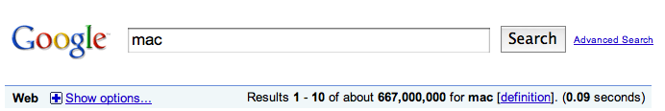
Scoring as the basis of ranked retrieval
We want to return in order the documents most likely to be useful to the searcher
Assign a score that measures how well document and query “match”

Slide 14
Query-document matching scores
We need a way of assigning a score to a query/document pair
Why isn’t it just for a score for a document?
Besides whether or not a query (or query word) occurs in a document, what other indicators might be useful?
  How many times the word occurs in the document
  Where the word occurs
  How “important” is the word – for example, a vs. motorcycle
  …

Slide 15
Recall: Binary term-document incidence matrix
Each document is represented by a binary vector ∈ {0,1}^{|V|}

Slide 16
Term-document count matrix
Consider the number of occurrences of a term in a document:
  Each document is a count vector in ℕ^{v}: a column below
What information is lost with this representation?

Slide 17
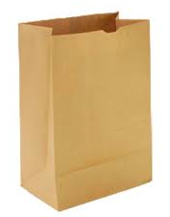
Bag of words representation
Represent a document by the occurrence counts of each word
Ordering of words is lost
John is quicker than Mary and Mary is quicker than John have the same vectors
=

Slide 18
Boolean queries: another view
query
document
For the boolean representation, we can view a
query/document as a set of words

Slide 19
Boolean queries: another view
query
document
We want to return those documents where there is an overlap, i.e. intersection between the two sets

Slide 20
Bag of words
query
document
What is the notion of “intersection” for the bag or words model?

Slide 21
Bag of words
query
document
Want to take into account term frequency

Slide 22
Some things to be careful of…
query
query
document
document
Say I take the document and simply append it to itself. What happens to the overlap?
Need some notion of the length of a document

Slide 23
Some things to be careful of…
query
query
document
the the the
the the …
What about a document that contains only frequent words, e.g. the?

Slide 24
Some things to be careful of…
query
query
document
the the the
the the …
Need some notion of the importance of words

Slide 25
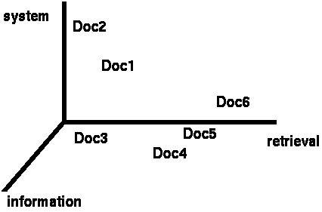
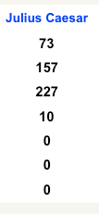
Documents as vectors
We have a |V|-dimensional vector space
Terms are axes of the space
Documents are points or vectors in this space
Very high-dimensional: hundreds of millions of dimensions when you apply this to a web search engine
This is a very sparse vector - most entries are zero

Slide 26
Queries as vectors
Key idea 1: Do the same for queries: represent them as vectors in the space
Key idea 2: Rank documents according to their proximity to the query in this space
How should we rank documents?
|V| dimensional space

Slide 27
Formalizing vector space proximity
We have points in a |V| dimensional space
How can we measure the proximity of documents in this space?
First cut: distance between two points
Euclidean distance?

Slide 28
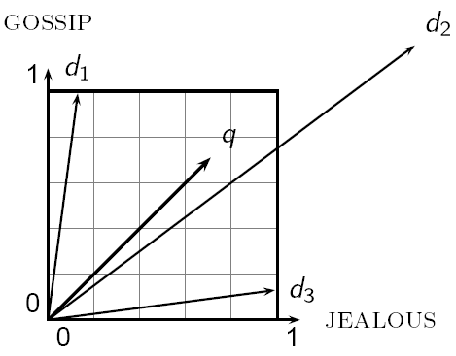
Why distance is a bad idea
Which document is closer using Euclidian distance?
Which do you think should be closer?

Slide 29
Issues with Euclidian distance
the Euclidean distance between q and d₂ is large
but, the distribution of terms in the query q and the distribution of terms in the document d₂ are very similar
This is not what we want!

Slide 30
Use angle instead of distance
back to our thought experiment: take a document d and append it to itself. Call this document d′
“Semantically” d and d′ have the same content
d
d’

Slide 31
Use angle instead of distance
The Euclidean distance between the two documents can be quite large
The angle between the two documents is 0, corresponding to maximal similarity
d’
d

Slide 32
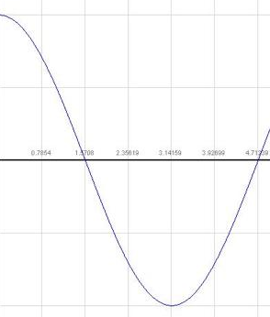
From angles to cosines
Cosine is a monotonically decreasing function for the interval [0º, 180º]
The following two notions are equivalent.
  Rank documents in decreasing order of the angle between query and document
  Rank documents in increasing order of cosine(query,document)

Slide 33
cosine(query,document)
How do we calculate the cosine between two vectors?

Slide 34
cosine(query,document)
If they are unit length:
Dot product
cos(q,d) is the cosine similarity of q and d … or, equivalently, the cosine of the angle between q and d.

Slide 35
“unit length” vectors
What is a “unit vector” or “unit length vector”?
Are our vectors unit length?
No… we need some notion of the length of a document

Slide 36
Length normalization
A vector can be (length-) normalized by dividing each of its components by its length – for this we use the L₂ norm:

Slide 37
Length normalization
What effect will this have on d and d’?
d
d’
they will have identical vectors after length-normalization

Slide 38
cosine(query,document)
Dot product
Unit vectors
cos(q,d) is the cosine similarity of q and d … or,
equivalently, the cosine of the angle between q and d.

Slide 39
Cosine similarity with 3 documents
How similar are the novels:
SaS: Sense and Sensibility
PaP: Pride and Prejudice
WH: Wuthering Heights
Term frequencies (counts)
term | SaS | PaP | WH
affection | 115 | 58 | 20
jealous | 10 | 7 | 11
gossip | 2 | 0 | 6
Notes:
plot out vectors on the board

Slide 40
Some things to be careful of…
query
query
document
the the the
the the …
Need some notion of the importance of words

Slide 41
Term importance
Rare terms are more informative than frequent terms
  Recall stop words
Consider a term in the query that is rare in the collection (e.g., arachnocentric)
A document containing this term is very likely to be relevant to the query arachnocentric
We want a high weight for rare terms like arachnocentric
Ideas?

Slide 42
Document frequency
We will use document frequency (df) to capture this in the score
Terms that occur in many documents are weighted less, since overlapping with these terms is very likely
  In the extreme case, take a word like the that occurs in EVERY document
Terms that occur in only a few documents are weighted more

Slide 43
Collection vs. Document frequency
The collection frequency of is the number of occurrences in the collection, counting multiple occurrences
Example:
Word | Collection frequency | Document frequency
insurance | 10440 | 3997
try | 10422 | 8760
Which word is a better search term (and should get a higher weight)?

Slide 44
Document frequency
How does “importance” or “informativeness” relate to document frequency?
Word | Collection frequency | Document frequency
insurance | 10440 | 3997
try | 10422 | 8760

Slide 45
Inverse document frequency
df_{t} is the document frequency of t: the number of documents that contain t
  df is a measure of the informativeness of t
We define the idf (inverse document frequency) of t by
where N is the number of documents in the collection
what does the log do?

Slide 46
Inverse document frequency
Why do we have N here?
normalizes for corpus size:
N/df_{t} = proportion of documents containing term t

Slide 47
idf example, suppose N= 1 million
term | df_{t} | idf_{t}
calpurnia | 1 | 6
animal | 100 | 4
sunday | 1,000 | 3
fly | 10,000 | 2
under | 100,000 | 1
the | 1,000,000 | 0
There is one idf value for each term t in a collection.

Slide 48
idf example, suppose N= 1 million
term | df_{t} | idf_{t}
calpurnia | 1
animal | 100
sunday | 1,000
fly | 10,000
under | 100,000
the | 1,000,000
What if we didn’t use the log?

Slide 49
idf example, suppose N= 1 million
term | df_{t} | idf_{t}
calpurnia | 1 | 1,000,000
animal | 100 | 10,000
sunday | 1,000 | 1,000
fly | 10,000 | 100
under | 100,000 | 10
the | 1,000,000 | 1
The log dampens the scores

Slide 50
Putting it all together
We have a notion of term frequency overlap
We have a notion of term importance
We have a similarity measure (cosine similarity)
Can we put all of these together?
Define a weighting for each term
The tf-idf weight of a term is the product of its tf weight and its idf weight

Slide 51
tf-idf weighting
Best known weighting scheme in information retrieval
Increases with the number of occurrences within a document
Increases with the rarity of the term in the collection
Works surprisingly well!
Works in many other application domains

Slide 52
Binary → count → weight matrix
Each document is now represented by a real-valued vector of tf-idf weights ∈ R^{|V|}
We then calculate the similarity using cosine similarity with these vectors

Slide 53
Burstiness
Take a rare word like arachnocentric
What is the likelihood that arachnocentric occurs in a document?
Given that you’ve seen it once, what is the likelihood that you’ll see it again?
Does this have any impact on our model?

Slide 54
Log-frequency weighting
Want to reduce the effect of multiple occurrences of a term
A document about “Clinton” will have “Clinton” occurring many times
Rather than use the frequency, us the log of the frequency
0 → 0, 1 → 1, 2 → 1.3, 10 → 2, 1000 → 4, etc.

Slide 55
Cosine similarity with 3 documents
How similar are the novels:
SaS: Sense and Sensibility
PaP: Pride and Prejudice
WH: Wuthering Heights
Term frequencies (counts)
term | SaS | PaP | WH
affection | 115 | 58 | 20
jealous | 10 | 7 | 11
gossip | 2 | 0 | 6
Notes:
plot out vectors on the board

Slide 56
3 documents example contd.
Log frequency weighting
After normalization
term | SaS | PaP | WH
affection | 3.06 | 2.76 | 2.30
jealous | 2.00 | 1.85 | 2.04
gossip | 1.30 | 0 | 1.78
wuthering | 0 | 0 | 2.58
term | SaS | PaP | WH
affection | 0.789 | 0.832 | 0.524
jealous | 0.515 | 0.555 | 0.465
gossip | 0.335 | 0 | 0.405
wuthering | 0 | 0 | 0.588
cos(SaS,PaP) ≈
0.789 ∗ 0.832 + 0.515 ∗ 0.555 + 0.335 ∗ 0.0 + 0.0 ∗ 0.0 ≈ 0.94
cos(SaS,WH) ≈ 0.79
cos(PaP,WH) ≈ 0.69

Slide 57
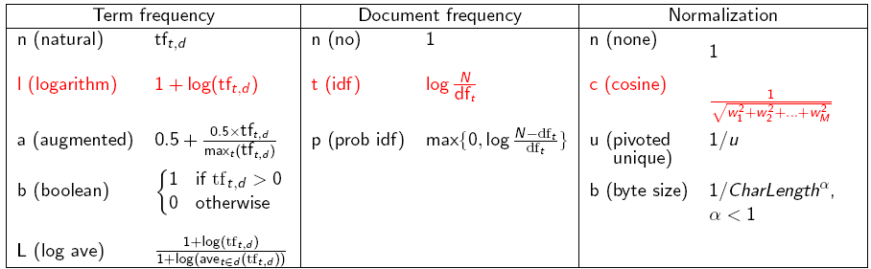
tf-idf weighting has many variants
Why is the base of the log in idf immaterial?

Slide 58
Weighting may differ in queries vs. documents
Many search engines allow for different weightings for queries vs documents
To denote the combination in use in an engine, we use the notation qqq.ddd with the acronyms from the previous table
Example: ltn.ltc means:
Query: logarithmic tf (l in leftmost column), idf (t in second column), no normalization …
Document logarithmic tf, no idf and cosine normalization
Is this a bad idea?

Slide 59
tf-idf example: ltn.lnc
(log idf none . log none cosine)
Document: car insurance auto insurance
Query: best car insurance
Term | Query |  |  |  |  | Document |  |  | Prod
 | tf-raw | tf-wt | df | idf | wt | tf-raw | tf-wt | n’lized
auto | 0 | 0 | 5000 | 2.3 | 0 | 1
best | 1 | 1 | 50000 | 1.3 | 1.3 | 0
car | 1 | 1 | 10000 | 2.0 | 2.0 | 1
insurance | 1 | 1 | 1000 | 3.0 | 3.0 | 2
Doc length =

Slide 60
tf-idf example: ltn.lnc
Document: car insurance auto insurance
Query: best car insurance
Term | Query |  |  |  |  | Document |  |  | Prod
 | tf-raw | tf-wt | df | idf | wt | tf-raw | tf-wt | n’lized
auto | 0 | 0 | 5000 | 2.3 | 0 | 1 | 1 | 0.52 | 0
best | 1 | 1 | 50000 | 1.3 | 1.3 | 0 | 0 | 0 | 0
car | 1 | 1 | 10000 | 2.0 | 2.0 | 1 | 1 | 0.52 | 1.04
insurance | 1 | 1 | 1000 | 3.0 | 3.0 | 2 | 1.3 | 0.677 | 2.04
Doc length =
Score = 0+0+1.04+2.04 = 3.08

Slide 61
Summary – vector space ranking
Represent the query as a weighted tf-idf vector
Represent each document as a weighted tf-idf vector
Compute the cosine similarity score for the query vector and each document vector
Rank documents with respect to the query by score
Return the top K (e.g., K = 10) to the user

