Slide 1
Index Compression
David Kauchak
cs458
Fall 2012
adapted from:
http://www.stanford.edu/class/cs276/handouts/lecture5-indexcompression.ppt

Slide 2
Administrative
Assignment 1?
Homework 2 out
“What I did last summer” lunch talks today

Slide 3
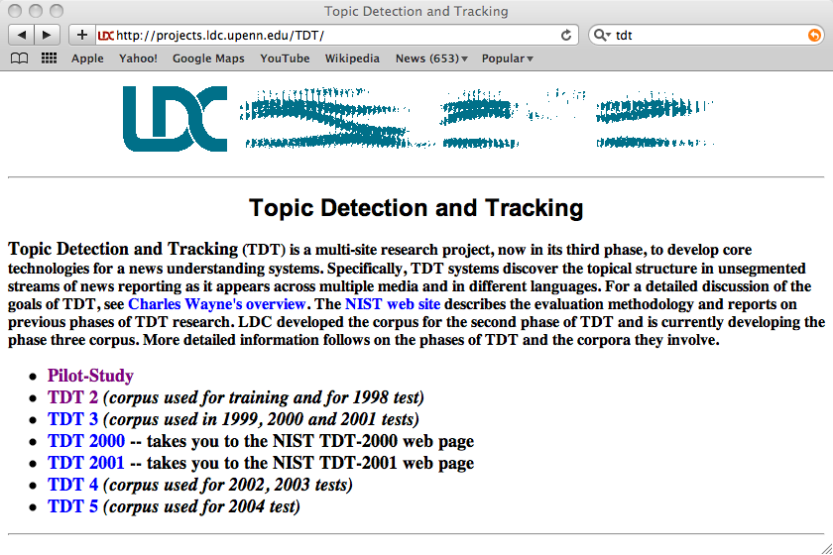

Slide 4
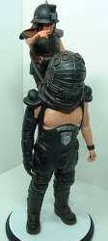
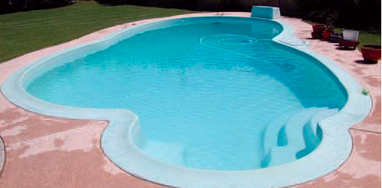

Distributed indexing
Maintain a master machine directing the indexing job
Break up indexing into sets of (parallel) tasks
Master machine assigns each task to an idle machine from a pool
Besides speed, one advantage of a distributed scheme is fault tolerance
Master
Tasks

Slide 5
Distributed indexing
Quick refresh of the non-parallelized approach:
I did enact Julius
Caesar I was killed
i' the Capitol;
Brutus killed me.
word 1
word 2
…
So let it be with
Caesar. The noble
Brutus hath told you
Caesar was ambitious
word n
1. create term list
2. sort term list
3. create postings list

Slide 6
Distributed indexing
Split into smaller, parallelizable chunks
I did enact Julius
Caesar I was killed
i' the Capitol;
Brutus killed me.
word 1
word 2
…
So let it be with
Caesar. The noble
Brutus hath told you
Caesar was ambitious
word n
1. create term list
2. sort term list
3. create postings list

Slide 7
Parallel tasks
We will use two sets of parallel tasks
  Parsers (Step 1: create term list)
  Inverters (Steps 2-3: sort term list, create postings list)
split documents up for parsers
all docs

Slide 8
Parsers
Read a document at a time and emits (term, doc) pairs (Step 1)
Parser writes pairs into j partitions
Each partition is for a range of terms’ first letters
  (e.g., a-f, g-p, q-z) – here j=3.
did 1
enact 1
caesar 1
capitol 1
brutus 1
be 2
caesar 2
brutus 2
caesar 2
a-f
g-p
was 1
the 1
so 2
with 2
told 2
was 2
q-z

Slide 9
Inverters
Collects all (term, doc) pairs for one term-partition
Sorts and writes to postings lists
a-f
a-f
a-f
a-f
index for a-f
a-f
a-f
a-f
1b. concatenate
2. sort term list
3. create postings list

Slide 10
Data flow
assign
Master
assign
Postings
Parser
a-f
g-p
q-z
Inverter
a-f
Parser
a-f
g-p
q-z
Inverter
g-p
splits
Inverter
q-z
Parser
a-f
g-p
q-z
Map
phase
Reduce
phase
Segment files

Slide 11
MapReduce
MapReduce (Dean and Ghemawat 2004) is a robust and simple framework for distributed computing without having to write code for the distribution part
The Google indexing system (ca. 2002) consists of a number of phases, each implemented in MapReduce
MapReduce and similar type setups are hugely popular for web-scale development!

Slide 12
MapReduce
Index construction is just one phase
After indexing, we need to be ready to answer queries
There are two ways to we can partition the index:
  Term-partitioned: one machine handles a subrange of terms
  Document-partitioned: one machine handles a subrange of documents
Which do you think search engines use? Why?
word 1
word 2
…
word n

Slide 13
Index compression
Compression techniques attempt to decrease the space required to store an index
What other benefits does compression have?
  Keep more stuff in memory (increases speed)
  Increase data transfer from disk to memory
    [read compressed data and decompress] is faster than [read uncompressed data]
    What does this assume?
      Decompression algorithms are fast
      True of the decompression algorithms we use

Slide 14
How does the vocabulary size grow with the size of the corpus?
vocabulary size
number of documents

Slide 15
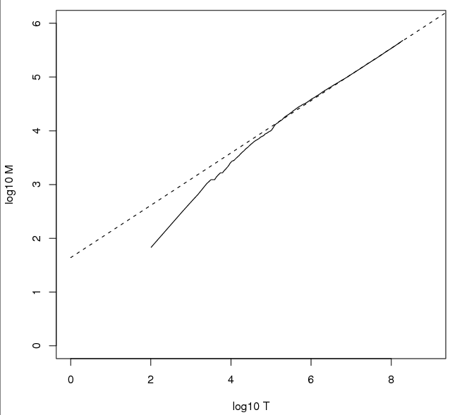
How does the vocabulary size grow with the size of the corpus?
log of the vocabulary size
log of the number of documents

Slide 16
Heaps’ law
vocab size = k (tokens)^{b}
Typical values:
30 ≤ k ≤ 100
b ≈ 0.5
V = k T^{b}
Does this explain the plot we saw before?
What does this say about the vocabulary size as we increase the number of documents?
  there are almost always new words to be seen: increasing the number of documents increases the vocabulary size
  to get a linear increase in vocab size, need to add exponential number of documents
log V= log k + b log(T)

Slide 17
vocab growth vs. size of the corpus
log₁₀M = 0.49 log₁₀T + 1.64
is the best least squares fit.
M = 10^{1.64}T^{0.49}
k = 10^{1.64} ≈ 44
b = 0.49.
log of the vocabulary size
log of the number of documents

Slide 18
Discussion
vocab size = k (tokens)^{b}
Typical values:
30 ≤ k ≤ 100
b ≈ 0.5
V = k T^{b}
How do token normalization techniques and similar efforts like spelling correction interact with Heaps’ law?

Slide 19
Heaps’ law and compression
index compression is the task of reducing the memory requirement for storing the index
What implications does Heaps’ law have for compression?
  Dictionary sizes will continue to increase
  Dictionaries can be very large

Slide 20
How does a word’s frequency relate to it’s frequency rank
word frequency
word’s frequency rank

Slide 21
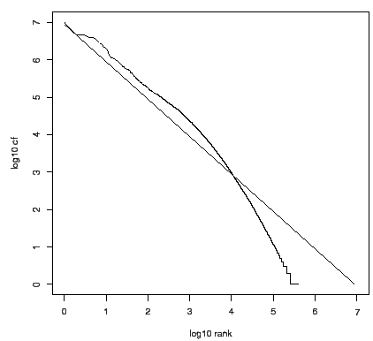
How does a word’s frequency relate to it’s frequency rank
log of the frequency
log of the frequency rank

Slide 22
Zipf’s law
In natural language, there are a few very frequent terms and very many very rare terms
Zipf’s law: The i th most frequent term has frequency proportional to 1/i
where c is a constant
frequency_{i} ∝ c/i
log(frequency_{i}) ∝ log c – log i

Slide 23
Consequences of Zipf’s law
If the most frequent term (the) occurs cf₁ times, how often do the 2nd and 3rd most frequent occur?
  then the second most frequent term (of) occurs cf₁/2 times
  the third most frequent term (and) occurs cf₁/3 times …
If we’re counting the number of words in a given frequency range, lowering the frequency band linearly results in an exponential increase in the number of words

Slide 24
Zipf’s law and compression
What implications does Zipf’s law have for compression?
Some terms will occur very frequently in positional postings lists
Dealing with these well can drastically reduce the index size
word frequency
word’s frequency rank

Slide 25
Compresssing the inverted index
word 1
word 2
What do we need to store?
How are we storing it?
…
word n

Slide 26
Compressing the inverted index
Two things to worry about:
dictionary:
  make it small enough to keep in main memory
  Search begins with the dictionary
postings:
  Reduce disk space needed, decrease time to read from disk
  Large search engines keep a significant part of postings in memory

Slide 27
Lossless vs. lossy compression
What is the difference between lossy and lossless compression techniques?
Lossless compression: All information is preserved
Lossy compression: Discard some information, but attempt to keep information that is relevant
  Several of the preprocessing steps can be viewed as lossy compression: case folding, stop words, stemming, number elimination.
  Prune postings entries that are unlikely to turn up in the top k list for any query
Where else have you seen lossy and lossless compresion techniques?

Slide 28
The dictionary
If I asked you to implement it right now, how would you do it?
How much memory would this use?
word 1
word 2
…
word n

Slide 29
The dictionary
Array of fixed-width entries
  ~400K terms; 28 bytes/term = 11.2 MB.
20 bytes
4 bytes each
(assume 1byte chars)
(assuming 32-bit)

Slide 30
Fixed-width terms are wasteful
Any problems with this approach?
  Most of the bytes in the Term column are wasted – we allocate 20 bytes for 1 letter terms
    And we still can’t handle supercalifragilisticexpialidocious
Written English averages ~4.5 characters/word
  Is this the number to use for estimating the dictionary size?
Ave. dictionary word in English: ~8 characters
Short words dominate token counts but not type average

Slide 31
Any ideas?
Store the dictionary as one long string
Gets ride of wasted space
If the average word is 8 characters, what is our savings over the 20 byte representation?
Theoretically, 60%
Any issues?
….systilesyzygeticsyzygialsyzygyszaibelyiteszczecinszomo….

Slide 32
Dictionary-as-a-String
Store dictionary as a (long) string of characters:
  Pointer to next word shows end of current word
….systilesyzygeticsyzygialsyzygyszaibelyiteszczecinszomo….
Total string length =
400K x 8B = 3.2MB
Pointers resolve 3.2M
positions: log₂3.2M =
22bits = 3bytes
How much memory to store the pointers?

Slide 33
Space for dictionary as a string
Fixed-width
  20 bytes per term = 8 MB
As a string
  5.6 MB (3.2 for dictionary and 2.4 for pointers)
30% reduction!
Still a long way from 60%. Any way we can store less pointers?

Slide 34
Blocking
Store pointers to every kth term string
….systilesyzygeticsyzygialsyzygyszaibelyiteszczecinszomo….
What else do we need?

Slide 35
Blocking
Store pointers to every kth term string
  Example below: k = 4
Need to store term lengths (1 extra byte)
….7systile9syzygetic8syzygial6syzygy11szaibelyite8szczecin9szomo….
⎫ Save 9 bytes
⎬ on 3
⎭ pointers.
Lose 4 bytes on
term lengths.

Slide 36
Net
Where we used 3 bytes/pointer without blocking
  3 x 4 = 12 bytes for k=4 pointers,
now we use 3+4=7 bytes for 4 pointers.
Shaved another ~0.5MB; can save more with larger k.
Why not go with larger k?

Slide 37
Dictionary search without blocking
How would we search for a dictionary entry?
….systilesyzygeticsyzygialsyzygyszaibelyiteszczecinszomo….

Slide 38
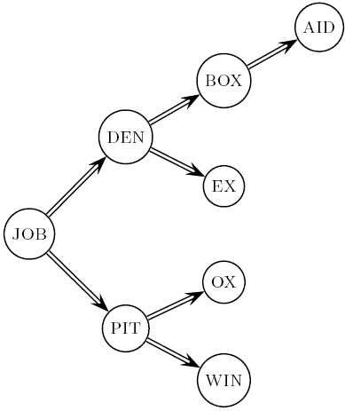
Dictionary search without blocking
Binary search
Assuming each dictionary term is equally likely in query (not really so in practice!), average number of comparisons = ?
(1 + 2*2+4*3+4)/8 = 2.6

Slide 39
Dictionary search with blocking
What about with blocking?
….7systile9syzygetic8syzygial6syzygy11szaibelyite8szczecin9szomo….

Slide 40
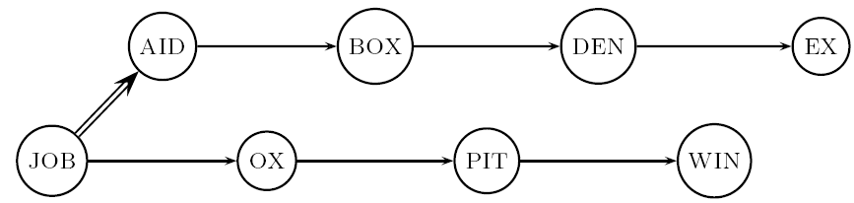
Dictionary search with blocking
Binary search down to 4-term block
  Then linear search through terms in block.
Blocks of 4 (binary tree), avg. = ?
(1+2∙2+2∙3+2∙4+5)/8 = 3 compares

Slide 41
More improvements…
  8automata8automate9automatic10automation
We’re storing the words in sorted order
Any way that we could further compress this block?

Slide 42
Front coding
Front-coding:
  Sorted words commonly have long common prefixes – store differences only (for last k-1 in a block of k)
  8automata8automate9automatic10automation
→8automat*a1e2ic3ion
Encodes automat
Extra length
beyond automat
Begins to resemble general string compression

Slide 43
RCV1 dictionary compression
Technique | Size in MB
Fixed width | 11.2
String with pointers to every term | 7.6
Blocking k = 4 | 7.1
Blocking + front coding | 5.9

Slide 44
Postings compression
The postings file is much larger than the dictionary, by a factor of at least 10
A posting for our purposes is a docID
Regardless of our postings list data structure, we need to store all of the docIDs
For Reuters (800,000 documents), we would use 32 bits per docID when using 4-byte integers
Alternatively, we can use log₂ 800,000 ≈ 20 bits per docID

Slide 45
Postings: two conflicting forces
Where is most of the storage going?
Frequent terms will occur in most of the documents and require a lot of space
A term like the occurs in virtually every doc, so 20 bits/posting is too expensive.
  Prefer 0/1 bitmap vector in this case
A term like arachnocentric occurs in maybe one doc out of a million – we would like to store this posting using log₂ 1M ~ 20 bits.

Slide 46
Postings file entry
We store the list of docs containing a term in increasing order of docID.
  computer: 33,47,154,159,202 …
Is there another way we could store this sorted data?
Store gaps: 33,14,107,5,43 …
  14 = 47-33
  107 = 154 – 47
  5 = 159 - 154

Slide 47
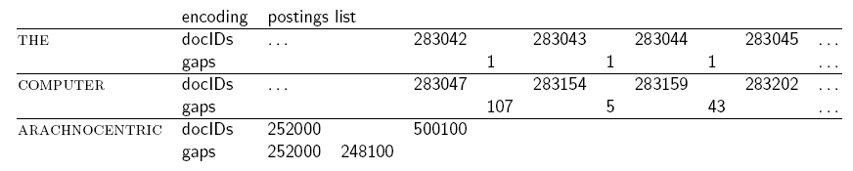
Fixed-width
How many bits do we need to encode the gaps?
Does this buy us anything?

Slide 48
Variable length encoding
Aim:
  For arachnocentric, we will use ~20 bits/gap entry
  For the, we will use ~1 bit/gap entry
Key challenge: encode every integer (gap) with as few bits as needed for that integer
1, 5, 5000, 1, 1524723, …
for smaller integers, use fewer bits
for larger integers, use more bits

Slide 49
Variable length coding
1, 5, 5000, 1, 1124 …
1, 101, 1001110001, 1, 10001100101 …
Fixed width:
000000000100000001011001110001 …
every 10 bits
Variable width:
11011001110001110001100101 …
?

Slide 50
Variable Byte (VB) codes
Rather than use 20 bits, i.e. record gaps with the smallest number of bytes to store the gap
1, 101, 1001110001
00000001, 00000101, 00000010 01110001
1 byte
1 byte
2 bytes
00000001000001010000001001110001
?

Slide 51
VB codes
Reserve the first bit of each byte as the continuation bit
If the bit is 1, then we’re at the end of the bytes for the gap
If the bit is 0, there are more bytes to read
For each byte used, how many bits of the gap are we storing?
1, 101, 1001110001
100000011000010100000100 11110001

Slide 52
Example
docIDs | 824 | 829 | 215406
gaps |  | 5 | 214577
VB code | 00000110 10111000 | 10000101 | 00001101 00001100 10110001
Postings stored as the byte concatenation
000001101011100010000101000011010000110010110001
Key property: VB-encoded postings are
uniquely prefix-decodable.
For a small gap (5), VB
uses a whole byte.

Slide 53
Other variable codes
Instead of bytes, we can also use a different “unit of alignment”: 32 bits (words), 16 bits, 4 bits (nibbles) etc.
What are the pros/cons of a smaller/larger unit of alignment?
  Larger units waste less space on continuation bits (1 of 32 vs. 1 of 8)
  Smaller unites waste less space on encoding smaller number, e.g. to encode ‘1’ we waste (6 bits vs. 30 bits)

Slide 54
More codes
100000011000010100000100 11110001
Still seems wasteful
What is the major challenge for these variable length codes?
We need to know the length of the number!
Idea: Encode the length of the number so that we know how many bits to read

Slide 55
Gamma codes
Represent a gap as a pair length and offset
offset is G in binary, with the leading bit cut off
  13 → 1101 → 101
  17 → 10001 → 0001
  50 → 110010 → 10010
length is the length of offset
  13 (offset 101), it is 3
  17 (offset 0001), it is 4
  50 (offset 10010), it is 5

Slide 56
Encoding the length
We’ve stated what the length is, but not how to encode it
What is a requirement of our length encoding?
  Lengths will have variable length (e.g. 3, 4, 5 bits)
  We must be able to decode it without any ambiguity
Any ideas?
Unary code
  Encode a number n as n 1’s, followed by a 0, to mark the end of it
  5 → 111110
  12 → 1111111111110

Slide 57
Gamma code examples
number | length | offset | γ-code
0
1
2
3
4
9
13
24
511
1025

Slide 58
Gamma code examples
number | length | offset | γ-code
0 |  |  | none
1 | 0 |  | 0
2 | 10 | 0 | 10,0
3 | 10 | 1 | 10,1
4 | 110 | 00 | 110,00
9 | 1110 | 001 | 1110,001
13 | 1110 | 101 | 1110,101
24 | 11110 | 1000 | 11110,1000
511 | 111111110 | 11111111 | 111111110,11111111
1025 | 11111111110 | 0000000001 | 11111111110,0000000001

Slide 59
Gamma code properties
Uniquely prefix-decodable, like VB
All gamma codes have an odd number of bits
What is the fewest number of bits we could expect to express a gap (without any other knowledge of the other gaps)?
  log₂ (gap)
How many bits do gamma codes use?
  2 ⎣log₂ (gap)⎦ +1 bits
  Almost within a factor of 2 of best possible

Slide 60
Gamma seldom used in practice
Machines have word boundaries – 8, 16, 32 bits
Compressing and manipulating at individual bit-granularity will slow down query processing
Variable byte alignment is potentially more efficient
Regardless of efficiency, variable byte is conceptually simpler at little additional space cost

Slide 61
RCV1 compression
Data structure | Size in MB
dictionary, fixed-width | 11.2
dictionary, term pointers into string | 7.6
with blocking, k = 4 | 7.1
with blocking & front coding | 5.9
collection (text, xml markup etc) | 3,600.0
collection (text) | 960.0
Term-doc incidence matrix | 40,000.0
postings, uncompressed (32-bit words) | 400.0
postings, uncompressed (20 bits) | 250.0
postings, variable byte encoded | 116.0
postings, γ−encoded | 101.0

Slide 62
Index compression summary
We can now create an index for highly efficient Boolean retrieval that is very space efficient
Only 4% of the total size of the collection
Only 10-15% of the total size of the text in the collection
However, we’ve ignored positional information
Hence, space savings are less for indexes used in practice
  But techniques substantially the same

