Slide 1
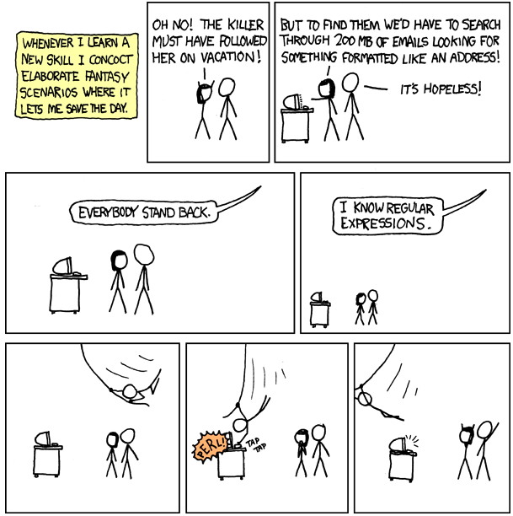
http://www.xkcd.com/208/

Slide 2
Online Advertising
David Kauchak
cs458
Fall 2012

Slide 3
Administrative
Papers due tomorrow
Review assignments out Saturday morning
  Review due Sunday
Project presentations next Friday, 7-10pm
  shoot for 15-20 min

Slide 4
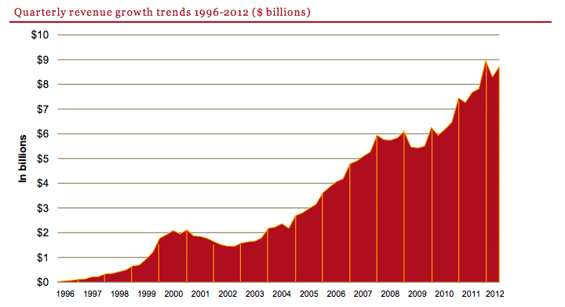
Online advertising $
http://www.iab.net/media/file/IAB_Internet_Advertising_Revenue_Report_HY_2012.pdf

Slide 5
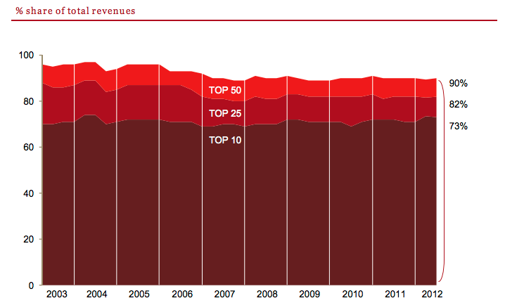
Who’s making the $?
http://www.iab.net/media/file/IAB_Internet_Advertising_Revenue_Report_HY_2012.pdf

Slide 6
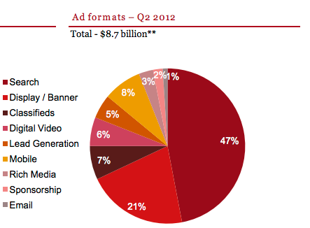
Where is the $ coming from?
http://www.iab.net/media/file/IAB_Internet_Advertising_Revenue_Report_HY_2012.pdf

Slide 7
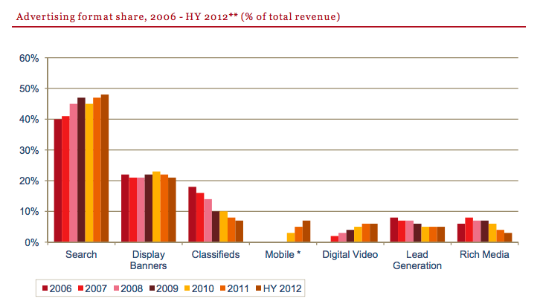
Where is the $ coming from?
http://www.iab.net/media/file/IAB_Internet_Advertising_Revenue_Report_HY_2012.pdf

Slide 8
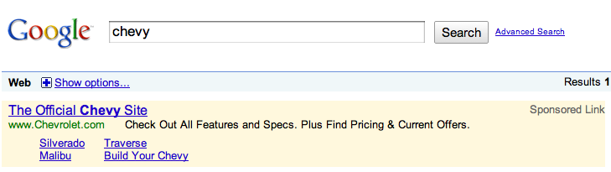

3 major types of online ads
Banner ads
Keyword linked ads
Context linked ads

Slide 9
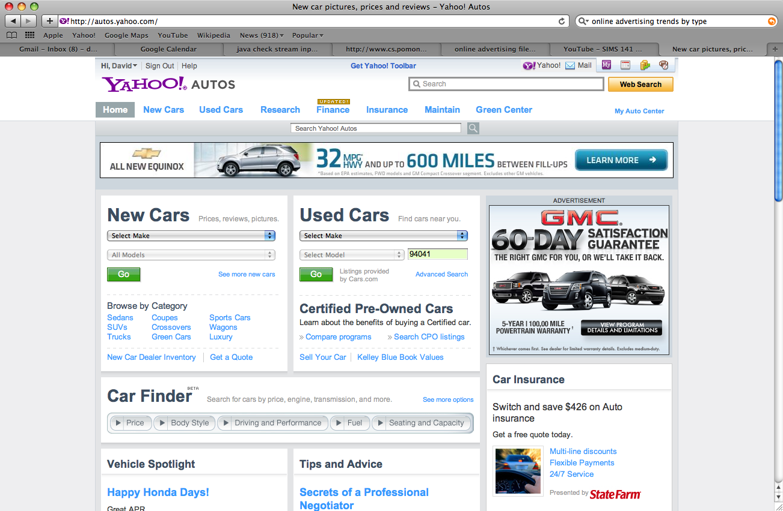
Banner ads
standardized set of sizes

Slide 10
Ad formats
Floating ad: An ad which moves across the user's screen or floats above the content.
Expanding ad: An ad which changes size and which may alter the contents of the webpage.
Polite ad: A method by which a large ad will be downloaded in smaller pieces to minimize the disruption of the content being viewed
Wallpaper ad: An ad which changes the background of the page being viewed.
Trick banner: A banner ad that looks like a dialog box with buttons. It simulates an error message or an alert.
Pop-up: A new window which opens in front of the current one, displaying an advertisement, or entire webpage.
Pop-under: Similar to a Pop-Up except that the window is loaded or sent behind the current window so that the user does not see it until they close one or more active windows.
Video ad: similar to a banner ad, except that instead of a static or animated image, actual moving video clips are displayed.
Map ad: text or graphics linked from, and appearing in or over, a location on an electronic map such as on Google Maps.
Mobile ad: an SMS text or multi-media message sent to a cell phone.
http://people.ischool.berkeley.edu/~hal/Courses/StratTech09/Lectures/Advertising/online-advertising.ppt

Slide 11

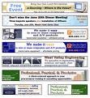




Components for display advertising
User
Ad server
Advertiser
Ad platform/exchange
Publisher

Slide 12
Banner ad process
Advertiser “purchases inventory”
  directly from the publisher
  from an ad exchange
    to avoid the headache, publishers often sell inventory to an exchange
Specifies a price in CPM
  cost per 1000 impressions
Specify max impressions
Advertiser
Publisher
Ad platform/exchange

Slide 13
Banner ad process
Advertiser uploads banners to banner server
Ad server
Advertiser

Slide 14
Banner ad process
User
Publisher
User visits a page with places for ads
Need to decide which ads to show

Slide 15
Banner ad process
Publisher
Ad platform/exchange
Ad server

Slide 16
What are the problems/inefficiencies with this process?
Pricing
  Fairly static: difficult to change price regularly
  variable pricing based on user, etc
  cpm pricing doesn’t take into account clicks, revenue, etc.
User targeting
  We’re only targeting users based on the site/page visited
  What about a user that visits the same page everyday (e.g. nytimes)?
Banner creation is fairly static
  situation specific banners

Slide 17
Current trends: user targeting
User
What information might we know about a user?
  many of the sites a user has visited
    cookies
    everytime an ad is shown to a user, the ad is requested and we know which site the user is at
    e.g. doubleclick cookie
  Which ads the user has seen
  Which ads the user has clicked on
  Geographic information (via IP)
  Demographic information (age, gender, profession, …)
    Signed in to Yahoo, Hotmail, etc.
  Day of week, time of day, part of the month
  Lots of other information
    How much money they make
    Whether they’ve bought anything recently
    Mortgage payment
    Habits, etc.

Slide 18
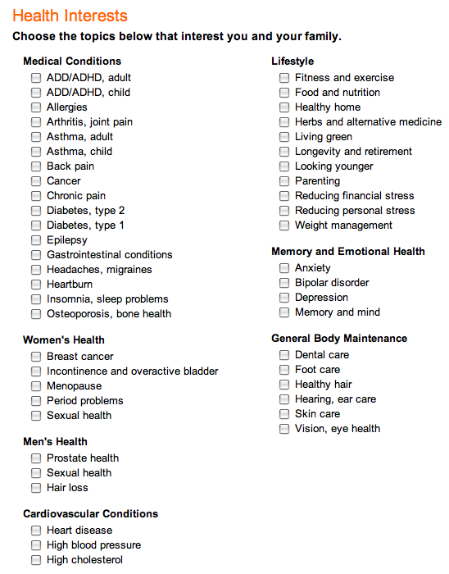
User targeting: RealAge
Calculate your “biological age” based on a questionaire
150 questions
27 million people have taken the test
Information is used for marketing purposes

Slide 19
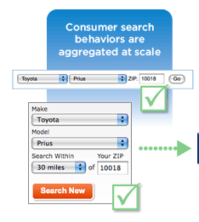
User targeting: data aggregation
Companies aggregate this data
  Bluekai
  Excelate

Slide 20
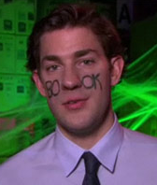

User targeting: Social networking sites
Sites like myspace and facebook have lots of information about users, users’ friends, etc
  use content on a user’s page
  use information about a user’s friends, e.g. purchases

Slide 21
User targeting: bottom line
On a per impression basis, we have lots of information about the user the ad will be shown to
User
age
gender
location
income
search history
number of ad views
…

Slide 22
Banner ad pricing
Advertising exchange
  Auction-based system for purchasing ads
  Auction happens roughly per impression
  Auction targeting based on user characteristics
  recent trend (last year or two)
$3 CPM for men, ages 20-25, CA NY FL from 12-5pm

Slide 23
Banner ad exchanges
Advertiser “uploads” bids to exchange
  via spreadsheet
  or programmatically
  Specify targeting
  Can also set thresholds on user views
Auction is performed by exchange
Downsides?
Advertiser
Ad platform/exchange

Slide 24
Ideal ad exchange: true auction
User
Publisher
age
gender
location
income
search history
number of ad views
…
Advertiser
Ad platform/exchange
bid($)

Slide 25
True auction: technical challenges
We need to make a decision quickly (on the order of a few hundred ms)
  multiple advertisers
  advertiser must make decision
  network latency
  perform auction
  this happens millions of times a day
  …

Slide 26
True auction: some first attempts
Doubleclick “callback”
  specify a “bidder” based on some targeting specifications
  bidder only bids on impressions that match criterion
bidder1
men, 20-25
Advertiser
Ad platform/exchange
bidder2
NY
bidder3
women, CA
bid($)

Slide 27
True auction: AppNexus
Ex-RightMedia folks
Initially, cloud computing
Advertiser runs a bidder server side
  avoid network latency
  auction is self-contained at the exchange
  Requires framework on exchange side for security, speed, etc.

Slide 28
Pricing
Advertisers don’t care about CPM
  CPC (cost per click)
  CPA (cost per action)
  RPM (revenue per impression)
Some work to move exchanges towards this
Challenge?
  Need to estimate these from data
  Data is very sparse ~1/1000 people click
  Similar order of magnitude for purchases (though depends on the space)

Slide 29
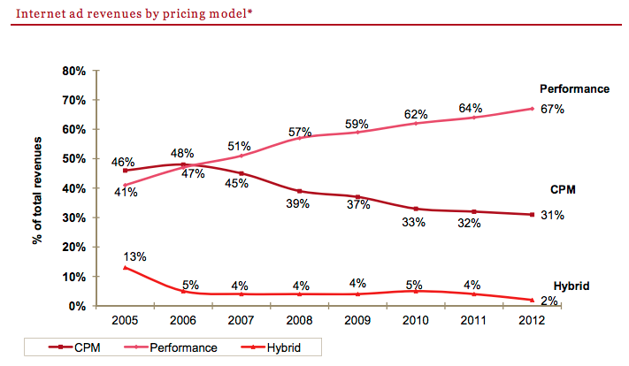
Performance-based pricing
http://www.iab.net/media/file/IAB_Internet_Advertising_Revenue_Report_HY_2012.pdf

Slide 30



Paid search components
User
Advertiser
Ad platform/exchange
Publisher
Ad server

Slide 31

Paid search query
Ad platform/exchange
query
User
Publisher
Ad server

Slide 32
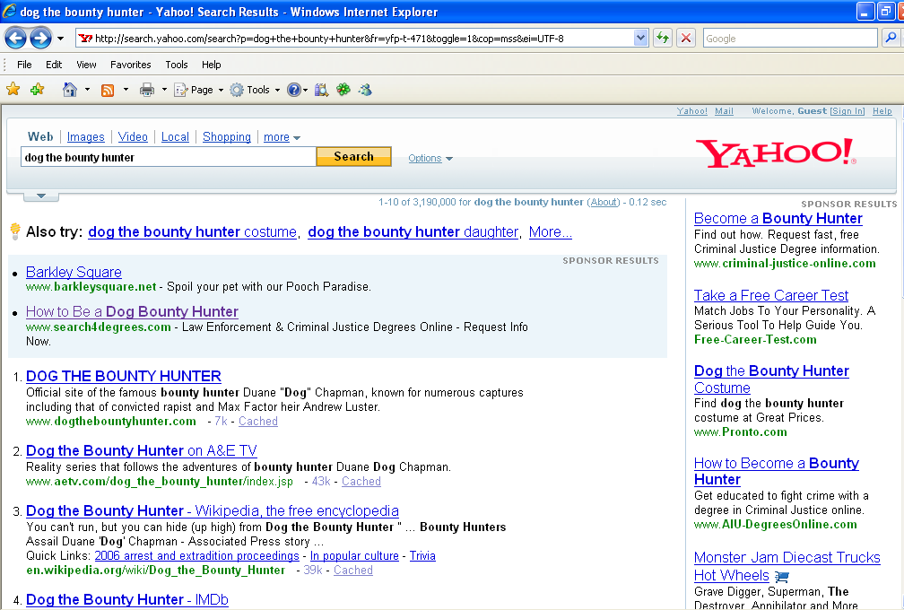

Slide 33
What is required of the advertiser?
Ad platform/exchange
Advertiser
Publisher
Ad server

Slide 34
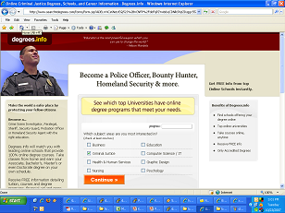

Advertiser
landing page
set of keywords
bids
$
ad copy

Slide 35
A bit more structure than this…
Advertiser
millions of keywords
<100K keywords
campaign1
…
<100 keywords
…
adgroup1
adgroup2
adgroup3
…
keyword1
keyword2

Slide 36
Adgroups
Adgroups are the key structure
Adcopy and landing pages are associated at the Adcopy level
Keywords should be tightly themed
  promotes targeting
  makes google, yahoo, etc. happy

Slide 37
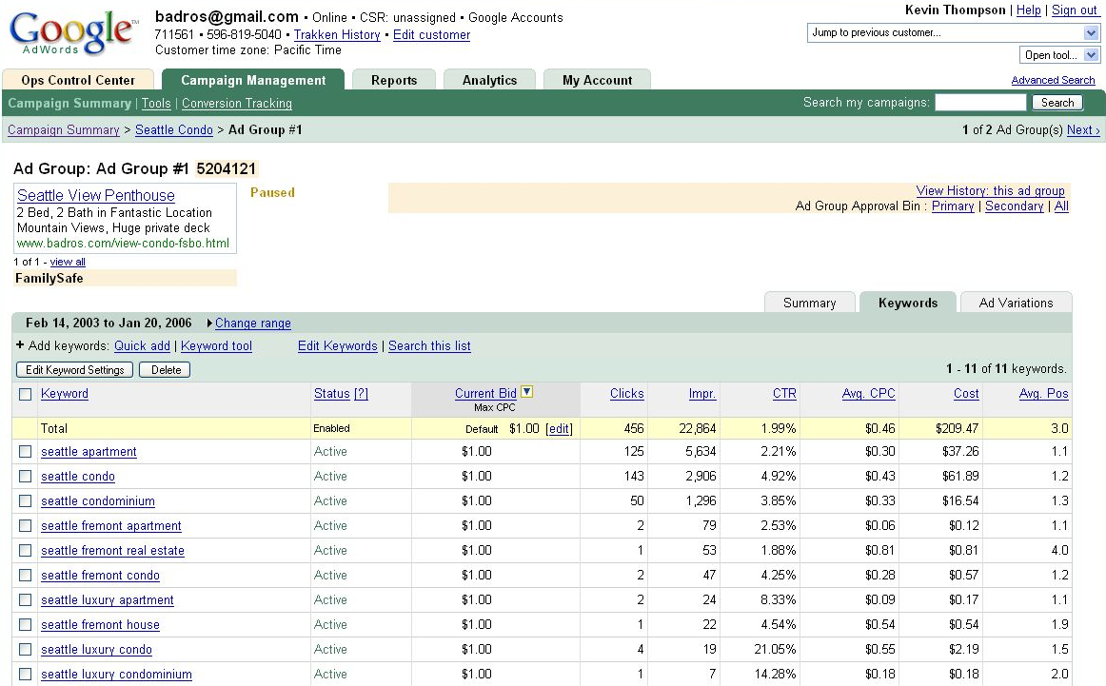
Creating an AdWords Ad

Slide 38
Behind the scenes
keywords
Advertiser
Ad platform/exchange
keywords
Publisher
Advertiser
Ad server
query
keywords
Advertiser

Slide 39
Behind the scenes
keywords
Advertiser
Ad platform/exchange
keywords
Publisher
Advertiser
?
Ad server
query
keywords
Advertiser
matching problem

Slide 40
Behind the scenes
Other data (site content, ad content, account, …)
For all the matches…
advertiser A
bid $
Search engine ad ranking
advertiser B
bid $
advertiser C
bid $

Slide 41
Behind the scenes: keyword auction
Other data (site content, ad content, account, …)
Site bids for keyword:
“dog the bounty hunter”
Display ranking
Web site A
bid $
Web site B
Search engine ad ranking
Web site B
Web site A
bid $
Web site C
Web site C
bid $

Slide 42
Search ad ranking
Bids are CPC (cost per click)… though they weren’t always…
How do you think Google determines ad ranking?
score = CPC * CTR * “quality score” * randomness
cost/clicks * clicks/impression = cost/impression
Is it a good web pages?
Good adcopy?
Adcopy related to keyword?
Enhances user experience, promoting return users
don’t want people reverse engineering the system
data gathering

Slide 43
1st price auction
Each bidder pays what they bid
Not used by search engines. Why?
Don’t work well for repeat auctions!
Bidder
value
Bid1
A
9
10
How would the bids change next time (assuming a blind auction)?
B
7
5

Slide 44
1st price auction
Each bidder pays what they bid
Not used by search engines. Why?
Don’t work well for repeat auctions!
Bidder
value
Bid1
Bid2
A
9
10
7
A is going to want to decrease it’s bid
B increase
B
7
5
6

Slide 45
1st price auction
Each bidder pays what they bid
Not used by search engines. Why?
Don’t work well for repeat auctions!
Bidder
value
Bid1
Bid2
Bid3
A
9
10
7
6
A decrease
B increase
B
7
5
6
7

Slide 46
1st price auction
Each bidder pays what they bid
Not used by search engines. Why?
Don’t work well for repeat auctions!
Bidder
value
Bid1
Bid2
Bid3
Bid4
A
9
10
7
6
8
B
7
5
6
7
7

Slide 47
1st price auction
Each bidder pays what they bid
Not used by search engines. Why?
Don’t work well for repeat auctions!
Bidder
value
Bid1
Bid2
Bid3
Bid4
Bid5
A
9
10
7
6
8
8
B
7
5
6
7
7
5

Slide 48
1st price auction
Each bidder pays what they bid
Not used by search engines. Why?
Don’t work well for repeat auctions!
In general, tend to end up with unstable bids in a “sawtooth” pattern
bid down when you’re winning
bid up to get back in first
bid back down

Slide 49
Auction system
2nd price auction (Vickrey auction)
  Winner pays one penny more than the 2nd place bid
  Slightly complicated by modified scoring
  Avoids sawtooth problem, but still not perfect
Bidder
Bid
Bidder
Price
A
10
A
5.01
B
5
B
1.01
C
1
C
1

Slide 50
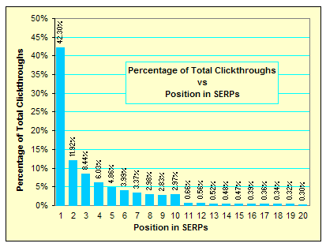
CTR with respect to position
Note, these are not CTRs, but relative CTRs
http://www.seo-blog.com/serps-position-and-clickthroughs.php

Slide 51
Predicted CTR
score = CPC * CTR * “quality score” * randomness
Any problem with using CTR of a keyword?
  Zipf’s law: most keywords get very little traffic
  CTRs are generally ~1-3%
  Need a lot of impressions to accurately predict CTR
  New advertisers, new adcopy, …
Major prediction task
  machine learning
  lots of features
  share data within an advertiser and across advertisers

Slide 52
Factors affecting revenue for search engine
Monetization
(RPM)
Revenue
Queries
=
Revenue
Clicks
Clicks
Queries
=
x
Revenue
Clicks
Queries w/ Ads
Queries
Ads
Queries w/ Ads
Clicks
Ads
=
x
x
x
=
x
CPC
Coverage
x
Depth
x
CTR per Ad
Price
Quantity
Quality
http://people.ischool.berkeley.edu/~hal/Courses/StratTech09/Lectures/Advertising/online-advertising.ppt

Slide 53
Increasing search engine revenue
Increase CPC (cost per click)
  Increase conversion rate (i.e. post click performance)
  Increase competition (higher bids)
Increase coverage and depth
  More keywords
    more keywords per advertiser (i.e. keyword tools)
    more advertisers
  More broadly matching keywords to queries
Increase CTR (click through rate)
  Show more relevant ads in higher positions
  Encourage high quality ads
  Precise keyword/query matching

Slide 54
Advertiser margin
margin = revenue - cost
Revenue
Action
Actions
Impression
x
Impressions
- cost
=
x
Revenue
Action
Actions
Click
Clicks
Impression
Impressions
- cost
=
x
x
x
Revenue
Action
Actions
Click
Clicks
Impression
-
Cost
Click
=
x
x
x
Impressions
revenue per transaction
conversion rate
CTR
CPC

Slide 55
Increasing advertiser margin
Increase revenue per transaction
  sales, marketing
  increase price
Increase conversion rate (actions per click)
  better landing page
    better offers
  cheaper price
  more offers/options
Increase click through rate
  better adcopy
Increase impressions
  more keywords
Decrease cost per click
  decrease bid
  increase “quality score”
  bid on less competitive keywords

Slide 56
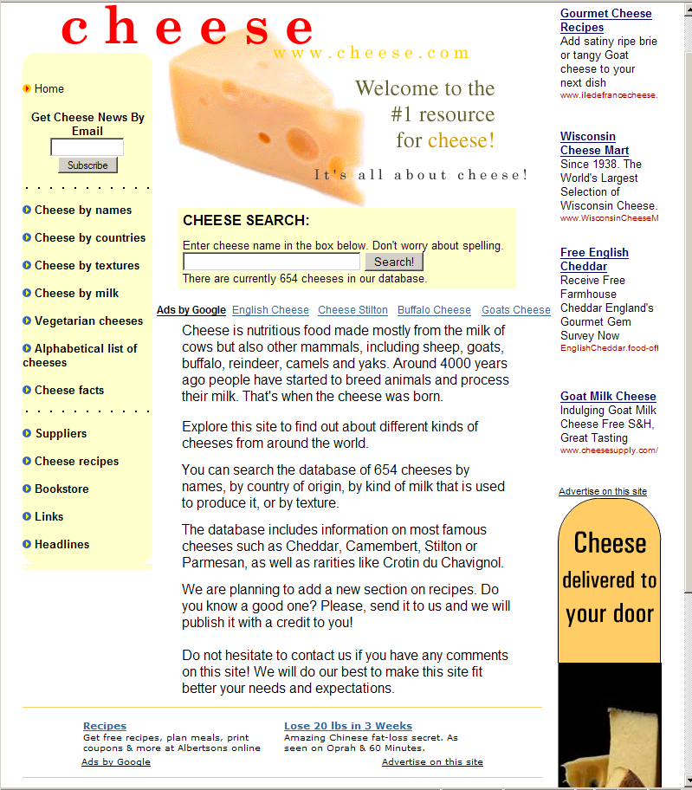
Contextual advertising

Slide 57
Contextual Advertising
Text ads on web pages
Uses similar technology and framework to search advertising
  Advertiser supplies keywords, adgroups, adcopy, bids
  Rather than match queries, match text on page
Some differences
  A lot more text, so many more matches and multiple matches
  Generally lower CTRs, lower conversion performance, adjustments made in payment
Easy way for search engines to expand revenue
Challenges
  extracting “keywords” from a web page
  be careful about matching. e.g. wouldn’t want to show a competitors ad

Slide 58
How the ads are served
function google_show_ad() {
var w = window;
w.google_ad_url = 'http://pagead2.googlesyndication.com/pagead/ads?' +
'&url=' + escape(w.google_page_url) +
'&hl=' + w.google_language;
document.write('<ifr' + 'ame' +
' width=' + w.google_ad_width +
' height=' + w.google_ad_height +
' scrolling=no></ifr' + 'ame>');
}
google_show_ad();
http://people.ischool.berkeley.edu/~hal/Courses/StratTech09/Lectures/Advertising/online-advertising.ppt

Slide 59
Lots of problems in online advertising
Display (banner ads)
  Banners on the fly
  User targeting
    Predict performance based on user data
    Tracking users
  auctions
    buyer strategy
    auction holder policies
  Banner/ad selection

Slide 60
Lots of problems in online advertising
Paid search
  keyword generation
  adgroup generation
  keyword performance estimation
    impressions/volume, CTR, conversion rate, rev.
  adcopy generation
  bid management
  auction mechanisms
  keyword/query matching

Slide 61
Lots of problems
Misc
  Data analysis
    What works well
    Trends in the data
    Anomalies
  click fraud
  scale (many of these things must happen fast!)
  Landing page optimization

Slide 62
Typical CPMs in advertising
Outdoor: $1-5 CPM
Cable TV: $5-8 CPM
Radio: $8 CPM
Online
  Display $5-30 CPM
  Contextual: $1-$5 CPM
  Search: $1 to $200 CPM
Network/Local TV: $20 CPM
Magazine: $10-30 CPM
Newspaper: $30-35 CPM
Direct Mail: $250 CPM
http://people.ischool.berkeley.edu/~hal/Courses/StratTech09/Lectures/Advertising/online-advertising.ppt

