Slide 1
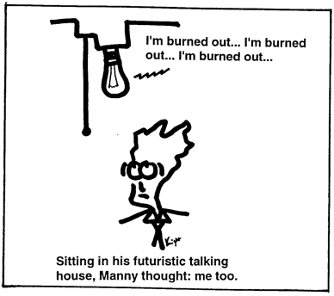
http://www.isi.edu/natural-language/people/knight3.html

Slide 2
Text Classification
David Kauchak
cs458
Fall 2012
adapted from: http://www.stanford.edu/class/cs276/handouts/lecture10-textcat-naivebayes.ppt
http://www.stanford.edu/class/cs276/handouts/lecture11-vector-classify.ppt
http://www.stanford.edu/class/cs276/handouts/lecture12-SVMs.ppt

Slide 3
Administrative
Lunch talk today
CS lunch tomorrow, Ross – LaForce 121
Finalized proposals
Start working on the project now!

Slide 4
Git repository
https://github.com/dkauchak/cs458-f12.git
Getting your own copy:
sign up for a github account
https://help.github.com/articles/fork-a-repo
Other Tutorials:
http://schacon.github.com/git/gittutorial.html
http://www.cs.middlebury.edu/~dkauchak/classes/s12/cs312/lectures/lecture4-git.pdf

Slide 5
Git
Each project will “fork” their own GitHub project
Your team can interact with this project as much as you want without affecting the general project
When you want to merge with the main code base:
git pull upstream master (make sure you have the latest changes)
git status (Make sure all the files you’re using are in the git repository)
Make sure your code compiles!
Make sure your code runs (run your tests)
git push origin master
Issue a pull request on github

Slide 6
Git
Don’t wait too long to merge with the main project
But… don’t bug me too often with pull requests
I’ll manage the project repository for now… I won’t be very happy if you issue pull requests that break the main code base ☹

Slide 7
Document Classification: training
(AI)
(Programming)
(HCI)
Classes:
ML
Planning
Semantics
Garb.Coll.
Multimedia
GUI
Training
Data:
learning
intelligence
algorithm
reinforcement
network...
planning
temporal
reasoning
plan
language...
programming
semantics
language
proof...
garbage
collection
memory
optimization
region...
...
...

Slide 8
Document Classification: testing
which class?
“planning
language
proof
intelligence”
Test
Data:
(AI)
(Programming)
(HCI)
Classes:
ML
Planning
Semantics
Garb.Coll.
Multimedia
GUI
Training
Data:
learning
intelligence
algorithm
reinforcement
network...
planning
temporal
reasoning
plan
language...
programming
semantics
language
proof...
garbage
collection
memory
optimization
region...
...
...

Slide 9
Document Classification: testing
“planning
language
proof
intelligence”
Test
Data:
(AI)
(Programming)
(HCI)
Classes:
ML
Planning
Semantics
Garb.Coll.
Multimedia
GUI
Training
Data:
learning
intelligence
algorithm
reinforcement
network...
planning
temporal
reasoning
plan
language...
programming
semantics
language
proof...
garbage
collection
memory
optimization
region...
...
...

Slide 10
How might this be useful for IR?

Slide 11
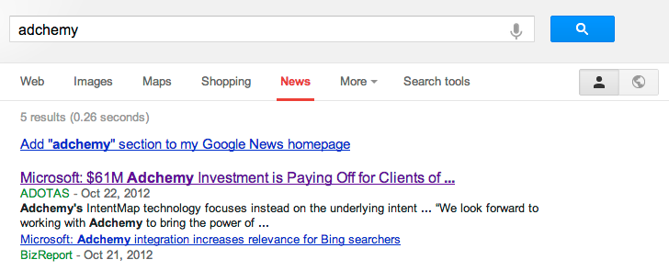
Standing queries

Slide 12
Standing queries
You have an information need, say:
Unrest in the Niger delta region
Adchemy, Inc
…
You want to rerun an appropriate query periodically to find new news items on this topic
You will be sent new documents that are found
it’s classification not ranking

Slide 13
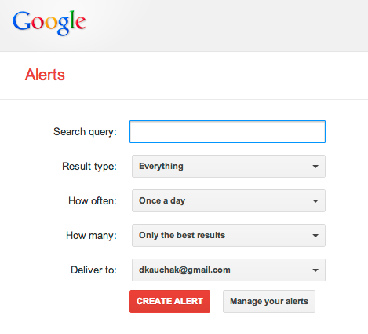
Standing queries

Slide 14
Spam filtering
From: "" <takworlld@hotmail.com>
Subject: real estate is the only way... gem oalvgkay
Anyone can buy real estate with no money down
Stop paying rent TODAY !
There is no need to spend hundreds or even thousands for similar courses
I am 22 years old and I have already purchased 6 properties using the
methods outlined in this truly INCREDIBLE ebook.
Change your life NOW !
=================================================
Click Below to order:
http://www.wholesaledaily.com/sales/nmd.htm
=================================================

Slide 15
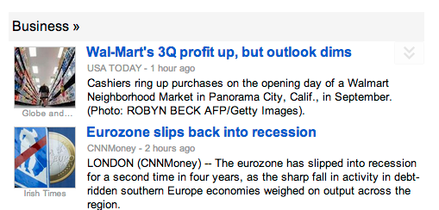
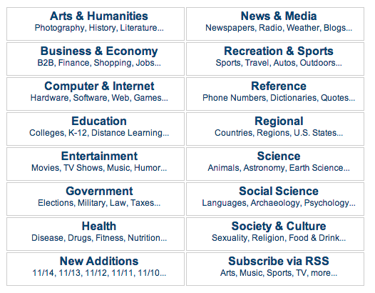
Many other applications…
link spam??

Slide 16
How would you do it?
…
Pros and cons of different approaches?

Slide 17
Manual approach
Used by Yahoo! (originally; now present but downplayed), Looksmart, about.com, ODP, PubMed
Very accurate when job is done by experts
Consistent when the problem size and team is small
Difficult and expensive to scale
Means we need automatic classification methods for big problems

Slide 18
A slightly better manual approach
Hand-coded, rule-based systems
A few companies provide an “IDE” for writing such rules
Accuracy is often very high if a rule has been carefully refined over time by a subject expert
Building and maintaining these rules is expensive

Slide 19
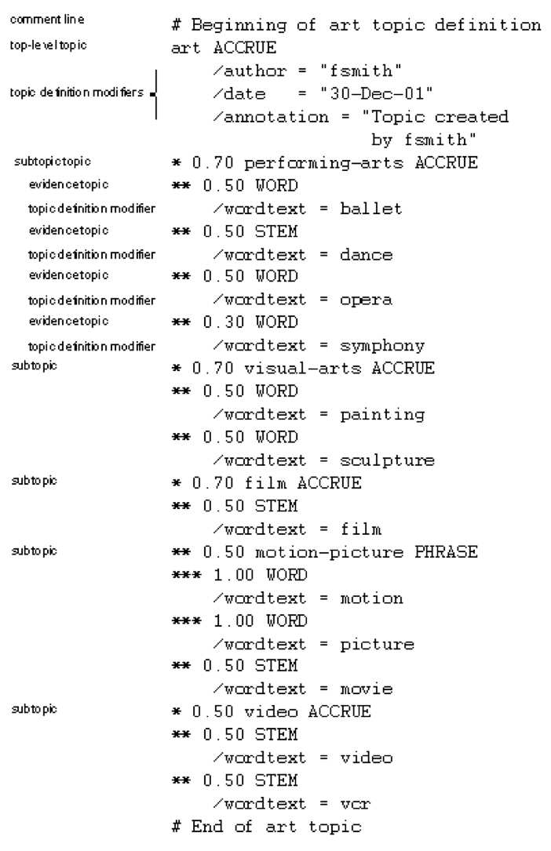
A complex classification rule
maintenance issues!
Hand-weighting of terms

Slide 20
Automated approaches
Supervised learning of a document-label assignment function
Many systems partly rely on machine learning (Autonomy, MSN, Verity, Enkata, Yahoo!, …)
k-Nearest Neighbors (simple, powerful)
Naive Bayes (simple, common method)
Support-vector machines (new, more powerful)
… plus many other methods
Many commercial systems use a mixture of methods
Pros/Cons?
Results can be very good!
No free lunch: requires hand-classified training data

Slide 21
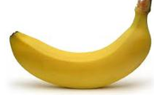
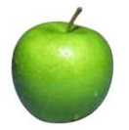
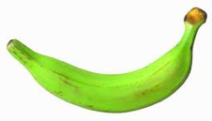
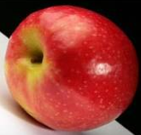
Supervised learning setup
APPLES
BANANAS
Given labeled data…

Slide 22
Unsupervised learning
Unupervised learning: given data, but no labels

Slide 23
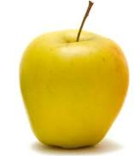
Supervised learning
Given labeled examples, learn to label unlabeled examples
APPLE or BANANA?
learn to classify unlabeled

Slide 24
Training
Labeled data
Data
Label
0
0
model
1
train a
predictive
model
1
0

Slide 25
Training
Labeled data
Data
Label
not spam
not spam
model
e-mails
spam
train a
predictive
model
spam
not spam

Slide 26
testing/classifying
Unlabeled data
labels
1
0
model
0
1
predict
the label
0

Slide 27
testing/classifying
Unlabeled data
labels
spam
not spam
model
not spam
e-mails
spam
predict
the label
not spam

Slide 28
Feature based learning
Training or learning phase
Raw data
Label
features
Label
f₁, f₂, f₃, …, f_{m}
0
0
f₁, f₂, f₃, …, f_{m}
0
0
f₁, f₂, f₃, …, f_{m}
1
classifier
1
f₁, f₂, f₃, …, f_{m}
1
train a
predictive
model
extract
features
1
f₁, f₂, f₃, …, f_{m}
0
0

Slide 29
Feature based learning
Testing or classification phase
Raw data
labels
features
f₁, f₂, f₃, …, f_{m}
1
f₁, f₂, f₃, …, f_{m}
0
f₁, f₂, f₃, …, f_{m}
classifier
0
extract
features
f₁, f₂, f₃, …, f_{m}
1
predict
the label
0
f₁, f₂, f₃, …, f_{m}

Slide 30
Feature examples
Raw data
Features?

Slide 31
Feature examples
Raw data
Features
Clinton said banana repeatedly last week on tv, “banana, banana, banana”
(1, 1, 1, 0, 0, 1, 0, 0, …)
clinton
said
california
across
tv
wrong
banana
capital
Occurrence of words

Slide 32
Feature examples
Raw data
Features
Clinton said banana repeatedly last week on tv, “banana, banana, banana”
(4, 1, 1, 0, 0, 1, 0, 0, …)
clinton
said
california
across
tv
wrong
banana
capital
Frequency of word occurrence

Slide 33
Feature examples
Raw data
Features
Clinton said banana repeatedly last week on tv, “banana, banana, banana”
(1, 1, 1, 0, 0, 1, 0, 0, …)
clinton said
said banana
across the
tv banana
wrong way
capital city
california schools
banana repeatedly
Occurrence of bigrams

Slide 34
Lots of other features
POS: occurrence, counts, sequence
Constituents
Whether ‘V1agra’ occurred 15 times
Whether ‘banana’ occurred more times than ‘apple’
If the document has a number in it
…
Features are very important, but we’re going to focus on the models today

Slide 35
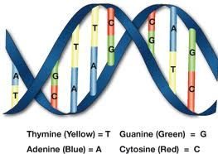
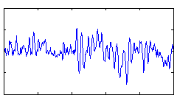
Power of feature-base methods
General purpose: any domain where we can represent a data point as a set of features, we can use the method

Slide 36
The feature space
f₂
Government
Science
Arts
f₁
Notes:
- once we have the features, often nice to think about these as just data points in some m-dimensional space

Slide 37
The feature space
Spam
f₂
not-Spam
f₃
f₁

Slide 38
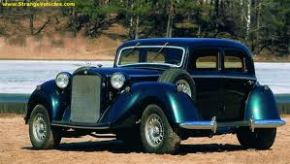
Feature space
f₁, f₂, f₃, …, f_{m}
m-dimensional space
How big will m be for us?

Slide 39
Bayesian Classification
We represent a data item based on the features:
Training
a:
b:
For each label/class, learn a probability distribution based on the features

Slide 40
Bayesian Classification
We represent a data item based on the features:
Classifying
Given an new example, classify it as the label with the largest conditional probability

Slide 41
Bayes’ Rule
How can we use this?

Slide 42
Bayes rule for classification
conditional (posterior) probability
prior probability
Why not model P(Label|Data) directly?
Notes:
as we talked about before, often much easier to estimate P(L|D) vs. P(D|L)
sometimes nicer to break it into two separate models so we don’t have to handle everything in a singe model and instead, use two simpler models

Slide 43
Bayesian classifiers
different distributions for different labels
Bayes rule
two models to learn for each label/class

Slide 44
The Naive Bayes Classifier
spam
buy
enlargement
assume binary features for now
viagra
now
the
Conditional Independence Assumption: features are independent of each other given the class:

Slide 45
Estimating parameters
p(‘v1agra’ | spam)
p(‘the’ | spam)
p(‘enlargement’ | not-spam)
…
For us:
How do we estimate these probabilities?

Slide 46
Maximum likelihood estimates
number of items with label
total number of items
number of items with the label with feature
number of items with label

Slide 47
Naïve Bayes Text Classification
Features: word occurring in a document (though others could be used…)
Does the Naïve Bayes assumption hold?
Are word occurrences independent given the label?
Lot’s of text classification problems
sentiment analysis: positive vs. negative reviews
category classification
spam

Slide 48
Naive Bayes on spam email
http://www.cnbc.cmu.edu/~jp/research/email.paper.pdf
Notes:
This graph is from
http://www.cs.utexas.edu/users/jp/research/email.paper.pdf
Naive-Bayes vs. Rule-Learning in Classification of Email
Jefferson Provost, UT Austin

Slide 49
SpamAssassin
Naive Bayes has found a home in spam filtering
Paul Graham’s A Plan for Spam
A mutant with more mutant offspring...
Naive Bayes-like classifier with weird parameter estimation
Widely used in spam filters
But also many other things: black hole lists, etc.
Many email topic filters also use NB classifiers

Slide 50
NB: The good and the bad
Good
Easy to understand
Fast to train
Reasonable performance
Bad
We can do better
Independence assumptions are rarely true
Smoothing is challenging
Feature selection is usually required

Slide 51
Recall: Vector Space Representation
Each document is a vector, one component for each term/word
Normally normalize vectors to unit length
High-dimensional vector space:
Terms are axes
10,000+ dimensions, or even 100,000+
Docs are vectors in this space
How can we do classification in this space?

Slide 52
Documents in a Vector Space
Government
Science
Arts

Slide 53
Test Document of what class?
Government
Science
Arts

Slide 54
Test Document = Government
Government
Science
Arts

Slide 55
k-Nearest Neighbor (k-NN)
To classify document d:
Find k nearest neighbors of d
Choose as the class the majority class within the k nearest neighbors

Slide 56
Example: k=6 (6-NN)
Government
Science
Arts

Slide 57
k Nearest Neighbor
What value of k should we use?
Using only the closest example (1NN) to determine the class is subject to errors due to:
A single atypical example
Noise
Pick k too large and you end up with looking at neighbors that are not that close
Value of k is typically odd to avoid ties; 3 and 5 are most common.

Slide 58
k-NN decision boundaries
Government
Science
Arts
k-NN gives locally defined decision boundaries between
classes – far away points do not influence each classification
decision (unlike in Naïve Bayes, etc.)

Slide 59
Similarity Metrics
Nearest neighbor methods depends on a similarity (or distance) metric
Ideas?
Euclidean distance.
Binary instance space is Hamming distance (number of feature values that differ)
For text, cosine similarity of tf.idf weighted vectors is typically most effective

Slide 60
k-NN: The good and the bad
Good
No training is necessary
No feature selection necessary
Scales well with large number of classes
Don’t need to train n classifiers for n classes
Bad
Classes can influence each other
Small changes to one class can have ripple effect
Scores can be hard to convert to probabilities
Can be more expensive at test time
“Model” is all of your training examples which can be large

Slide 61
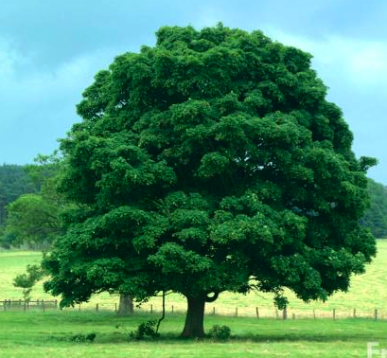
Bias/variance trade-off
Is this a tree?

Slide 62
Bias/variance trade-off
Is this a tree?

Slide 63
Bias/variance trade-off
Is this a tree?

Slide 64
Bias/variance trade-off
Is this a tree?

Slide 65
Bias/Variance
Bias: How well does the model predict the training data?
high bias – the model doesn’t do a good job of predicting the training data (high training set error)
The model predictions are biased by the model
Variance: How sensitive to the training data is the learned model?
high variance – changing the training data can drastically change the learned model

Slide 66
Bias/Variance
Another way to think about it is model complexity
Simple models
may not model data well
high bias
Complicated models
may overfit to the training data
high variance
Why do we care about bias/variance?

Slide 67
Bias/variance trade-off
We want to fit a polynomial to this, which one should we use?

Slide 68
Bias/variance trade-off
Bias: How well does the model predict the training data?
high bias – the model doesn’t do a good job of predicting the training data (high training set error)
The model predictions are biased by the model
Variance: How sensitive to the training data is the learned model?
high variance – changing the training data can drastically change the learned model
High variance OR high bias?

Slide 69
Bias/variance trade-off
Bias: How well does the model predict the training data?
high bias – the model doesn’t do a good job of predicting the training data (high training set error)
The model predictions are biased by the model
Variance: How sensitive to the training data is the learned model?
high variance – changing the training data can drastically change the learned model
High bias

Slide 70
Bias/variance trade-off
Bias: How well does the model predict the training data?
high bias – the model doesn’t do a good job of predicting the training data (high training set error)
The model predictions are biased by the model
Variance: How sensitive to the training data is the learned model?
high variance – changing the training data can drastically change the learned model
High variance OR high bias?

Slide 71
Bias/variance trade-off
Bias: How well does the model predict the training data?
high bias – the model doesn’t do a good job of predicting the training data (high training set error)
The model predictions are biased by the model
Variance: How sensitive to the training data is the learned model?
high variance – changing the training data can drastically change the learned model
High variance

Slide 72
Bias/variance trade-off
Bias: How well does the model predict the training data?
high bias – the model doesn’t do a good job of predicting the training data (high training set error)
The model predictions are biased by the model
Variance: How sensitive to the training data is the learned model?
high variance – changing the training data can drastically change the learned model
What do we want?

Slide 73
Bias/variance trade-off
Bias: How well does the model predict the training data?
high bias – the model doesn’t do a good job of predicting the training data (high training set error)
The model predictions are biased by the model
Variance: How sensitive to the training data is the learned model?
high variance – changing the training data can drastically change the learned model
Compromise between bias and variance

Slide 74
k-NN vs. Naive Bayes
How do k-NN and NB sit on the variance/bias spectrum?
k-NN has high variance and low bias.
more complicated model
can model any boundary
but very dependent on the training data
NB has low variance and high bias.
Decision surface has to be linear
Cannot model all data
but, less variation based on the training data
Notes:
Bias/variance in terms of resulting classifier given randomly selected training set; why it is a tradeoff; when to choose low-bias method, when to choose low-variance method

Slide 75
Bias vs. variance: Choosing the correct model capacity
Which separating line should we use?

