Slide 1
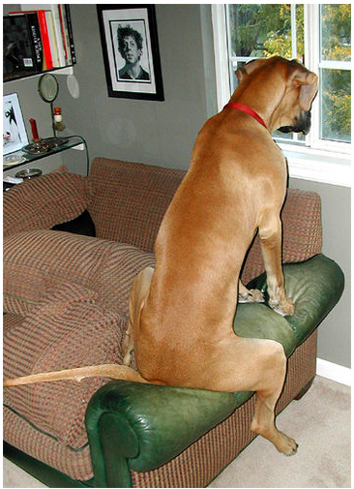
http://www.flickr.com/photos/56685562@N00/565216/

Slide 2
Document Image Retrieval
David Kauchak
cs458
Fall 2012
adapted from:
David Doermann http://terpconnect.umd.edu/~oard/teaching/796/spring04/slides/11/796s0411.ppt

Slide 3
Admin
Schedule
Friday by 6pm Assignment 4 writeup
Sunday: Sent me an e-mail with team and topic
Tuesday:
Quiz!
Project proposal draft
Project proposal discussion
Thursday: Finalized project proposal
Rest of the semester…
Quiz 2?
Grading

Slide 4
Assign 4 write-ups
Some general comments
explain data set and characteristics
explain your evaluation measure(s)
think about the points you’re trying to make, then use the data to make that point
comment on anything abnormal or surprising in the data
dig deeper if you need to
if you have multiple evaluation measures, use them to explain/understand different behavior
try and explain why you got the results you obtained

Slide 5
Information retrieval systems
Spend 10 minutes playing with three different image retrieval systems
http://en.wikipedia.org/wiki/Image_retrieval has a number
What works well?
What doesn’t work well?
Anything interesting you noticed?

Slide 6
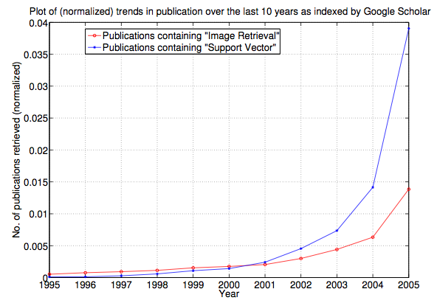
Image Retrieval
http://infolab.stanford.edu/~wangz/project/imsearch/review/JOUR/datta_TR.pdf

Slide 7
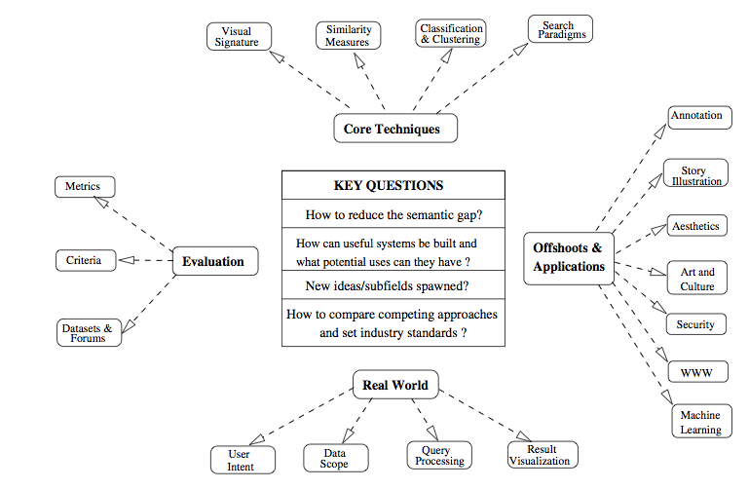
Image Retrieval Problems
http://infolab.stanford.edu/~wangz/project/imsearch/review/JOUR/datta_TR.pdf

Slide 8
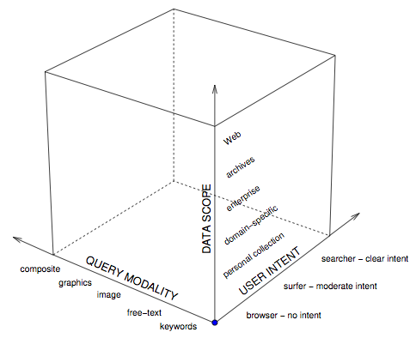
Different Systems
http://infolab.stanford.edu/~wangz/project/imsearch/review/JOUR/datta_TR.pdf

Slide 9
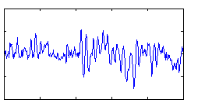
Information retrieval: data
amount of data
data characteristics
Text retrieval
trillions of web pages
user generated
some semi-structured
link structure
within an order of magnitude in “private” data
Audio retrieval
mostly professionally generated
co-occurrence statistics
order of a few billion?
last fm has 150M songs
Image retrieval
This is blowing up!
60 photos/sec uploaded via instagram
4.5 million photos/day Flickr
> 100 billion photos on Facebook
user generated
becoming more prevelant
some tagging
incorporated into web pages (context)

Slide 10
Information retrieval: challenges
challenges
other dimensions?
Text retrieval
scale
ambiguity of language
link structure
spam
Audio retrieval
query language
user interface
features/pre-processing
Image retrieval
query language
user interface
features/pre-processing
ambiguity of pictures
data size

Slide 11
Today: Document Image Search
Why not general image search?

Slide 12
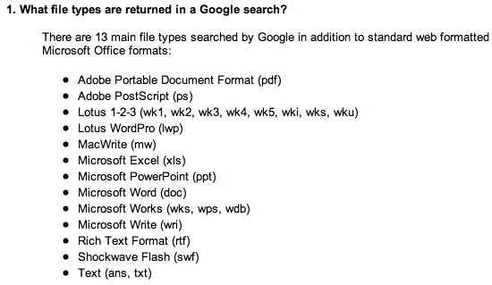
What’s in a document?
I give you a file I downloaded
You know it has text in it
What are the challenges in determining what characters are in the document?
File format:
http://www.google.com/help/faq_filetypes.html

Slide 13
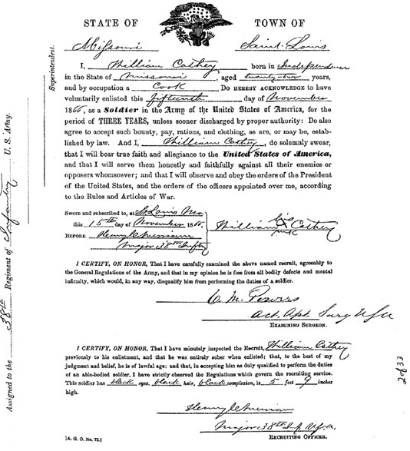
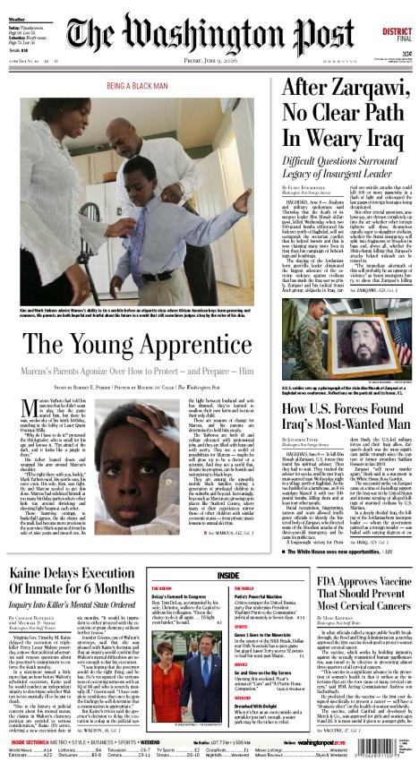
Is this a document?

Slide 14
Document Images
A document image is a document that is represented as an image, rather than some predefined format
Like normal images, contain pixels
often binary-valued (black, white)
But greyscale or color sometimes
300 dots per inch (dpi) gives the best results
But images are quite large (1 MB per page)
Faxes are normally 72 dpi
Usually stored in TIFF or PDF format
Want to be able to process them like text files

Slide 15
Sources of document images
Web
http://dli.iiit.ac.in/
Arabic news stories are often GIF images
Google Books, Project Gutenberg (though these are a bit different)
Library archives
Other
Tobacco Litigation Documents
49 million page images

Slide 16
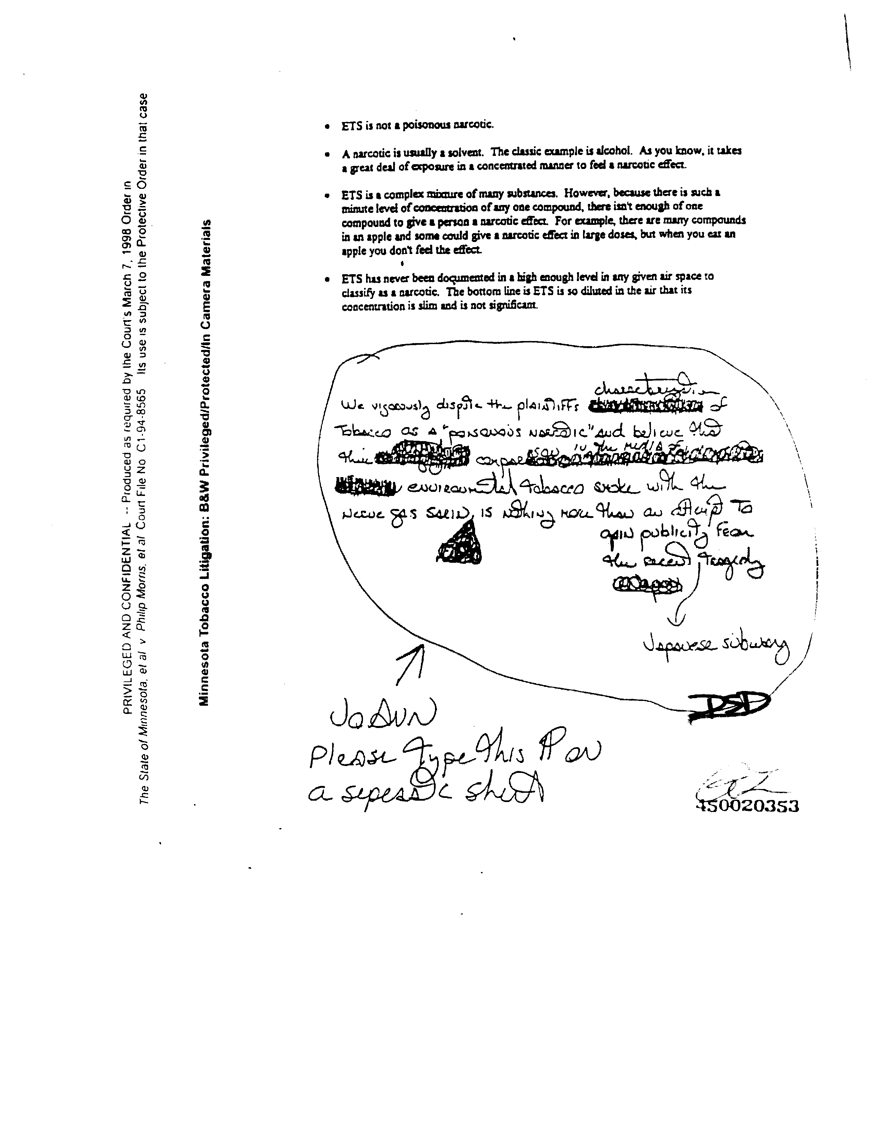
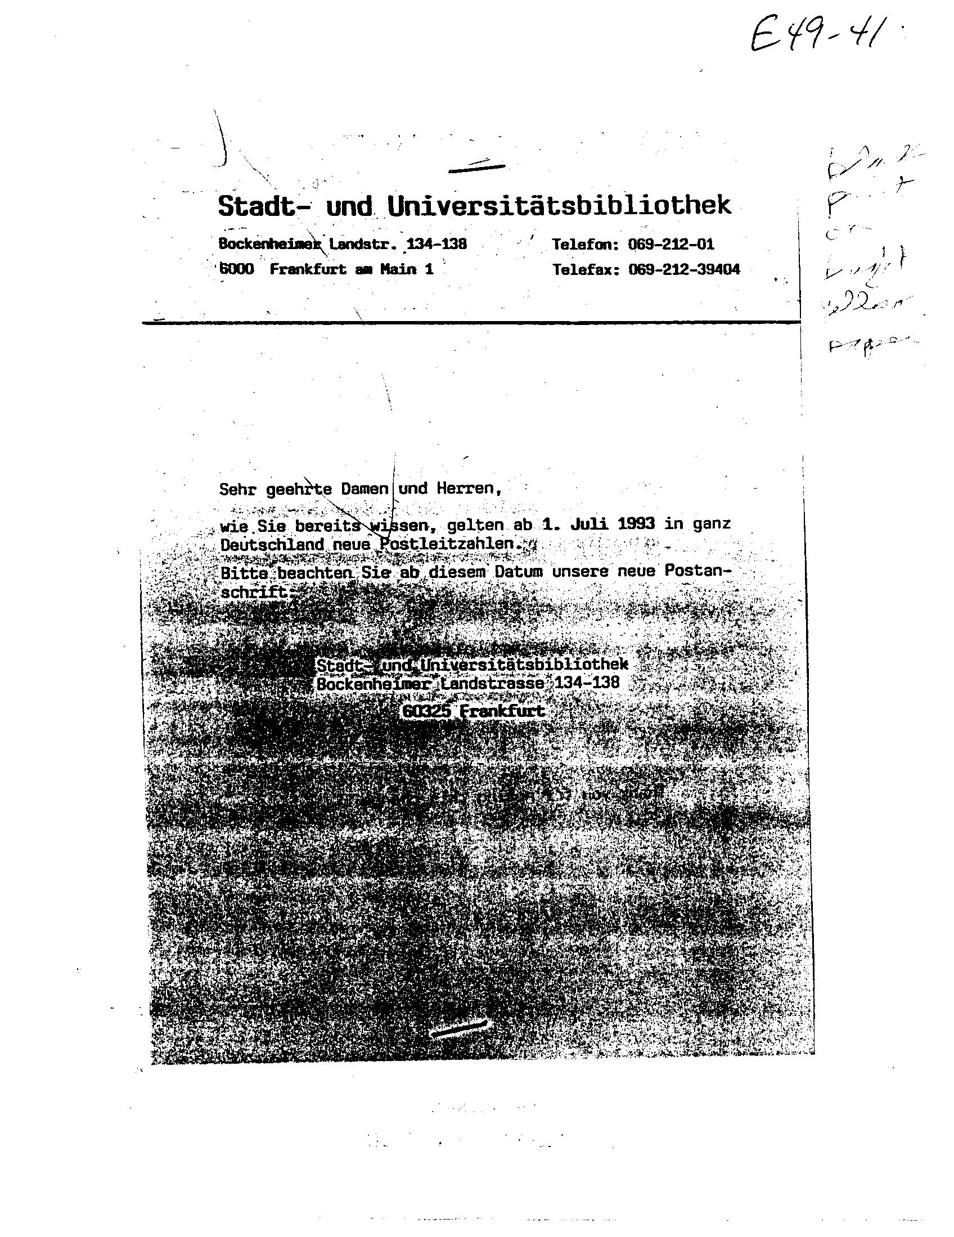
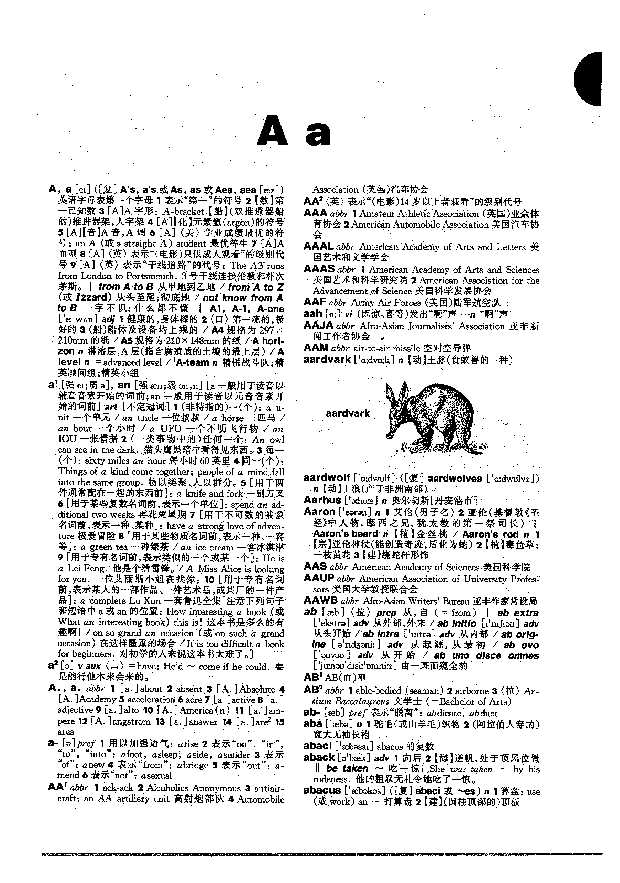
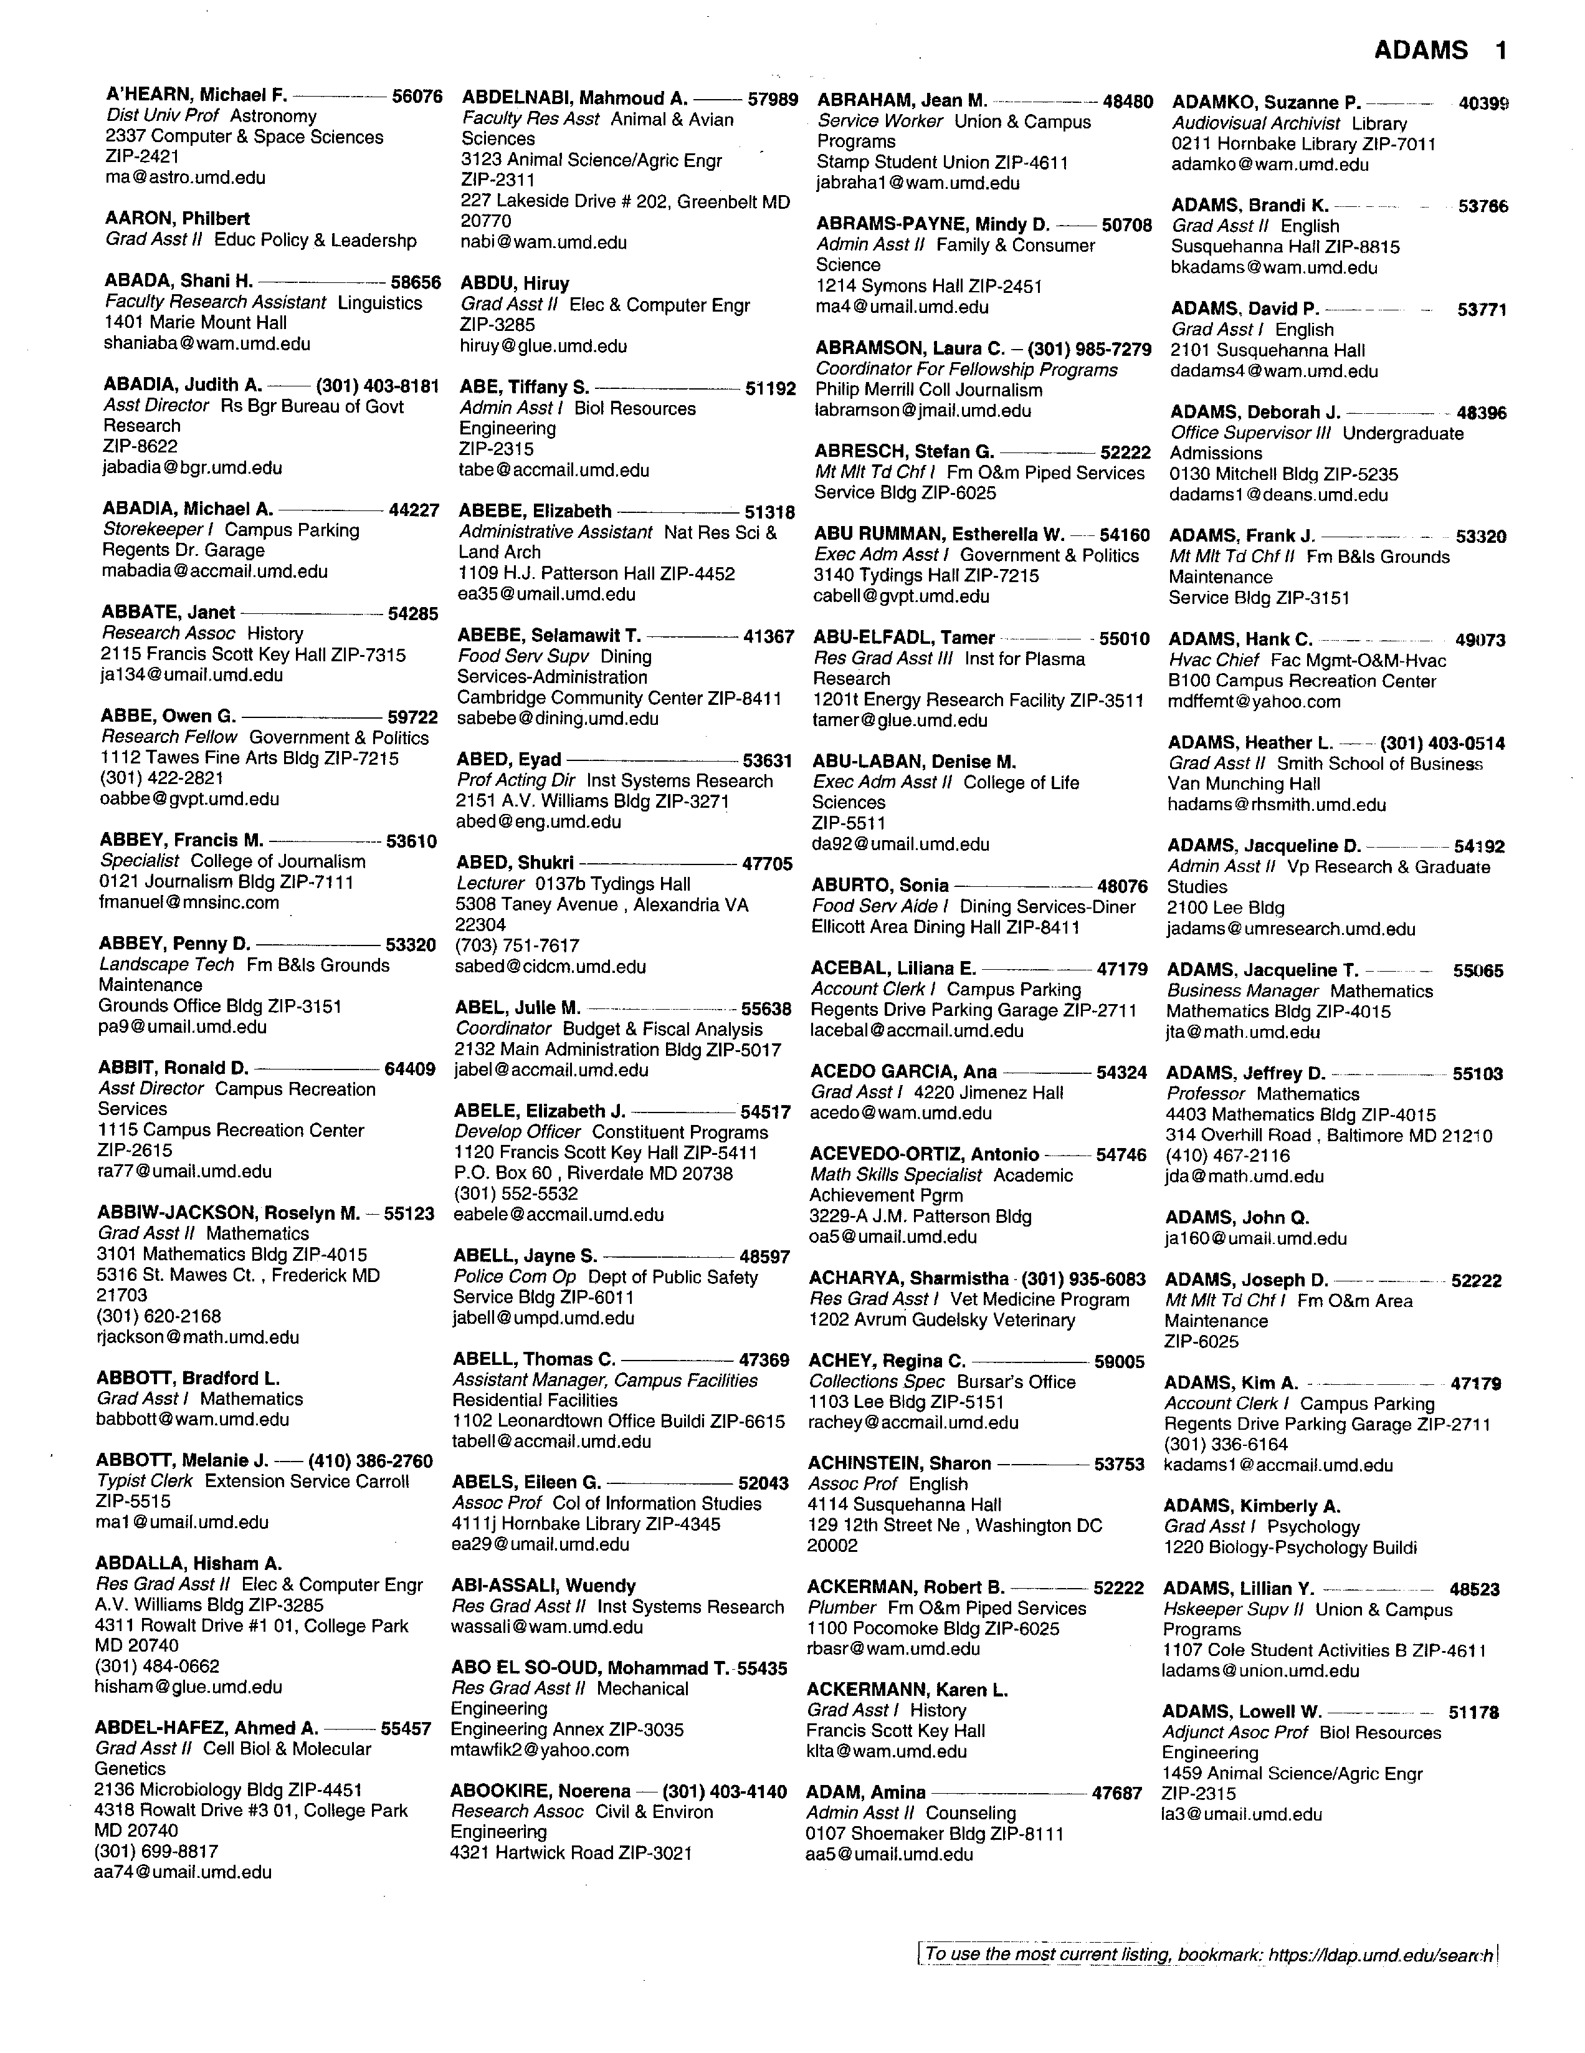
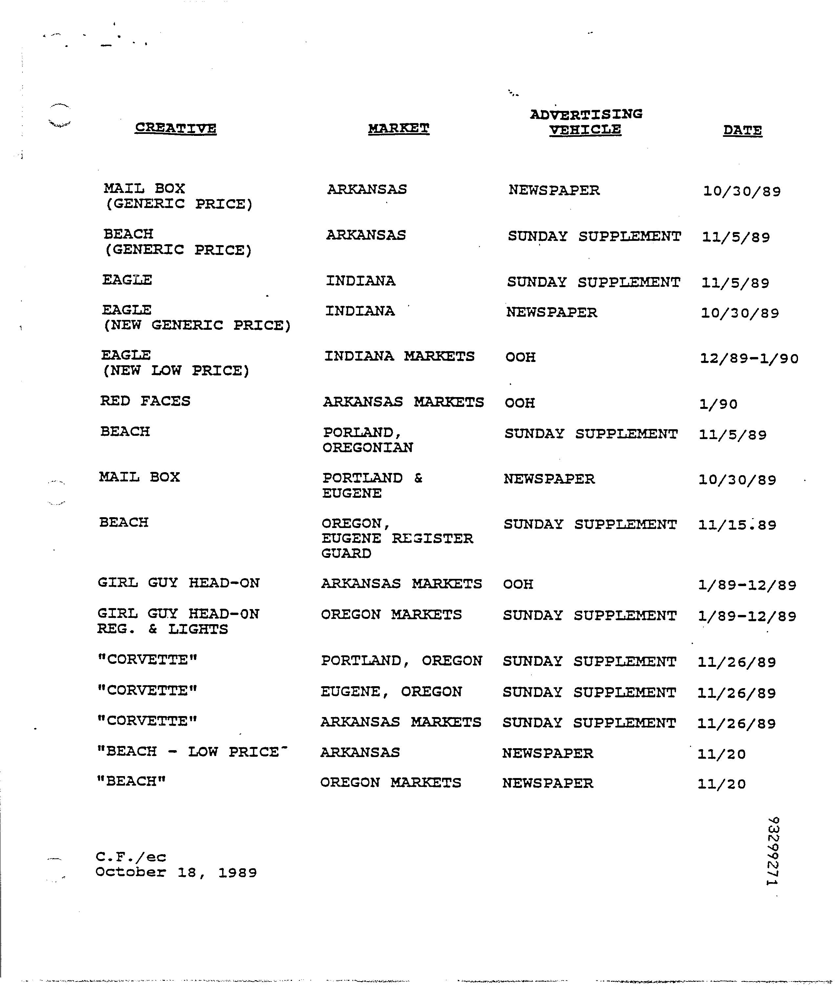
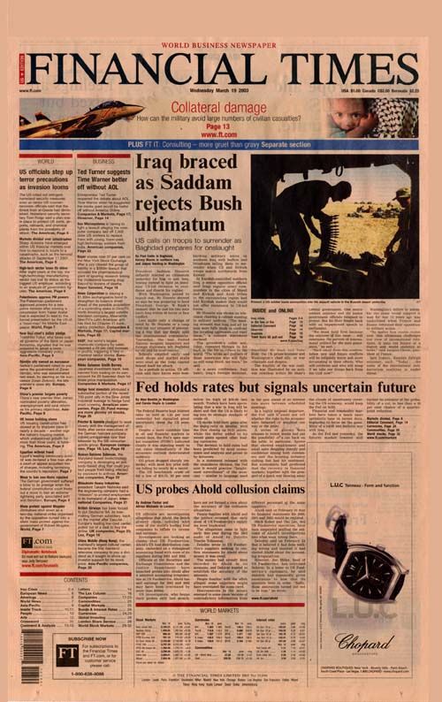
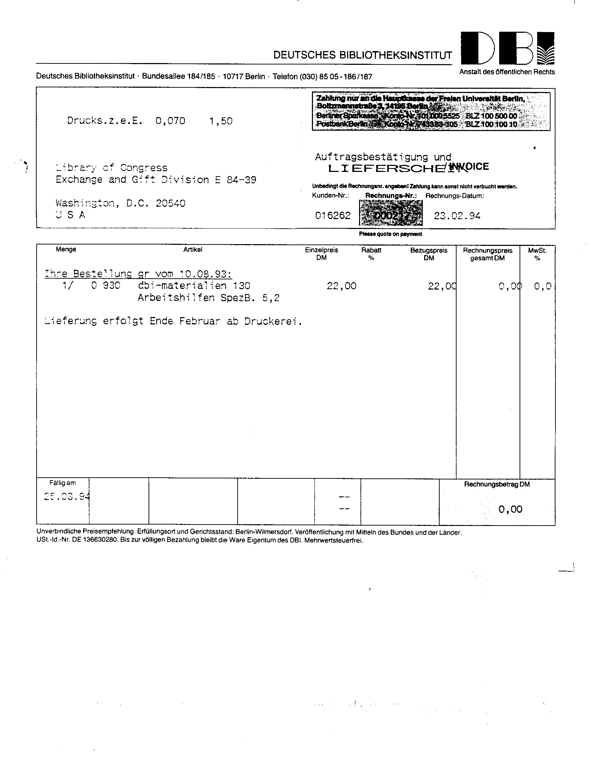
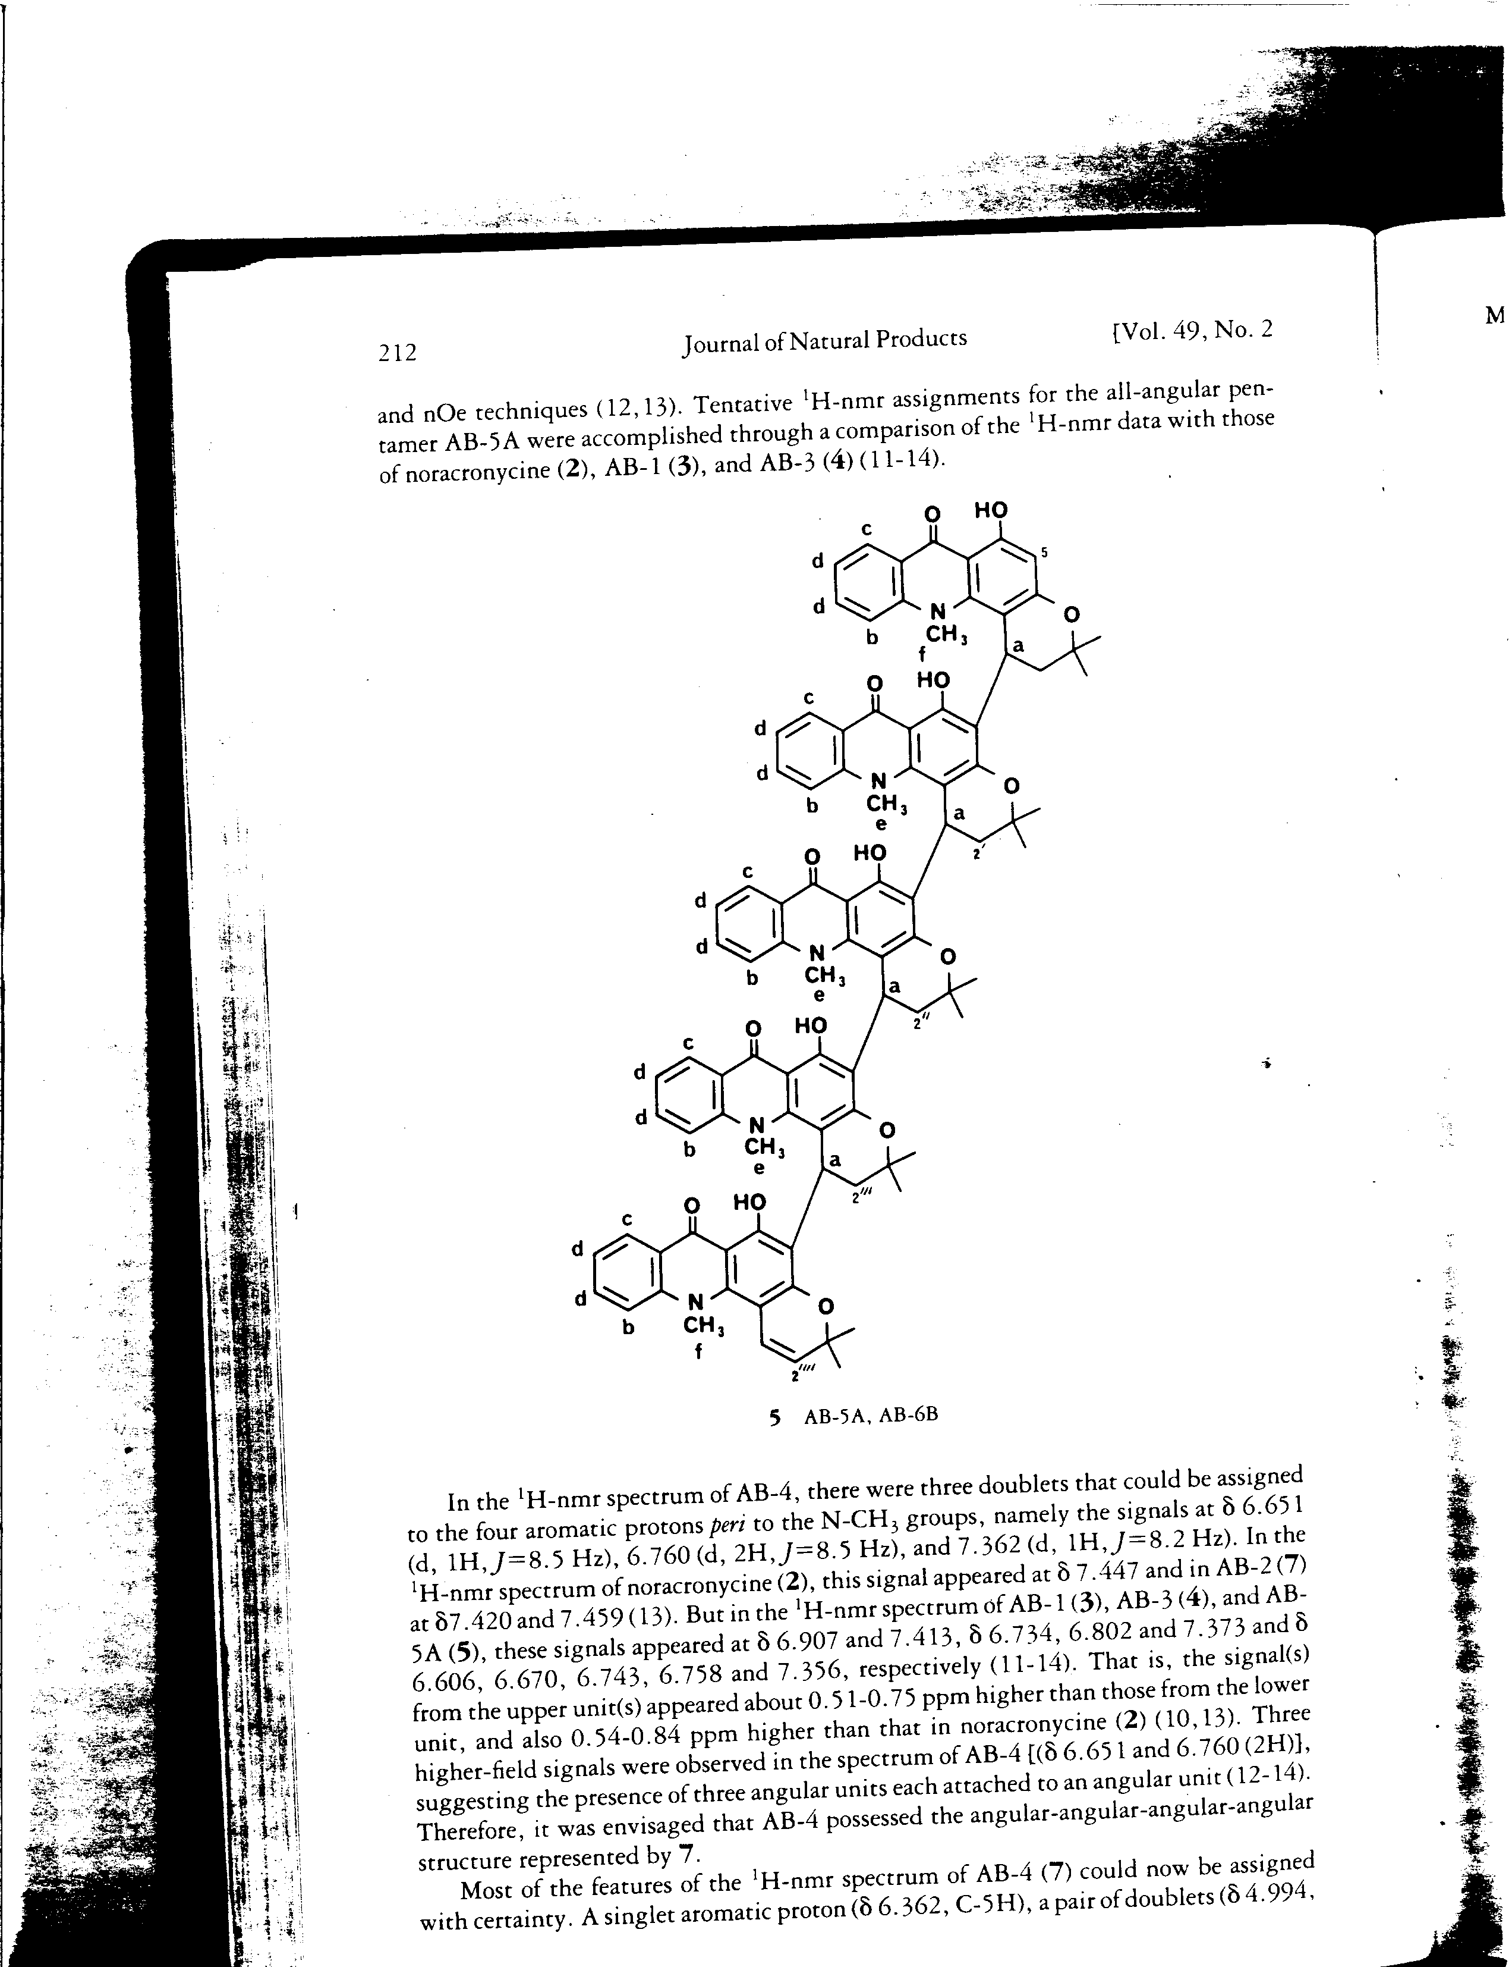

Slide 17
Document Image Database
DOCUMENT
DATABASE
IMAGE
Collection of scanned images
Need to be available for indexing and retrieval, abstracting, routing, editing, dissemination, interpretation
NOTE: more needs than just searching!

Slide 18
What are the challenges?
What are the sub-problems?

Slide 19
Challenges
They’re an image ☺
Quality
scan orientation
noise
contrast
Hand-written text
Hand-written diagrams

Slide 20
Additional Reading
A. Balasubramanian, et al. Retrieval from Document Image Collections, Document Analysis Systems VII, pages 1-12, 2006.
D. Doermann. The Indexing and Retrieval of Document Images: A Survey. Computer Vision and Image Understanding, 70(3), pages 287-298, 1998.

