Slide 1
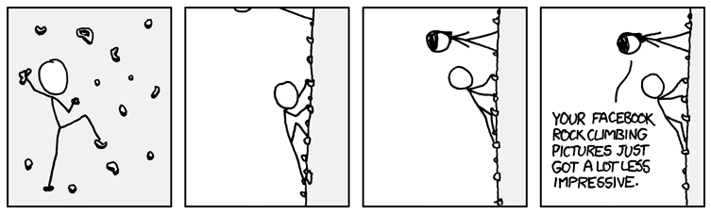
http://www.xkcd.com/655/

Slide 2
Audio Retrieval
David Kauchak
cs458
Fall 2012
Thanks to Doug Turnbull for some of the slides

Slide 3
Administrative
Assignment 4 part 1 due Tuesday
Final project instructions out soon…
  I’ll send an e-mail
Homework 4
No class next Tuesday!

Slide 4
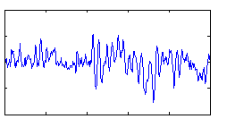
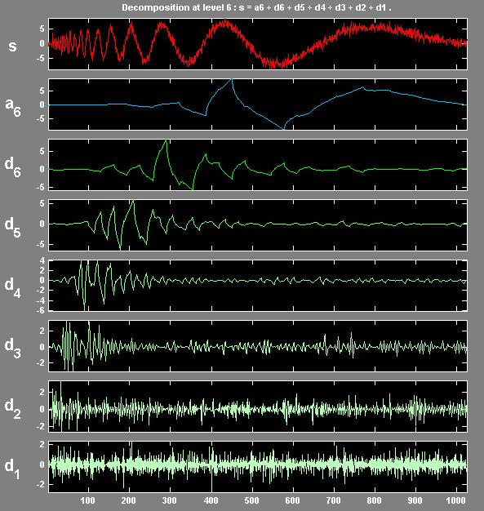
Audio Index construction
Audio files to
be indexed
wav
mp3
midi
audio preprocessing
slow,
jazzy,
punk
indexer
may be keyed off of text
may be keyed off of audio features
Index

Slide 5
Audio retrieval
Query
Index
Systems differ by what the query input is and how they figure out the result

Slide 6
Song identification
Given an audio signal, tell me what the “song” is
Index
Examples:
  Query by Humming
  1-866-411-SONG
  Shazam
  Bird song identification
  …

Slide 7

Song identification
How might you do this?
Query by humming
“song” name

Slide 8

Song identification
“song” name

Slide 9
Song similarity
Find the songs that are most similar to the input song
song
Index
Examples:
  Genius
  Pandora
  Last.fm

Slide 10
Song similarity
How might you do this?
IR approach
f₁ f₂ f₃ … f_{n}
f₁ f₂ f₃ … f_{n}
f₁ f₂ f₃ … f_{n}
f₁ f₂ f₃ … f_{n}
f₁ f₂ f₃ … f_{n}
f₁ f₂ f₃ … f_{n}
rank by cosine sim

Slide 11

Song similarity: collaborative filtering
user₁
user₂
user₃
user₄
user_{n}
song₁
song₂
song₃
What might you conclude from this information?
…
song_{m}

Slide 12
Songs using descriptive text search
jazzy,
smooth,
easy listening
Index
Examples:
  Very few commercial systems like this …

Slide 13
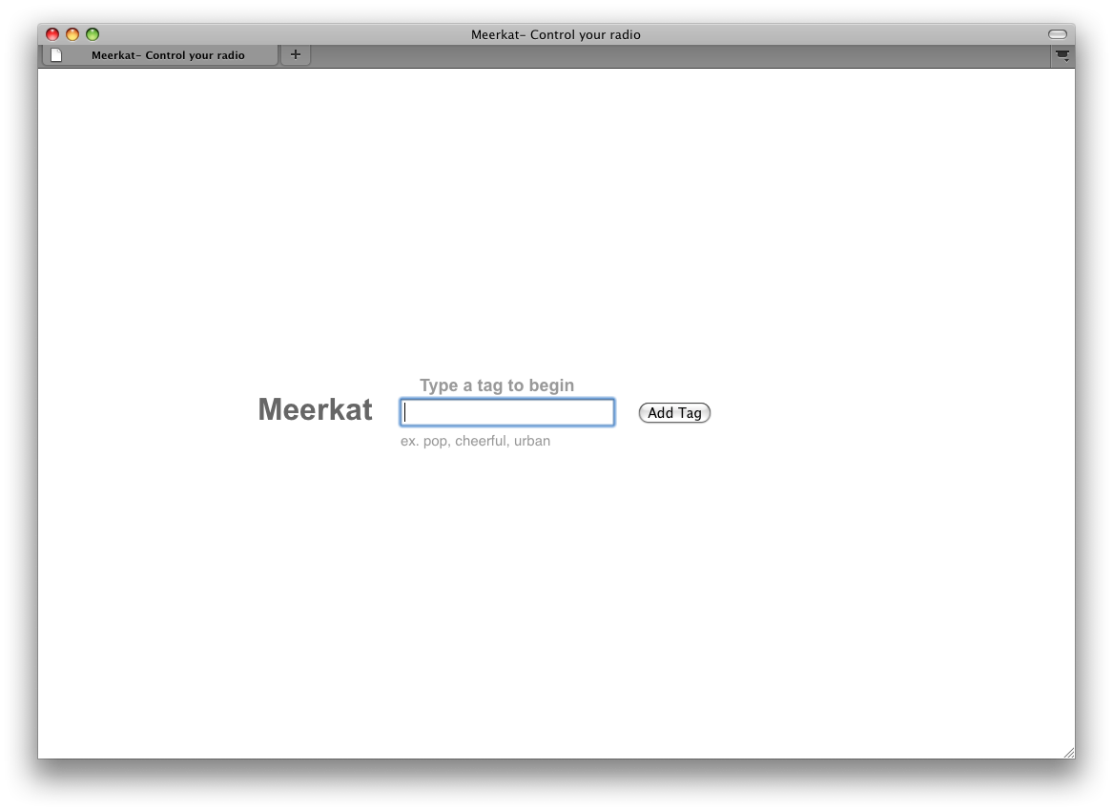
Notes:
A music engine functions in much the same way:
We have songs, we have a query and we want a ranked list of songs.
What is less clear is how we create this music index.
This is, essentially the question that we posed to our question in class last spring.
How might you do it?

Slide 14
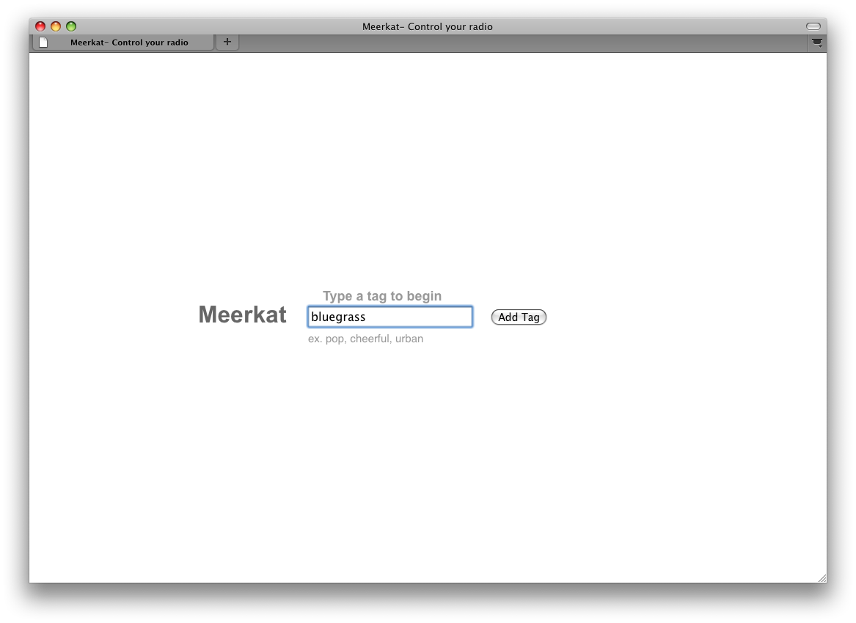
Notes:
We type Bluegrass and click go.

Slide 15
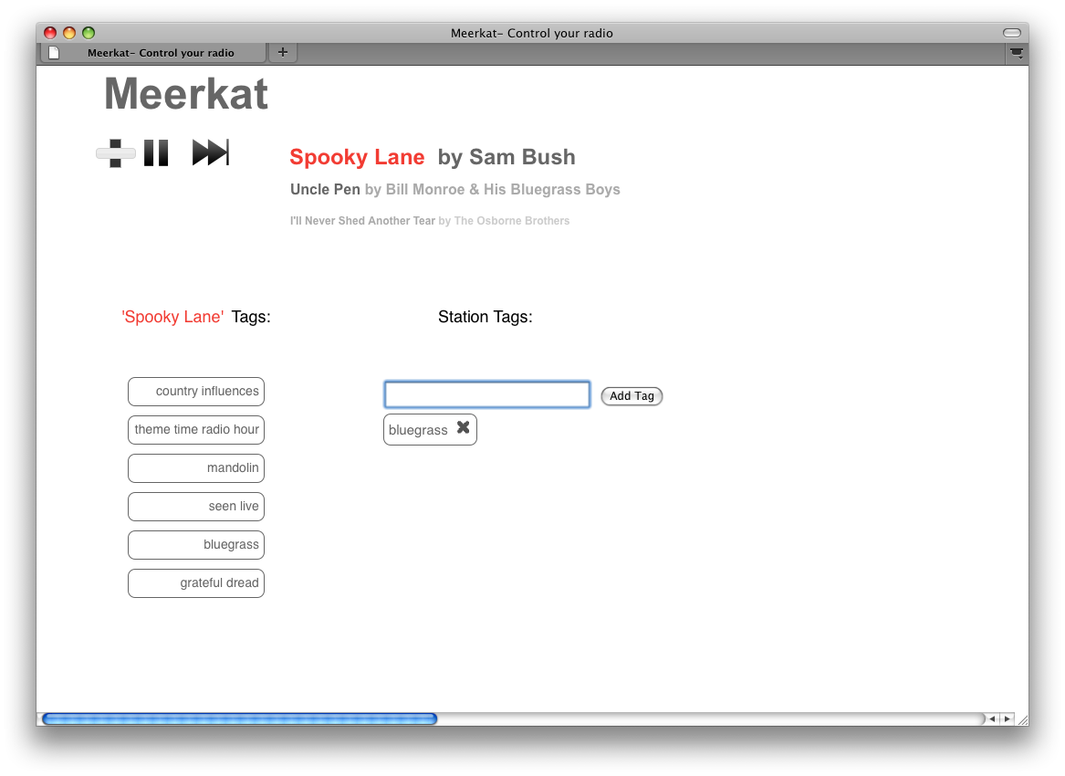

Notes:
The personalized radio play begins play music, in this case a song called spooky lane by Sam Bush.
We have standard controls: volume slider (need a little work), Play/Pause, and fast forward (in case you don’t like the songs we are recommending)
It also show the next two up coming songs.
On the left is 6 tags that describe the current song.
We can select one of these tags, say “mandolin”, and add it to our radio station so that futures songs will be bluegrass songs with mandolin.

Slide 16
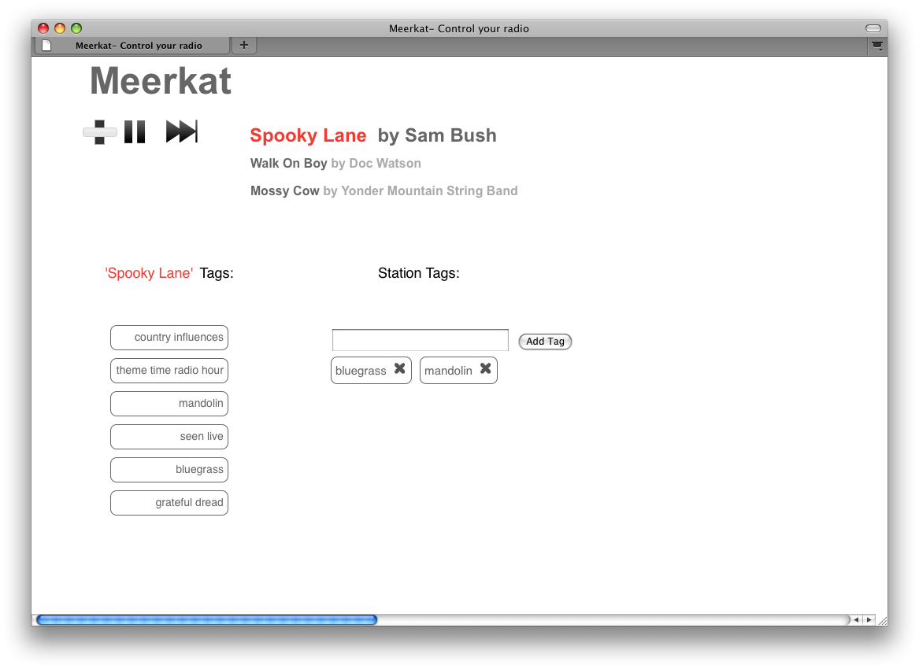
Notes:
Notices that this updates the futures songs.

Slide 17
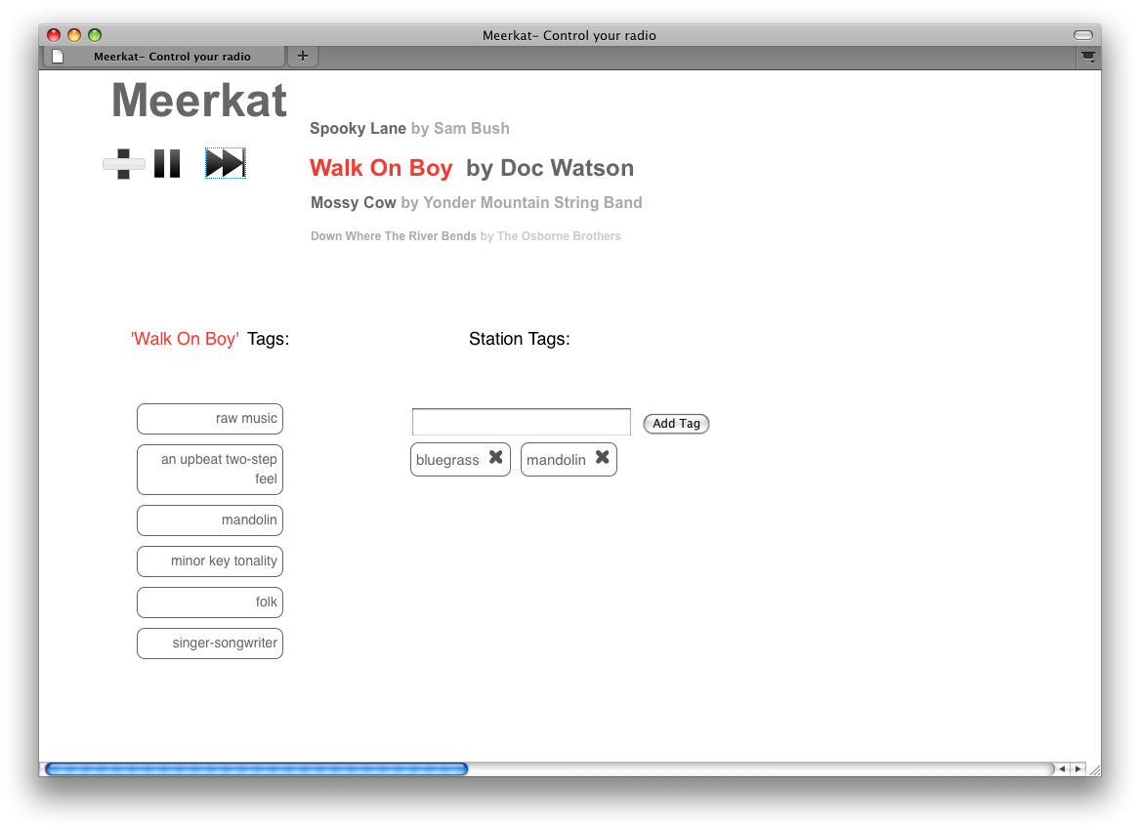
Notes:
Eventually the songs runs it course (or we skip it) and the next songs starts playing. In this case, Walk on Boy by Doc Watson.
This is the front end, but the truly exciting stuff is in the back end…
But before I can describe the backend, we need to learn about how typical search engines like Google work…

Slide 18
Music annotation
The key behind keyword based systems is annotating the music with tags
dance, instrumental, rock
blues, saxaphone, cool vibe
pop, ray charles, deep
Ideas?

Slide 19
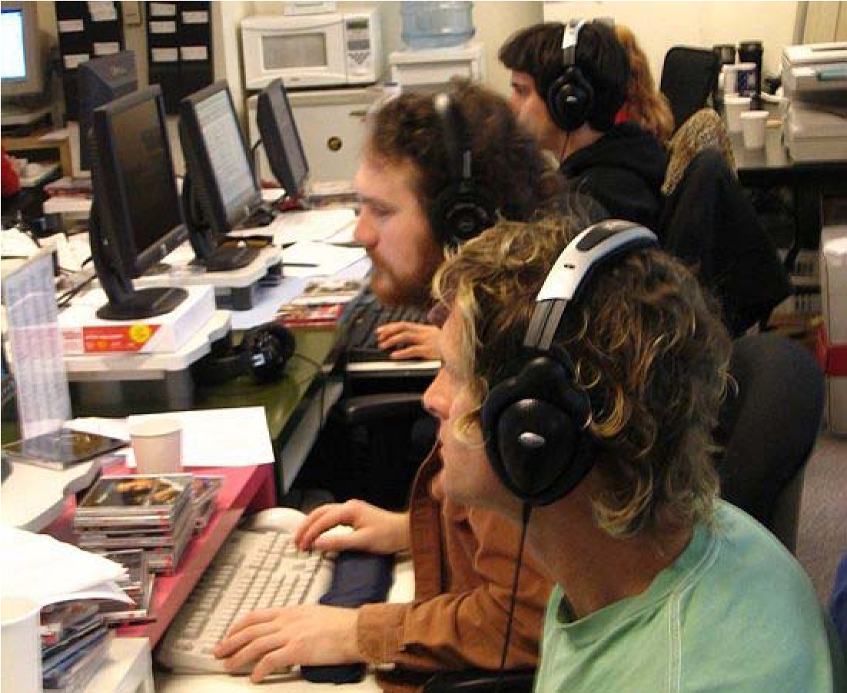
Annotating music
The human approach
“expert musicologists” from Pandora
Pros/Cons?

Slide 20
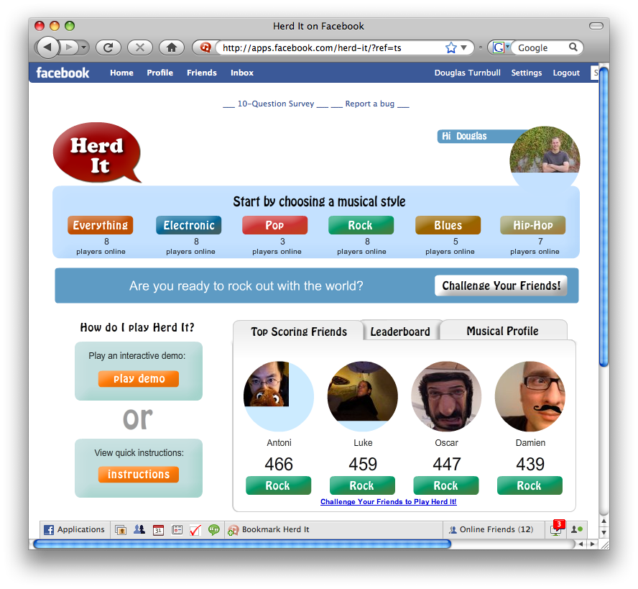
Annotating music
Another human approach: games

Slide 21
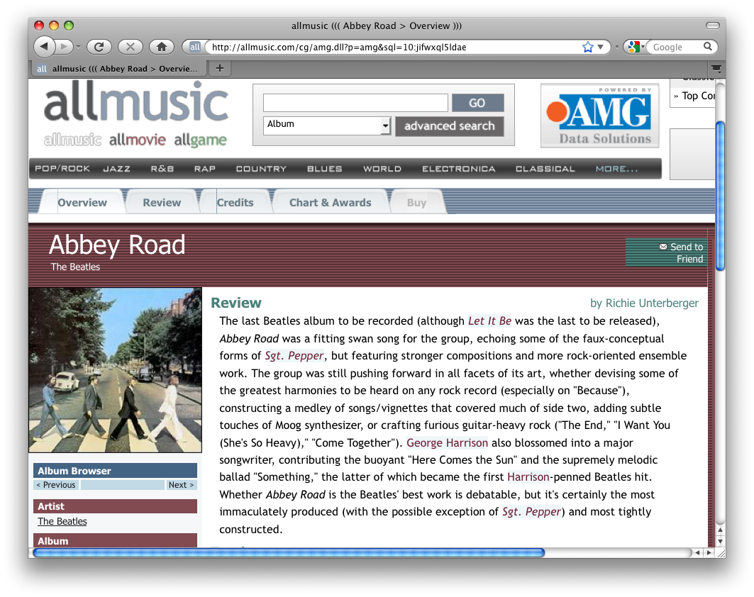
Annotating music
the web: music reviews
challenge?

Slide 22
Automatically annotating music
Learning a music tagger
song
signal
review
tagger
tagger
blues, saxaphone, cool vibe

Slide 23
Automatically annotating music
Learning a music tagger
song
signal
review
What are the tasks we need to accomplish?
tagger

Slide 24

System Overview
Data
Features
Model
Training Data
Vocabulary
T
T
Learning
Annotation
Document Vectors (y)
Audio-Feature
Extraction (X)

Slide 25
Automatically annotating music
First step, extract “tags” from the reviews
Frank Sinatra - Fly me to the moon
This is a jazzy, singer / songwriter song that is calming and sad. It features acoustic guitar, piano, saxophone, a nice male vocal solo, and emotional, high-pitched vocals. It is a song with a light beat and a slow tempo.
Dr. Dre (feat. Snoop Dogg) - Nuthin' but a 'G' thang
This is a dance poppy, hip-hop song that is arousing and exciting. It features drum machine, backing vocals, male vocal, a nice acoustic guitar solo, and rapping, strong vocals. It is a song that is very danceable and with a heavy beat.

Slide 26
Automatically annotating music
First step, extract “tags” from the reviews
Frank Sinatra - Fly me to the moon
This is a jazzy, singer / songwriter song that is calming and sad. It features acoustic guitar, piano, saxophone, a nice male vocal solo, and emotional, high-pitched vocals. It is a song with a light beat and a slow tempo.
Dr. Dre (feat. Snoop Dogg) - Nuthin' but a 'G' thang
This is a dance poppy, hip-hop song that is arousing and exciting. It features drum machine, backing vocals, male vocal, a nice acoustic guitar solo, and rapping, strong vocals. It is a song that is very danceable and with a heavy beat.

Slide 27
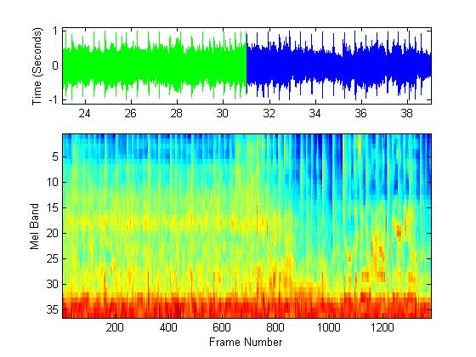
Content-Based Autotagging
Learn a probabilistic model that captures a relationship between audio content and tags.
Frank Sinatra
‘Fly Me to the Moon’
‘Jazz’
‘Male Vocals’
‘Sad’
‘Slow Tempo’
Autotagging
p(tag | song)
Notes:
We consider this a supervised multi-class, multi-label problem.

Slide 28
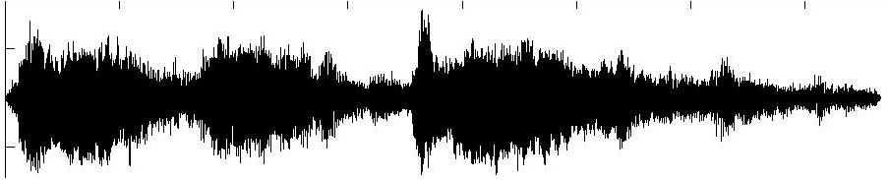
Modeling a Song
Bag of MFCC vectors
+
+
+
+
+
+
+
+
+
+
+
+
+
+
+
+
+
+
+
+
+
+
+
+
+
+
+
+
+
+
+
+
+
+
+
+
+
+
+
+
+
+
+
+
+
+
+
+
+
+
+
+
+
+
+
+
+
+
+
+
+
+
+
+
+
+
+
+
+
+
+
+
+
+
+
+
+
+
+
+
+
+
+
+
+
+
+
+
+
+
+
+
+
+
+
+
+
+
+
+
+
+
+
+
+
+
+
+
+
+
+
+
+
+
+
+
+
+
+
+
+
+
+
+
+
+
+
+
+
+
+
+
+
+
+
+
+
+
+
+
+
+
+
+
+
+
+
+
+
+
+
+
+
+
+
+
+
+
+
+
+
+
+
+
+
+
+
+
+
+
+
+
+
+
+
+
+
+
+
+
+
+
+
+
+
+
+
+
+
+
+
+
+
+
+
+
+
+
+
+
+
+
+
+
+
+
+
+
+
+
+
+
+
+
+
+
cluster feature vectors
+
+
+
+
+
+
+
+
+
+
+
+
+
+
+
+
+
+
+
+
+
+
+
+
+
+
+
+
+
+
+
+
+
+
+
+
+
+
+
+
+
+
+
+
+
+
+
+
+
+
+
+
+
+
+
+
+
+
+
+
+
+
+
+
+
+
+
+
+
+
+
+
+
+
+
+
+
+
+
+
+
+
+
+
+
+
+
+
+
+
+
+
+
+
+
+
+
+
+
+
+
+
+
+
+
+
+
+
+
+
+
+
+
+
+
+
+
+
+
+
+
+
+
+
+
+
+
+
+
+
+
+
+
+
+
+
+
+
+
+
+
+
+
+
+
+
+
+
+
+
+
+
+
+
+
+
+
+
+
+
+
+
+
+
+
+
+
+
+
+
+
+
+
+
+
+
+
+
+
+
+
+
+
+
+
+
+
+
+
+
+
+
+
+
+
+
+
+
+
+
+
+
+
+
+
+
+
+
+
+
+
Notes:
Segway - But first we must collect data that reflects these semantic associations between the audio content and words used to describe the audio content.

Slide 29
Modeling a Tag
Take all songs associated with tag t
Estimate ‘features clusters’ for each song
Combine these clusters into a single representative model for that tag
romantic
romantic
Mixture of song clusters
+
+
+
+
+
+
+
+
+
+
+
+
+
+
+
+
+
+
+
+
+
+
+
+
+
+
+
+
+
+
+
+
+
+
+
+
+
+
+
+
+
+
+
+
+
+
+
+
Tag Model
+
+
+
+
+
+
+
+
+
+
+
+
+
+
+
+
+
+
+
+
+
+
+
+
+
+
+
+
+
+
+
+
+
+
+
+
+
+
+
+
clusters
+
+
+
+
+
+
+
+
+
+
+
+
+
+
+
+
+
+
+
+
+
+
+
+
+
+
+
+
+
+
+
+
+
+
+
+
+
+
+
+
+
+
+
+
+
+
+
+
+
+
+
+
+
+
+
+
+
+
+
+
+
+
+
+
+
+
+
+
+
+
+
+
+
+
+
+
+
+
+
+
+
+
+
+
+
+
+
+
+
+
+
+
p(x|t)
+
+
+
+
+
+
+
+
+
+
+
+
+
+
+
+
+
+
+
+
+
+
+
+
+
+
+
+
+
+
+
+
+
+
+
+
+
+
+
+
+
+
+
+
+
+
Notes:
Benefits
+ Computationally efficient for parameter estimation and inference
+ ‘Smoothed’ song representation → better density estimate

Slide 30
Determining Tags
Calculate the likelihood of the features for a tag model
Romantic?
Inference with
Romantic Tag Model
S1
+
+
+
+
+
+
+
+
+
+
+
+
+
+
+
+
+
+
+
+
+
+
+
+
+
+
+
+
+
+
+
+
+
+
+
+
+
+
+
+
+
+
+
+
+
+
+
+
+
+
+
+
+
+
+
+
+
+
+
+
+
+
+
+
+
+
+
+
+
+
+
+
+
+
+
+
+
+
+
+
+
+
+
+
+
+
+
+
+
+
+
+
+
+
+
+
+
+
+
+
+
+
+
+
+
+
+
+
+
+
+
+
+
+
+
+
romantic?
+
+
+
+
+
+
+
+
+
+
+
+
+
+
+
+
+
+
+
+
+
+
+
+
+
+
+
+
+
+
+
+
+
S2
+
+
+
+
+
+
+
+
+
+
+
+
+
+
+
+
+
+
+
+
+
+
+
+
+
Notes:
Benefits
+ Computationally efficient for parameter estimation and inference
+ ‘Smoothed’ song representation → better density estimate

Slide 31
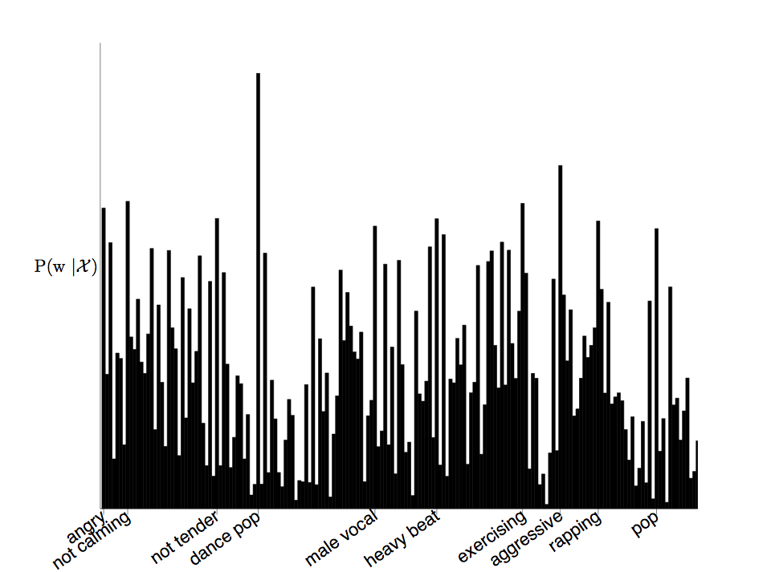
Annotation
Semantic Multinomial for “Give it Away” by the Red Hot Chili Peppers
http://www.youtube.com/watch?v=Mr_uHJPUlO8

Slide 32
The CAL500 data set
The Computer Audition Lab 500-song (CAL500) data set
500 ‘Western Popular’ songs
174-word vocabulary
  genre, emotion, usage, instrumentation, rhythm, pitch, vocal characteristics
3 or more annotations per song
55 paid undergrads annotated music for 120 hours
Other Techniques
Text-mining of web documents
‘Human Computation’ Games

Slide 33
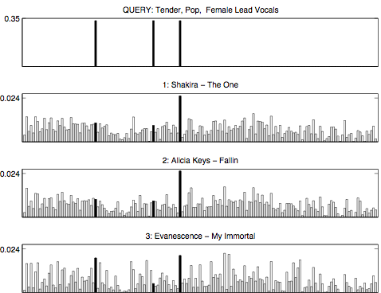
Retrieval
The top 3 results for - “pop, female vocals, tender”
0.33
1. Shakira - The One
0.02
2. Alicia Keys - Fallin’
0.02
3. Evanescence - My Immortal
0.02

Slide 34
Retrieval
Query | Retrieved Songs
‘Tender’ | Crosby, Stills and Nash - Guinnevere Jewel - Enter from the East Art Tatum - Willow Weep for Me John Lennon - Imagine Tom Waits - Time
‘Female Vocals’ | Alicia Keys - Fallin’ Shakira - The One Christina Aguilera - Genie in a Bottle Junior Murvin - Police and Thieves Britney Spears - I'm a Slave 4 U
‘Tender’ AND ‘Female Vocals’ | Jewel - Enter from the East Evanescence - My Immortal Cowboy Junkies - Postcard Blues Everly Brothers - Take a Message to Mary Sheryl Crow - I Shall Believe
Notes:
1) All Tender songs make sense, but this brings up the notion of subjectivity.
2) Female Vocal is more objective, but Junior Murvin is a man. If you listen, it sound more like a woman.
3) When we combine words, note that CSN, Art, John, Tom fall off, but Jewel remains.
Alicia, Shakira, Christina, and Britiney all fall off and are replace is other females singer that are more tender
4)The Everly Brothers, like Junior, have pretty femine voices - music knowledge discovery

Slide 35
Annotation results
Annotation of the CAL500 songs with 10 words from a vocabulary of 174 words.
Model | Precision | Recall
Random | 0.14 | 0.06
Our System | 0.27 | 0.16
Human | 0.30 | 0.15
Notes:
Key point: By pooling human annotations, our model can produce annotations that are as consistent as annotations produced by individuals, when compared against a population average.
Precision of 0.10 means that 1 out of 10 times a word is used it is used correctly.
Recall of 0.10 mean that of the 10 times a word is used, our system identifies it 1 time.
The empirical upper bound on Recall is because most songs are annotated with more than 10 words so we can’t be perfect
Human model is found by holding out individual annotations from the ground truth and then comparing it to the ground truth.

Slide 36
Retrieval results
Model | AROC
Random | 0.50
Our System - 1 Word | 0.71
Our System - 2 Words | 0.72
Our System - 3 Words | 0.73
Notes:
173 1 word queries
4K 2-word query
50K 3 word queries

Slide 37
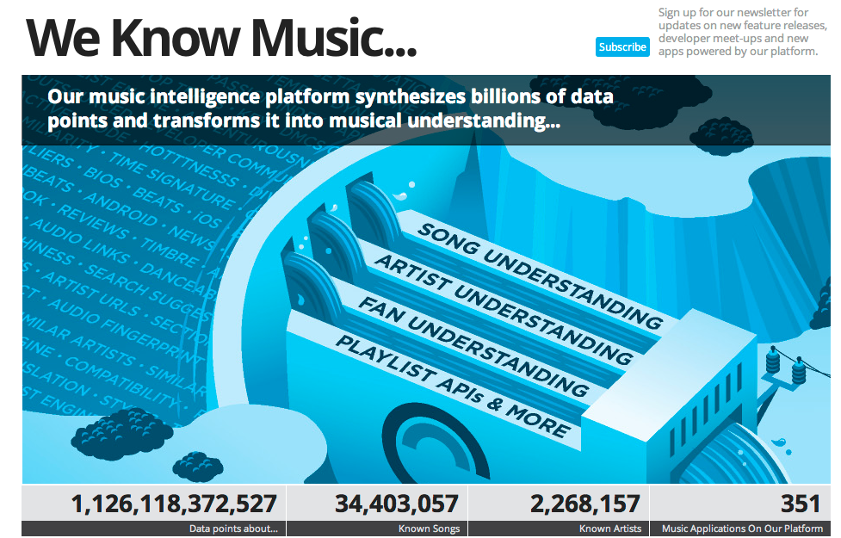
Echo nest
http://the.echonest.com/

