Slide 1
Audio Retrieval
David Kauchak
cs458
Fall 2012

Slide 2
Administrative
Assignment 4
  Two parts
Midterm
  Average: 52.8
  Median: 52
  High: 57
In-class “quiz”: 11/13

Slide 3
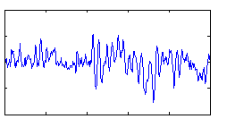
Audio retrieval
text retrieval
corpus
audio retrieval
corpus

Slide 4
What do you want from an audio search engine?
Name: You might know the name of the song or the artist
Genre: You might try “Bebop,” “Latin Jazz,” or “Rock”
Instrumentation: The tenor sax, guitar, and double bass are all featured in the song
Emotion: The song has a “cool vibe” that is “upbeat“ with an “electric texture”
Some other approaches to search:
  musicovery.com
  pandora.com (song similarity)
  Genius (collaborative filtering)

Slide 5
Current audio search engines
What are they?
What can you search by?
How well do they work?
How could they been improved?
Challenges?

Slide 6





Text Index construction
Documents to
be indexed
Friends, Romans, countrymen.
text preprocessing
friend , roman , countrymen .
indexer
friend
2
4
Inverted index
roman
1
2
countryman
13
16

Slide 7
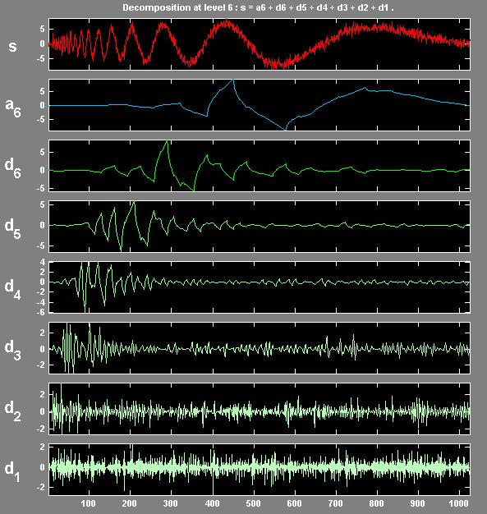
Audio Index construction
Audio files to
be indexed
wav
mp3
midi
audio preprocessing
slow,
jazzy,
punk
Today
indexer
may be keyed off of text
may be keyed off of audio features
Index

Slide 8
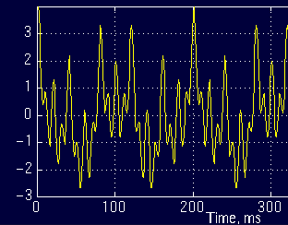
Sound
What is sound?
  A longitudinal compression wave traveling through some medium (often, air)
  Rate of the wave is the frequency
  You can think of sounds as a sum of sign waves

Slide 9
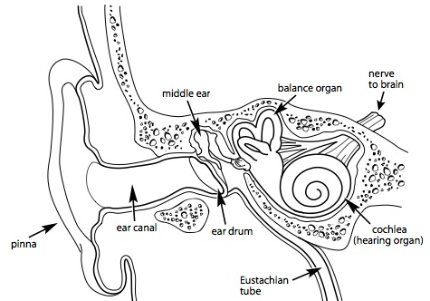
Sound
How do people hear sound?
  The cochlea in the inner ear has hair cells that "wiggle" when certain frequency are encountered
http://www.bcchildrens.ca/NR/rdonlyres/8A4BAD04-A01F-4469-8CCF-EA2B58617C98/16128/theear.jpg

Slide 10
Digital Encoding
Like everything else for computers, we must represent audio signals digitally
Encoding formats:
  WAV
  MIDI
  MP3
  Others…

Slide 11
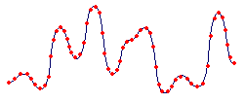
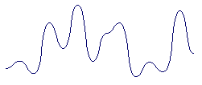
WAV
Simple encoding
Sample sound at some interval (e.g. 44 KHz).
High sound quality
Large file sizes

Slide 12
MIDI
Musical Instrument Digital Interface
MIDI is a language
Sentences describe the channel, note, loudness, etc.
16 channels (each can be thought of and recorded as a separate instrument)
Common for audio retrieval and classification applications

Slide 13
MP3
Common compression format
3-4 MB vs. 30-40 MB for uncompressed
Perceptual noise shaping
  The human ear cannot hear certain sounds
  Some sounds are heard better than others
  The louder of two sounds will be heard
Lossy or lossless?
  Lossy compression
  quality depends on the amount of compression
  like many compression algorithms, can have issues with randomness (e.g. clapping)

Slide 14
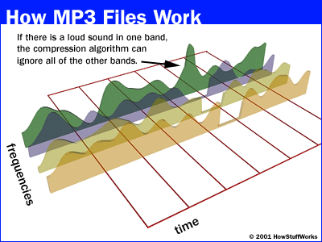
MP3 Example

Slide 15
Features
Weight vectors
word frequency
count normalization
idf weighting
length normalization
?

Slide 16
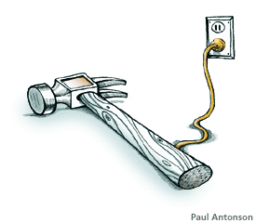
Tools for Feature Extraction
Fourier Transform (FT)
Short Term Fourier Transform (STFT)
Wavelets

Slide 17
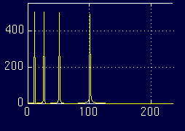
Fourier Transform (FT)
Time-domain Frequency-domain

Slide 18
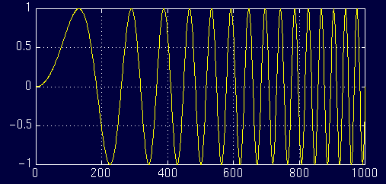
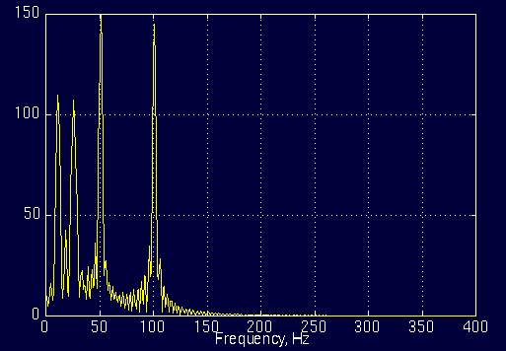
Another FT Example
Time
Frequency

Slide 19
Problem?
≈

Slide 20
Problem with FT
FT contains only frequency information
No time information is retained
Works fine for stationary signals
Non-stationary or changing signals cause problems
  FT shows frequencies occurring at all times instead of specific times
Ideas?

Slide 21
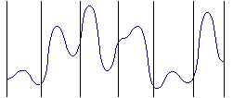
Short-Time Fourier Transform (STFT)
Idea: Break up the signal into discrete windows
Treat each signal within a window as a stationary signal
Take FT over each part
…

Slide 22
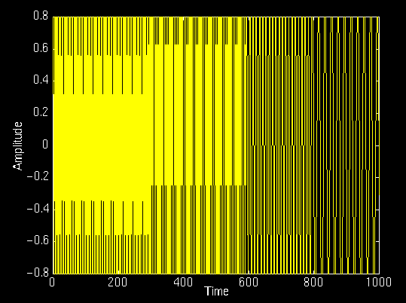
STFT Example
amplitude
time
frequency

Slide 23
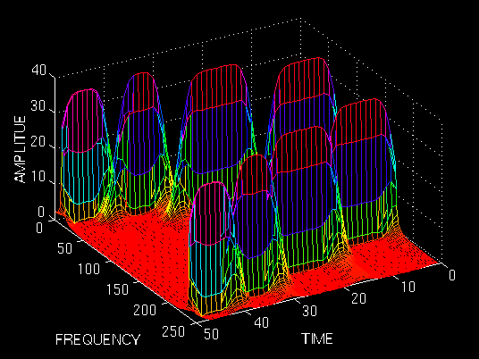
STFT Example

Slide 24
Problem: Resolution
How do we pick the window size? Trade-offs?
We can vary time and frequency accuracy
  Narrow window: good time resolution, poor frequency resolution
  Wide window: good frequency resolution, poor time resolution

Slide 25
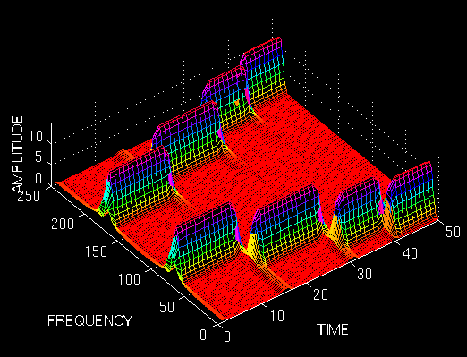
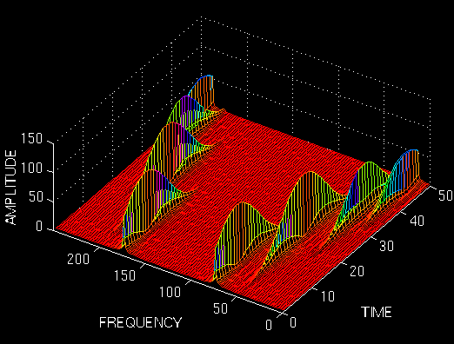
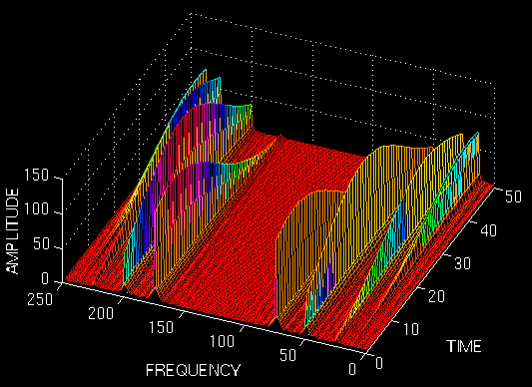
Varying the resolution
Ideas?

Slide 26
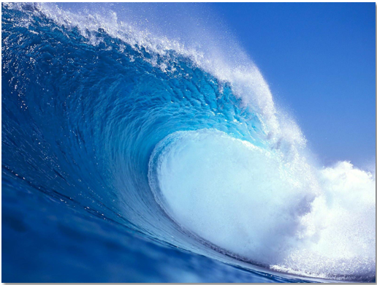
Wavelets
Wave
Wavelets
☺

Slide 27
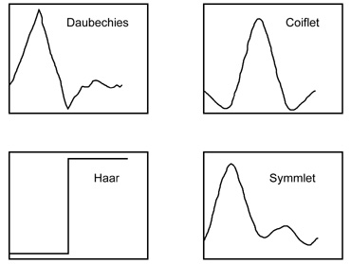
Wavelets
Wavelets respond to signals that are similar

Slide 28
Wavelet response
A wavelet responds to signals that are similar to the wavelet
?

Slide 29
Wavelet response
Scale matters!
?

Slide 30
Wavelet Transform
Idea: Take a wavelet and vary scale
Check response of varying scales on signal

Slide 31
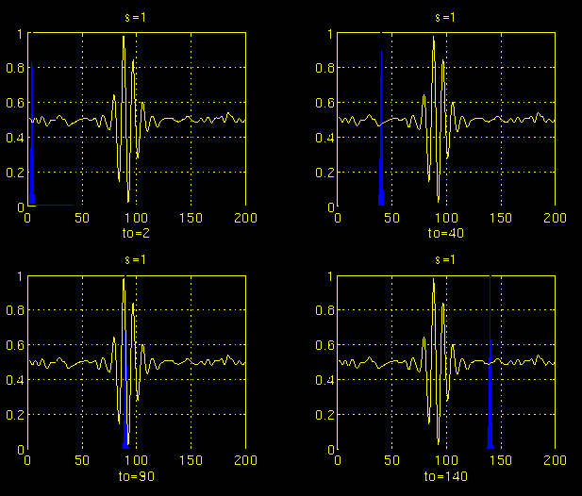
Wavelet Example: Scale 1

Slide 32
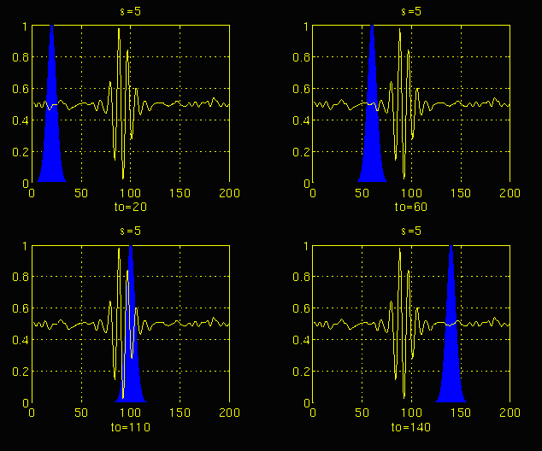
Wavelet Example: Scale 2

Slide 33
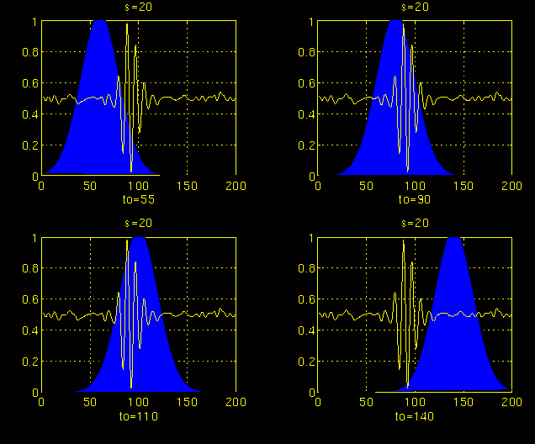
Wavelet Example: Scale 3

Slide 34
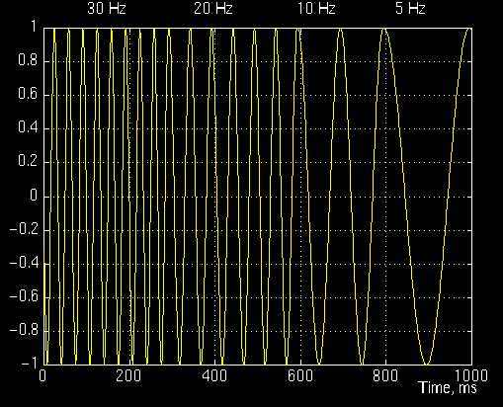
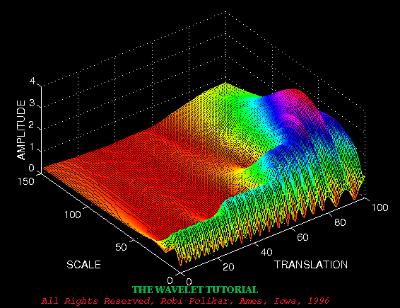
Wavelet Example
Scale = 1/frequency
Translation ≈ Time

Slide 35
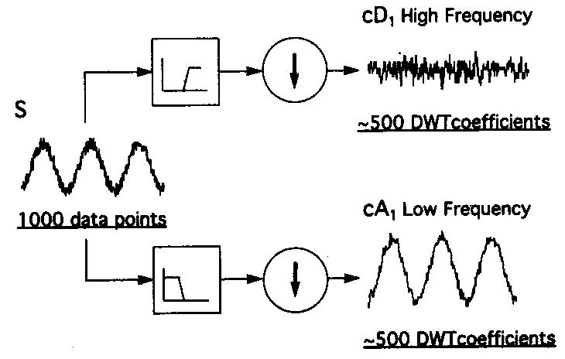
Discrete Wavelet Transform (DWT)
Wavelets come in pairs (high pass and low pass filter)
Split signal with filter and downsample

Slide 36
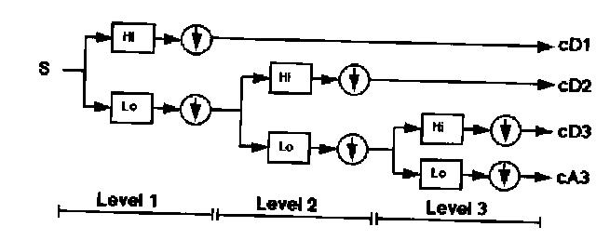
DWT cont.
Continue this process on the low frequency portion of the signal

Slide 37
DWT Example
signal
low frequency
high frequency

Slide 38
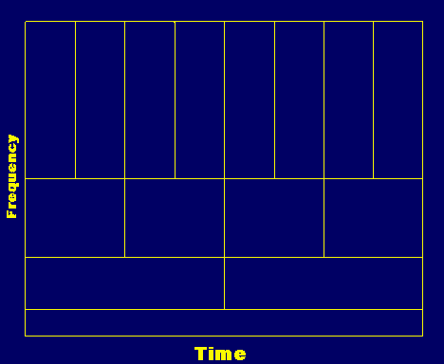
How did this solve the resolution problem?
Higher frequency resolution at high frequencies
Higher time frequency at low frequencies

Slide 39
Feature Extraction
All these transforms help us understand how the frequencies changes over time
Features extraction:
  Mel-frequency cepstral coefficients (MFCCs)
    Attempt to mimic human ear
  Surface features (texture, timbre, instrumentation)
    Capture frequency statistics of STFT
  Rhythm features (i.e the “beat”)
    Characteristics of low-frequency wavelets

Slide 40
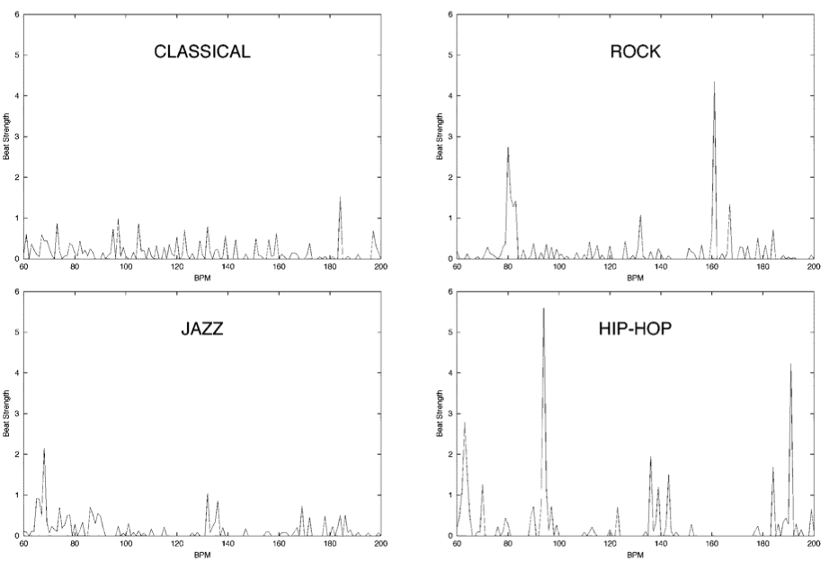
rock, hip-hop, classical or jazz?

Slide 42
Music Classification
Data
  Audio collected from radio, CDs and Web
    Speech vs. music
    Genres: classic, country, hiphop, jazz, rock
    4-types of classical music
  50 samples for each class, 30 sec. long
  Task is to predict the genre of the clip
Approach
  Extract features
  Learn genre classifier

Slide 43
Music Classification
Data
  Audio collected from radio, CDs and Web
    Speech vs. music
    Genres: classic, country, hiphop, jazz, rock
    4-types of classical music
  50 samples for each class, 30 sec. long
  Task is to predict the genre of the clip
How well do you think we can do?

Slide 44
General Results
 | Music vs. Speech | Genres | Classical
Random | 50% | 16% | 25%
Classifier | 86% | 62% | 76%

Slide 45
Results: Musical Genres
 | Classic | Country | Disco | Hiphop | Jazz | Rock
Classic | 86 | 2 | 0 | 4 | 18 | 1
Country | 1 | 57 | 5 | 1 | 12 | 13
Disco | 0 | 6 | 55 | 4 | 0 | 5
Hiphop | 0 | 15 | 28 | 90 | 4 | 18
Jazz | 7 | 1 | 0 | 0 | 37 | 12
Rock | 6 | 19 | 11 | 0 | 27 | 48
Pseudo-confusion matrix

Slide 46
Results: Classical
 | Choral | Orchestral | Piano | String
Choral | 99 | 10 | 16 | 12
Orchestral | 0 | 53 | 2 | 5
Piano | 1 | 20 | 75 | 3
String | 0 | 17 | 7 | 80
Confusion matrix

Slide 47
Thanks
Robi Polikar for his old tutorial
(http://www.public.iastate.edu/~rpolikar/WAVELETS/WTtutorial.html)

