Slide 1
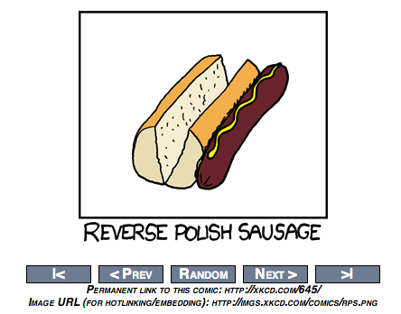

Slide 2
Web Crawlers and Link Analysis
David Kauchak
cs458
Fall 2011
adapted from:
http://www.stanford.edu/class/cs276/handouts/lecture15-linkanalysis.ppt
http://webcourse.cs.technion.ac.il/236522/Spring2007/ho/WCFiles/Tutorial05.ppt

Slide 3
Administrative
Midterm
Timeline
  HW 4 due Friday (can work in pairs)
  Assignment 4 out soon: due Friday 11/9
  Project proposal drafts: Thursday 11/8
  Project discussion/coordination: in-class Tuesday 11/13
    This leaves three weeks for final projects
Lunch Thursday

Slide 4

Web crawlers

Slide 5
Web crawlers
Find pages on the web
How would you do it?
What are some of the challenges?

Slide 6
Basic crawler
Begin with “seed” URLs in the queue
  Get a URL from the queue
  Fetch the page
  Parse the page and extract URLs it points to
  Place the extracted URLs on a queue

Slide 7
Web crawlers
Crawling is similar at a high-level to traditional graph search
How is it different?
  Latency/bandwidth issues (we have to actually fetch each node)
  Malicious pages
    Spam
    Spider traps
  Politeness concerns – don’t hit the same server too frequently
  Duplicate pages
  Web is not fully connected

Slide 8
Fetching web pages
Given a URL, we first need to fetch the actual web page
What steps need to happen?
  Find the web server
    similar to “call Dave Kauchak” – we need to know how to contact the web server
    Computers on the web are specified by IP addresses
    DNS (domain name service) offers a directory lookup from domain to IP address
    DNS lookup is distributed and can be slow
www.cs.middlebury.edu/classes/cs458/index.html
domain name
file location

Slide 9
Fetching web pages
Given a URL, we first need to fetch the actual web page
What steps need to happen?
  Contact the web server and download the file
    A web server is just a computer connected to the internet listening on port 80 (or sometimes 8080) for HTTP requests
    Connect to the server and request the particular page
www.cs.middlebury.edu/classes/cs458/index.html
domain name
file location
      > telnet www.cs.middlebury.edu 80
      GET /index.html HTTP/1.1
      Host: www.cs.middlebury.edu
      User-Agent: Mozilla/4.0 (compatible; MSIE 7.0; Windows NT 5.1)

Slide 10
Parse web page and extract URLs
Challenges/issues?

Slide 11
Parse web page and extract URLs
Parsing the web page
  Deal with many of the issues we talked about previously, like encoding, etc.
  Full HTML parsing can be a pain since web browsers are fault tolerant
Many HTML variants
  http://en.wikipedia.org/wiki/HTML
  Javascript, flash, …

Slide 12

Parse web page and extract URLs
Extract URLs
  Handle “relative” URLs, e.g. “administrivia.html”
  Remove duplicate URLs
Besides extracting the URLs/links for crawling purposes, is there anything else we need them for?

Slide 13
Connectivity Server
[CS1: Bhar98b, CS2 & 3: Rand01]
Support for fast queries on the web graph
  Which URLs point to a given URL?
  Which URLs does a given URL point to?
Stores the mappings in memory
Applications
  Crawl control
  Web graph analysis
    Connectivity, crawl optimization
  Link analysis

Slide 14
Polite web crawlers
A web crawler has few constraints on which pages it can visit, but it must adhere to politeness policies
  Never hit the same web server (generally IP) more frequently than once a second
  Only one connection open to a giver web server at a time
  robots.txt

Slide 15
Robots.txt
Protocol for giving spiders (“robots”) limited access to a website, originally from 1994
  www.robotstxt.org/wc/norobots.html
Website announces its request on what can(not) be crawled
  For a domain, create a file Domain/robots.txt
  This file specifies access restrictions

Slide 16
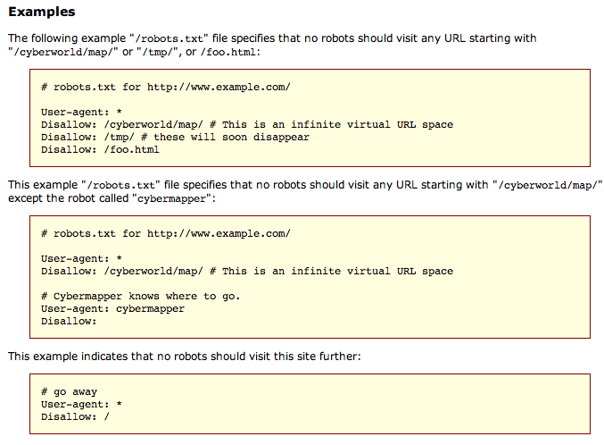
Robots.txt examples

Slide 17
Robots.txt example
What does this one say?
User-agent: *
Disallow: /yoursite/temp/
Allow: /yoursite/temp/bobs_burgers.html
User-agent: Google
Disallow:

Slide 18
Robots.txt example
No robot should visit any URL starting with
"/yoursite/temp/” except bobs_burger.html. The robot called “Google” may visit any of the pages.
User-agent: *
Disallow: /yoursite/temp/
Allow: /yoursite/temp/bobs_burgers.html
User-agent: Google
Disallow:
not all crawlers support Allow

Slide 19
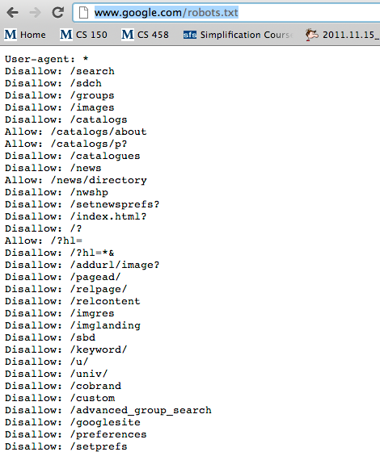
They can get complicated: Google.com

Slide 20
Basic crawl architecture
WWW
DNS
Doc
FP’s
robots
filters
URL
set
Parse
Fetch
Content
seen?
URL
filter
Dup
URL
elim
URL Queue

Slide 21
Web crawler scale
The biggest challenges for web crawlers is dealing with the size of the web
How many web pages per second would we need to download to obtain 1 billion web pages in a month?
  30 d * 24 h * 60 m * 60 s = 2,592,000
  1,000,000,000/2,592,000 = 385 pages/sec
Have to be multithreaded/multi-computer
Logistics become trickier

Slide 22
Web crawler scale issues
What complications does this create?
  Can’t hit same web server
    Often pages point to pages on the same server
    Can’t just wait… need to keep servers busy
    Cache robots.txt
  Distributed computing
    Duplicate URL detection
    Keeping track of who’s doing what
    Cache DNS lookup since it’s slow
The URL queue becomes an important data structure to try and prioritize things appropriately
  Can’t just do a priority queue!

Slide 23
URL frontier: Mercator scheme
URLs
Prioritizer
manages
URL priority
K front queues
Biased front queue selector
Back queue router
enforce
“politeness”
B back queues
Single host on each
Back queue selector
Crawl thread requesting URL

Slide 24
Priority
Prioritizer assigns to URL an integer priority between 1 and K
  Appends URL to corresponding queue
Heuristics for assigning priority?
  Refresh rate sampled from previous crawls
  Importance
  Application-specific (e.g., “crawl news sites more often”)

Slide 25

Web crawler

Slide 26
The Web as a Directed Graph
Page A
Page B
hyperlink
A hyperlink between pages denotes author perceived relevance AND importance
How can we use this information?

Slide 27
Query-independent ordering
First generation: using link counts as simple measures of popularity
Two basic suggestions:
  Undirected popularity:
    Each page gets a score = the number of in-links plus the number of out-links (3+2=5)
  Directed popularity:
    Score of a page = number of its in-links (3)
problems?

Slide 28

What is pagerank?
The random surfer model
Imagine a user surfing the web randomly using a web browser
The pagerank score of a page is the probability that a random surfing user will visit a given page
http://images.clipartof.com/small/7872-Clipart-Picture-Of-A-World-Earth-Globe-Mascot-Cartoon-Character-Surfing-On-A-Blue-And-Yellow-Surfboard.jpg

Slide 29
Random surfer model
We want to model the behavior of a “random” user interfacing the web through a browser
Model is independent of content (i.e. just graph structure)
What types of behavior should we model and how?
  Where to start
  Following links on a page
  Typing in a url (bookmarks)
  What happens if we get a page with no outlinks
  Back button on browser

Slide 30
Random surfer model
Start at a random page
Go out of the current page along one of the links on that page, equiprobably
1/3
1/3
1/3

Slide 31
Random surfer model
Start at a random page
Go out of the current page along one of the links on that page, equiprobably
What about?

Slide 32
Random surfer model
“Teleporting”
  If a page has no outlinks always jump
  to random page
  With some fixed probability, randomly jump to any other page, otherwise follow links

Slide 33
Random surfer model
Start at a random page
If the page has no outlinks:
randomly go to another page
otherwise:
- probability α:
randomly go to another page
- probability 1-α,
Go out of the current page along one of the links on that page, equiprobably

Slide 34
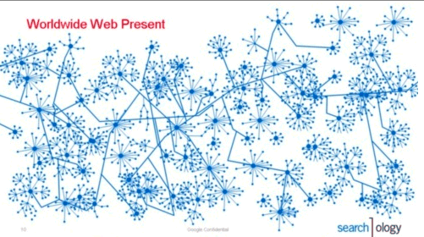
The questions…
Given a graph and a teleporting probability, we have some probability of visiting every page
What is that probability of visiting for each page in the graph?
http://3.bp.blogspot.com/_ZaGO7GjCqAI/Rkyo5uCmBdI/AAAAAAAACLo/zsHdSlKc-q4/s640/searchology-web-graph.png

Slide 35
Markov process
A markov process is defined by:
  x₁, x₂, …, x_{n} a set of states
  An n by n transition matrix describing the probability of transitioning to state x_{j} given that you’re in state x_{i}
…
x₁
x₂
x_{n}
x₁
x₂
rows must sum to 1
x_{ij}: p(x_{j}|x_{i})
…
x_{n}
Anybody know why it’s called a markov process?

Slide 36
Markov Process
Coke vs. Pepsi Example
Given that a person’s last cola purchase was Coke, there is a 90% chance that their next cola purchase will also be Coke.
If a person’s last cola purchase was Pepsi, there is an 80% chance that their next cola purchase will also be Pepsi.
State diagram?
transition matrix:
coke
pepsi
0.9
0.1
0.8
coke
coke
pepsi
pepsi
0.2

Slide 37
Markov Process
Coke vs. Pepsi Example (cont)
Given that a person is currently a Pepsi purchaser, what is the probability that he will purchase Coke two purchases from now?
transition matrix:
coke
pepsi
0.9
0.1
0.8
coke
coke
pepsi
pepsi
0.2

Slide 38
Markov Process
Coke vs. Pepsi Example (cont)
Given that a person is currently a Pepsi purchaser, what is the probability that they will purchase Coke two purchases from now?
Two scenarios:
Pepsi -> Coke
Coke -> Coke
coke
pepsi

Slide 39
Markov Process
Coke vs. Pepsi Example (cont)
Given that a person is currently a Pepsi purchaser, what is the probability that they will purchase Coke two purchases from now?
Two scenarios:
Pepsi -> Coke
0.8 * 0.2
Coke -> Coke
0.2 * 0.9
Total: 0.34
coke
pepsi

Slide 40
Markov Process
Coke vs. Pepsi Example (cont)
Given that a person is currently a Pepsi purchaser, what is the probability that they will purchase Coke two purchases from now?
coke
pepsi
coke
pepsi
coke
pepsi
coke
pepsi
Pepsi → ?
? → Coke

Slide 41
Markov Process
Coke vs. Pepsi Example (cont)
Given that a person is currently a Coke purchaser, what is the probability that he will purchase Pepsi three purchases from now?
coke
pepsi
coke
pepsi
coke
pepsi
coke
pepsi

Slide 42
Steady state
In general, we can calculate the probability after n purchases as P^{n}
We might also ask the question, what is the probability of being in state coke or pepsi?
This is described by the steady state distribution of a markov process
  Note, this is a distribution over states not state transitions
How might we obtain this?

Slide 43
Steady state
We have some initial vector describing the probabilities of each starting state
  For example, coke drinker: x = [1, 0]
  We could have said a person that drinks coke 80% of the time, x = [0.80, 0.20]
coke
pepsi
coke
pepsi
coke
pepsi

Slide 44
Steady state
Most common:
  start with some initial x
  xP, xP², xP³, xP⁴, …
  For many processes, this will eventually settle

Slide 45
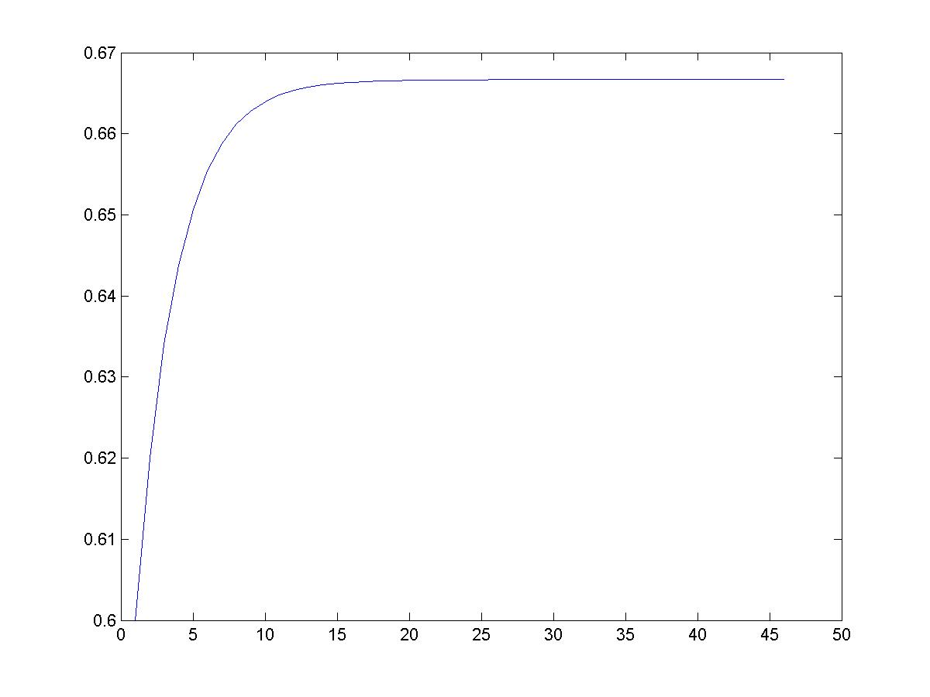
Markov Process
Coke vs. Pepsi Example (cont)
Simulation:
2/3
Pr[X_{i} = Coke]
0.9
0.1
0.8
coke
pepsi
0.2
week - i

Slide 46
Back to pagerank
Can we use this to solve our random surfer problem?
  States are web pages
  Transitions matrix is the probability of transitioning to page A given at page B
  “Teleport” operation makes sure that we can get to any page from any other page
Matrix is much bigger, but same approach is taken…
  P, P², P³, P⁴, …

Slide 47
Pagerank summary
Preprocessing:
  Given a graph of links, build matrix P
  From it compute steady state of each state
  An entry is a number between 0 and 1: the pagerank of a page
Query processing:
  Retrieve pages meeting query
  Integrate pagerank score with other scoring (e.g. tf-idf)
  Rank pages by this combined score

Slide 48

The reality
Pagerank is used in google, but so are many other clever heuristics

Slide 49
Pagerank: Issues and Variants
How realistic is the random surfer model?
  Modeling the back button
  Surfer behavior sharply skewed towards short paths
  Search engines, bookmarks & directories make jumps non-random
Note that all of these just vary how we create our initial transition probability matrix

Slide 50
Biased surfer models
Random teleport to any page is not very reasonable
Biased Surfer Models
  Weight edge traversal probabilities based on match with topic/query (non-uniform edge selection)
  Bias jumps to pages on topic (e.g., based on personal bookmarks & categories of interest)

Slide 51
Topic Specific Pagerank
Conceptually, we use a random surfer who teleports, with say 10% probability, using the following rule:
    Selects a category based on a query & user-specific distribution over the categories
    Teleport to a page uniformly at random within the chosen category
What is the challenge?

Slide 52
Topic Specific Pagerank
Ideas?
Offline:Compute pageranks for individual categories
  Query independent as before
  Each page has multiple pagerank scores – one for each category, with teleportation only to that category
Online: Distribution of weights over categories computed by query context classification
  Generate a dynamic pagerank score for each page - weighted sum of category-specific pageranks

Slide 53
Spamming pagerank

Slide 54
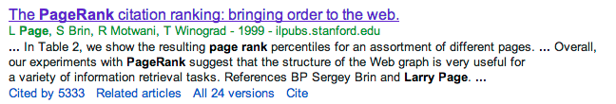
Other link analysis
Pagerank is not the only link analysis method
  Many, many improvements/variations of pagerank
  Hubs and authorities

