Slide 1
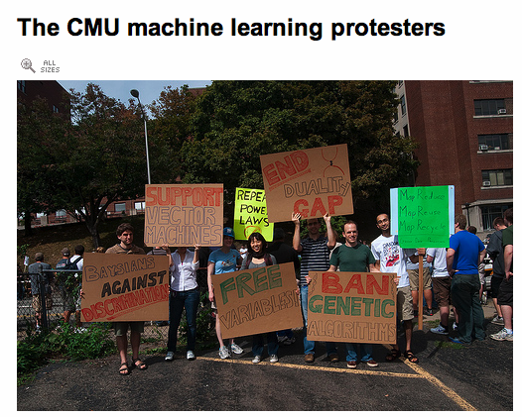
http://www.flickr.com/photos/30686429@N07/3953914015/in/set-72157622330082619/

Slide 2
Web basics
David Kauchak
cs458
Fall 2012
adapted from:
http://www.stanford.edu/class/cs276/handouts/lecture13-webchar.ppt

Slide 3
Administrative
Schedule for the next two weeks
  Sunday 10/21: assignment 3 (start working now!)
  Friday 10/19 – Tuesday 10/23: midterm
    1.5 hours
    take-home
    can take it any time in that window
      must NOT talk to anyone else about the midterm until after Tuesday
    open book and open notes, though closed web

Slide 4
Course feedback
Thanks!
If you ever have other feedback…
Assignments/homeworks
  I do recognize that they are a lot of hard work
  but they should be useful in learning (and fun in a love/hate sort of way)
  will lighten up some in the final half/third of the course
Course content
  Lots of different IR systems (I understand sometimes we cover a lot of random topics)
  Underneath the covers, a lot of it is engineering and trial and error

Slide 5
Course feedback
4
4
1
3
4
5
overall how is the class going

Slide 6
Course feedback
8
5
4
1
<5
5-10
10-15
3
4
5
time spent /wk
difficulty

Slide 7
Informal quiz

Slide 8
Boolean queries
c OR a AND f
a AND f OR c
c b d
e d c
b d f
a f e

Slide 9
Outline
Brief overview of the web
Challenges with web IR:
Web Spam
Estimating the size of the web
Detecting duplicate pages

Slide 10
Brief (non-technical) history
Early keyword-based engines
  Altavista, Excite, Infoseek, Inktomi, ca. 1995-1997
Sponsored search ranking: Goto.com (morphed into Overture.com)
  Your search ranking depended on how much you paid
  Auction for keywords: casino was expensive!

Slide 11
Brief (non-technical) history
1998+: Link-based ranking pioneered by Google
  Blew away all early engines save Inktomi
  Great user experience in search of a business model
  Meanwhile Goto/Overture’s annual revenues were nearing $1 billion
Result: Google added paid-placement “ads” to the side, independent of search results
Yahoo followed suit, acquiring Overture (for paid placement) and Inktomi (for search)

Slide 12
Why did Google win?
Relevance/link-based
Simple UI
Hardware – used commodity parts
  inexpensive
  easy to expand
  fault tolerance through redundancy
What’s wrong (from the search engine’s standpoint) of having a cost-per-click (CPC) model and ranking ads based only on CPC?

Slide 13
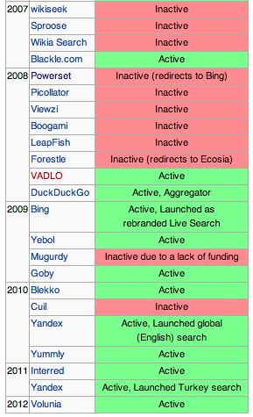
Post 2000
Lot’s of start-ups have tried…
  Snap (2005): Overture’s previous owner
  Cuil (2008): ex-google employees
  Powerset (2007): NLP folks (a lot from Xerox PARC) … bought by Microsoft
  Many more… http://en.wikipedia.org/wiki/Web_search_engine

Slide 14
Current market share
Google: 67%
Bing: 16%
Yahoo: 13%
Ask: 3%
AOL: 1.5%
Rest: 9%
(comscore)
http://searchenginewatch.com/article/2205504/Bing-Gains-More-Ground-in-Search-Engine-Market-Share-Yahoo-Resumes-Downward-Slide

Slide 15

Web search basics
User
Web spider
Search
Indexer
The Web
Indexes
Ad indexes

Slide 16
User needs/queries
Researchers/search engines often categorize user needs/queries into different types
For example…?

Slide 17
User Needs
Need [Brod02, RL04]
  Informational – want to learn about something (~40%)
  Navigational – want to go to that page (~25%)
  Transactional – want to do something (web-mediated) (~35%)
    Access a service
    Downloads
    Shop
  Gray areas
    Find a good hub
    Exploratory search “see what’s there”
Low hemoglobin
United Airlines
Seattle weather
Mars surface images
Canon S410
Car rental Brasil

Slide 18
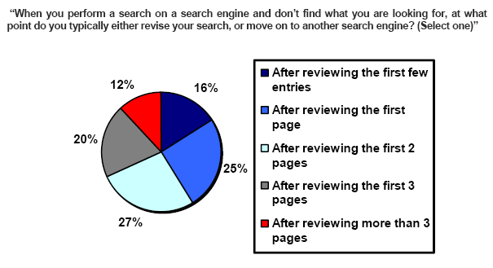
How far do people look for results?
(Source: iprospect.com WhitePaper_2006_SearchEngineUserBehavior.pdf)

Slide 19
Users’ empirical evaluation of results
Quality of pages varies widely
  Relevance is not enough
  Other desirable qualities (non IR!!)
    Content: Trustworthy, diverse, non-duplicated, well maintained
    Web readability: display correctly & fast
    No annoyances: pop-ups, etc

Slide 20
Users’ empirical evaluation of results
Precision vs. recall
  On the web, recall seldom matters
  Recall matters when the number of matches is very small
What matters
  Precision at 1? Precision above the fold?
  Comprehensiveness – must be able to deal with obscure queries
User perceptions may be unscientific, but are significant over a large aggregate

Slide 21
How is the web unique?
No design/co-ordination
Content includes truth, lies, obsolete information, contradictions …
Unstructured (text, html, …), semi-structured (XML, annotated photos), structured (Databases)…
Financial motivation for ranked results
Scale much larger than previous text collections … but corporate records are catching up
Growth – slowed down from initial “volume doubling every few months” but still expanding
Content can be dynamically generated
The Web

Slide 22
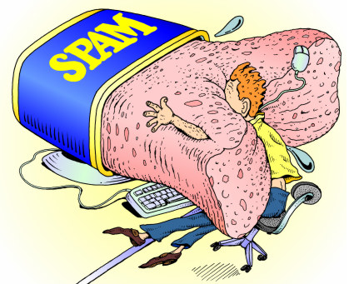
Web Spam
http://blog.lib.umn.edu/wilsper/informationcentral/spam.jpg

Slide 23
The trouble with sponsored search …
It costs money. What’s the alternative?
Search Engine Optimization:
  “Tuning” your web page to rank highly in the algorithmic search results for select keywords
  Alternative to paying for placement
  Intrinsically a marketing function
Performed by companies, webmasters and consultants (“Search engine optimizers”) for their clients
Some perfectly legitimate, more very shady

Slide 24
Simplest forms
First generation engines relied heavily on tf/idf
What would you do as an SEO?
SEOs responded with dense repetitions of chosen terms
  e.g., maui resort maui resort maui resort
  Often, the repetitions would be in the same color as the background of the web page
    Repeated terms got indexed by crawlers
    But not visible to humans on browsers
Pure word density cannot
be trusted as an IR signal

Slide 25
Variants of keyword stuffing
Misleading meta-tags, excessive repetition
Hidden text with colors, style sheet tricks, etc.
Meta-Tags =
“… London hotels, hotel, holiday inn, hilton, discount, booking, reservation, sex, mp3, britney spears, viagra, …”

Slide 26
Spidering/indexing
Any way we can take
advantage of this system?
Web spider
Indexer
The Web
Indexes

Slide 27
Cloaking
Serve fake content to search engine spider
SPAM
Y
Is this a Search
Engine spider?
N
Real
Doc
Cloaking

Slide 28
More spam techniques
Doorway pages
  Pages optimized for a single keyword that re-direct to the real target page
Link spamming/link farms
  Mutual admiration societies, hidden links, awards – more on these later
  Domain flooding: numerous domains that point or re-direct to a target page
Robots
  Fake query stream – rank checking programs
    “Curve-fit” ranking programs of search engines

Slide 29
The war against spam
Quality signals - Prefer authoritative pages based on:
  Votes from authors (linkage signals)
  Votes from users (usage signals)
Policing of URL submissions
  Anti robot test
Limits on meta-keywords
Robust link analysis
  Ignore statistically implausible linkage (or text)
  Use link analysis to detect spammers (guilt by association)
Spam recognition by machine learning
  Training set based on known spam
Family friendly filters
  Linguistic analysis, general classification techniques, etc.
  For images: flesh tone detectors, source text analysis, etc.
Editorial intervention
  Blacklists
  Top queries audited
  Complaints addressed
  Suspect pattern detection

Slide 30
More on spam
Web search engines have policies on SEO practices they tolerate/block
  http://help.yahoo.com/help/us/ysearch/index.html
  http://www.google.com/intl/en/webmasters/
Adversarial IR: the unending (technical) battle between SEO’s and web search engines
Research http://airweb.cse.lehigh.edu/

Slide 31

Size of the web
http://www.stormforce31.com/wximages/www.jpg

Slide 32
What is the size of the web?
BIG!
http://www.worldwidewebsize.com/

Slide 33
What is the size of the web?
The web is really infinite
  Dynamic content, e.g., calendar
  Soft 404: www.yahoo.com/<anything> is a valid page
What about just the static web… issues?
  Static web contains syntactic duplication, mostly due to mirroring (~30%)
  Some servers are seldom connected
  What do we count? A url? A frame? A section? A pdf document? An image?

Slide 34
Who cares about the size of the web?
It is an interesting question, but beyond that, who cares and why?
Media, and consequently the user
Search engine designer (crawling, indexing)
Researchers

Slide 35
What can we measure?
Besides absolute size, what else might we measure?
Users interface is through the search engine
  Proportion of the web a particular search engine indexes
  The size of a particular search engine’s index
  Relative index sizes of two search engines
Challenges with these approaches?
Biggest one: search engines don’t like to let
people know what goes on under the hood

Slide 36
Search engines as a black box
Although we can’t ask how big a search engine’s index is, we can often ask questions like “does a document exist in the index?”
search results
for doc
doc
identifying
query
?
search
engine

Slide 37
Proportion of the web indexed
We can ask if a document is in an index
How can we estimate the proportion indexed by a particular search engine?
random
sample
proportion of
sample in index
search
engine
web

Slide 38
Size of index A relative to index B
proportion of
sample in index
engine
A
random
sample
web
engine
B

Slide 39
Sampling URLs
Both of these questions require us to have a random set of pages (or URLs)
Problem: Random URLs are hard to find!
Ideas?
Approach 1: Generate a random URL contained in a given engine
  Suffices for the estimation of relative size
Approach 2: Random pages/ IP addresses
  In theory: might give us a true estimate of the size of the web (as opposed to just relative sizes of indexes)

Slide 40
Random URLs from search engines
Issue a random query to the search engine
  Randomly generate a query from a lexicon and word probabilities (generally focus on less common words/queries)
  Choose random searches extracted from a query log (e.g. all queries from Middlebury College)
From the first 100 results, pick a random page/URL

Slide 41
Things to watch out for
Biases induced by random queries
  Query Bias: Favors content-rich pages in the language(s) of the lexicon
  Ranking Bias: Use conjunctive queries & fetch all
  Checking Bias: Duplicates, impoverished pages omitted
  Malicious Bias: Sabotage by engine
  Operational Problems: Time-outs, failures, engine inconsistencies, index modification
Biases induced by query log
  Samples are correlated with source of log

Slide 42

Random IP addresses
Generate
random IP
xxx.xxx.xxx.xxx
check if there is
a web server at
that IP
collect pages
from server
randomly pick
a page/URL

Slide 43
Random IP addresses
[Lawr99] Estimated 2.8 million IP addresses running crawlable web servers (16 million total) from observing 2500 servers
OCLC using IP sampling found 8.7 M hosts in 2001
Netcraft [Netc02] accessed 37.2 million hosts in July 2002

Slide 44
Random walks
View the Web as a directed graph
Build a random walk on this graph
  Includes various “jump” rules back to visited sites
    Does not get stuck in spider traps!
    Can follow all links!
  Converges to a stationary distribution
    Must assume graph is finite and independent of the walk.
    Conditions are not satisfied (cookie crumbs, flooding)
    Time to convergence not really known
  Sample from stationary distribution of walk
  Use the “strong query” method to check coverage by SE

Slide 45
Conclusions
No sampling solution is perfect
Lots of new ideas ...
....but the problem is getting harder
Quantitative studies are fascinating and a good research problem

