Slide 1
Probability
David Kauchak
CS159 – Spring 2011

Slide 2
Admin
Read article for discussion on Thursday
Assignment advice
  test individual components of your regex first, then put them all together
  write test cases

Slide 3








Corpus statistics
www.nytimes.com 1/25/2011

Slide 4
Basic Probability Theory: terminology
An experiment has a set of potential outcomes, e.g., throw a dice, “look at” another sentence
The sample space of an experiment is the set of all possible outcomes, e.g., {1, 2, 3, 4, 5, 6}
In NLP our sample spaces tend to be very large
  All words, bigrams, 5-grams
  All sentences of length 20 (given a finite vocabulary)
  All sentences
  All parse trees over a given sentence

Slide 5
Basic Probability Theory: terminology
An event is a subset of the sample space
Dice rolls
  {2}
  {3, 6}
  even = {2, 4, 6}
  odd = {1, 3, 5}
NLP
  a particular word/part of speech occurring in a sentence
  a particular topic discussed (politics, sports)
  sentence with a parasitic gap
  pick your favorite phenomena…

Slide 6
Events
We’re interested in probabilities of events
  p({2})
  p(even)
  p(odd)
  p(parasitic gap)
  p(word)

Slide 7
Random variables
A random variable is a mapping from the sample space to a number (think events)
It represents all the possible values of something we want to measure in an experiment
For example, random variable, X, could be the number of heads for a coin
Really for notational convenience, since the event space can sometimes be irregular
space | HHH | HHT | HTH | HTT | THH | THT | TTH | TTT
X | 3 | 2 | 2 | 1 | 2 | 1 | 1 | 0

Slide 8
Random variables
We can then talk about the probability of the different values of a random variable
The definition of probabilities over all of the possible values of a random variable defines a probability distribution
space | HHH | HHT | HTH | HTT | THH | THT | TTH | TTT
X | 3 | 2 | 2 | 1 | 2 | 1 | 1 | 0
X | P(X)
3 | P(X=3) = 1/8
2 | P(X=2) = 3/8
1 | P(X=1) = 3/8
0 | P(X=0) = 1/8

Slide 9
Probability distribution
To be explicit
  A probability distribution assigns probability values to all possible values of a random variable
  These values must be >= 0 and <= 1
  These values must sum to 1 for all possible values of the random variable
X | P(X)
3 | P(X=3) = 1/2
2 | P(X=2) = 1/2
1 | P(X=1) = 1/2
0 | P(X=0) = 1/2
X | P(X)
3 | P(X=3) = -1
2 | P(X=2) = 2
1 | P(X=1) = 0
0 | P(X=0) = 0

Slide 10
Unconditional/prior probability
Simplest form of probability is
  P(X)
Prior probability: without any additional information, what is the probability
  What is the probability of a heads?
  What is the probability of a sentence containing a pronoun?
  What is the probability of a sentence containing the word “banana”?
  What is the probability of a document discussing politics?
  …

Slide 11
Joint distribution
We can also talk about probability distributions over multiple variables
P(X,Y)
  probability of X and Y
  a distribution over the cross product of possible values
NLPPass | P(NLPPass)
true | 0.89
false | 0.11
NLPPass AND EngPass | P(NLPPass, EngPass)
true, true | .88
true, false | .01
false, true | .04
false, false | .07
EngPass | P(EngPass)
true | 0.92
false | 0.08

Slide 12
Joint distribution
Still a probability distribution
  all values between 0 and 1, inclusive
  all values sum to 1
All questions/probabilities of the two variables can be calculated from the joint distribution
NLPPass AND EngPass | P(NLPPass, EngPass)
true, true | .88
true, false | .01
false, true | .04
false, false | .07
What is P(ENGPass)?

Slide 13
Joint distribution
Still a probability distribution
  all values between 0 and 1, inclusive
  all values sum to 1
All questions/probabilities of the two variables can be calculate from the joint distribution
NLPPass AND EngPass | P(NLPPass, EngPass)
true, true | .88
true, false | .01
false, true | .04
false, false | .07
0.92
How did you figure that out?

Slide 14
Joint distribution
NLPPass AND EngPass | P(NLPPass, EngPass)
true, true | .88
true, false | .01
false, true | .04
false, false | .07

Slide 15
Conditional probability
As we learn more information, we can update our probability distribution
P(X|Y) models this (read “probability of X given Y”)
  What is the probability of a heads given that both sides of the coin are heads?
  What is the probability the document is about politics, given that it contains the word “Clinton”?
  What is the probability of the word “banana” given that the sentence also contains the word “split”?
Notice that it is still a distribution over the values of X

Slide 16
Conditional probability
x
y
In terms of pior and joint distributions, what is the conditional probability distribution?

Slide 17
Conditional probability
Given that y has happened, in what proportion of those events does x also happen
x
y

Slide 18
Conditional probability
Given that y has happened, what proportion of those events does x also happen
x
y
NLPPass AND EngPass | P(NLPPass, EngPass)
true, true | .88
true, false | .01
false, true | .04
false, false | .07
What is:
p(NLPPass=true | EngPass=false)?

Slide 19
Conditional probability
NLPPass AND EngPass | P(NLPPass, EngPass)
true, true | .88
true, false | .01
false, true | .04
false, false | .07
What is:
p(NLPPass=true | EngPass=false)?
= 0.125
Notice this is very different than p(NLPPass=true) = 0.89

Slide 20
A note about notation
When talking about a particular assignment, you should technically write p(X=x), etc.
However, when it’s clear , we’ll often shorten it
Also, we may also say P(X) or p(x) to generically mean any particular value, i.e. P(X=x)
= 0.125

Slide 21
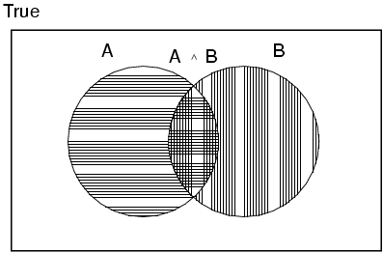
Properties of probabilities
P(A or B) = ?

Slide 22
Properties of probabilities
P(A or B) = P(A) + P(B) - P(A,B)

Slide 23
Properties of probabilities
P(¬E) = 1– P(E)
More generally:
  Given events E = e₁, e₂, …, e_{n}
P(E1, E2) ≤ P(E1)

Slide 24
Chain rule (aka product rule)
We can view calculating the probability of X AND Y occurring as two steps:
Y occurs with some probability P(Y)
Then, X occurs, given that Y has occured
or you can just trust the math… ☺

Slide 25
Chain rule

Slide 26
Applications of the chain rule
We saw that we could calculate the individual prior probabilities using the joint distribution
What if we don’t have the joint distribution, but do have conditional probability information:
  P(Y)
  P(X|Y)

Slide 27
Bayes’ rule (theorem)

Slide 28
Bayes rule
Allows us to talk about P(Y|X) rather than P(X|Y)
Sometimes this can be more intuitive
Why?

Slide 29
Bayes rule
p(disease | symptoms)
  For everyone who had those symptoms, how many had the disease?
  p(symptoms|disease)
    For everyone that had the disease, how many had this symptom?
p( linguistic phenomena | features )
  For all examples that had those features, how many had that phenomena?
  p(features | linguistic phenomena)
    For all the examples with that phenomena, how many had this feature
p(cause | effect) vs. p(effect | cause)

Slide 30
Gaps
V
I just won’t put these away.
direct object
These, I just won’t put away.
filler
I just won’t put away.
gap

Slide 31
Gaps
What did you put away?
gap
The socks that I put away.
gap

Slide 32
Gaps
Whose socks did you fold and put away?
gap
gap
Whose socks did you fold ?
gap
Whose socks did you put away?
gap

Slide 33
Parasitic gaps
These I’ll put away without folding .
gap
gap
These I’ll put away.
gap
These without folding .
gap

Slide 34
Parasitic gaps
These I’ll put away without folding .
gap
gap
1. Cannot exist by themselves (parasitic)
These I’ll put my pants away without folding .
gap
2. They’re optional
These I’ll put away without folding them.
gap

Slide 35
Parasitic gaps
http://literalminded.wordpress.com/2009/02/10/dougs-parasitic-gap/

Slide 36
Frequency of parasitic gaps
Parasitic gaps occur on average in 1/100,000 sentences
Problem:
  Joe Linguist has developed a complicated set of regular expressions to try and identify parasitic gaps. If a sentence has a parasitic gap, it correctly identifies it 95% of the time. If it doesn’t, it will incorrectly say it does with probability 0.005. Suppose we run it on a sentence and the algorithm says it is a parasitic gap, what is the probability it actually is?

Slide 37
Prob of parasitic gaps
  Joe Linguist has developed a complicated set of regular expressions to try and identify parasitic gaps. If a sentence has a parasitic gap, it correctly identifies it 95% of the time. If it doesn’t, it will incorrectly say it does with probability 0.005. Suppose we run it on a sentence and the algorithm says it is a parasitic gap, what is the probability it actually is?
G = gap
T = test positive
What question do we want to ask?

Slide 38
Prob of parasitic gaps
  Joe Linguist has developed a complicated set of regular expressions to try and identify parasitic gaps. If a sentence has a parasitic gap, it correctly identifies it 95% of the time. If it doesn’t, it will incorrectly say it does with probability 0.005. Suppose we run it on a sentence and the algorithm says it is a parasitic gap, what is the probability it actually is?
G = gap
T = test positive

Slide 39
Prob of parasitic gaps
  Joe Linguist has developed a complicated set of regular expressions to try and identify parasitic gaps. If a sentence has a parasitic gap, it correctly identifies it 95% of the time. If it doesn’t, it will incorrectly say it does with probability 0.005. Suppose we run it on a sentence and the algorithm says it is a parasitic gap, what is the probability it actually is?
G = gap
T = test positive

Slide 40
Prob of parasitic gaps
  Joe Linguist has developed a complicated set of regular expressions to try and identify parasitic gaps. If a sentence has a parasitic gap, it correctly identifies it 95% of the time. If it doesn’t, it will incorrectly say it does with probability 0.005. Suppose we run it on a sentence and the algorithm says it is a parasitic gap, what is the probability it actually is?
G = gap
T = test positive

Slide 41
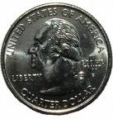
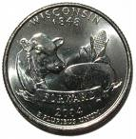
Obtaining probabilities
H
H
T
T
H
T
H
H
T
T
We’ve talked a lot about probabilities, but not where they come from
  What is the probability of “the” occurring in a sentence?
  What is the probability of “Middlebury” occurring in a sentence?
  What is the probability of “I think today is a good day to be me” as a sentence?

Slide 42
Obtaining probabilities
training data
estimate from actual data
P(…)

Slide 43
Estimating probabilities
What is the probability of “the” occurring in a sentence?
We don’t know!
We can estimate that based on data, though:
number of sentences with “the”
total number of sentences

Slide 44
Maximum likelihood estimation
Intuitive
Sets the probabilities so as to maximize the probability of the training data
Problems?
  Amount of data
    particularly problematic for rare events
  Is our training data representative

Slide 45
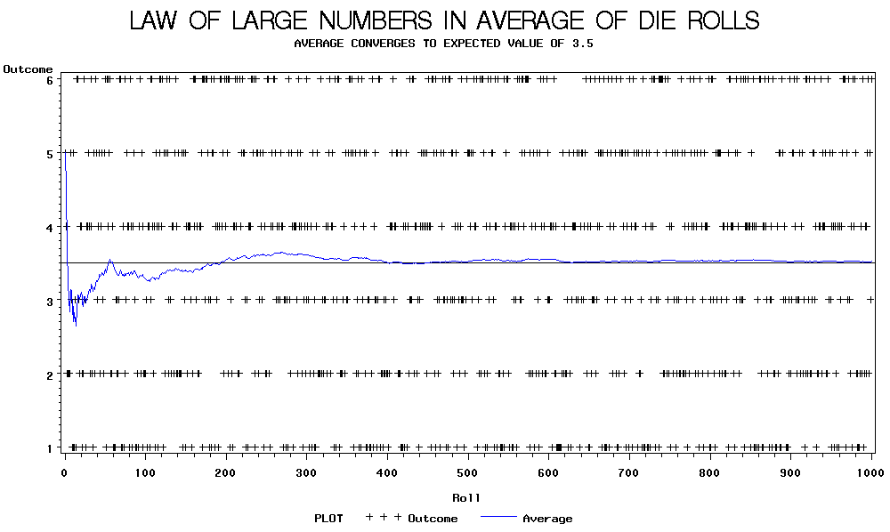

Slide 46
Back to parasitic gaps
Say the actual probability is 1/100,000
We don’t know this, though, so we’re estimating it from a small data set of 10K sentences
What is the probability that, by chance, we have a parasitic gap sentence in our sample?

Slide 47
Back to parasitic gaps
p(not_parasitic) = 0.99999
p(not_parasitic)¹⁰⁰⁰⁰ ≈ 0.905 is the probability of us NOT finding one
So, probability of us finding one is ~10%, in which case we would incorrectly assume that the probability is 1/10,000 (10 times too large)
Remember Zipf’s law from last time… NLP is all about rare events!

